Slide 1
MCBXF series production tendering
Fernando Toral (CIEMAT)
On behalf of MCBXF CERN-CIEMAT Collaboration
Series production Kick-off Meeting, 23rd April 2021

Slide 2
Tendering: main guidelines
Funding is provided by CERN, CDTI and CIEMAT.
Tendering has been done in four months: we thank warmly the support from CIEMAT procurement department and CDTI.
Contract has been awarded to Elytt Energy. It was signed by March 15th.
Scope: delivery of 6 long (A) and 11 short (B) MCBXF magnets.
Technical specification has been agreed with CERN.
Acceptance criteria has been agreed with CERN.
Manufacturing and inspection plan has been agreed with CERN: quality documentation, tests and hold points.
Quality documentation will guarantee traceability. It will be uploaded at CERN servers: MTF and EDMS. Templates have been agreed with CERN.
Drawings will be stored at EDMS (CERN), both of prototypes, series magnets and tooling (about 2000 drawings).

Slide 3
Parts exchange
CERN will supply the insulated superconducting cable, the steel for the collars, the iron for the yokes, the keys for the outer dipole collars and the instrumentation of the collars.
CERN will supply the warm magnetic measurement bench and training.
CERN will take care of powering tests (at SM18 or FREIA).
CIEMAT will supply the copper wedges, the end spacers and the collars (fine blanking).
CIEMAT will make a new Call for Tender for the supply of the end spacers. It is the only pending large contract (not in the critical path).

Slide 4
Manufacturing and Inspection Plan
A complete manufacturing and inspection plan is included in the technical specifications, both for the coils and for the magnet assembly.

Slide 5
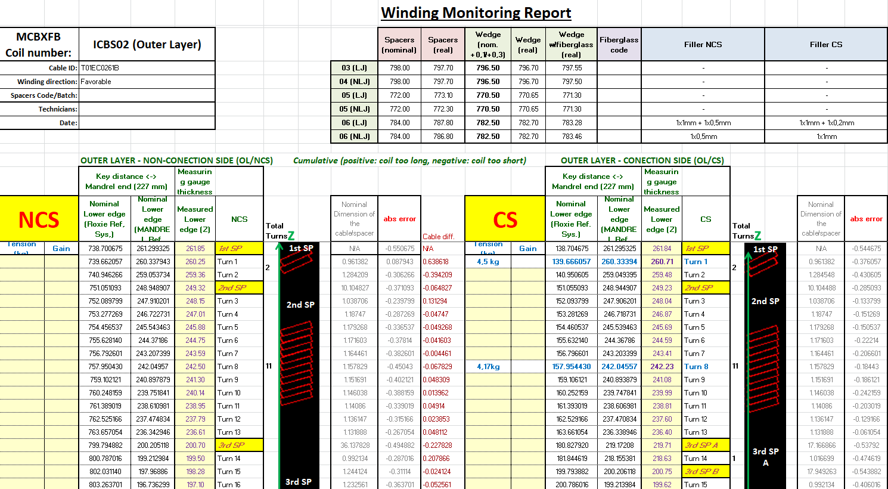
Quality control: templates
A set of templates must be filled as quality assurance: winding report, thermal cycles, electrical measurements…

Slide 6
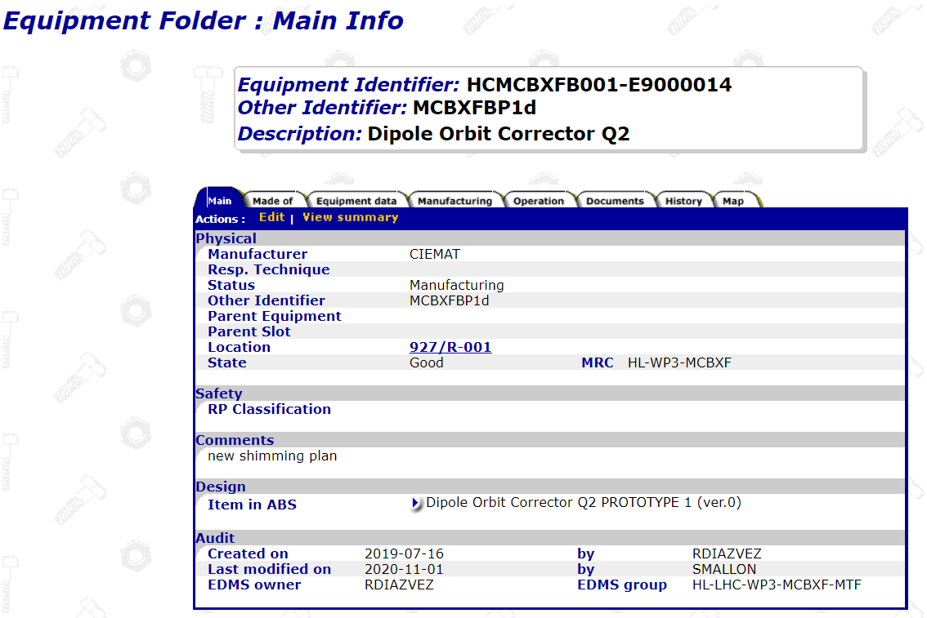
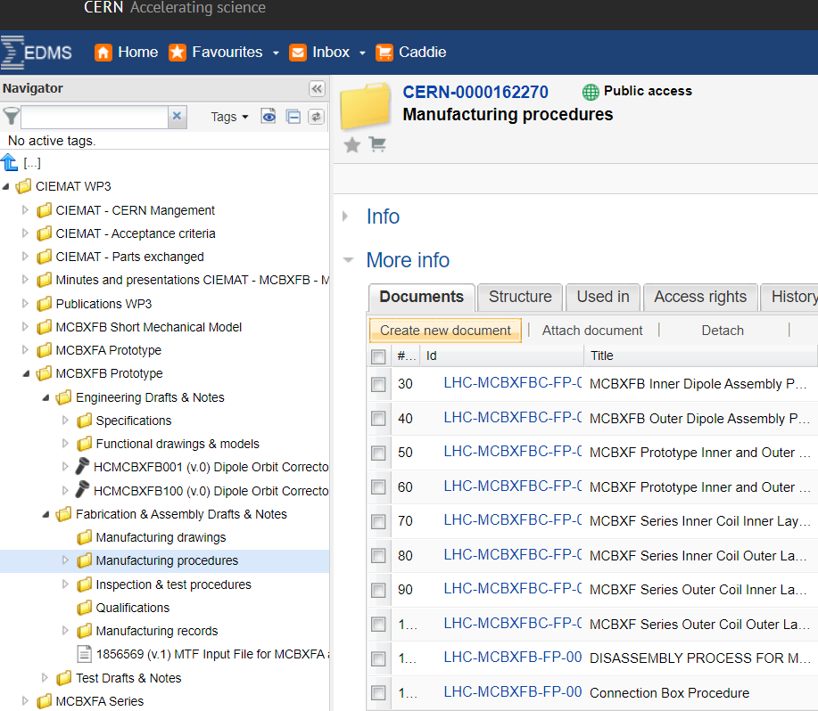
Quality control: traceability and documentation
Documentation to guarantee traceability and quality control will be stored at CERN servers (MTF, EDMS).

Slide 7
Technological transfer to industry
An Elytt engineer was learning at CIEMAT during three months to prepare the offer.
Some Elytt technicians have come to CIEMAT to be trained with the most delicate tasks, some of them specific for MCBXF magnets: binder, impregnation mould, assembly. They can participate in the assembly of MCBXFB01 at CERN (see J.C. Pérez talk).
During the production of the first magnet at Elytt premises, one person from CIEMAT will be always present to guarantee the technological transfer.
CIEMAT has prepared detailed procedures for each step of production: coil winding, binder, impregnation, assembly, parts production (ground insulation, collar packages, collaring shoes). They are uploaded to EDMS.
There are thousands of photos to help know-how transfer.
We are supporting Elytt to contact suppliers for components, tooling and materials.

Slide 8
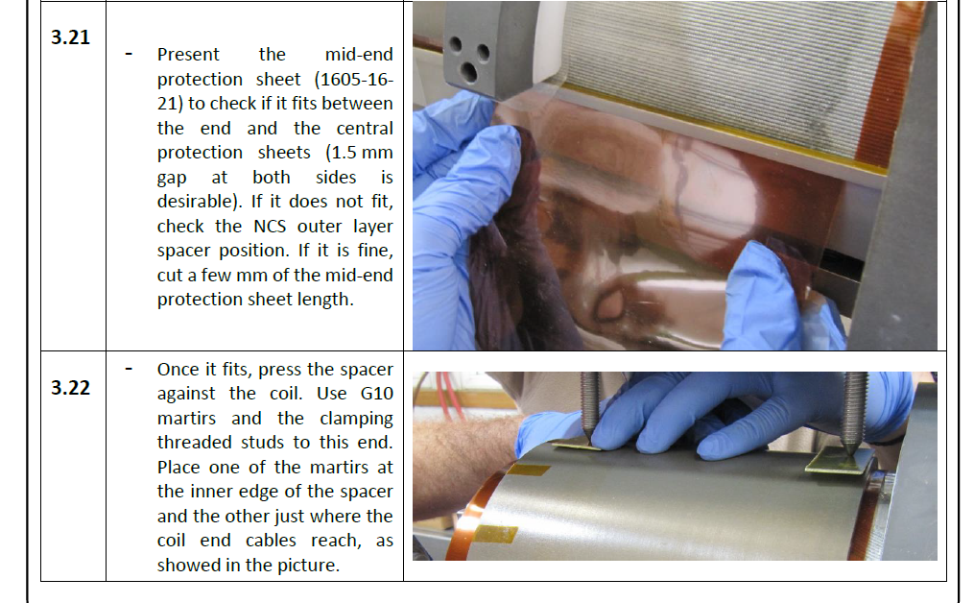
Procedures: example

Slide 9
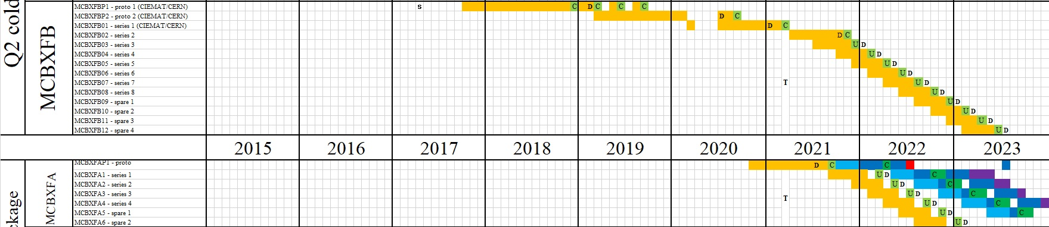
Schedule
Schedule is very tight for the production of the first magnets: real work has already started!
A decision needs to be made on inner dipole coil length after the powering test of MCBXFB01.

Slide 10
Organization to follow-up the contract
CIEMAT
Task leader: Fernando Toral
Contract responsible: Carla Martins
Fabrication follow-up: Oscar Duran
Quality control and documentation follow-up: Teresa Martínez
Magnetic measurement support: Luis González
CERN
HL-LHC project leader: Oliver Bruning
HL-LHC WP3 (magnets) leader: Ezio Todesco
Project engineer: Juan Carlos Pérez

Slide 11
Conclusions
MCBXF series magnet contract has been awarded to Elytt Energy on March 15th.
Technical specification, acceptance criteria and MIP have been agreed with CERN.
Technological transfer from CIEMAT to Elytt Energy is being done.
Schedule for the delivery of the first magnets is very tight: real work has already started!

Slide 12
Thanks for your attention

