Slide 1

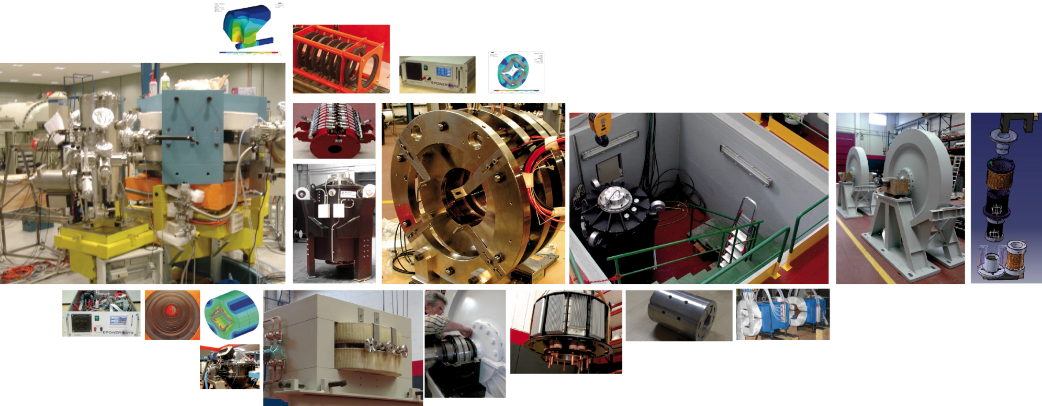

MCBXF kick off. 23 April 2021
Calle Orense 11, 2 º B - 28020 Madrid - Spain - Phone: +34 91 411 09 63 - Fax: +34 91 411 09 64 - www.elytt.com

Slide 2
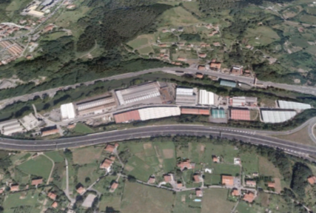
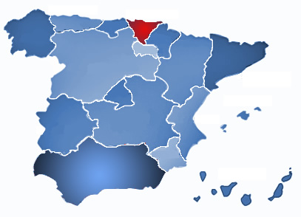

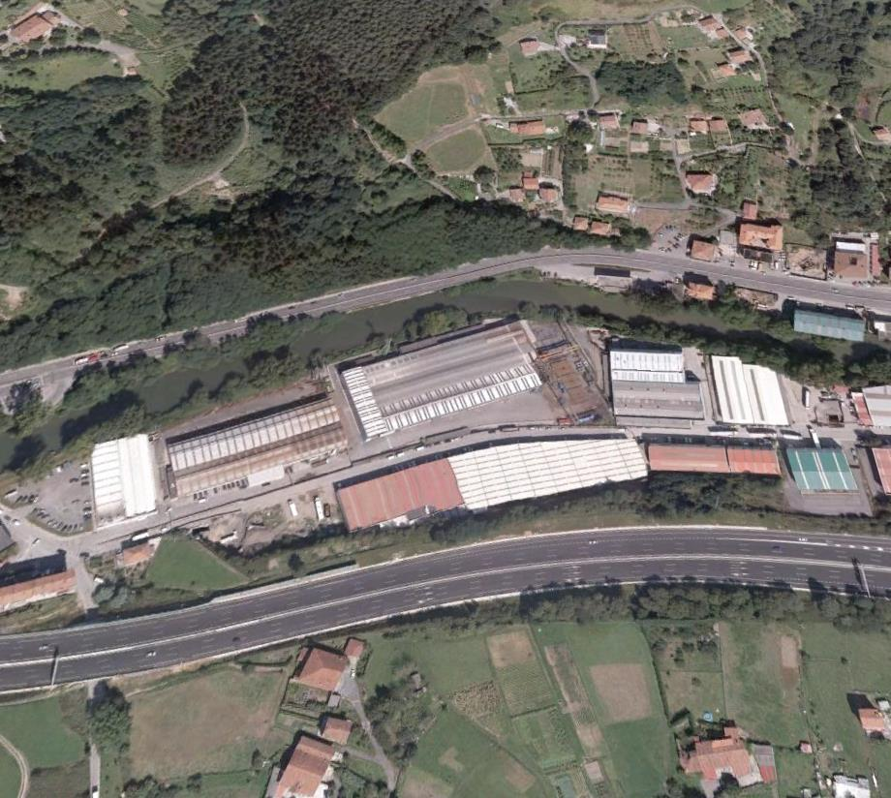
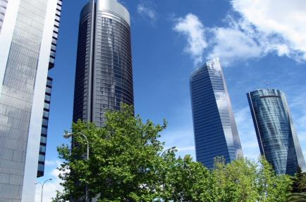
Location
Manufacturing. 2 sites: Artea, Llodio (MCBXF)
Business & Engineering (Madrid)

Slide 3



















Clients
F4E/ITER/EFDA (Europe).
CERN (Europe)
CORNELL(USA)
FAIR / GSI (Germany).
CEA(France).
ILL (France)
CIEMAT (Spain).
ESS Bilbao (Spain).
CMAM (Madrid, Spain).
DESY (Germany).
GSI (Germany).
JULICH (Germany).
CPI (USA).
CSIC (Spain).

Slide 4
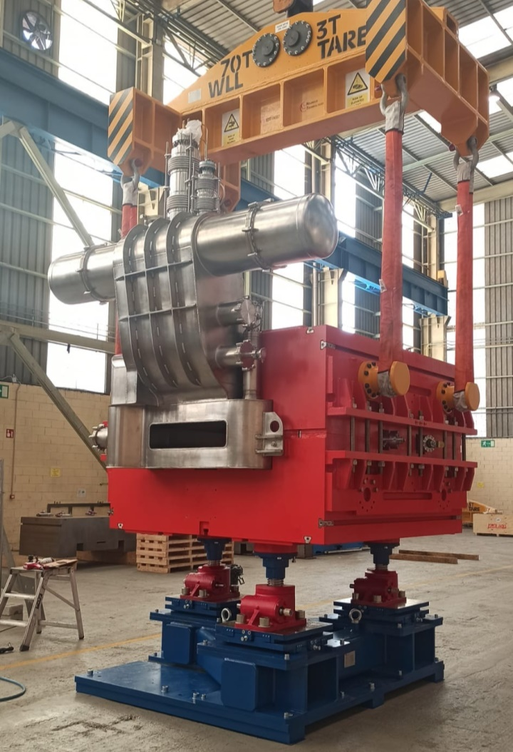
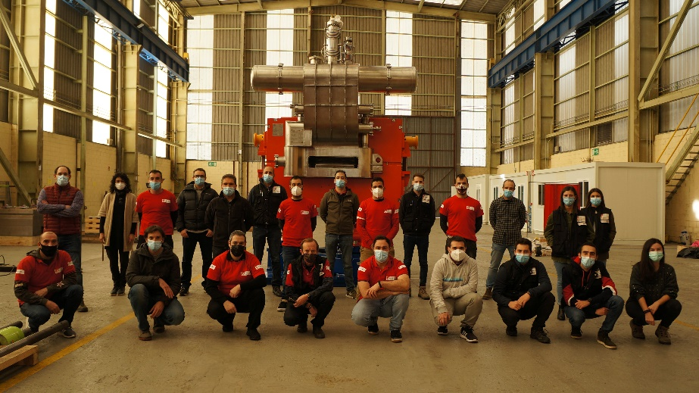
Dipole Magnets for the Super Fragment Separator project at FAIR
Elytt Energy is awarded with a contract for FAIR (Facility for Antiproton and Ion Research in Europe GmbH), for the supply of 24 Superconductor Superferric dipoles. Magnets for the Super Fragment Separator project
The Super- Fragment -Separator(Super-FRS) project is an in-flight separator with a rigidity of up to 20 T.m.
The super fragment separator will separate a primary beam of elements within some hundred nanoseconds, thus very short-lived nuclei can be studied efficiently.

Slide 5
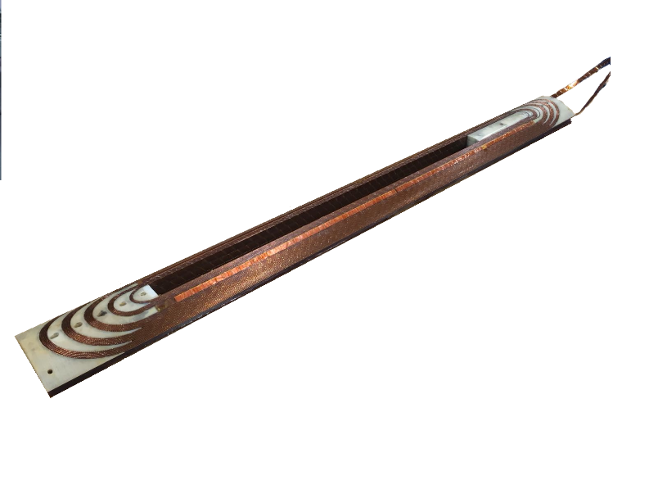
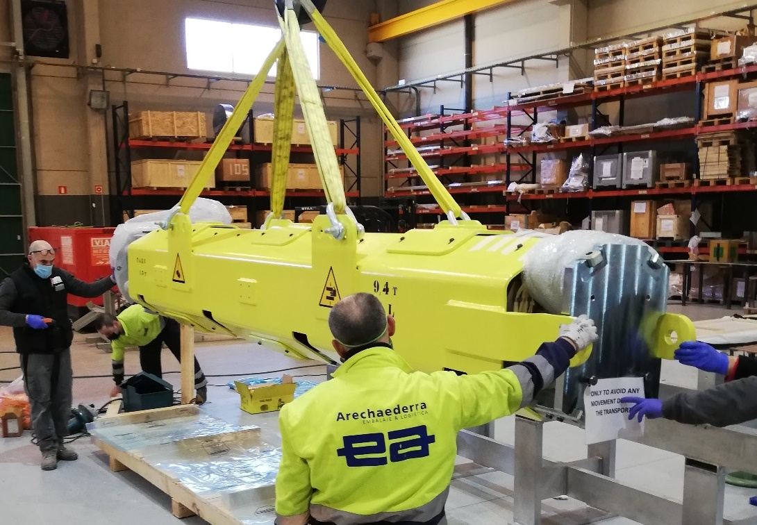
QUACO
Design and Manufacture of 1 Magnet
The QUACO project is a part of the IR magnets in HL-LHC at CERN and has as objective the production of the first First-of-a-kind HL-LHC “two-in-one quadrupoles magnets“

Slide 6
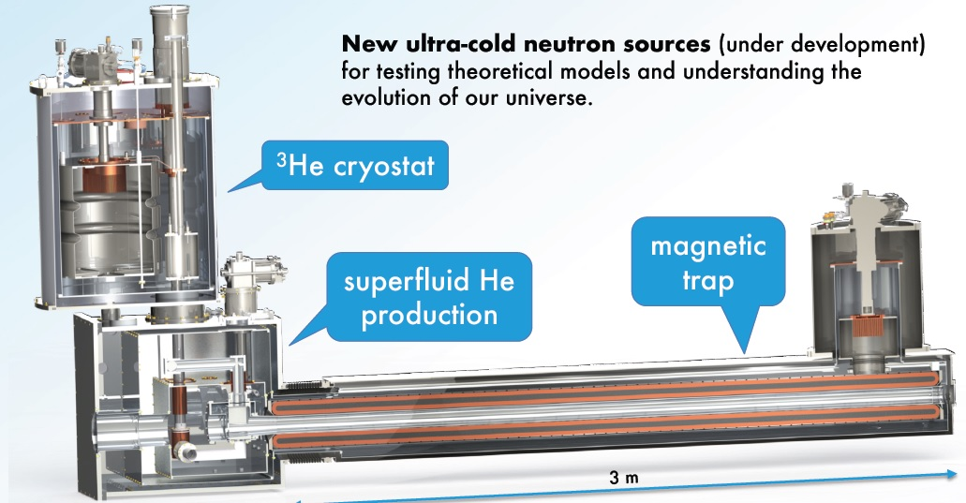
SUPERCONDUCTING MAGNETIC TRAP FOR SUPERSUN ILL

Slide 7
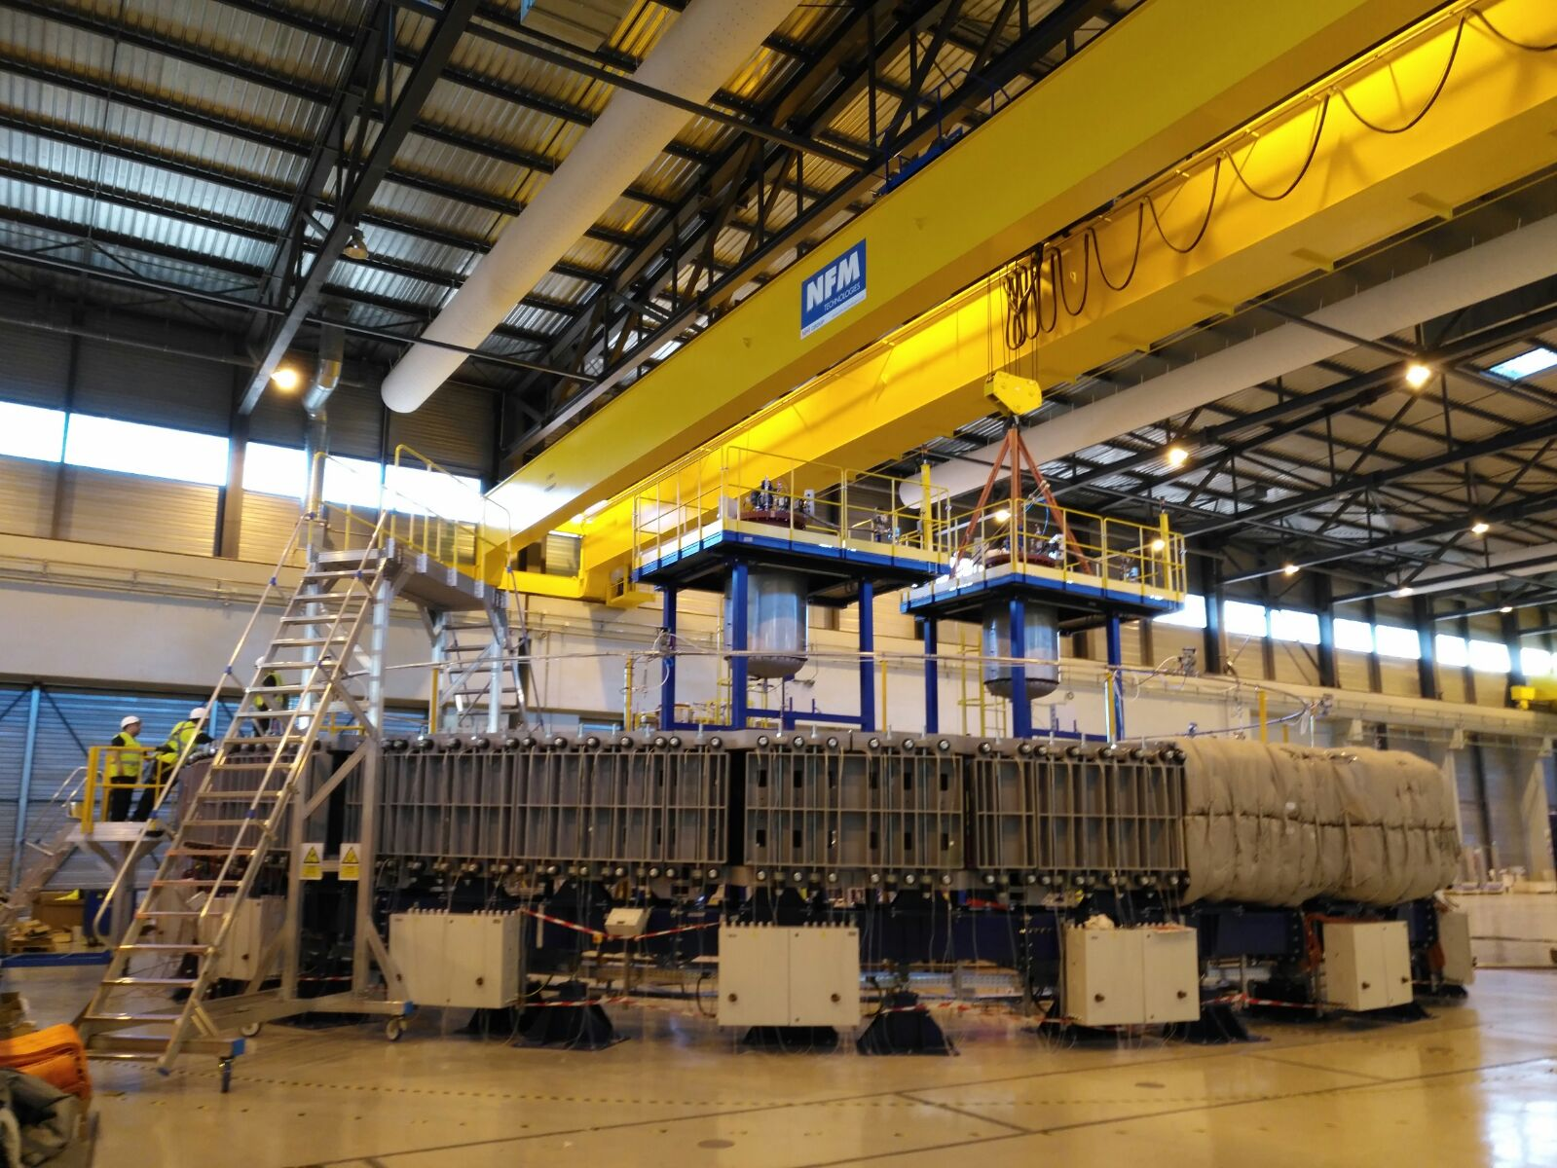
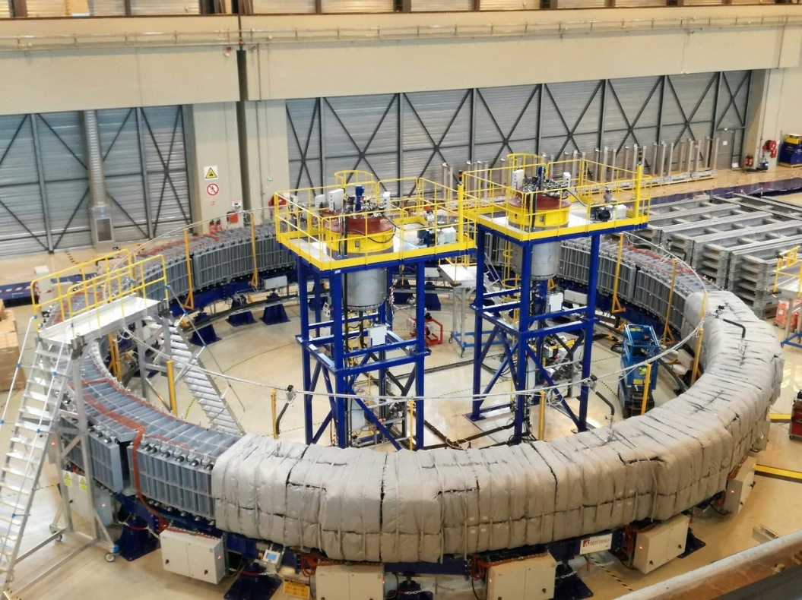
IMPREGNATION TOOLING AND ADDITIONAL TOOLING FOR ITER POLOIDAL FIELD COILS.
Desing & Manufacturing of 12 impregnation stations and impregnation support

Slide 8
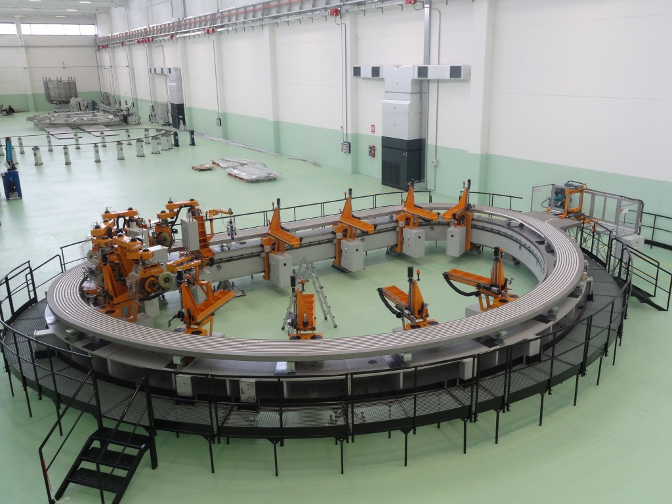
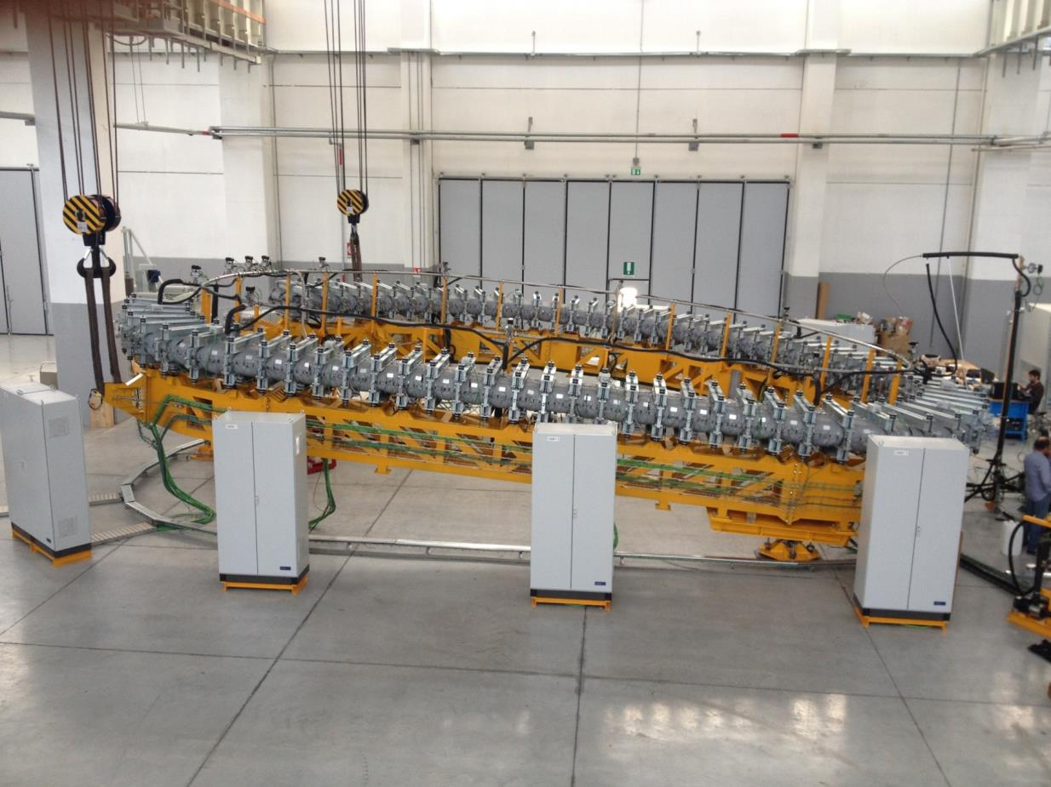
Manufacturing of 10 Superconducting coils for ITER/F4E:
ELYTT Energy is member of one International Consortium, responsible for the manufacture of 10 Winding Packs for the Toroidal field coils

Slide 9
SCHEDULE. MCBXF B
TASK | END
Milestones | 25/07/2023
Manufacturing milestones | 25/07/2023
MCBXFB | 06/07/2023
MCBXFB02.Manufacturing and shipping to CERN | 23/12/2021
MCBXFB03. Manufacturing and shipping to FREIA (Uppsala) | 01/02/2022
MCBXFB04. Manufacturing and shipping to FREIA (Uppsala) | 16/03/2022
MCBXFB05. Manufacturing and shipping to FREIA (Uppsala) | 05/05/2022
MCBXFB06. Manufacturing and shipping to FREIA (Uppsala) | 21/06/2022
MCBXFB07. Manufacturing and shipping to FREIA (Uppsala) | 29/08/2022
MCBXFB08. Manufacturing and shipping to FREIA (Uppsala) | 26/10/2022
MCBXFB09. Manufacturing and shipping to FREIA (Uppsala) | 02/01/2023
MCBXFB10. Manufacturing and shipping to FREIA (Uppsala) | 02/03/2023
MCBXFB11. Manufacturing and shipping to FREIA (Uppsala) | 09/05/2023
MCBXFB12. Manufacturing and shipping to FREIA (Uppsala) | 06/07/2023
Note: the first MCBXF magnet is MCBXFB02 because Ciemat is manufacturing MCBXFB01

Slide 10
SCHEDULE. MCBXF A
TASK | END
Milestones | 25/07/2023
Manufacturing milestones | 25/07/2023
MCBXFA | 25/07/2023
MCBXFA1. Manufacturing and shipping to test site | 07/06/2022
MCBXFA2. Manufacturing and shipping to test site | 14/09/2022
MCBXFA3. Manufacturing and shipping to test site | 17/11/2022
MCBXFA4. Manufacturing and shipping to test site | 26/01/2023
MCBXFA5. Manufacturing and shipping to test site | 20/04/2023
MCBXFA6. Manufacturing and shipping to test site | 25/07/2023

Slide 11
SCHEDULE. Detailed
Strategy:
Two lines for winding, binding, impregnation. One line for collaring and yoking
Start in first line with Outer coil MCBXFB02 (inner coil final length pending)
Start in second with Outer coil of MCBXFB03. Once finished, continue with MCBXFA

Slide 12
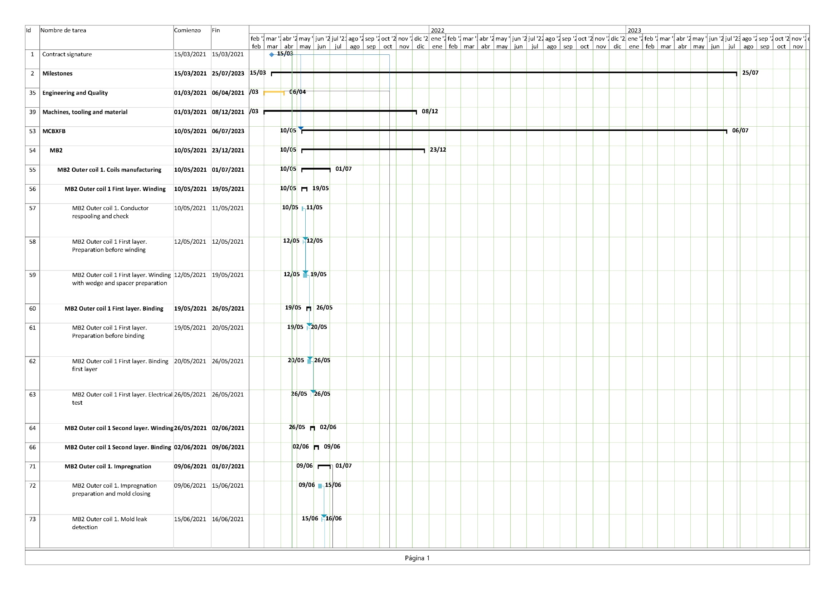
SCHEDULE. Detailed

Slide 13
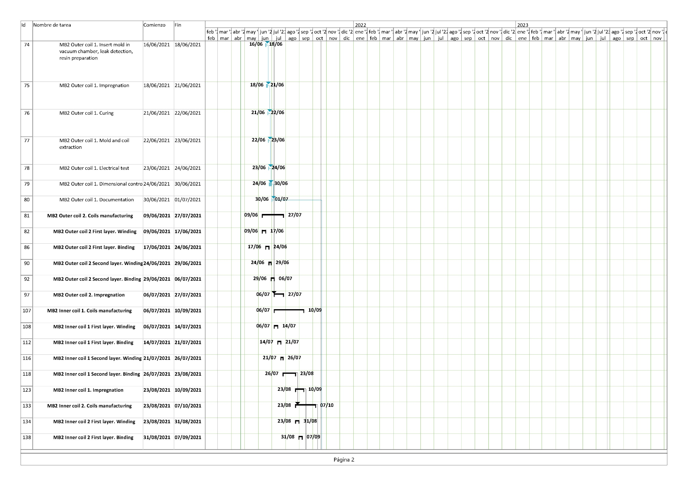
SCHEDULE. Detailed

Slide 14
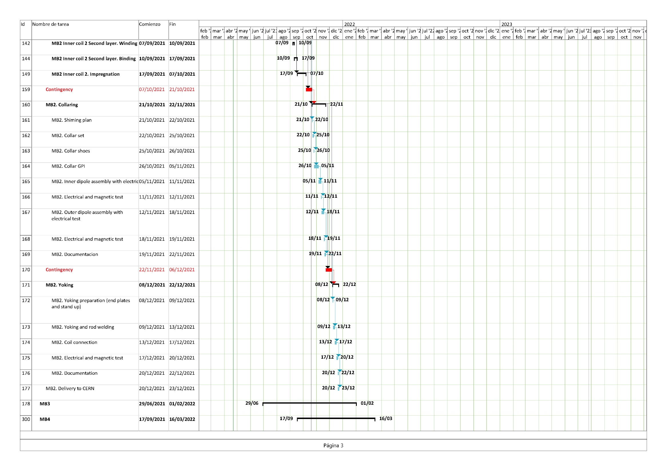
SCHEDULE. Detailed

Slide 15
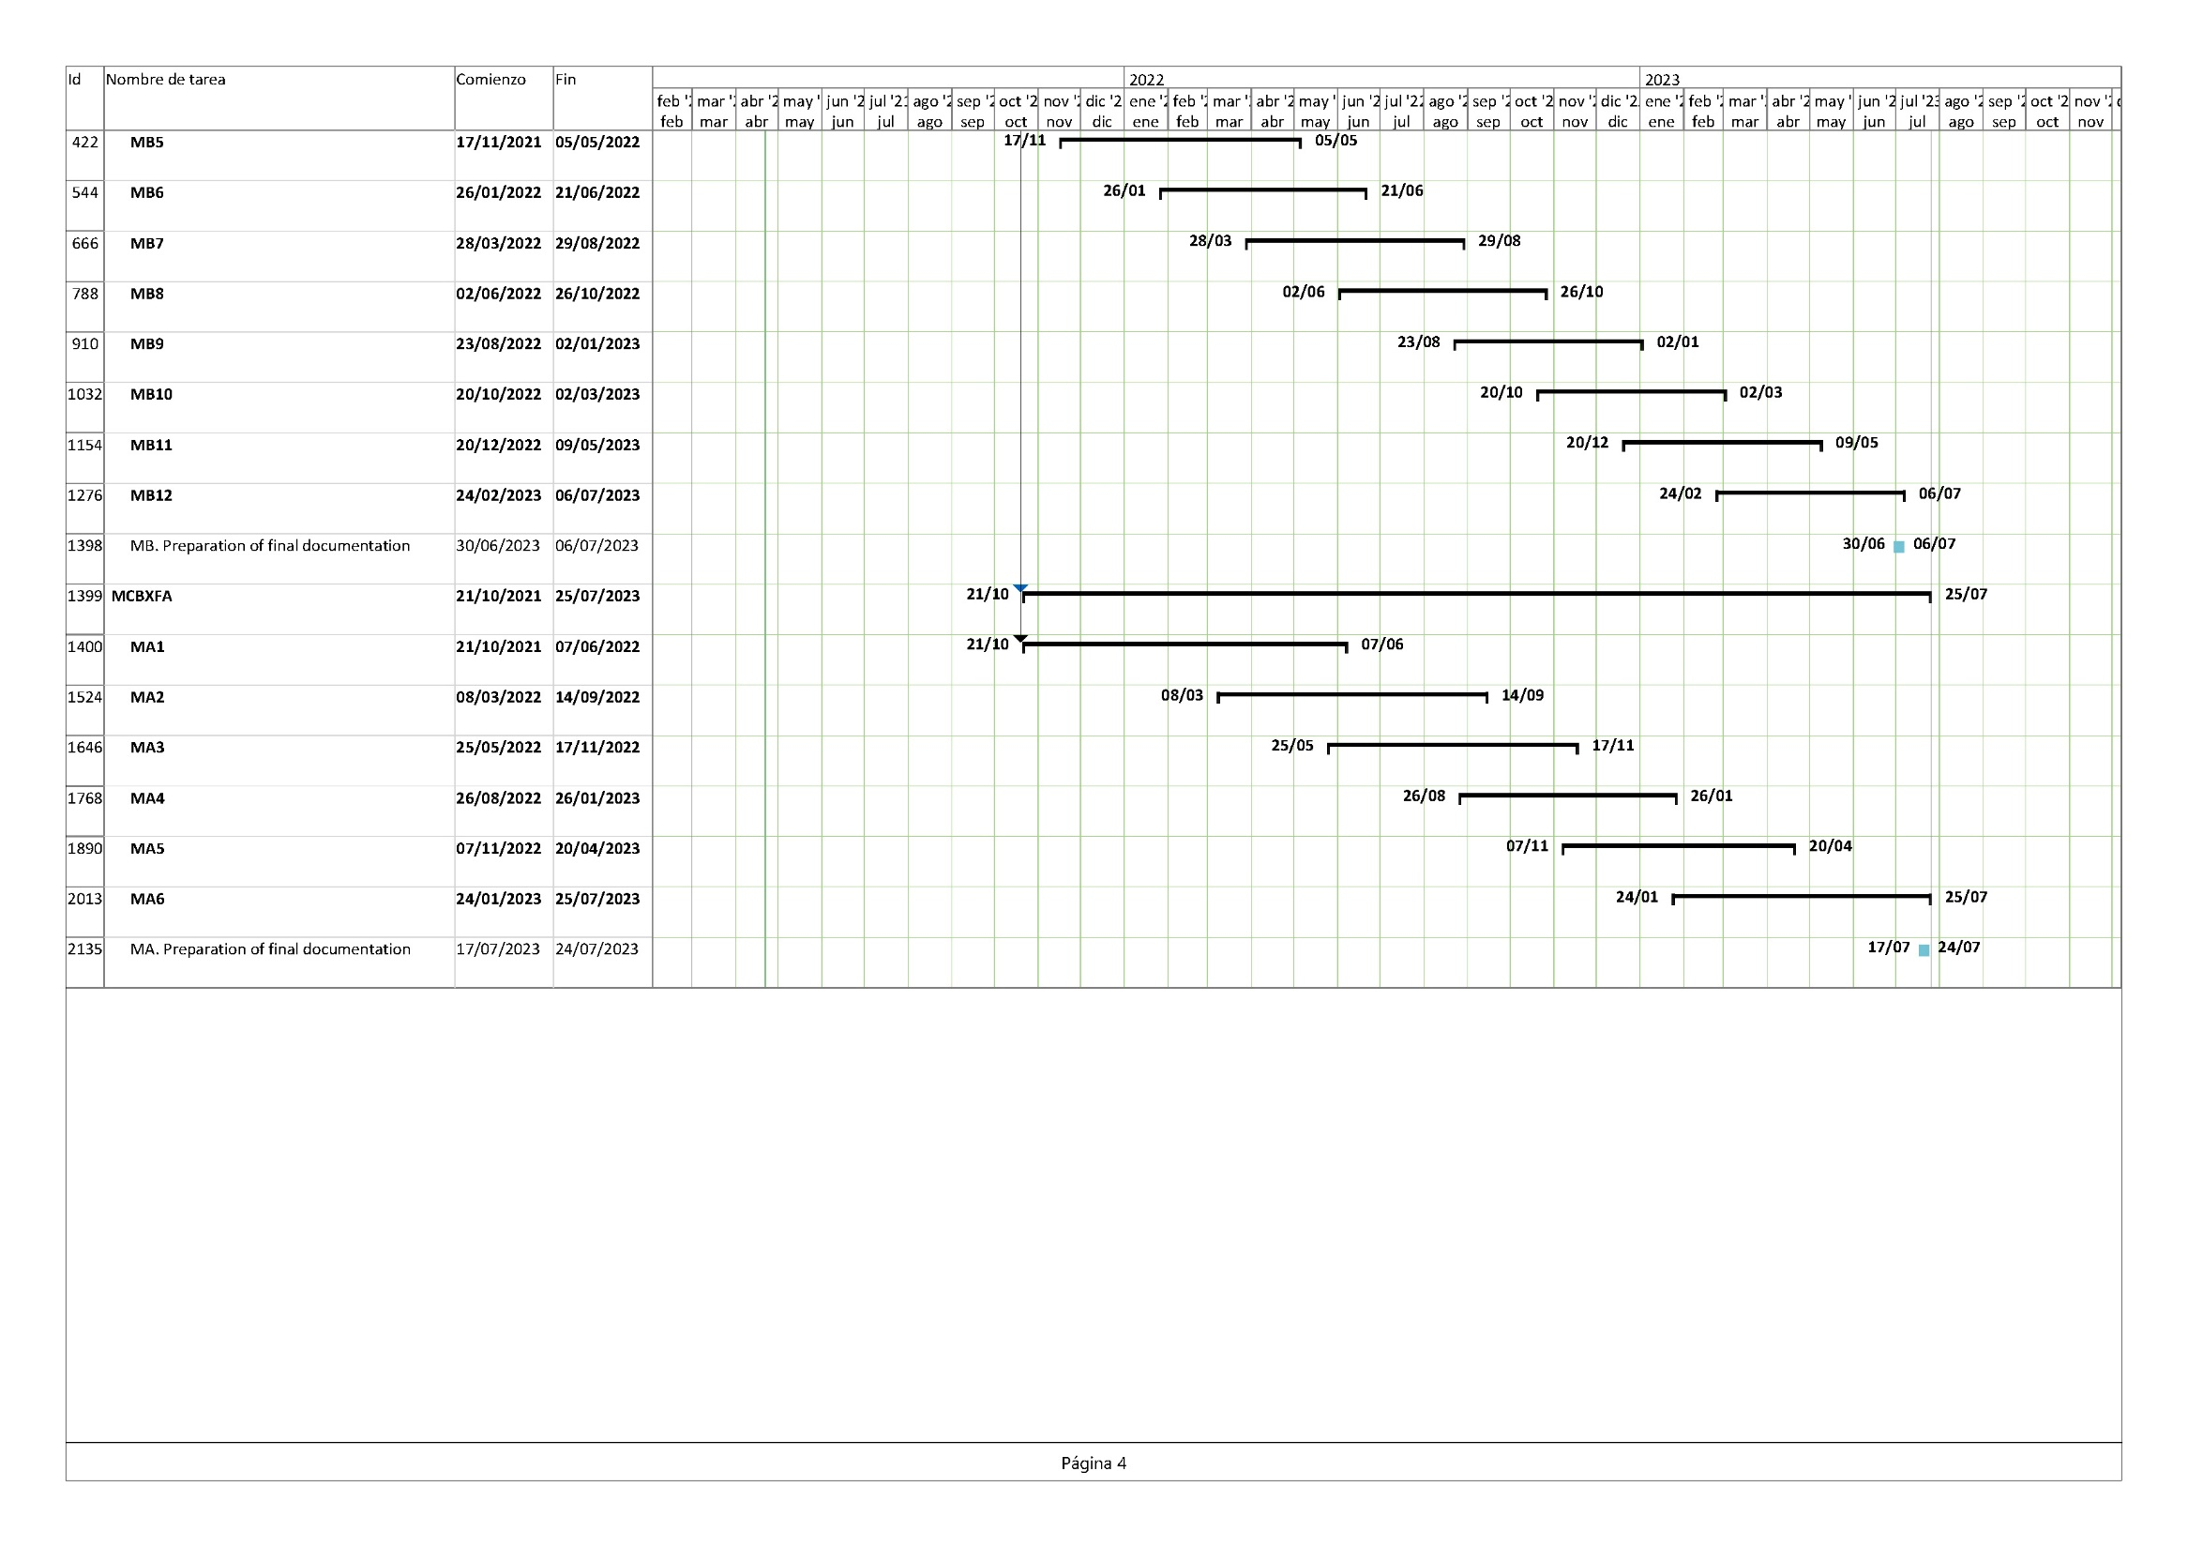
SCHEDULE. Detailed

Slide 16
Resources
Project Manager: Aitor Echeandia/Marcos Garcia
Responsible Engineer: Mikel Oñate with Michel Lopez support
Purchase responsible: Igor Etxeberria
Quality responsible: Olatz Aldecoa
Production responsible: Iker Irigoyen
Technicians: 6 technicians assigned. 4 more to be assigned when needed

Slide 17
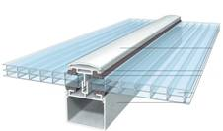
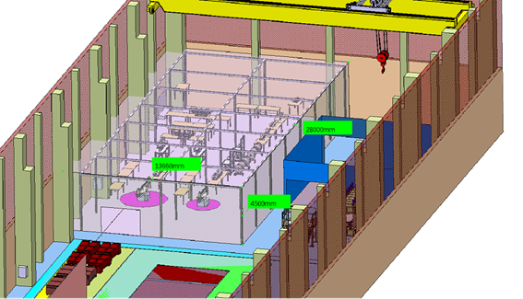
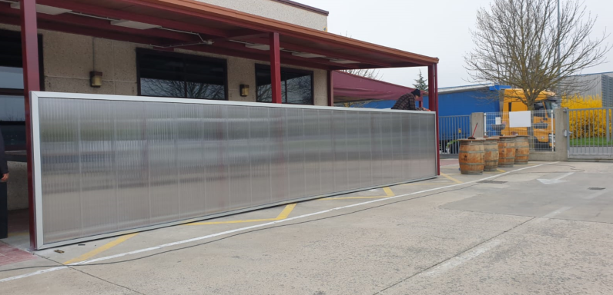
Working area
Acclimatised area with cellular polycarbonate → First of may

Slide 18
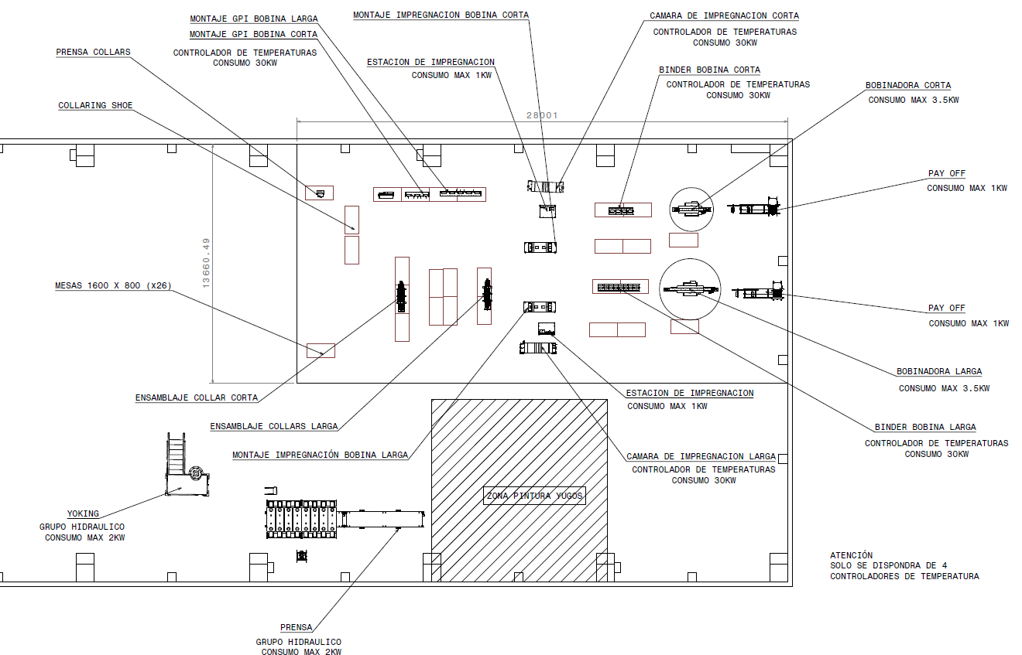
Ground Insulations
/ Collaring shoes / Collars
BINDER
WINDING
Collaring assembly
IMPREGNATION
Final assembly tooling
Collaring press

Slide 19
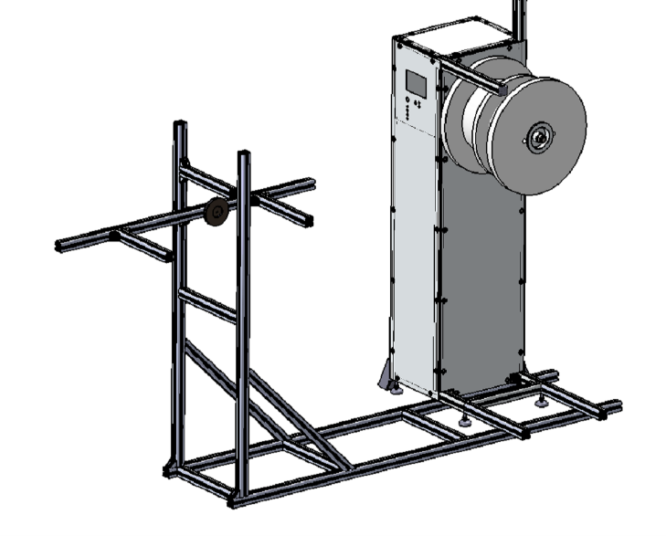
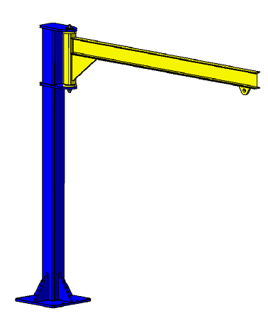
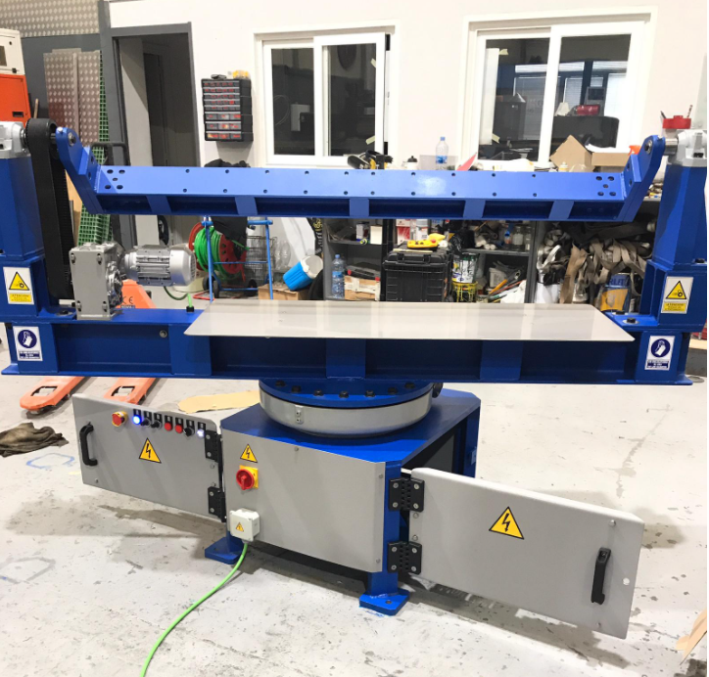
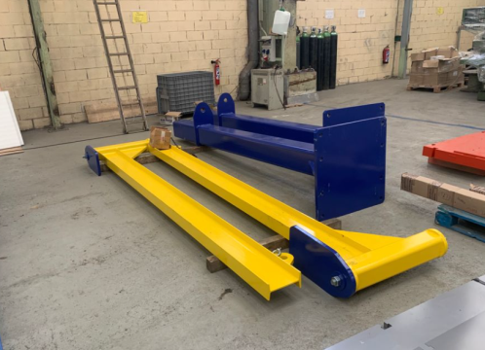
Winding
One winding machine manufactured and prepared
Second winding machine manufacturing
One pay-off machine manufactured. Ready for assembly.
Pillar jib support for spool hanger.
Ready for assembly.

Slide 20
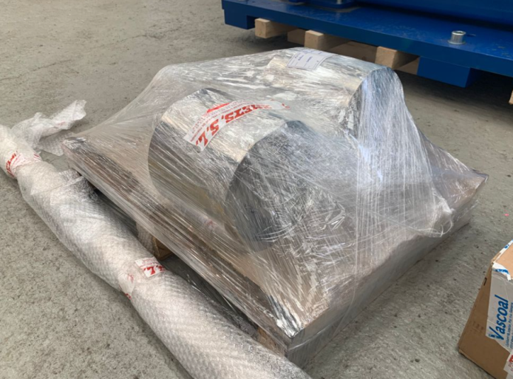
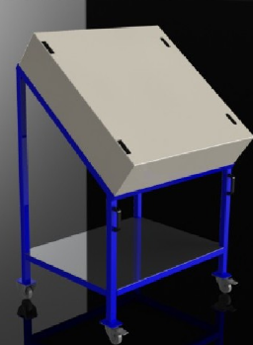
Winding tooling
Gage to check spacer´s → Received
Outer winding mandrel → First of may
Outer winding tooling → First of may
Binding
Temperature controllers → Manufactured
Outer binder tooling → Middle May

Slide 21
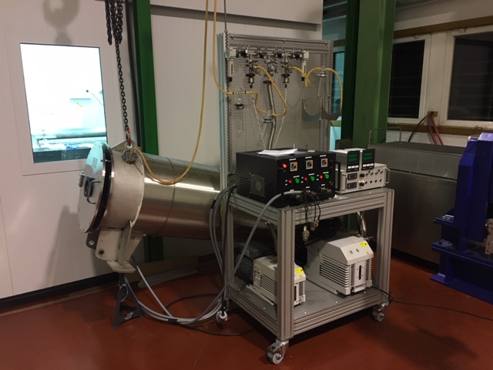
Impregnation
Vacuum impregnation system (same as Ciemat) → Manufacturing / End of may
Vacuum chamber (same as Ciemat) → Manufacturing / End of May
Outer impregnation mould MCBXFB → End of May

Slide 22
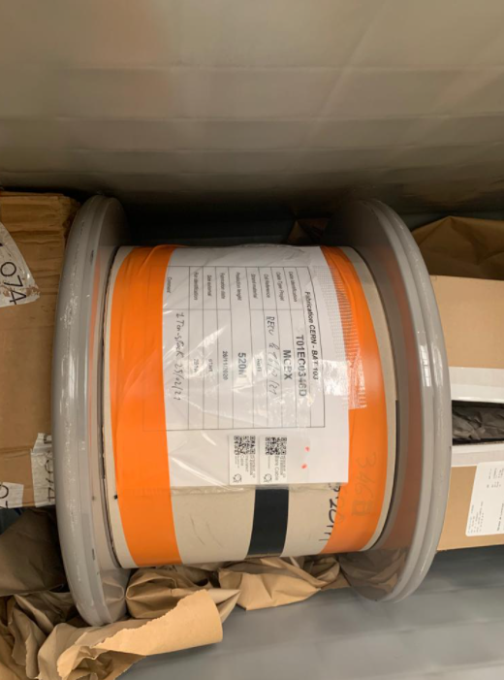
Winding, Binding and Impregnation Material (consumables)
First spool (T0E1C0346D) for the first outer coil of MCBXFB magnet received
Second spool (0T01EC0346E ) → Last week of April
Apical AV500→ First week of May
CTD-BDR-1.1 (Binder) & CTD101K (impregnation) → First week of May
Fibre Glass tape and sheaths → First week of May
Nomex, Duratron , Self-adhesive Teflon and other consumables → 1st and 2nd week of May

Slide 23
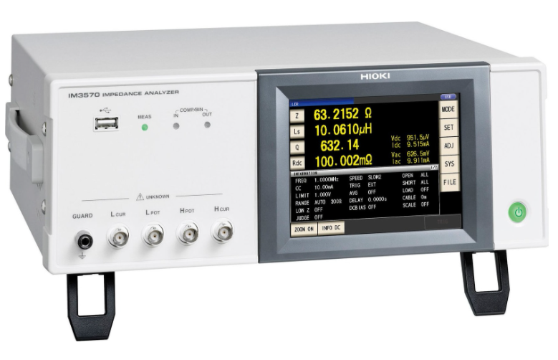
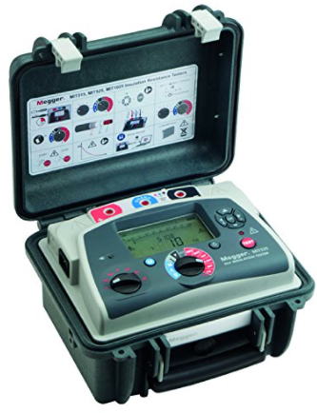
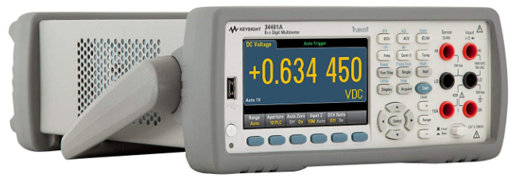
Impregnated coil Electrical Tests Equipment
LCR meter - Impedance Analyzer HIOKI IM3570 + L2000 probes → First of May
MIT-525-EU MEGGER Insulation meter → First of May
Digital multimeter, 6 1/2 digit, Truevolt DMM 34461A → First of May

Slide 24
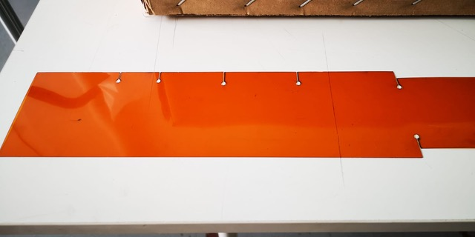
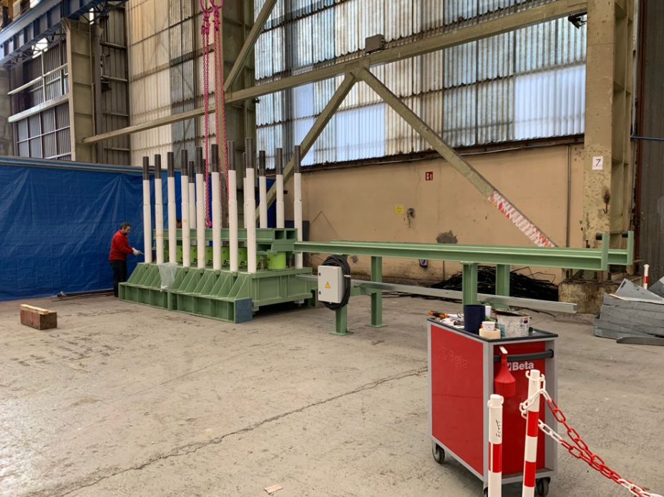
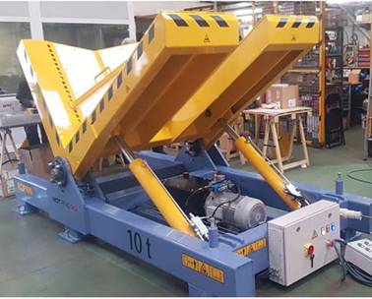
Pending tasks
Polyimide insulation laser cutting supplier searching
Tilter type choice
Collaring press assembly

Slide 25

FOR FURTHER INFORMATION CONTACT:
Aitor Echeandia
Project Manager
Phone: +34 91 411 09 63
Fax: +34 91 411 09 64
Email: aitor.echeandia@elytt.com

