Slide 1

Early LHC data preparations for SUSY searches at CMS
Didar Dobur
University of Florida
Representing the CMS Collaboration
ICHEP
22-28 July 2010, Paris

Slide 2


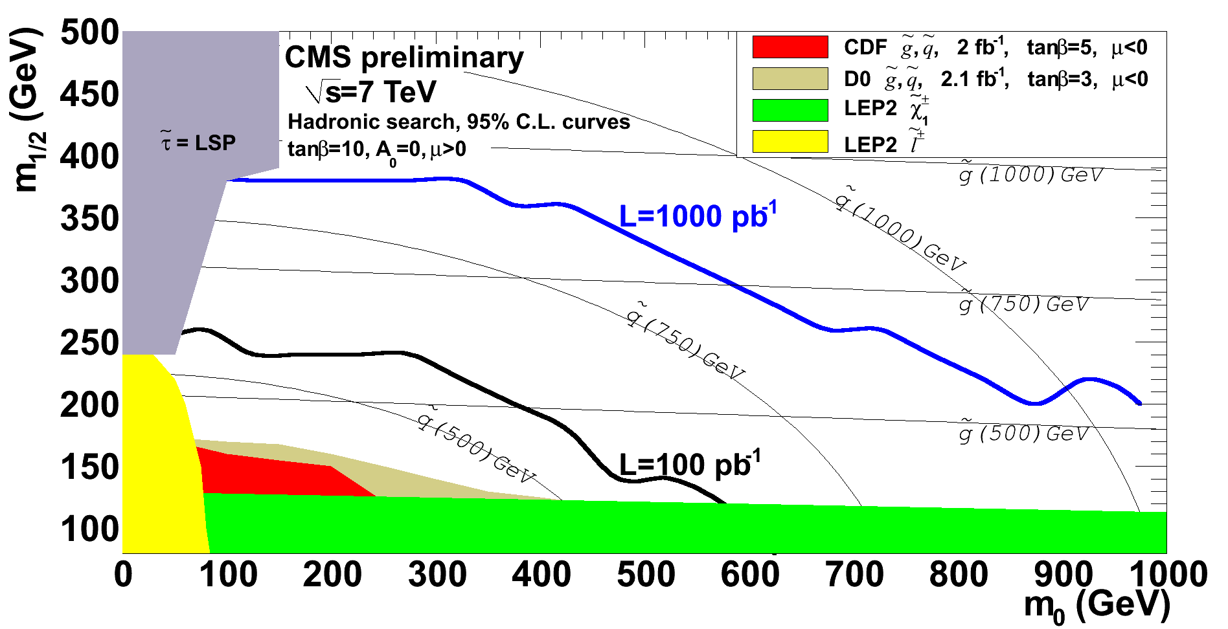
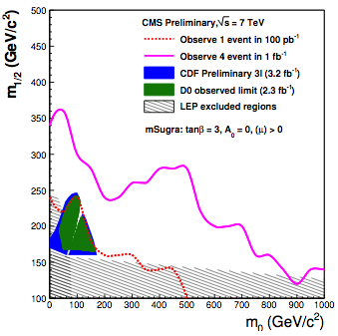
Introduction
sensitivity to mSUGRA with fully hadronic signaure
Sensitivity with Same-Sign di-lepton
TEVATRON
CMS
CMS
7 TeV data of ~100 pb⁻¹ should provide sensitivity to SUSY parameter space well beyond the current limits set by TEVATRON
The sensitivity reach strongly depends on how well we understand the SM backgrounds
Didar Dobur 2/18 ICHEP 2010 Paris

Slide 3
Introduction
Strategies to suppress and measure SM backgrounds are studied in detail using MC in the past years
7 TeV data used (11-65 nb⁻¹) for testing some of these methods in the available phase-space (not yet where we expect SUSY signal)
QCD is not expected to be dominant background for most of the search topologies, but poorly known (large!) cross sections, need to be measured from data:
Suppressing QCD using topological observables
Predicting QCD contributions to Missing E_{T} (MET)
data-driven techniques to measure QCD background for lepton(s) + Jets +MET signatures
Material used in this presentation is documented in SUS-10-001, and see JME-10-004 for detailed MET studies for SUSY searches, see Slide 18 for full references
Didar Dobur 3/18 ICHEP 2010 Paris

Slide 4
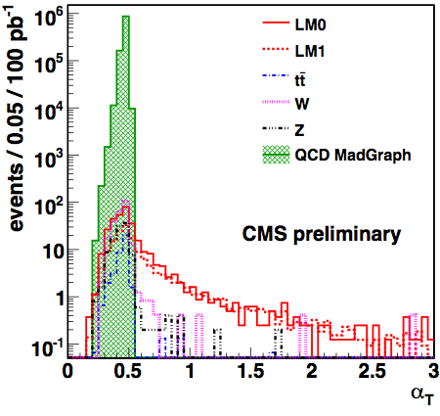


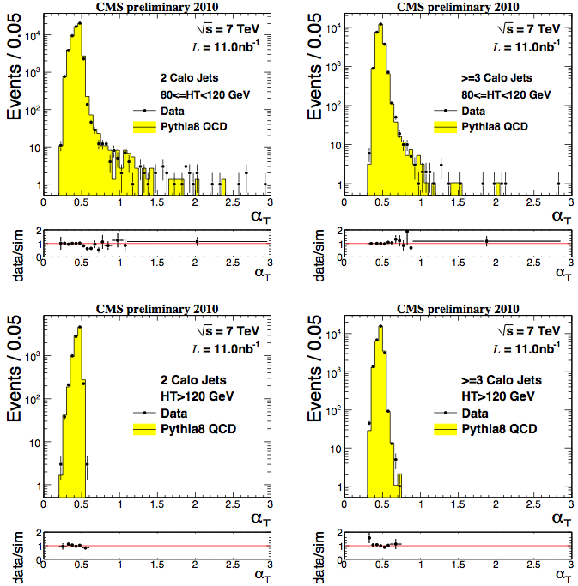

Suppressing QCD with α_{T}
A powerful variable for suppressing mis-measured QCD
Well measured back-to-back di-jet system α_{T} ≈0.5, if one jet is mis-measured α_{T} <0.5
√s=10 TeV MC
SUSY
2 Jets
H_{T} [80,120]
2 Jets
H_{T} >120 GeV
Study fraction of events with α_{T} >0.55
The data shows the expected sharp fall around α_{T ~} 0.5, improves for higher H_{T}
Didar Dobur 4/18 ICHEP 2010 Paris

Slide 5
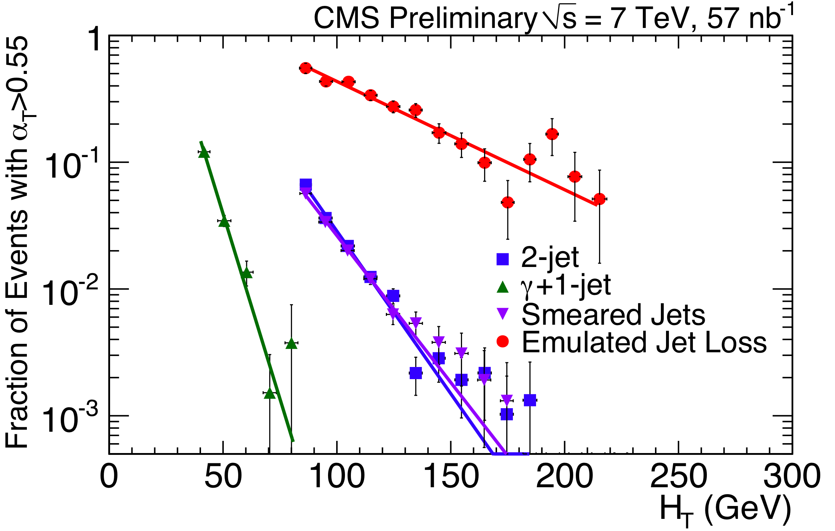
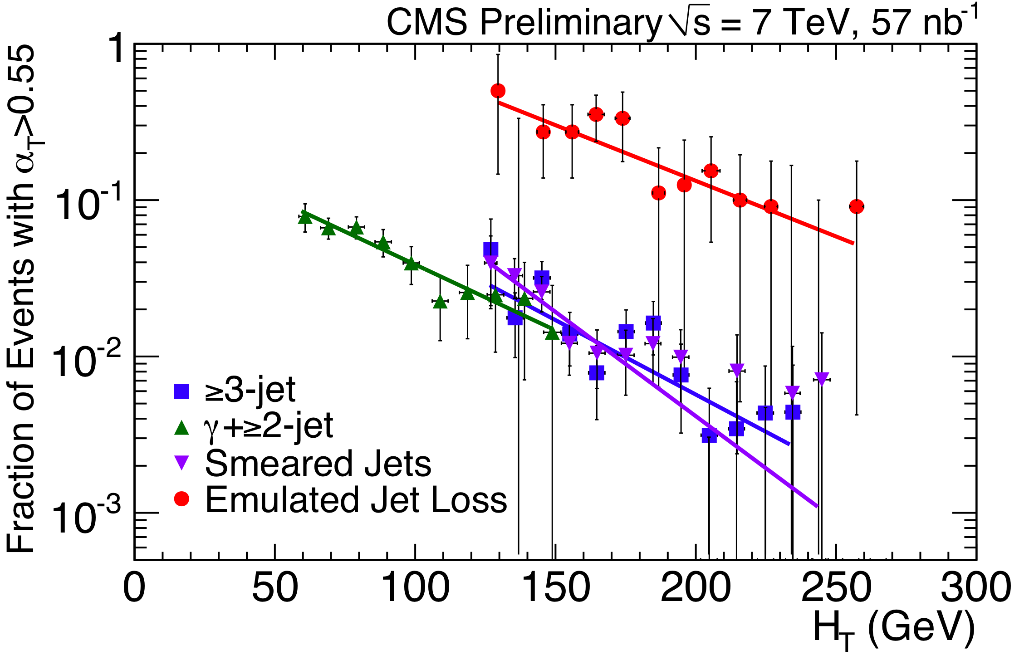
H_{T} dependence of α_{T}
Rejection power of α_{T} is expected to get better with increasing H_{T}
Examine this assumption in the available H_{T} range:
2-Jet
multi-Jet
Expected decrease (approx. exponential) with H_{T} is observed for both 2-jet and ≥3-jets
Better performance with increasing H_{T} holds also for:
Extended also for leptonic search channels (not shown here)
    In γ+jet(s) events where photon is treated as a jet
    Emulating extreme jet losses
    Smearing jet energies
Didar Dobur 5/18 ICHEP 2010 Paris

Slide 6
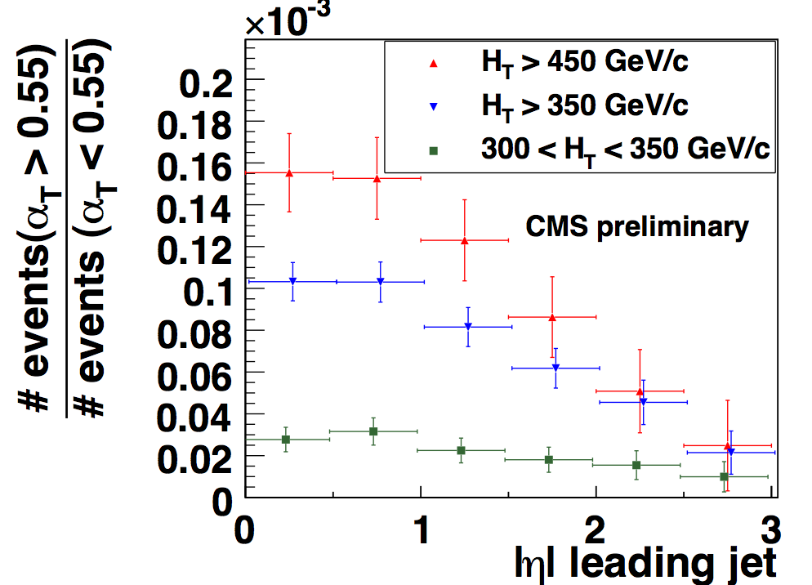
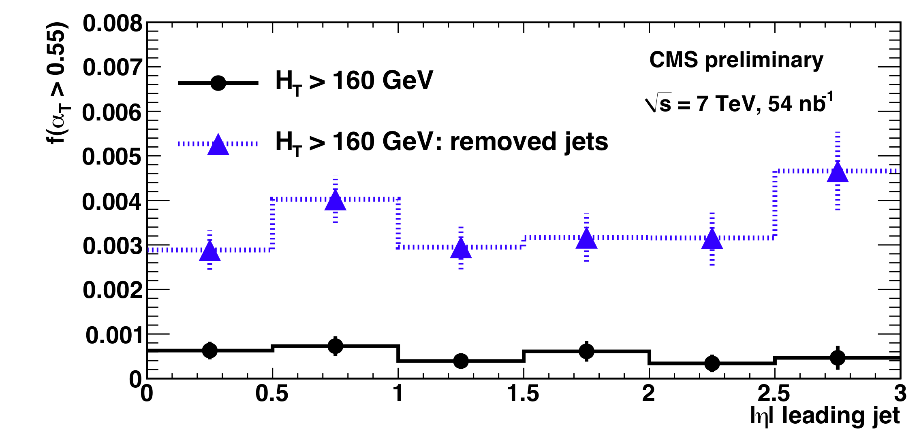
α_{T} versus pseudorapidity
√s=10 TeV MC
Having verified α_{T} behavior with H_{T} , one can use data at lower H_{T} to estimate SM background at high H_{T} by exploiting its expected uniformity versus η
The method was studied with 10 TeV MC
Fraction of events with α_{T}>0.55 as a function of the leading jet η
SUSY + SM
Flat behavior across η, even when a jet is removed
Didar Dobur 6/18 ICHEP 2010 Paris

Slide 7
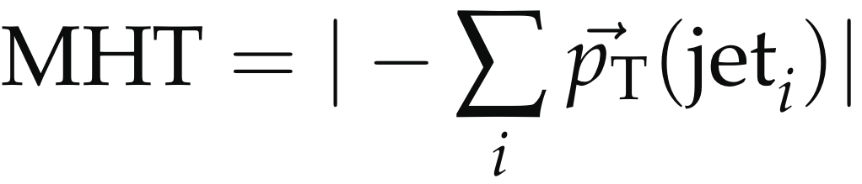
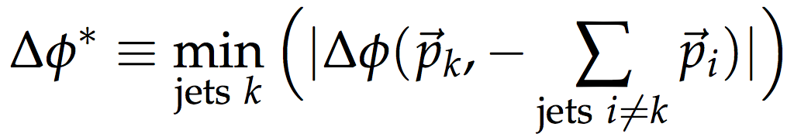
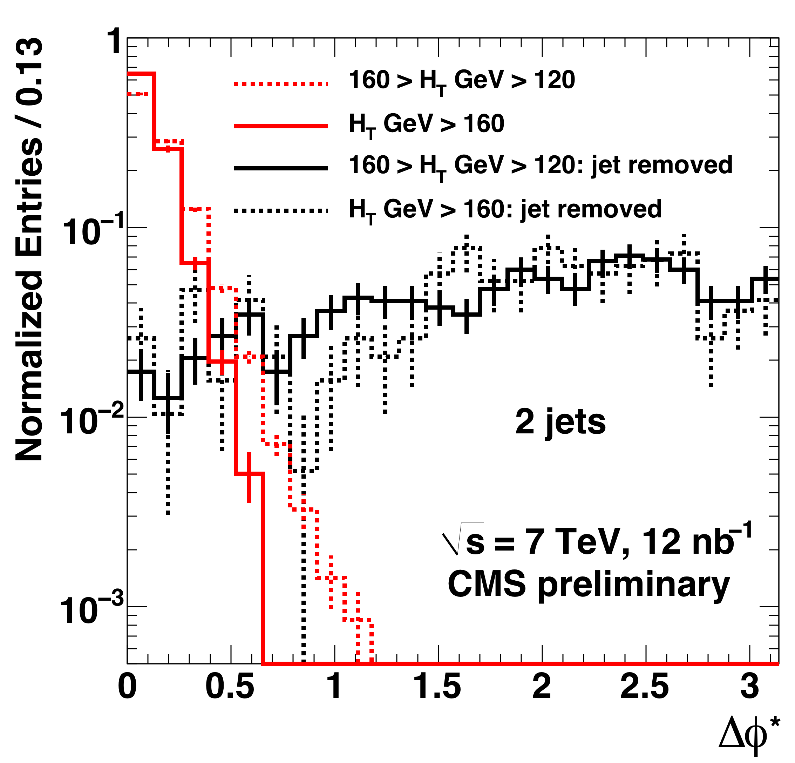
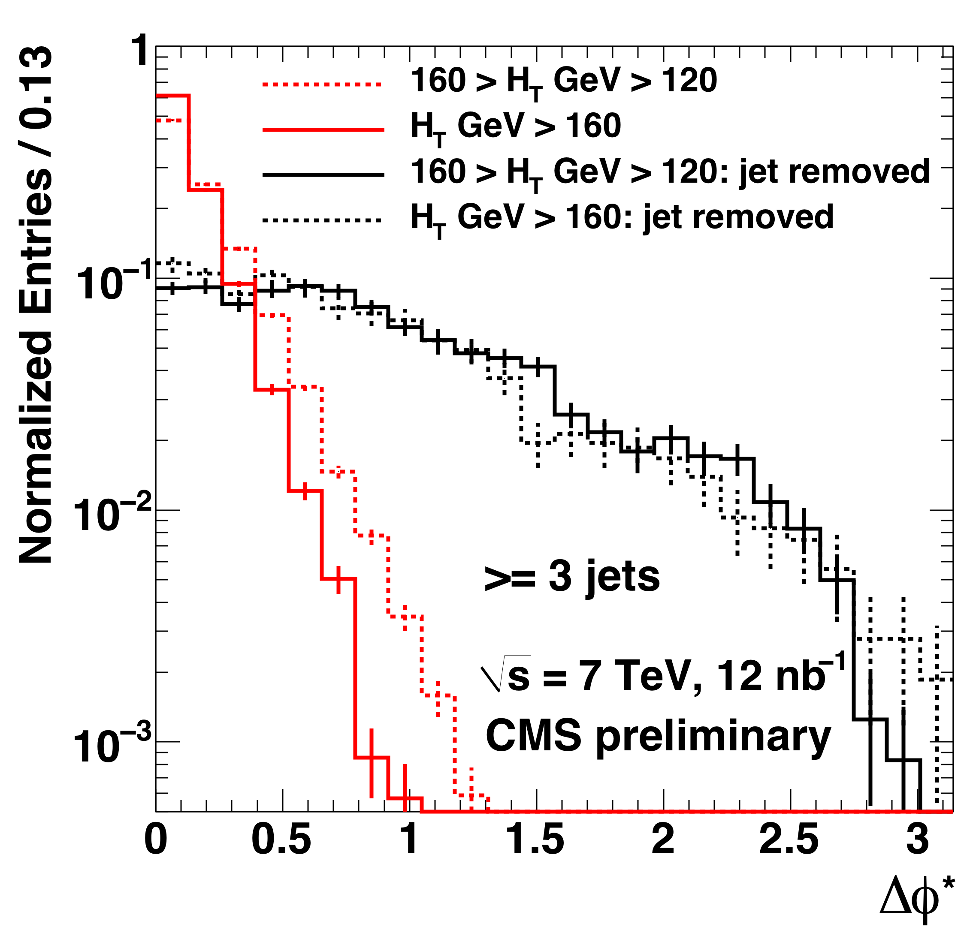
Suppressing QCD with Δφ*
A complementary observable, Δφ*, to diagnose background events where one jet mis-measured.
Test each jet to see if it is responsible for the MHT (vectorial sum of the jet p_{T})
MHT
Δφ
j_{k}
expect small Δφ* for QCD
more uniform for real MET (emulated by removing one jet)
Data confirms the expected behavior in both di- and multi-jets
Resolution improves with H_{T}
Didar Dobur 7/18 ICHEP 2010 Paris

Slide 8

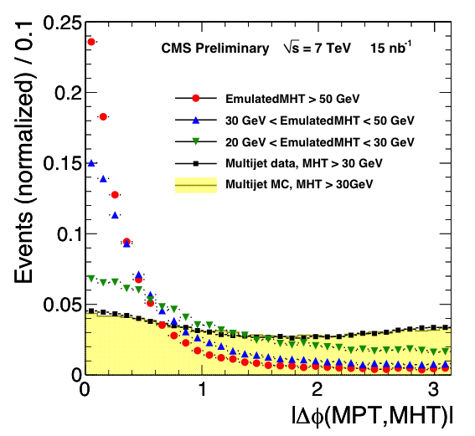
Tracker (MPT) vs Calorimeter (MHT)
  Independent measurement of missing momentum from Tracker & Calorimeter
  Compare the direction of MPT and MHT, Δϕ(MPT,MHT)
Very little correlation between the directions of MPT and MHT when no real MHT is present (QCD)
peaks towards zero for real MHT (emulated by removing a random jet)
Also useful to remove events with a fake MHT due to noise in the calorimeter
Didar Dobur 8/18 ICHEP 2010 Paris

Slide 9
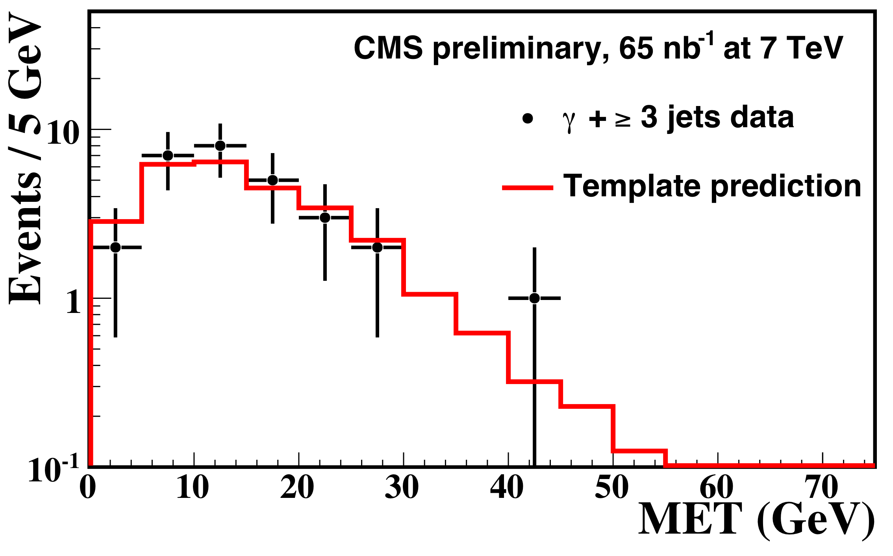
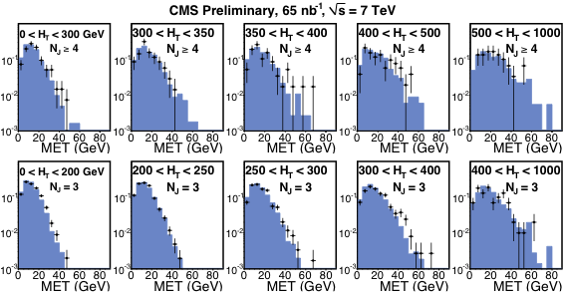
Predicting high MET tail
MET background to lepton+jets+MET signatures from real MET (e.g. in W/Z) and MET due to mis-measurements
Test the method for the latter
Use MET templates from multi-jet events to predict MET for γ+jets events
MET templates from multi-jet events
Good agreement between predicted and observed distributions:
for MET > 15 GeV
predicted = 12.5
observed = 11
p_{T}(γ) > 15 GeV
p_{T}(Jet) > 40 GeV
Didar Dobur 9/18 ICHEP 2010 Paris

Slide 10
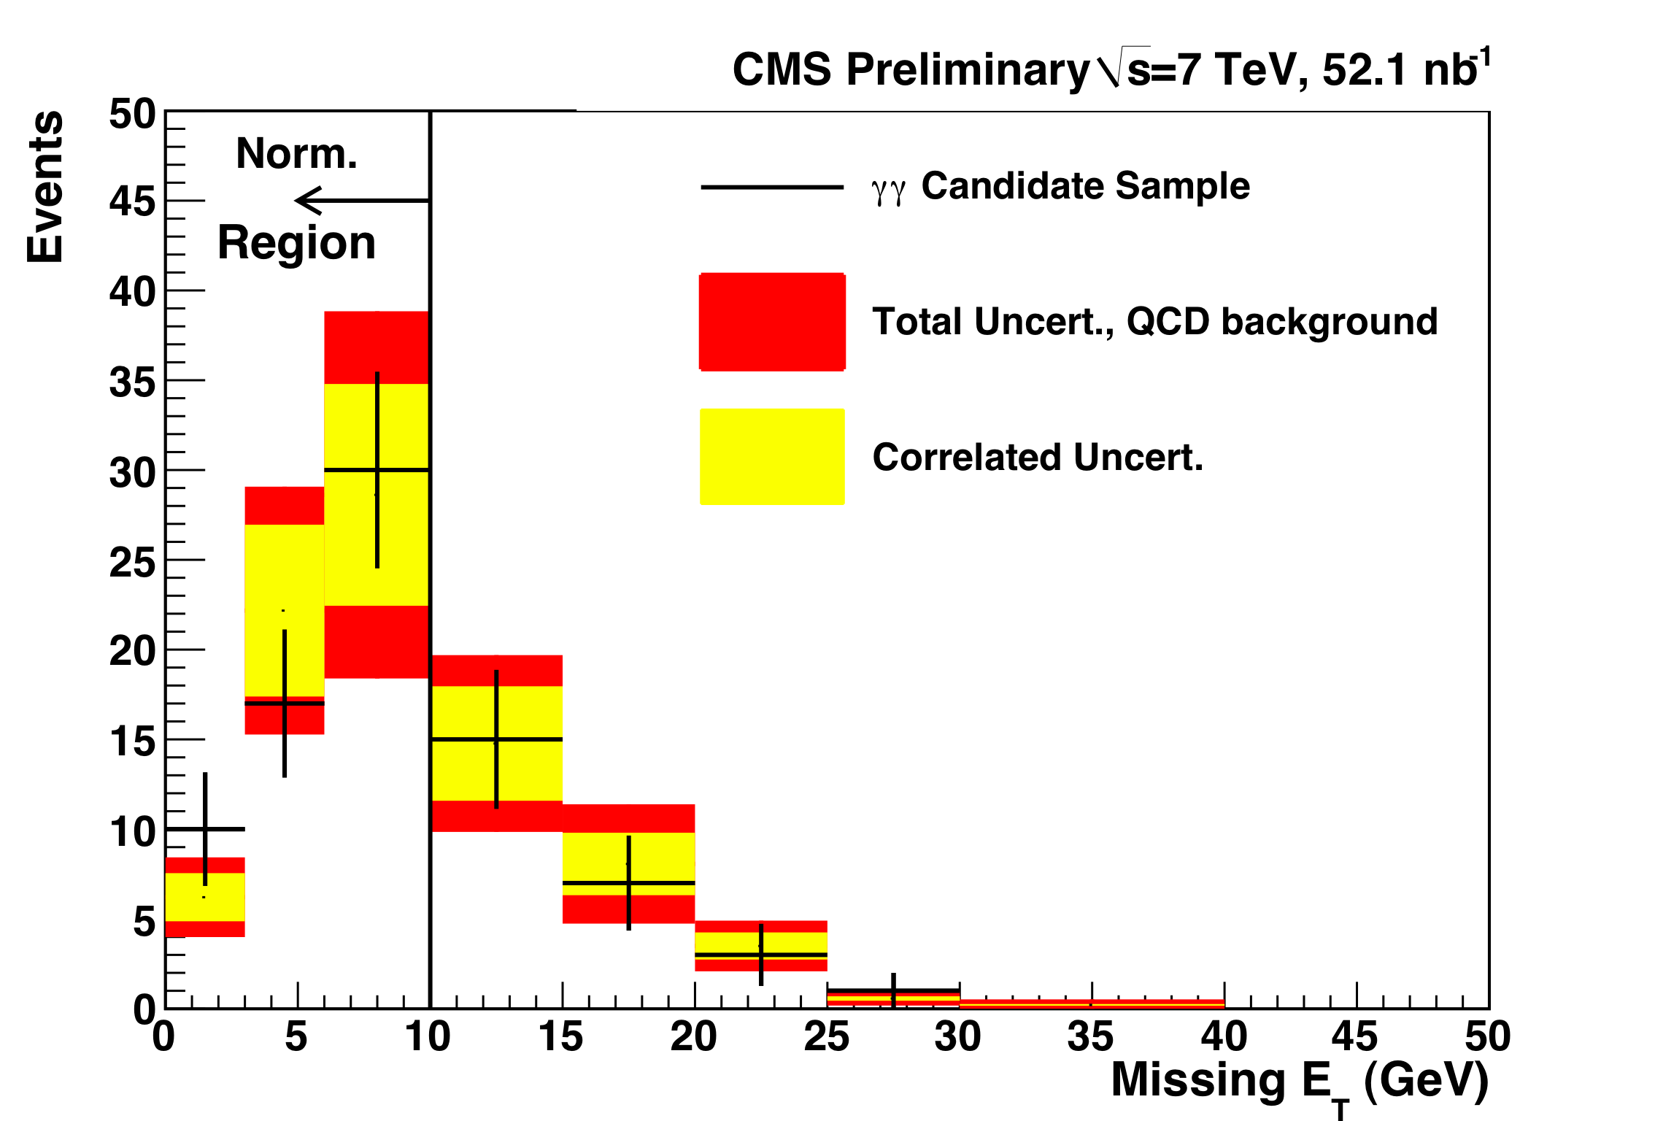
Predicting MET tail in γγ search
γγ + MET is one of the early search channels
  Physics backgrounds Wγγ/Ζγγ
  Wγ, electron mis-id as γ
  multi-jet (direct γγ) + fake MET (dominant)
Prediction:
  Measure MET distribution in a control sample with 2 fake photons , selected by inverting Isolation requirement
  Use number of selected events at MET < 10 GeV to normalize the measured templates.
Prediction consistent with number of observed events,
For MET > 20 GeV:
Predicted = 4.2 ± 1.5 Observed = 4 events
Didar Dobur 10/18 ICHEP 2010 Paris

Slide 11
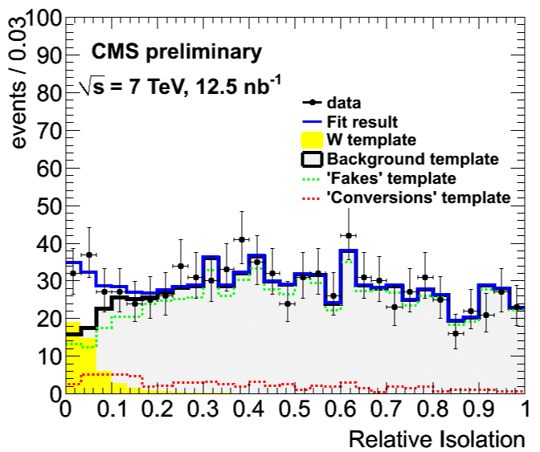
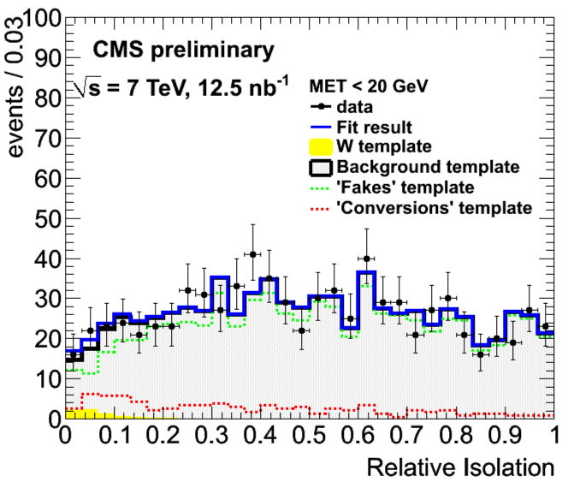

QCD background for e+Jets+MET
QCD contributes to e + Jets+ MET signature
    heavy-flavor decays and jets mis-identified as electron
    electrons due to photon conversion
Select control samples dominated by each of above sources by inverting selection cuts perform fit using Relative Isolation distributions
Isolation template for W➔eν contribution from MC
MET < 20 GeV
(RelIso<0.3) Predicted : 224 ± 13
Observed : 263
(RelIso<0.3) Predicted : 215 ± 13
Observed : 215
Didar Dobur 11/18 ICHEP 2010 Paris

Slide 12
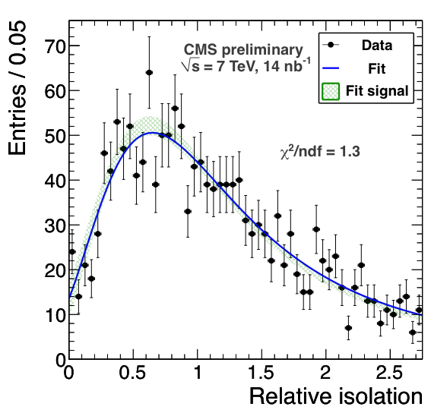
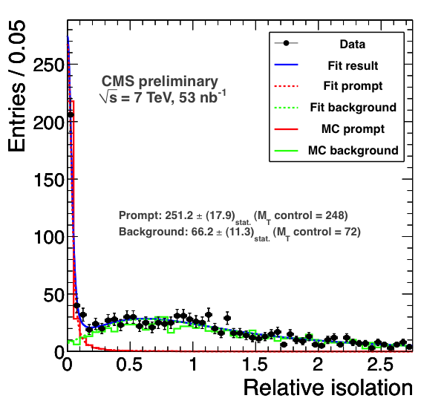
QCD background for μ+Jets+MET
QCD contributes to μ + Jets+ MET signature :
  mainly due to heavy-flavor decays to muons
  A fit procedure for Relative Isolation to predict bckgrd from non-prompt muons
MET > 20 GeV
Prompt : 251.2 ± 17.9 , Observed= 248
Bckgrd : 66.2 ± 11.3 , Observed =72
MET < 20 GeV
H_{T}>20 GeV
Good agreement between Predicted and Observed event yield in the signal region
Didar Dobur 12/18 ICHEP 2010 Paris

Slide 13
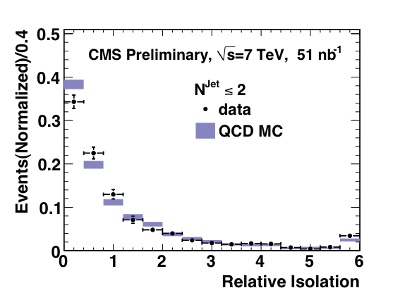
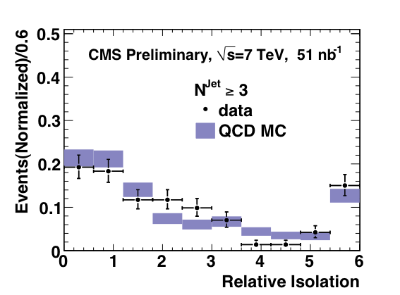
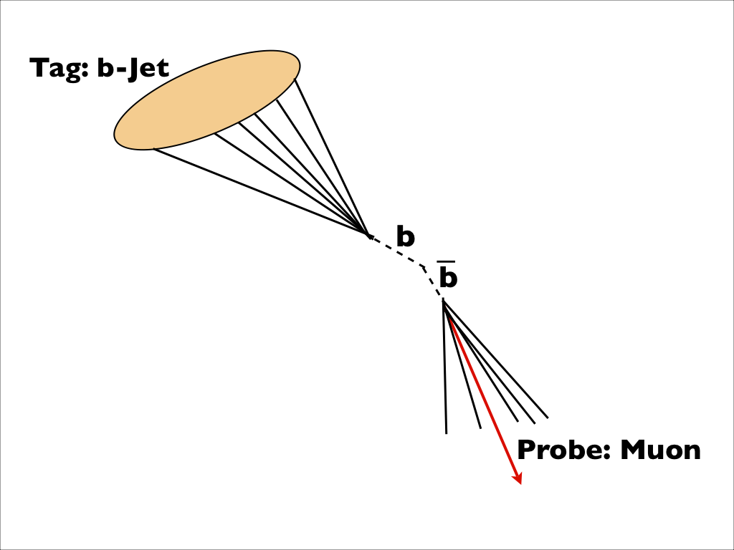
ttBar background for SS di-μ
ttBar is the dominant background for Same-Sign (SS) di-μ signature: one from W and the other from b-decays
Isolation is the main handle
Tag&Probe method to measure isolation distribution of muons coming from heavy flavor decays
Strong dependency on the event topology, e.g. jet multiplicity
Didar Dobur 13/18 ICHEP 2010 Paris

Slide 14
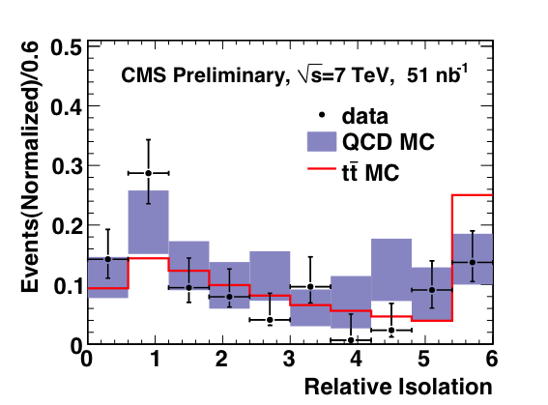
Muon Isolation Template
Significant differences in jet multiplicity and p_{T}(μ) in ttBar and generic QCD
Re-weighting procedure to take this difference into account
The agreement between QCD MC (data-driven) and ttBar MC (matching to the generator level ) demonstrates the principle of the method
Data agrees qualitatively with ttBar MC, for a quantitative prediction more data is necessary
Didar Dobur 14/18 ICHEP 2010 Paris

Slide 15
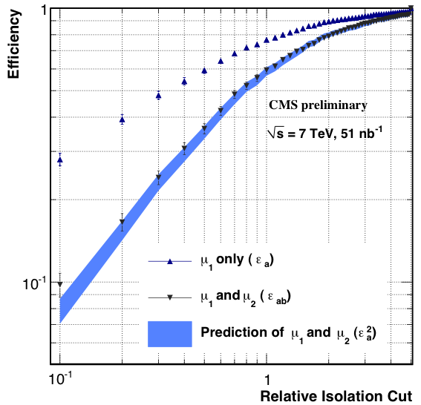
QCD background for SS di-μ
QCD is expected to be the subdominant background for SS di-μ signature
Exploit the fact that some selection cuts are uncorrelated ➔ selection efficiency for each cut can be measured in control samples
IsoCut(μ₁) : Isolation of μ₁ , ε_{Isoμ1}
IsoCut(μ₂) : Isolation of μ₂ , ε_{Isoμ2}
METCut : third jet and MET, ε_{MET}
ε_{AllCuts} = ε_{Isoμ1} . ε_{Isoμ2} . ε_{MET}
?
ε_{Isoμ1μ2} = (ε_{Isoμ1})²
test the factorization of cuts IsoCut(μ₁) and IsoCut(μ₂), no jet & MET requirement yet
data indicates isolation of the μ₁ and μ₂ can be factorized
Didar Dobur 15/18 ICHEP 2010 Paris

Slide 16
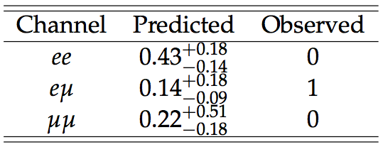
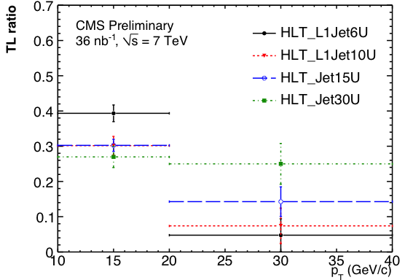
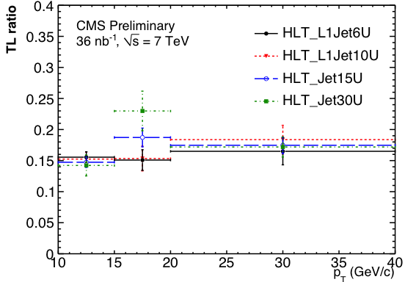
SM background for SS di-lepton
Data driven method for estimating SM background for SS ee , μμ and eμ channels
Use a control sample (loose lepton-id & isolation) to measure efficiency of passing all analysis cuts, ( “TL ratio” ), as a function of lepton kinematics.
Monitor measured Tight-to-Loose-Ratios using different jet-triggered samples.
Electrons
Muons
Predictions obtained using HLT_Jet15U
Measured TL ratio is stable within 50%
Predicted & observed number of SS di-lepton events consistent
Didar Dobur 16/18 ICHEP 2010 Paris

Slide 17
Summary & Outlook
Understanding of the SM background is the first step towards BSM searches
Dedicated methods to suppress the backgrounds and data-driven techniques to measure them from data are in place
The data collected by CMS at 7 TeV allowed us to test some of these methods; data confirms the performance of the methods obtained with MC
LHC performs very well; as of today four times more ( ~300 nb⁻¹) data than what is presented here is available
Stay tuned for updates, we are at the beginning of an exciting journey
Didar Dobur 17/18 ICHEP 2010 Paris

Slide 18
References
https://twiki.cern.ch/twiki/bin/view/CMSPublic/PhysicsResults
“Performance of Methods for Data-Driven Background Estimation in SUSY Searches”, CMS Physics Analysis Summary: SUS-10-001
“CMS MET Performance in Jet Events from pp Collisions at sqrt s= 7 TeV”, JME-10-004.
“The CMS physics reach for searches at 7 TeV “, CMS-NOTE-2010-008
“SUSY searches with dijet events”, CMS Physics Analysis Summary: SUS-08-005
“Search strategy for exclusive multi-jet events from supersymmetry at CMS”, CMS Physics Analysis Summary: SUS-09-001
“Data-Driven Background Estimates for SUSY Di-Photon Searches”, CMS Physics Analysis Summary: SUS-09-004
L.Randall and D. Tucker-Smith, “Dijet searches for Supersymmetry at the LHC ”, Phys.RevLett. 101221803 (2008)
Didar Dobur 18/18 ICHEP 2010 Paris

