Slide 2
Modern SEM materials and methods at CERN
Christophe Vuitton
Benjamin Moser

Slide 3

Modern SEM materials and methods at CERN
Christophe Vuitton
Benjamin Moser
Presentation to Aries

Slide 4

Modern SEM materials and methods at CERN
Christophe Vuitton
Benjamin Moser
Presentation to Aries

Slide 5
Overview
Functionality of a SEMGRID
Production of SEMGRID platines
Preparation of wires for SEMGRIDS
Electrical connections for SEMGRIDS
DAQ
Sticking wires

Slide 6
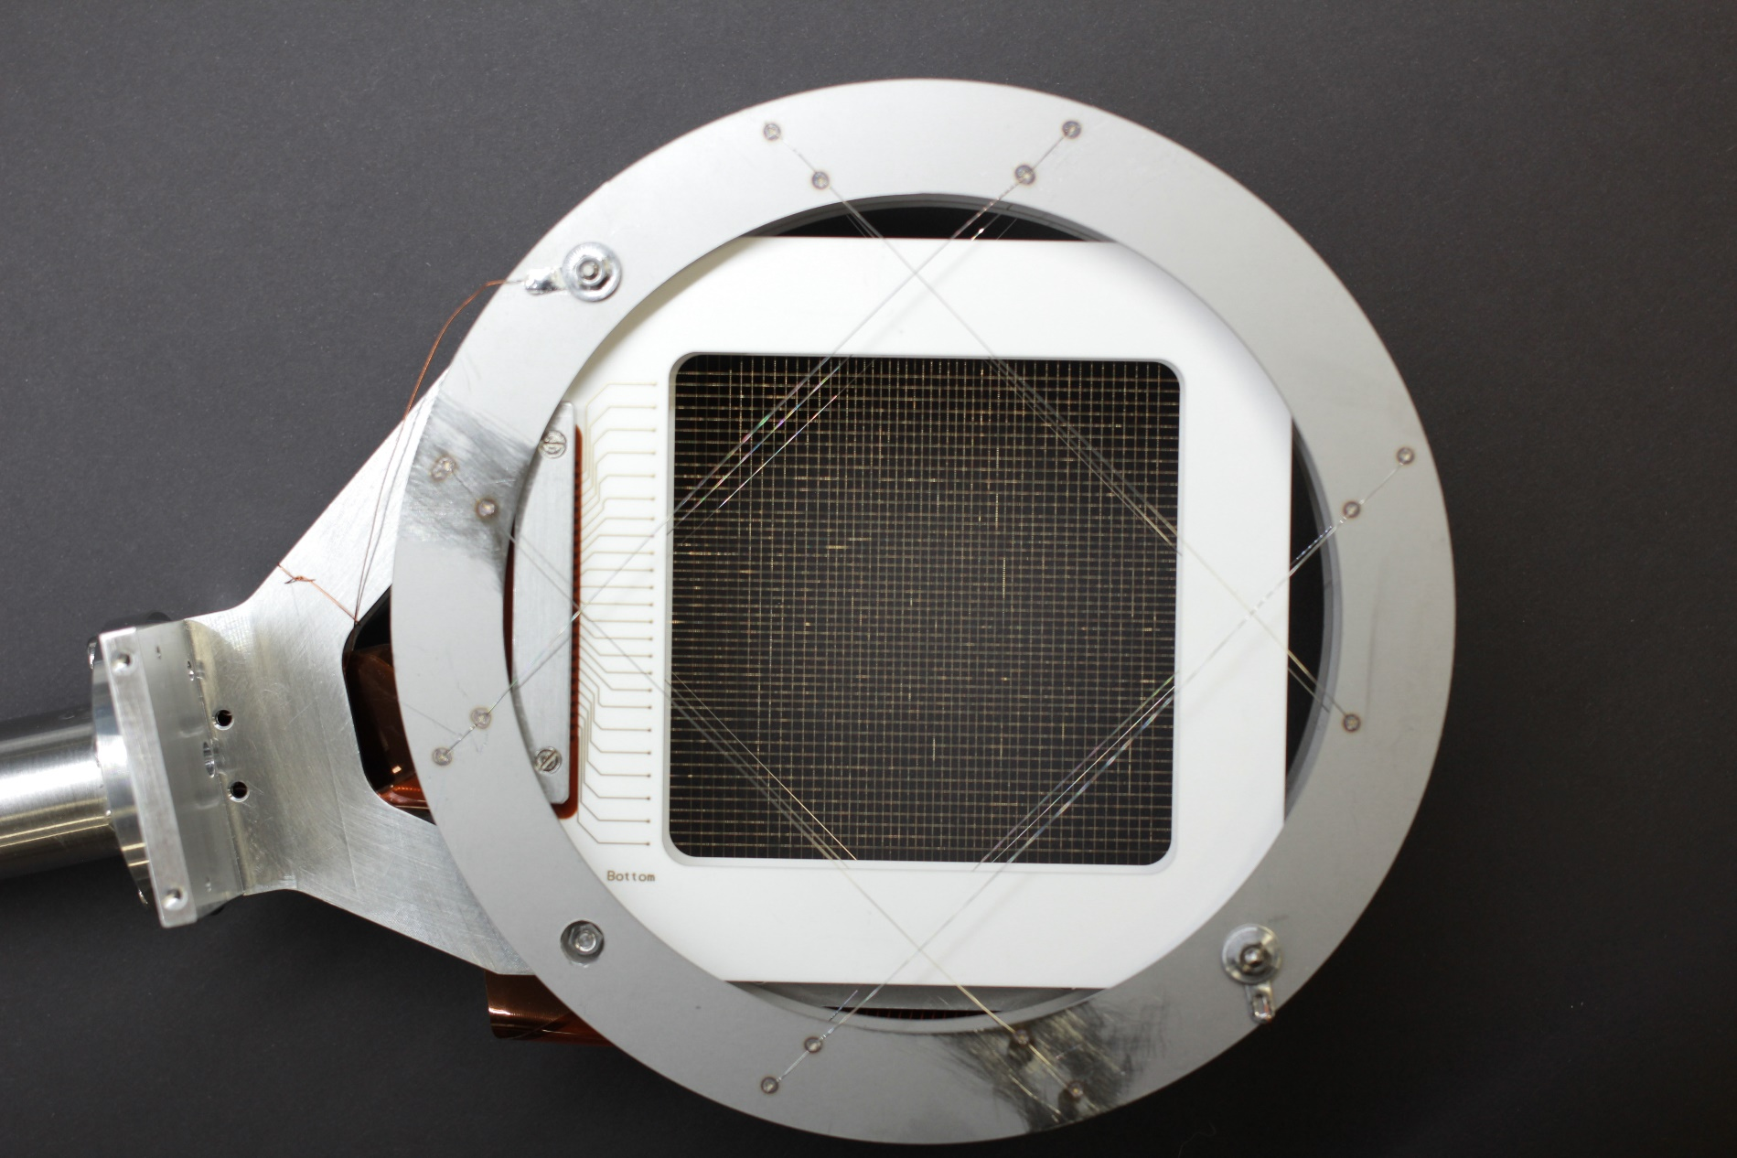
How does a SEMGRID work
When the beam passes secondary electrons are ejected from the wires
This results in current flowing in the wire
Spatial resolution is given by the wire spacing
Time resolution by the DAQ system

Slide 7
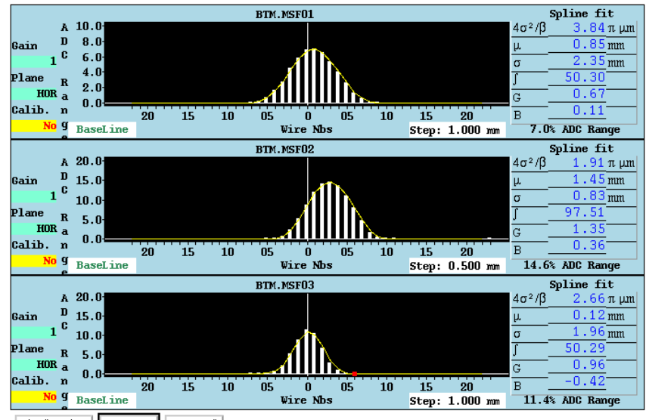
How does a SEMGRID work
When the beam passes secondary electrons are ejected from the wires
The current flowing back onto the wires is measured
Resolution is given by wire distance

Slide 8
By design, SEM grids measure the beam transverse profiles. The profile data can be used to infer:
Transverse emittance
Position
Intensity
Energy and energy spread

Slide 9
Components of a SEMGRID HEAD
Support structure
BIAS
Wire support
Connector
Wires
“cabling”

Slide 10
Components of a SEMGRID HEAD
Support structure
BIAS
Wire support
Connector
Wires
“cabling”

Slide 11
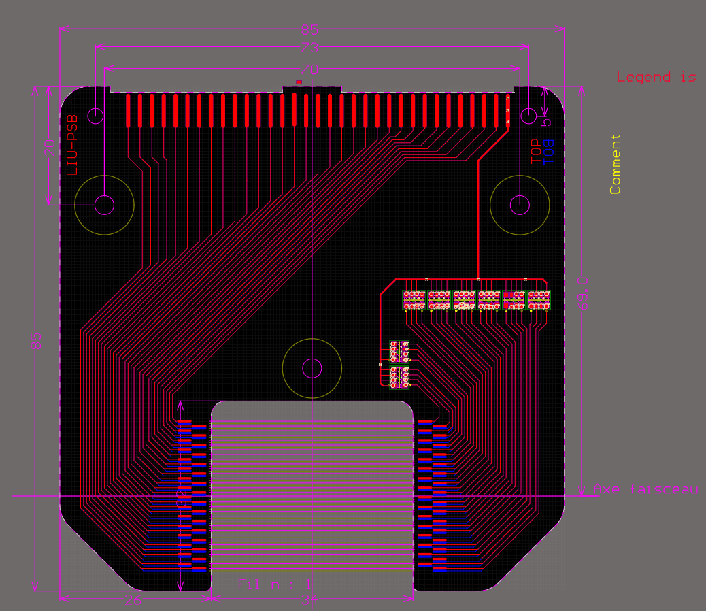
Wire support
A PCB with pads to solder the wire grid onto
Materials used need to conform to CERN vacuum requirements
Overall PCB design is given by beam aperture, vessel for the instrument and spacing of the grid
Using Resistors for test signal to confirm the state the wires without beam

Slide 12
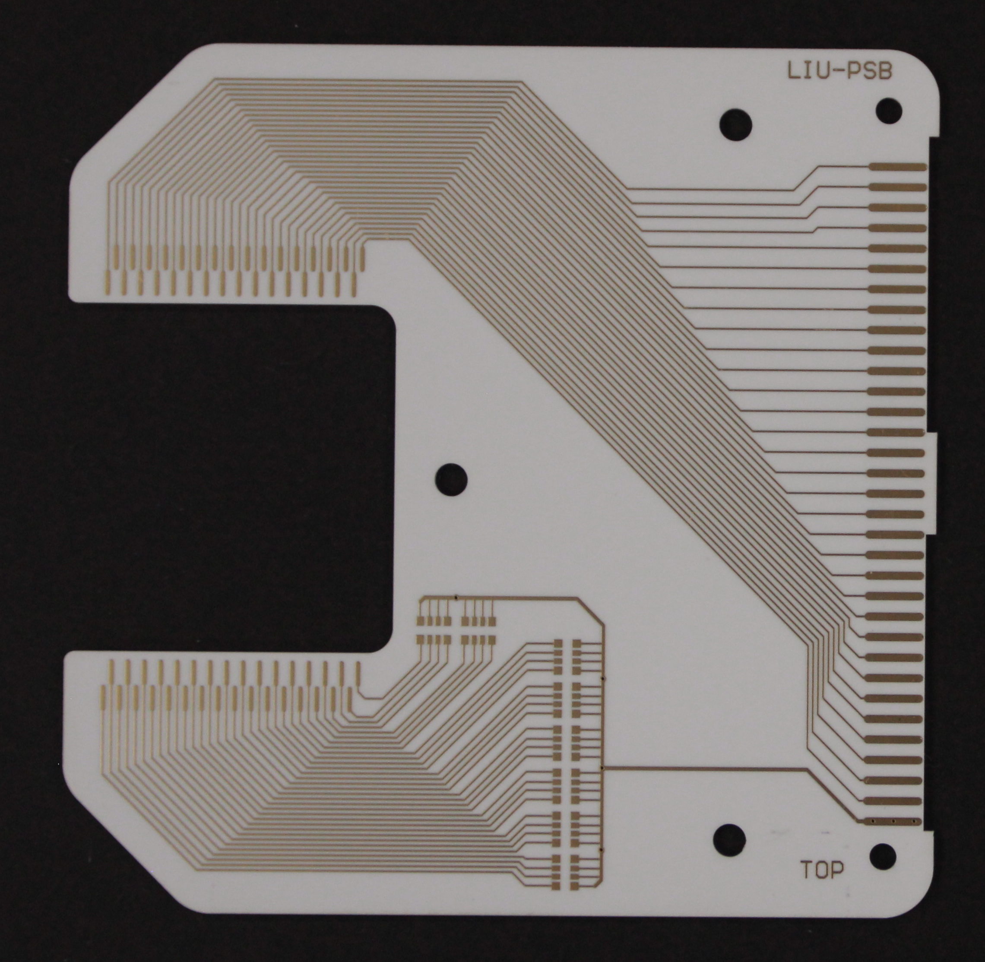
Wire support
Alumina (Al2O3) ceramic substrate 96-97%
Biggest Panel possible with our providers so far are 160x240mm
PCB tracks single or double sided
VIAS diameter 0.3 mm
Tracks thickness 35 μm (1oz) copper with ENIG finish
SMD Resistor 1 MΩ packs
Possible to order as a “standard product”
Performed vacuum acceptance tests at CERN and so far had no issues with them, all cleared for installation

Slide 13
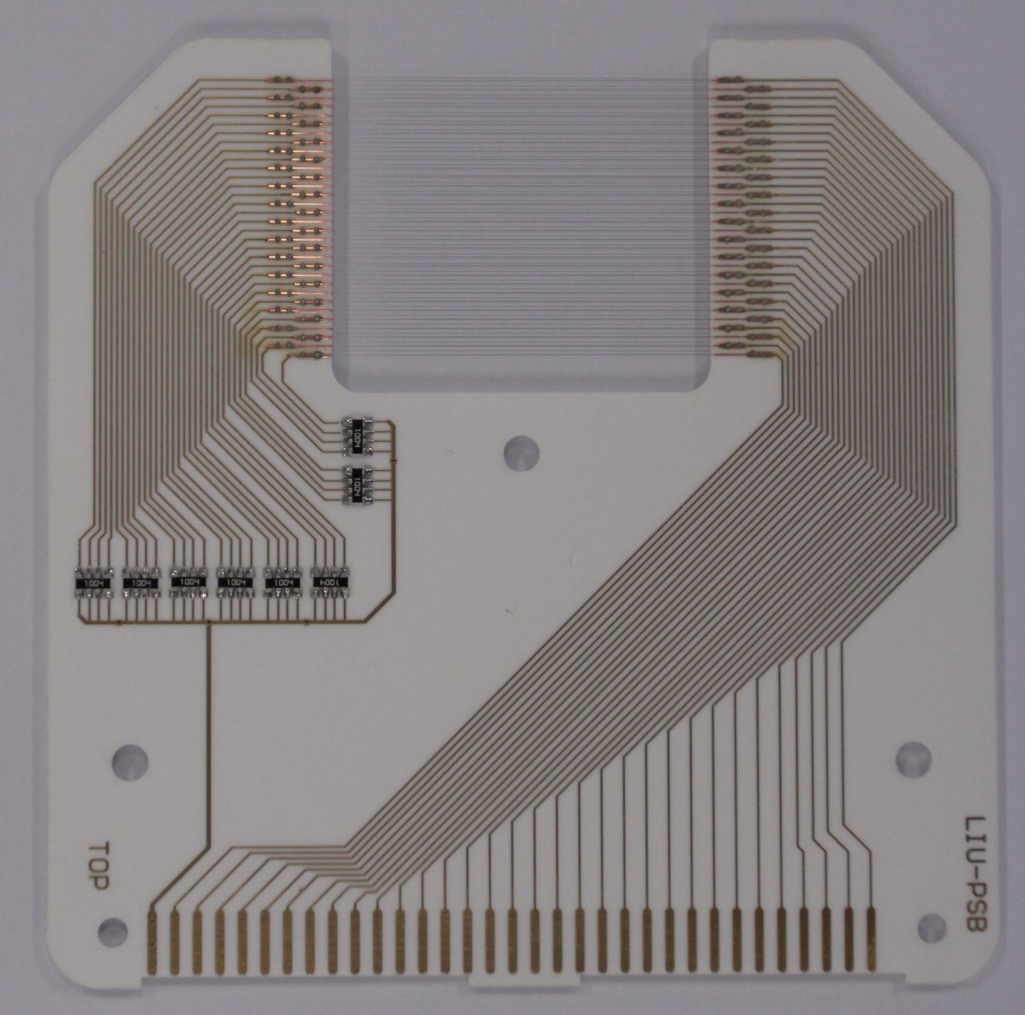
Examples
Grid with 0.4 mm spacing

Slide 14
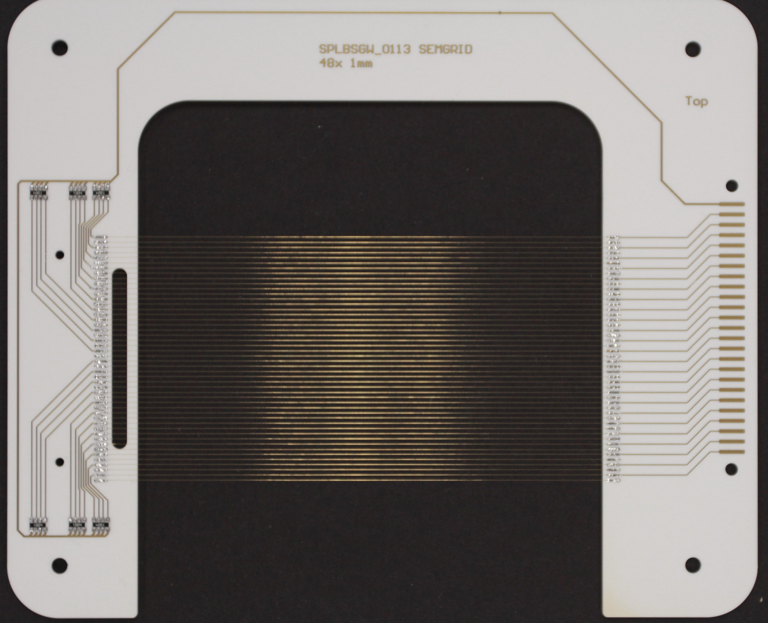
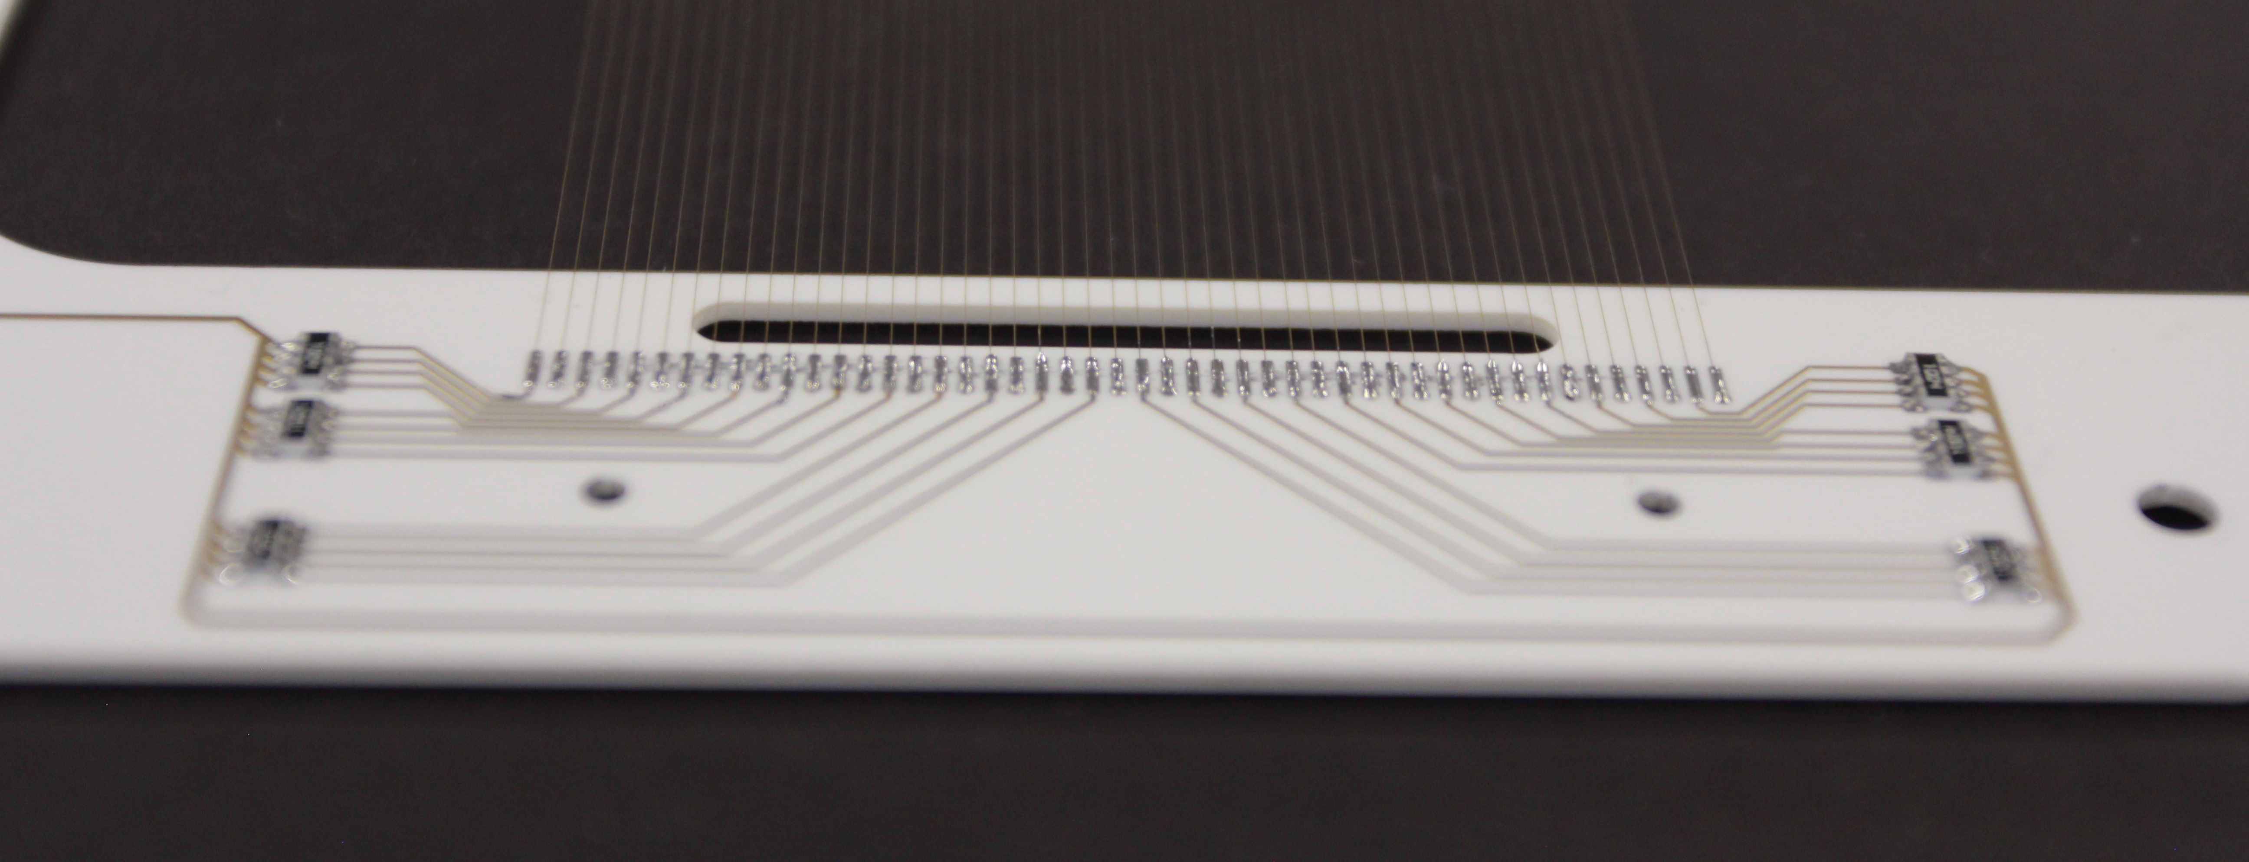
Examples
Grid with 1 mm spacing

Slide 15
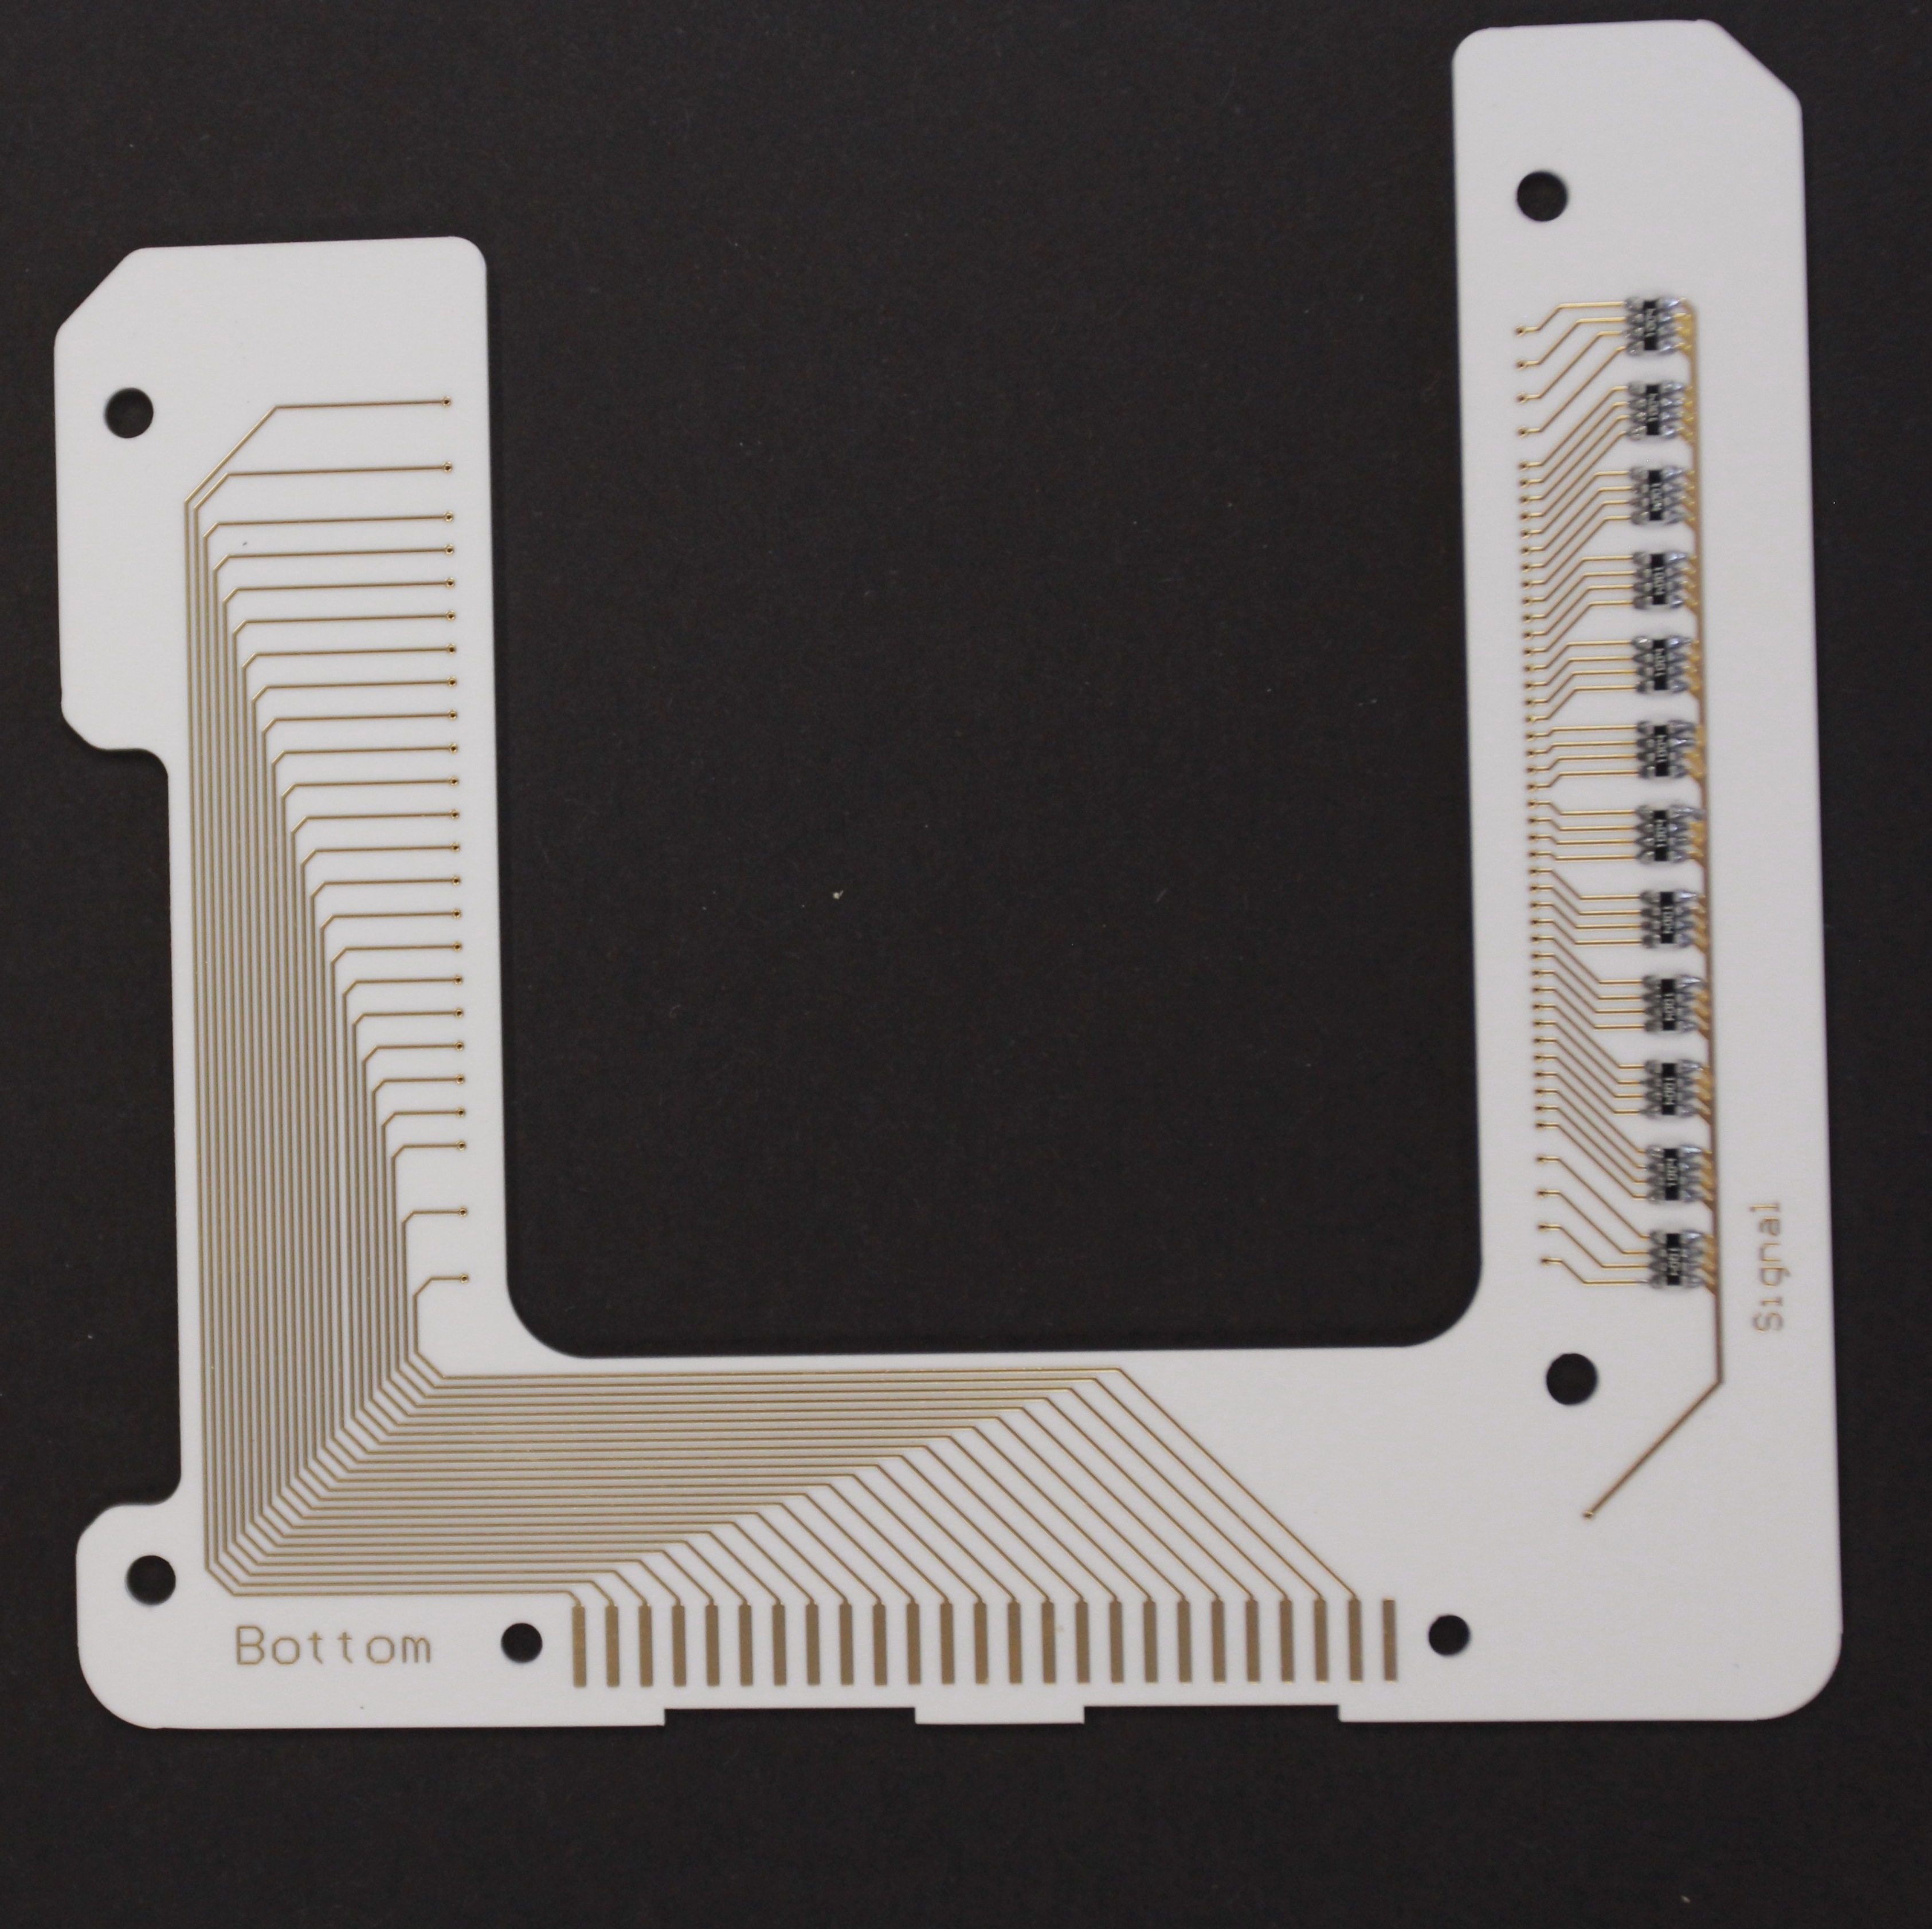
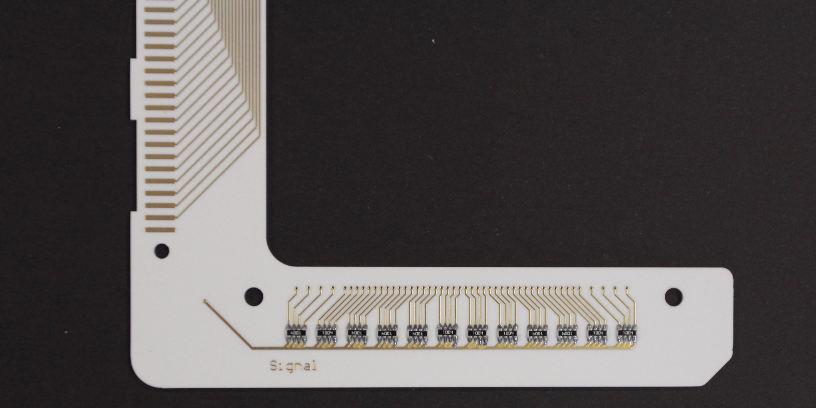
Examples
Grid with smaller spacing in the centre of the beam

Slide 16
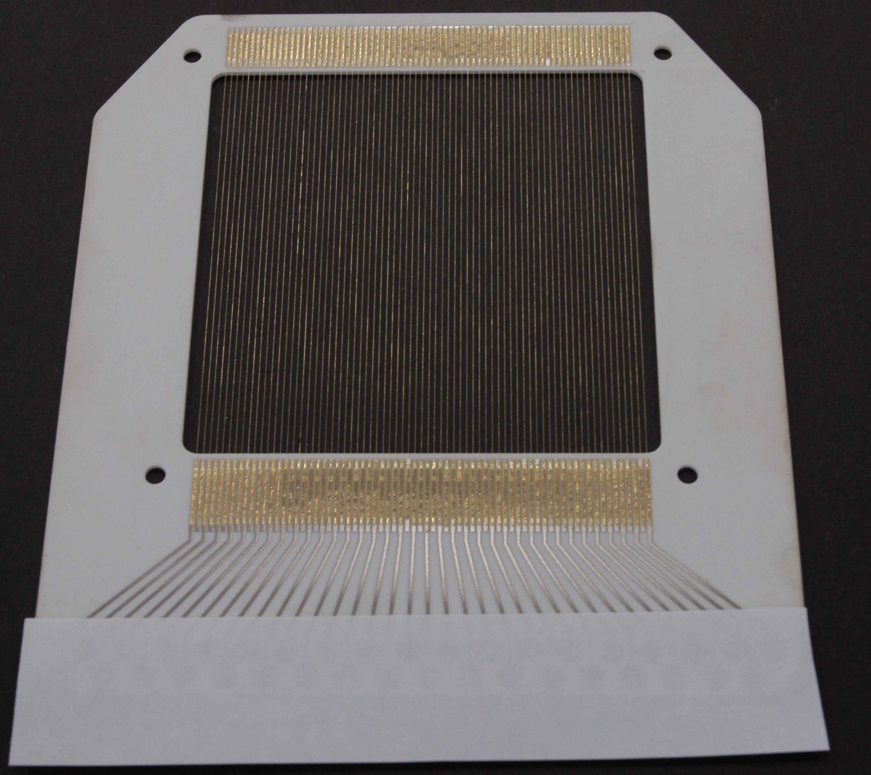
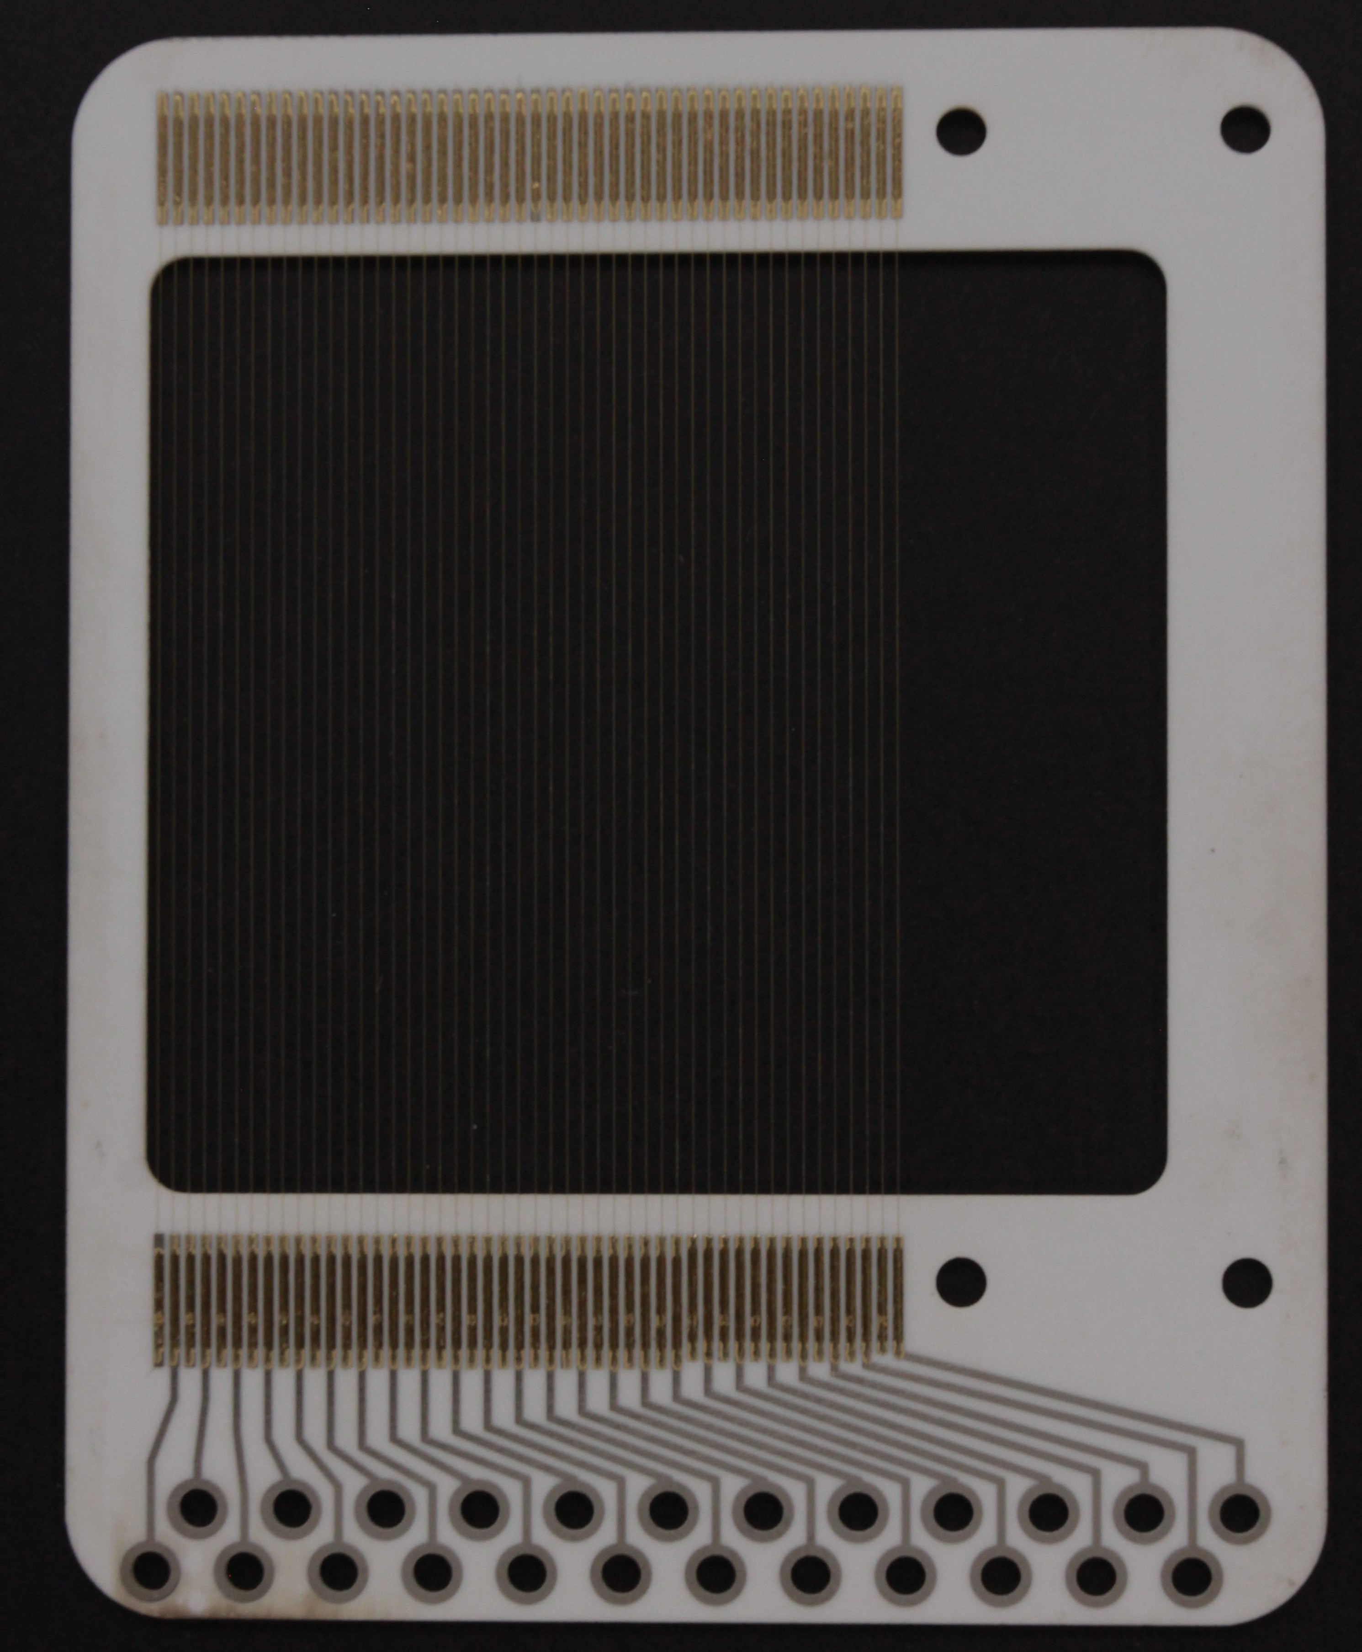
Examples
With gold solder, can be baked out to 200 C

Slide 17
Components of a SEMGRID HEAD
Support structure
BIAS
Wire support
Connector
Wires
“cabling”

Slide 18
Wires
Material | Diameter | Tension of the wire | Smallest wire distance
Tungsten with gold coating | 40 μm | 1.5 N | 0.4 mm
Carbon ex-brai | 34 μm | 0.2 N | 0.4 mm

Slide 19
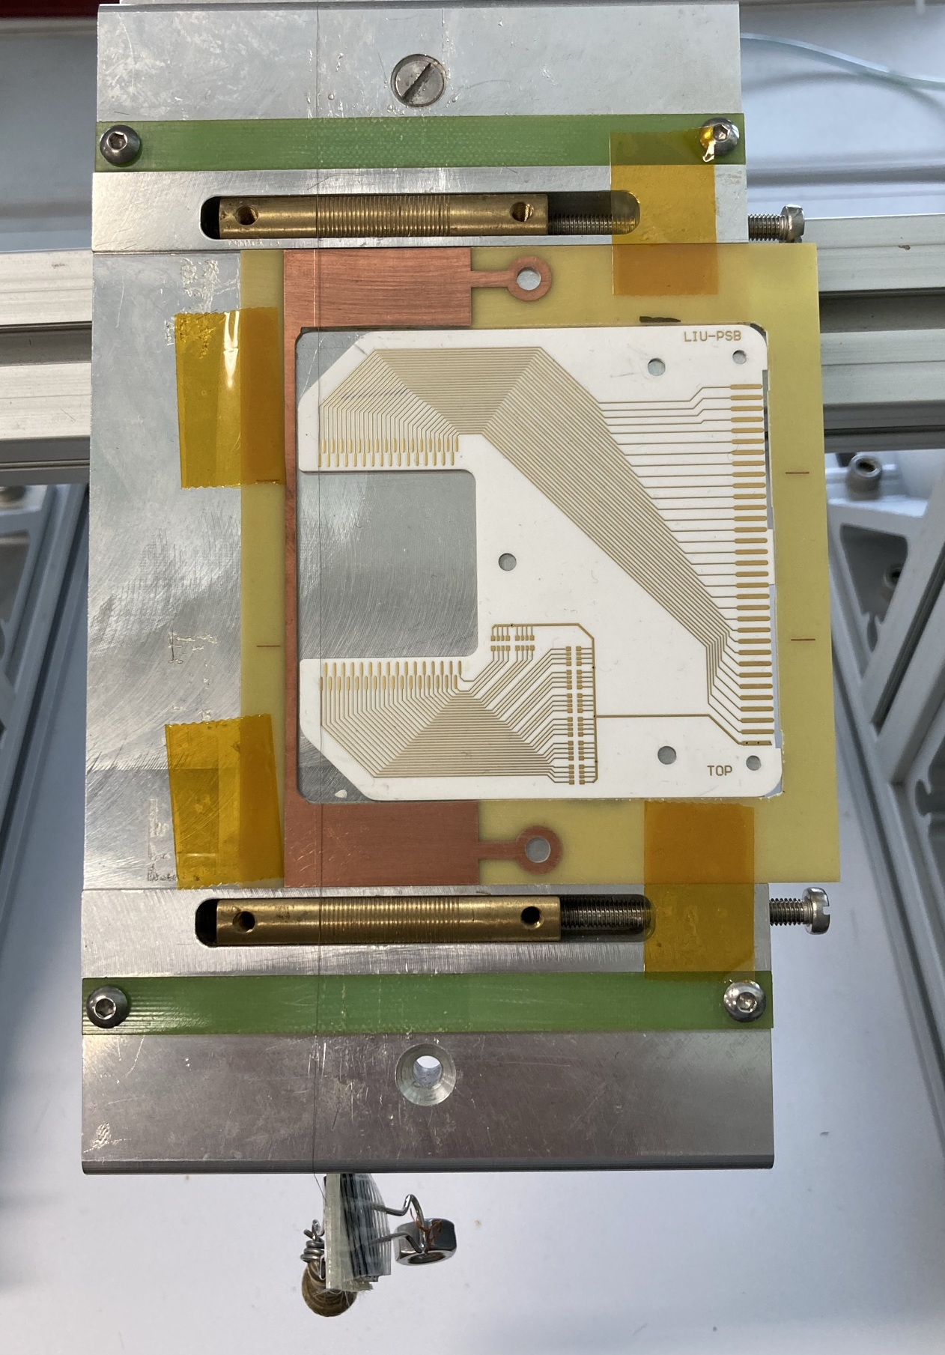
Preparation of the wire grid
Guides on either side, which need to be aligned by hand
Laying the wires by hand
Used for Carbon wires as they are more stiff and tend to break when bent too much

Slide 20
Preparation of the wire grid
Winding machine
Grid pattern can be machined onto guiding rails
With a program the linear motor moves while the winding machine winds the grid
Creates 4 grids in one go
Used for tungsten wires

Slide 21
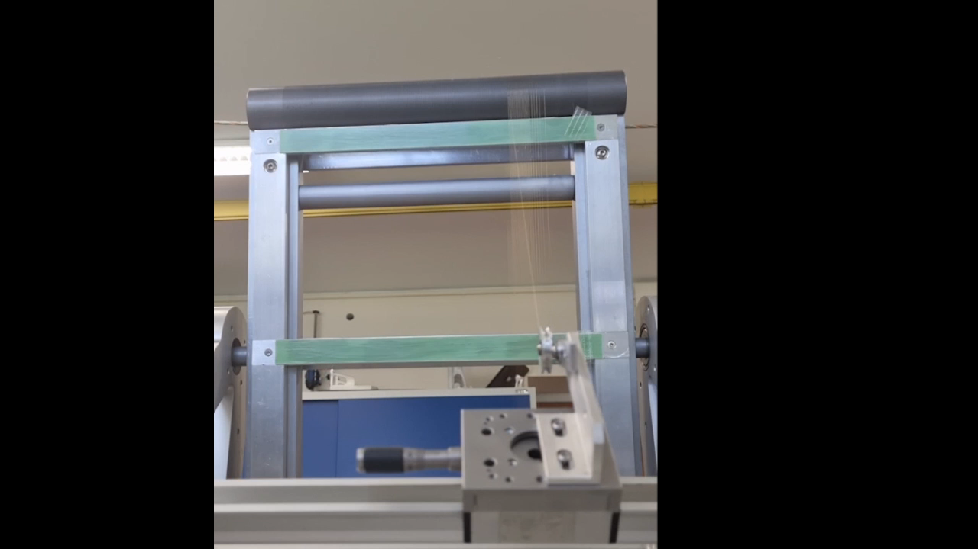
Preparation of the wire grid
Winding machine
Grid pattern can be machined onto guiding rails
With a program the linear motor moves while the winding machine winds the grid
Creates 4 grids in one go
Used for tungsten wires

Slide 22
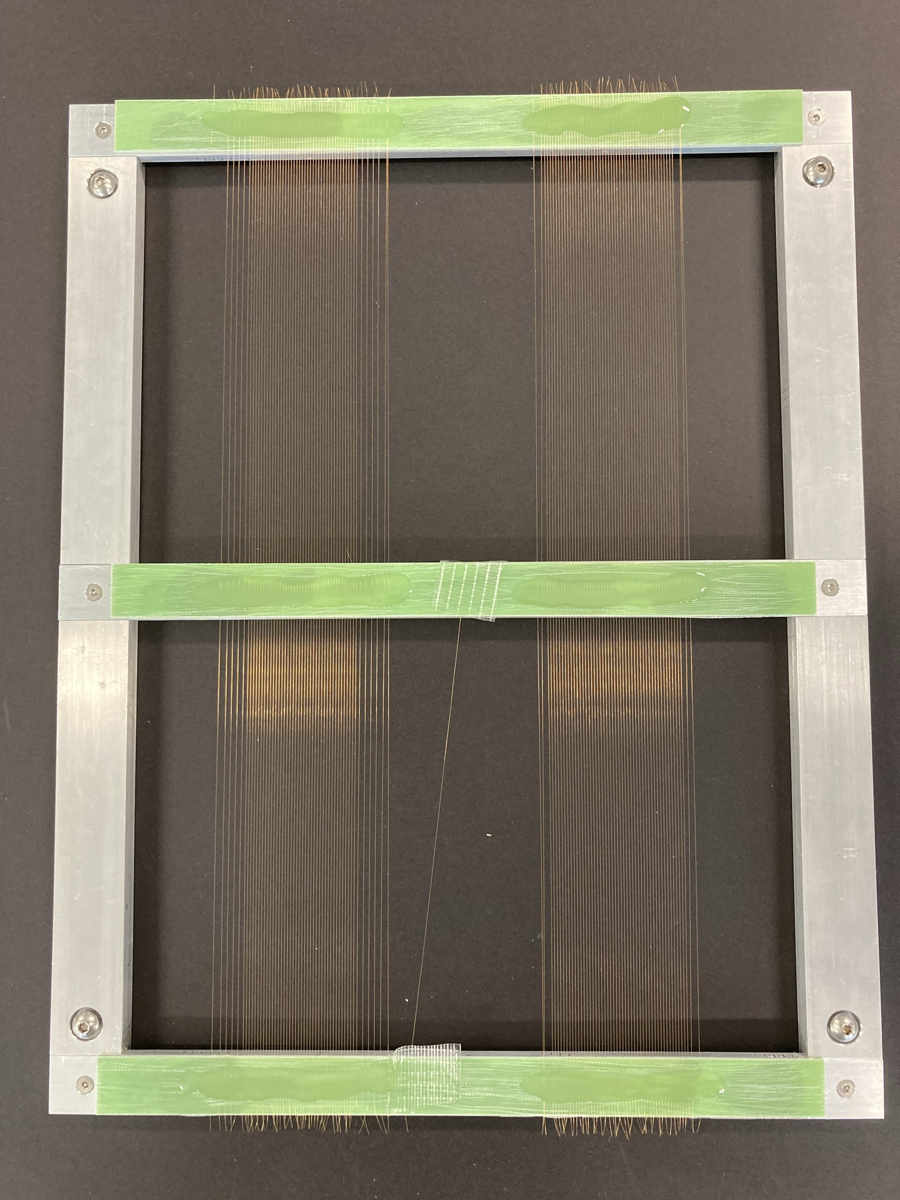
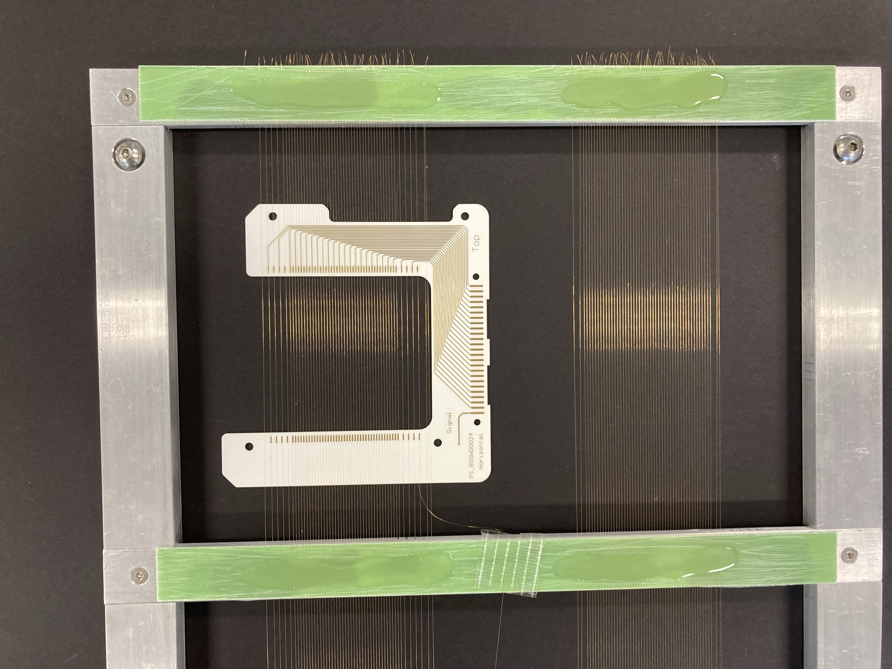
Preparation of the wire grid
Winding machine
Grid pattern can be machined onto guiding rails
With a program the linear motor moves while the winding machine winds the grid
Creates 4 grids in one go
Used for tungsten wires

Slide 23
Components of a SEMGRID HEAD
Support structure
BIAS
Wire support
Connector
Wires
“cabling”

Slide 24
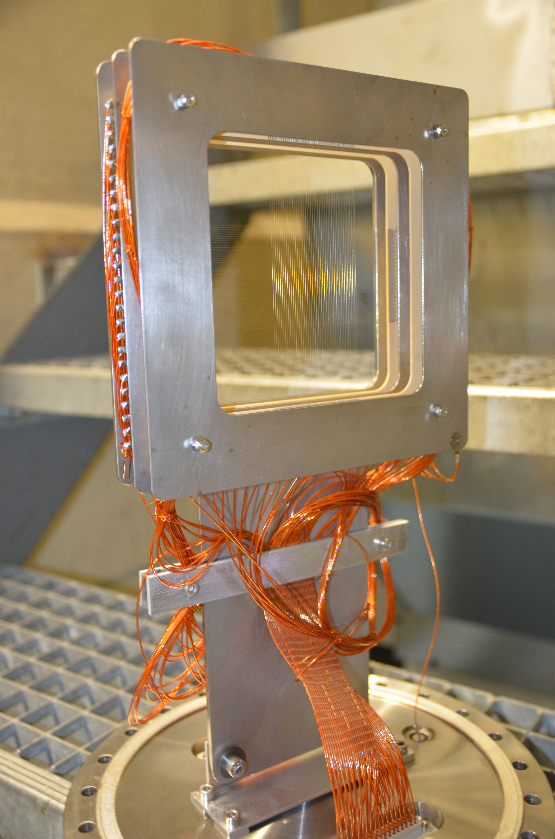
Cabling
Single kapton isolated wires wired from the connector to the grid
Issues of cable/pin swapping
Can become a bit messy

Slide 25
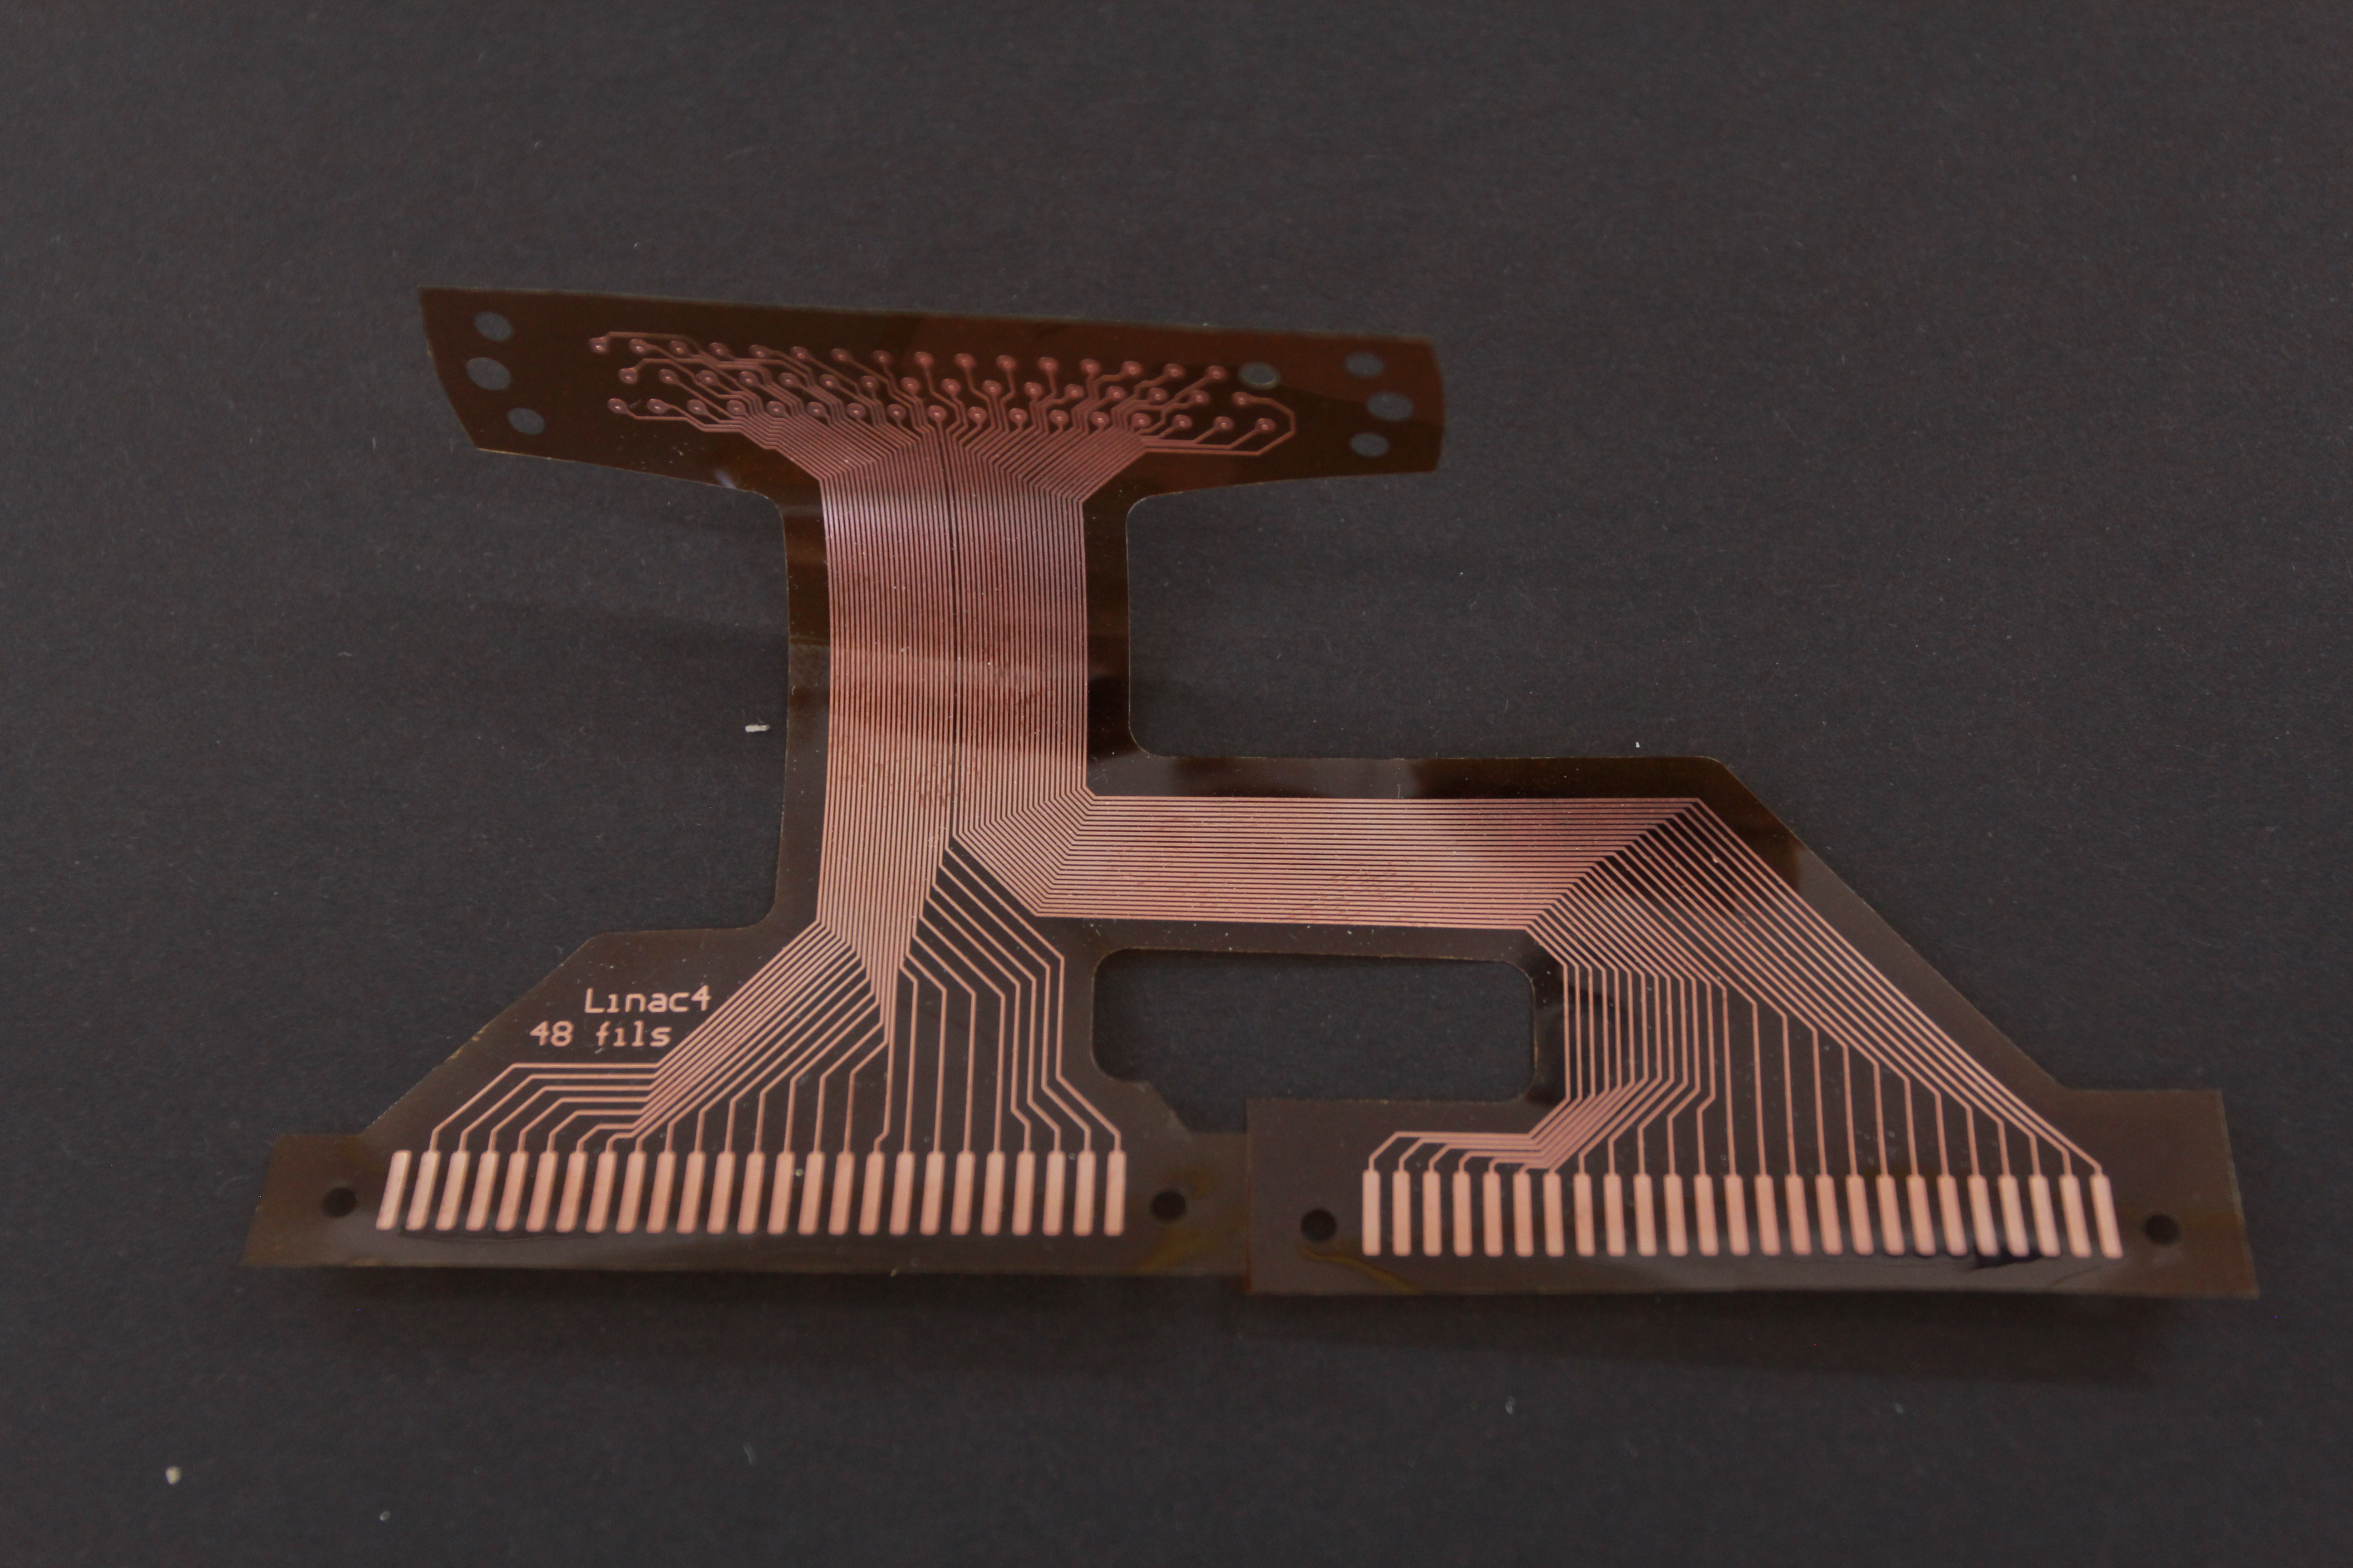
Cabling
FLEX-PCB for cabling
Easy to design
Easier to replace in case of issues
Easy to produce

Slide 26
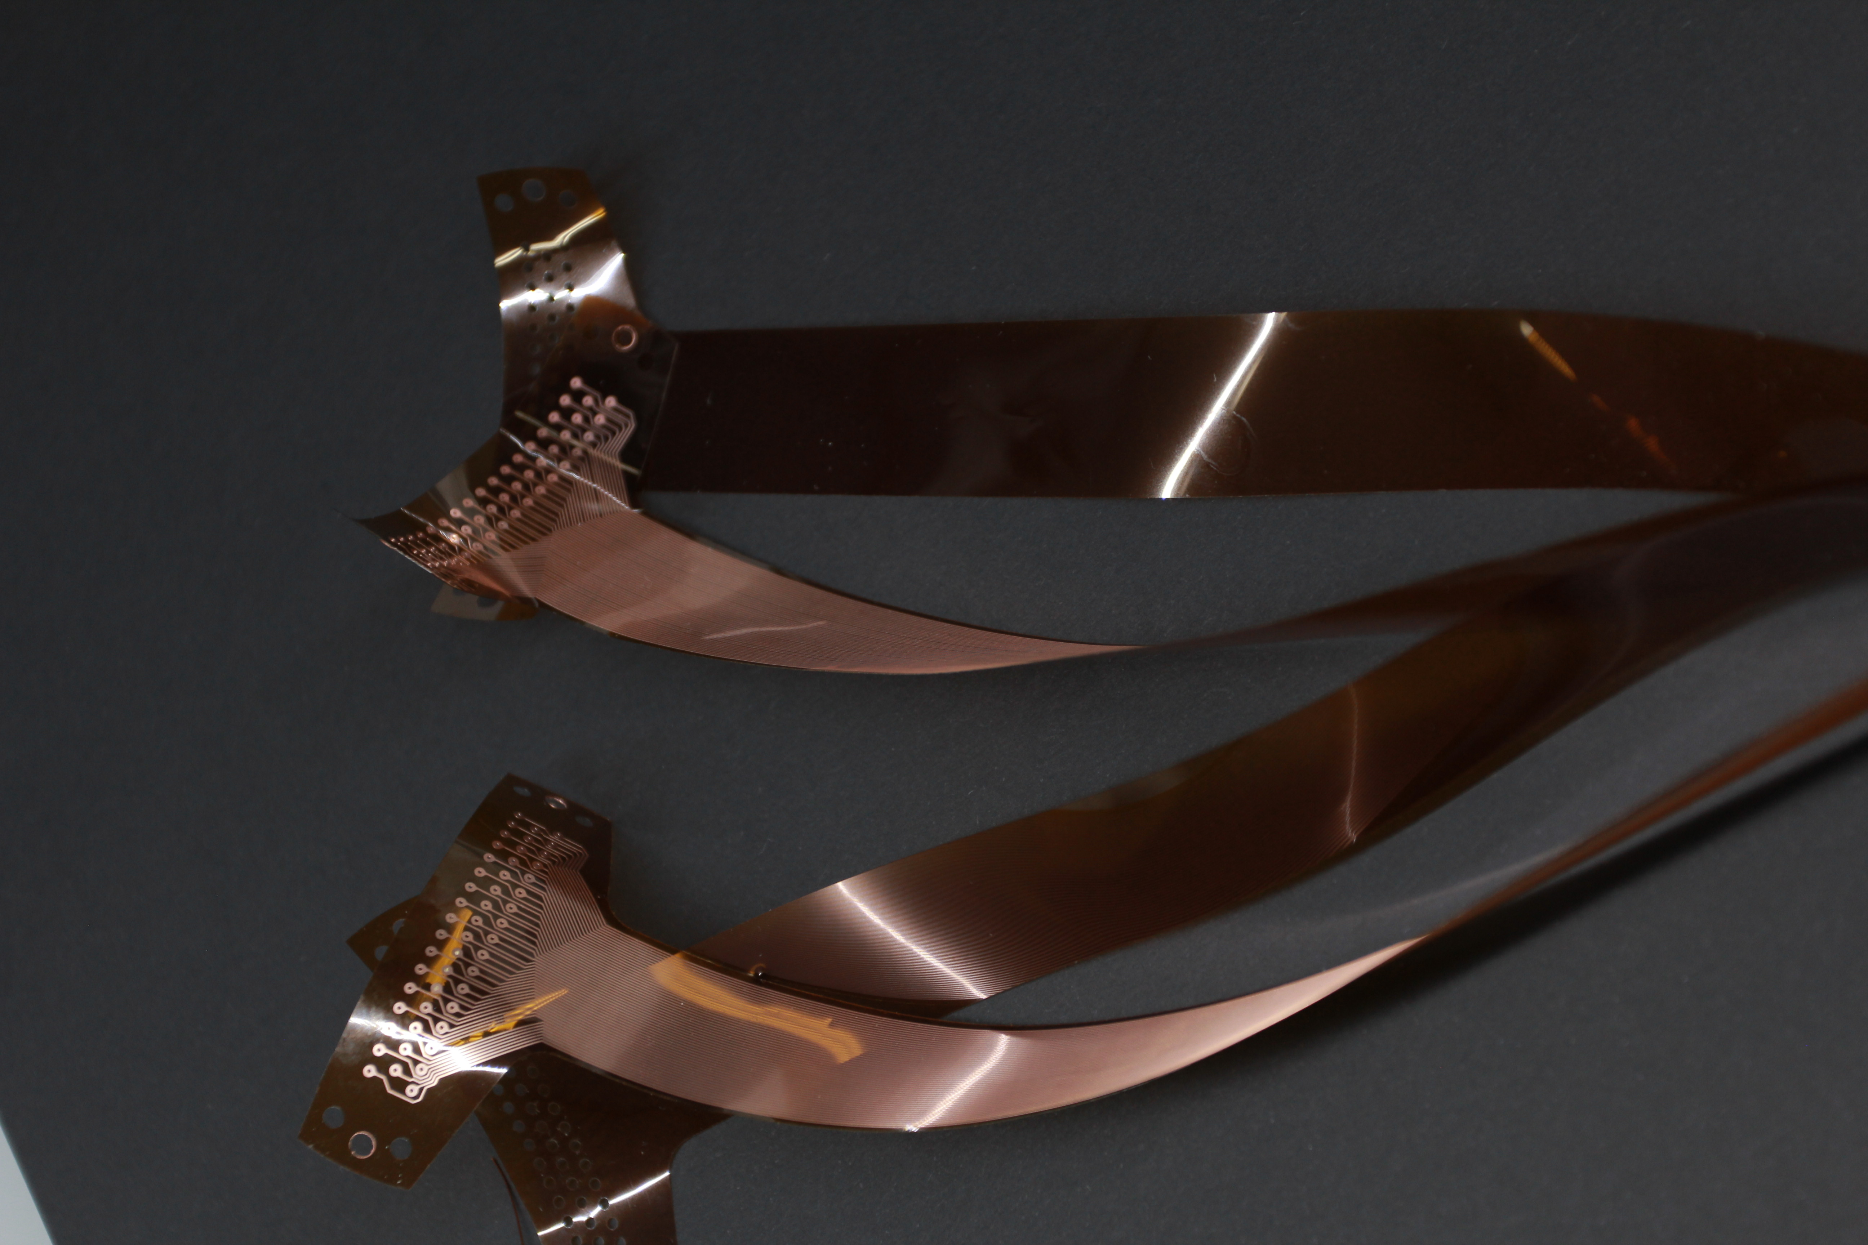
Cabling
Single and double layer
APICAL NP polyimide film as base
Copper finish of 30 μm with a 5μm base
Using empty polyimide films to protect against shorts with the vacuum vessel or each other
Performed vacuum acceptance tests at CERN and so far had no issues with them, all cleared for installation

Slide 27
Components of a SEMGRID HEAD
Support structure
BIAS
Wire support
Connector
Wires
“cabling”

Slide 28
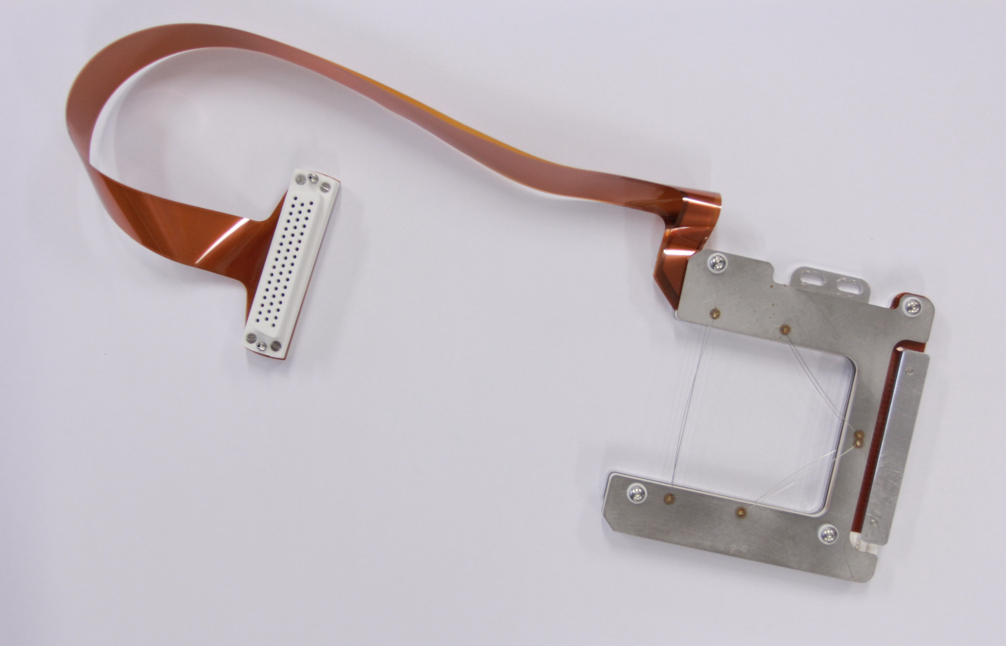
Connector
Flex PCB requires a different kind of connection than single wires on both the PCB and the feedthrough side
Connectors for both side have been developed and used at CERN

Slide 29
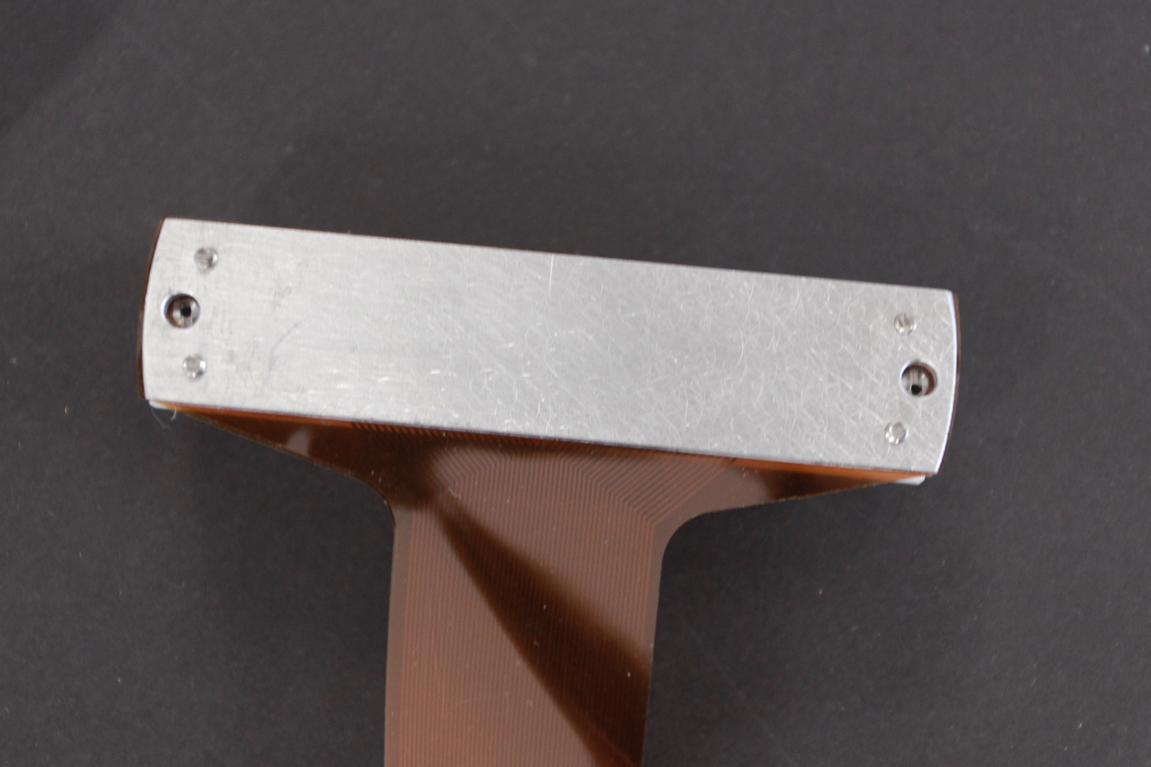
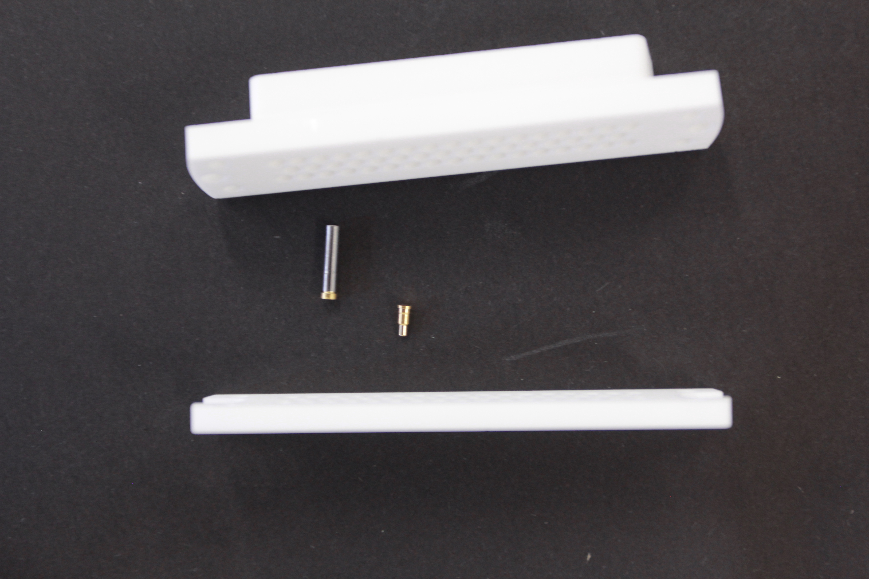
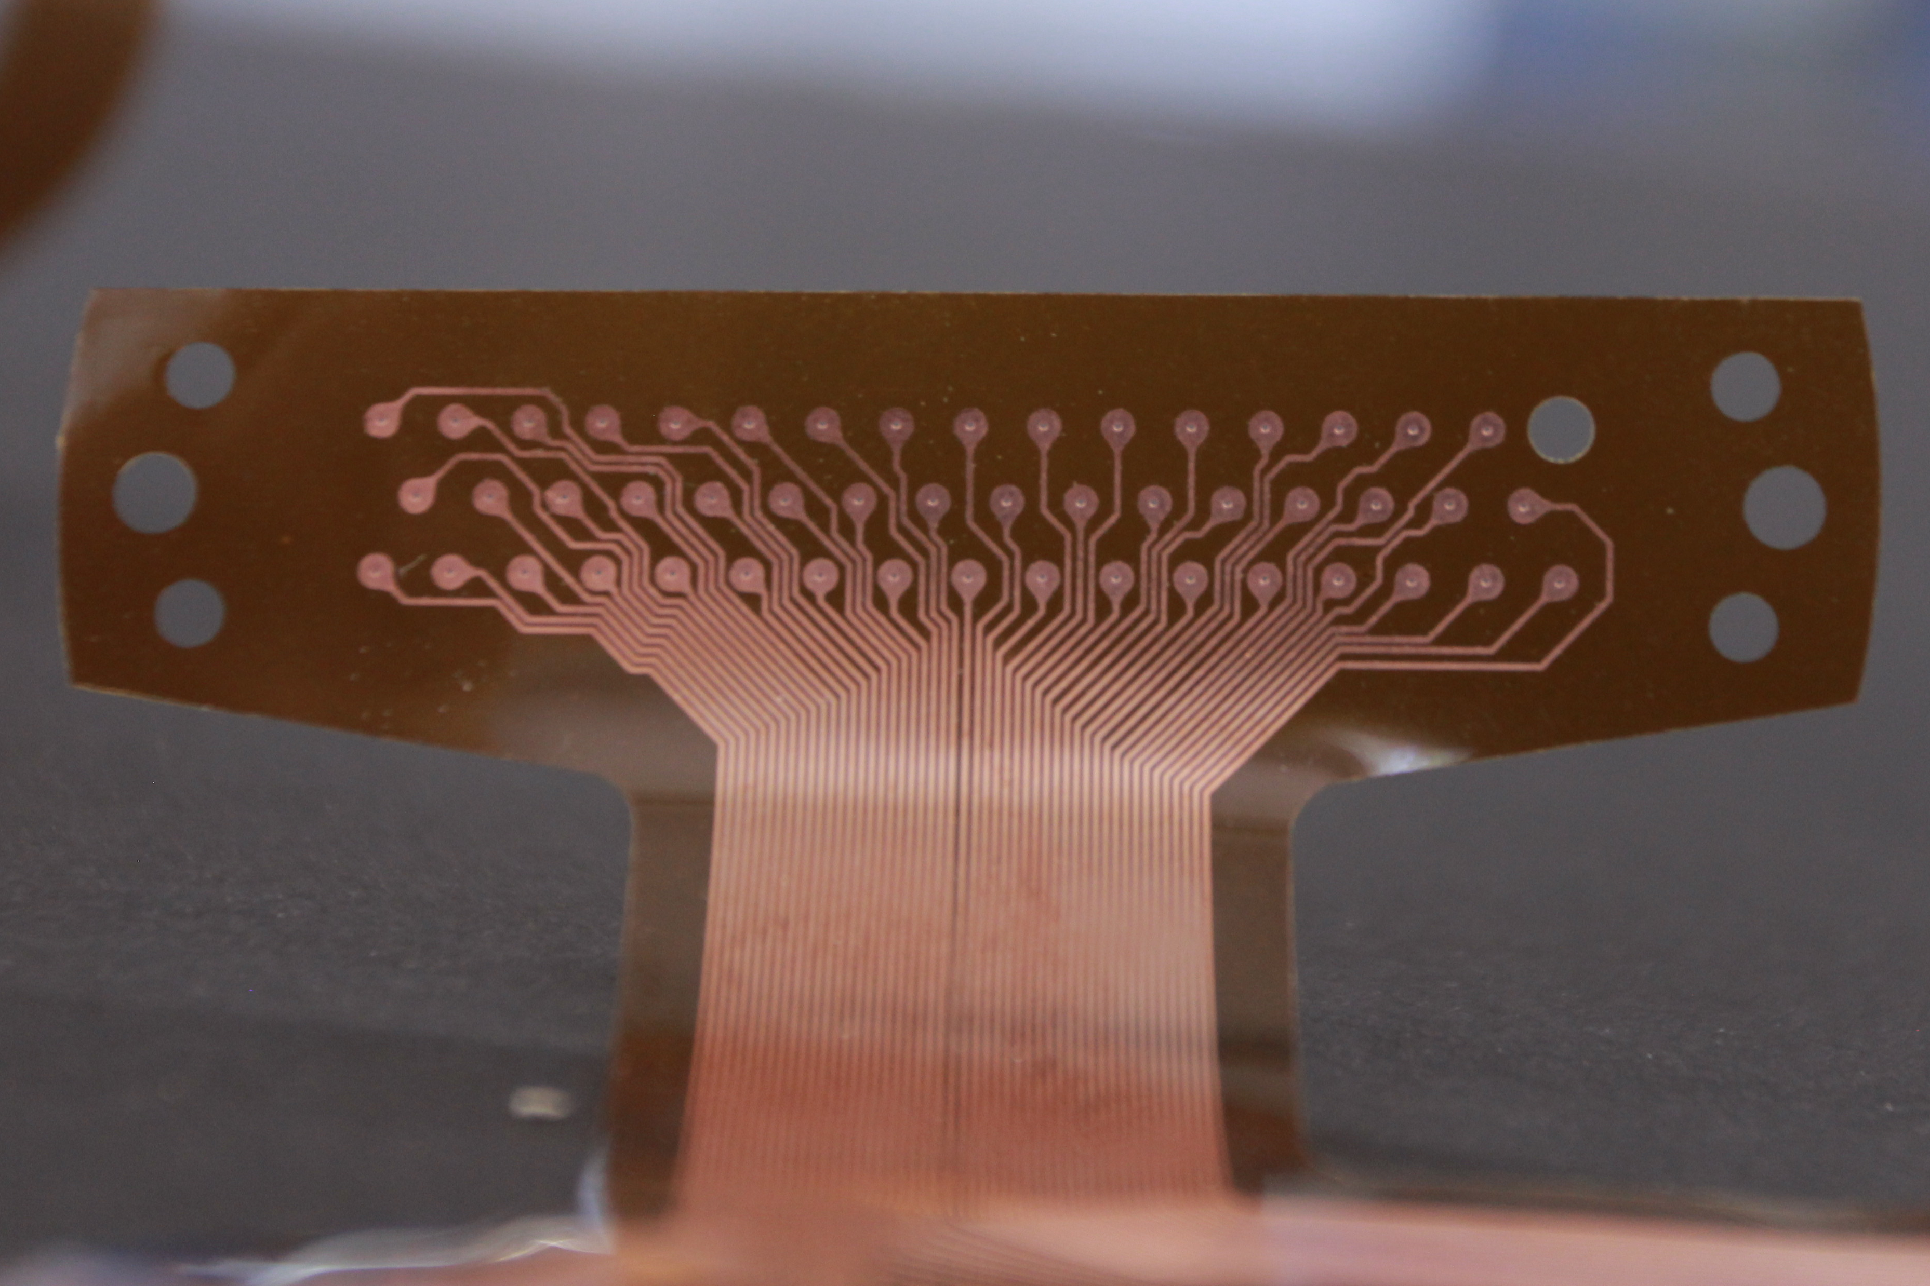
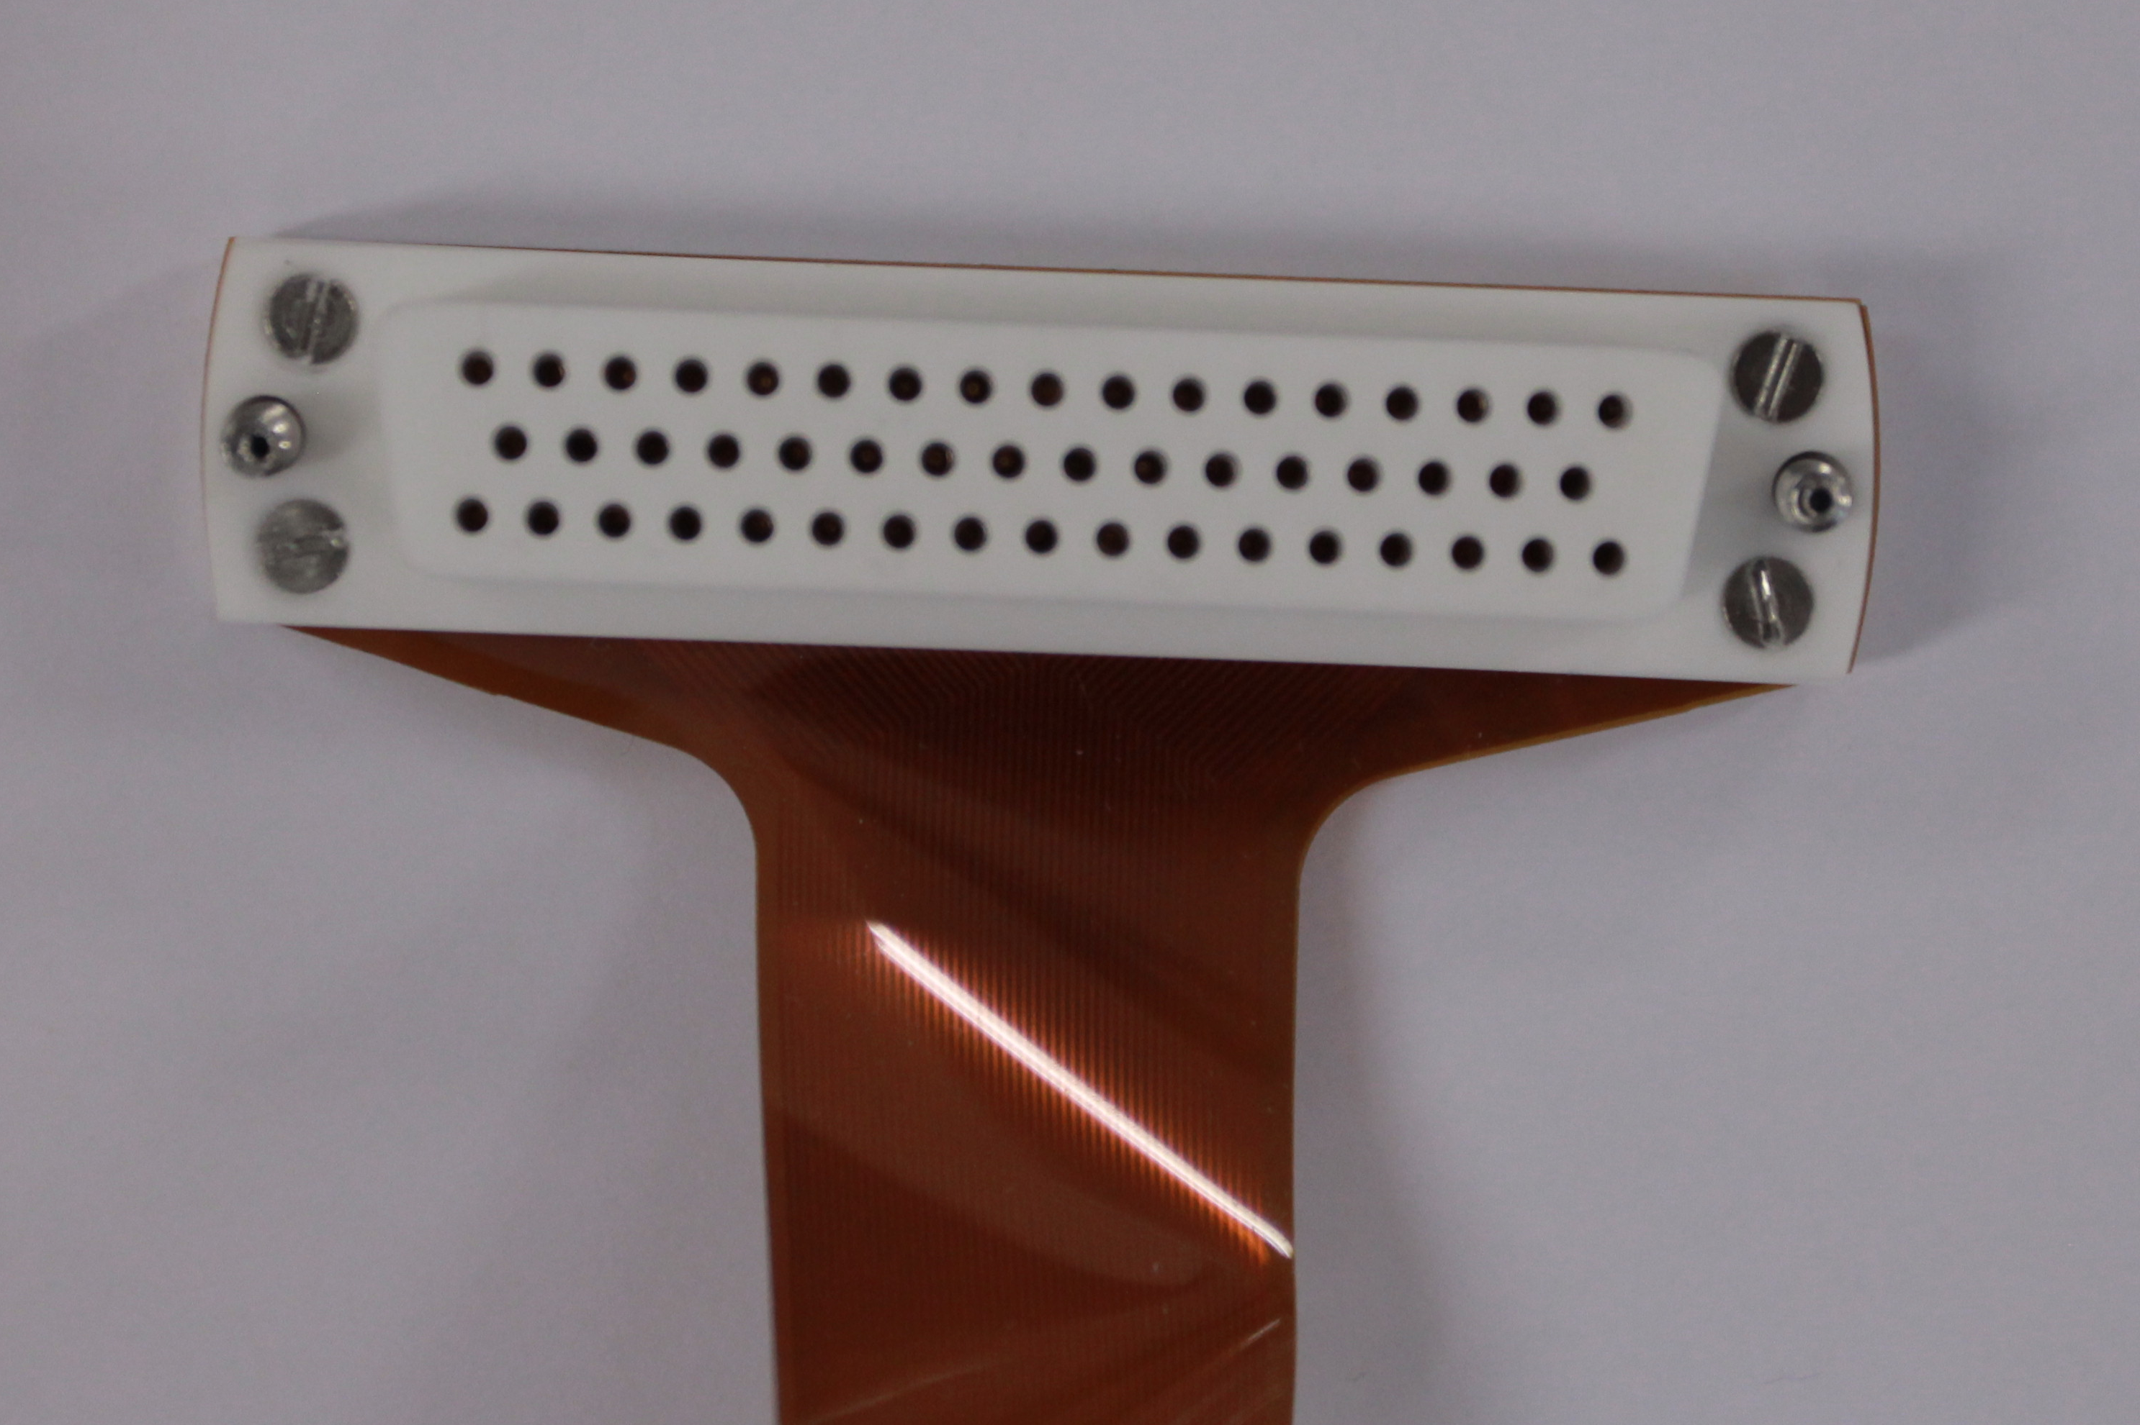
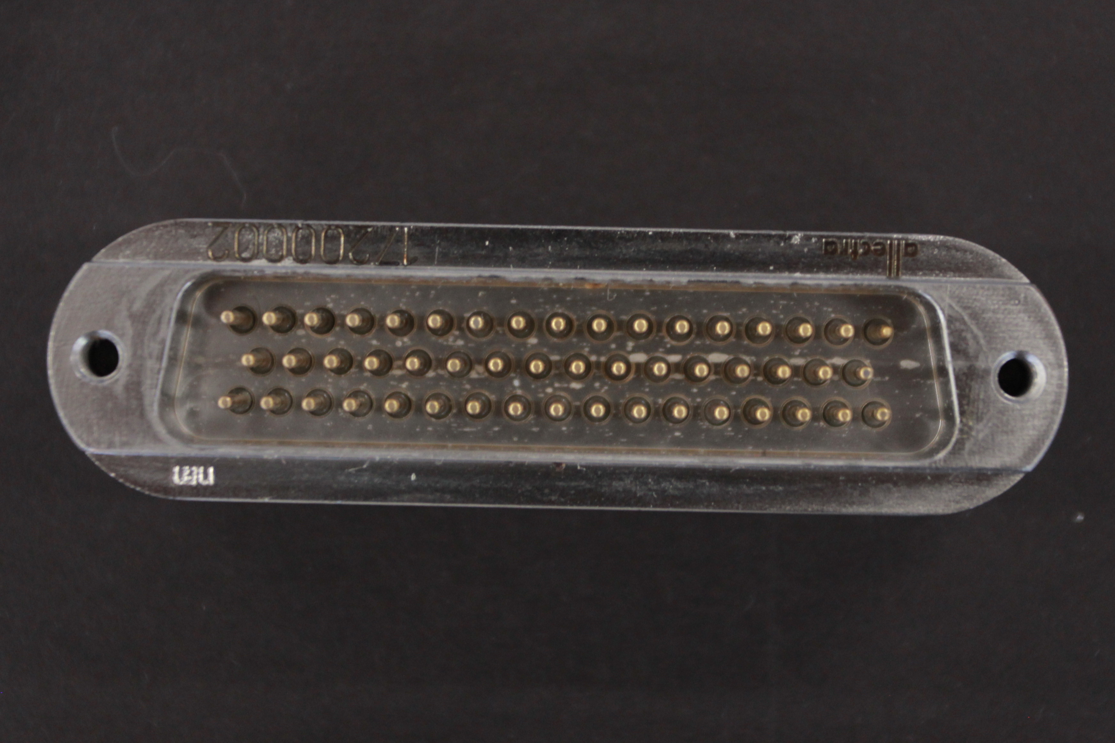
Connector feedthrough side

Slide 30
Connector feedthrough side
Macor® piece connects onto D-Sub 50
FLEX-PCB
Cut crimp contact
Macor® counterpiece
Spring loaded contact

Slide 31
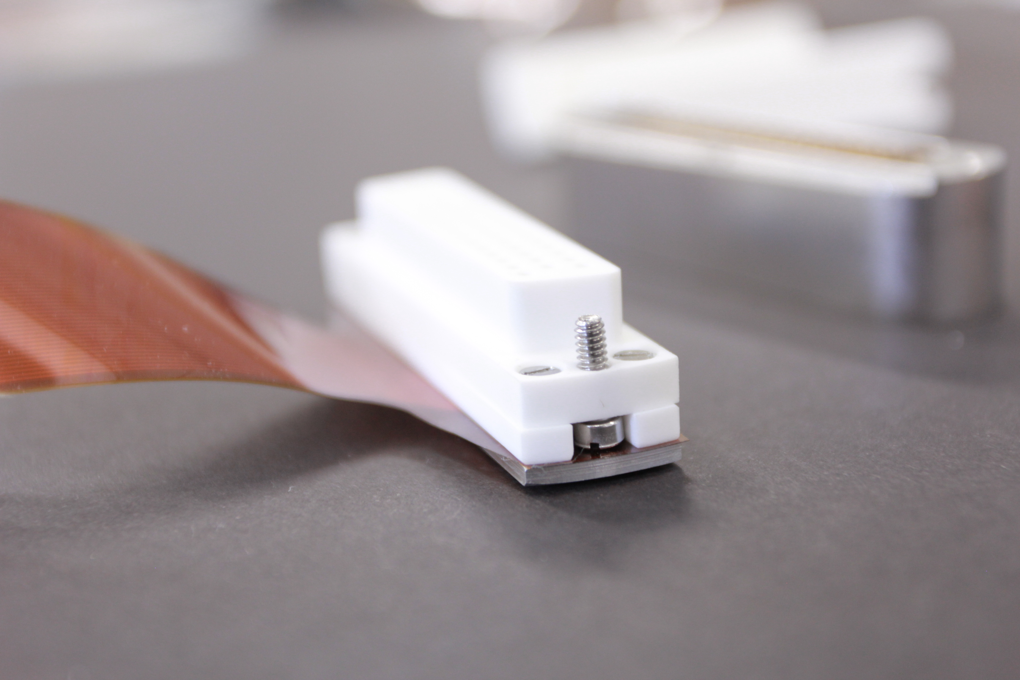
Connector feedthrough side
Macor® piece connects onto D-Sub 50
FLEX-PCB
Cut crimp contact
Macor® counterplate
Spring loaded contact

Slide 32
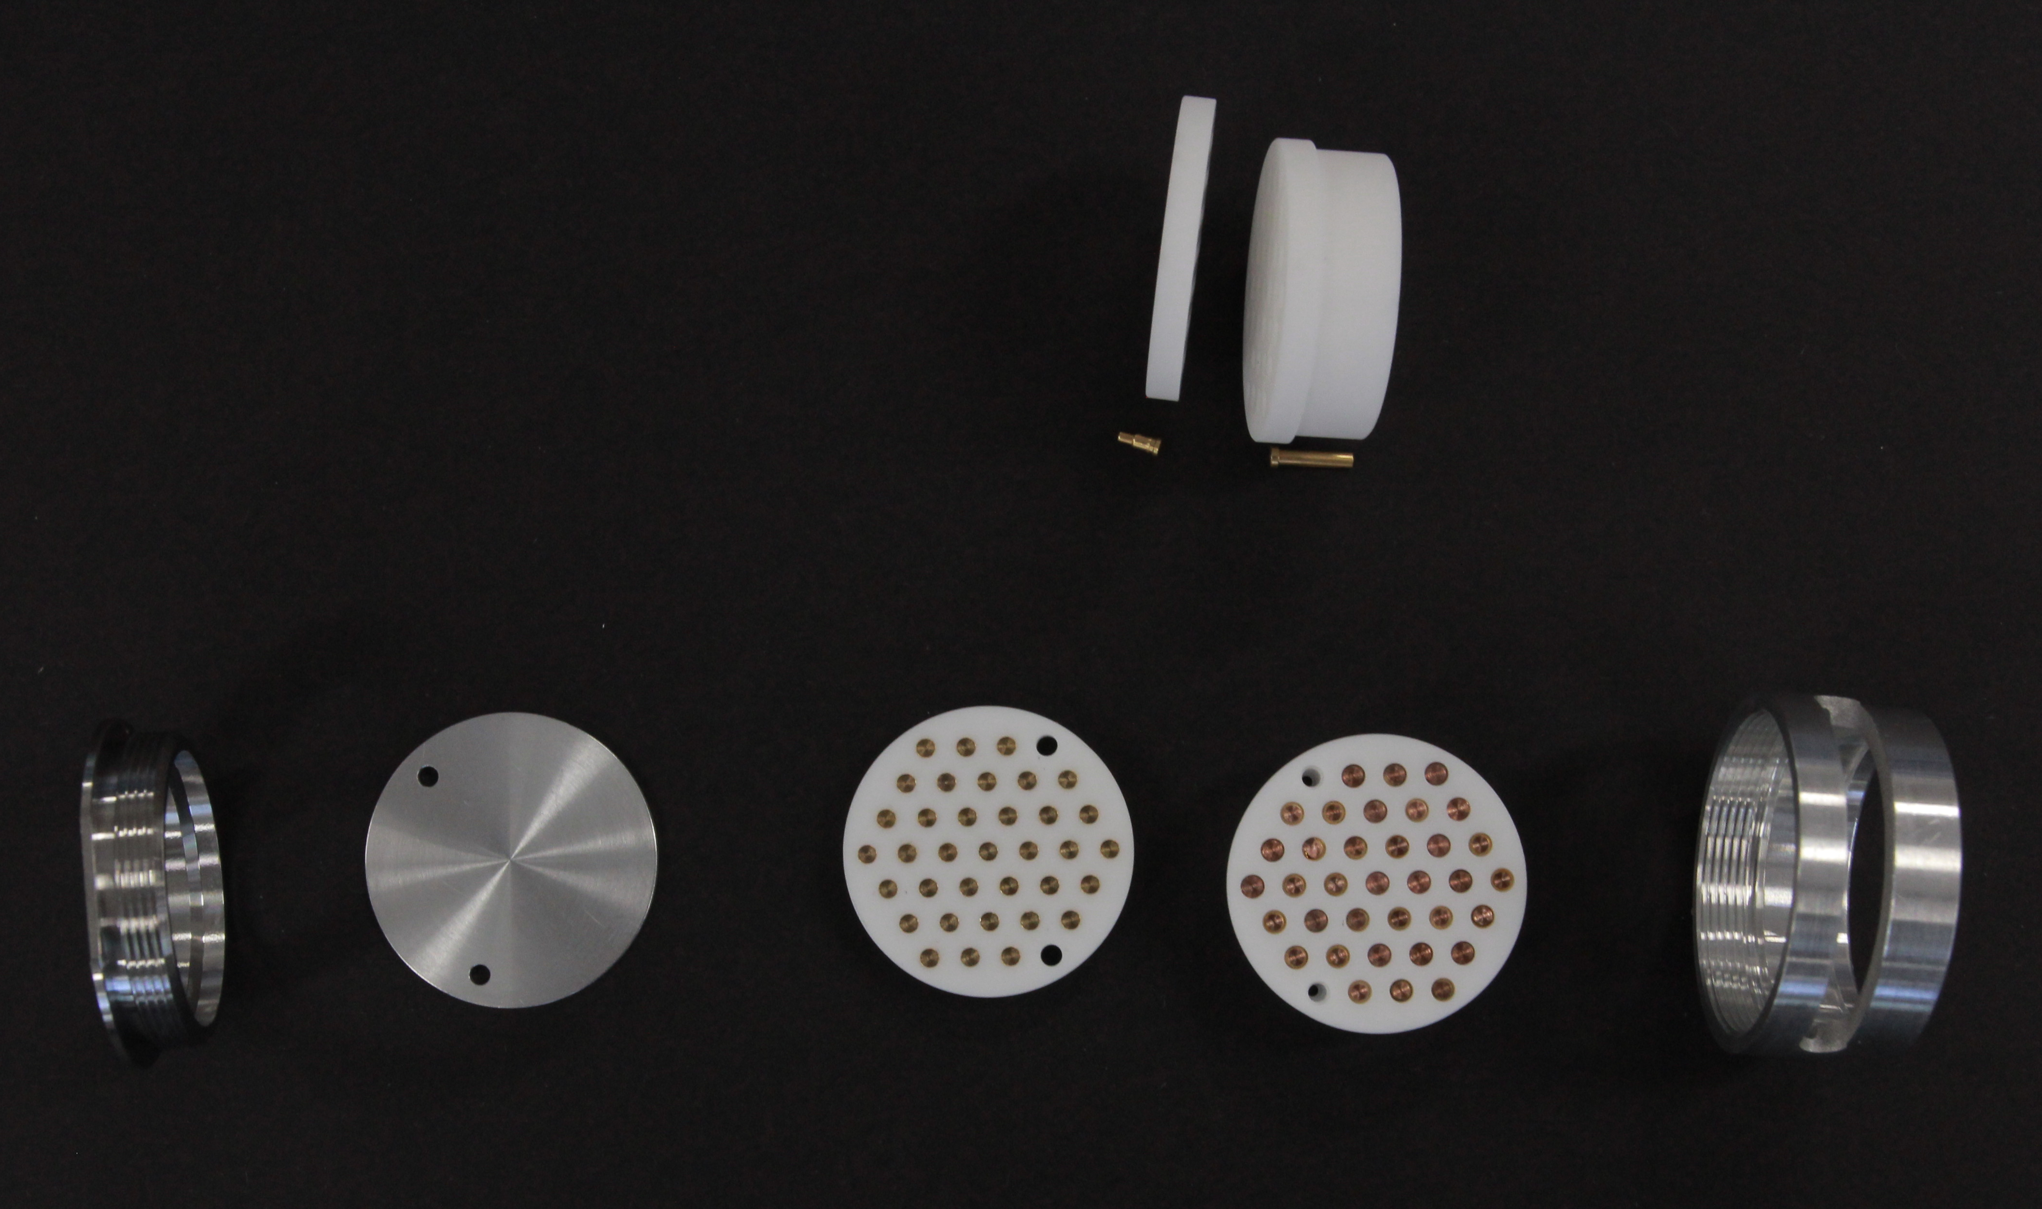
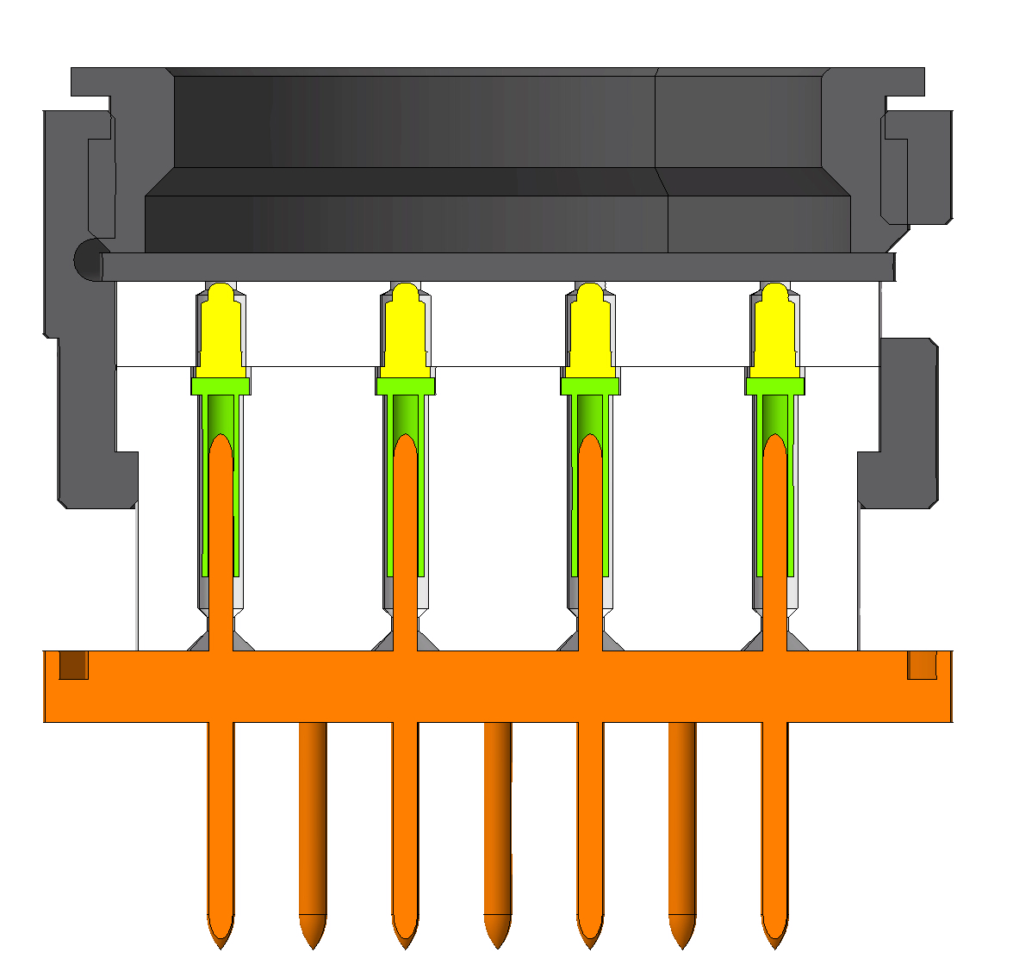
Connector feedthrough side
37 pin round connector

Slide 33
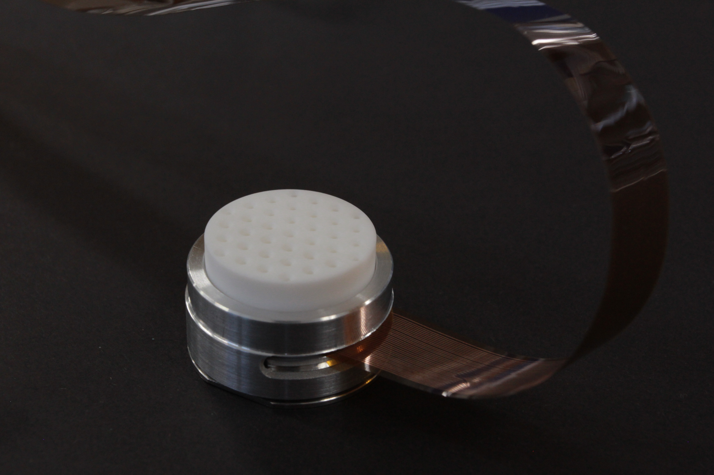
Connector feedthrough side
37 pin round connector

Slide 34
Connector PCB side
Flex PCB folds and pads make direct contact with pads on PCB

Slide 35
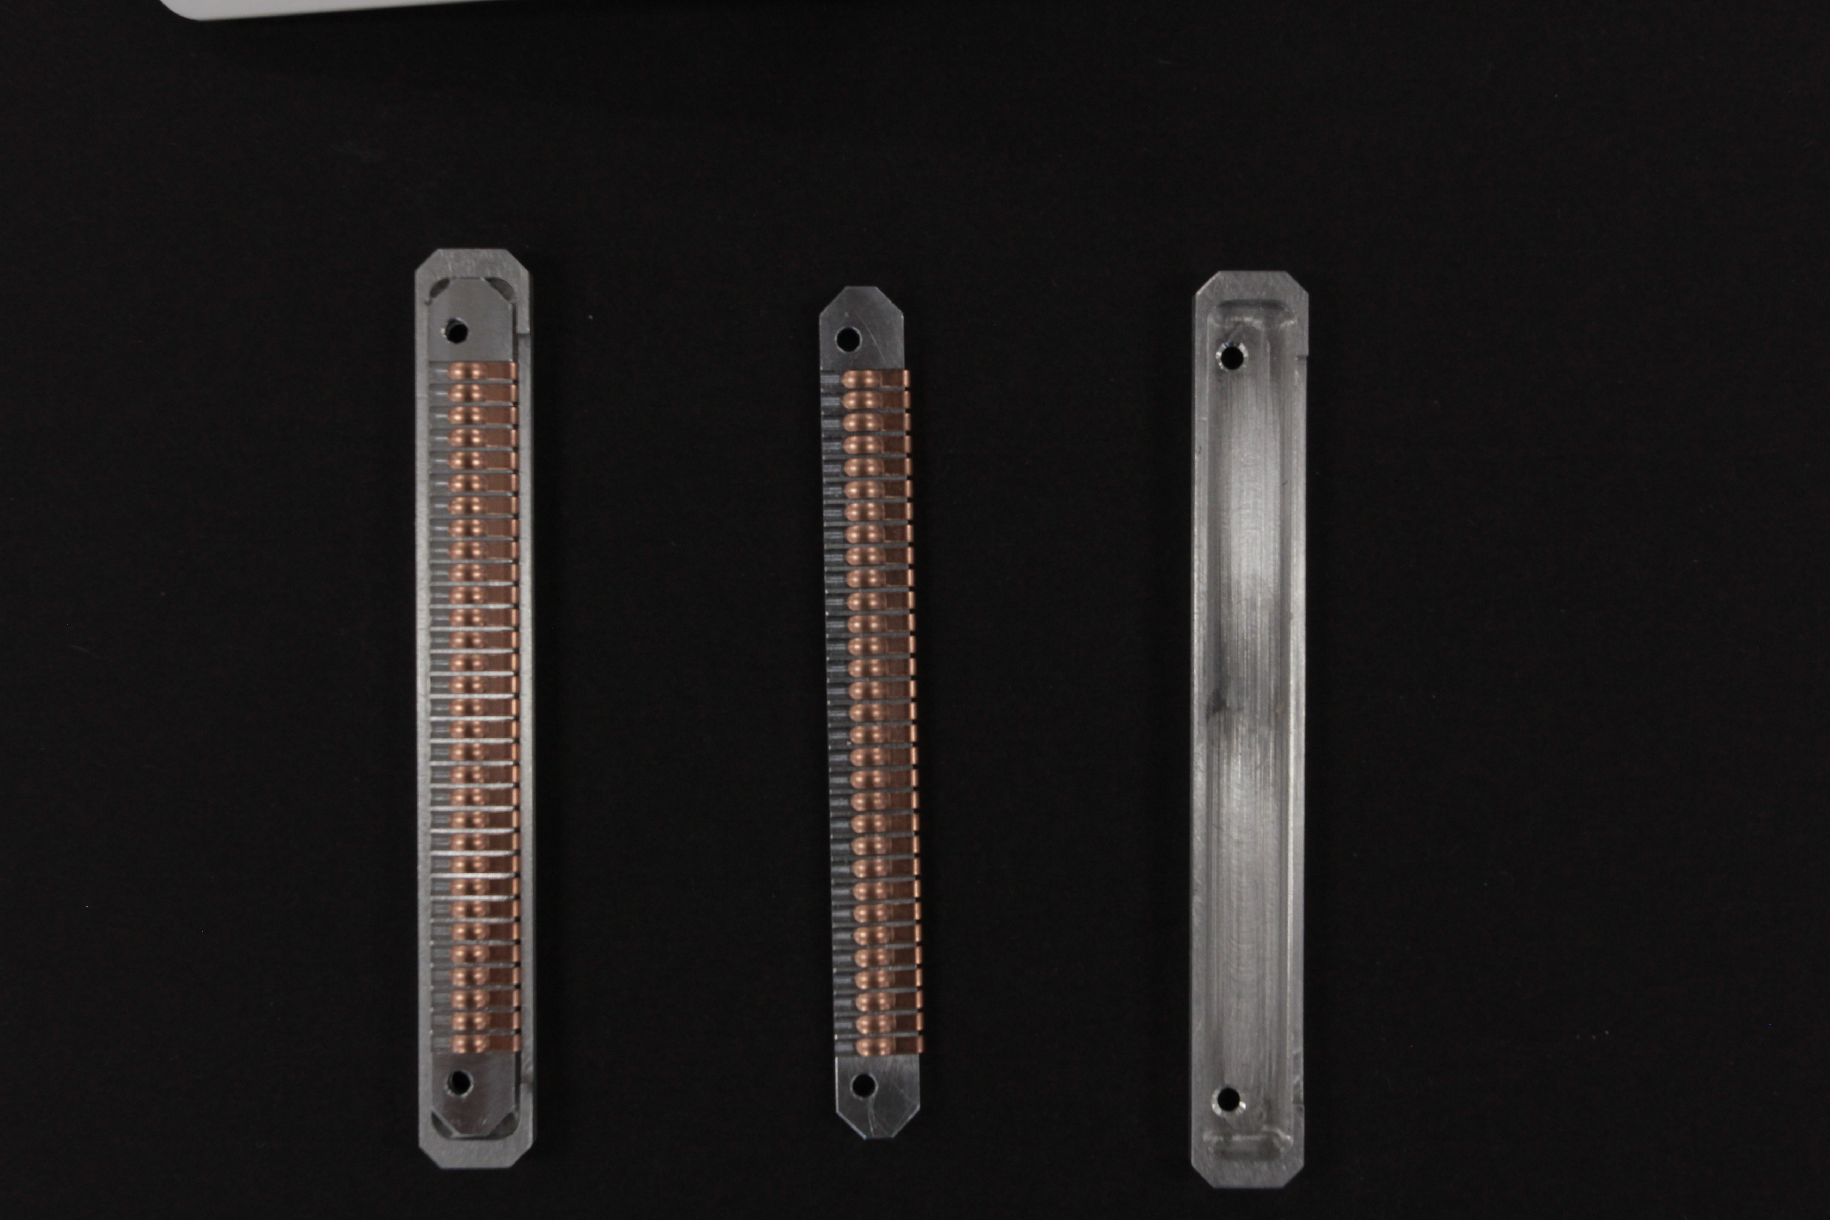
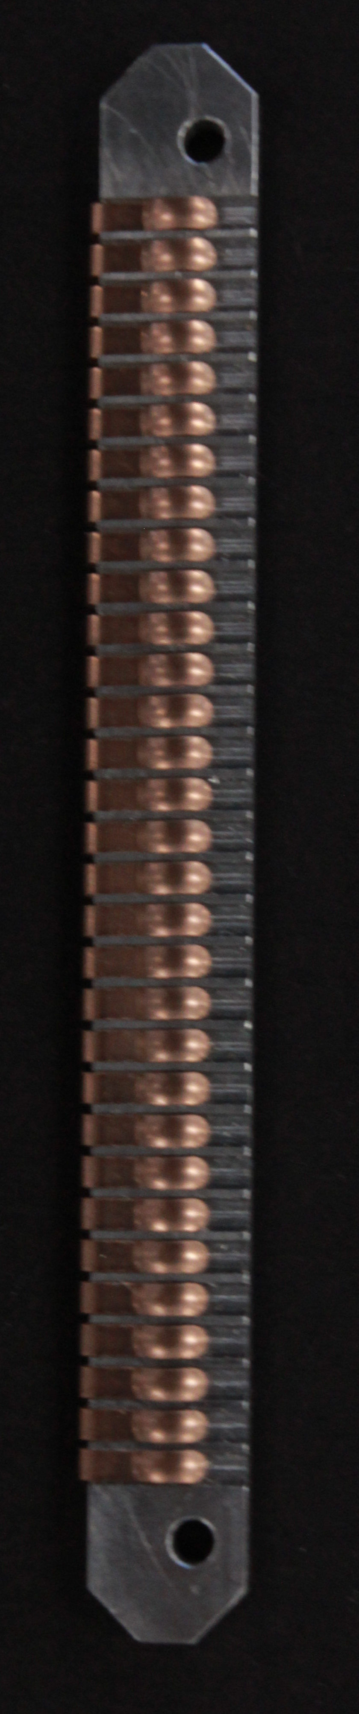
Connector PCB side
RF finger strip
mounted on a support piece (Al)
Fully assembled contact strip for one side
Shell made out of aluminium

Slide 36
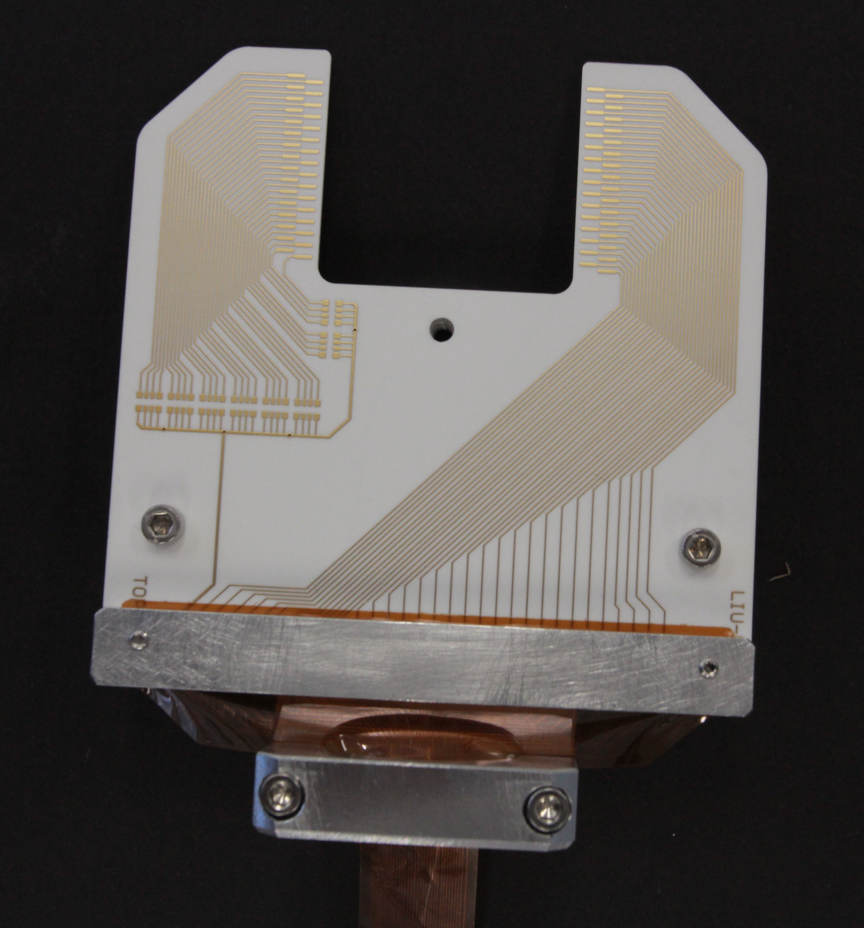
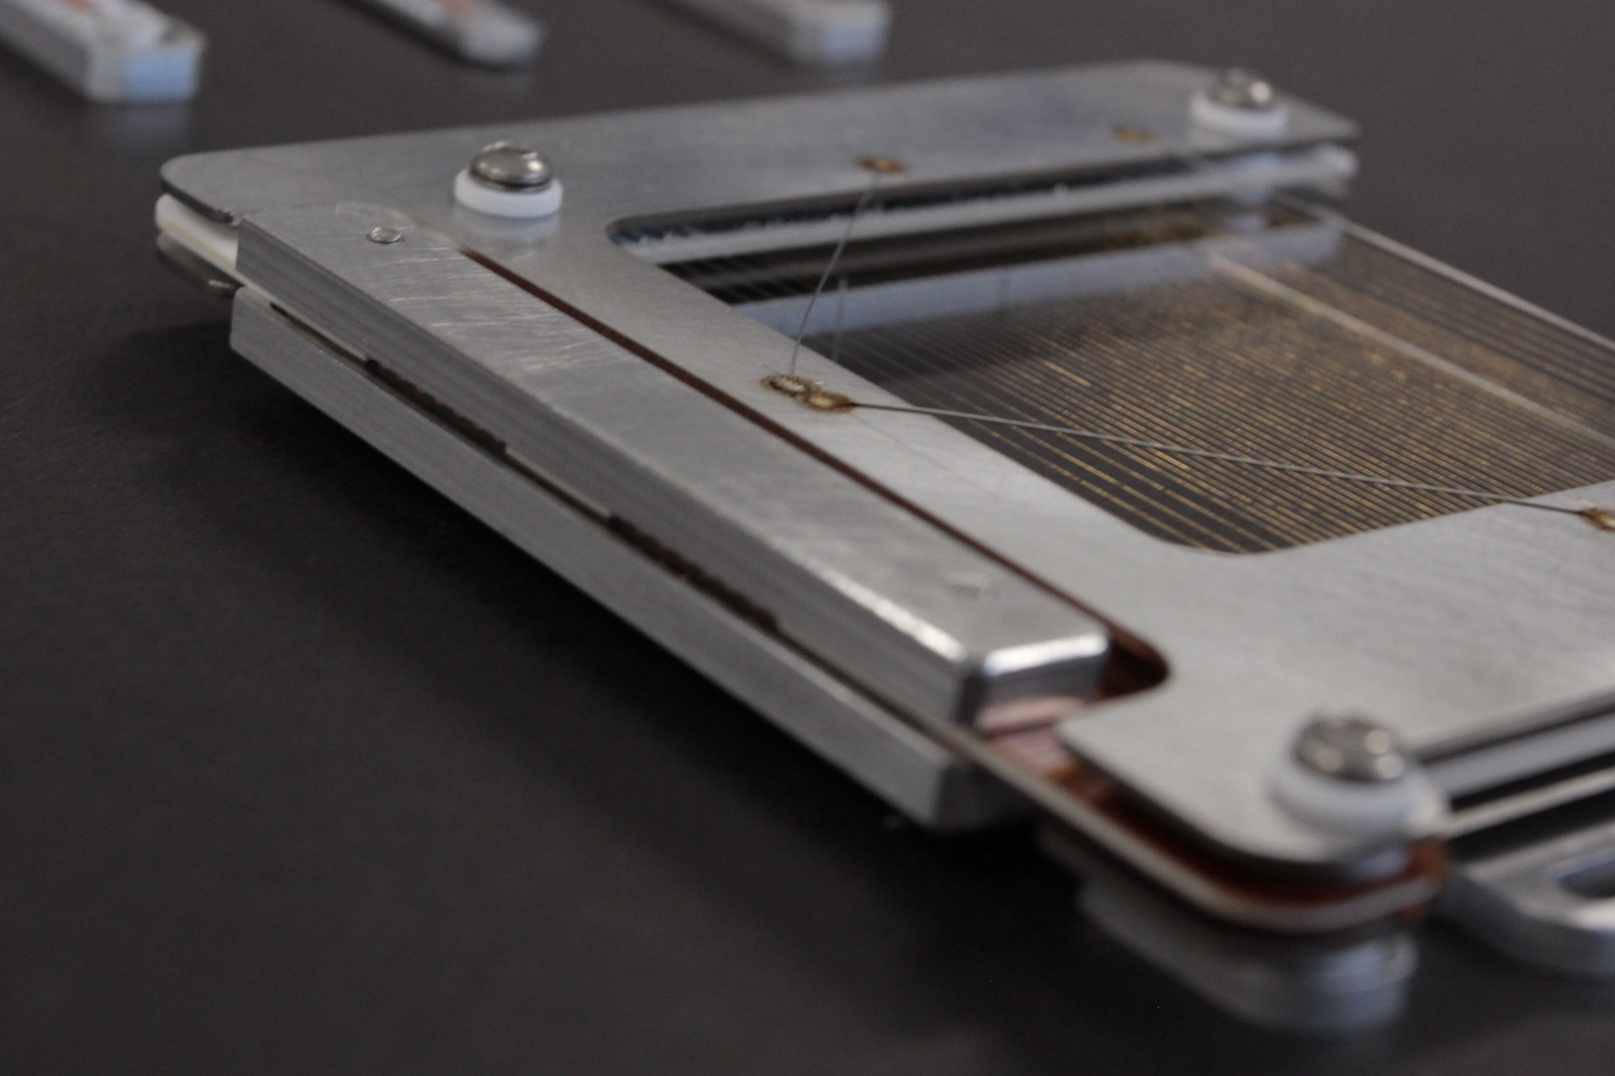
Connector PCB side
Clamped onto the PCB with the Flex

Slide 37
DAQ
Machine | Current range | Gain range | ADC type | Comments
Linear amplifier (LINAC) | 1 μA -> 10 mA | 1/10 -> x1000 | Samples: 4 μs | A linear line
Integrator amplifier (circulating) | 2.5 pC -> 250 nC | X1->x100’000 | Samples: 4 μs | Bunch beam
TbT Booster (linear) | 1 μA -> 100 μA | x1 -> x100 | Samples: 240 ns | Turn by turn measurement
TbT PS (linear) | 10 nA -> 1 mA | 1/100 -> x1000 | Samples: 240 ns | Turn by turn measurement
SPS VME acquisition 2 mode | Linear: 50 nA -> 20 uA Integrator: 1nC -> 400 nC | Linear: 1, 20 ,400 | Samples: 20ms | Use integrator for injection to SPS Use linear for Experiment extraction

Slide 38
Sticking wires
Issue of gold coated tungsten wires “sticking” to each other observed in LINAC 4 after being used in beam
Due to beam hitting the wire the wires start heating up
Thermal expansion of the wire causes them to lose part of the tension
We suspect tungsten wires become magnetic due to the beam and attract each together
Wires bond together, temperature at bonding point must be higher than 1100°C as that is the melting point of gold
Once the heat is gone they are stuck together

Slide 39

Solution ?
Tungsten wire
$$\overset{→}{F}$$
Solder point
PCB
Create an additional pocket on the PCB after the solder
Apply some force which will act on the wire when it is heated up and loses tension to re-tension
Design exists needs to be tested with beam

Slide 40
Special Thanks to
Patrick Bouvier, Michel Duraffourg, Guilhem Elias, Roman Riac, Federico Roncarolo, Jean Tassan-Viol, Raymond Veness,

Slide 41
Any questions? Comments? Similar experiences? Additional ideas?

