Slide 1


Specification Changes of 316 LN ESR after higher temperature procedure
316 LN ESR unlimited material?
Vilcins, Silke, MDI, DESY Hamburg, Germany
21-23 June 2021

Slide 2
Guideline
316 LN ESR unlimited material?
01 History of ConFlat Flange
“Wheeler” Flanges
Higher temperature processes are used for…
02 Motivation
Sample of diagnostic components
Outgassing
02 Situation
Damage to sealing area
Pictures of damaged parts
Quick comparison of 20 ° vs 2 ° CF knife edges
04 Results of material analysis
Hardness measurements
Illustrations
Outgassing analysis
06 Summary
07 Quick outlook
Alloy 50, a new material for high temperature application
First results

Slide 3
History of ConFlat Flange

Slide 4

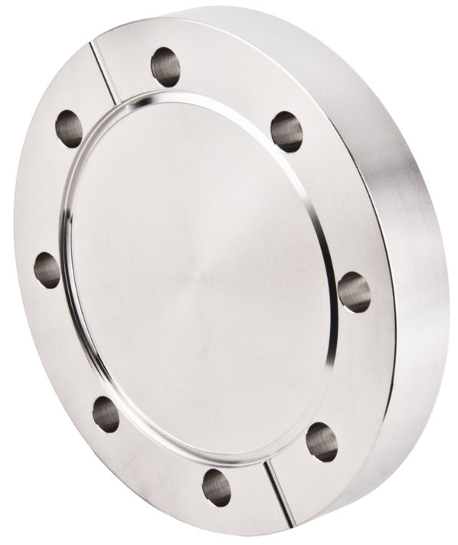
“Wheeler” Flanges
316 LN ESR unlimited material?
  Varian was looking for a gasket which is almost leak tight after 500°C and more (mid 50s)
  No gasket types were found, one junior engineer suggested using a conical seal surface
  Varian decided to transfer this conical design onto the flange surface
  The ConFlat Flange was born, first flange materials were 304 L and later 304 LN (ESR)
William R. Wheeler
  In the 60s/70s at DESY also used 304 (1.4301) and 304 L
  At DESY in the early 80s 316 L was used, followed by 316 Ti
  Mid 90s the specification was changed to 316 LN
https://sep.yimg.com/ay/vacuumshopper/4-50-od-double-sided-cf-6.gif)

Slide 5
Higher temperature processes are used for…
316 LN ESR unlimited material?
High temperature brazing with pure copper, silver eutectic brazing alloys, palladium or copper tin alloy (from 785 – 1110°C)
Stress relief heat treatments for ultra precise manufacturing
“Insitu” outbaking in beamlines
Vacuum firing (for reducing hydrogen peak in bulk material)
Cleaning of welding areas
Reducing of water peaks after wet cleaning
Easy way of particle reducing in complex structural

Slide 6
Motivation

Slide 7
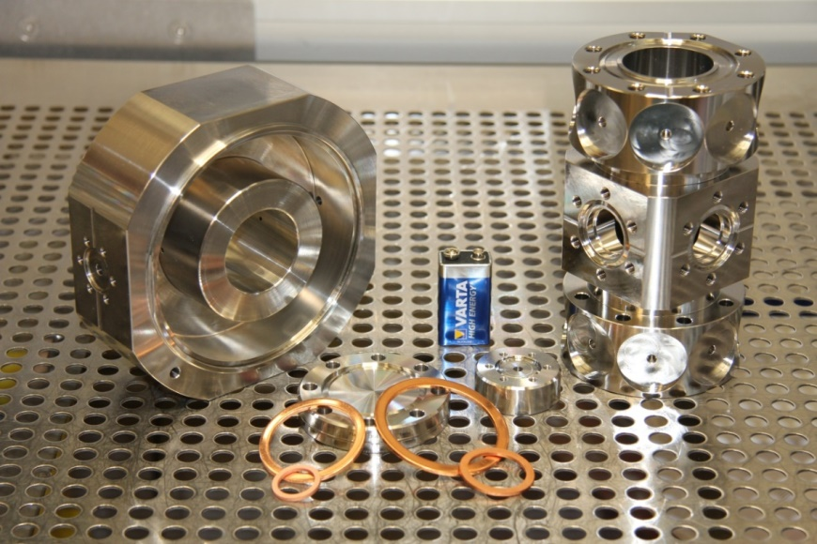
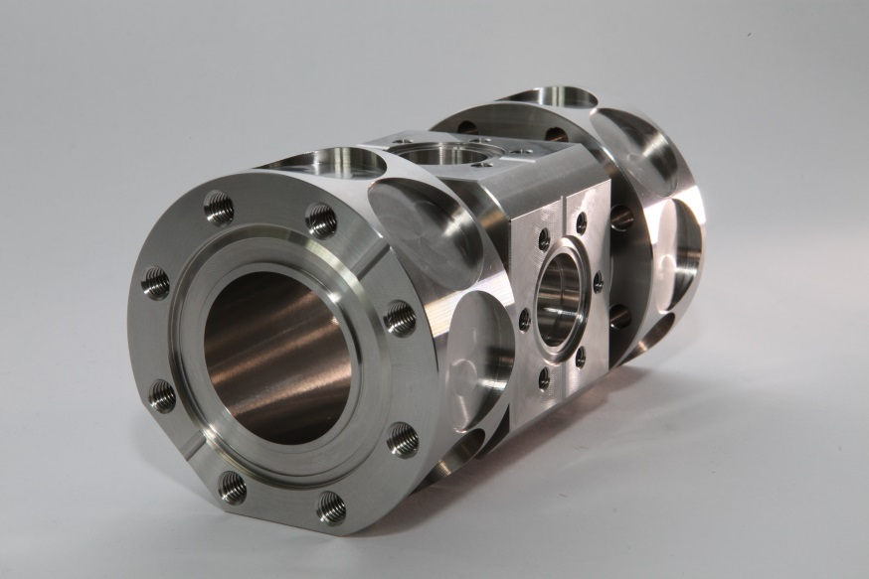
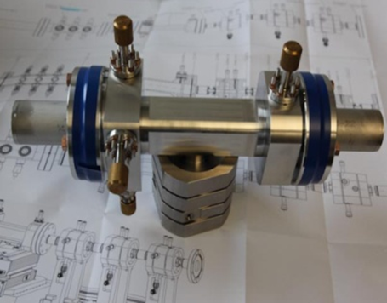
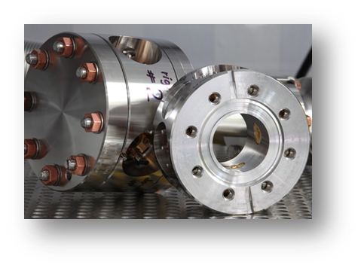
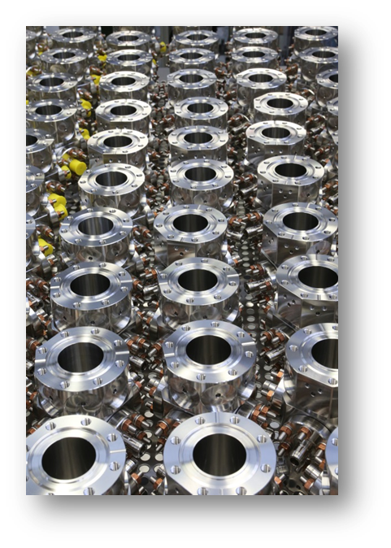
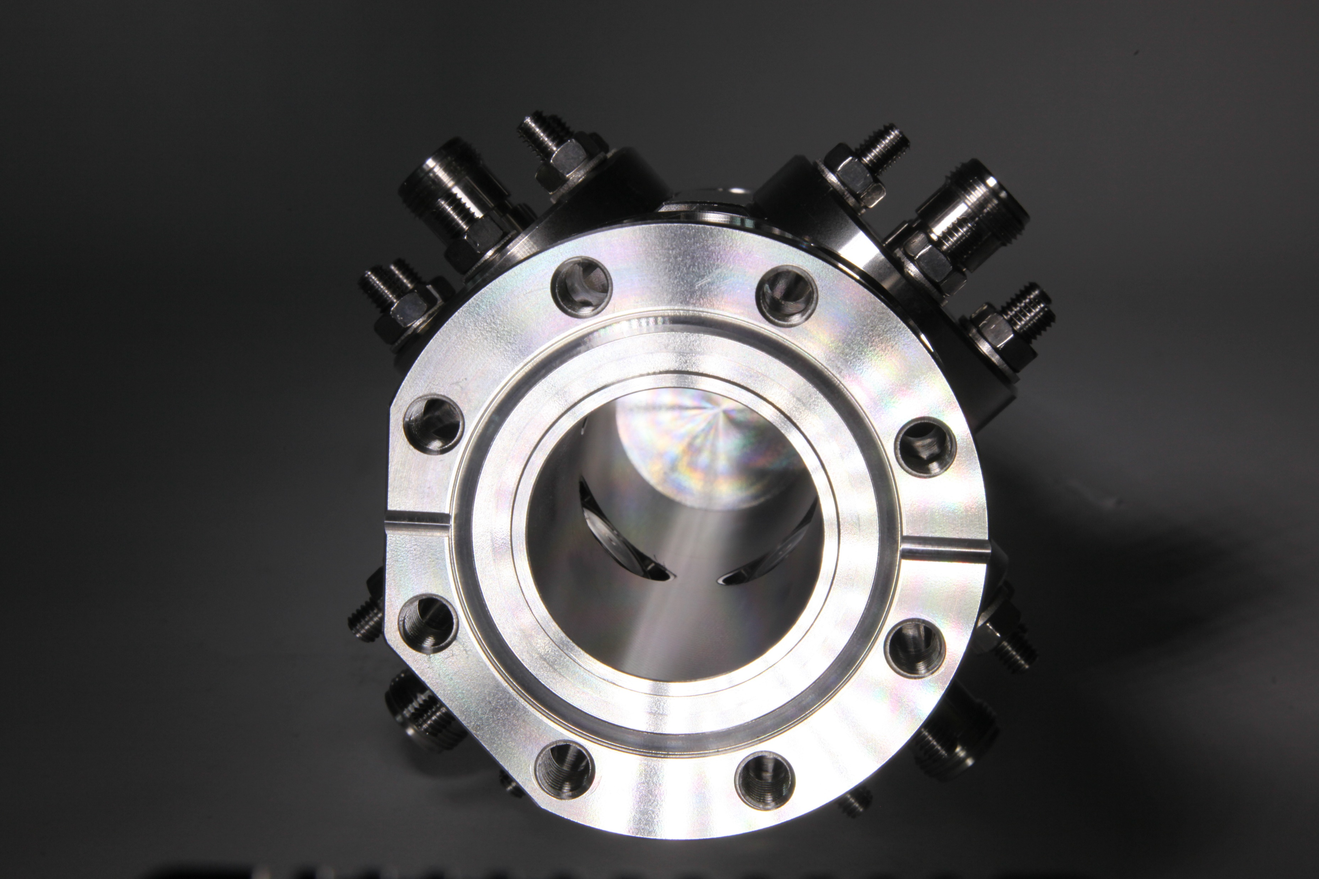
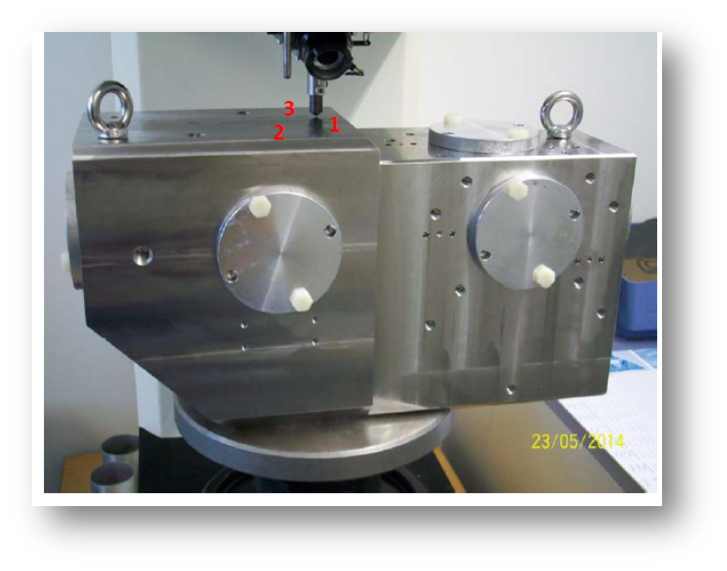
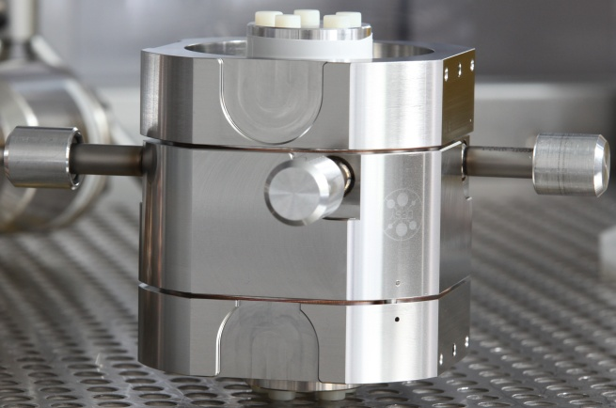
Sample of diagnostic parts
316 LN ESR unlimited material?
XFEL Button BPM with feedthroughs (~280 bodies made inhouse @ DESY/Okuma)
Picture taken by Dirk Nölle and group MDI3 (DESY)

Slide 8
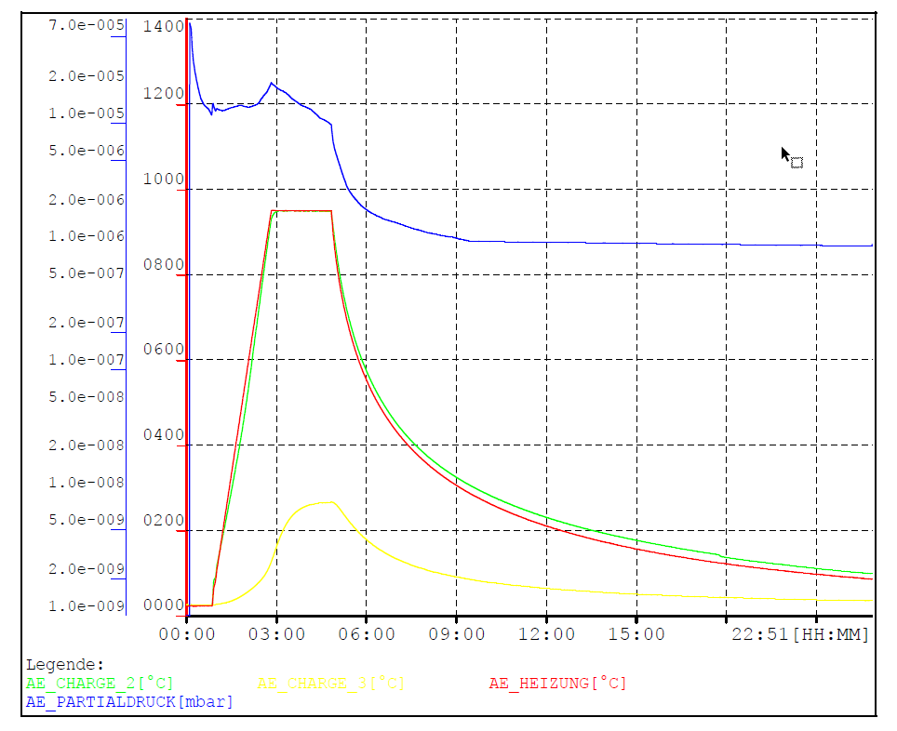
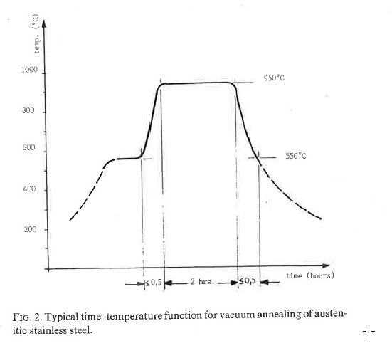
Outgassing
316 LN ESR unlimited material?
Principle diagram of “CERN” process taken from (W. Unterlechner “Some improvement work on ConFlat joints and their limit of reliability in large-size ultrahigh vacuum system”
~1.5 h
Furnace protocol @ “DESY”

Slide 9
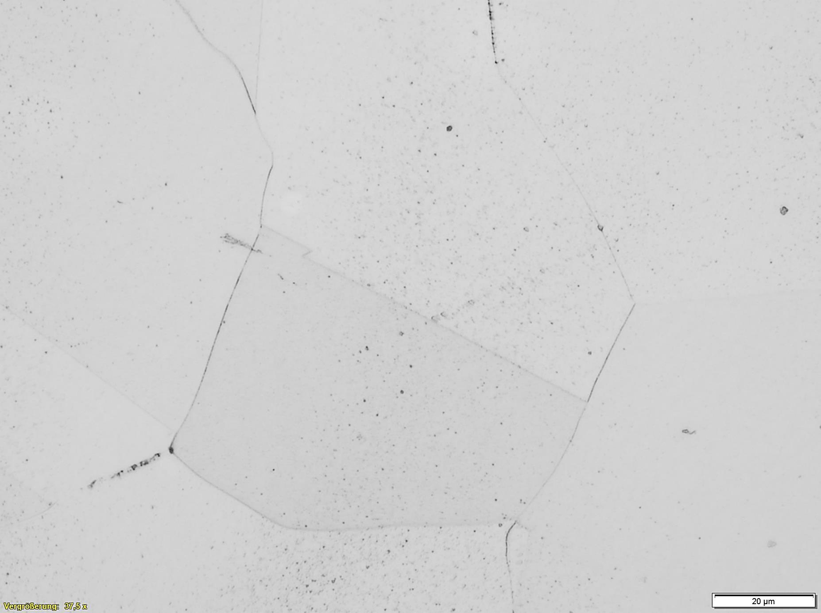
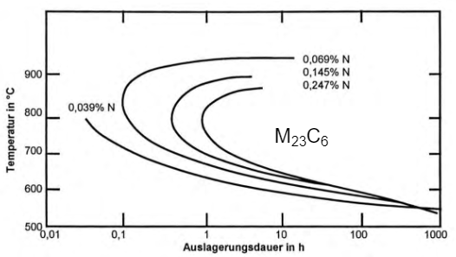
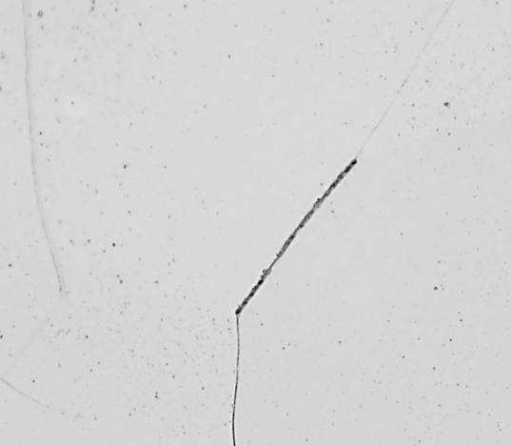
Outgassing
From 500 ° C, 𝑀₂₃ 𝐶₆-carbides (M = Cr, Fe) form at the grain boundaries, which are resistant up to 900 ° C
Reason: increased diffusion coefficient of Carbon
The result is chromium depletion in the environment → intergranular corrosion → grain disintegration
Nitrogen itself forms nitrides, but also inhibits inter-metallic corrosion
316 LN ESR unlimited material?
Carbides at grain boundaries of 316 LN (sample 51)
2 h
950°C for 2 h
Courtesy by Alexey Ermakov, DESY
„Important for technological advances in the field is the decomposition of austenite must be avoided due to the deleterious consequences
to the mechanical properties and corrosion resistance.“
Precipitation of
At 650°C for 4 h
Carbides at grain boundaries of 316 LN (sample 31)
Or 500°C for longer time
TTT (Temperature-Time-Transformation) diagram of Type austenitic stainless steel X5CrNiMo 17-13-5 (1.4436 ?) (Handbook of stainless steels, D. Peckner, I.M. Bernstein. McGraw-Hill, 1977)
Courtesy by Alexey Ermakov, DESY

Slide 10
Situation

Slide 11
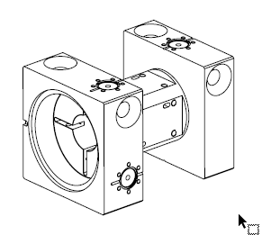
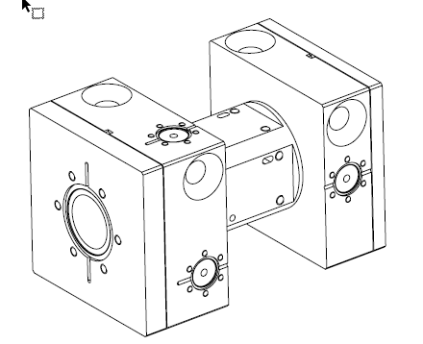
Damage to sealing area
316 LN ESR unlimited material?
4 Cavity BPM‘s were build by a company (2018), incl. „stress relieved firing“, the CF 40 flange were fabricated by turning and the CF 16 flange by milling
Before brazing the hardness was measured and was in the range of material certification ~174 HB
After fabrication brazing at high temperature @ 1110°C with pure copper foils
After brazing the parts were assembled and vacuum tested
  The CF 16 flange were tightened with 3 Nm and leaks… no alternative gasket design works!
  The CF 40 flanges were tightened, also after 5 closes
The hardness was checked again and dropped down to 145-154 HB!
Specification Changes of 316 LN ESR after higher temperature procedure | S. Vilcins | June 2021 |

Slide 12
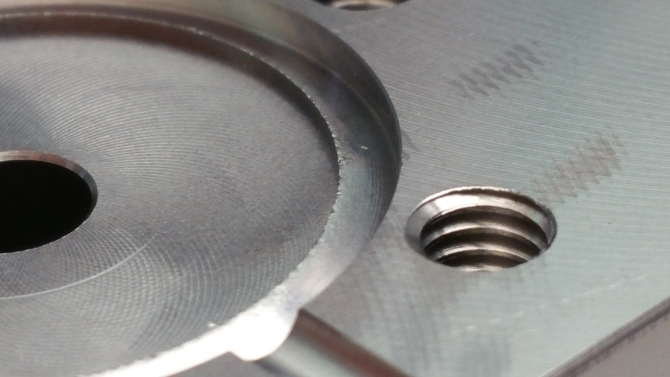
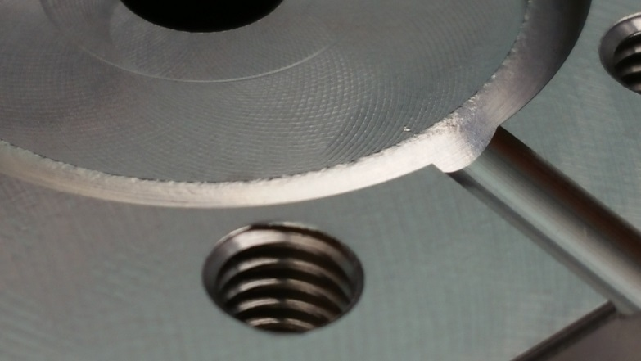
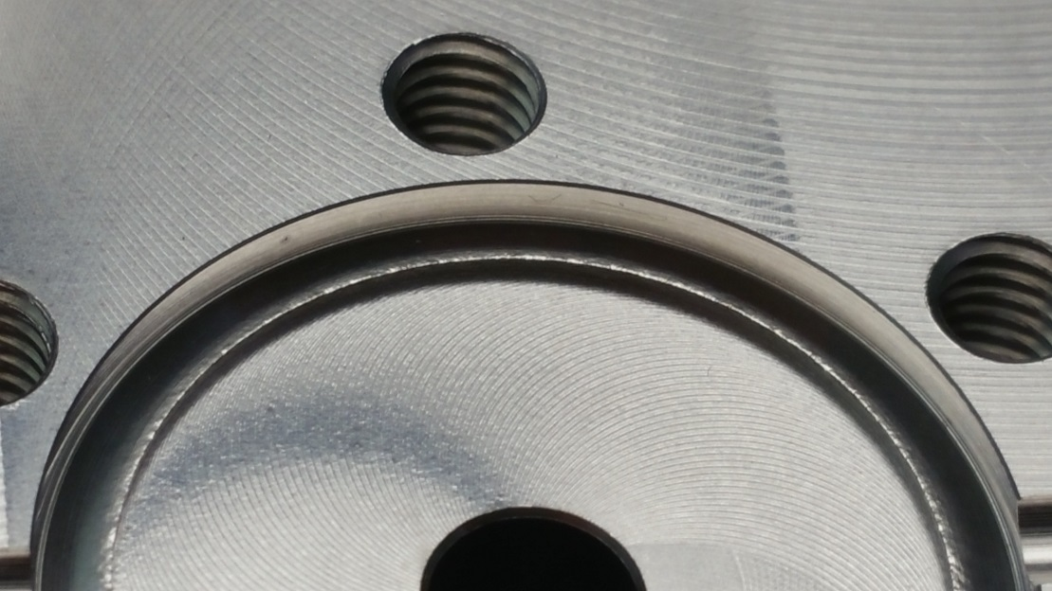
Pictures of damaged parts
316 LN ESR unlimited material?
„orange skin“ on CF 16 316 LN ESR flanges

Slide 13
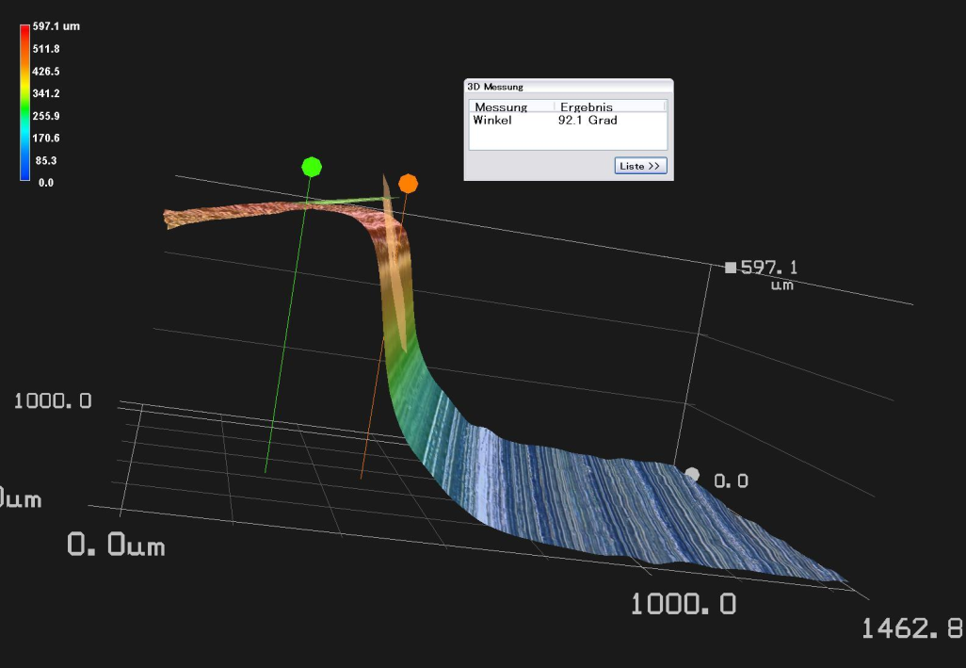
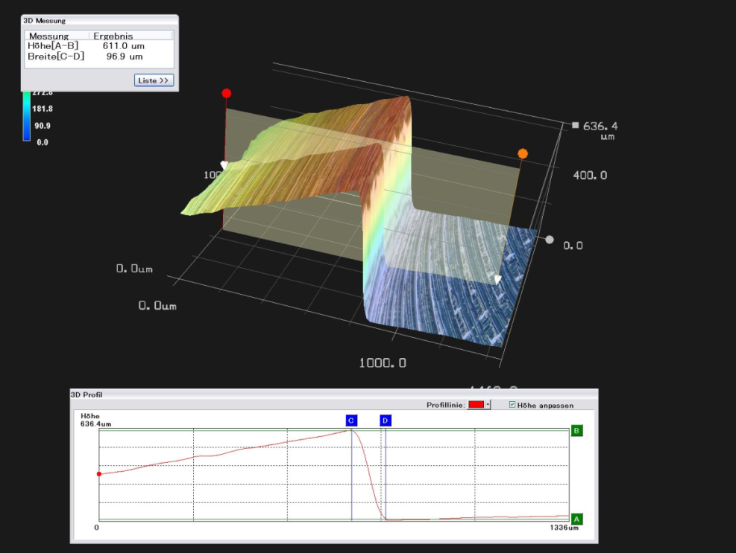
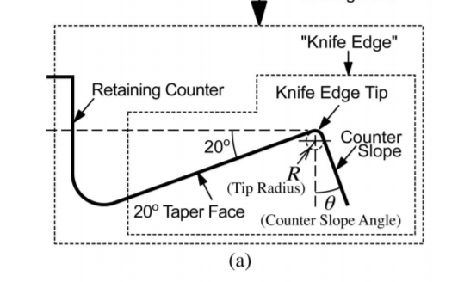
Quick comparison of 20 ° vs 2 ° CF knife edges
316 LN ESR unlimited material?
Courtesy by Fred Knof, DESY
Dependence of the seal property of ConFlattype flanges on the fine dimensions of the knife edge Cite as: Journal of Vacuum Science & Technology A 21, 438 (2003); https://doi.org/10.1116/1.1545758 Submitted: 17 October 2002 . Accepted: 16 December 2002 . Published Online: 10 February 2003 Satoshi Kurokouchi, Satsuo Shinoda, and Shinsaku Morita

Slide 14
Quick comparison of 20 ° vs 2 ° CF knife edges
316 LN ESR unlimited material?
„Reprint“ by a 20° counter slope angle
Courtesy by BAM Berlin; Oberflächenmodifizierung und -messtechnik
https://www.bam.de
„Reprint“ by a 2° counter slope angle
Initial hardness of copper gasket was 85 HB

Slide 15
Results of material analysis

Slide 16
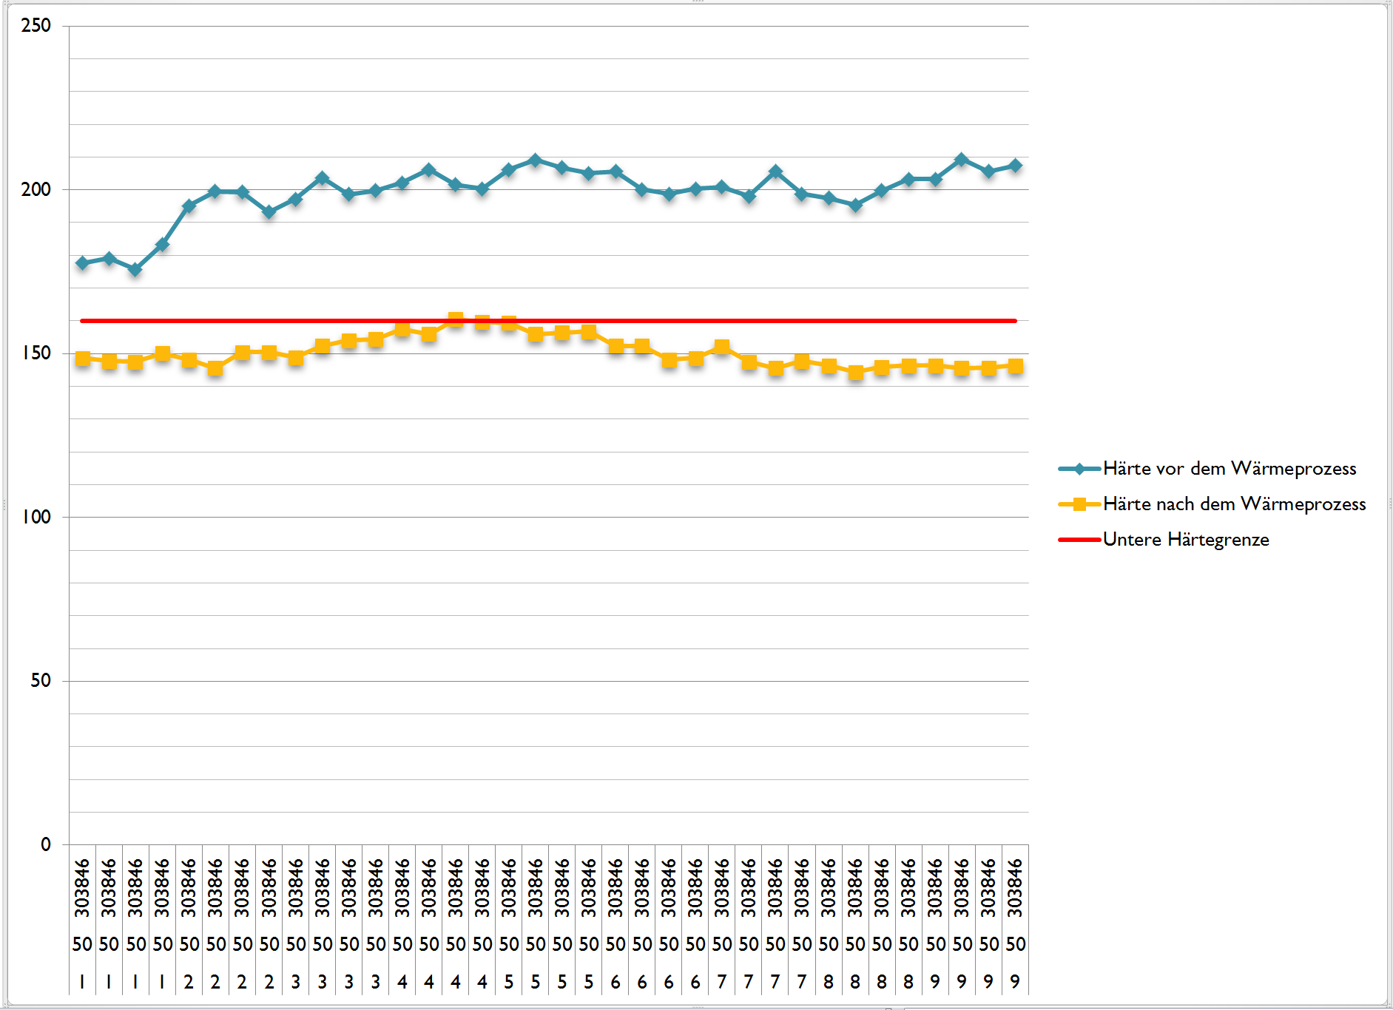
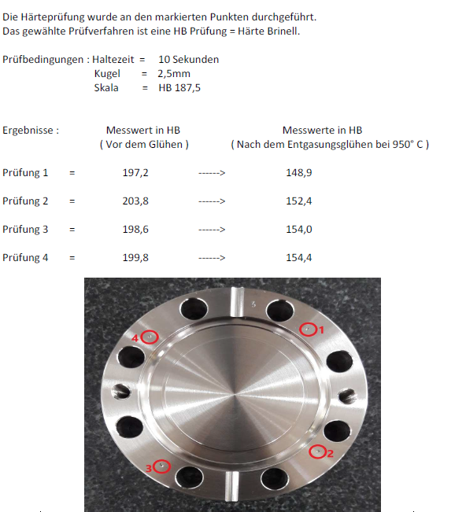
Hardness measurements
ConFlat flanges 316 LN DN 50
Number 1-3: 950° C for 2h
Number 4-5: 1025° C 15 min, CuSn20
Number 6-7: 1050° C, 15 min, CuSn12
Number 8-9: 1110°C, 15 min, 15 min
316 LN ESR unlimited material?

Slide 17
Hardness measurements
316 LN ESR unlimited material?
Grain size | Hardness before higher temperature process | Hardness after higher temperature process | Hardness Margin in % | Nitrogen
6 | 167 | 165 | 1,2 | 0.1586
5 | 188 | 170 | 5,6 | 0.16
5 | 162 | 160 | 1,2 | 0.173
4 | 188 | 172 | 8,5 | 0.165
4 | 185 | 176 | 4,86 | 0.175
4 | 162 | 160 | 1,23 | 0.177
4 | 182 | 172 | 5,49 | 0.167
3 | 163 | 159,6 | 2,1 | 0,18
3 | 178 | 167 | 6,2 | 0.17
3 | 188 | 173 | 8 | 0.168
3 | 175 | 146 | 16,6 | 0.161
3 | 195 | 148 | 24 | 0,15
3 | 199 | 145 | 27 | 0,15
Dependency between grain size and nitrogen to hardness loses after thermal processes can be presented…
Table of different material charges and hardness values after heat treatments

Slide 18
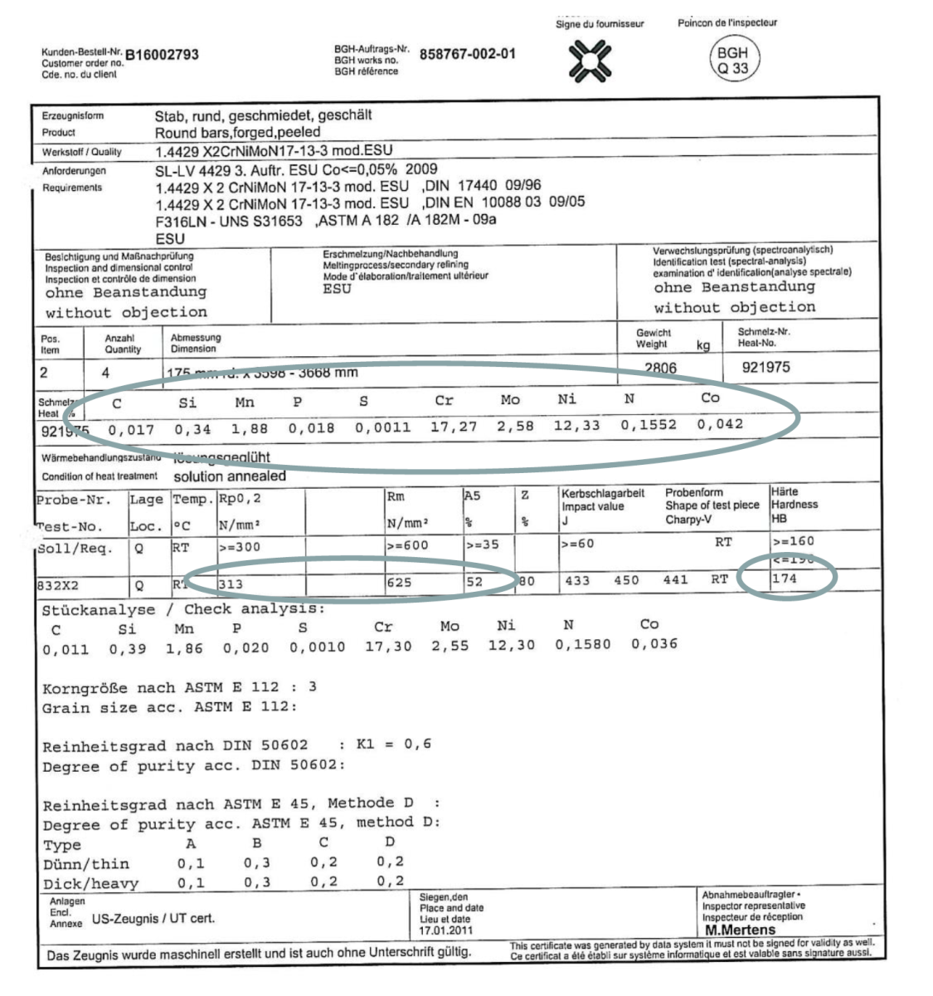
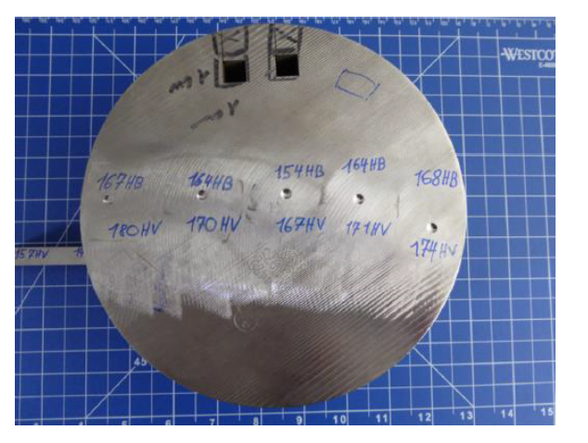
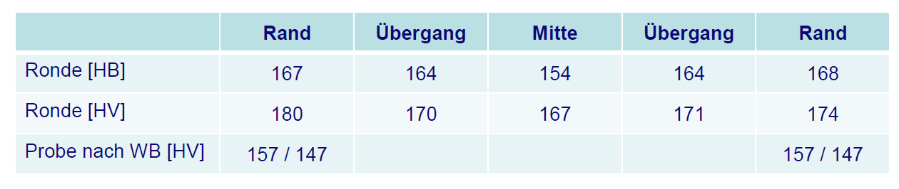
Hardness measurements
316 LN ESR unlimited material?
Courtesy by BGH https://www.bgh.de/de/startseite

Slide 19
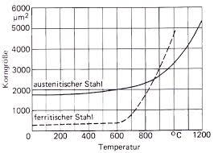
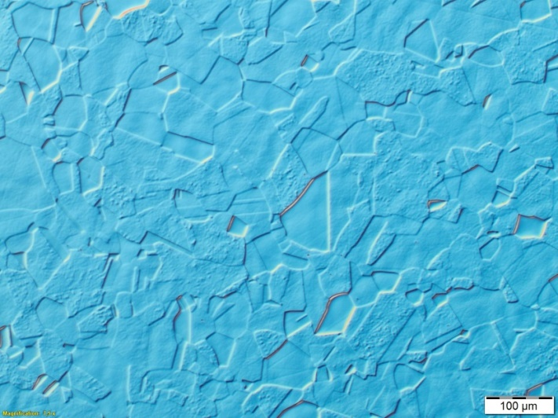
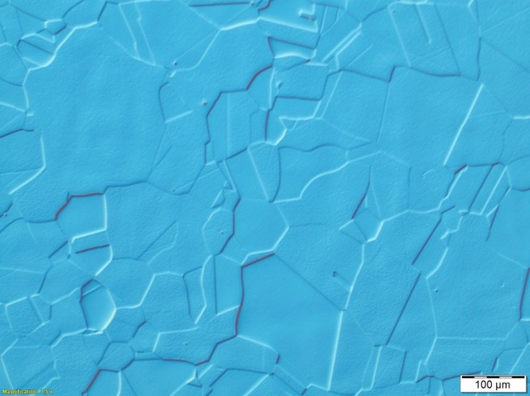
Illustration
Grain size dependancy to temperature
316 LN ESR unlimited material?
316 LN before brazing @ 1050°C
..after brazing @1050°C
Grain size 3-4
From „Strassburg and Wehner“
Courtesy by Alexey Ermakov, DESY
The grain size increase by factor of 1.5
Grain size 2-3

Slide 20
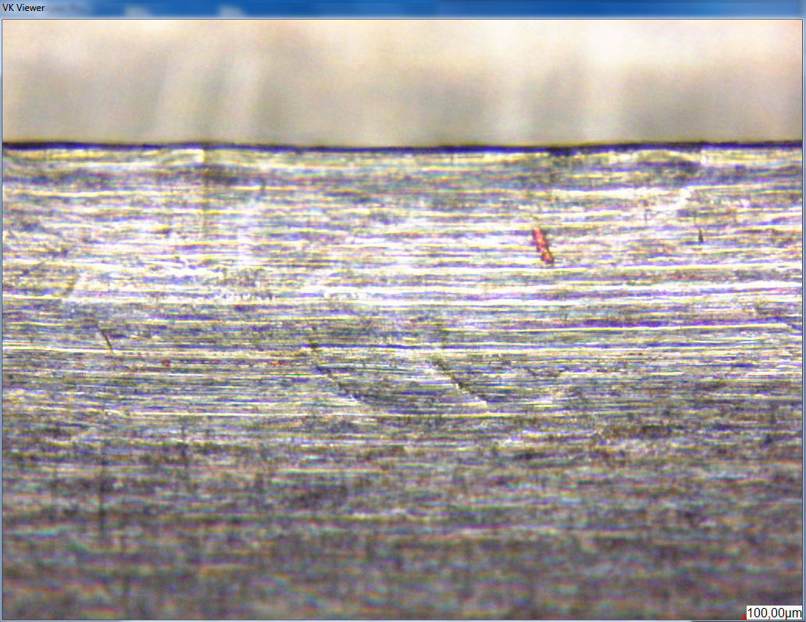
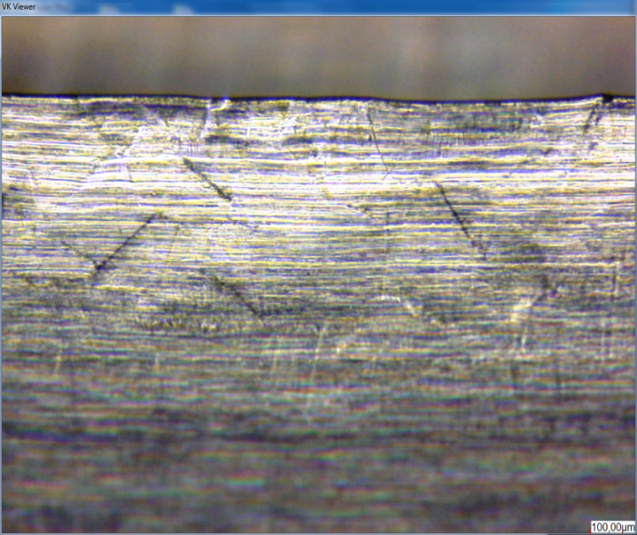
Illustration
316 LN ESR unlimited material?
Microscope image of a damaged knife edge (view under 90 ° on taper angle surface)
Courtesy by Mario Lengkeit, DESY

Slide 21
Outgassing analysis
316 LN ESR unlimited material?
Measurement | Sample number
 | 21 | 31 | 43 | 51
1 | 128 | 131 | 131 | 155
2 | 131 | 121 | 128 | 150
3 | 128 | 124 | 128 | 150
4 | 121 | 128 | 128 | 155
5 | 128 | 128 | 121 | 159
6 | 135 | 118 | 115 | 150
7 | 135 | 121 | 124 | 164
8 | 128 | 124 | 121 | 159
9 | 128 | 124 | 121 | 164
10 | 124 | 131 | 124 | 159
Average | 129 | 125 | 124 | 157
min | 121 | 118 | 115 | 150
max | 135 | 131 | 131 | 164
Reducing of Hydrogen…
Sample number | Max. annealing in °C | Minutes at Temperature | Hydrogen (ppm)
51 | 300 | 4320 | 1.00 +/- 0.13
43 | 500 | 3600 | 0.47 +/- 0.05
31 | 950 | 12 | 0.71 +/- 0.09
21 | 1050 | 6 | 0,59 +/- 0.11
Eltra ONH-2000 Melt extraction, march 2020, RUHR-UNIVERSITÄT BOCHUM
220 HB hardness of the material before heat treatment

Slide 22
Summary

Slide 23
Summary (mechanical)
316 LN ESR unlimited material?
The focus of this presentation is not on the scientific results, but on the practical advice and pragmatic solution approaches based on experience, analysis and investigation, as well as the presentation of boundary conditions
The temperature range of 900-600 ° C is critical because of carbides or nitrides, which can be formed in it
  Metallic phases such as sigma, chi can arise and the „folding over“ into alpha-martensite, which can be reduced by adding nitrogen to the alloy
The 316 LN loses its hardness at temperatures of 300 ° C
Avoid a 2 ° knife angle "Counter Slope-angle", always use 20 ° or more (e.g. PSI)
The smaller the grain, less hardness losses; the higher the nitrogen value means lower losses of hardness after heat treatments
Nitrogen cannot be added to the 316 LN indefinitely, the limit is around 0.20%
Solution annealing and quenching partly „give“ the hardness to raw material, renewed heat input has a negative effect on the hardness
The basic hardness of the 316 LN is between 130-160 HB! (next page!)
The hardness of the austenite depends on:
  The “dislocation density” of the structure in raw material
  The nitrogen content
  Grain size and
  Solid solution strengthening (by incorporation or substitution)
There is one exception that flanges are made from drawn material (answer not found yet)

Slide 24
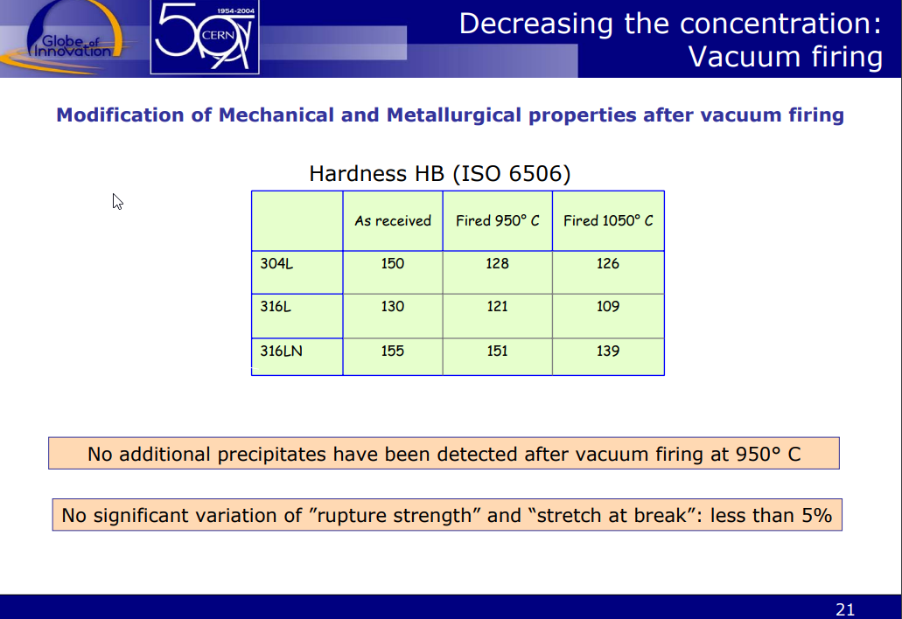
Summary (mechanical)
316 LN ESR unlimited material?
Heat treatments of 316 LN (ESR) decrease, increase, produce or reduce…
  Hardness
  Permittivity
  Grain structure
  Carbides
  Nitrides
  Hydrogen
  …therefore processes like welding,branzing and stress relief heat treatments require special attention
From Paolo Chigiatto (CERN) https://cas.web.cern.ch/sites/cas.web.cern.ch/files/lectures/platjadaro-2006/chiggiato-2.pdf)

Slide 25
Summary (Outgassing)
316 LN ESR unlimited material?
At low temperatures (<300 ° C) almost no outgassing because the thermal energy is too low
Between 500 ° C and 900 ° C formation of 𝑀₂₃ 𝐶₆ and
  possibly σ-phase intergranular corrosion
  and grain disintegration
Crystal recovery always takes place
Over 900 ° C complete crystal recovery including grain growth
A vacuum annealing treatment, which leads to a low outgassing rate with constant hardness, appears to be physically impossible.
Results are taken out of a work presentation: Ulrich Pototschnig (Monatanuni Leoben , Austria)

Slide 26
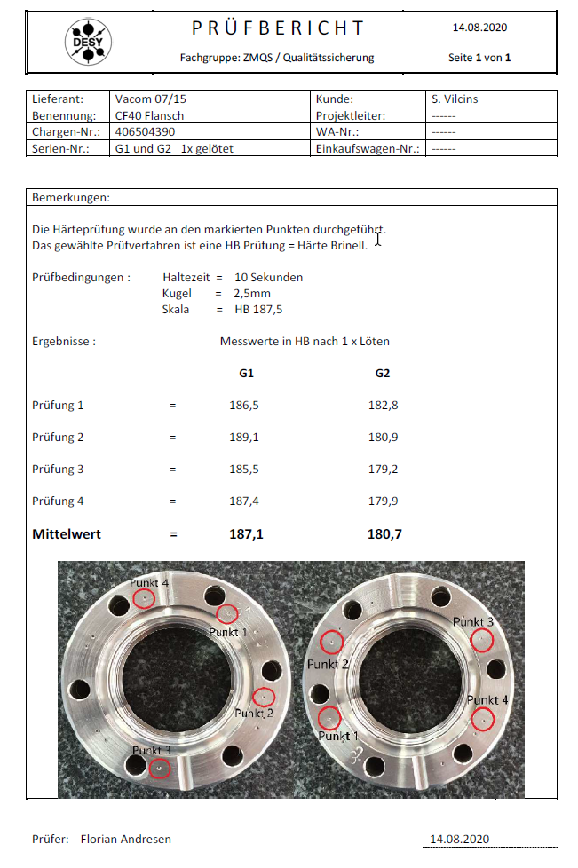
Summary
316 LN ESR unlimited material?
Abnormalities:
We received ConFlat flanges that were not forged 2D, which showed that the hardness did not collapse as much after a heat process
Why: Has to be investigated…one possibility, the “cold” reshaping (rolling) process causes a deformation (crystal grid structure) that is more temperature stable …

Slide 27
Quick outlook

Slide 28
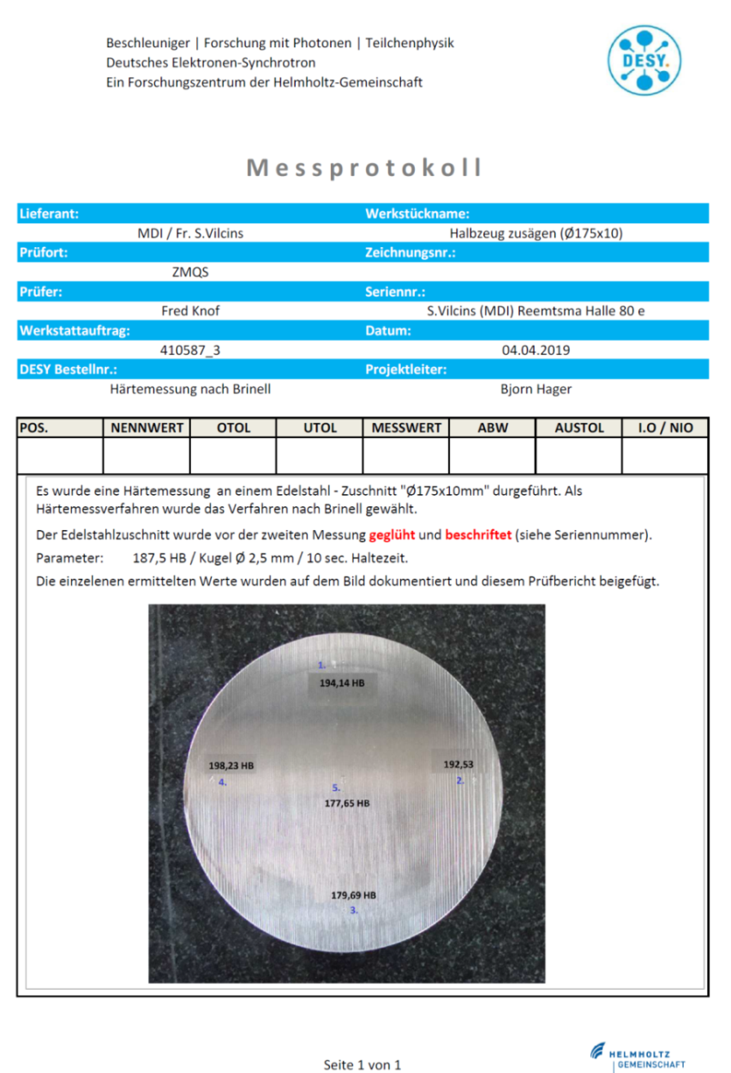
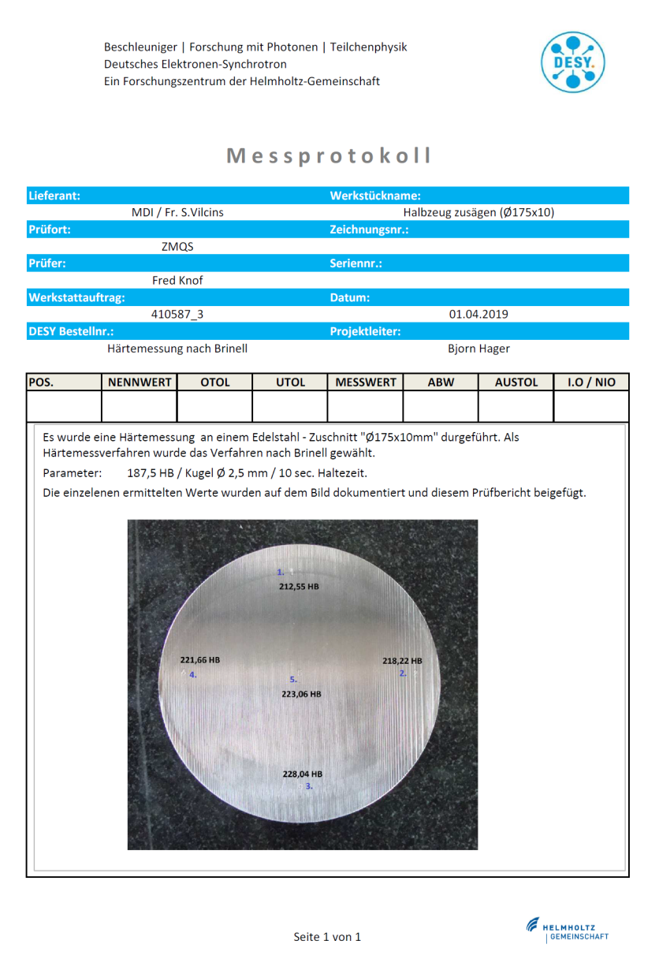
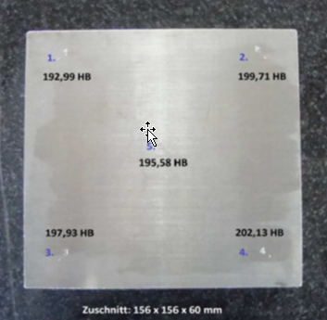
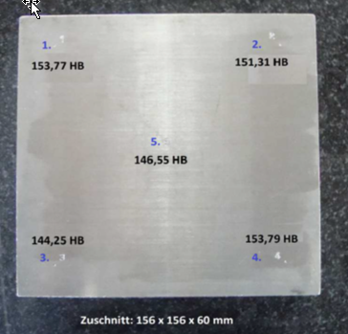
Alloy 50, a new material for high temperature application
316 LN ESR unlimited material?
316 LN ESR, 3D forged
Alloy 50, (XM 19, 1.3964)

Slide 29
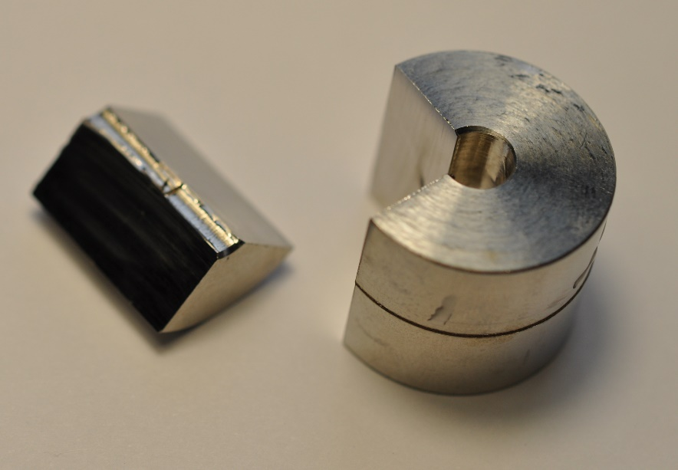
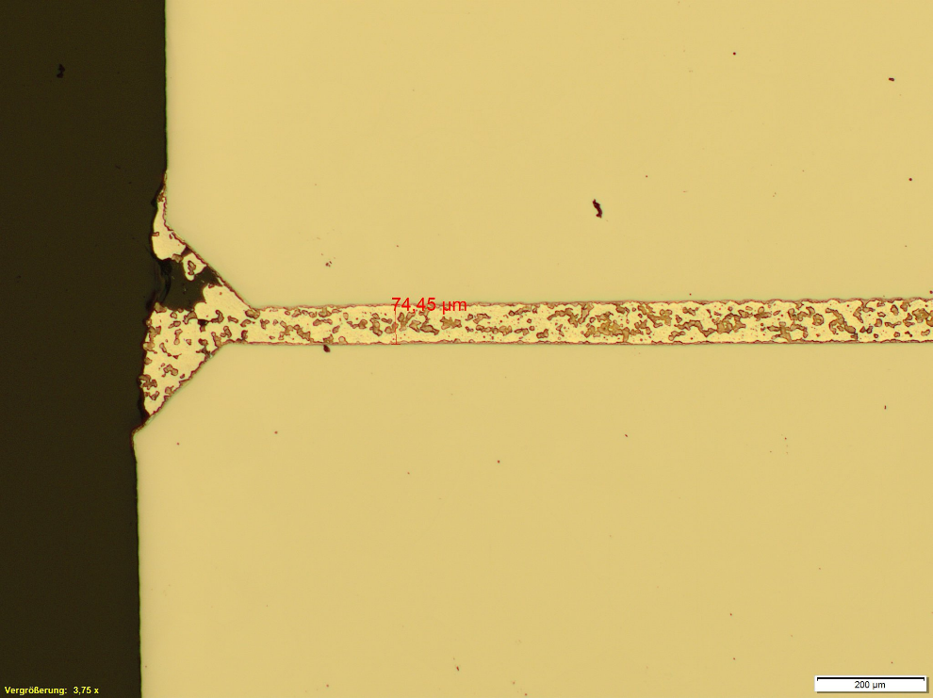
Alloy 50, a new material for high temperature application
316 LN ESR unlimited material?
Werkstoff-Nr. | Norm | Bezeichnung | C | Si | Mn | P | S | N | Cr | Ni | Mo | Nb | Ti | Al | B | Rp0,2 | Rp1,0 | Rm | A | KV | Permeabilität | Bemerkungen
 |  |  | % min | % min | % min | % min | % min | % | % | % | % | % min | % | max % | % | Mpa min | Mpa min | MPa | % min | J min | µr typische Werte
1.3964 | SEW 390 | X2CrNiMnMoNNb21-16-5-3 | 0,030 | 1,00 | 4,0 to 6,0 | 0,025 | 0,010 | 0,20 to 0,35 | 20,0 to 21,5 | 15,0 to 17,0 | 3,0 to 3,5 | 0,25 | - | - | - | 365 | - | 700 to 950 | 30 | 85 | 1,004
AISI XM 19, “Alloy 50” or (1.3964)
Higher hardness limits, up to 230 HB, because of very high Nitrogen level (+)
Very low permittivity (+)
Resistive against stress corrosion cracking and intermetallic corrosion (+)
Weldability: good (+)
Machinability: average (-)
Brazeability: good (+) (with Saxonia 6488 B-Ag64CuInMnNi @ 730/780°) lower temperature as 316 LN with no active layers (Nickel…)
UHV compatible (+)
Courtesy by Alexey Ermakov, DESY

Slide 30

Alloy 50, a new material for high temperature application
316 LN ESR unlimited material?
A 316 LN is trimmed to the limits of technical and physical feasibility -after heat treatment you will have a complete different material with change of properties-
Another way can be a “new” materials, such Alloy 50 XM 19 (1.3964), not a cheap material but has a lot of better material properties and so much more advantages for higher treatment applications…

Slide 31
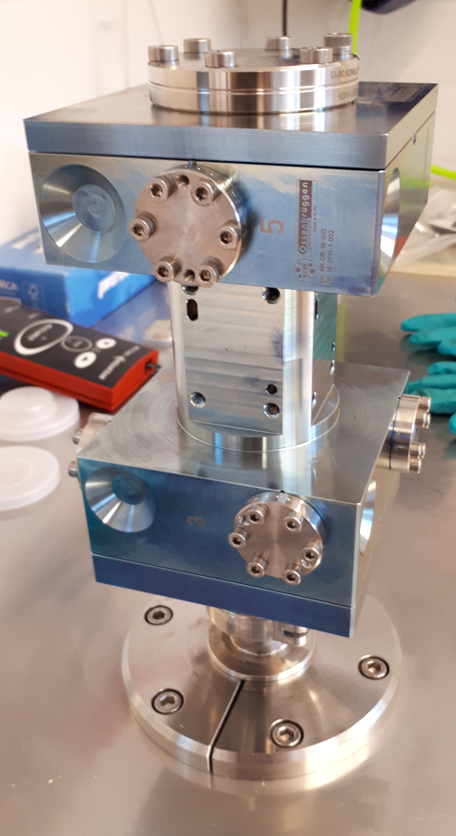
First results
316 LN ESR unlimited material?
Same price range as 316 LN
Precise machining was possible (accuracy in a few µm…)
Very good RF properties
RGA was good
And leak tight to 10 ⁻¹⁰ mbar l/s
Excellent hardness after brazing 220 HB
Courtesy by Dierk Liebertz, DESY
Courtesy by Fred Knof, DESY

Slide 32


Thanks a lot...any questions

Slide 33
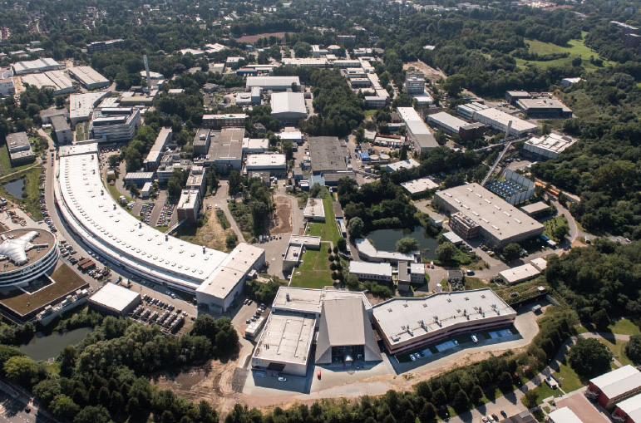
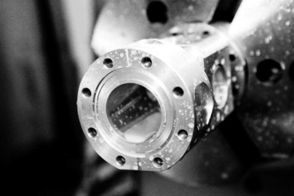
Silke Vilcins
MDI 3
silke.vilcins@desy.de
0049 40 8998 3902

Slide 34
Back up

Slide 35
Common materials for these Flanges
316 LN ESR unlimited material?
304 L (1.4307):
Element | Min | Max
C | - | 0.03
Mn |  | 2
Ni | 8 | 10.5
Cr | 17.5 | 19.5
Mo | - | -
S | - | 0.015
Si | - | 1
P | - | 0.045
N | - | 0.1
Properties | Metric
Tensile strength | 485 MPa
Yield strength | 200 MPa
Elongation at break (in 50 mm) | 40%
Hardness, Brinell | 201
Hardness, Rockwell B | 92

Slide 36
Common materials for these Flanges
316 LN ESR unlimited material?
304 LN (1.4311):
Element | Min | Max
C | - | 0.03
Mn |  | 2
Ni | 8 | 12
Cr | 18 | 20
Mo | - | -
S | - | 0.03
Si | - | 1
P | - | 0.045
N | 0.1 | 0.16
Properties | Metric
Tensile strength | 515 MPa
Yield strength | 205 MPa
Elongation at break (in 50 mm) | 40%
Hardness, Brinell | 217
Hardness, Rockwell B | 95

Slide 37
Common materials for these Flanges
Element | Min | Max
C | - | 0.03
Mn | - | 2
Ni | 11 | 14
Cr | 16.5 | 18.5
Mo | 2.5 | 3
S | - | 0.03
Si | - | 0.75
P | - | 0.04
N | 0.12 | 0.22
316 LN ESR unlimited material?
316 LN ESR for UHV applications has to be…
  Have adequate hardness
  Less permeability
  Suitable for high temperature brazing
  Low outgassing rate
  Weldable
  Good machinable
  Less non metallic inclusions
  Reliability under cryogenic temperature
  Low permeation
  homogeneous
Properties | Metric
Tensile strength | 580 MPa
Yield strength | 280 MPa
Elongation at break (in 50 mm) | 40%
Hardness, Brinell | 250
Hardness, Rockwell B | 90

Slide 38
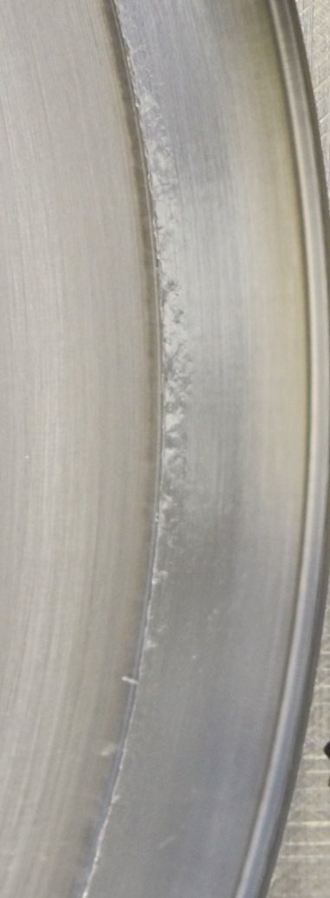
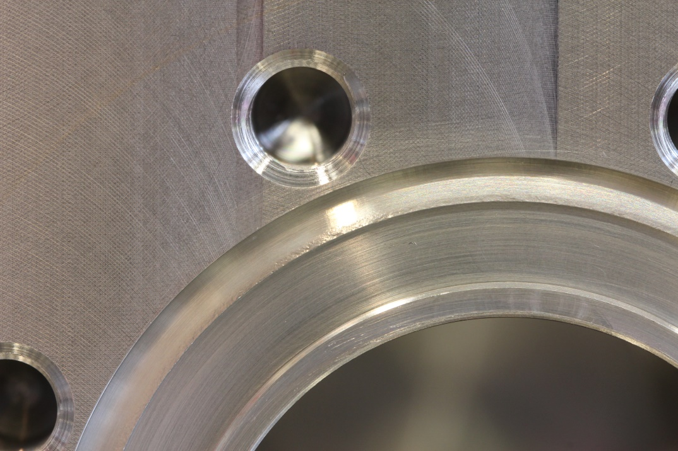
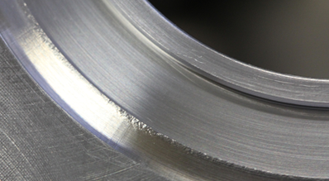
Pictures of damaged parts
316 LN ESR unlimited material?

Slide 39
Summary
316 LN ESR unlimited material?
Options I: Change to a lower outgassing temperature of 300°C
More extensive study at 300°C with reduced annealing time
Sufficient hardness possibly possible
Does not solve welding/brazing problems
Options II: Alternative material production process
Stainless steel should be produced by VAR ("vacuum arc remelting")
Possibility of avoiding all annealing treatments
H content is significantly reduced, but there is no information on outgassing rates
Expensive material and not easy to buy
Results are taken out of a work presentation: Ulrich Pototschnig (Monatanuni Leoben , Austria)

Slide 40
Summary
316 LN ESR unlimited material?
Option III: Questioning the requirements
Requirements may be unnecessarily strict
More practice-oriented requirements, where unannealed components may be installed to a limited extent
No technical progress, has to be defined
Option IV: Using of 1.3964 (Alloy 50)
Supposedly has a basic hardness of mote then 180-190 HB after heat treatments
Few trials are sufficient, no process changes necessary
Brazing at lower temperature possible
No lot of publication available for application as vacuum and accelerator steel
Welding test not finished now
Results are taken out of a work presentation: Ulrich Pototschnig (Monatanuni Leoben , Austria)

Slide 41
Back up Alloy 50

Slide 42
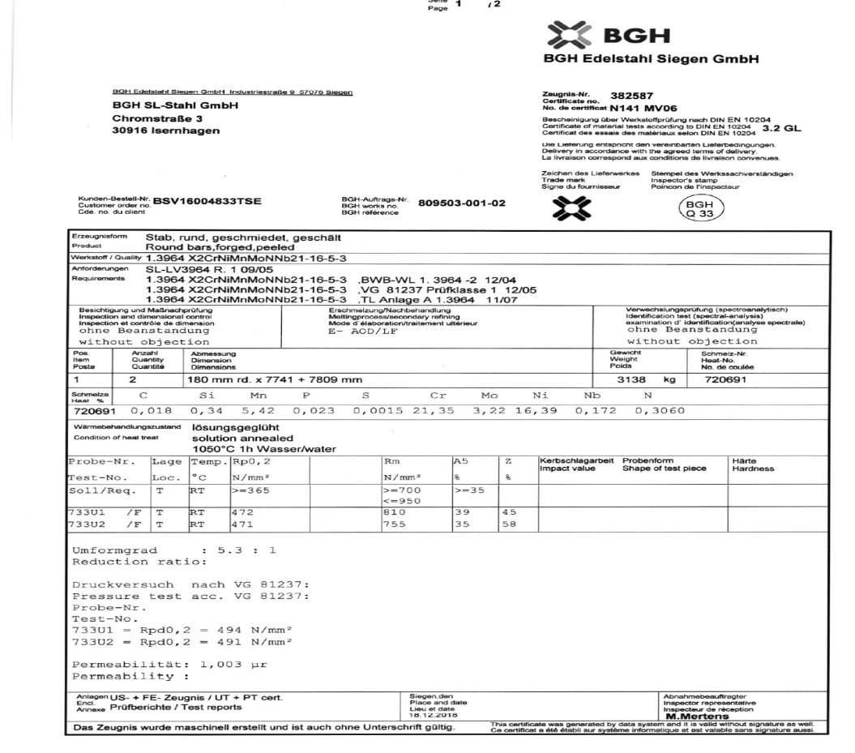
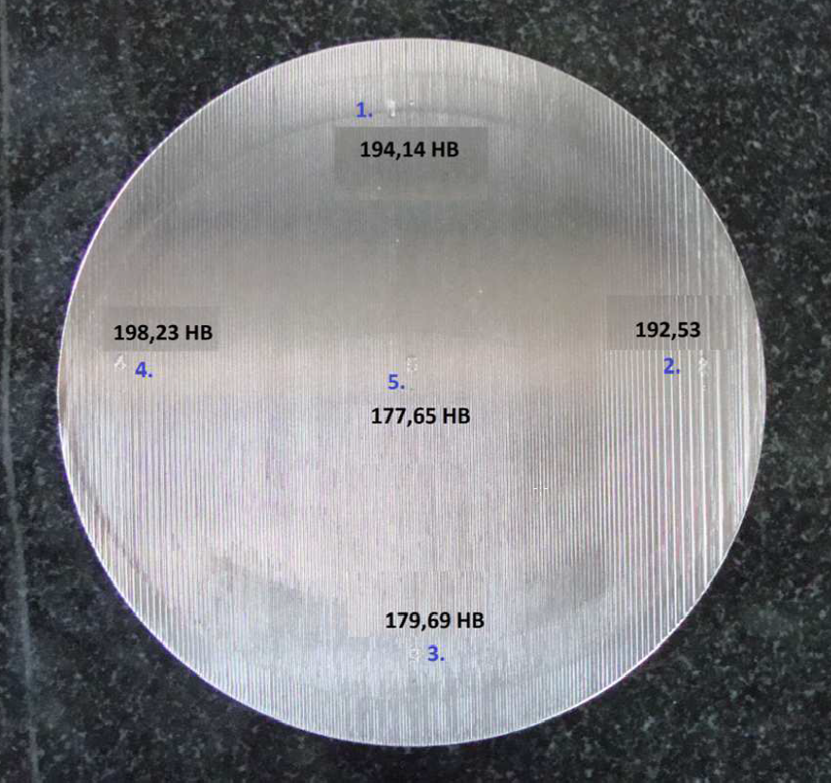
New materials for high temperature application
316 LN ESR unlimited material?
Alloy 50, (XM 19)

