Slide 1





Version: 03.06.21_V0
Coatings for UHV Instrument Stray Light Suppression
Presented by: Ben Jensen - CTO

Slide 2
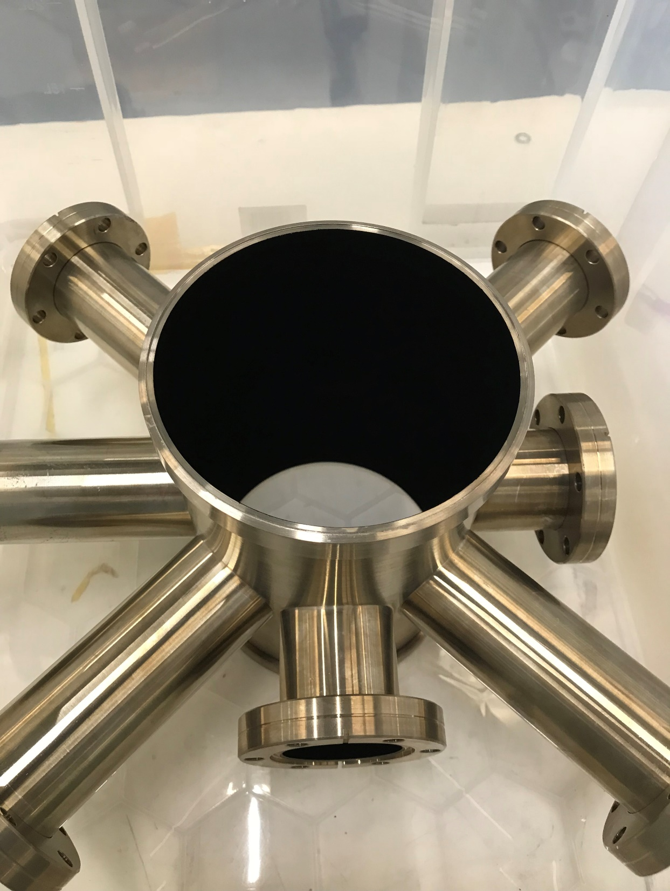
Desirable Properties for UHV Coatings Used in Stray Light Control
High absorbance at specific instrument wavelength
Good TIS and BRDF to simplify baffle design
Low outgassing at chamber operational temperatures
Compatible with UHV bakeout
No degradation from long term UV exposure
Tolerant to gamma and proton radiation exposure without breakdown or particulate generation
Thermally stable
Electrically conductive
UHV Instrument module coated with S-VIS
Notes:
2

Slide 3
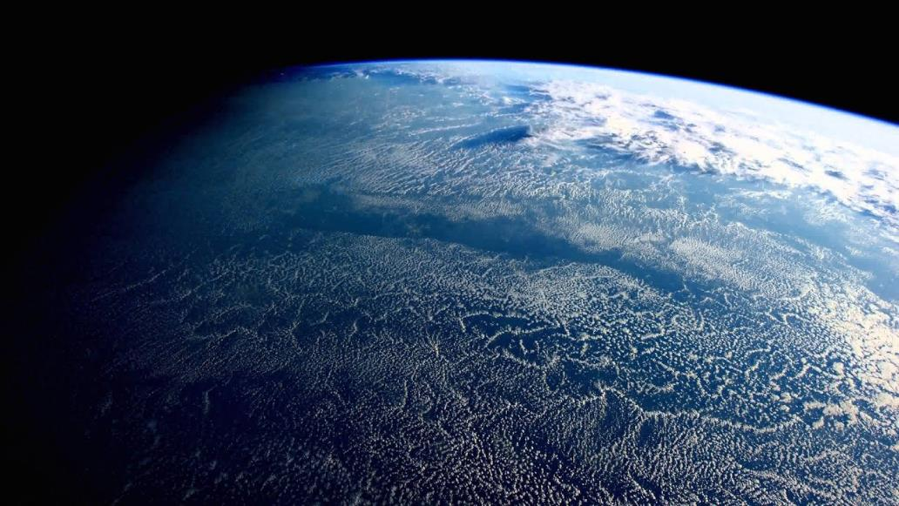
Vantablack UHV compatible coatings
S-VIS: Space and terrestrial instruments
S-IR: Space and terrestrial calibration systems
CX2: Space and terrestrial instruments
Tested by CERN
Not tested by CERN
All the above coatings have accumulated well over a billion miles in low earth orbit on spacecraft external positions

Slide 4
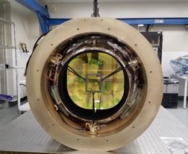
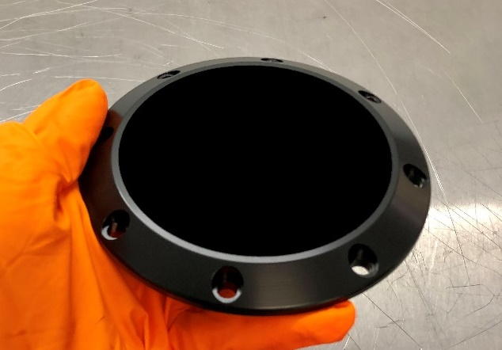
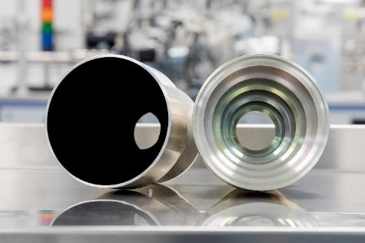
Coatings Discussed Today
Vantablack S-VIS - Requires Vacuum post processing
TRL 9 (8 years total in low earth orbit on multiple terrestrial applications)
Used in terrestrial instruments to improve SL and SN ratio
Qualified from 1k to 573k
Supplied as a bonded or unbonded material
General Information for S-VIS
Spray application process with vacuum plasma post processing
Exceptional performance from UV-THz (>500um)
Exceptional THR, TIS and BRDF
Electrically conductive: 110-130 Ohm/sq
Used for instruments, baffles, cold shields and optics
Maximum part size limited to 650mm x 450mm
Good on baffle knife edges and sharp transitions
Handling sensitivity means it should not be used on surfaces subject to direct contact or abrasion during assembly or use
Vantablack CX2 - (beta phase development coating)
Straight spray applied coating with no post processing
Subaru PFS Spectrograph 77k lens assy
HV laser beam power dump
Optical baffle system: coated vs. uncoated

Slide 5
Vantablack S-VIS: Total Hemispherical Reflectance
Reflectivity: performs across a very wide spectral range >600µm
Notes:
5

Slide 6
Vantablack S-VIS BRDF & TIS Chart: Visible Spectrum
BRDF: retains performance from all viewing angles
Wavelength: 400nm – 800nm Optowhite source
Incident Zenith Angle: 50.0
Polarizers: Yes – Angle 0°
Raw data is available on request

Slide 7
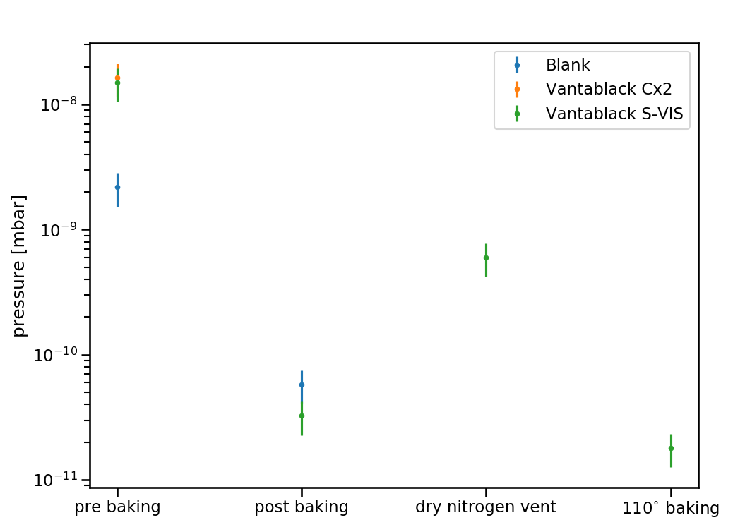
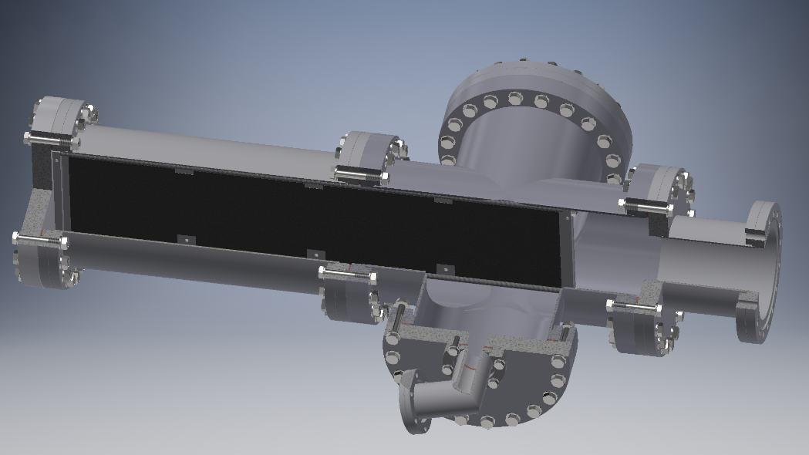
Vacuum Pumping: Ultimate Pressure After Bakeout
Sample Size: 560mm x 130mm x 3mm
One sample CX2
One sample Bonded S-VIS
Baking @ ~210°C,
~2 weeks
Baking @ ~120°C,
~24 hours
UHV Test chamber
Pumping/baking profile
Data courtesy of CERN ATTRACT Program
Notes:
7

Slide 8
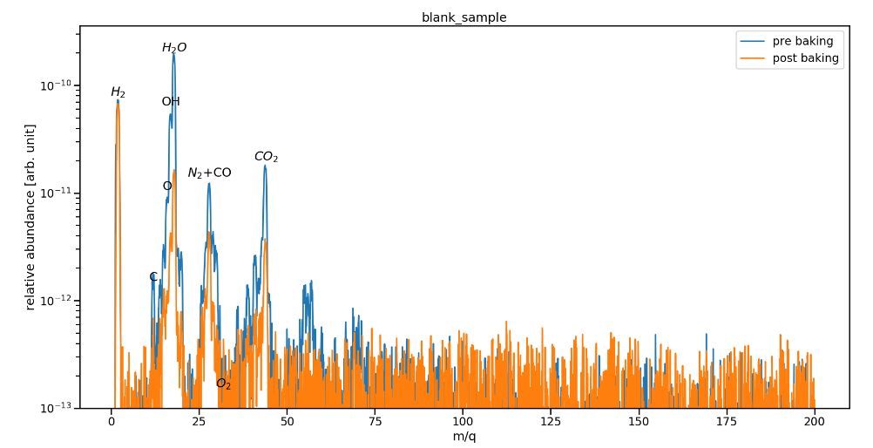
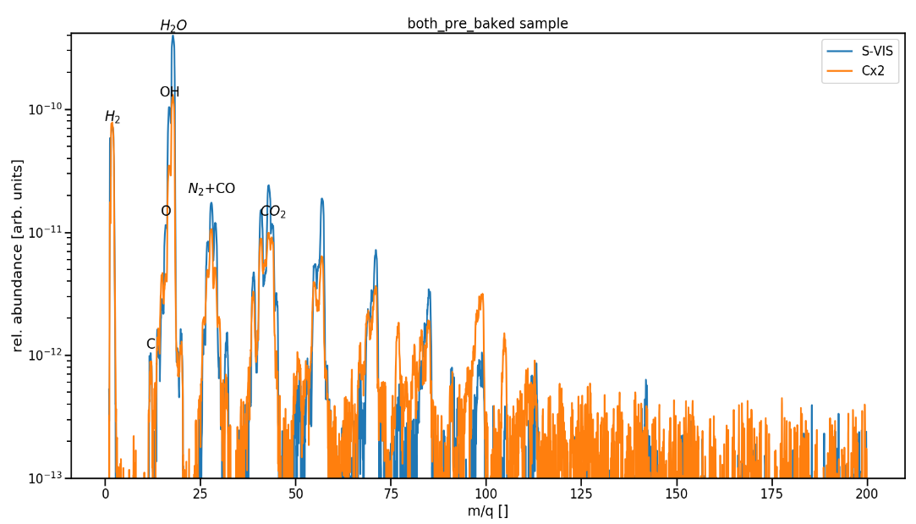
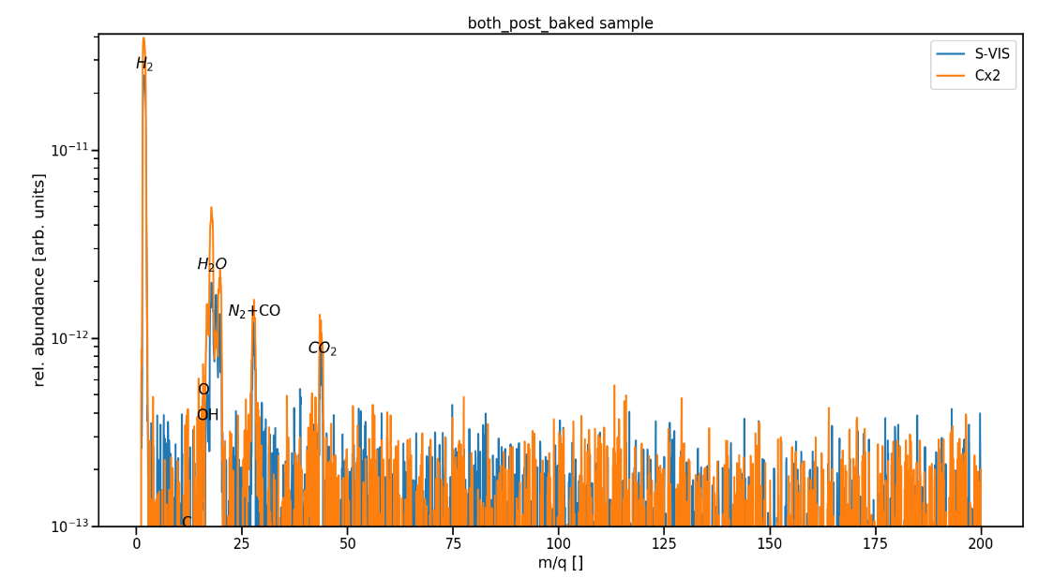
Vacuum Cleanliness – RGA Data Pre and Post Bakeout
Data courtesy of CERN ATTRACT Program
Notes:
8

Slide 9
Vantablack S-VIS/CX2 TVAC
Multiple¹ S-VIS and CX2 substrates have been TVAC cycle processed under a variety of conditions. The below chart is a typical cycle profile.
Maximum temperature limit | Minimum temperature limit | Number of cycles | Dwell time | Temperature ramp rate
+100°C | -100°C | 20 | 2 hours | 10°C min
Results:
No change in optical properties (220nm – 14000nm)
No particulates collected on capture plates
No structural change detected in the coating
No condensed material collected on the QCM
¹Measurements by multiple third parties as part of flight qualification testing
Notes:
9

Slide 10

Vantablack S-VIS: (VUV) Vacuum UV Exposure
Bands denote measurement instrument
artefacts from spectrometer light pipe
Wavelength range: 115nm – 700nm
Sources: Deuterium and Xenon
Acceleration Factor: 10
Substrate Temperature: 180°C
No change in reflectance after 7000 ESH Exposure
Measurement by TS Space Systems (ESA/NASA Audited equipment)

Slide 11
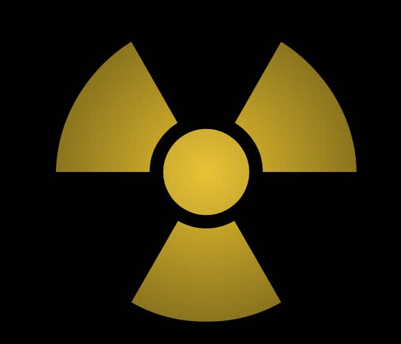
Vantablack S-VIS: Radiation Resistance
6061-T6 Aluminium with MIL-DTL-5541, Type I, Class III passivation layer below bonded S-IR
6061-T6 Aluminium with clear anodize finish below bonded S-VIS
Coated substrates exposed to a dose of or over 2Mrad proton + 2Mrad gamma radiation
Tests repeated on multiple substrates
Results:
Optical properties unchanged
No particulates generated
No damp heat degradation of the coating after the following test:
  • T = 85 deg. C.
  • R.H. = 95% humidity.
  • Time = 20 days continuous.
¹Measurement by undisclosed third party as part of flight qualification test
²Measurement also completed on S-VIS by undisclosed US third party as part of flight qualification test
Notes:
11

Slide 12
Vantablack S-VIS: Atmospheric Thermal Soak
The coupon is heated to 200°C in air on a hot plate at 50% RH and held for 4 hours to test for delamination or a change in optical properties. The cycle is repeated 5 times and then the sample is re-measured.
Variation is within the uncertainty of the spectrometers

Slide 13
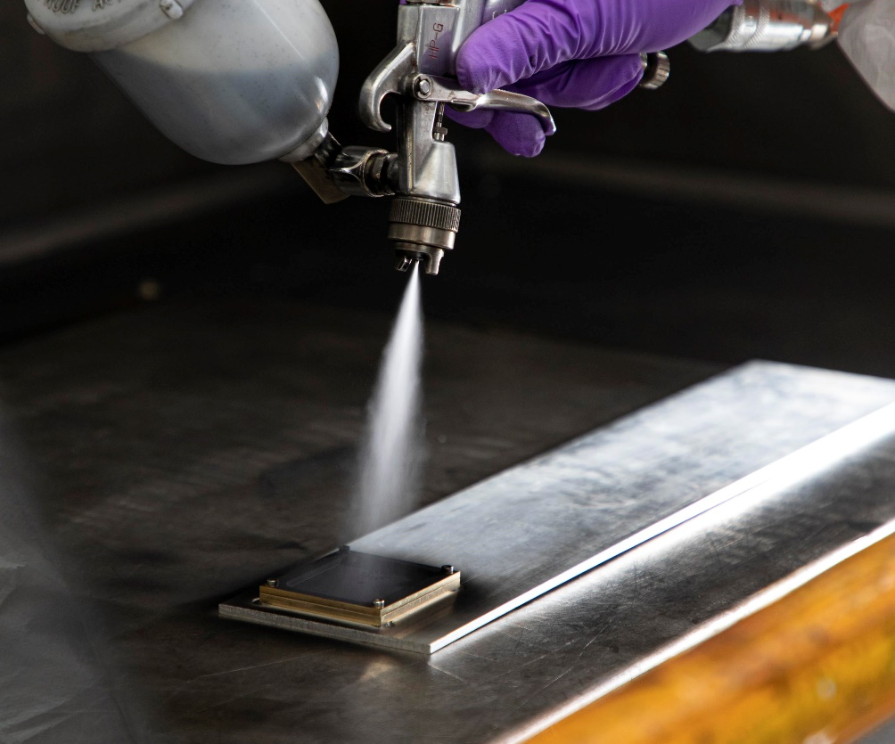
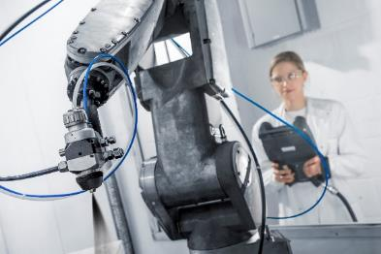
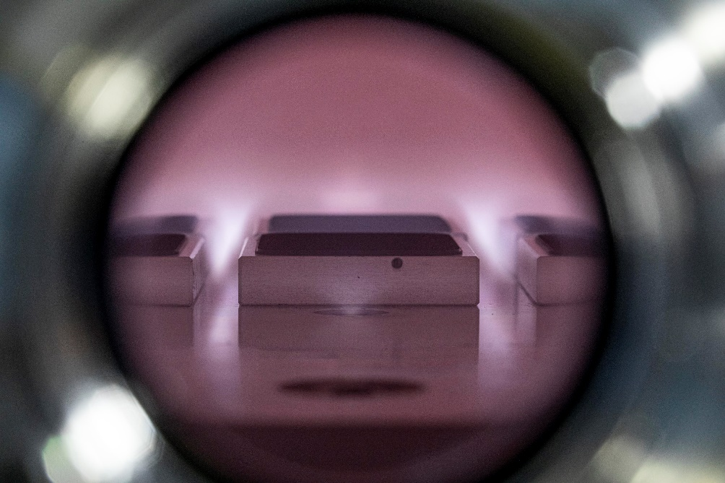
Application Process for S-VIS/CX2
Preparation
Tooling design & manufacture
Masking is done using hard tooling or silicon free tape
Spray deposition
Polyimide base layer (if used) and carbon nanotube films are deposited by spraying either by hand or robot (line of sight)
Masking is removed after spray deposition stages
Post-processing (activation)
Coatings are post-processed in SNS’ own reactors to create required optical cavities and also to make the finished coating super-hydrophobic
Reactor process steps take place under vacuum and up to 280℃
Vantablack CX2
Simple spray application process using conventional spray systems
Vacuum degassing 24hrs after spraying to make UHV compatible
Notes:
13

Slide 14
Design Considerations
Component Size & Form
Parts to be coated must fit within vacuum chamber envelope
Maximum 650mm(X) 450mm(Y) and 125/230mm(Z) – larger chamber possible/investment
Spray process is LoS – so ”shadow” areas cannot be coated – design for access/assemble
Tubes and holes
For open ended tubes <c150mm length we aim to limit L/D to 2.5max – please consult us
Blind tubes/cavities can be difficult due to fan gas turbulence
Knife edges
Excellent coating of knife edges is possible with the polyimide bonded version of S-VIS
Coating should not be terminated at the edge
Knife edge angle should be 30∘ or greater
Threads & Grooves
Functional threads should not be coated
Grooves can be coated – though high aspect ratio grooves can be difficult
Pooling or over-etching can occur
450-400
Max 230
650-400
RED AREAS IN SPRAY SHADOW
✗
✓
Min 30º
Notes:
14

Slide 15
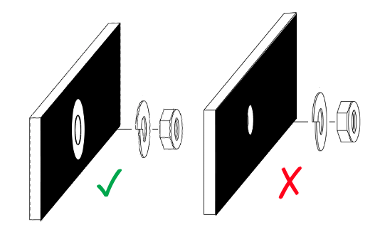
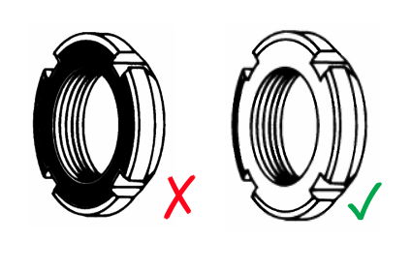
Design Considerations
Substrate Materials
A wide range of substrate materials can be coated
  Metals, ceramics and glasses – some engineering polymers
Vantablack does not provide corrosion protection but coating can be applied to Alodine/Surtech treated surfaces
Coating on anodised surfaces is OK, must be hot-water sealed
Gold surfaces to be Vantablack coated must have a nickel underlayer
Handling
As the Vantablack surface cannot be touched, consideration must be given to how parts will be handled and packed for shipping
Existing (or new) features to be designated as handling points
Ensure screwheads/washers do not impact coated areas
Any features for tool engagement should be clear of Vantablack coating
MISSE deployment (Image credit: NASA)
Notes:
15

Slide 16

Thank you for listening!
Q&A
MISSE deployment (Image credit: NASA)
Notes:
16

