Slide 1

EASy
(Easy Alignment System)
A new Approach to High-Precision 6-Axes-Positioning of Accelerator Parts
Ufuk Akkaya, Roland Platzer
06/23/2021

Slide 2
Content
EASy - Easy Alignment System
Working Principle and Advantages
  Overview
  Construction
  Drivetrain
Types and Sizes
EASy Projects at DESY
Characteristics and Comparison
Motor Control Unit: EASy-Move
  Overview
  EtherCAT Terminals
  Program Structure
  Integration in Control Systems
  User Interface
Outlook for the future

Slide 3
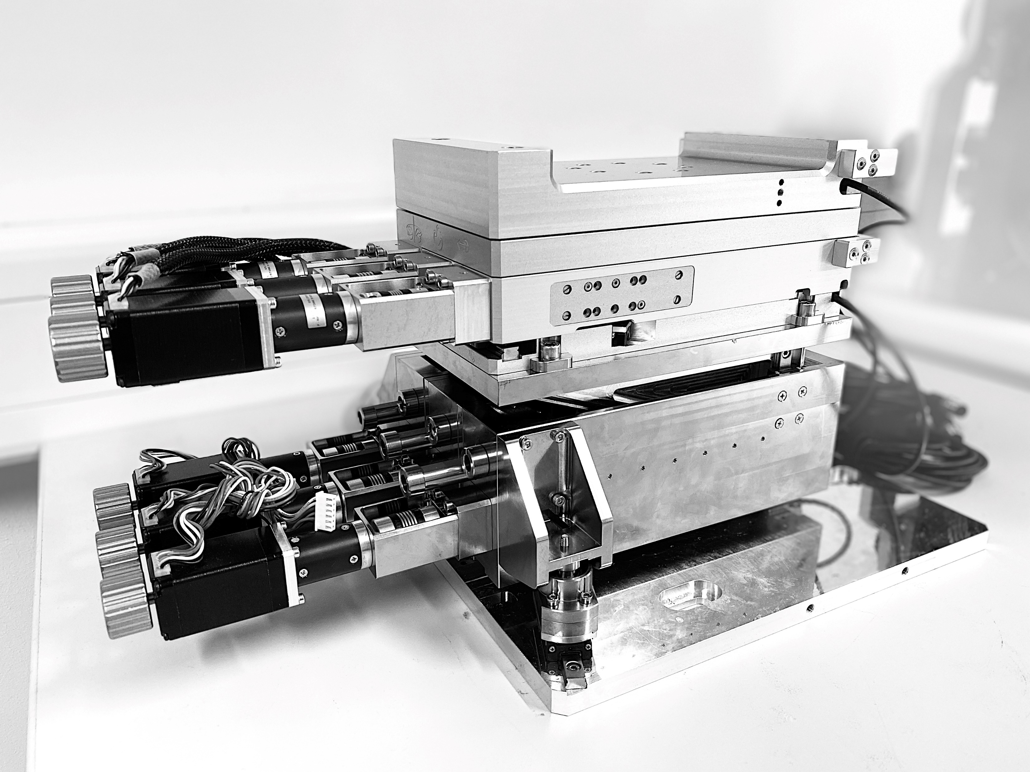

Working Principle and Advantages
Overview
A new positioning system was developed by the department of engineering and design at DESY to meet the needs of its users for the accelerators and experiments.
The new patented arrangement* has following advantages:
Easy accessibility
Well adjustable
High precision
High stiffness and high first eigenfrequencies
Compactness
Manual and motorized operation
Adjustable hard stops and limit switches
(and software limits for motorized models)
Direct and absolute measuring system
*by Ernst-Otto Saemann
Patent-Nr. 19169661.6-1013
in DE, FR, GB, CH, SE ,NL

Slide 4
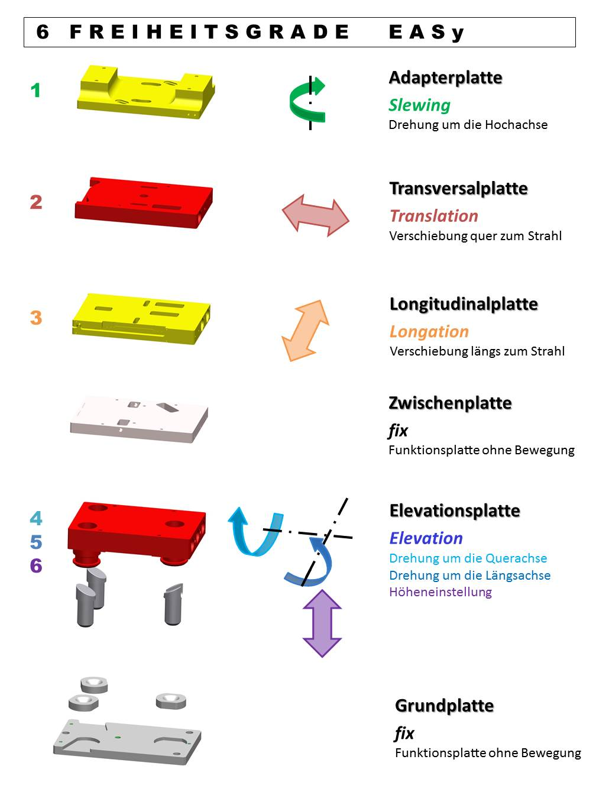
Construction
Working Principle and Advantages
6
The key characteristics of the EASy principle are:
Rotary Table
Three-Point support
One-sided actuation (manual or motorized)
(1.) and (2.) each realize up to six DoFs with plates you can individually select when configurating an EASy for your needs (Modularity)
Plates are moved via:
Dynamic friction
(for Basic and Advanced types)
  Simple low-cost solution
linear bearings and ball-screw-drives
(for Precision types)
  Zero-clearance and –backlash
  High precision
5
1.
4
3.
3
2
1
2.

Slide 5
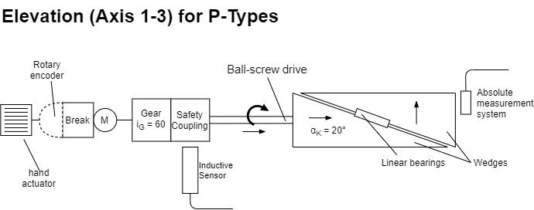
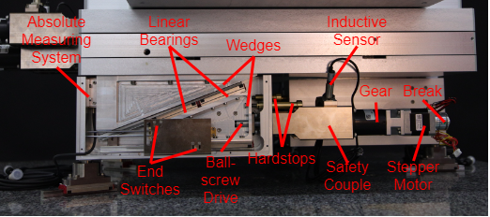
Drivetrain
Working Principle and Advantages

Slide 6
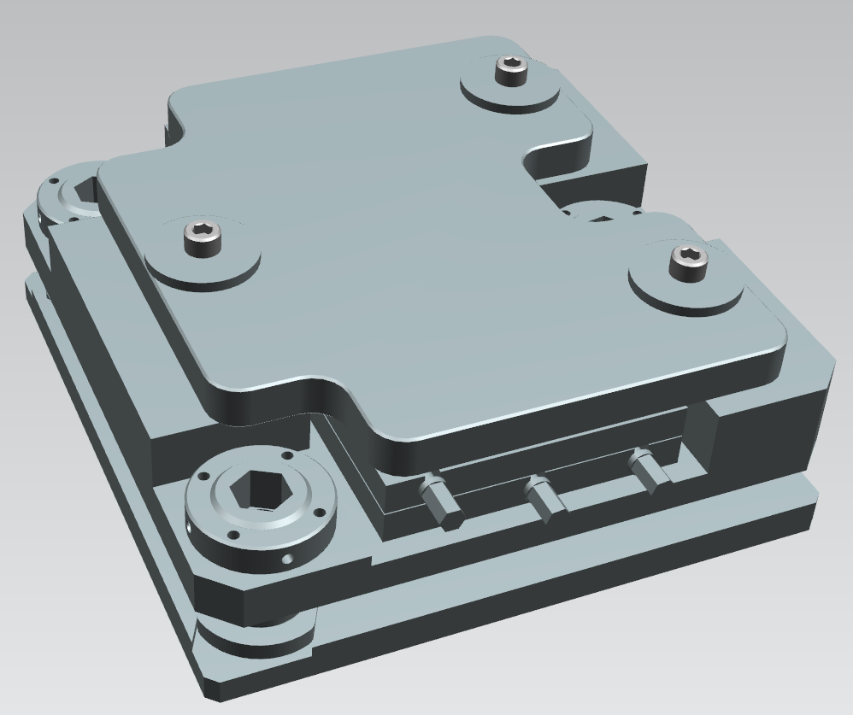
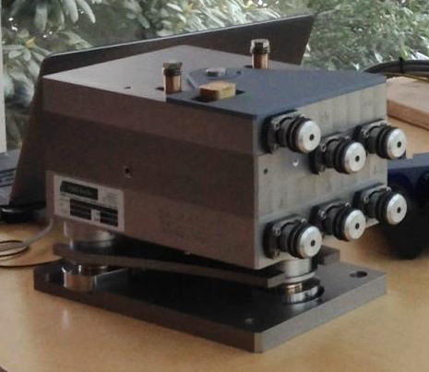
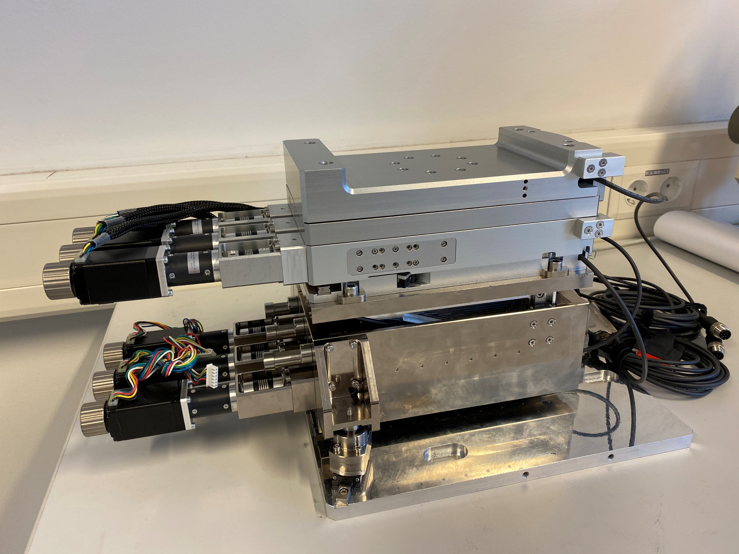
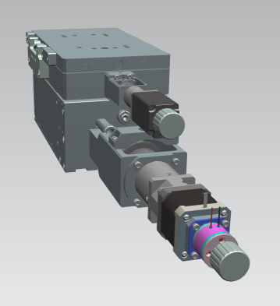
Types and Sizes
EASy - Easy Alignment System
The modular principle of EASy allows to have several applications in different price categories and grades as well as in the number of DoFs.
The EASy series consists of 4 types so far:
B … type Basic
Most simple positioning unit based on EASy principle.
A … type Advanced
Positioning unit with front handling. Good precision for a decent price
P … type Precision
Positioning unit with motorized front handling and high precision – optimized for periodic usage.
P-N … type „P-N“
High precision EASy, reduced to 2 axes for cost efficiency and compactness

Slide 7
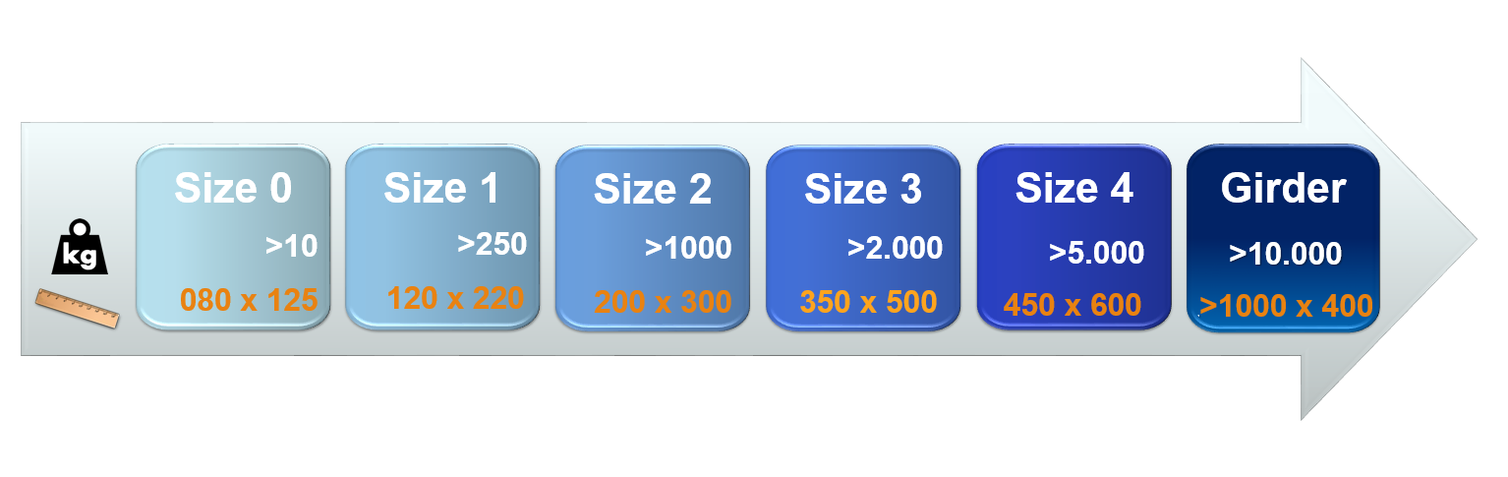
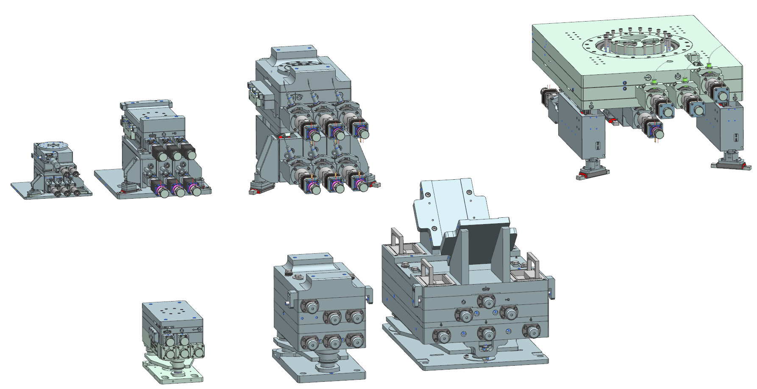
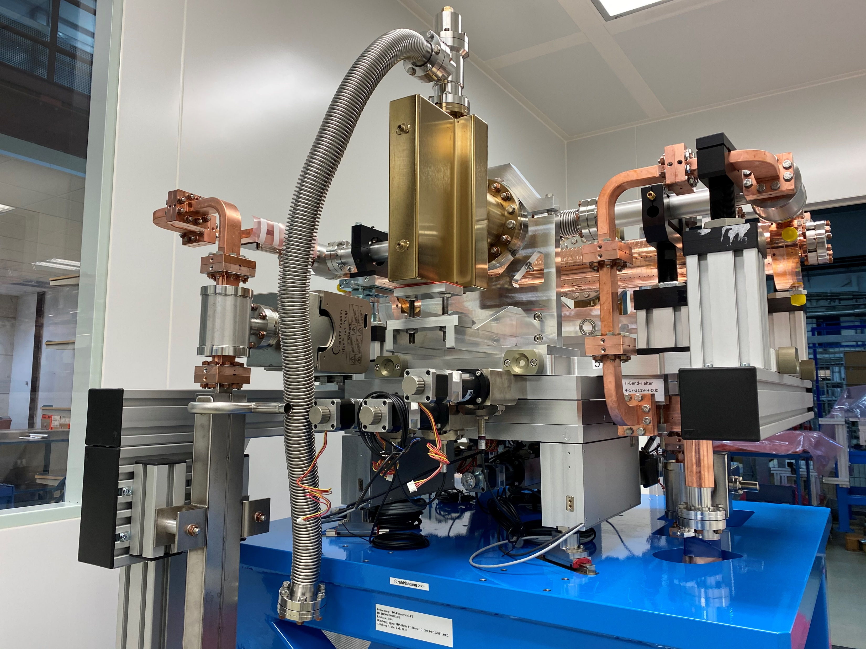
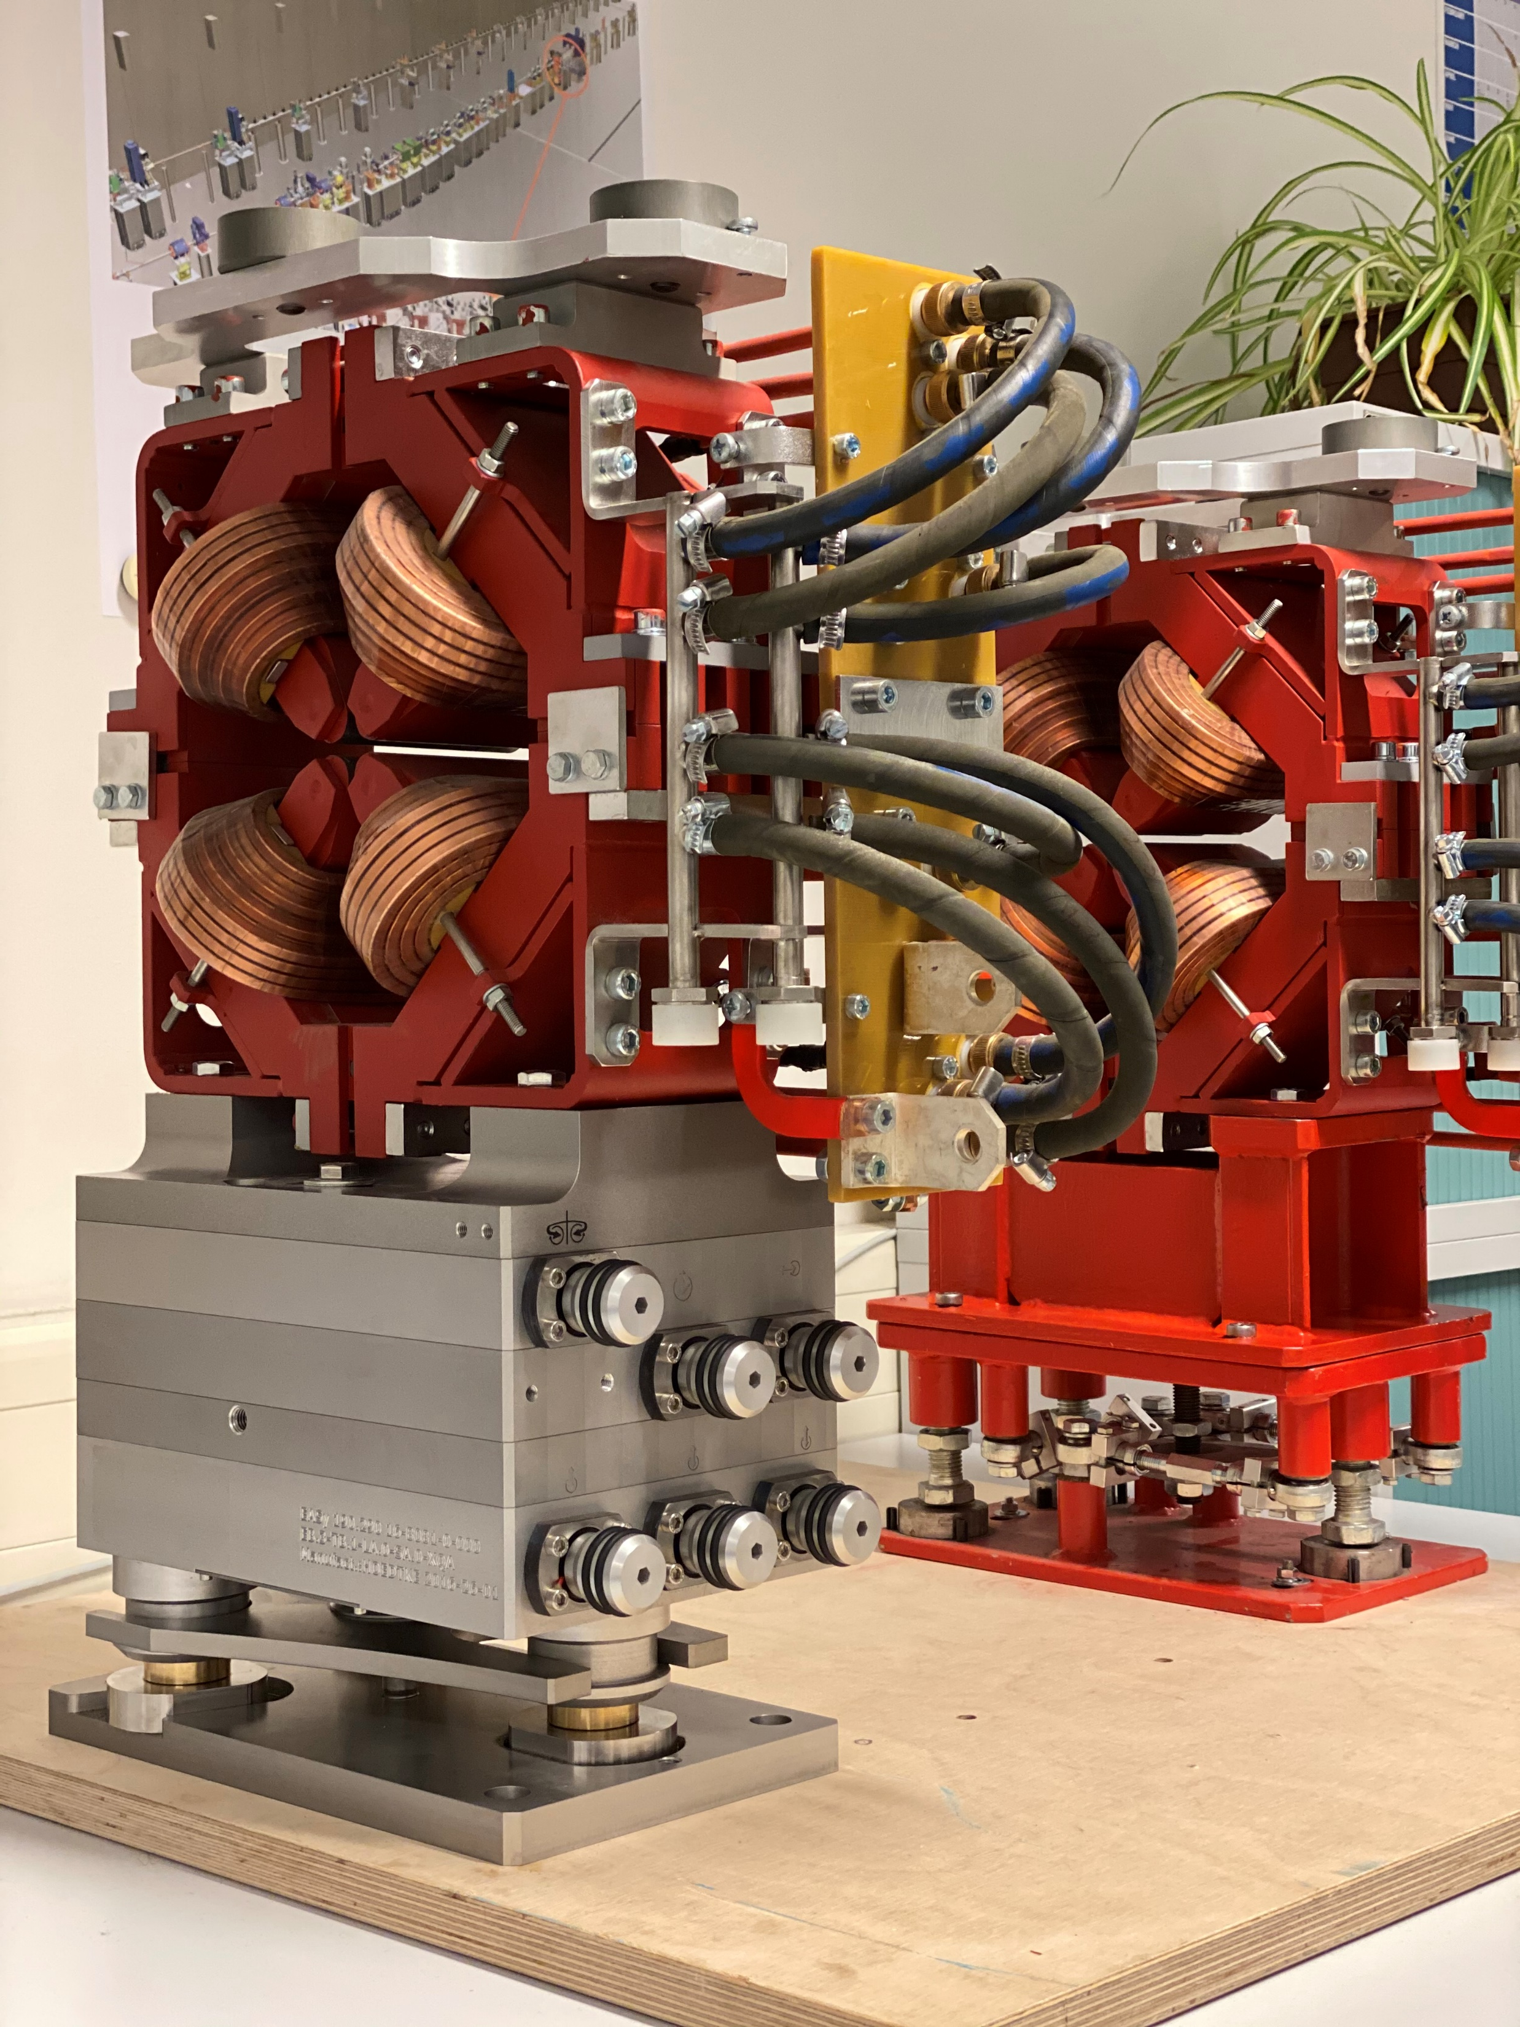
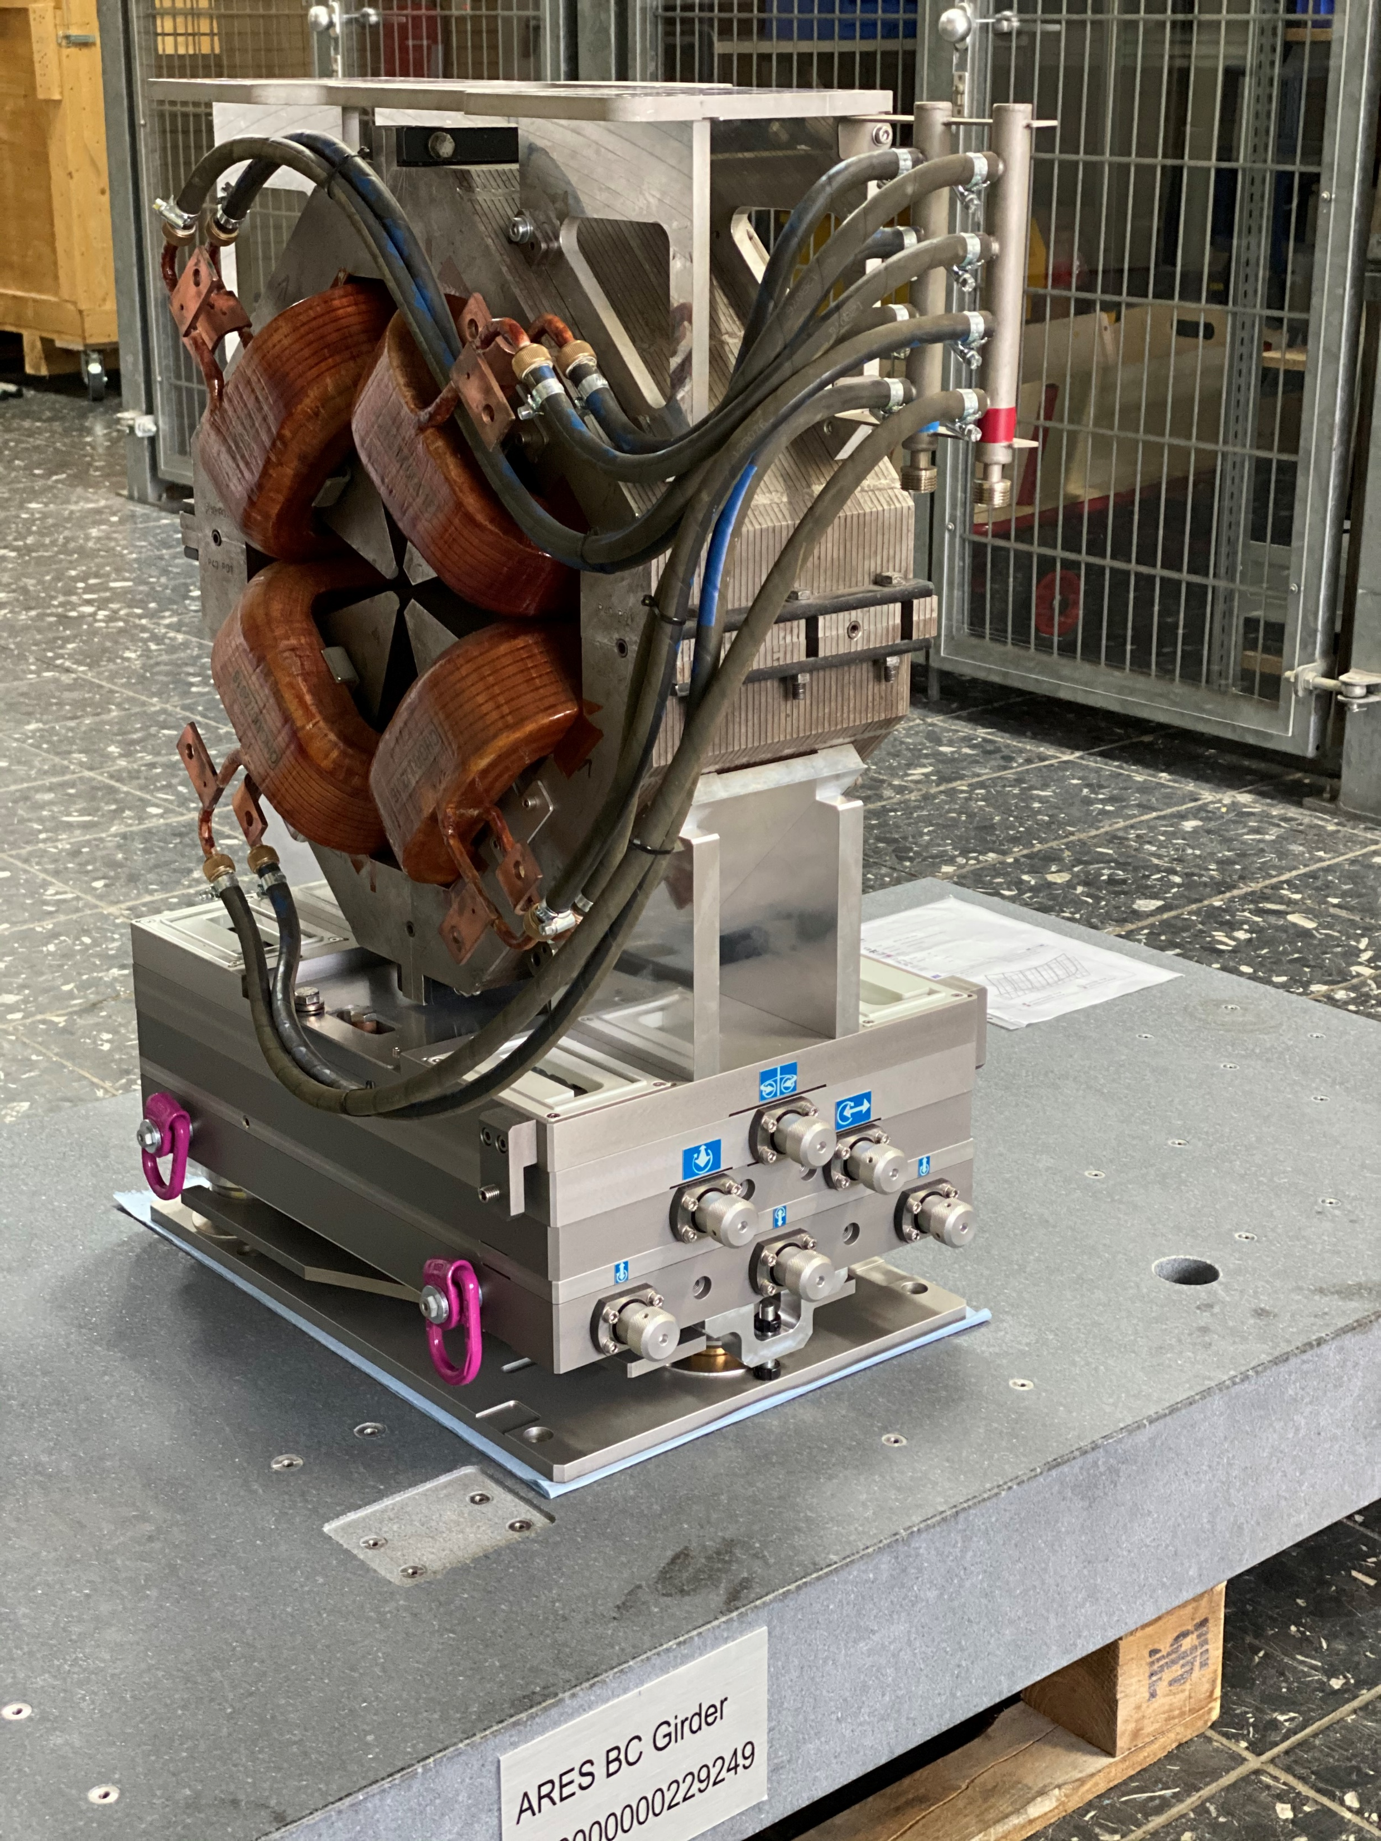
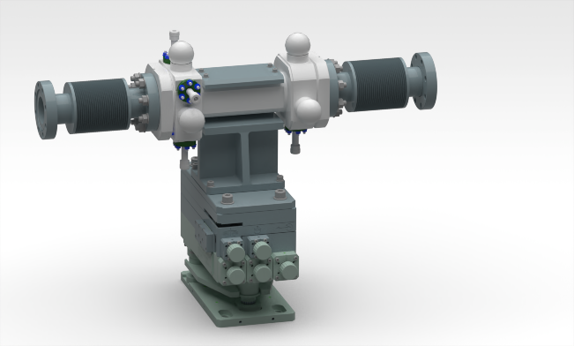
Types and Sizes
EASy - Easy Alignment System
Each EASy type is available in up to 6 sizes:
Different sizes
[carrying capacity in kg]
[footprint in mm]
EASy CAD-models
Examples of use
BPMs Magnets in different sizes Cavities

Slide 8
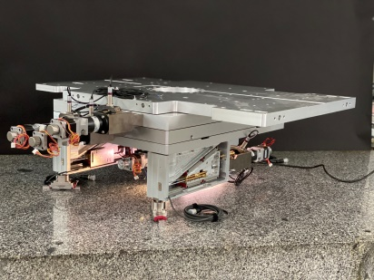
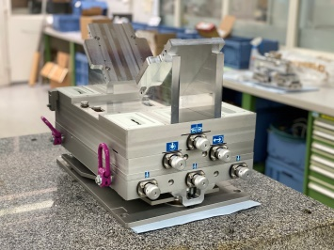
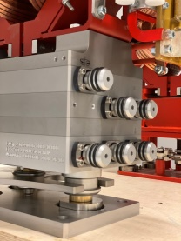
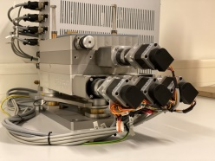
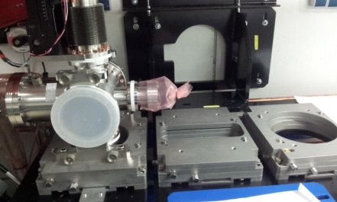
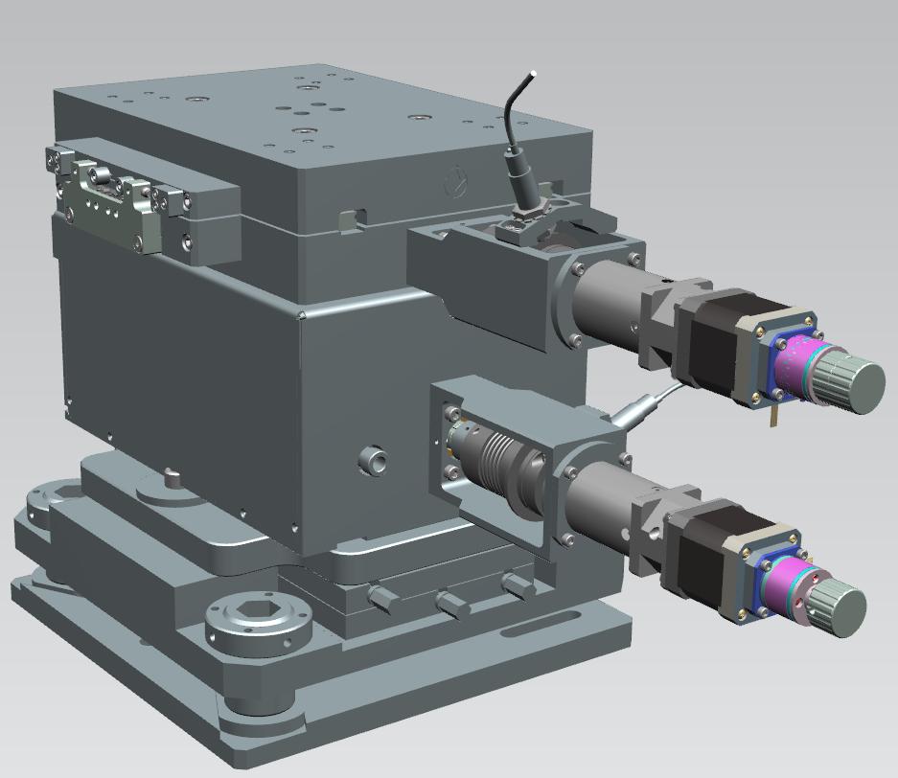
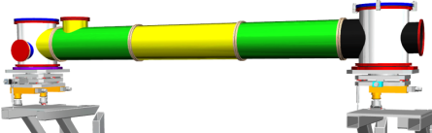
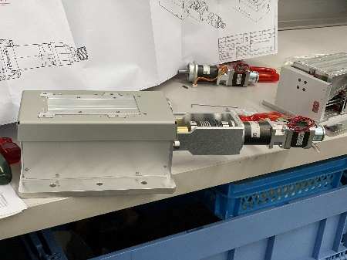
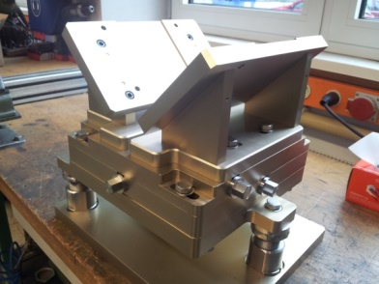
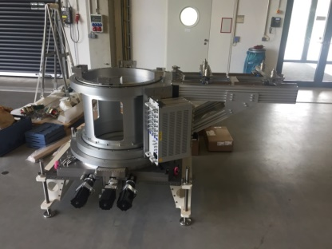
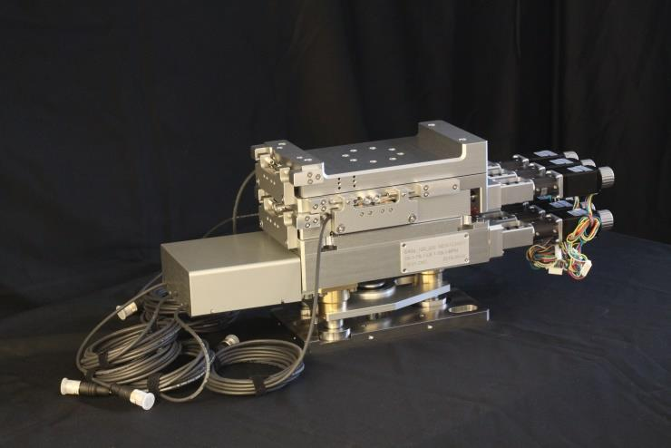

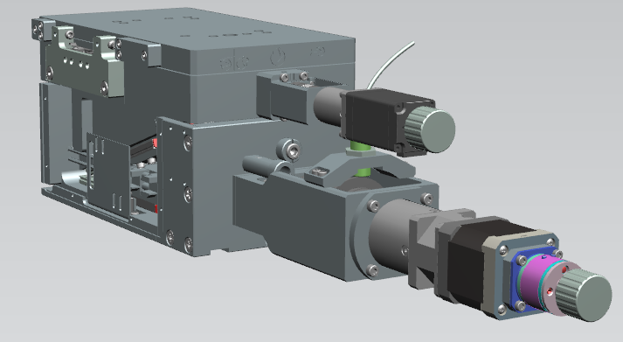
EASy Projects at DESY
EASy - Easy Alignment System
EASy A3
Prototypes for PETRA IV
EASy P4
FLASH, ARES
EASy A2
Prototype for s-FLASH
Rotary Table B3
LUX
EASy B2+P2-N
FLASH
Girder unit
Design for XFEL
2015
2016
2017
2018
2019
2020
2021
2022
EASy P1-N
ALPS
EASy P1-N
For CMS detectors
EASy B2
Prototype
Rotary Table A4
FLASH
EASy A1
Prototype for ARES
EASy P1
ARES
EASy P1-N
FLASH

Slide 9
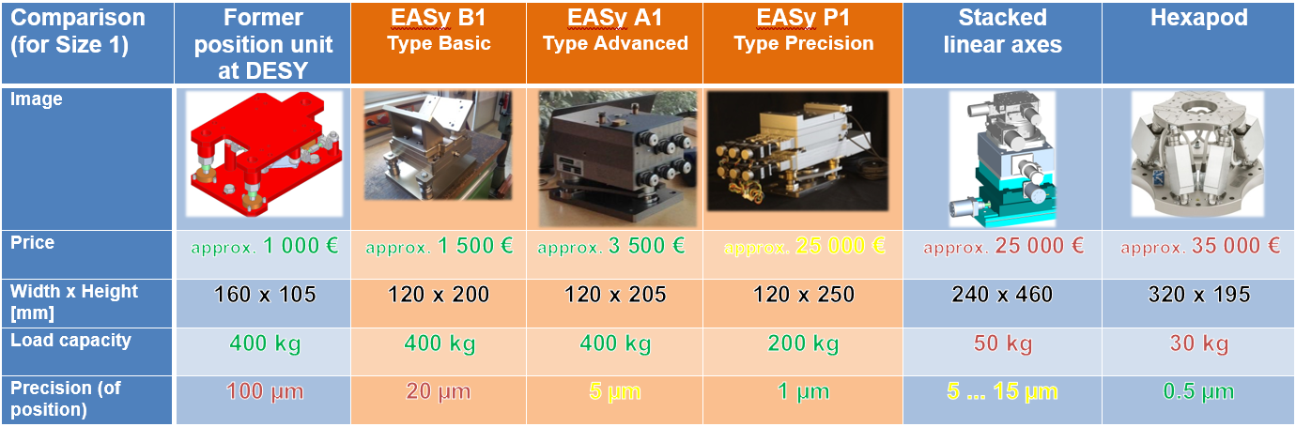
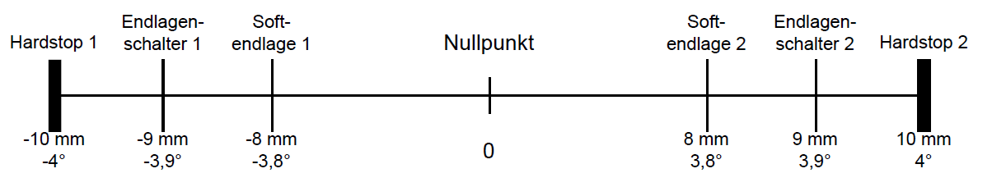
Characteristics and Comparison
EASy - Easy Alignment System
Hardstop -
End Switch -
Software Limit -
Software Limit +
End Switch +
Hardstop +

Slide 10
Characteristics and Comparison
EASy - Easy Alignment System

Slide 11
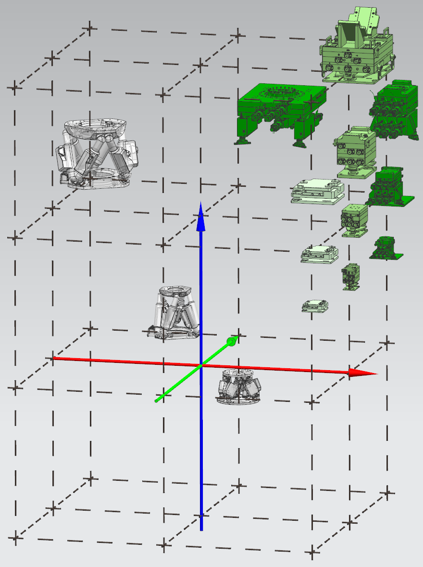
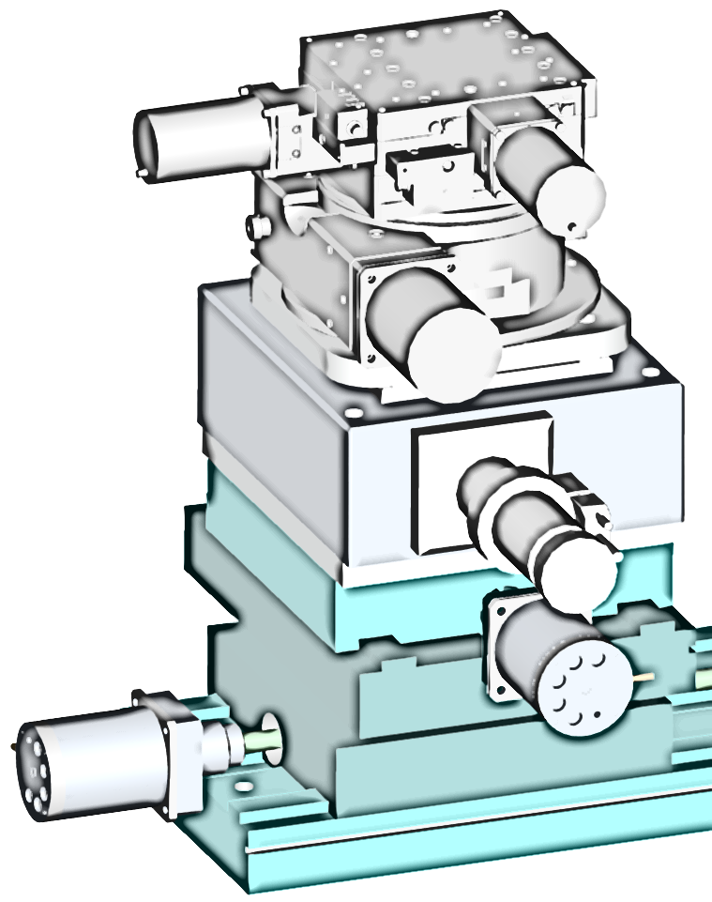
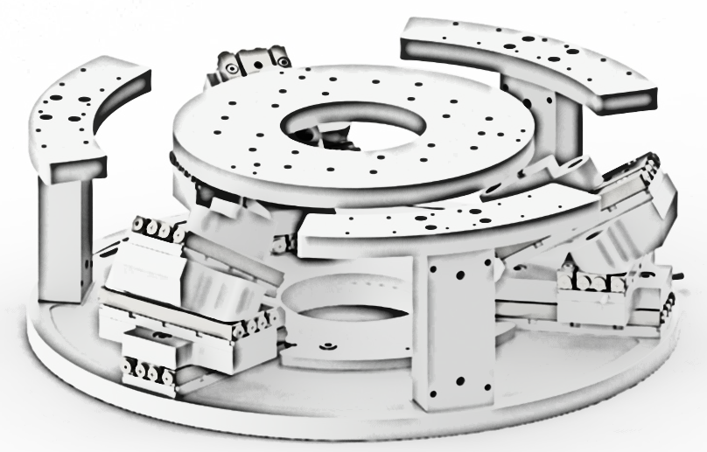
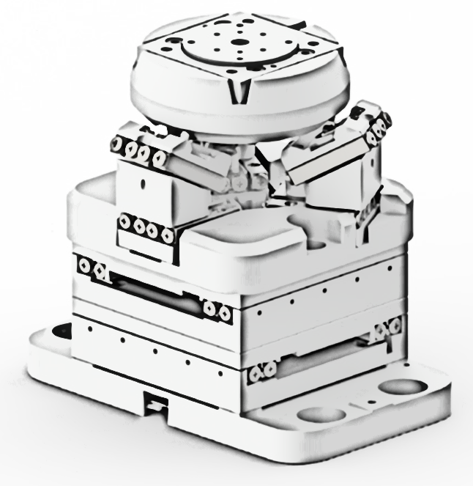
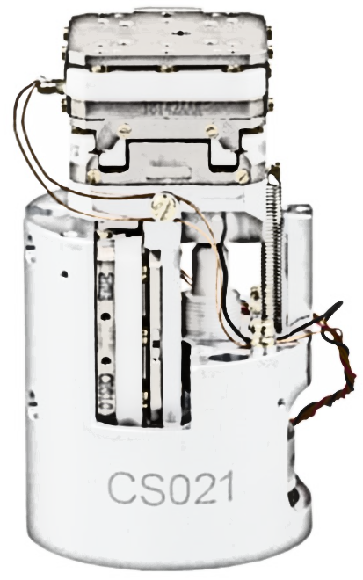
Characteristics and Comparison
EASy - Easy Alignment System
Compared to other solutions on the market, the EASy-family has the unique advantage to combine
Precision
Compactness
Carrying capacity
Carrying capacity
Precision
Compactness

Slide 12
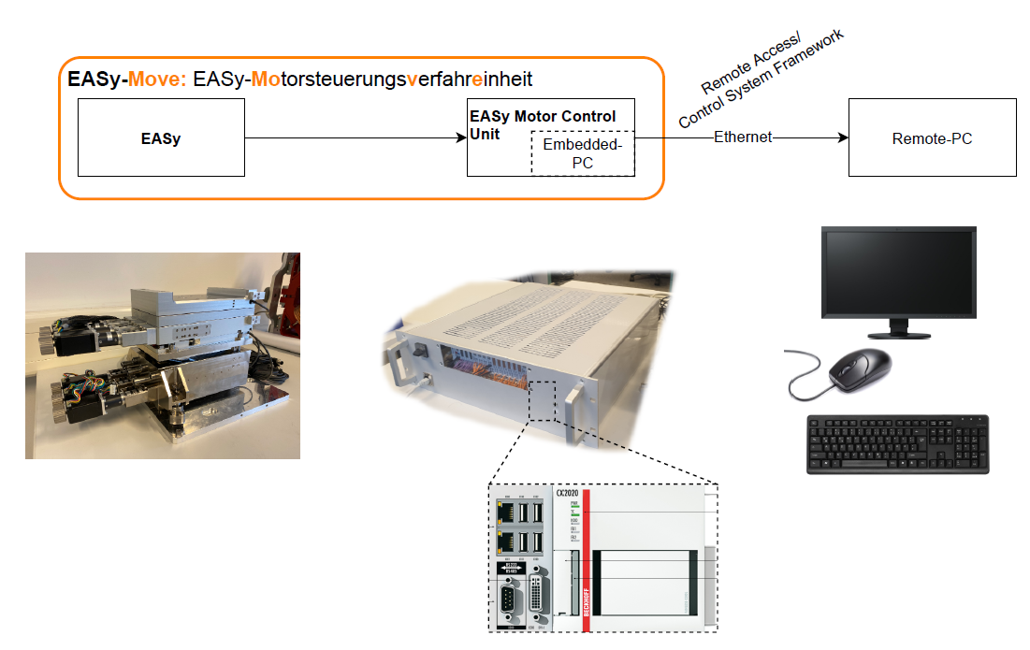
Motor Control Unit: EASy-Move
Overview

Slide 13
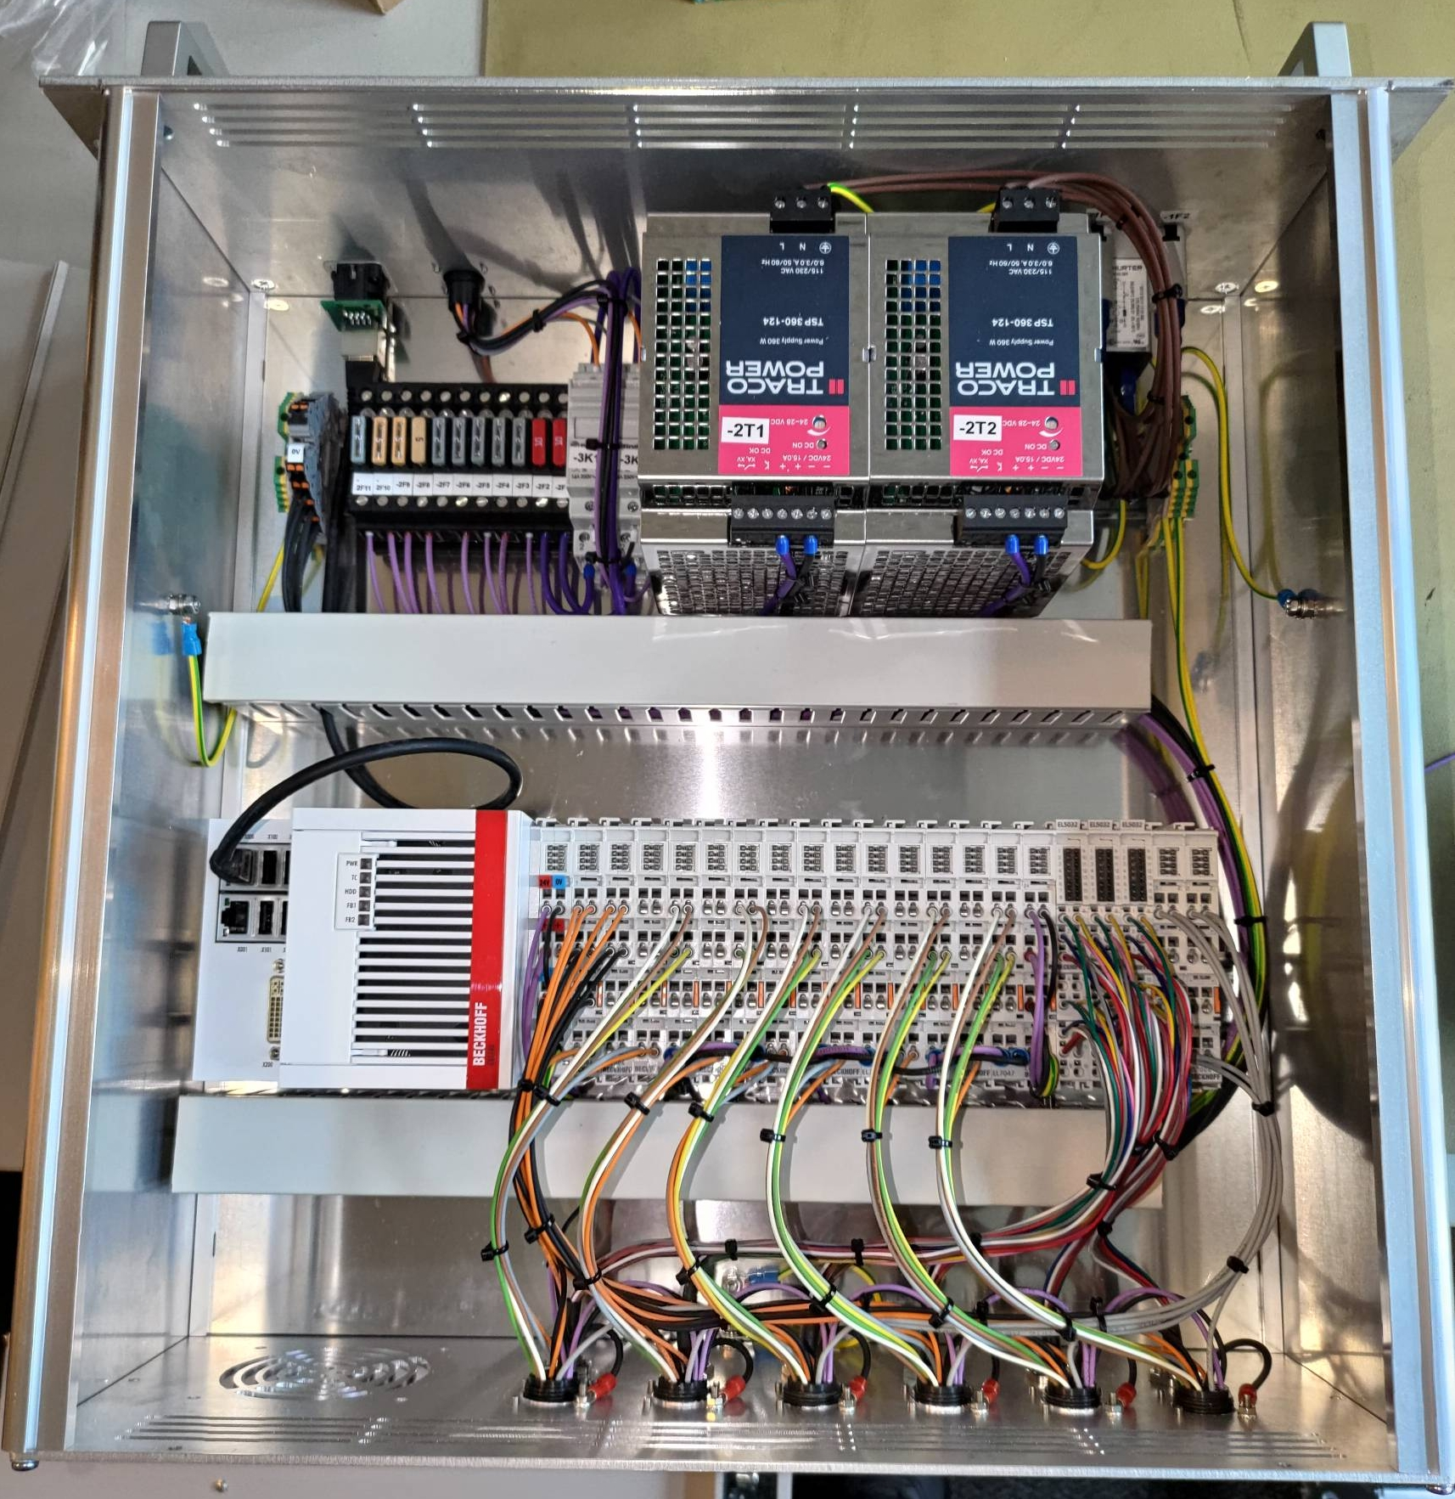

EtherCAT-Terminals
Motor Control Unit: EASy-Move
CX5140: High-performant Embedded-PC
  Software-PLC
  EtherCAT-Communication
    Capable of Ethernet
    > 100 Mbits/s
    Real-time capability
EL7037: Stepper Motor Driver 24V/1,5A
  Contacts for end switches and incr. Encoders
EL5032: EnDat2.2 terminals
  for absolute measuring systems
EL1004: digital Input (e.g. for safety couplings)
EL2004: digital Output (e.g. for motor breaks)
EL2612: Relay terminal
  for resetting the supply of measuring systems close to the beamline
The terminal block is modularly extendable

Slide 14
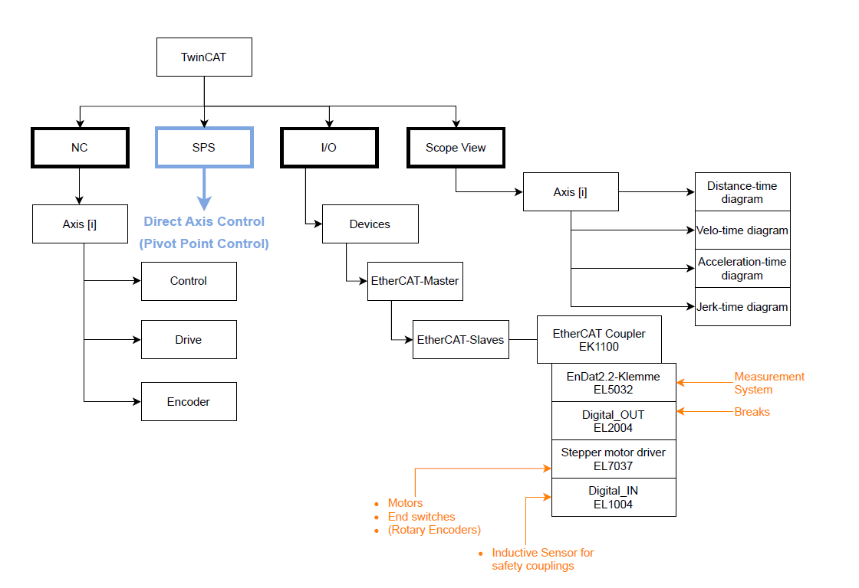
Program Structure
Motor Control Unit: EASy-Move
Modularity for software and hardware

Slide 15
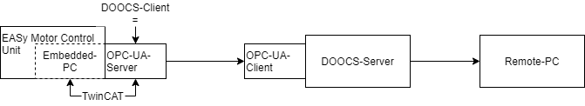
Integration in Control Systems at DESY
Motor Control Unit: EASy-Move
Test Server established for DOOCS-System
  Software-Framework for Control Systems at DESY
  Server-Client-Architecture
  User-interface (JDDD) to view parameters along beamlines
Easy integration thanks to
  Combability of TwinCAT with OPC-UA
  EtherCAT-Protocol being based on Ethernet
More infos at: https://doocs-web.desy.de/

Slide 16
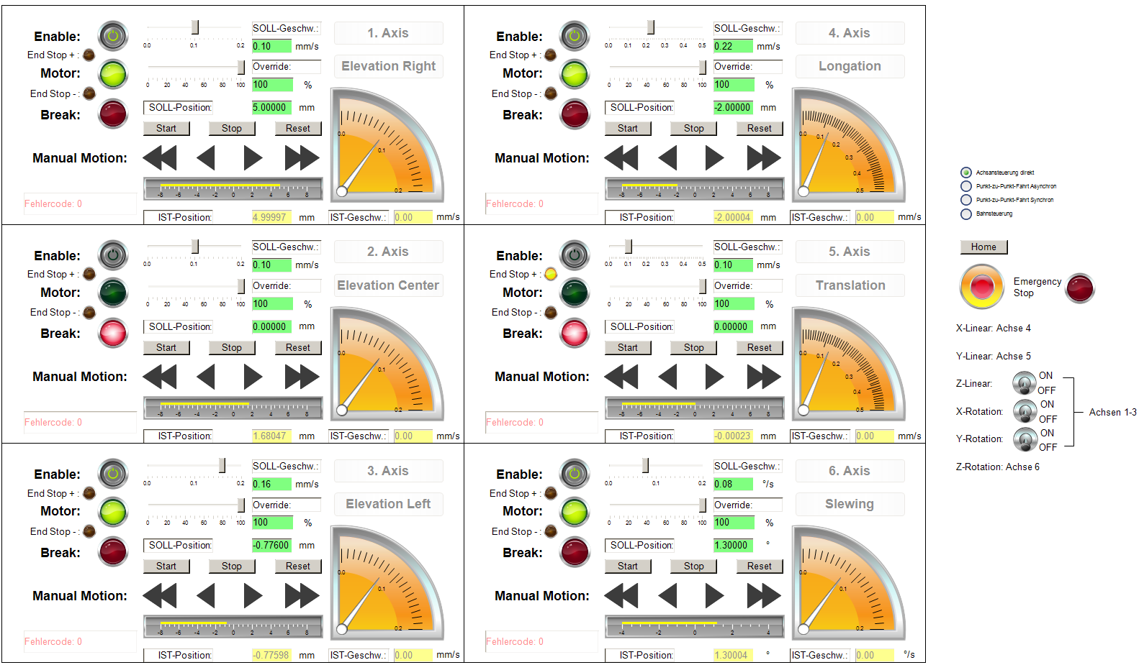
User Interface
Motor Control Unit: EASy-Move

Slide 17
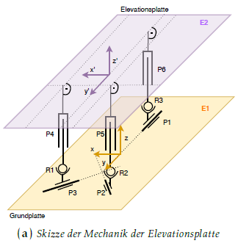

Outlook for the future (2021)
EASy - Easy Alignment System
Realizing a “Pivot Point Control”
  PTP and CP control
  High performance and precise positioning and movement control by
    Programming in MATLAB and C++
    Integrating those modules in the realtime environment of TwinCAT
CE-Certification for EASy and Motor control unit
Redesigning EASy models based on experiences with prototypes
Further measurements for positioning accuracy an repeatability

Slide 18
Contact
Roland Platzer
ZM1
roland.platzer@desy.de
040 8998 4988
Ufuk Akkaya
ZM1
ufuk.akkaya@desy.de
040 8998 4988

