Slide 1

Design Study
High Luminosity LHC (HL-LHC) update w.r.t. 1st meeting.
Collaborative Project
FP7-INFRASTRUCTURE-2010
By Lucio Rossi – CERN
2nd Meeting @ CERN 8 September 2010

Slide 2
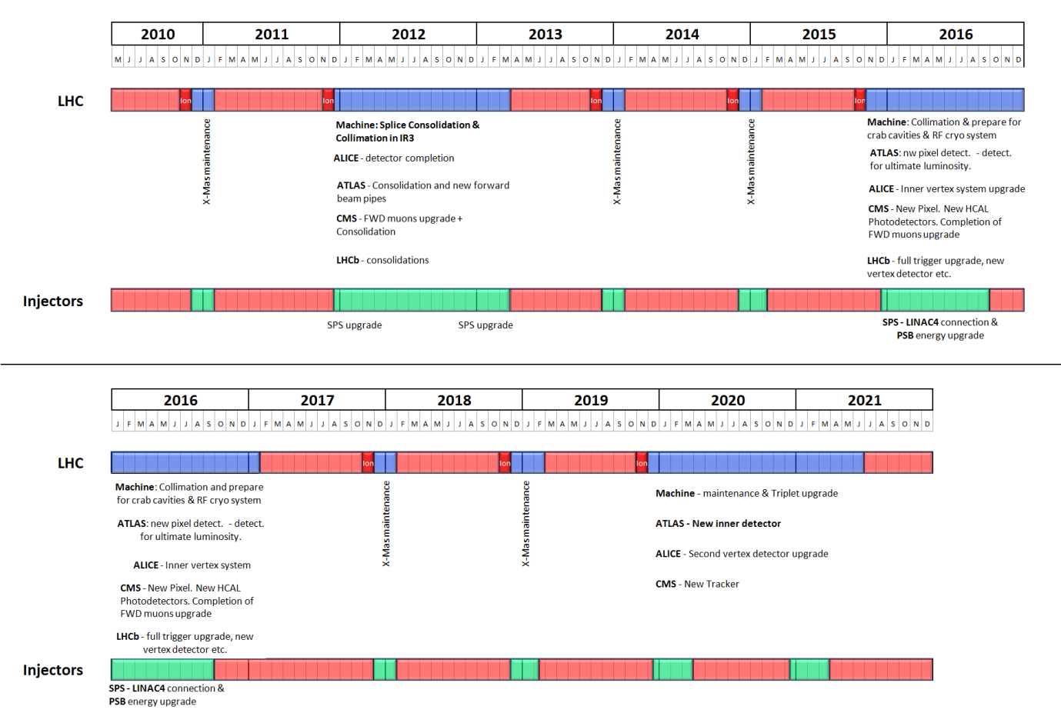
CERN plan : all around LHC
Stop INJ in 2012
No shutdown in 2015 to maximize Physics
Nobody will be surprised if instalaltion of HL equipment will shift 1 year…

Slide 3
Situation at CERN
New CERN plan endorsed by special SPC and FC of end of August
Reduction in budget is acceptable to preserve the physics plan
LHC is even reinforced
  New plan on Collimation in P3 accepted (if compatible), to be confirmed in next Chamonix workshop
  Key technologies for the upgrade all « protected » or increased (caveat: we suffer lack of personnel)
  The next big shutdown is 1 year later (2016)
    We buy time to be really prepared to use it

Slide 4
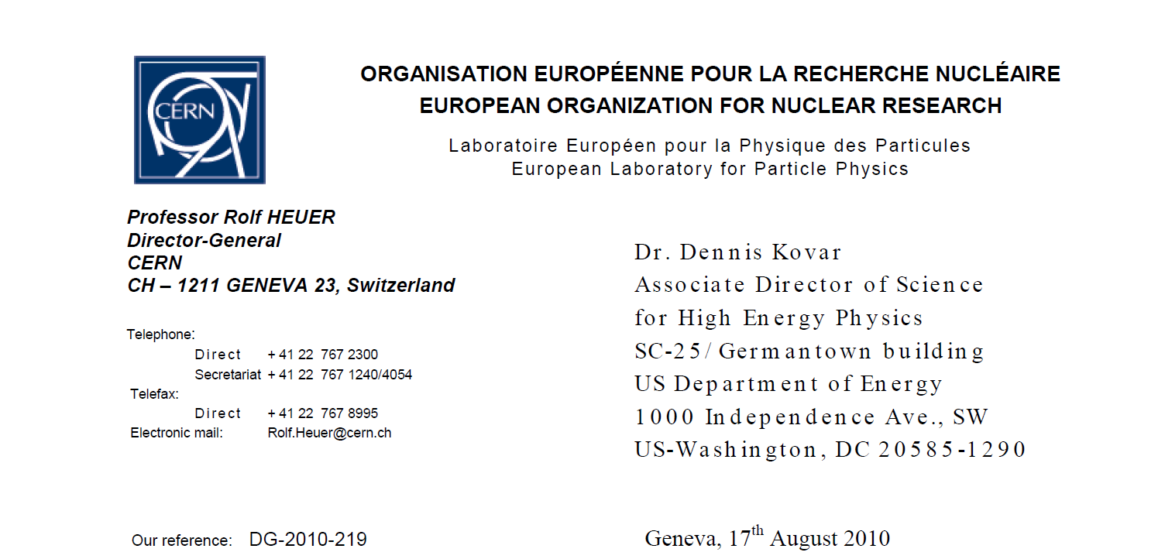
Strong endorsement by DG

Slide 5
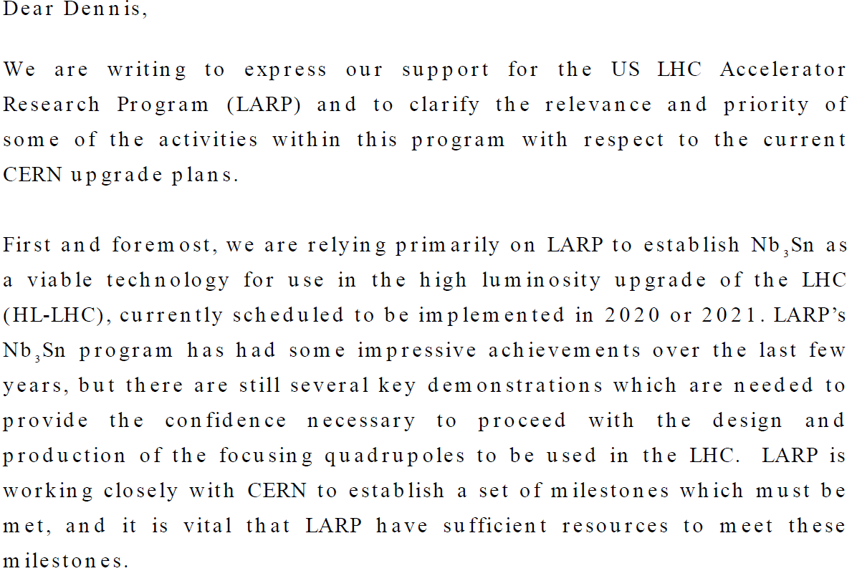

Slide 6
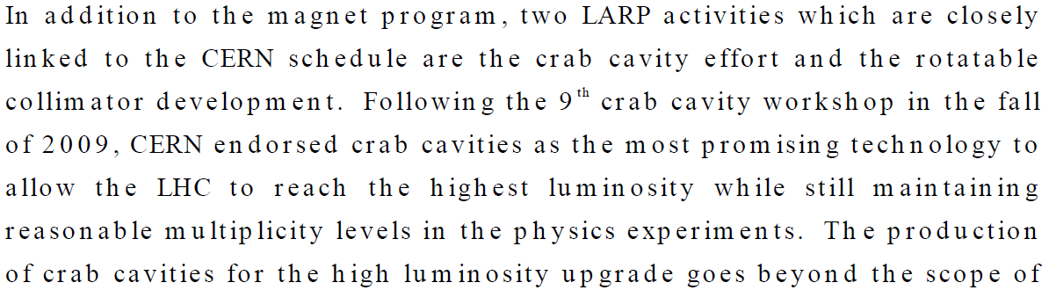
Plus a letter by Steve Meyers to state the Mission NEED for Crab Cavities

Slide 7
General features of HL-LHC
Cost of LHC upgrades (accelerator part): ∼ 500 Millions (CHF?,US$ ?, € ?...)
Cost of R&D and technological development: 10%, i.e. 50 Millions
Cost of Design: 10%, too, 50 Millions
  To be significative the FP7 DS should be at least 20% of the design effort, i.e 10 Millions

Slide 8
General features
10 M€ total cost over 4 years: July 2011-June2015
Reimbursment by EU
  We ai m to 40% to be reimbursed by EU (of course compromise will be reality)
    CERN offers by free personnel for WPs, but will be reimbursed 100% for management. Exception for fellows.
    This may make very attractive for other partners: possibility of 50% reimbursement for Universities ?
Use EuCard (and other programs) for technical development
  Most of resources on personnel
  Some hardware, especially for orphan items
Generate positive attitude in other labs:
  Non EU labs can participate to governance (but no EU funds)
The names herein are CERN coordinators: each of it will be joined by a non-CERN coordinator. Except project Coordinator, the co-ordinator ijn charge for two years, nominated by the governing board.

Slide 9
WP 1 – Management
Lucio Rossi
Main tasks
  General management of the DS and link with other similar entities outside EU
  Milestones and review plan (reviewing as methodology of working)
  General plan and coherence of the parameters
    Link with all repositories of info (CERN and outside)
  Integration and planning
  Risk Analysis and mitigation plans
  Coordination with the LHC machines performance and planning
  LHC INJ requirements
  Coordination with Physics requirement
  Outreach and dissemination
  Radioprotection and Enviroment impact

Slide 10
WP1 participants
CERN
CEA,
PSI,
GSI,
J-PARC,
US labs

Slide 11
WP list
(with CERN co-coordinators)
WP2 Acc.Physics : Oliver Bruning
WP3 -Magnet Design : Ezio Todesco
WP4: Crab Cavity Design : Ed Ciapala/Erk Jensen
WP5 – Collimation & Beam Losses : Ralph Assmann
WP6 – Machine Protection: Jorg Wenninger
WP7 -Machine-Experiment Interface : Austin Ball/Marzio Nessi

Slide 12
Other WPs (in HL-LHC but not necessarily in the FP7 Design Study)
11 T dipole coupled with CRYOcollimator (for P2, P7, …
Sc links to remove Power Supply from tunnel : R2E general problem
New Cryo-plant in Point 4
…
Not all work can be in the DS, but a few more can enter (if convenient)

Slide 13
Milestone
20 July : Meeting with our EU & US-J partners
8 September : 2nd Meeting
September : visit Brux.?
19 (or 21, or 22) October: first draft and 3rd Meeting
16 (or 18) November: 4st meeting
Deadline submission: 25 November
Lucio + Oliver + JPK
Lucio & Oliver + all
JPK
Lucio & Oliver + all
Lucio & Oliver + all
Lucio & all!!

Slide 14
Actions
Define draft Project Structure (re-use S-LHC ?)
  Repository (edms) structure
  Website
Template for WP to be circulated by 25 Sept.
Check of the disponibilty to sign the grant agreement by non-EU partner
  So far KEK seems OK
  LBNL also (signature by Division leader?)
  Other US labs ? Or LARP or DOE ?

