Slide 1
Design concepts for high field magnets
E. Todesco
MSC Group, TE Department, CERN
1st June 2021

Slide 2
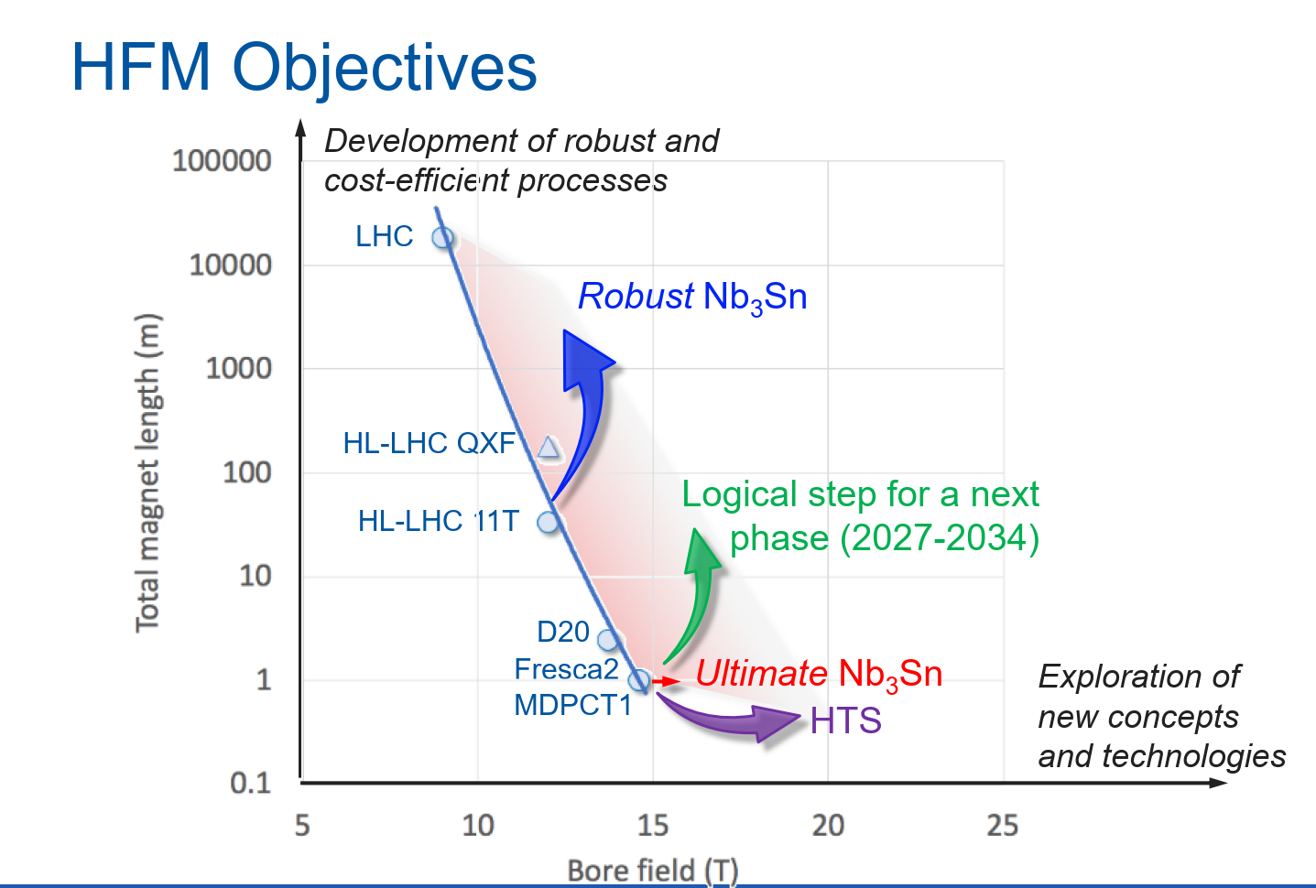
CONTENTS
12+T: two layers cosθ
cosθ
14+T:
four layers
block, cc
Towards 20 T:
CCT
HFM objectives, L. Bottura

Slide 3
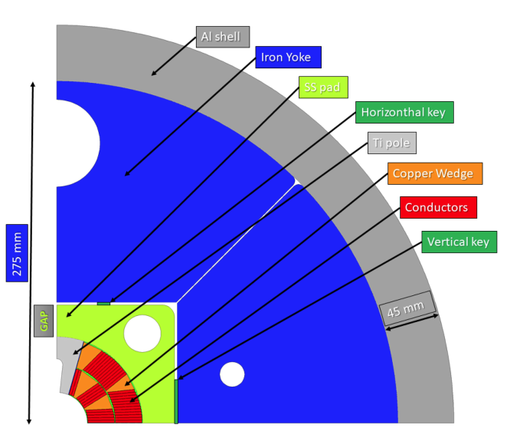
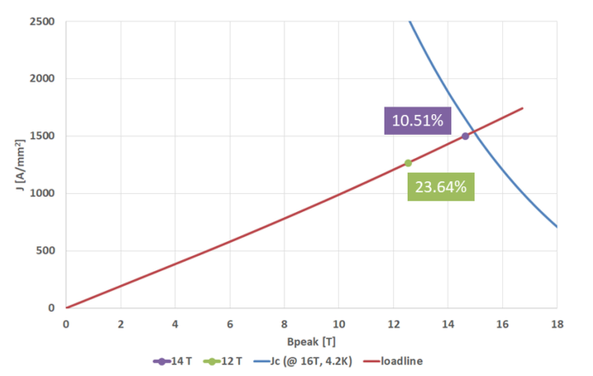
12+ T: COSθ − TWO LAYERS
Fully exploiting the two layer option
  This is the FalconD design: 1 mm strand, 40 strand cable, 12 T is reached at 76% of the loadline with Nb₃Sn today performance
  With respect to 11 T, lower loadline, lower current density, lower prestress even with one tesla increase in bore field
      This option was brought to its extreme with a 40 mm width cable E. Holik, et al. IEEE TAS 28 (2018)
What would happen with a smaller width cable?
  Dependence on the coil width from 21 to 18 mm (using MQXF cable)
  With -15% in coil width, we lose 3.5% on the short sample field - in terms of operational field at 75%, loss of order of 0.4 T
The FalconD design (A. Pampaloni, et al., IEEE TAS 31 (2021), R. Valente et al., IEEE TAS 31 (2021)

Slide 4
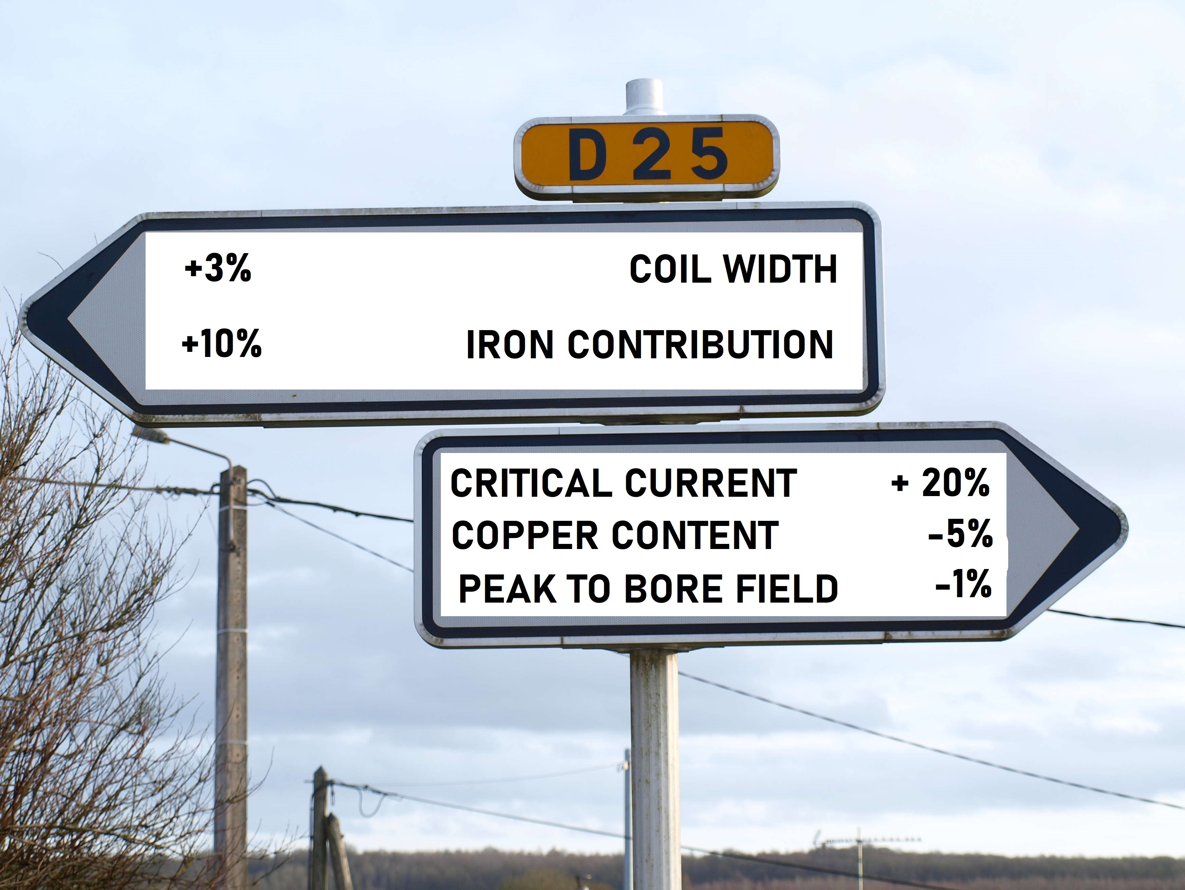
A SENSITIVITY ANALYSIS
A fully analytic estimate of sensitivity to magnet parameters is possible
  It gives relevant indication on the directions to find the optimum, that may be invisible when looking for a cross-sections when you are obliged to change several parameters at the same time … (see also Unit 8 of design lectures)
  I will show the principles in one slide and then give two directions (iron and peak/bore ratio)

Slide 5
SENSITIVITY ANALYSIS
Factor X: ratio between the critical surface slope and the loadline slope
  For example, in FalconD is 333/100=3.33
  This factor is the parameter driving the sensitivity
Any relative increase in
  Critical current
  Width of the coil
  Efficiency of the layout (see later)
  Fraction of superconductor in the insulated coil
  Contribution of iron to field for a fixed current
… gives a variation in short sample field weighted by ~1/1+X
  1st example for FalconD: cable width
  reduction of 15% gives a
  short sample reduction
  of ~15%/(1+3.3)~3.5%
  2nd example for FalconD: strand Cu
  increase from 0.9 to 1.2 → reduction
  of sc quantity from 52% to 45% (-16%) →
  short sample redacution of ~16%/4.3=3.7%
333 A/mm²/T
100 A/mm²/T
Example of the FalconD loadline

Slide 6
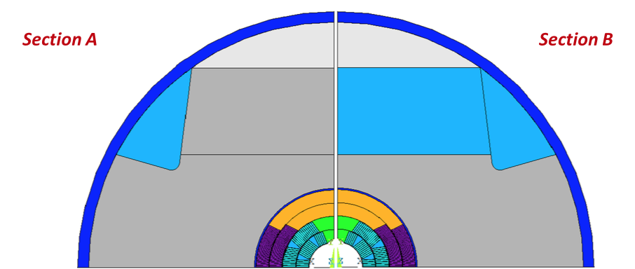
12+ T: COSθ − TWO LAYERS
First direction: enhancing iron contribution
  An increase of y% of the iron enhancement of the field at a fied current gives two beneficial effects:
    Reduce the current density by y%, and therefore the stress by y%
    Increase the short sample field by y%/(1+X)
  Example
    Coil width of 42 mm, with hypotetical 25 mm collars has ΔB/B=0.21
    Coil width of 42 mm, with b&k and 5 mm spacers has ΔB/B=0.33
    1.33/1.21=10% larger loadline slope, 10% smaller azimuthal stress, 2.3% larger short sample field
  This option was pushed to its extreme
  in MDPCT1, where the iron is in contact
  to the outer layer of the coil
MDPCT1 design (I. Novitski, A. Zlobin et al., IEEE TAS 26 (2016)

Slide 7
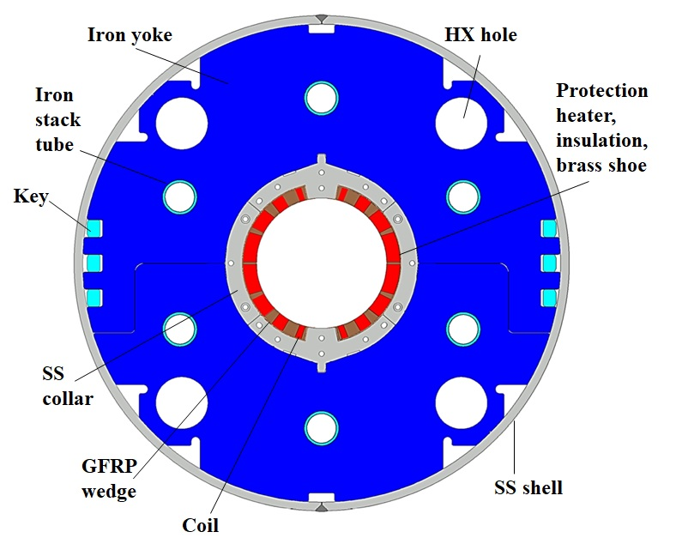
12+ T: COSθ − TWO LAYERS
First direction: enhancing iron contribution
  An increase of y% of the iron enhancement of the field at a fied current gives two beneficial effects:
    Reduce the current density by y%, and therefore the stress by y%
    Increase the short sample field by y%/(1+X)
  Example
    Coil width of 42 mm, with hypotetical 25 mm collars has ΔB/B=0.21
    Coil width of 42 mm, with b&k and 5 mm spacers has ΔB/B=0.33
    1.33/1.21=10% larger loadline slope, 10% smaller azimuthal stress, 2.3% larger short sample field
This is also the way chosen by HL-LHC D1:
collaring with iron, thin spacers
This allowed have full preload to support
the large stress due to e.m. forces (110 MPa)
HL-LHC D1 design (T. Nakamoto, M. Sugano et al., IEEE TAS 25 (2015)

Slide 8
12+ T: COSθ − TWO LAYERS
Second direction: improving the ratio λ peak field/bore field
  The sensitivity of the short sample field is more favourable for our cases: a decrease of λ increases the short sample of X/(1+X)
    Therefore a large fraction of the improvement on the ratio goes in the increase of the short sample field
  Example: for a two layer coil, with large coil width (order of 40 mm), X~3.3, decreasing the ratio peak field to bore field from 1.04 to 1.02 gives a short sample increase of 2%×3.3/(1+3.3)=1.6%
  The same increase in field would be obtained via a 1.6%×4.3=7% more coil width

Slide 9
12+ T: COSθ − TWO LAYERS -STRUCTURES
Transverse structure: stainless steel collars
  + All the experience of the 11 T
  + Two in one design already validated on short models – apertures are nearly decoupled
  - Not validated on magnets longer than 2 m
  - No possibility of having a full preload
Transverse structure: collaring with iron
  +/- The way explored in MDPCT1 for four layers; only one case until now
  + Very rigid structure, large contribution of iron to lower the current density
  - Not validated on magnets longer than 2 m
  - Transition from single to double aperture is feasible but not totally straightforward
Transverse structure: bladder and keys and Al shell
  + The only structure validated (without SS shell) for 4.2 m long magnets
  + Possibility of higher preload
  + Possibility of gaining more from iron contribution
  - Vast experience for quadrupoles but never developed for dipoles
  - Transition from single to double aperture is is feasible but not totally straightforward
Axial structure: tie rods and end plates
  + The only structure validated on long Nb₃Sn magnets

Slide 10
CONTENTS
cosθ
14+T:
four layers
block, cc
HFM objectives, L. Bottura

Slide 11
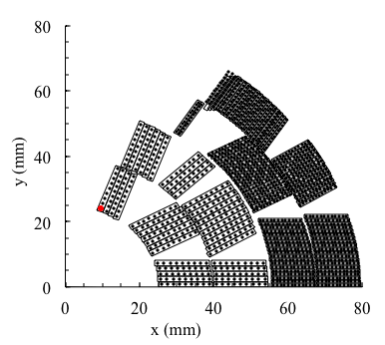
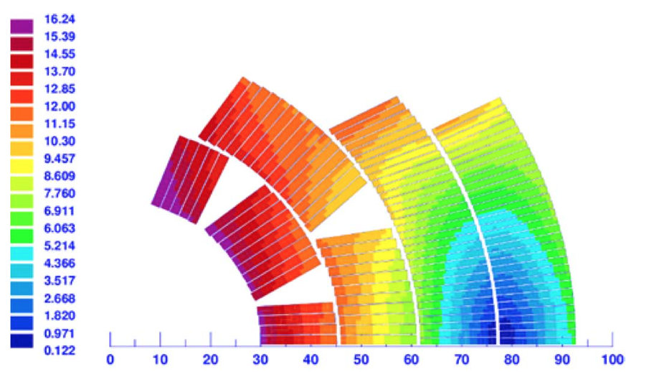
Nb₃Sn ULTIMATE: COSθ − FOUR LAYERS
To explore the ultimate limit of Nb₃Sn, one has to add more conductor, i.e. go from a two layer to a four layers
  Two built Nb₃Sn magnets: D20 in LBNL, and MDPCT1 in FNAL – never for Nb-Ti
We all know that this game is very expensive
  The factor X of the coil is order of 5, rather than 3 as in a double layer
  If we double the coil width (100% increase) you get only ~25% more in short sample field (2-3 additional T)
  At the same time the quantity of conductor is more than doubling (for instance having a 25 mm aperture radius and 4 layers with a cable width of 15 mm, the coil quantity increases by a factor 2.75)
  Manufacturing cost ×2, conductor cost ×2-3
D20 coil
(D. Dell’Orco, et al., IEEE TAS 5 (1995)
MDPCT1 coil
(I. Novitski, A. Zlobin et al., IEEE TAS 26 (2016)

Slide 12

Nb₃Sn ULTIMATE: GRADING
Grading can help to make the magnet more efficient (as used both in D20 and in MDPCT1)
  D20: 80% larger current density in the outer layer (not pertinent for HFM)
  MDPCT1: 35% larger current density in the outer layer
  Example: having a 50% larger current density in the outer two layers, you can use 2×10 mm coil for the outer layer instead of 2×15 mm – in this challenging example, grading allows to reduce the conductor mass by ~30%
Grading has the drawback on the accumulation of azimuthal stress, that scales with current density
  Therefore when you go from the two inner to the two outer layers, there is a stress increase equal to the grading – partially cured by reducing the angle
$$σ_{θ}(r)=\int_{0}^{α}{Bjr\sin{θ}dθ=}\frac{1}{2}Bjr$$
Lower angle α in outer layers
D20 coil
(D. Dell’Orco, et al., IEEE TAS 5 (1995)
MDPCT1 coil
(I. Novitski, A. Zlobin et al., IEEE TAS 26 (2016)

Slide 13
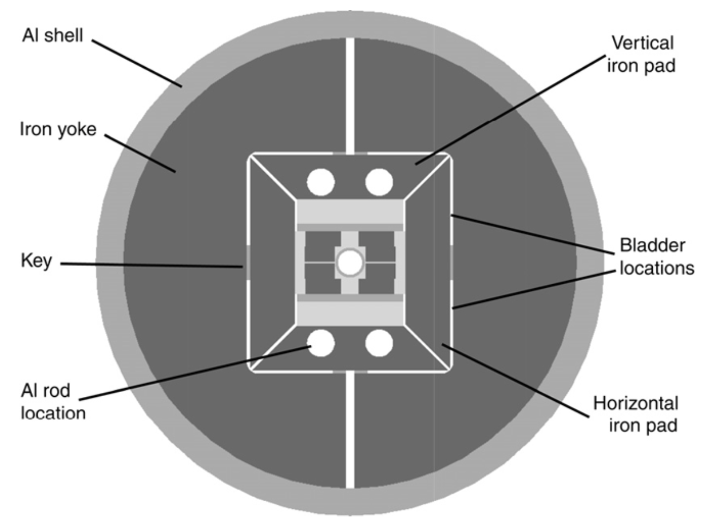
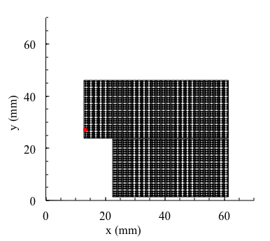
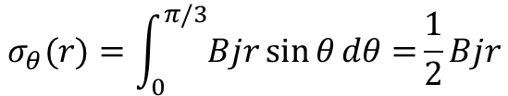
BLOCKS
The block design has one main difference w.r.t. cosθ
  The lack of the arc patterns of the coil removes the issue of the azimuthal stress since there is no accumulation in the midplane
    The price to pay is the presence of a inner structure to support the upper deck
Limited experience, first case was HD2 reaching the field record of 13.74 T but at 4.5 K, never tested at 1.9 K
$$σ_{θ}(r)=\int_{0}^{π/3}{Bjr\sin{θ}dθ=}\frac{1}{2}Bjr$$
azimuthal stress
Radial stress
HD2 design (G. L. Sabbi, et al., IEEE TAS 15)

Slide 14
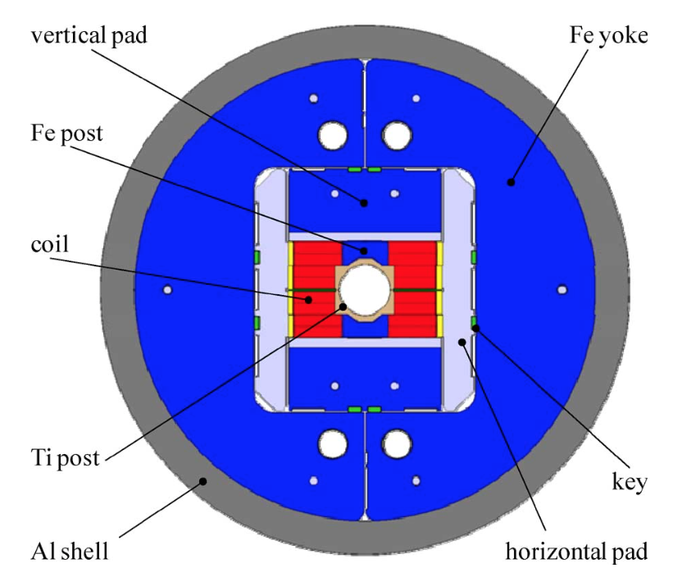
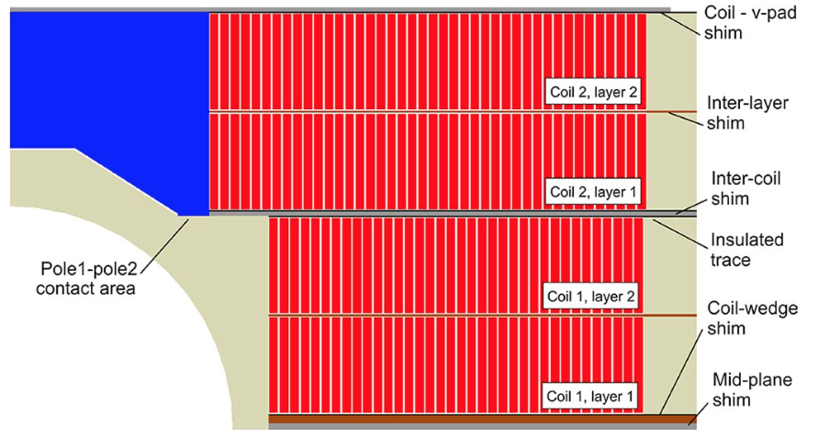
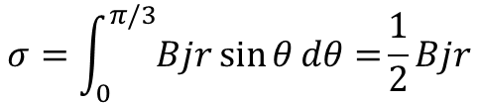
BLOCKS
This options becomes very attractive for large aperture magnets (100 mm - 150 mm) since the azimuthal stress scales with the magnet aperture
  The case of Fresca2, a double layer deck with a 100 mm aperture – 14.6 T reached
$$σ=\int_{0}^{π/3}{Bjr\sin{θ}dθ=}\frac{1}{2}Bjr$$
50 mm
Fresca2 design (P. Ferracin, et al., IEEE TAS 23)

Slide 15
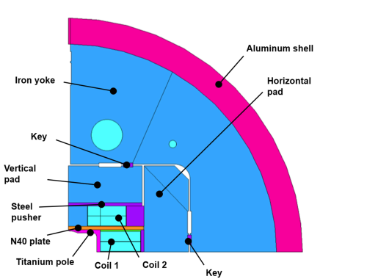

BLOCKS
This options becomes very attractive for large aperture magnets (100 mm - 150 mm) since the azimuthal stress scales with the magnet aperture
  Also the EDIPO is considering the same design
$$σ=\int_{0}^{π/3}{Bjr\sin{θ}dθ=}\frac{1}{2}Bjr$$
50 mm
75 mm
EDIPO design option (D. Martins Araujo, et al., IEEE TAS 31)

Slide 16
BLOCKS
In terms of efficiency, the block is lower with respect to a cosθ
  Let us look at the field given for the same quantity of conductor
  (see also https://indico.cern.ch/event/915752/)
Reference: cosθ layout with wedges to optimize field quality: γ_{c}=6.6×10⁻⁴
  HD2: γ_{c}=5.9×10⁻⁴, 10% less than the cosθ
  Fresca2: γ_{c}=6.1×10⁻⁴, 7.5% less than the cosθ
The experience in building these magnets is much less developed with respect to cosθ
  We are comparing few (~10) manufactured Nb₃Sn block coils with respect to hundreds of cosθ coils, and 2 block coils magnets (HD2 and Fresca2) with respect to several tens of cosθ design magnets (MSUT, D20, HFDA, TQ, LQ, HQ, MQXF, 11 T, MDPCT1 …)
But the performance is there (both HD2 and FrescaII reached 85% of loadlina fraction)
The most critical point is the manufacturing and support of the flared ends

Slide 17
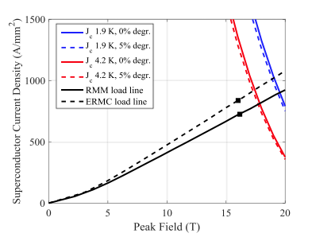
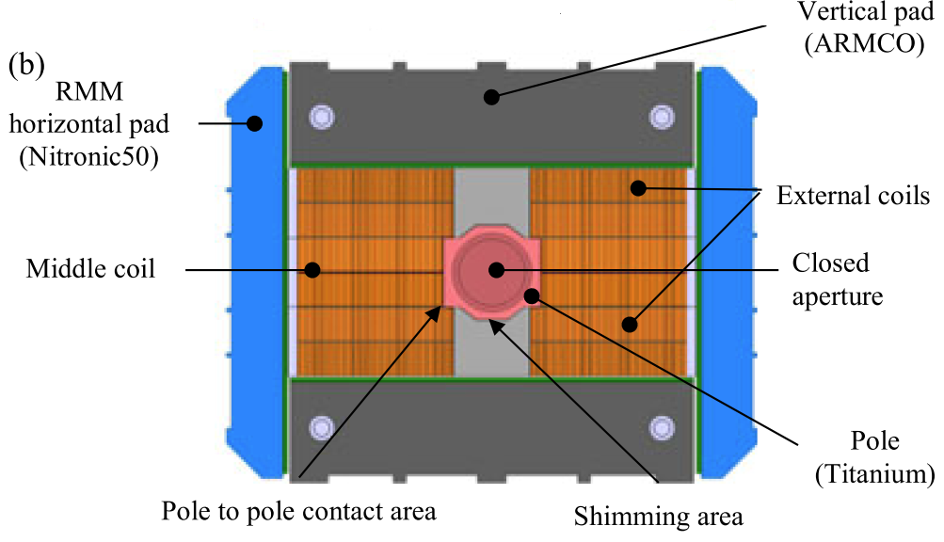
BLOCKS
Three layers – explored by D. Tommasini, RMM
  The main advantage, besides the simplicity of the cross-section, is three coils rather than four → 25% less in manufacturing costs
  RMM three coil block design [S. Izquierdo Bermudez, et al. IEEE TAS 27 (2017)]
    Factor X is ~5, with a loadline slope of 50 A/mm²/T and a critical surface slope of 250 A/mm²/T
    Any improvement in loadline, critical current density, … is weighted by a factor 6
  RMM three coil block design [S. Izquierdo Bermudez, et al. IEEE TAS 27 (2017)]

Slide 18
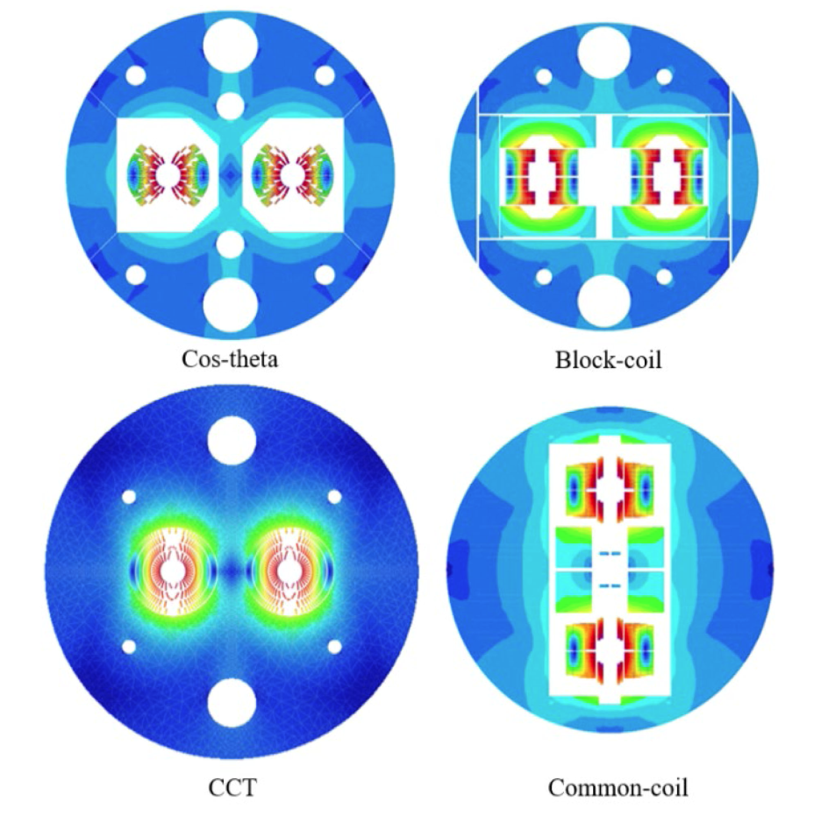
THE 16 T LAYOUTS
Four layers cosθ (INFN)
  M. Sorbi et al IEEE TAS 27
Block (CEA)
  H. Felice et al IEEE TAS 29
Common coil (CIEMAT)
  F. Toral et al IEEE TAS 28
CCT (PSI)
  B. Auchmann et al IEEE TAS 27
A review in D. Schoerling et al, IEEE TAS 29 (2019)
  To reach such an ambitious target, conductor current density increased to 1500 A/mm² at 16 T, and loadline fraction increased to 86%

Slide 19
LOADLINE FRACTION (MARGIN)
HL-LHC
max achieved in
few short models
LHC dipoles
at 7.0 TeV
16 T
Performance limitation
11 T
Virgin training
LHC dipoles
at 6.5 TeV
Possible range
for 12+ T
MQXF
~100% rate of success
in Nb₃Sn HL-LHC
Hic sunt correctors

Slide 20
CONTENTS
Towards 20 T:
CCT
HFM objectives, L. Bottura

Slide 21
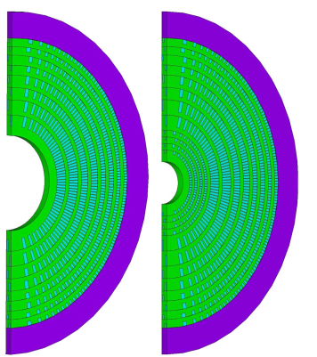
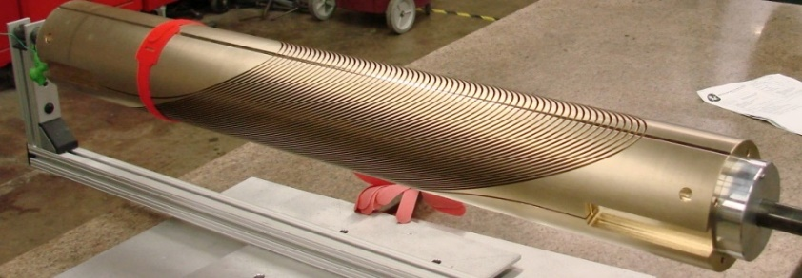

TOWARDS 20 T - CANTED COSθ
$$σ_{r}∝\frac{B^{2}}{2μ}$$
Towards 20 T, the radial stress enters the scene
  The radial stress, proportional to the magnetic pressure, and independent of the magnet design, approaches the 150-200 MPa range and therefore stress should be intercepted
    Magnetic pressure is 90 MPa at 15 T, and 160 MPa at 20 T - however, the radial stress is about 20-50% larger due to the asymmetry of the field with respect to the aperture (it worse than a solenoid)
Towards 20 T, HTS have to be used in the inner layers
  HTS inserts should carefully consider the mechanical interference with the Nb₃Sn coils (see also talk of T. Lecvrevisse) – non trivial interaction
The CCT design as developed by LBNL has intrinsic features to cure both problems with an extremely modular design
  The non negligible loss of efficiency is affordable since one gains the stress interception both radial and azimuthal
Ongoing program with Nb-Ti, Nb₃Sn
  See talk of S. Prestemon in April HFM workshop
  CCT designs towards 20 T [L. Brouwer, S. Caspi, S. Prestemon, IEEE TAS 25 (2015)]

Slide 22
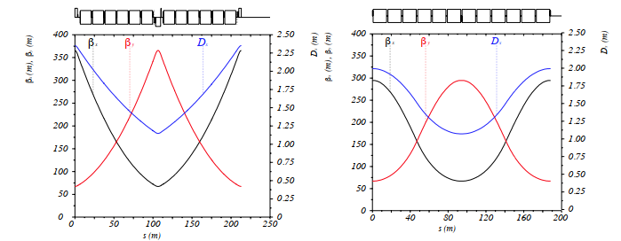
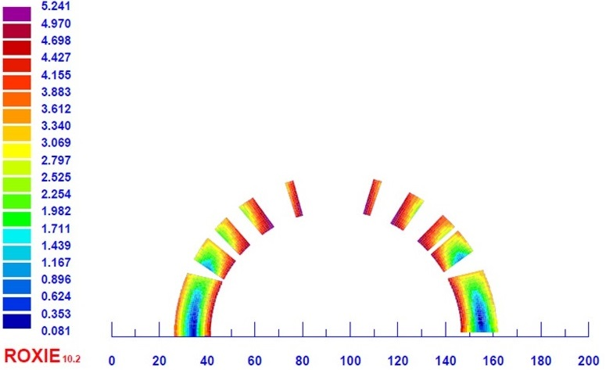
A NOVEL LAYOUT BASED ON OLD CONCEPT
Recently A. Devred suggested exploring a combined function lattice for FCC
  As in low energy accelerators, spread the quadrupole in the dipoles
  Advantage: increase the filling factor, and getting rid of cell quadrupoles
  It would require a quadrupolar gradient order of 300 units, as in the HL-LHC D2 bare coils: small left-right asymmetry of the order of 1 mm
  This could be injected in any magnet design
Beta functions in a FODO lattice (left) and in a combined function cell lattice (right) [M. Giovannozzi, in progress]

Slide 23
CONCLUSIONS
The design options for HFM
  12+ T: two layer cosθ is the workhorse
  14+ T: a four layer cosθ as built in FNAL
  The block design, a way to removing the azimuthal stress issue
  The common coil path: removing the end issue
  Above ~15 T: the CCT option with stress interception (also radial)
HFM will have to find a delicate equilibrium between
  Risk minimization for the program: continuing the most promising paths that are being explored in the community, building block by block on previous experience, to have a «fast» succesful result
  New design options and unexplored ideas, allowing keeping the diversity of the research

