Slide 1
Subscale and model magnets for Nb₃Sn: a necessary step?
Hélène Felice
01/06/2021
Special thanks to:
B. Auchmann, D. Tommasini, E. Rochepault, JC Perez

Slide 2
What are we talking about?
Subscale and model magnets
  Subscale: <1 m typically ~500 mm
  Models: 1 to 2 meters
  Simplified version of magnets
    Magnet without an aperture such as racetracks
    reduced amount of conductor
  Short version (1 to 2 meters) of «real» magnets with an aperture, optimized field quality, features of an accelerator-ready magnet
Mock-ups, mechanical models, powered (or not powered) samples are also of interest
=> Inventory of our “community toolbox” – not a review of recent results
=> Attempt here to summarize some key problematics we need to tackle and if they are addressable by our toolbox

Slide 3


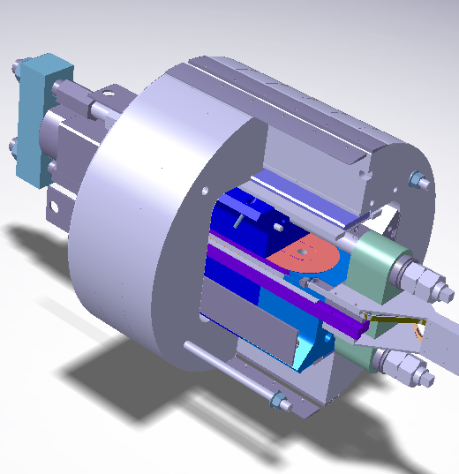
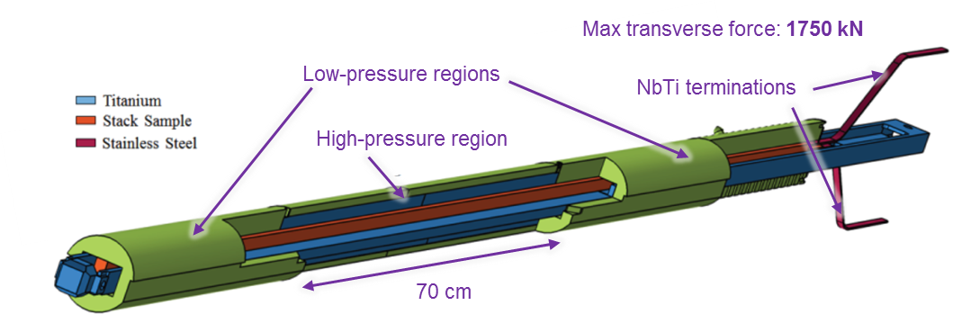

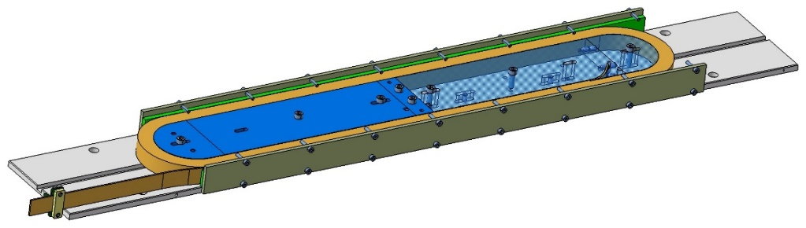


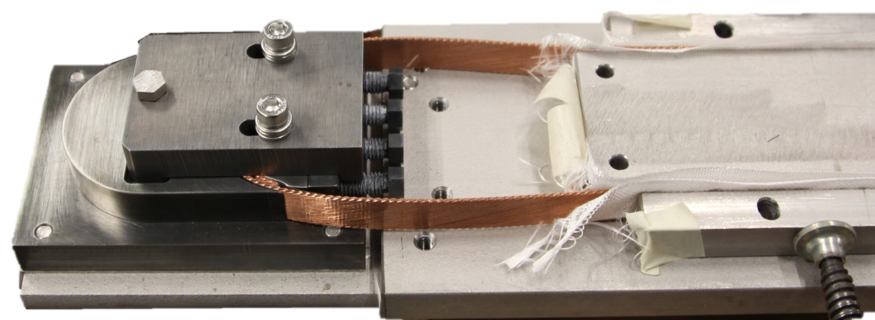

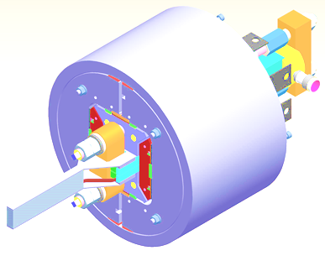
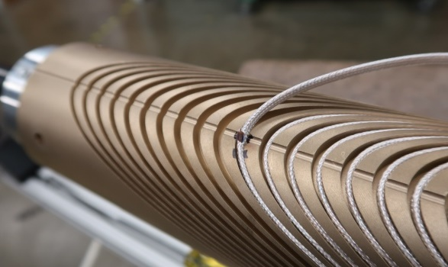
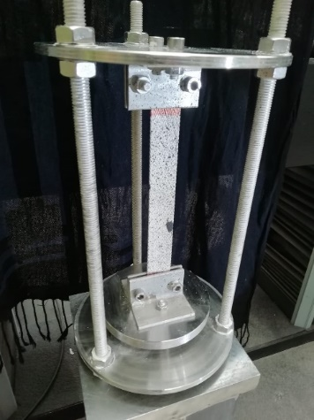

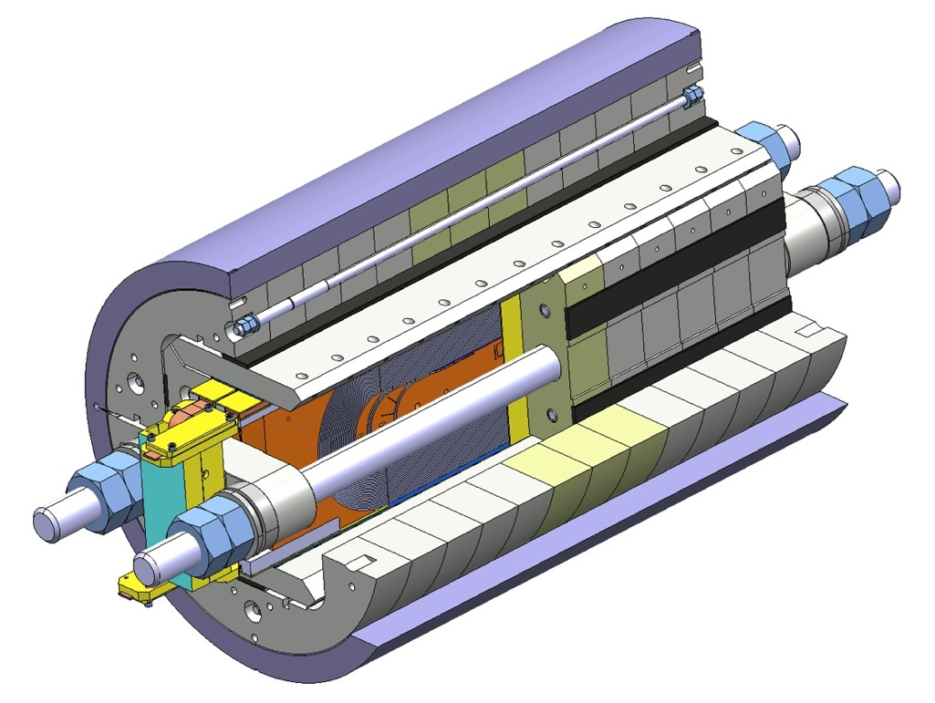
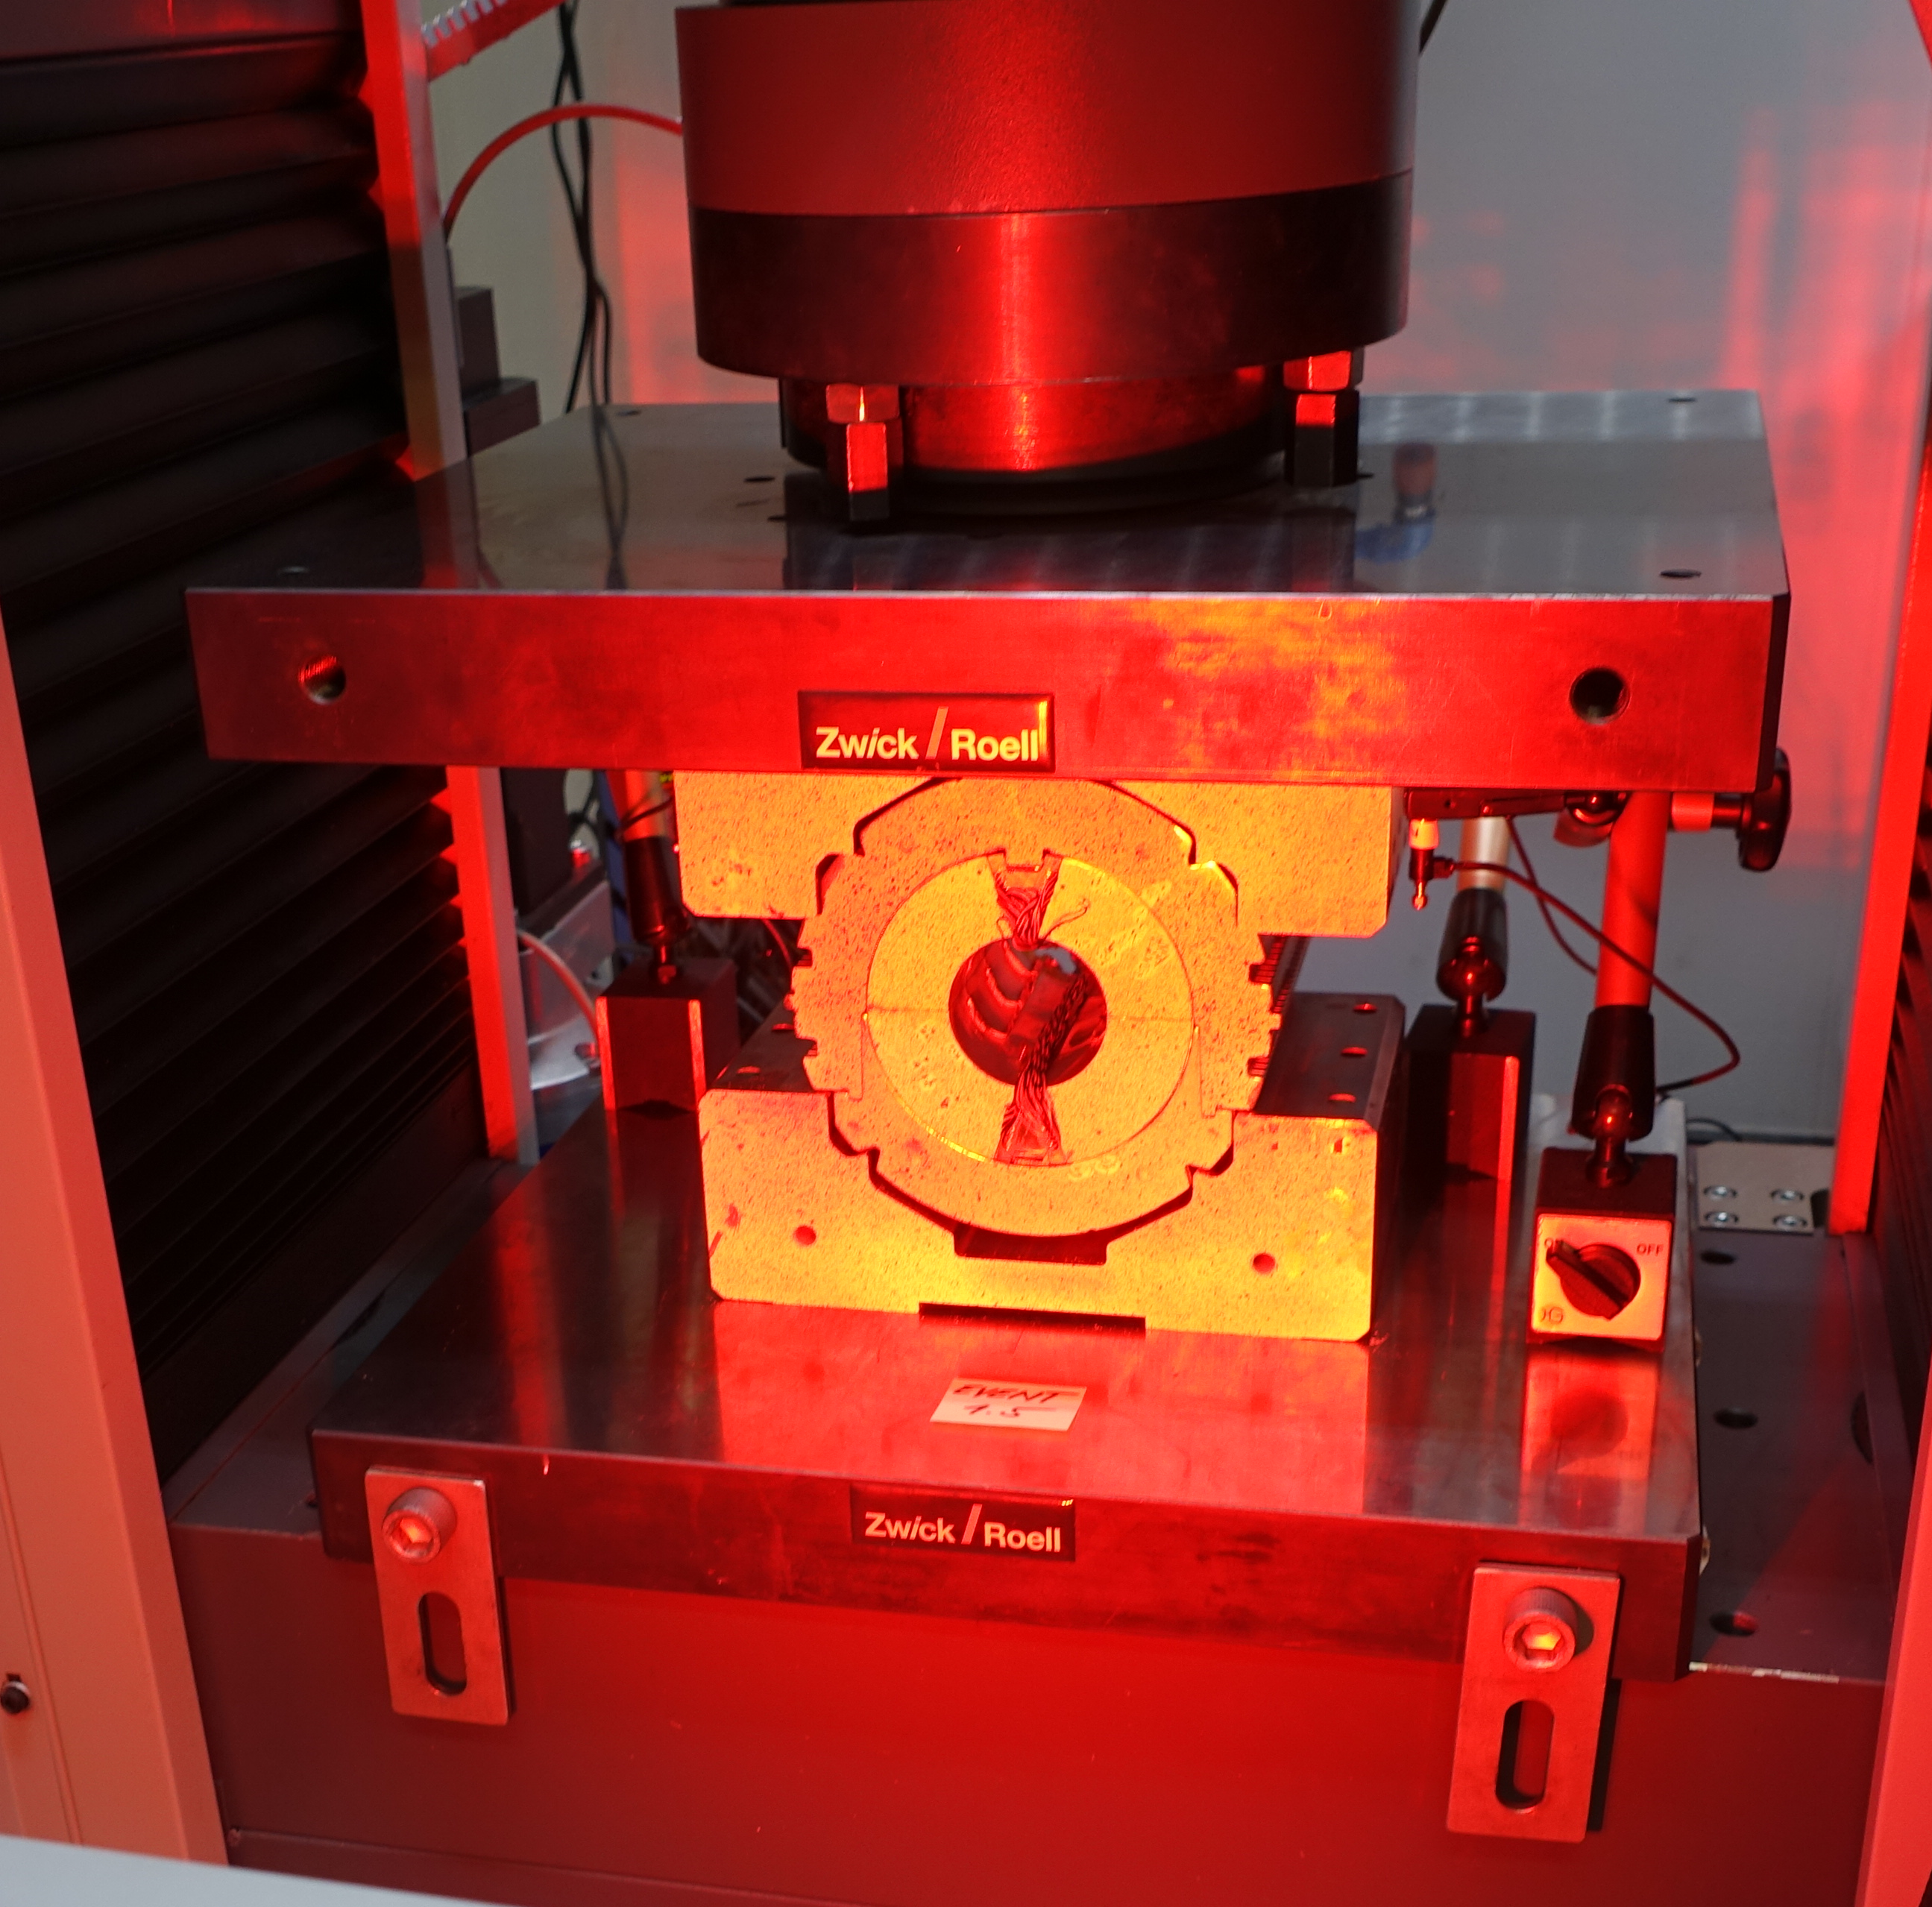

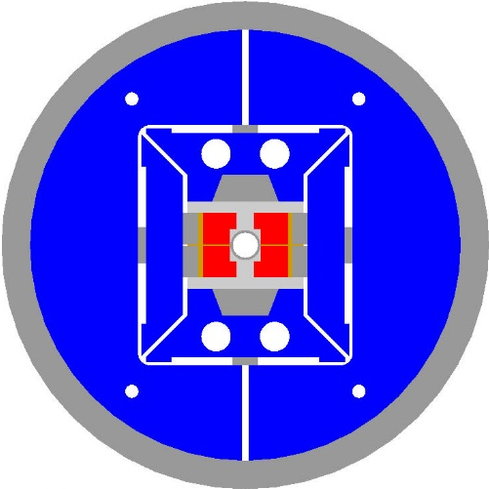
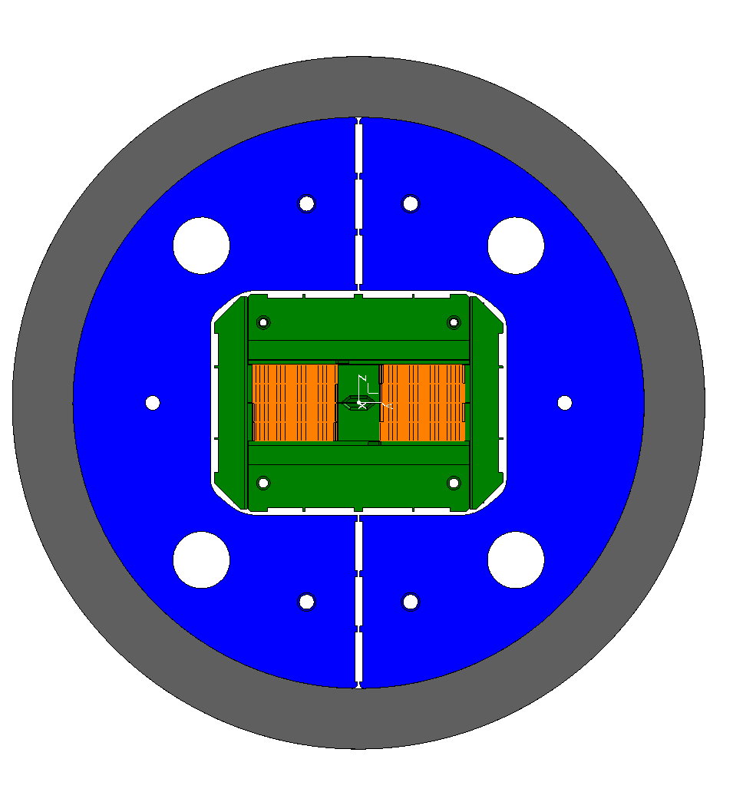
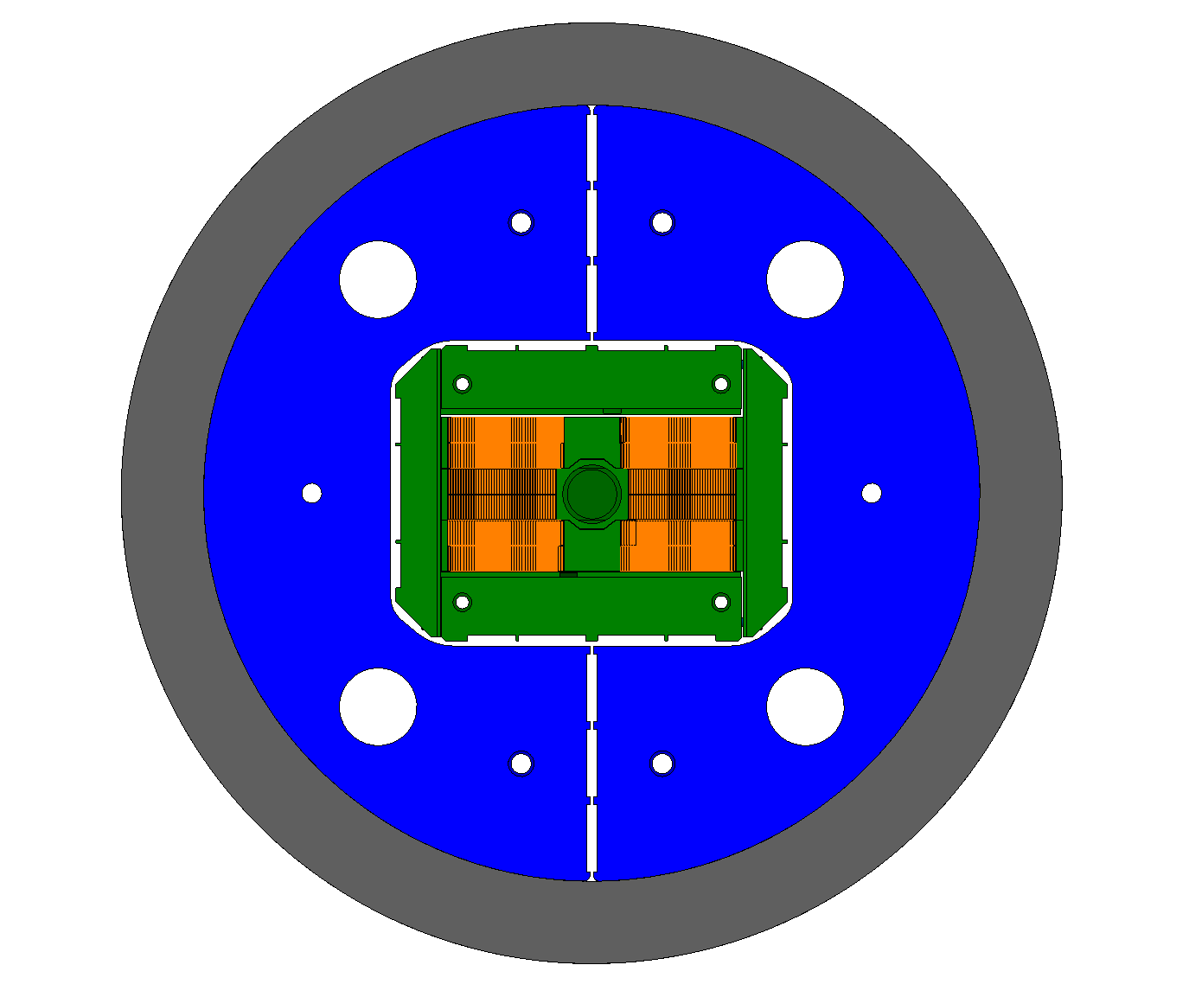



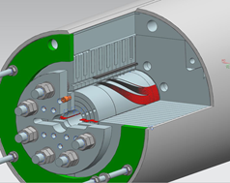
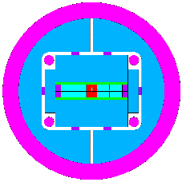
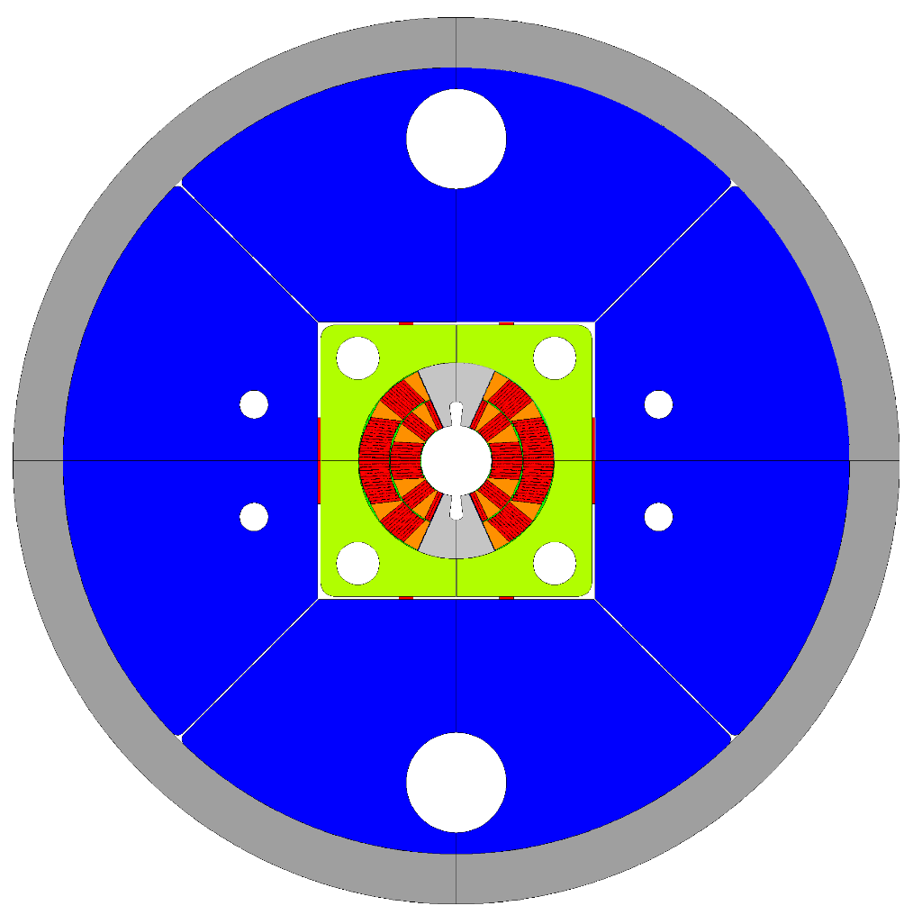

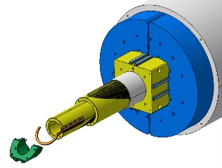
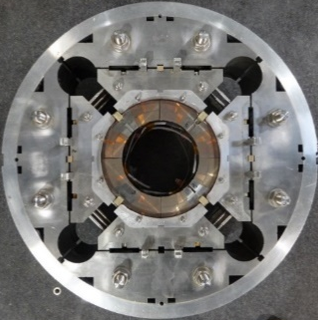
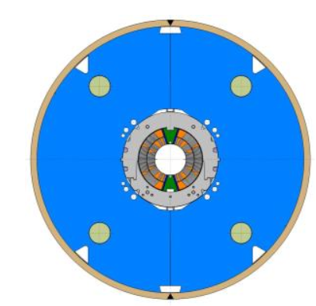
Toolbox: mock ups, powered samples, subscale and Model magnets
SMC
Powered Samples
SD
CCT subscale
RMC
Mock-ups and Mechanical models
Existing Subscale Magnets
BOnding eXperiment
HD3
eRMC
RMM
R2D2
FALCOND
CCT
Common Coil
10-12 T
Graded racetrack
MQXFS
11 T
12-14 T Double Layer cosθ
MDPCT
Model magnets under development
Recent or unique Existing model magnets
Courtesy of S. Izquierdo Bermudez, J.C. Perez, S. Farinon, F.Toral, E. Rochepault, B. Auchman, M. Daly, P. Ferracin, F. Lackner, S. Zlobin, M. Dhalle, B. Bordini, P Bruzzone

Slide 4
Nb₃Sn Magnets: what do we need to address?
We have some open questions on:
Coil and Magnet Design
Magnet manufacturing process: coil -> magnet assembly -> cold mass assembly
Magnet Performance analysis and understanding
Disclaimer: Work is already ongoing in various institutes

Slide 5
Why can the subscale and model magnets contribute?
Advantages
    Cheaper and Faster turn-over
    Allow to implement complexity gradually
    Allow to focus on dedicated topic
    The subscale/short models are not behaving perfectly!
Drawbacks/ Caveat:
    Subscale and short models may not capture the complete story => need to define properly the question to address and the limits of subscale or short models

Slide 6
Coil Design
+ allow fast testing of new conductors
+ allow the implementation of specific design features
SMC
Conductor validation/characterization
As part of the development of new strands, new «reinforced», High Cp conductors
  Can be rather quickly implemented in subscale coils
Coil technology
Training reduction: what is the most favorable Pole to conductor adhesion condition : glued/unglued/ impregnated with debonding plane?
  Explorable in subscale magnets then in model magnets
Graded design? => Nb₃Sn/Nb₃Sn splice demonstration
  Explorable in subscale and model magnets

Slide 7
Coil Winding & Curing
+ allow the test of fabrication processes
- Importance to keep in mind the scale-up when designing the tooling
Coil Winding:
  Cable dimension: what is the largest windable cable? In cos theta, in block design, CCT?
    Close collaboration between magnet designer and conductor experts
    Mock-up: define a set of cables and proceed with winding tests with 3D printed components. Systematic study
  Dimension control of wound coils /repeatability
    Contribution of short models
Coil Curing:
  Tooling development to remove the need for binder
    develop a dedicated tooling on existing coil design and wind with Cu and then SC

Slide 8
Coil Heat Treatment
+ allow implementation of specific tooling features
+ reduced scale allows for highly demanding experiments
- Importance to keep in mind the scale-up when designing the tooling
The key objective at this stage is to understand the strain state of Nb₃Sn after HT
Understand the conductor dimensional changes during HT and the consequent strain
  Need to develop measurements methods during HT – Tooling and Infrastructure development: achievable on cable samples – on subscale
Understand the influence of tooling and components on final dimension and strain state of the coil
  Require instrumentation development which can be implemented at HT Temperature and on small scale experiments
Accommodate this dimensionnal change during fabrication to end up with a strain-free Nb₃Sn
  Development of appropriate tooling and components in particular for block configuration: demonstration on short models flared end design
Modeling of the coil during HT?
  Comparison simulation/in situ measurements doable on samples and possibly small scale coils
  Seek out contribution from partners outside the magnet community

Slide 9
Coil Impregnation
+ allow quick iteration
- Need to keep in mind long coils impregnation constraints
Ensure coil dimension uniformity: !! Impact on stress distribution in the magnet
  Not explorable with suscale but with model magnets longer than 1 m
Minimize energy release due to cracking during cool down and magnet powering
  Explore new impregnation material
  Understand driving parameters (thoughness?) => Implement new resins in subscale magnets, selection and implementation in model magnets
  See Davide Tommasini ’s talk
Ensure coil conductor to coil parts (pole, spacers) electrical integrity
  Dieletrically qualify reacted and impregnated samples
  Implement validated insulation scheme in subscale magnets and in model magnets
SMC
CCT subscale

Slide 10
Magnet Mechanical Design(I)
+ allow rapid comparison with simulation
+ allow dense mechanical instrumentation
- Limitation in understanding of longitudinal effects
  See Bernhard Auchmann’s talk for modeling strategy
Mechanical properties in FE models - measurements of impregnated and reacted conductor
    A lot of measurements already performed
      first step is a data base at the community level and assessment of missing/incomplete data
      Complete measurement through ten stacks and mechanical mock-ups
    Proper implementation in our FE simulation
      short models are good tools for simulation/mechanical measurement benchmarking
Contact condition between coil and components:
  Subscale/ short models: Controlled Experiments on adhesion and bonding conditions
  Implementation in simulation systematically

Slide 11
Magnet Mechanical Design (II)
+ allow rapid comparison with simulation results
+ allow dense mechanical instrumentation
- Limitation in understanding of longitudinal effects
Explore the maximum stress acceptable in Nb₃Sn magnets
  Jc dependence to stress
    Perform systematic Jc(σ) dependence measurements on cables
    Systematic preload studies should be performed on model magnets to correlate measurements on cable and on magnets => in-coil performance
    Implementation of the Jc(σ) dependence in the design loop in a systematic way
What is the proper level of end support? Precompression or rigid/ hard stop?
  Systematic studies could be done on dipole model magnets
Axial support in block coils with flared ends
  Importance to move away from racetracks => design of a dedicated flared ends model with small cable or less turns to test end support concepts

Slide 12
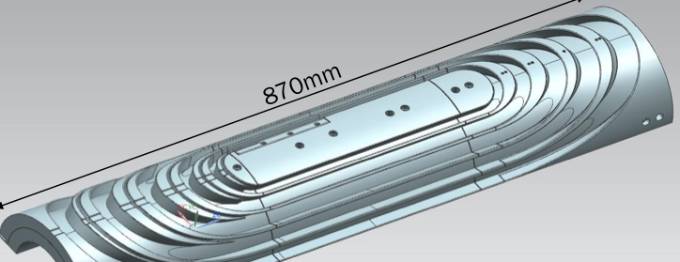
Magnet Mechanical Design (III)
+ allow rapid comparison with simulation
+ allow dense mechanical instrumentation
- Limitation in understanding of longitudinal effects
Understand the impact of coil and parts tolerances on stress distribution in the coil
  Intimately linked to our ability to make very reproducible coils with well controlled dimension
  Mechanical models to understand support structure sensitivity
    If laminated structure: a slice is enough
    If non laminated structure: ensure that mech. model is representative of the long magnet in terms of the achievable parts tolerance.
Stress management:
  New concepts can be demonstrated at a reduced scale
Demonstration of B&K support structure for
    Single aperture costheta
    Double aperture dipole magnets
      subscale racetrack double aperture ?

Slide 13
Quench protection &
Magnet Performance
+ allow large amount of instrumentation => better mapping of the magnet
+ allow understanding of some training mechanicsm
Impact of quenches on magnet performance:
  hot spot temperature exploration : Assess missing info and proceed with controlled experiment on subscales and models
  Combine mechanical and quench protection analysis in a systematic way to understand the stress distribution due to uneven temperature distribution during quench
Better understanding training and magnet performance
  Test of innovative detection and protection devices, instrumentation
  Signal analysis – controlled experiment on damaged strand in subscale
Validation of field quality
  Short model magnets are representative as a first step

Slide 14
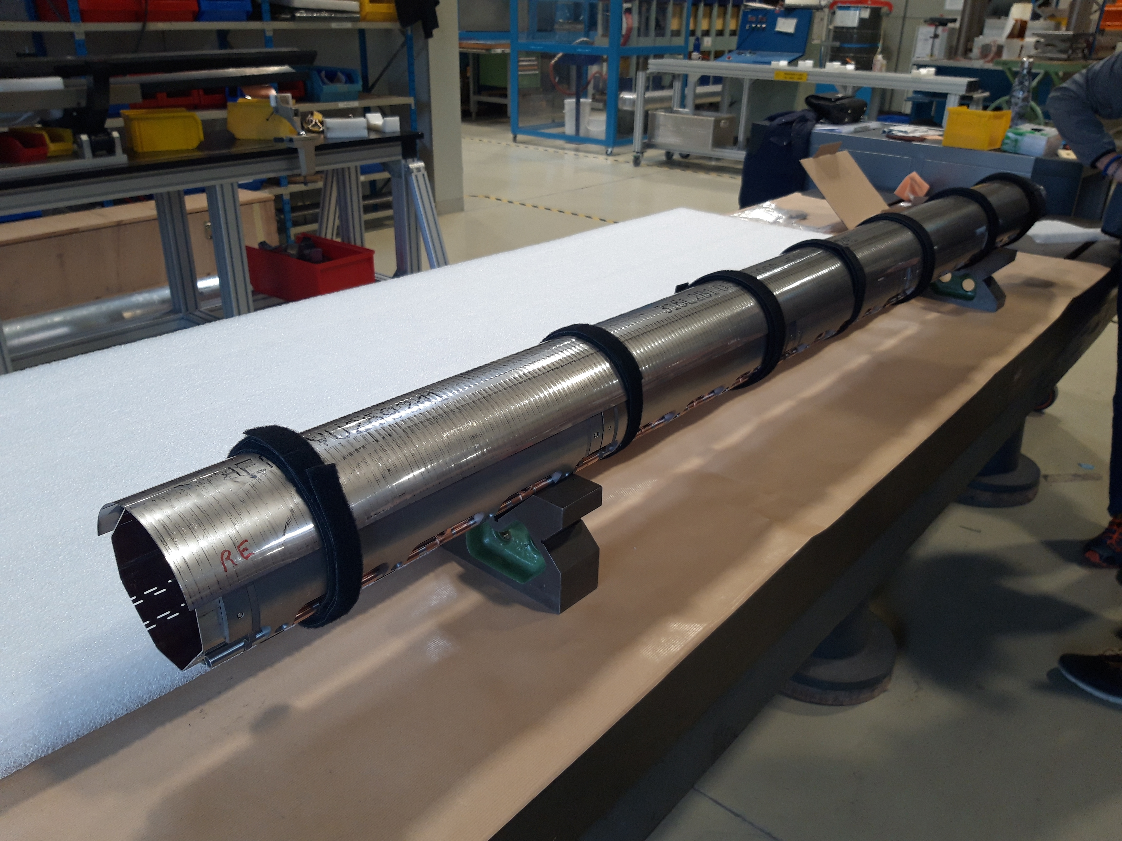
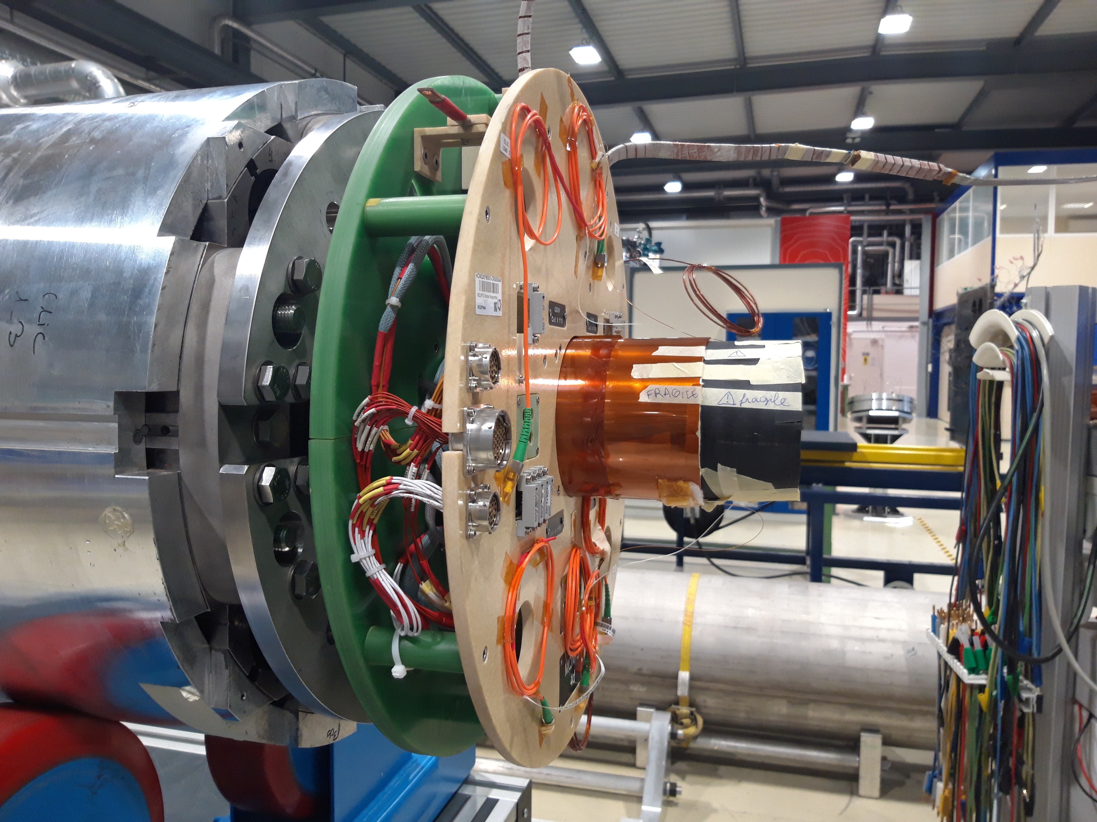
Magnet Integration in cold mass
+ mostly relevant in the transverse plane of the magnet
- Will not address longitudinal aspects
Beyond the magnet: the cold mass
Test of certain features necessary for the final integration
  Beam screen: Magnetic measurement and quenches
Most importantly, understand if some cold mass assembly steps might have an impact on coil stress
  Example of the stainless steel shell welding: Relevance of model magnets

Slide 15
In Conclusion
Are powered samples, subscale and model magnets a necessary step? DEFINITELY YES
Most of the topics we need to address at the technology level can be addressed in subscale and model magnets (with contribution from mock ups and powered samples too)
We need a systematic approach to tackle the open questions and we can only do it as a worldwide magnet community.
Importance to use competencies outside the magnet community to bring expertise when we do not have in house: Example of collaborations between CERN and ETHZ or CEA and ENS -LMT
Existing models and subscale tools can rapidly contribute to various topics
Any new model tools will require substential design work + fabrication
Long (> 2m) magnet toward a robust dipole development should not be put aside
  Limit of subscale and models: exploration of full lenght effects => possible to consider simplified long magnet as an intermediate step
Importance of a strategy rapidly at the magnet community level

