Slide 1

Specific needs for future quadrupole magnets (lattice/insertion) for a next generation collider
High Field Accelerator Magnets – Roadmap Preparation (Workshop 1 and 3 June 2021)
C. Lorin
1st june 2021
https://indico.cern.ch/event/1032199/

Slide 2
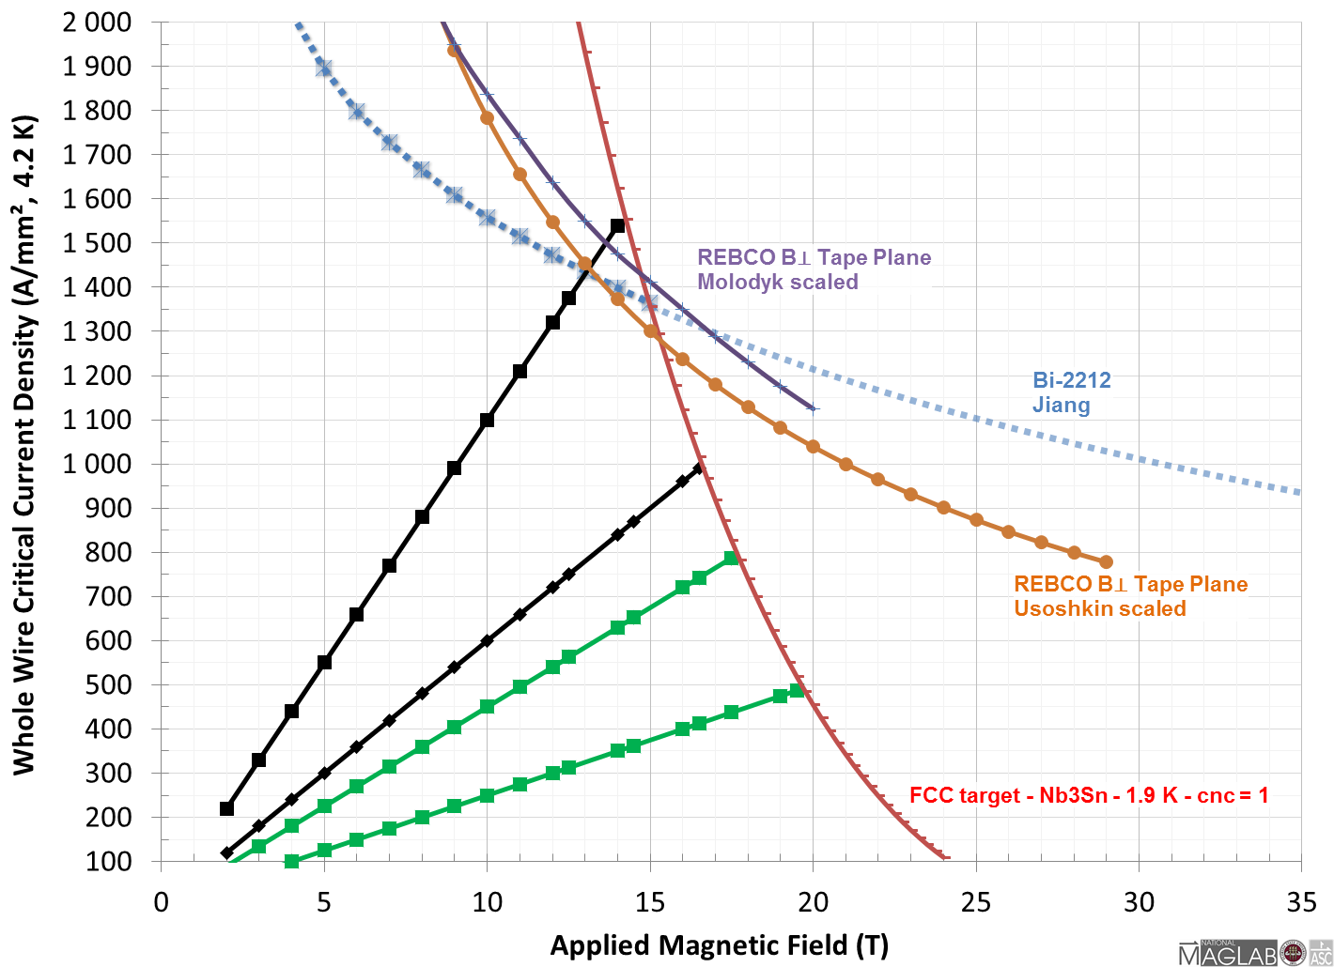
HTS FCC-hh quadrupoles?
REBCO data are scaled to:
a 50 µm substrat with 2x25 µm of copper
to get a copper/non-copper ratio (cnc) = 1
REBCO : still a long way to get a robust accelerator type cable with a weak magnetization.
Bi-2212: accelerator type cable, what about mechanical resilience?
In any case, the avantage is not obvious for quadrupoles.
QUADS
DIPOLES
A. Molodyk et al., Development and large volume production of extremely high current density YBa2Cu3O7superconducting wires for fusion, Nature scientific reports, 11:2084 (2021)
A. Usoskin et al. Long-length YBCO coated conductors for ultra-high field applications: gaining engineering current density via pulsed laser deposition/alternating beam-assisted deposition route, SuST, 094005 (2019)
J. Jiang et al., High-Performance Bi-2212 Round Wires Made With Recent Powders, IEEE TAS 6400405, (2019)
M. Ortino et al, Evolution of the superconducting properties from binary to ternary APC-Nb3Sn wires, SuST 34, 035028 (2021)

Slide 3
FCC-hh magnet performance target (2018)
 | Magnet type | Number | Max. Strength (Ap.) | Length | SC material | LHC nominal strength (56 mm aperture) | LHC nominal strength scaled to 50 mm FCC aperture
LATTICE MAGNETS | Main Dipole (MB) | 4668 | 16 T | 14.1 m | Nb₃Sn | 8.33 T | 8.33 T
 | Main Quadrupole (MQ) | 744 | 360 T/m | 7.2 m | Nb₃Sn | 223 T/m | 250 T/m
 | Trim Quadrupole (MQT) | 120 | 220 T/m | 0.5 m | Nb-Ti | 123 T/m | 140 T/m
 | Skew Quadrupole (MQS) | 96 | 220 T/m | 0.5 m | Nb-Ti | 123 T/m | 140 T/m
 | Main Sextupole (MS) | 696 | 7000 T/m² | 1.2 m | Nb-Ti | 4430 T/m² | 5560 T/m²
 | Main Octupole (MO) | 480 | 200,000 T/m³ | 0.5 m | Nb-Ti | 63,000 T/m³ | 90,000 T/m³
 | Sextupole Corrector (MCS) | 9336 | 3000 T/m² | 0.11 m | Nb-Ti | 1630 T/m² | 2050 T/m²
 | Dipole Corrector (MCB) | 792 | 4 T | 1.2 m | Nb-Ti | 3 T | 3 T
 | DIS Trim Quadrupole (MQTL) | 48 | 220 T/m | 2.0 m | Nb-Ti | 129 T/m | 145 T/m
 | DIS Quadrupole (MQDA) | 48 | 360 T/m | 9.7 m | Nb₃Sn | 129 T/m | 145 T/m
IR MAGNETS | Q1-Q3 Low lumi | 4/IP | 270 T/m (64 mm) | 10.0 m | Nb₃Sn/Nb-Ti | 215 T/m (70 mm) | MQXA - 6.37 m
 | Q2 Low Lumi | 4/IP | 270 T/m (64 mm) | 15.0 m | Nb₃Sn/Nb-Ti | 215 T/m (70 mm) | MQXB - 5.5 m
 | Q1 High Lumi | 4/IP | 130 T/m (164 mm) | 14.3 m | Nb₃Sn | 133 T/m (150 mm)* | MQXFA - 4.2 m*
 | Q2 High Lumi | 8/IP | 105 T/m (210 mm) | 12.5 m | Nb₃Sn | 133 T/m (150 mm)* | MQXFB - 7.15 m*
 | Q3 High Lumi | 4/IP | 105 T/m (210 mm) | 14.3 m | Nb₃Sn | 133 T/m (150 mm)* | MQXFA - 4.2 m*
 | D1 | 4/IP | 12 T (100 mm) | 10.2 m | Nb₃Sn | 5.6 T (150 mm)* | MBXF - 6.3 m*
 | D2 | 4/IP | 10 T (60 mm) | 12.2 m | Nb₃Sn | 4.5 T (105 mm)* | MBRD – 7.8 m*
*High Lumi project : not yet in the machine
Slide based on [D. Schoerling 2018] https://indico.cern.ch/event/656491/contributions/2920305/attachments/1628231/2596868/Schoerling_OtherMagnets_2018.pdf
Most of the data come from https://indico.cern.ch/event/656491/timetable/?view=standard [C. LORIN, A. LOUZGUITI, T. OGITSU, S. FARINON, V. KASHIKHIN]

Slide 4
Interaction Region Quadrupoles

Slide 5

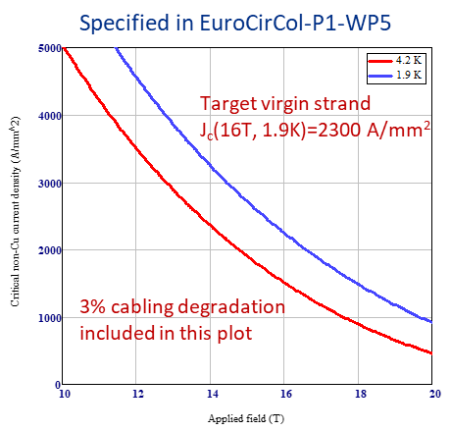
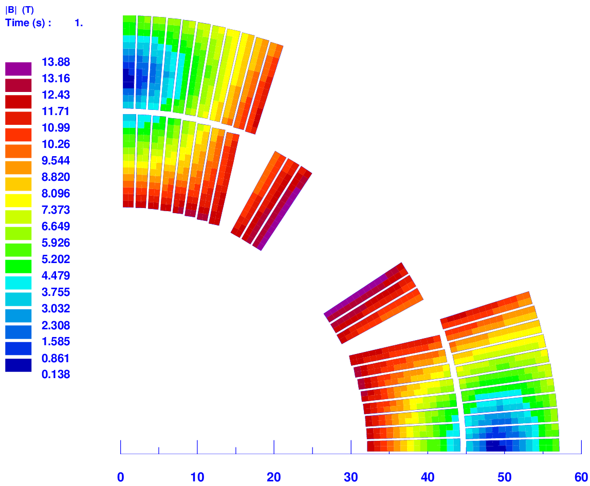
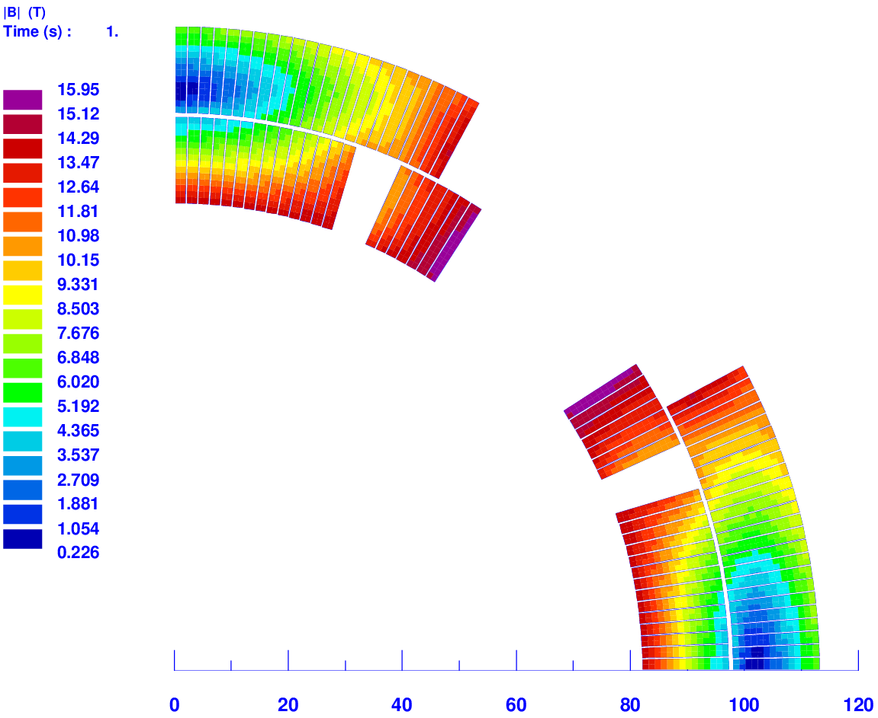
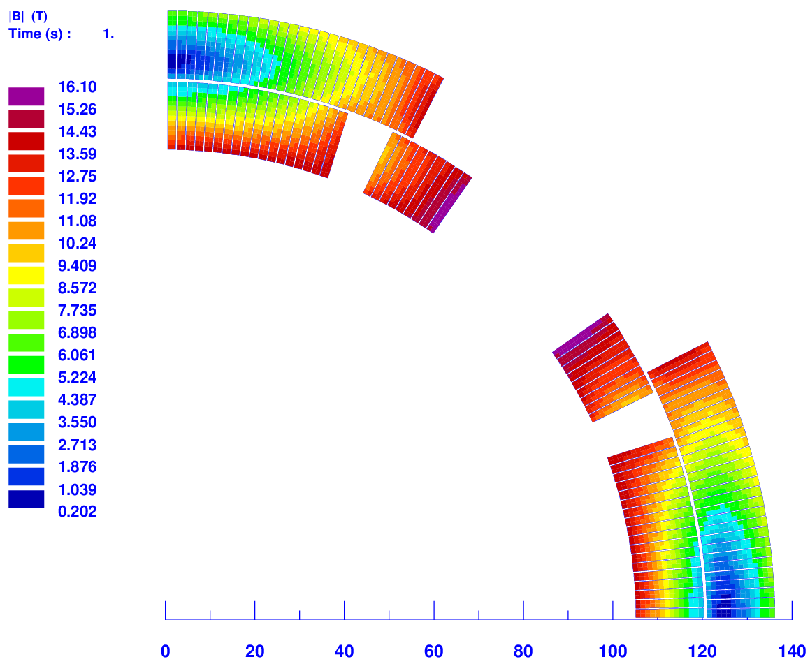
FCC IR quadrupole (SSL@1.9K)
[V. KASHIKHIN]
LL-Q1/Q2/Q3 HL-Q1 HL-Q2/Q3
380 T/m
167 T/m
131 T/m
Parameter | Unit | LL-Q1/Q2/Q3 | HL-Q1 | HL-Q2/Q3
Aperture | mm | 64 | 164 | 210
Iron yoke OD | mm | 350 | 700 | 900
Nominal gradient, G_{nom} | T/m | 270 | 130 | 105
Gradient (SSL at 1.9 K), G_{nom}/G_{max} | T/m | 270/380 | 130/167 | 105/131
Fraction of SSL at G_{nom} |  | 0.71 | 0.78 | 0.80
Peak coil field at G_{nom}/G_{max} | T | 9.9/13.9 | 12.4/16.0 | 12.9/16.1
Current at G_{nom}/G_{max} | kA | 15.2/21.9 | 17.7/23.4 | 17.7/22.7
Inductance at G_{nom}/G_{max} | mH/m | 1.89/1.83 | 8.77/8.44 | 13.60/13.14
Stored energy at G_{nom}/G_{max} | MJ/m | 0.22/0.44 | 1.37/2.31 | 2.13/3.39
F_{x} per octant at G_{nom}/G_{max} | MN/m | 0.99/1.86 | 2.94/4.62 | 3.71/5.55
F_{y} per octant at G_{nom}/G_{max} | MN/m | -1.22/-2.49 | -3.55/-6.04 | -4.48/-7.18
Azimuthal midplane stress in IL at G_{nom}/G_{max} | MPa | 65/97 | 138/233 | 185/295
Azimuthal midplane stress in OL at G_{nom}/G_{max} | MPa | 49/131 | 135/225 | 159/251
Hotspot (@nominal current & 30 ms delay) | K | ~320 | ~300 | ~320
Parameter | Unit | LL | HL (Q1 / Q2Q3
Strand diameter | mm | 0.800 | 1.000
Cu/nonCu ratio |  | 1.13
Number of strands |  | 28
Bare cable width | mm | 12.38 | 15.10
Bare cable mid-thickness | mm | 1.495 | 1.869
Insulation thickness per side | mm | 0.15
Keystone angle | ° | 1.6 | 1.2 / 0.98
https://indico.cern.ch/event/656491/timetable/?view=standard#124-triplets [V. KASHIKHIN]

Slide 6
FCC IR quadrupole (SSL@1.9K)
[V. KASHIKHIN]
LL-Q1/Q2/Q3 HL-Q1 HL-Q2/Q3
380 T/m
167 T/m
131 T/m
LL Q1/Q2/Q3
  Within reach of actual knowledge (1.6° keystone angle?) – grading with Nb-Ti?
HL-Q1
  Slightly more challenging than MQXF (High Lumi is the R&D phase ☺)
HL-Q2Q3 ->
  Azimuthal stress over actual limit at nominal (4 layers with more conductor to be checked)
  A bladder & key assembly (single aperture quadrupole)
  Protection is challenging as well (to be carefully investigated)
  Length of ~15 m (twice actual MQXF magnet)
https://indico.cern.ch/event/656491/timetable/?view=standard#124-triplets [V. KASHIKHIN]

Slide 7
Lattice Main Quadrupoles

Slide 8
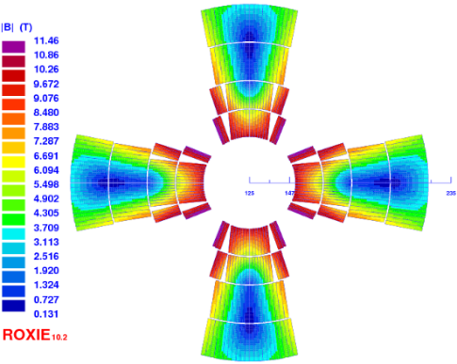
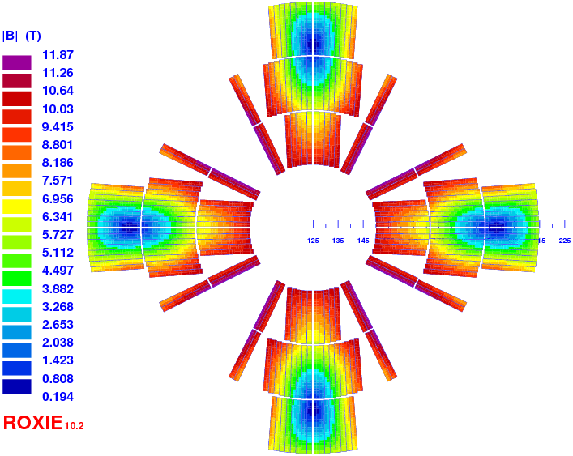
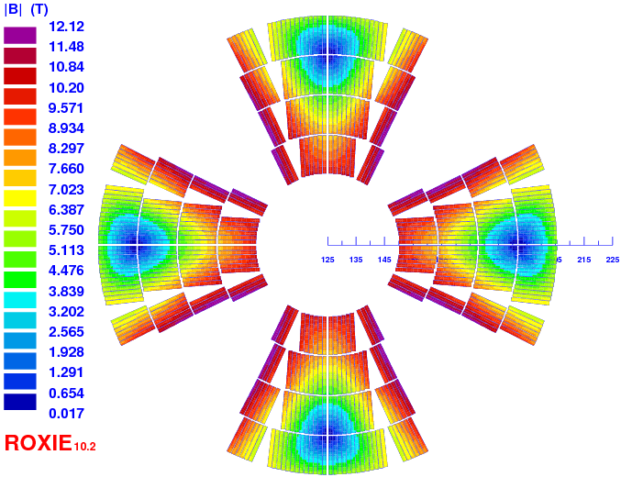
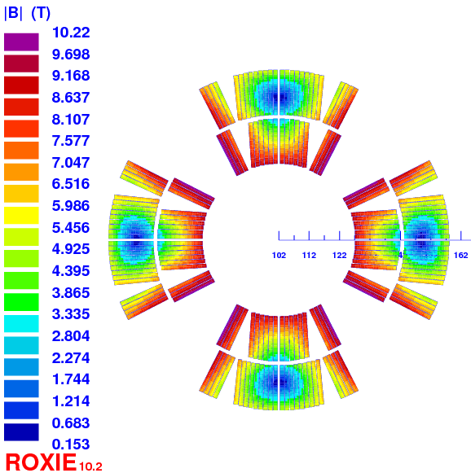
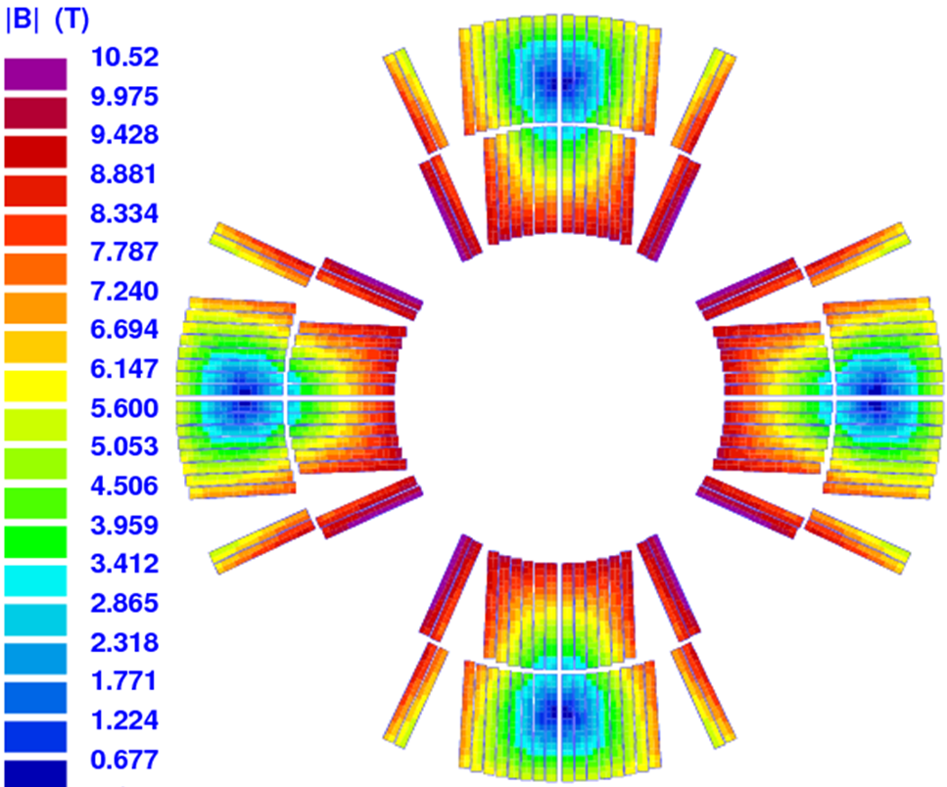
“Reminder”
1st FCC week
Cable: 40 x 0.7 mm + 38 x 1.065 mm
4 layers graded design (2×Nb₃Sn + 2×Nb-Ti) 407 T/m with 20% LL margin, no protection check
2nd FCC week
Cable: 40 x 1.0 mm / cnc = 1.55
3 layers design (3×Nb₃Sn) 413 T/m with 20% LL margin, 40 ms protection delay [E. Todesco]
3rd FCC week
Cable: 36 x 0.7 mm / cnc = 2.1
4 layers design (4 × Nb₃Sn) 400 T/m with 14% LL margin, 40 ms protection delay
4th FCC week
Cable: 40 x 0.7 mm / cnc = 1.8
2 layers design (2×Nb₃Sn) 353 T/m with 20% LL margin, 30 ms protection delay
5th FCC week
Cable: 35 x 0.85 mm / cnc = 1.65
2 layers design (2×Nb₃Sn) 367 T/m with 20% LL margin, 30 ms protection delay

Slide 9
Protection limitation
Limitation from the protection not from Jc
Dipole low field cable
36 strands x 0.7 mm / cnc 2.1 at the time of the study
(dipole common development)
C. Lorin et al. Design of a Nb3Sn 400 T/m Quadrupole for the Future Circular Collider, IEEE TAS 4004905 (2018)
C. Lorin et al., Exploration of Two Layer Nb₃Sn Designs of the Future Circular Collider Main Quadrupoles, IEEE TAS 4001005 (2019)

Slide 10
Protection limitation
Limitation from the protection not from Jc
Dipole low field cable
(dipole common development)
40 ms to 30 ms delay
=> +20 T/m or -13% of conductor
Δt = 5 ms -> ΔT ~ 50 K
C. Lorin et al. Design of a Nb3Sn 400 T/m Quadrupole for the Future Circular Collider, IEEE TAS 4004905 (2018)
C. Lorin et al., Exploration of Two Layer Nb₃Sn Designs of the Future Circular Collider Main Quadrupoles, IEEE TAS 4001005 (2019)

Slide 11
Cable specificity: High copper/non-copper ratio
This specificity may allow for a cable:
to increase the keystone angle (synergy with dipole, better distribution, less wedges)
C. Lorin et al. Design of a Nb3Sn 400 T/m Quadrupole for the Future Circular Collider, IEEE TAS 4004905 (2018)
M. Sorbi et al., The EuroCirCol 16T Cosine–Theta Dipole Option for the FCC, IEEE TAS 4001205 (2017)

Slide 12
Cable specificity: High copper/non-copper ratio
This specificity may allow for a cable:
to increase the keystone angle (synergy with dipole, better distribution, less wedges)
to increase the cable compaction (better mechanical stability/windability)
Winding trials made on a 50 mm mandrel with the 40 x 0.85 mm MQXF cable with a proper set of tooling
-> Next step: investigate the 0.7 mm strand cables as the FCC cos-theta dipole outer cable: 36/38 x 0.7 mm
C. Genot et al., FCC-hh conceptual designs and windability of the Main Quadrupoles , IEEE TAS 4000107 (2021)
M. Sorbi et al., The EuroCirCol 16T Cosine–Theta Dipole Option for the FCC, IEEE TAS 4001205 (2017)
R. Valente et al., Baseline Design of a 16 T cosθ Bending Dipole forthe Future Circular Collider, IEEE TAS 4003005 (2019)

Slide 13
Cable specificity: High copper/non-copper ratio
This specificity may allow for a cable:
to increase the keystone angle (synergy with dipole, better distribution, less wedges)
to increase the cable compaction (better mechanical stability/windability)
to reduce the flux jumps
C. Genot et al., FCC-hh conceptual designs and windability of the Main Quadrupoles , IEEE TAS 4000107 (2021)
B. Bordini et al. Impact of the Residual Resistivity Ratio on the Stability of Nb3Sn Magnets, IEEE TAS 4705804 (2012)

Slide 14
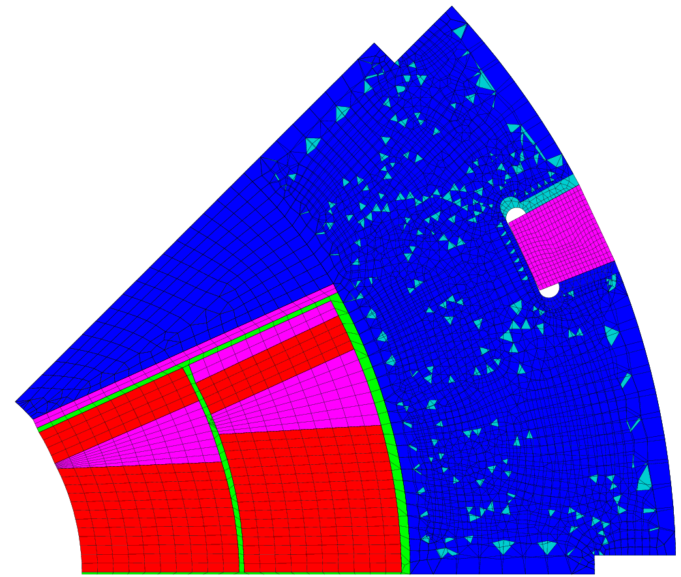
Mechanical stress – ‘order of magnitude’
Investigation on a 2 layers design with a collared option⁺
Double pancake glued (dark area)
Sliding contact elsewhere (without separation)
Mechanical properties:
Material | E [GPA] / 293 K | E [GPA] / 4.2 K | Pr | (L4.3K – L293K)/L293K
Nb₃Sn | 30 | 33 | 0.3 | 3.4e-3*
Epoxy | 5 | 8 | 0.34 | 6.0e-3
13RM19 (steel) | 200** | 210* | 0.28* | 2.7e-3**
DISCUP (copper) | 96*** | 96 | 0.3 | 3.3e-3
*Tommasini D. et al. https://indico.cern.ch/event/556692/contributions/2591664/ 3rd FCC week Berlin, 2017 + EuroCirCol meeting
**Lanza C., Perini D., Characteristics of the austenitic steels used in the LHC main dipoles, MT17, 24-28 September 2001, Geneva
***Scheuerlein et al, Mechanical properties of the HL-LHC 11 T Nb3Sn magnet constituent materials, IEEE TAS, 4003007, (2017)
⁺C. Lorin et al., Exploration of Two Layer Nb₃Sn Designs of the Future Circular Collider Main Quadrupoles, IEEE TAS 4001005 (2019)

Slide 15
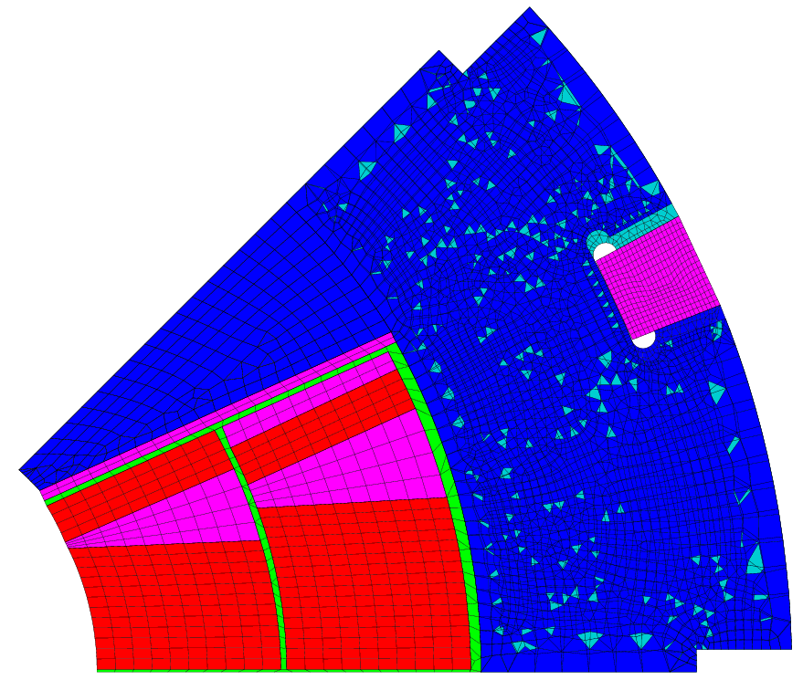
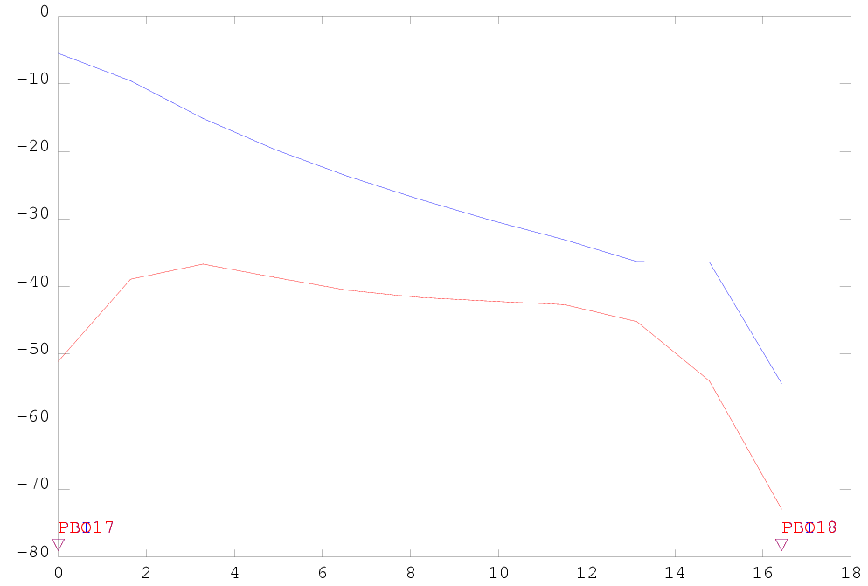
Mechanical stress – ‘order of magnitude’
Goal:
good coil-pole contact at nominal (< -5 MPa)
[MPa]
inner layer
outer layer
Insulated cable width
[mm]
Azimuthal stress in the Nb₃Sn blocks of the coil
Collaring | Collaring - 10% creep* | Cold | Powering
peak / average | peak / average | peak / average | peak / average
-101.5 / -85.5 | -91.4 / -76.9 | -88.5 / -73.2 | -111.1 / -69.7
*Felix Wolf : “Strong creep behavior starting at 125 MPa” in Effect of transverse stress applied during reaction heat treatment on the stiffness of Nb3Sn Rutherford cable stacks, https://indico.cern.ch/event/743626/contributions/3154023

Slide 16
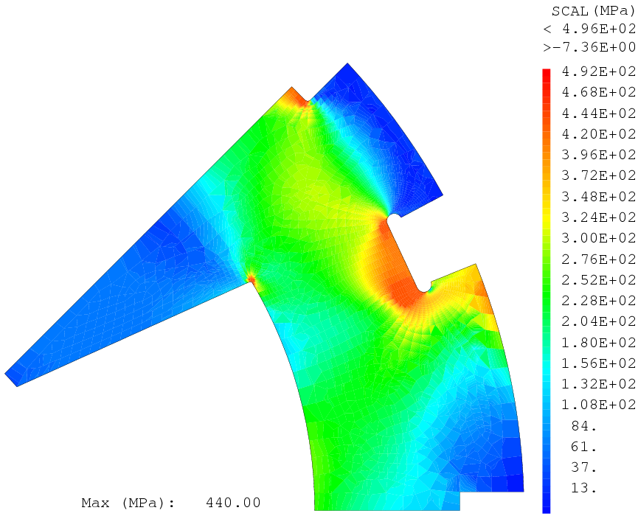
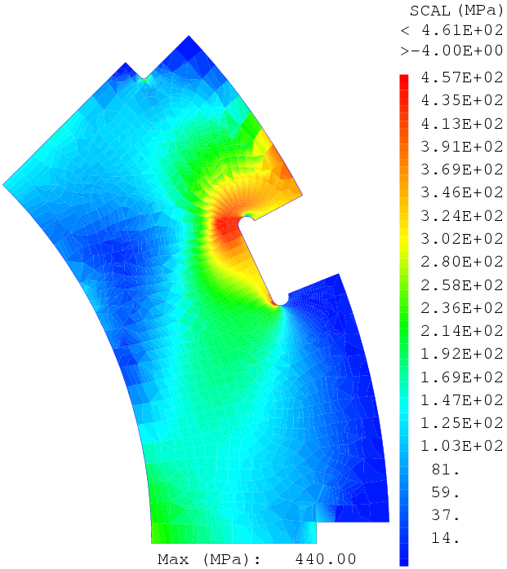
Mechanical stress – ‘order of magnitude’
Stress
conservative
440 MPa
200 GPa
Strain
Collar steel: 13RM19 (LHC quad steel)
Yield strength of the collars σ_{0.2} = 440 MPa*
Azimuthal stress in the Nb₃Sn blocks of the coil
Collaring Elasto Plastic model
peak / average
-111.6 / -86.5
Collaring Elastic model
peak / average
-101.5 / -85.5
*Lanza C., Perini D., Characteristics of the austenitic steels used in the LHC main dipoles, MT17, 24-28 September 2001, Geneva
**Bertinelli F., et al., Production of austenitic steel for the LHC superconducting dipole magnets, IEEE TAS, vol 16, no 2, (2006)
(for information YUS130 S for LHC dipoles**)

Slide 17
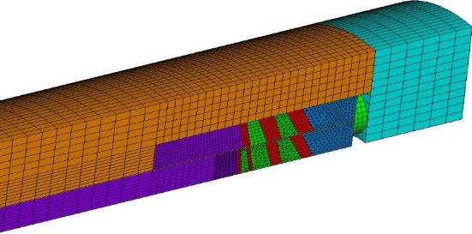
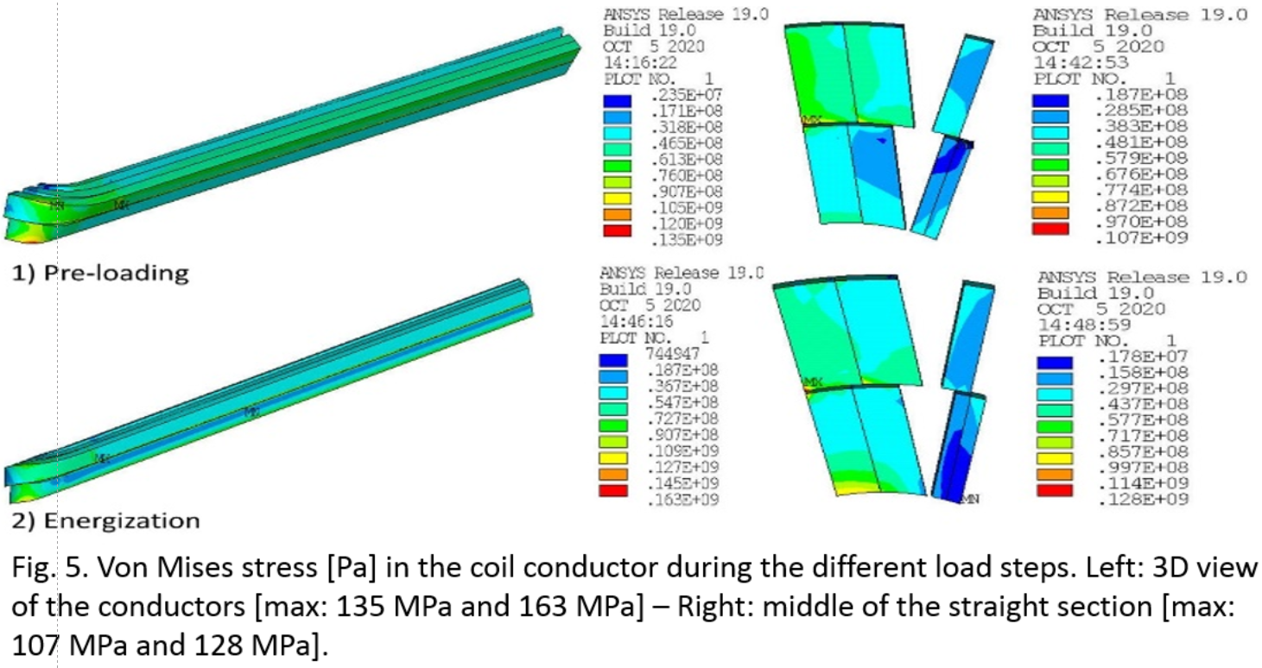
Mechanical stress – ‘order of magnitude’
3D investigation
3D straight section = 2D + 10 MPa
Very localized peak stress in the coil end
~140 MPa preloading
~170 MPa powering
C. Pes et al.,Preliminary 3D mechanical design of the FCC-hh main quadrupoles, IEEE TAS 4001304 (2021)

Slide 18
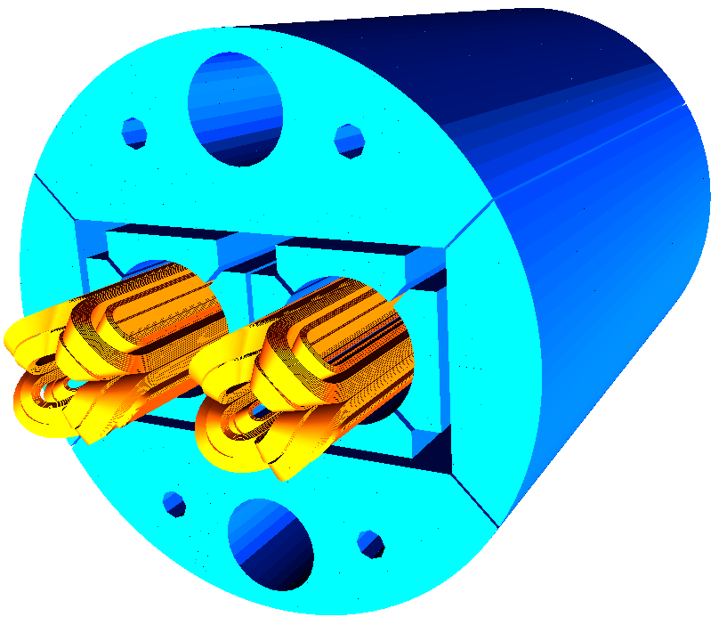
Mechanical stress – ‘order of magnitude’
FCC MQ - 2 layers / 10.5 T / 365 T/m:
  Averaged stress in the coil any time: 80 - 100 MPa
  Peak stress in the straight part any time: 110 - 130 MPa – very localized but all along the magnet
  Peak stress p-loading in the coil ends: 130 - 140 MPa – (turns-spacers contact)
  Peak stress powering in the coil ends: 160 - 170 MPa - (turns-spacers contact)
11 T preloading target is below 150 MPa
A collared option should be first envisaged (straight part stress < 130 MPa)
A bladder&key is very well suited for single ap. quadrupole, not straightforward to apply it to 2-in-1 ap. quadrupole (coupling)
A. Zlobin et al., Nb₃Sn Accelerator Magnets: Designs, Technologies and Performances, https://doi.org/10.1007/978-3-030-16118-7, (2019)
P. Ferracin et al.,Mechanical Analysis of the COllaring Process of the 11 T Dipole Magnet, IEEE TAS 4002705 (2019)
G. De Marzi et al., On the mechanisms governing the critical current reduction in Nb3Sn Rutherford cables under tranverse stress, 11:7369, Nature Scientific Reports (2021)

Slide 19
Conclusion: FCC IR needs/requirements
[V. KASHIKHIN]
Requirements close to MQXF… except for Q2Q3 HL version with some ambitious challenges:
  Strand performing @ Bss ~ 16 T (area of interest ≠ HFM dipole)
  Aperture ~210 mm
  Azimuthal stress ~190 MPa over the actual limit at nominal (4 layers to be considered?)
  A bladder&key assembly (single aperture quadrupole)
  Protection is challenging (to be carefully investigated)
  Length of ~15 m (twice the MQXF long version)

Slide 20
Conclusion: FCC MQ needs/requirements
Small strand (Φ ≤ 0.7 mm) + 30-40 strands cable (I ~ 13 kA – 18 kA)
High copper/non-copper ratio strand in synergy with current HFM dipole low field cable (cnc ~ 2)
  May release constraints on keystoning, flux jump, compaction, mechanical performance…
Strand performing @ Bss = 12 T – 15 T (area of interest ≠ HFM dipole)
Protection has to be challenged as for the HFM dipole (1 ms ~ 10 K or 2 T/m)
Supporting system and process to avoid assembly stress > 150 MPa
  130 MPa peak stress in the straight part
  How to reduce/manage axial stress in the coil ends

Slide 21
Conclusion: FCC MQ R&D proposal
Two layers design very challenging to reach the target of 360 T/m
Mechanically challenging to develop 2-in-1 quadrupole with bladder and key technology
Target objects (R&D to be defined to reach them):
  Single aperture, 2 layers, small cable (outer dipole), collared magnet ~340 T/m*
  Two additional layers on the previous core to get a 4 layers design >360 T/m
  *~360 T/m for 16 T dipole
  ~340 T/m for 15 T dipole
  Nevertheless, stronger gradient = more dipole room = less dipole field

