Slide 1
HFM Road-Map Virtual Workshop
Construction of High Field Magnets for a Future Hadron Collider
Frédéric SAVARY
Date: June 1st, 2021 - https://indico.cern.ch/event/1032199/

Slide 2
Outlook
Construction of the Nb₃Sn 11T dipole and MQXF (a first experience)
  From an idea to the execution of a work plan
  Associated challenges (technical, managerial)
  What we have learned
Perspectives towards industrialization on a (much) larger scale
  From the magnet point of view
  From R&D to series production, which way?
Considerations on manufacturing infrastructure
Cost targets
Concluding remarks

Slide 3
Outlook
Construction of the Nb₃Sn 11T dipole and MQXF (a first experience)
  From an idea to the execution of a work plan
  Associated challenges (technical, managerial)
  What we have learned
Perspectives towards industrialization on a (much) larger scale
  The magnet point of view
  From R&D to series production, which way?
Considerations on manufacturing infrastructure
Cost targets
Concluding remarks

Slide 4
The idea, the work plan and its execution (11T)
Set a plan, tailor it for the production of a small series of superconducting accelerator magnets made of a new technology, Nb₃Sn
There were stringent time constraints, with the need of installing 4 magnets during the Long Shutdown 2 (initially, even more magnets, later reduced to 4 to be installed + 2 spare magnets)
Start the development activities notwithstanding the (temporary) lack of internal resources due to the Long Shutdown 1 of LHC
Idea: call contribution from industry to compensate for this (2011) and to prepare industrial partners to future projects (medium / longer term)
The R&D activities and model programme started in the end of 2011 at FNAL in the US

Slide 5
The idea, the work plan and its execution, 1 (11T)
P h a s e 1:
P h a s e 2.a:
P h a s e 2.b:
Development contracts
  Complete manufacturing design of 11T, QXF
  Contribute to magnet model programme (short)
  Contribute to the design of tooling (long)
  Manufacture the coils and collared coils of the full-length prototype
Leading magnet manufacturers in Europe
  S156/TE: BNG – Germany
  S157/TE: Alstom – France
  S158/TE: ASG Superconductors – Italy
  S159/TE: Oxford Instruments – UK
  Kick-off meetings between Jul. & Oct. 13
Preparation of production of full-size 11T by industry, for coils and collared coils, on the CERN site
Preparation work for the part cold mass assembly also initiated, done in full by CERN, also for cryostating and cold tests
Series production
Contract signature for coils and collared coils on 2018-01-24
Contract execution started in early 2018 with “effective date” on
2018-02-12
First CC delivered on 2018-11-30
11T Task Force Nov. 17
SP107 tested in July 18
Start @ FNAL US
11T P h a s e 1
11T P h a s e 2.b
2011 | 2012 | 2013 | 2014 | 2015 | 2016 | 2017 | 2018 | 2019 | 2020
IDEA
L S 1
11T P h a s e 2.a
L S 2
SP101 tested
in June 14
SP109 tested in Dec. 18
Model programme @ CERN
Notes:
Although the orginal idea was that the series production take place in industry at their premises, it became obvious that the work should be done at CERN

Slide 6
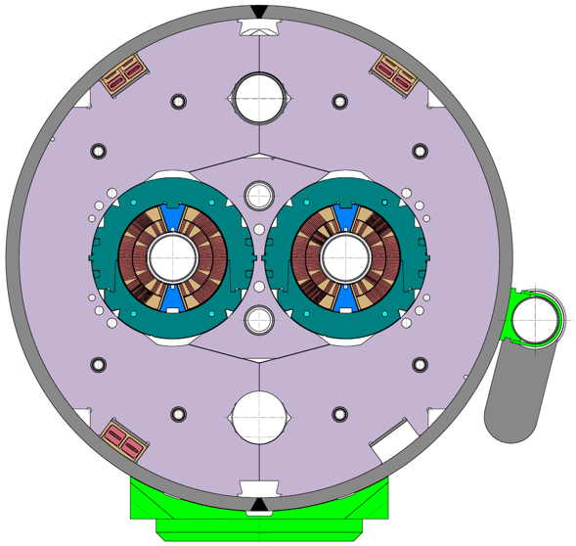
The idea, the work plan and its execution, 2 (11T)
IT-4282/TE/HL-LHC in June 17, contract signature (S197/TE) with Alstom-GE on 2018-01-24
“Provision of services at CERN for the manufacturing of collared coils for the 11 T dipole magnet
of HL-LHC” – Work to be done on the CERN site
Scope of work:
  30 coils
    16, Nb of coils needed to produce 4 magnets for installation in the machine
    8, Nb of coils needed to produce 2 spare magnets
    6, Nb of additional coils as contingency to cover for losses in production
  12 collared coils
    8, Nb of collared coils needed to produce 4 magnets
    4 Nb of collared coils needed to produce 2 spare magnets
  Finally, extended to 35 coils and 15 collared coils
Manpower:
  15 FTE·y (Alstom-GE) + 2 FTE·y (CERN cat. 2, Eng.) to oversee production + additional tech. support, QA and specific QC
Peak production rate:15 coils/year
Contract terminated on 2021-01-31:
  5 major NC’s in production with severe outcome: 4 coils rejected and 1 coil quarantined (excl. coils lost during cold tests)
  “COVID” delay of about 3 months

Slide 7
Managerial challenges (11T)
Prepare the group (TE-MSC) for the production of the first-of-a-kind superconducting accelerator magnet made of Nb₃Sn conductor, of 5.5-m length, and only a few units.
Form, and train a mixed team comprising contractor and CERN personnel.
A contractor carrying out work on the CERN site under its own responsibility with performance obligations.
Get people to work together, for the best, each party bearing its responsibilities and liabilities (the contractor being liable for the quality and performance of the collared coils, and CERN being responsible for providing manufacturing drawings/procedures, tooling/infrastructure, components, and execution of warm magnetic measurements).
Complete the engineering design of the full-length magnet on time, and a set of validated manufacturing and assembly procedures, in particular for the critical collaring operation for which a Task Force was put in place for this in November 2017.
CERN to learn from industry on production management, work methods, work breakdown structure and work station (“an area where work of a particular nature is carried out, such as a specific location on a manufacturing assembly line”), training of personnel and competency matrix, root cause analysis following NCs and 5 whys method through the fishbone – aka Ishikawa – diagram, FME (Foreign Material Exclusion),…

Slide 8
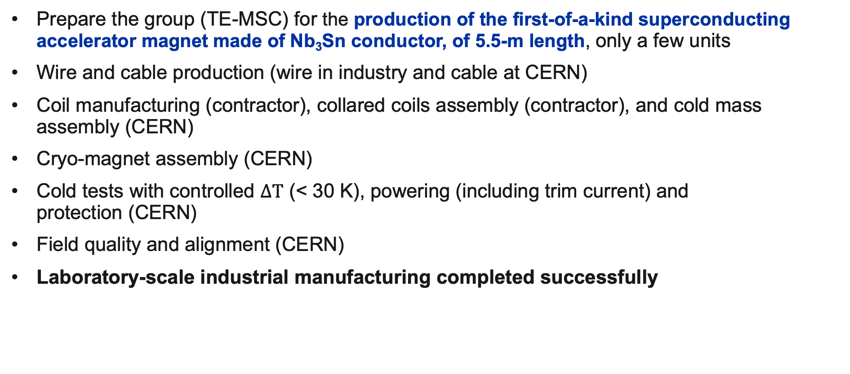
Technical challenges – On the positive side (11T)
Prepare the group (TE-MSC) for the production of the first-of-a-kind superconducting accelerator magnet made of Nb₃Sn conductor, of 5.5-m length, only a few units
Wire and cable production (wire in industry and cable at CERN)
Coil manufacturing (contractor), collared coils assembly (contractor), and cold mass assembly (CERN)
Cryo-magnet assembly (CERN)
Cold tests with controlled $∆T$ (< 30 K), powering (including trim current) and
protection (CERN)
Field quality and alignment (CERN)
Laboratory-scale industrial manufacturing completed successfully

Slide 9
11T coils production dashboard on 2020-09-26
2018
2019
2020
First collaring delivery
CERN requested holding time (collaring procedure)
17 coils produced in 2019, of which
15 coils accepted
Interruption of activities – CERN safe mode
Real start
Real delivery
Contractual
delivery

Slide 10
Technical challenges – on the “Need to be revisited” side
Lessons learned
Full-length cryo-magnets reveal features and behaviours that go beyond the experience collected along the short model programme. The R&D and the engineering work need to be revised.
Large components and tooling combined with (extremely) brittle material imply high production risk. Nb₃Sn coils are vulnerable even after impregnation (handling, storage, inspection … all require great care).
The longitudinal mechanics and the support of the coil ends are tricky. The axial e.m. forces are huge (45 t per aperture!), the cable/wire is bent, twisted, and stressed in all directions, with relatively uncertain support conditions (compared to the straight part). The design of the heads, in particular the shape of the head spacers, is of utmost importance.
(Very) Tight tolerances are specified, and it is easy to exceed the limits, which can imply unacceptable stress/strain on the cable/wire with risk of conductor damage.
Thermo-mechanical effects imply stress concentration, and therefore excursion beyond the conductor allowable limits.
The manufacturing process is artisanal with a lot of handwork. It is not yet sufficiently robust.
The cable insulation is (too) thin, and weak (low mechanical strength) while it is the local support of the cable/wire. The amount of resin, i.e. glue, is small, and adhesion to metallic parts is weak. The resin system is cracking, and detaching from the coil parts.

Slide 11
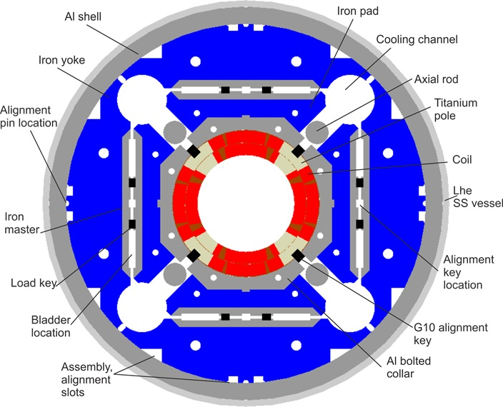
Production of MQXF
Courtesy E. Todesco
All magnets produced in house at CERN or US laboratories
Coil manufacturing
  Three different production lines (CERN Bldg. 180, BNL, FNAL),
  each one producing 50 coils – total of 150 coils – 170 m of
  Nb₃Sn magnets
    This is about one order of magnitude larger than what has been done so far
  Two lengths: 4.2 m and 7.15 m
  Until now, about 20 coils per production line were completed
Magnet assembly
  Two sites: LBNL and CERN
  At the end of HL LHC we will have
  assembled 30 magnets with
  bladder and key loading and Al shells
  7 magnets assembled in US and 3 at CERN

Slide 12
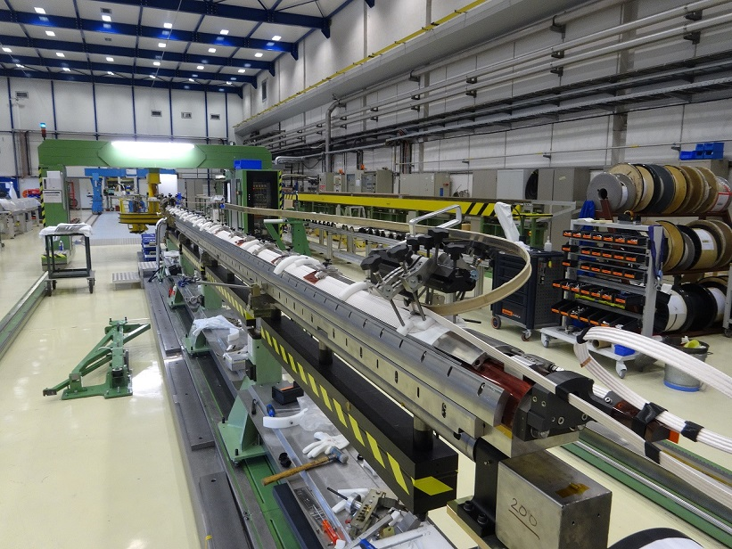
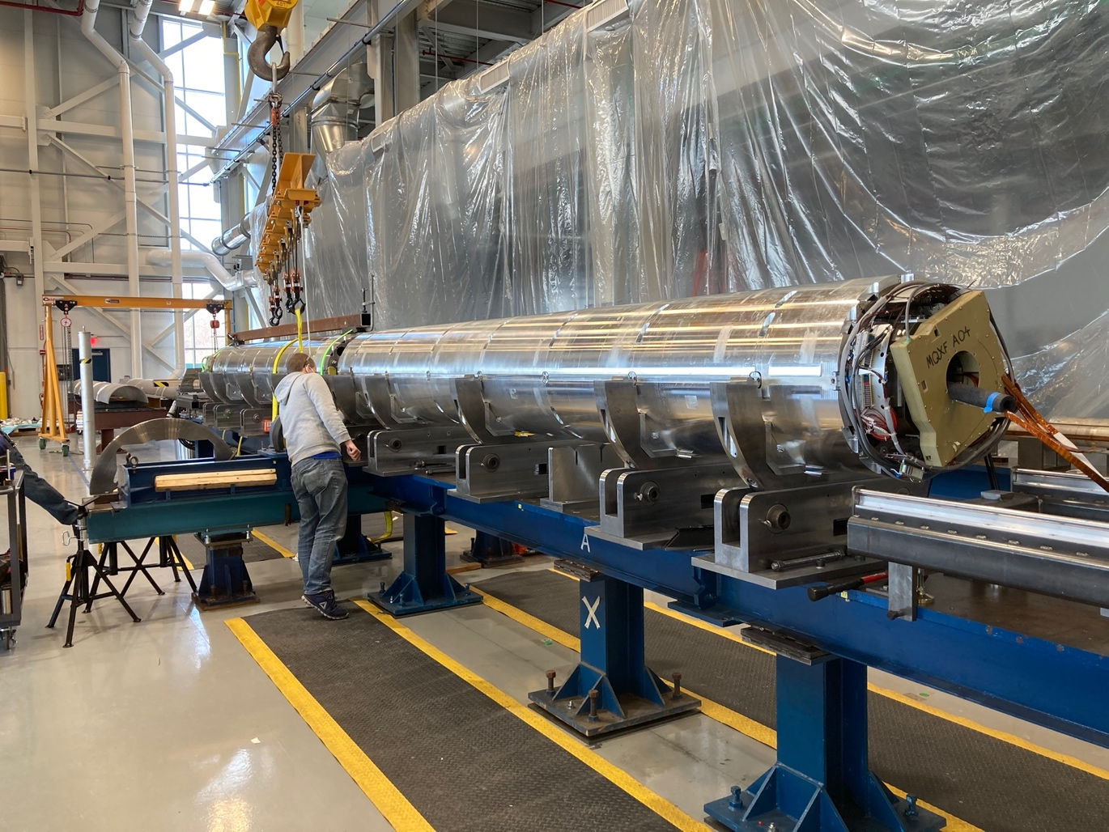
Production of MQXF
Courtesy E. Todesco
The production rate
  With the present layout of this first mini-series of Nb₃Sn magnet, one coil every 3 weeks per production line
The cost factor
  Coil manufacturing is a dominant per of the magnet (80% for the MQXF, assuming 5 coils per magnet – note this is a single aperture)
The main concerns
  As in 11 T, the rather high rate of rejected coils and the large number of manual operations during the coil manufacturing
  The control of azimuthal coil size.
7.15-m-long coil at CERN
(A. Milanese, S. Izquierdo Bermudez et al.)
Two 4.2-m-long magnets in FNAL
(G. Ambrosio, S. Feher, et al.)

Slide 13
Outlook
Construction of the Nb₃Sn 11T dipole and MQXF (a first experience)
  From an idea to the execution of a work plan
  Associated challenges (technical, managerial)
  What we have learned
Perspectives towards industrialization on a (much) larger scale
  The magnet point of view
  From R&D to series production, which way?
Considerations on manufacturing infrastructure
Cost targets
Concluding remarks

Slide 14
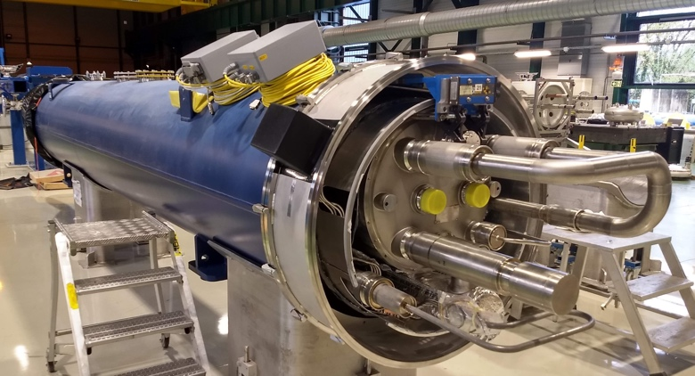
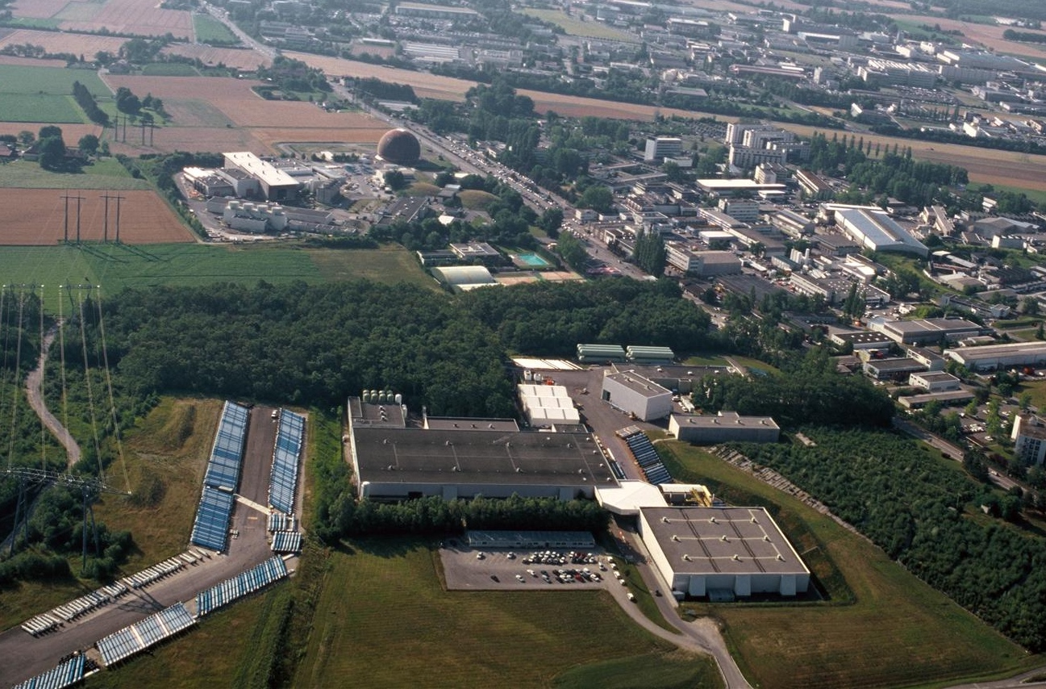
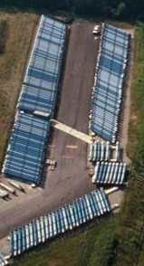
From 6 + 30 units
From 6 + 30 units to … 5000 … quite a challenge!

Slide 15
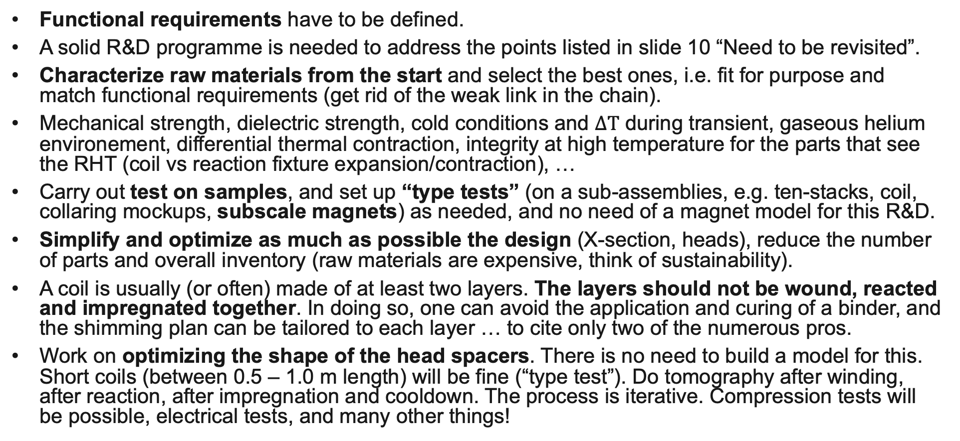
Towards industrialization – From the magnet side
Functional requirements have to be defined.
A solid R&D programme is needed to address the points listed in slide 10 “Need to be revisited”.
Characterize raw materials from the start and select the best ones, i.e. fit for purpose and match functional requirements (get rid of the weak link in the chain).
Mechanical strength, dielectric strength, cold conditions and $∆T$ during transient, gaseous helium environement, differential thermal contraction, integrity at high temperature for the parts that see the RHT (coil vs reaction fixture expansion/contraction), …
Carry out test on samples, and set up “type tests” (on a sub-assemblies, e.g. ten-stacks, coil, collaring mockups, subscale magnets) as needed, and no need of a magnet model for this R&D.
Simplify and optimize as much as possible the design (X-section, heads), reduce the number of parts and overall inventory (raw materials are expensive, think of sustainability).
A coil is usually (or often) made of at least two layers. The layers should not be wound, reacted and impregnated together. In doing so, one can avoid the application and curing of a binder, and the shimming plan can be tailored to each layer … to cite only two of the numerous pros.
Work on optimizing the shape of the head spacers. There is no need to build a model for this. Short coils (between 0.5 – 1.0 m length) will be fine (“type test”). Do tomography after winding, after reaction, after impregnation and cooldown. The process is iterative. Compression tests will be possible, electrical tests, and many other things!

Slide 16
Industrialization – The usual way
Time flying this direction → → → Focus on “sequence”
R & D
Prototyping
Production
Conductor and cable R&D
Scaling from short to full-length magnet
Pre-series (recall LHC)
Electro-magnetic design
Mechanical design
Add “machine” features and make it a true cold mass assembly and cryo-magnet
Series
Short Model Coils
Racetrack Model Coils
Short model magnet
Can we achieve the performance targets on a long magnet?
Prod. Readiness Review
Can we achieve the performance targets?
Readiness for installation

Slide 17
Industrialization – Another way for brainstorming
Time flying this direction → → → Focus on “sequence”
R & D
Model & Prototyping
Final validation – Production
Conductor and cable R&D
Engineering design of the full-length magnet
Model: a prototype of short length (tooling compatibility)
Cold testing of full-length coil can/should be envisaged
Prototype: a simplified cold mass assembly, fully instrumented (not a “machine” version of the cold mass assembly)
Pre-series in laboratory
Add “machine” features and make it a true cold mass assembly and cryo-magnet
Production Readiness R.
Electro-magnetic design
Mechanical design
Electrical design
Material characterization on samples
Type tests, subscale magnets (talk H. Felice)
Winding tests (optimization of head spacers)
Impregnation tests
Pre-series in industry
Series in industry
Can we achieve the performance targets?
Readiness for installation

Slide 18
Other important items
Specify as soon as possible the functional requirements, and be as much exhaustive as possible from the start
Component procurement
    This is a very important part of the job.
    QA/QC monitoring: manufacturing drawings, technical specifications, contract supervision (pre-series validation step, statistical process control, verification checks throughout production in order to intercept any deviation from the requirements).
    This requires resources!
QA/QC monitoring (magnet construction)
    MIP and procedures (writing procedures is a difficult job).
    Document management.
    Tooling commissioning, verification and calibration @ regular intervals.
    Training and qualification of personnel (including development of polycompetence).
  Statistical process control.
Storage
    Always a challenge, and the bigger the project the bigger the challenge!

Slide 19
Outlook
Construction of the Nb₃Sn 11T dipole and MQXF (a first experience)
  From an idea to the execution of a work plan
  Associated challenges (technical, managerial)
  What we have learned
Perspectives towards industrialization on a (much) larger scale
  The magnet point of view
  From R&D to series production, which way?
Considerations on manufacturing infrastructure
Cost targets
Concluding remarks

Slide 20
Tooling – winding (short vs long)
Winding mandrel rotates around a vertical axis and the cable spool is fixed
Best is to manufacture both short models and full-length magnets on the same type of machine
Short coil
Long coil
Winding mandrel does not rotate around a vertical axis and the cable spool is suspended to a gantry to turn around the coil

Slide 21

Robotic winding is not a crazy idea!
From the World Economic Forum (https://www.weforum.org):
COVID-19 has highlighted (1) the need to create more resilient supply chains and (2) the importance of human workers.
Automation alone can be expensive and inflexible, because robots are typically designed to carry out just one precise task.
The best choice is to pair robots with human workers, combining the strength and speed of industrial robots with the creativity and ingenuity of humans.
Manufacturing is faster, cheaper and safer when humans and robots work together.

Slide 22
Tooling – Impregnation system
Impregnation with coil horizontal, give it a try!
Reduce diameter of the vacuum chamber
Do we really need a vacuum chamber?
Notes:
u

Slide 23
Outlook
Construction of the Nb₃Sn 11T dipole and MQXF (a first experience)
  From an idea to the execution of a work plan
  Associated challenges (technical, managerial)
  What we have learned
Perspectives towards industrialization on a (much) larger scale
  The magnet point of view
  From R&D to series production, which way?
Considerations on manufacturing infrastructure
Cost targets
Concluding remarks

Slide 24
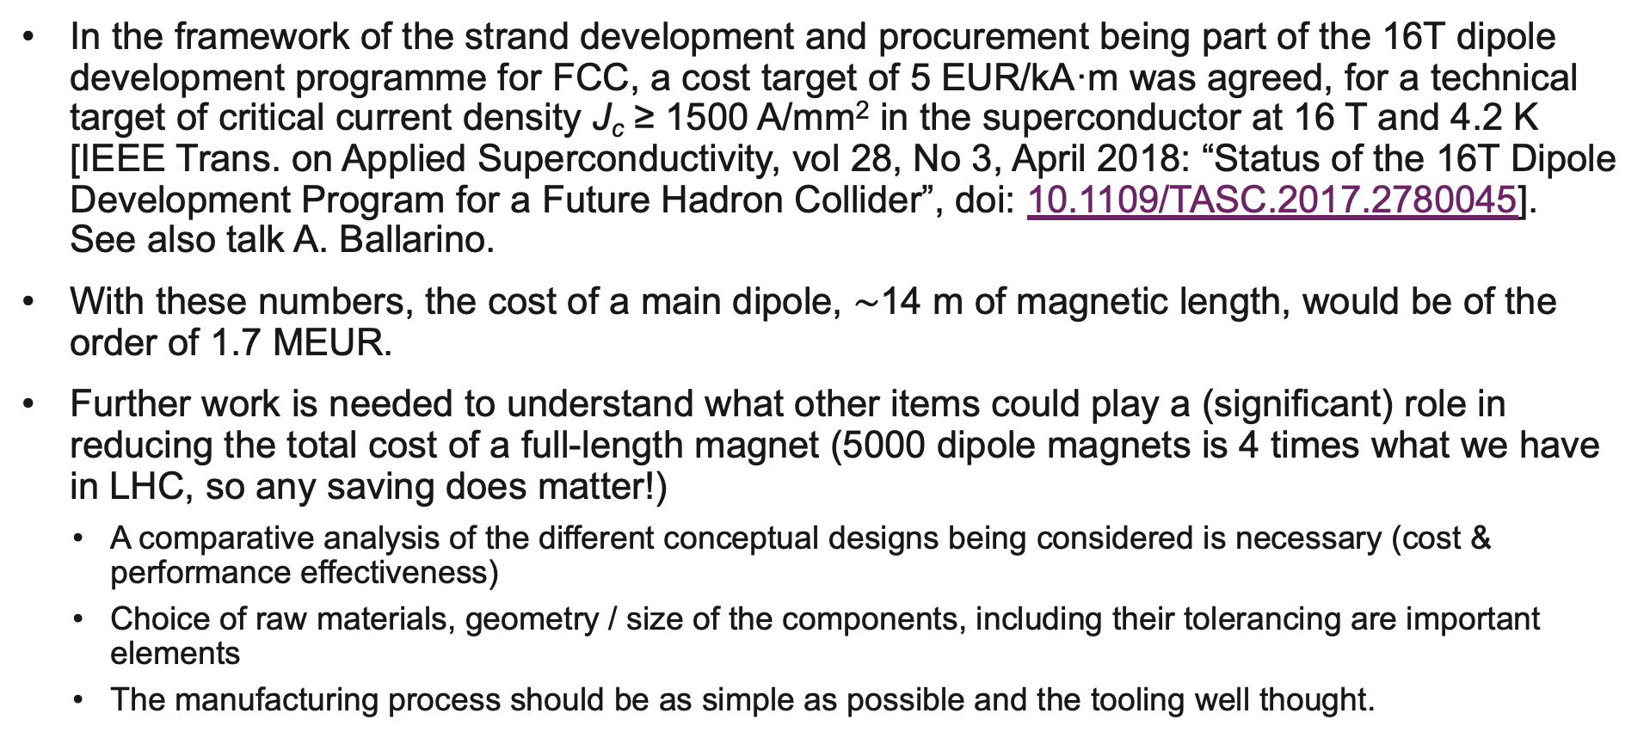
Current view of cost targets
In the framework of the strand development and procurement being part of the 16T dipole development programme for FCC, a cost target of 5 EUR/kA·m was agreed, for a technical target of critical current density J_{c} ≥ 1500 A/mm² in the superconductor at 16 T and 4.2 K
[IEEE Trans. on Applied Superconductivity, vol 28, No 3, April 2018: “Status of the 16T Dipole Development Program for a Future Hadron Collider”, doi: 10.1109/TASC.2017.2780045].
See also talk A. Ballarino.
With these numbers, the cost of a main dipole, $\sim$14 m of magnetic length, would be of the order of 1.7 MEUR.
Further work is needed to understand what other items could play a (significant) role in reducing the total cost of a full-length magnet (5000 dipole magnets is 4 times what we have in LHC, so any saving does matter!)
  A comparative analysis of the different conceptual designs being considered is necessary (cost & performance effectiveness)
  Choice of raw materials, geometry / size of the components, including their tolerancing are important elements
  The manufacturing process should be as simple as possible and the tooling well thought.

Slide 25
Outlook
Construction of the Nb₃Sn 11T dipole and MQXF (a first experience)
  From an idea to the execution of a work plan
  Associated challenges (technical, managerial)
  What we have learned
Perspectives towards industrialization on a (much) larger scale
  The magnet point of view
  From R&D to series production, which way?
Considerations on manufacturing infrastructure
Cost targets
Concluding remarks

Slide 26
Concluding remarks
The very large scale production of state of the art superconducting accelerator magnets made of Nb₃Sn will be challenging.
A large scale production implies adequate manufacturing methods and infrastructure in order to keep costs under control.
Still, the high quality requirements will remain a first priority with no compromise.
The definition and optimization of the production means need to be part of magnet development programme from the early stage of the project.
The ongoing projects of the 11T and the MQXF (both
CERN and US-AUP) provide very relevant experience
for us to define a consistent magnet development plan,
which could be based on a revised definition of the R&D
phase on the one side and of the Model&Prototyping
phase on the other side.

Slide 27
Thank you for your attention

Slide 28
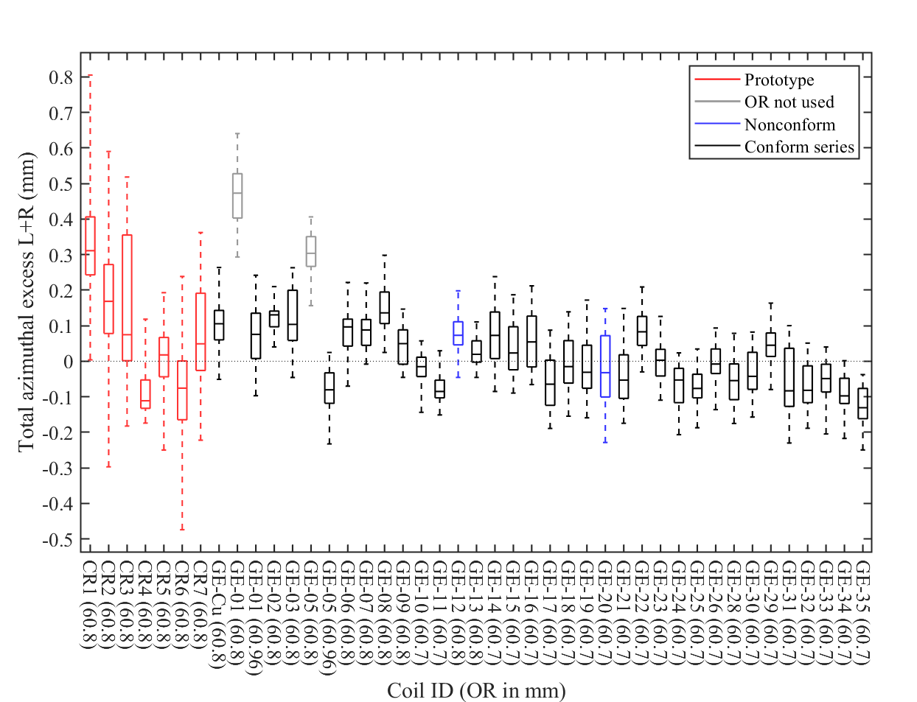
About reproducibility of a process throughout production
Graphs, courtesy D. Pulikowski & J.L. Rudeiros Fernandez
Total azimuthal excess per coil
Average quadrant excess when using tailored shims

Slide 29
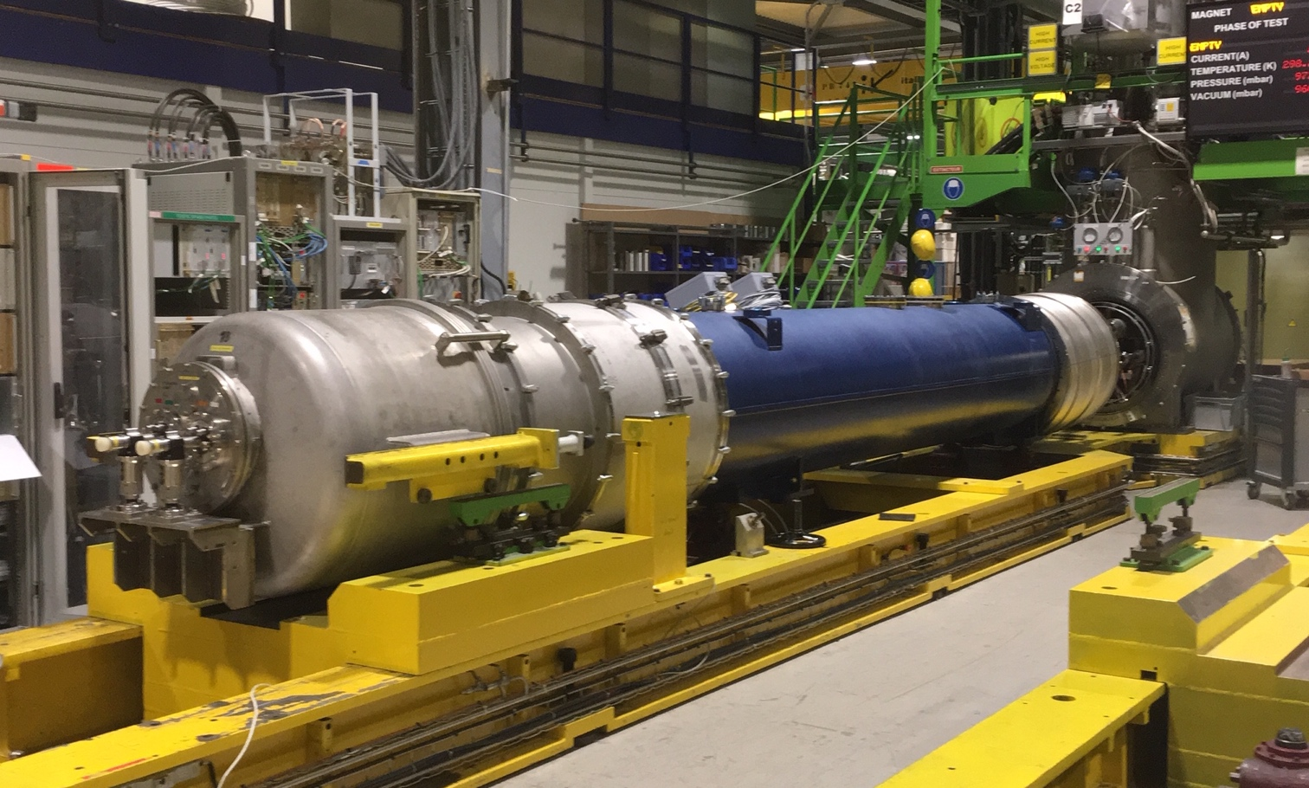
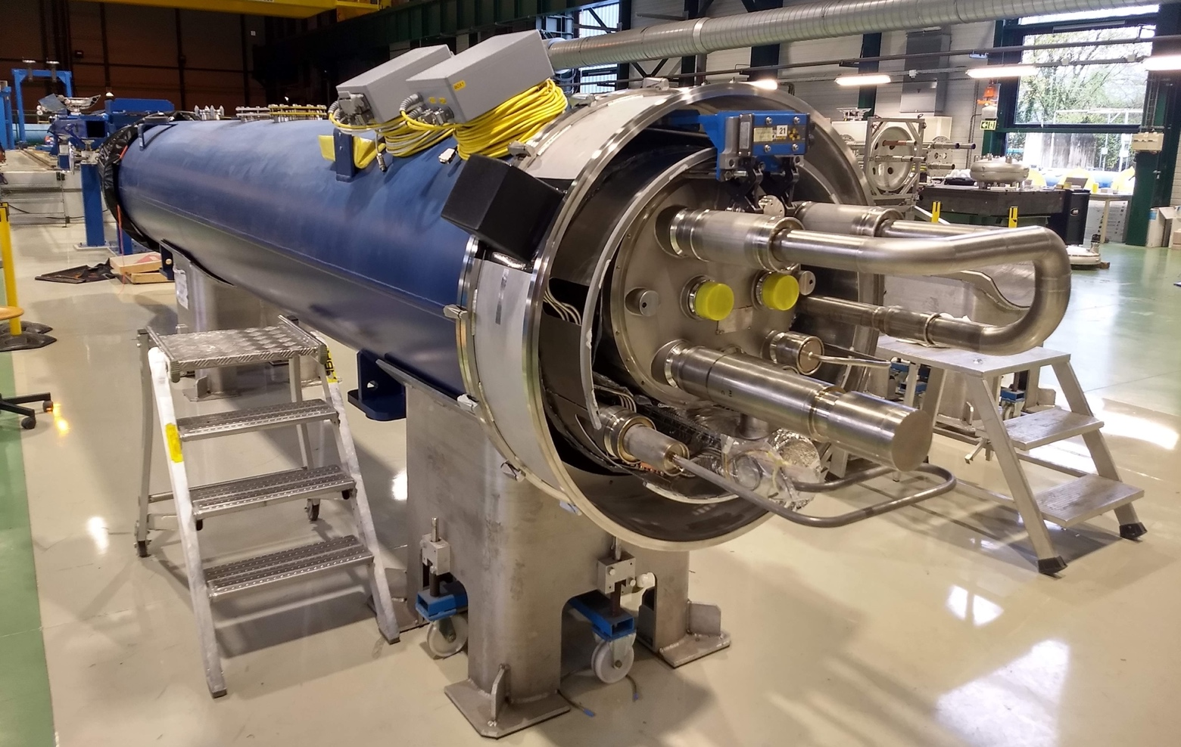
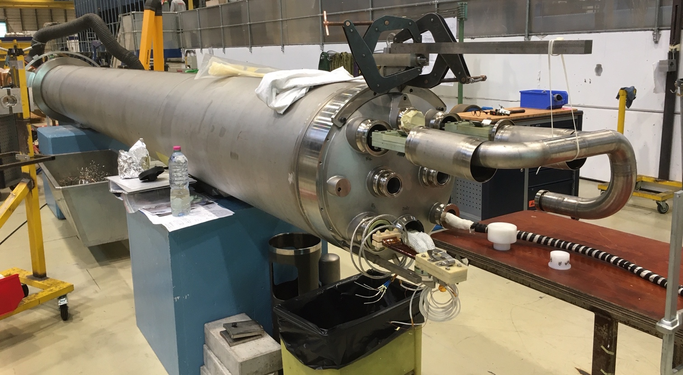
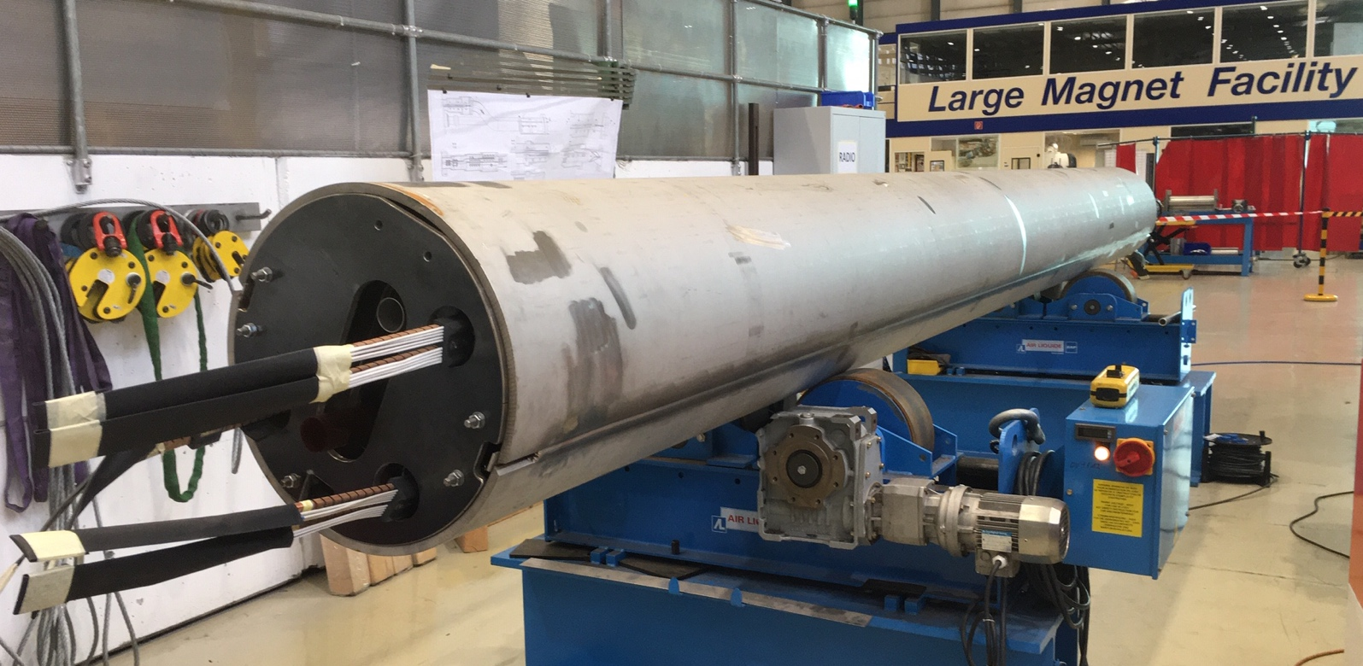
First four magnets @ different stages of fabrication
S2 - LMBHA001
8 November 2019
S1 - LMBHB002
Summer 2019
S3 - LMBHA002
11 November 2019
S4 - LMBHB003
11 November 2019

