Slide 1

Advanced Design Techniques
B. Auchmann (PSI/CERN), M. Maciejewski (ETHZ), S. Russenschuck (CERN), J. Smajic (ETHZ), G. Vallone (LBNL)
LDG HFM Roadmap Workshop, June 1st, 2021.
“Ideas and proposals for design, analysis and calculation framework and the establishment of a design code (brittle superconductors).”
Work supported by the Swiss State Secretariat for Education, Research and Innovation SERI.

Slide 2
Overview
HFM design and analysis
  Brief state of the art
  Strategic goals for design techniques
  A model-based systems engineering approach

Slide 3
Overview
HFM design and analysis
  Brief state of the art
  Strategic goals for design techniques
  A model-based systems engineering approach
Preface:
This presentation is necessarily incomplete in terms of technical topics, numerical tools, contributions from specialists around the world.
Much more complete overviews can be found in the State-of-the-Art presentations by Lucas Brouwer, Marc Dhallé, and Giorgio Vallone.

Slide 4
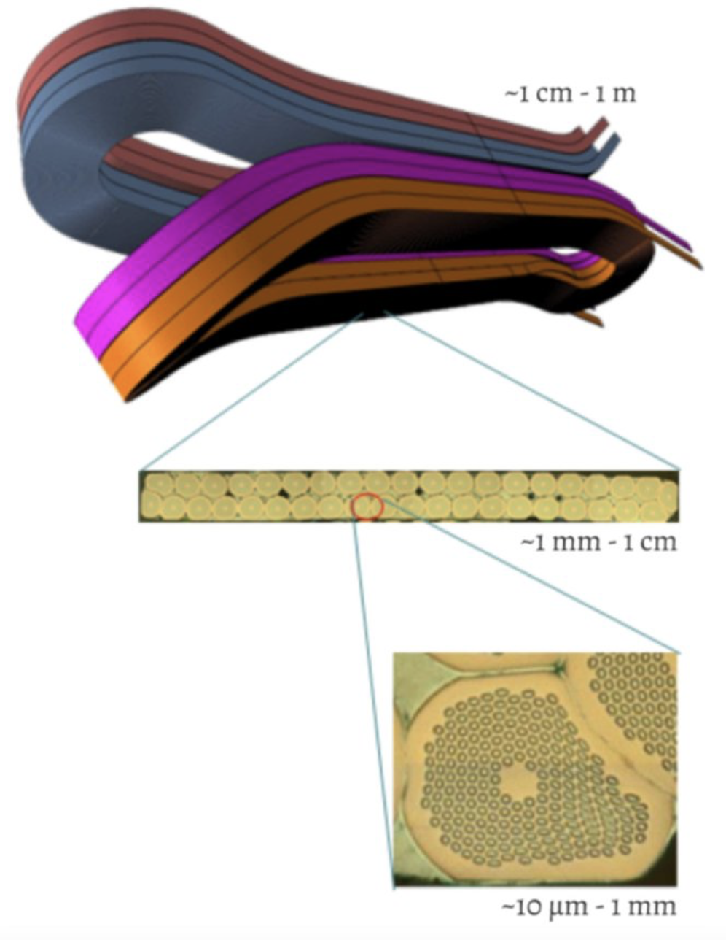
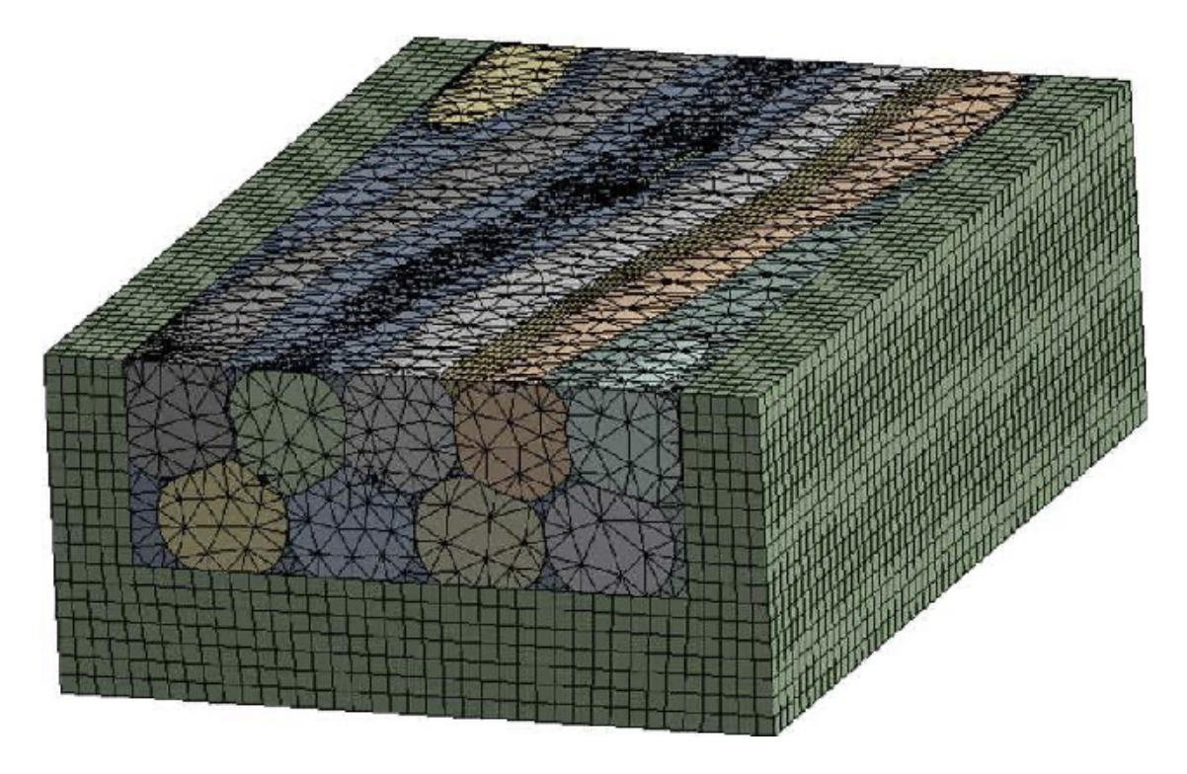
What we are good at – and less good at
As a community, we have shown that we can model most relevant physical phenomena involved in the design and analysis of HFM.
As examples, we select multi-scale modeling and multi-model analysis.
These are topics where we have made much progress over the past decade.
  On multi-scale modeling, deeply insightful work has been published by serveral labs, e.g., CEA (CoCaSCOPE), CERN, LBNL, FNAL, UniGE, to name a few.
  Multi-model analysis has been a mainstay of integrated design techniques and was further developed in the STEAM project at CERN.
Now we must translate this progress into improved design techniques.
G. Lenoir, P. Manil, et al. https://www.researchgate.net/project/CoCaSCOPE/

Slide 5
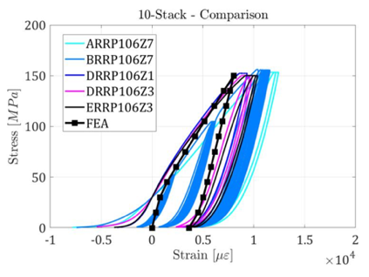
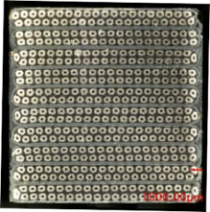
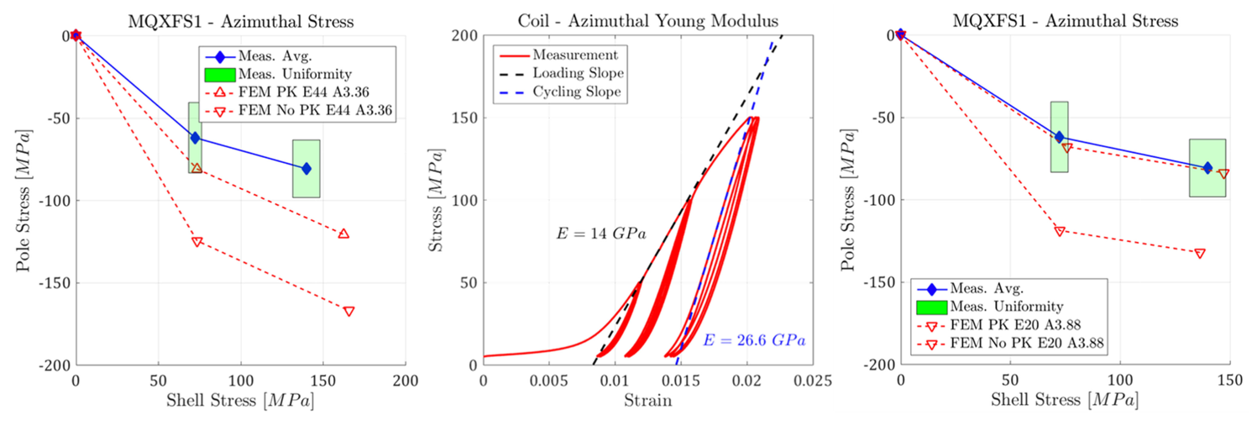
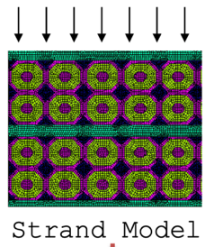
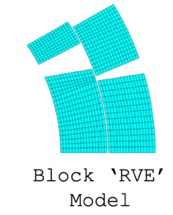
What we are good at – and less good at
Multi-scale workflows:
  Up-scaling (homogenization) moves from local models to a larger scale.
Linearized models
used in coil design.
See G. Vallone, HFM State of the Art Workshop, 2021;
For FE, Design curve: G. Vallone et al. Mechanical Performance of Short Models for MQXF, the Nb3Sn Low-beta Quadrupole for the
Hi-Lumi LHC, IEEE Trans. On Appl. SC, 27(4), 2017.

Slide 6
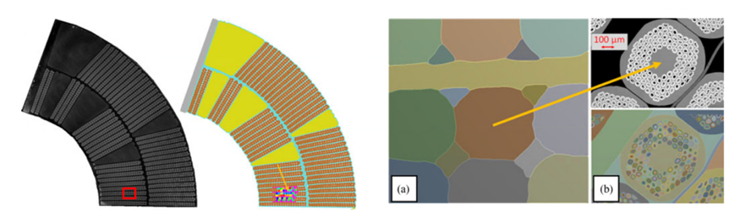
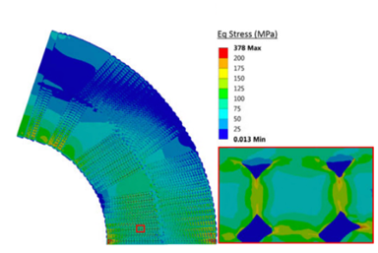
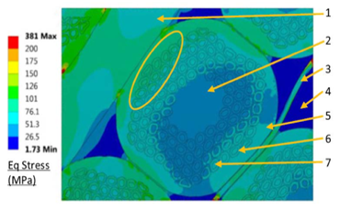
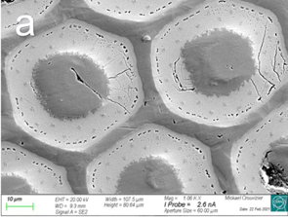
What we are good at – and less good at
Multi-scale workflows:
  Down-scaling (sub-modelling) analyzes local effects based on averaged results from large-scale models.
M. Daly et al., Multiscale Approach to the Mechanical Behavior of Epoxy Impregnated Nb3Sn Coils for
the 11 T Dipole, IEEE TASC, 28(3), 2018.

Slide 7
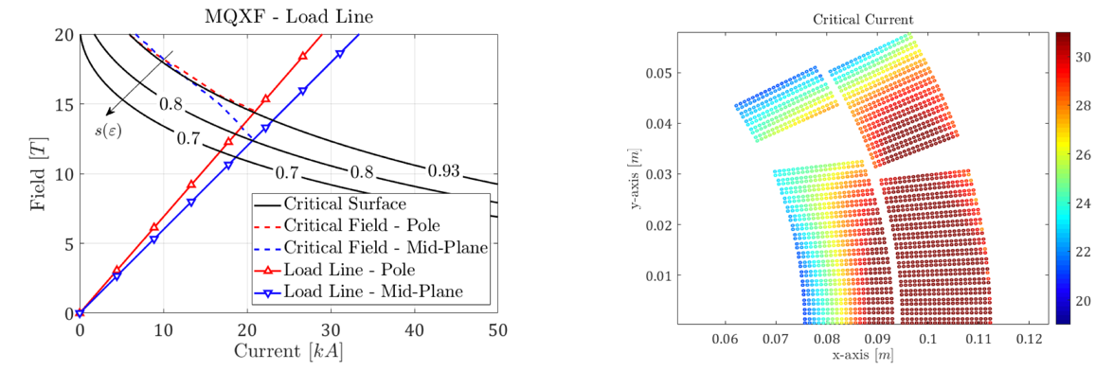
What we are good at – and less good at
Multi-scale workflows:
  Brute-force method. In 3D this approach requires HPC.
See G. Vallone et al., SUST (2020)

Slide 8
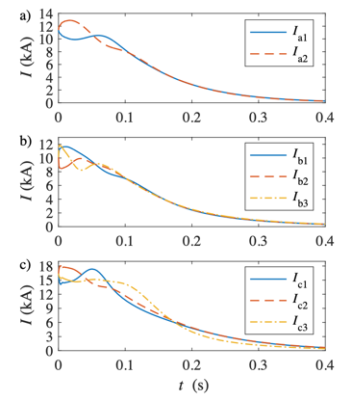
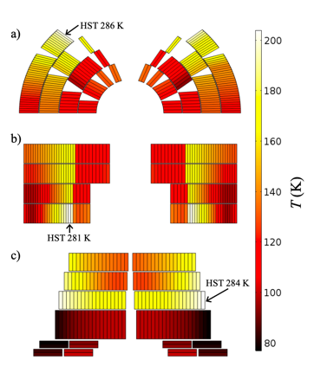
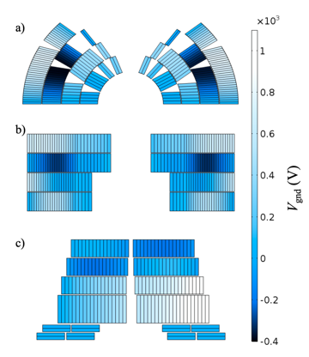
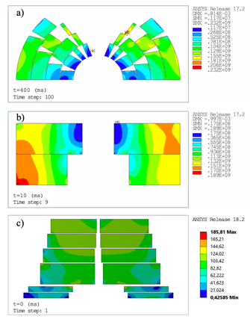
What we are good at – and less good at
Multi-model simulation:
  Quench protection in pre-loaded magnets and in particular CLIQ protection should be simulated with coupled models at the earliest design stages.
M. Prioli, et al., The CLIQ quench protection system applied to the 16 T FCC-hh dipole magnets, IEEE TASC, 29(8), 2019.
M. Maciejweski, et al., Coupling of Mechanical and Magneto-Thermal Models of Superconducting Magnet by Means of
Mesh Based Interpolation , IEEE TASC, 28, 2017.

Slide 9
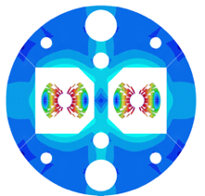
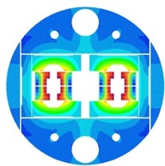
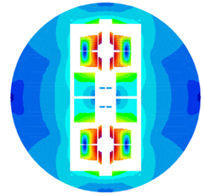
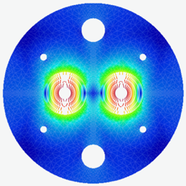




What we are good at – and less good at
EuroCirCol + CHART provided a well-coordinated design effort based on shared specifications and modeling workflows.
The concerted effort yielded directly comparable designs for relative evaluations.
But where can we improve upon the design techniques used in this exercise?

Slide 10
What we are good at – and less good at
Linear anisotropic mechancial material properties were used throughout.
  There was a constructive debate on the “correct” linear modulus in 2D and 3D.
Little validated data about damage limits was available
  150 MPa@RT, 200 MPa@1.9 K van Mises stress was used throughout.
Not all designs were checked for reversible performance reduction for the CDR.
  Easy-to-use and validated workflow emerged only towards the end of EuroCirCol.
In-design quench check was based on worst case assumptions.
  Not in one integrated optimization loop.
Coupled EM-thermal-mechanical CLIQ simulation only once for each design except CCT.
  Was found hard to repeat after a change of beam distance.
  Models were shared via eMail, not organized and versioned in a repository.

Slide 11
Overview
HFM design and analysis
  Brief state of the art
  Strategic goals for design techniques
  A model-based systems engineering approach

Slide 12
Strategic Needs
Sustainability
  Excellent modeling does not always have an impact on present or future designs.
Traceability
  Who can trace back what input parameters, code versions, apdl versions, etc., that have been used to produce a particular plot found in a ppt or pdf?
  Even more important when engaging in multi-scale and multi-model analyses.
Repeatability
  Examples:
    I am not able to rerun the mechanical analysis presented at our CD1 CCT-demonstrator Conceptual Design Review.
    Hardly any 3D models for LHC magnets still run/exist. None of the original quench analysis can be reproduced.
Flexibility
  Different labs and collaborators have/prefer different licenses.
  Innovative ideas, PhD theses require must build upon previous best practices, but without having to solve legacy issues.
Usability
  Flexibility should be hidden behind easy UIs for the standard design work.
Note that these are strategic needs for multi-year/decade projects with many stakeholders.

Slide 13
Overview
HFM design and analysis
  Brief state of the art
  Strategic goals for design techniques
  A model-based systems engineering approach

Slide 14







Model-Based Systems Engineering
“Model-based systems engineering (MBSE) is the formalized application of modelling to support system requirements, design, analysis, verification and validation activities beginning in the conceptual design phase and continuing throughout development and later life cycle phases.”
https://www.incose.org/incose-member-resources/corporate-advisory-board;
https://www.incose.org/docs/default-source/delaware-valley/mbse-overview-incose-30-july-2015.pdf;
International Council on Systems Engineering

Slide 15
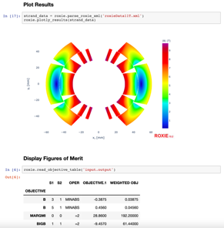

Models as Repositories of Data
MBSE moves from a document-centric paradigm for sharing of information
to a model-based sharing of information.
Models become repositories of data, queried to provide relevant information.
Models can be concatenated into automated workflows.
PhD/PostDoc
Specialists
Magnet Engineers
Project Leader
Industry
Excel spreadsheets
Models
Analysis scripts
Measurements
Document (doc, pdf, ppt) centric:
Oftentimes, the link between
the model, its results, and a report
is broken.
Model centric

Slide 16
Divide, Reunite, and Conquer
Materials Constitutive Mod
Wire / Tape Geometry
Cable Geometry / Coil Composite
Coil Geometry
Magnet Geometry
Circuit Topology
Cabling model
Winding, Reaction model
Resin
Transient EM model
Transient EM model
(Transient) EM mod
(Transient) EM mod (homog.)
Transient EM model
Composite
Mechanical and damage model
Mechanical and damage model
Homogenized mechanical mod
Mechanical model
Metals
Performance model
Performance model
Margin calculation
Bonded/sliding niterfaces
Thermal model
Homogenized thermal model
Homogenized
thermal model
Cryogenic model
Quench Propagation
Quench Propagation
Quench Protection
Quench Propagation
multi-scale
Analytical Scaling Laws
Analytical Scaling Laws
multi-model
CAD Interface
CAD interface
Manufacturing Interface
Optimization
Sensitivity and Tolerance Analysis
Co-Simulation
The above subdivision is incomplete and only presented for illustrative purposes.

Slide 17
Divide, Reunite, and Conquer
Materials Constitutive Mod
Wire / Tape Geometry
Cable Geometry / Coil Composite
Coil Geometry
Magnet Geometry
Circuit Topology
Cabling model
Winding, Reaction model
Resin
Transient EM model
Transient EM model
(Transient) EM mod
(Transient) EM mod (homog.)
Transient EM model
Behind each modeling task, we find:
Input from “Single Source of Truth”
Input from other tasks
Automatic generation of input for a numerical solver
Solver execution
Analysis of results
Creation of artefacts (input for other tasks)
Composite
Mechanical and damage model
Mechanical and damage model
Homogenized mechanical mod
Mechanical model
Metals
Performance model
Performance model
Margin calculation
Bonded/sliding niterfaces
Thermal model
Homogenized thermal model
Homogenized
thermal model
Cryogenic model
Quench Propagation
Quench Propagation
Quench Protection
Quench Propagation
multi-scale
Analytical Scaling Laws
Analytical Scaling Laws
multi-model
CAD Interface
CAD interface
Manufacturing Interface
Optimization
Sensitivity and Tolerance Analysis
Co-Simulation
The above subdivision is incomplete and only presented for illustrative purposes.

Slide 18
Divide, Reunite, and Conquer
Multi-scale Nb₃Sn mechanical and performance modeling.
Materials Constitutive Mod
Wire / Tape Geometry
Cable Geometry / Coil Composite
Coil Geometry
Magnet Geometry
Circuit Topology
Resin
EM model
Composite
Mechanical and damage model
Mechanical and damage model
Homogenized mechanical mod
Mechanical model
Metals
Performance model
Performance model
Margin calculation
Bonded/sliding niterfaces
multi-scale
The key lies in
  the succsessful automation of information flow among models,
  the automated execution of entire workflows, and
  the successful versioning and sharing in a model repository.
If successful, the MBSE approach promises unprecedented levels of
system understanding.
Notes:
We have models for all of these reatures, or at least we have numerical tools to implement them in.

Slide 19

CHART2/MagNum Project at ETHZ
The CHART2 MagNum project (main investigators M. Maciejewski,
J. Smajic, ETHZ-IEF) started in April 2021.
  CERN and PSI are observers, PSI and LBNL
  are beta-testers.
  The goal is the development of a lean MBSE
  platform for the management of multi-scale
  and multi-model design.
  The project uses standard technologies such
  as Jupyter notebooks and GitLab to solve the
  above strategic goals.
  The demo shown today constitutes the very
  steps of this project, which shall be opened
  to the community in the second year.

Slide 20
Divide, Reunite, and Conquer
Multi-model optimization proof of concept study
for innovative mechanical concept development
Materials Constitutive Mod
Coil Geometry
EM static model
multi-model
Composite
Homogenized mechanical mod
Metals
Margin calculation
Quench Protection
Optimization
Demo
Notes:
We have models for all of these reatures, or at least we have numerical tools to implement them in.

Slide 21
Notebooks for Modeling Tasks
We split up a design process into individual tasks, that is, work units with typical input/output behavior.
The community agrees on input/output (files) interfaces.
The tasks are implemented in interactive Notbooks (Jupyter Notebook).
  Notebooks call existing numerical solvers, create, and execute models (maintainability).
  Execution of a notebook produces an html report containing documentation, all input and version references (traceability).
  Notebooks contain and use a limited amount of code (maintainability).
  Notebooks can include simple user interfaces (usability) or
  open up their APIs for coding (flexibility).
  One and the same task can be implemented in different notebooks to account for adequate modeling depth, approach, or license preferences (flexibility).
  Best-practices (e.g., results from PhD or postDoc work) shall be encoded in notebooks and made accessible to the community (sustainability).

Slide 22

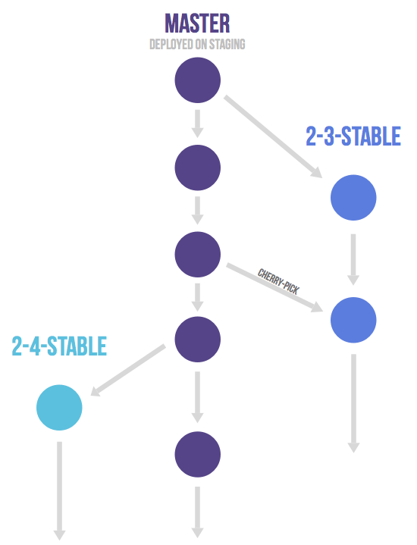
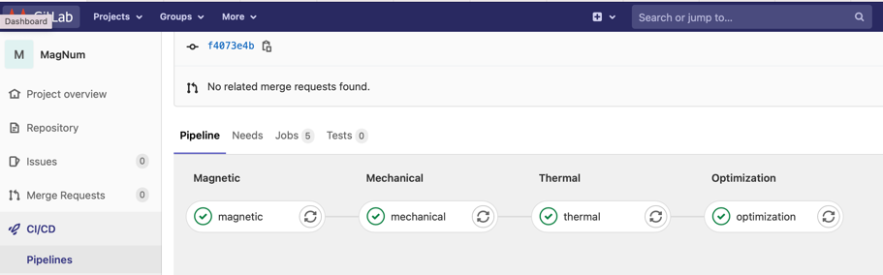
Workflows with Versioning and Auto-Execution
Modeling tasks (notebooks) and are concatenated into workflows
that are defined as pipelines in GitLab repositories.
GitLab is primarily used for consistent collaboration.
Gitlab allows to define pipelins, i.e., auto-executable workflows of tasks.
GitLab’s versioning is used for a traceable evolution of workflows over the project life cycle.
  Milestone events (CDR, TDR, etc.) are captured in dedicated branches,
  as-built versions are branches which shall evolve into digital twins,
  milestone and as-built versions are regularly auto-run and checked for reproducability.
GitLab allows to run each task (notebook) on a dedicated machine.
Reference
CDR
As-built
Each version
is auto-checked
and covered with
reports

Slide 23
Perspectives on Workflow-Based Design
PhD/PostDoc
  Be presented with a clear vision for sustainable develoment.
  Be embedded in a community of other developers and specialists.
  Build upon and compare to previous work without the weight of legacy code.
  Be motivated by the prospect of impact on future design in the community.
Subject-Matter Specialist
  Offer documented best-practice workflows to the wider community.
  Link your specialization into other models for multi-model analysis.
  Customize workflows for special project needs without creating legacy.
  Processing of experimental data, model-parameter identification, and model
  validation can be done in one integrated workflow.
Magnet Engineer
  Setup design pipeline according to your specs, priorities, preferences.
  Auto-update full design pipeline upon design changes.
  Trace back and repeat years-old simulations upon request / arrising need.
  Model-based information exchange with specialists for more in-depth
  understanding of our magnets.
  Build digital twins from as-built design versions.
  Bind-in test analyses and model validation directly through analysis tasks.
Project Leader
  Faster feedback time with less pain in case of spec changes.
PhD/PostDoc
Specialists
Magnet Engineers
Project Leader
Industry
Notes:
MBSE workflows / players

Slide 24
Conclusion
A priority for the coming years is to bridge the gap between our modeling capability and our design methodology.
  Novel numerical tools, where needed, are already under development.
  More innovation based on existing tools is expected from PhD and PostDoc projects.
We propose to lay the focus on ”making models talk to each other”.
The CHART2 MagNum project implements concepts from Model-Based Systems Engineering as a platform for collaborative modeling.
  The concept is based on standard technologies such as GitLab and Jupyter notebooks.
  We expect that adoption of the methodology lead to a more profound understanding of our magnets from the earliest stages of design onwards.
Forming a productive community around this approach is the goal for the second year of the MagNum project and beyond.
The approach naturally extends into QC/QA tasks during manufacturing, the construction of as-built models (buzz word digital twin), and data analysis during testing and operation.

Slide 25
Acknowledgments
MBSE concepts were introduced by M. Maciejewski based on the MIT online class ”Architecture and Systems Engineering”
(https://learn-xpro.mit.edu/systems-engineering)
Many of the technical implementations of MBSE concepts can be traced back to work done at CERN in the course of the following projects: STEAM, LHC SigMon, FuSuMaTech.
Thanks to CERN collaborators L. Bortot, Z. Charifouilline, P. Hagen, M. Mentink, M. Prioli, E. Ravaioli, A. Verweij from STEAM and SigMon, and to A. Siemko.
Special thanks to the CERN TE/MPE Software Team.
Thanks to F. Lackner for helping shape this presentation.

Slide 26
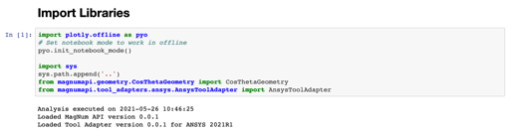
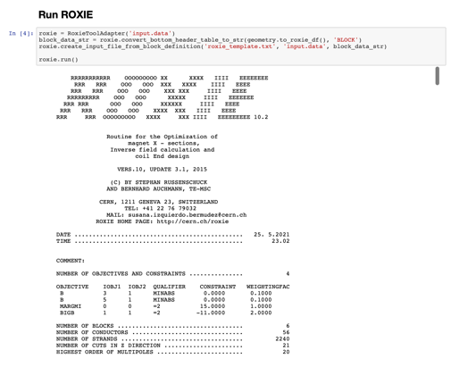
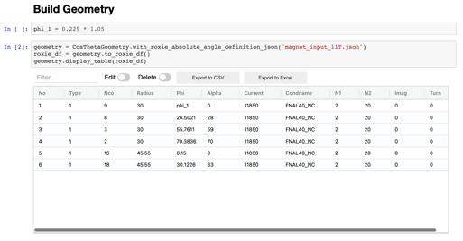
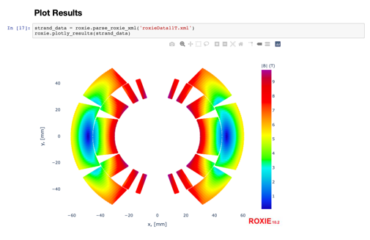
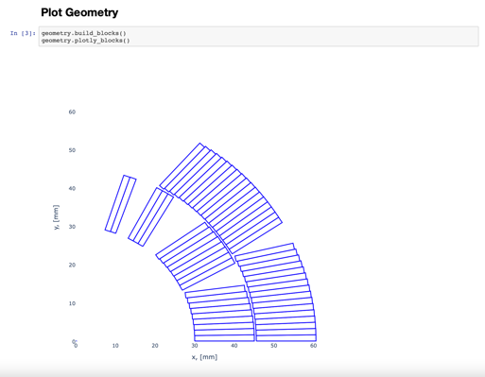
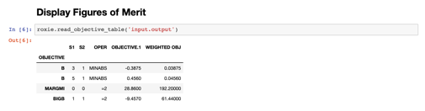

An EM Notebook based on ROXIE

Slide 27
Divide, Reunite, and Conquer
EuroCirCol-style design scheme.
Materials Constitutive Mod
Coil Geometry
Magnet Geometry
Circuit Topology
(Transient) EM mod
(Transient) EM mod (homog.)
Transient EM model
Composite
Homogenized mechanical mod
Mechanical model
Metals
Margin calculation
Homogenized thermal model
Quench Protection
Optimization
Notes:
We have models for all of these reatures, or at least we have numerical tools to implement them in.

Slide 28
Types of Numerical Tools 1/2
With every generation of accelerator magnets, we see an increase of:
  interconnectedness between physical disciplines,
  need for sub-modeling and homogenization,
  need for 3D simulations,
  transient simulations with extreme non-linearities,
  all of which becomes important already in the earliest stages of magnet design.
Numerical tools
  Network / Finite Differences, discretizing along and transverse to the coil winding
    tend to spearhead development and innovation in our field:
      many engineers/appl. physicists “need” to code in order to develop intuition,
      most intuitive form of numerics.
      reduces meshing difficulties.
      generally good performance.
    typically run into limitations related to
      non-linear iron yokes
      bulk superconductivity
    can be linked to reduced-vector-potential FEM or FEM/BEM by means of Biot Savart solver to overcome this.

Slide 29
Types of Numerical Tools 2/2
  Fully integrated commercial codes (ANSYS, COMSOL) are of increasing importance.
    in particular, when tight link to mechanical simulation is needed.
    many young engineers have key competence in one tool (Swiss knife).
  Open FEM tools play a role in electromagnetic and thermal modeling, implementing transient problems and workflows that involve submodelling and/or homogenization.
    encapsulation of numerics setup in easy-to-use and license-(cost)-free workflows will serve the wider community of magnet engineers.
    openness allows student to implement new features.
    license-(cost)-free workflows can run on clusters to cover a wider design space.

Slide 30
What Physical Models are Missing?
What is missing to improve our designs?
  2D and 3D nonlinear anisotropic material models for homogenization of coil-composite material properties.
  Improved contact modeling.
  Improved modeling of HTS REBCO tape screening currents.
  Homogenization of thermo-electro-magnetic and mechanical behavior of HTS cabls / NI coils.
  Evaluation of failure limits and performance reduction, evaluated through down-scaling.
  Homogenization of cable/strand coupling currents; 3D model including CCs.
  Coil dimensional changes during heat treatment.

