Slide 1

High Field Accelerator Magnets – Roadmap Preparation Workshop
1 and 3 June 2021
Magnet Insulation Systems
Davide Tommasini

Slide 2
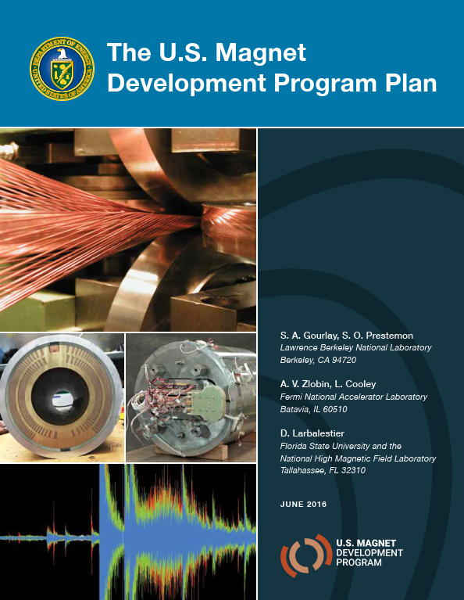
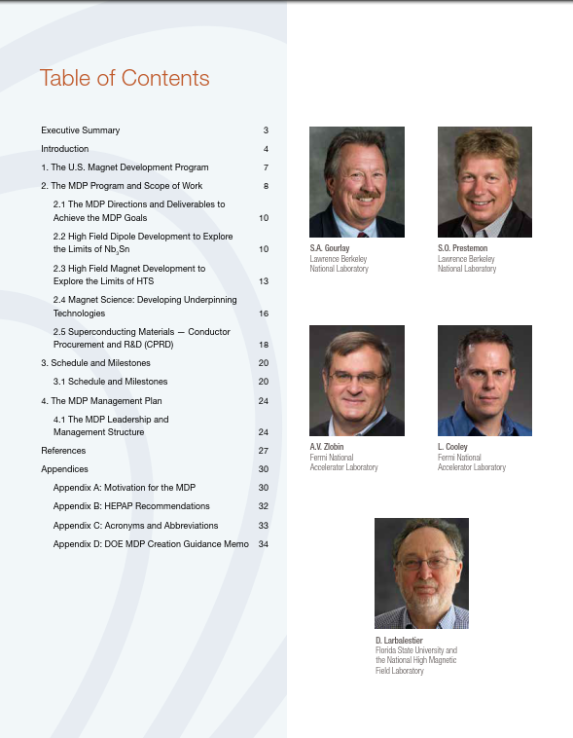
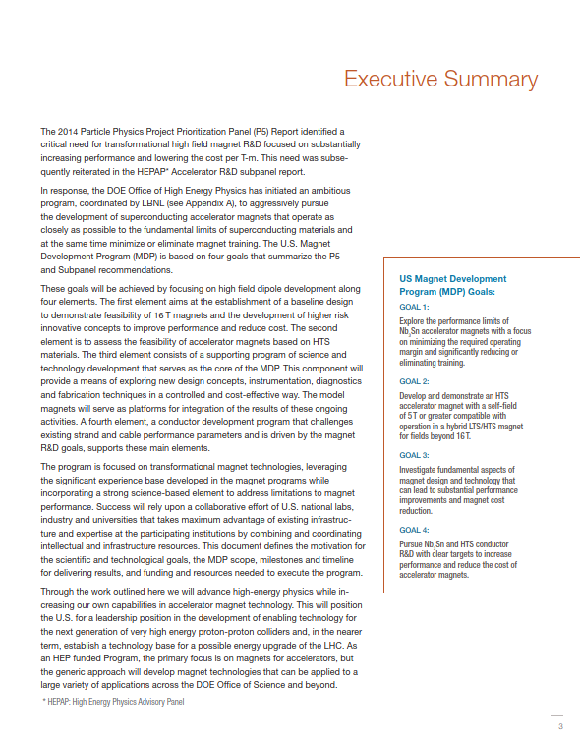
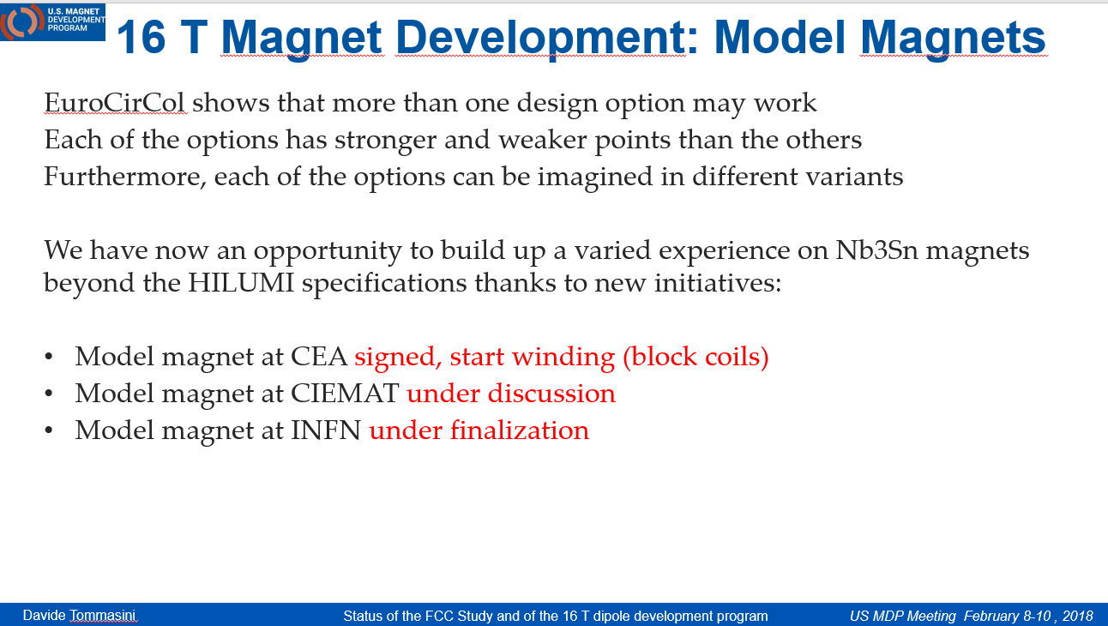
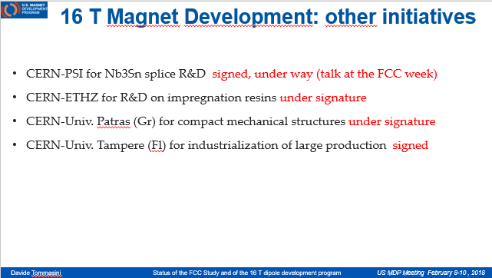
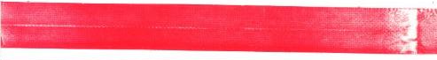
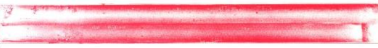
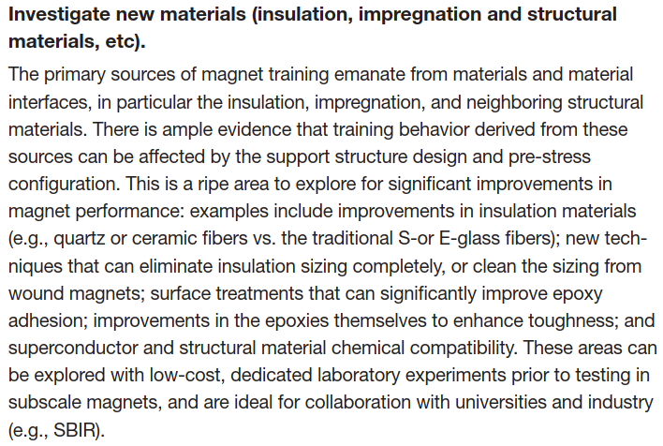
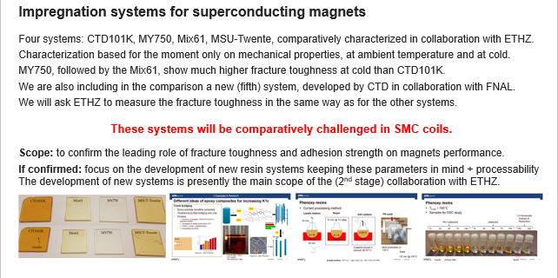
Insulation systems are already part of R&D programs
https://indico.cern.ch/event/641886/
SMC11T-1
(no mica)
Upper layer
Lower layer
SMC11T-3
(mica)
Upper layer
Lower layer

Slide 3
What we know (we refer here to Nb₃Sn)
Training is very (sometimes hugely) long
However training memory is very (sometimes exceptionally) good
The conductor is strain sensitive (few ‰): keep in mind that the peak stress is not F_{tot}/S_{tot}
*The limitations of Nb₃Sn magnets, when not linked to conductor instabilities, were so far due either to excessive stress (often already at warm) or to defective assembly (i.e. failure of longitudinal support).
The elastic modulus of impregnated coils is very high (20-40 GPa)
The azimuthal thermal contraction seems to be closer to that of aluminum than to that of copper
The longitudinal thermal contraction seems to follow that of the cable (around 2.7-2.9 ‰)
The dielectric insulation of the heat-treated cable is very poor (typically few kΩ @ << 1 kV)
The “reference” impregnation resin system has a low toughness at cold and low adhesion to metals
* Disclaimer : personal opinion

Slide 4
What we do not know
What does it really matter for training performance?
  stress distribution (during assembly and at cold)? How does friction impact the stress distribution and training?
  just a carefully assembly?
  impregnation system?
    how does the impregnation system participate to the strain distribution of the conductor? Is a more rigid resin better than a “soft” resin? What’s about concrete impregnation? What’s about polyurethane, or wax?
    adhesion? Do we prefer low adhesion or high adhesion?
    toughness? Is a high toughness impregnation system better than a low toughness system?
    thermal contraction? Different thermal contractions induce thermal stresses: what can we accept?
    thermal conductivity? What is it the role of thermal conductivity? Does a higher thermal conductivity help?
    heat capacity? What is the role of heat capacity in real life? Does a higher heat capacity help?
What are the exact structural parameters of an impregnated coil during assembly, cool-down and powering?
  we do not have yet a convincing parameter set for characterizing the structural parameters of a coil
  we have never measured the azimuthal thermal contraction under different conditions
  we did only few measurements of longitudinal thermal contraction, and still today sometimes we take isotropic
  ex. we could decrease the elastic modulus by filling more resin, but the thermal contraction also increases …
What is the role of the interfaces and discontinuities?
  between longitudinal wedges and between wedges and end spacers
  resin-rich volumes (in particular in the coil ends, but also between wedges)
  adhesion to the coil pole: better good adhesion or no adhesion? Better impregnated pole or removable pole?
  use of mica or other elements as “sliding surfaces”

Slide 5
I will not make a review of the work done so far
The charge for my talk is : what shall we ideally do as R&D?

Slide 6
Quantify what we know and what we do not know
Identify the parameters we think they do matter
Identify/develop methods to reproducibly measure/quantify them
Comparatively challenge extremes of these parameters at small scale (cable, coils, R&D magnets), independently on whether they can be applicable in “real life” (ex: highest toughness but no radiation resistance, or too short pot life)
Once there is an evidence that a certain parameter does matter, develop a new engineered system keeping this parameter in mind and qualify it first in R&D magnets
Challenge the new system in real life in real magnets
This requires:
To perform an exploratory investigation to “guess” what it may matter
To develop methods/tools for characterizing/measuring these parameters
To develop a “performance evaluation” program on small scale (see above)
To be capable of coordinating a material development (for example with partners as CTD or Huntsman)
In the following I’ll give some examples

Slide 7
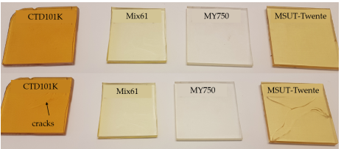
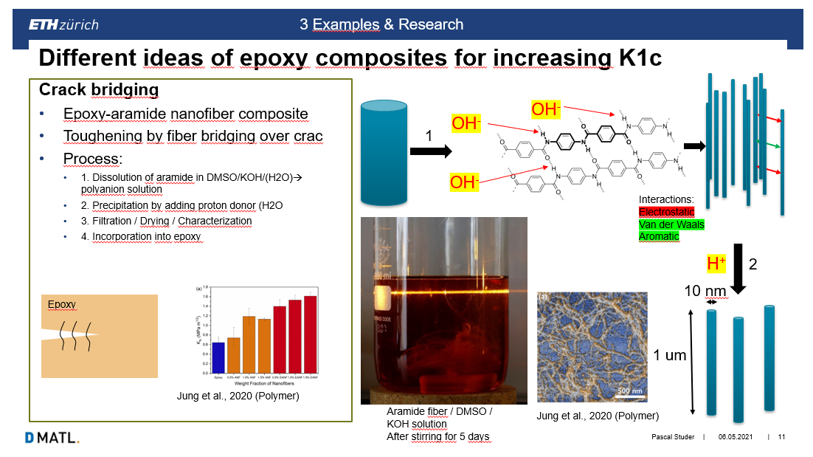
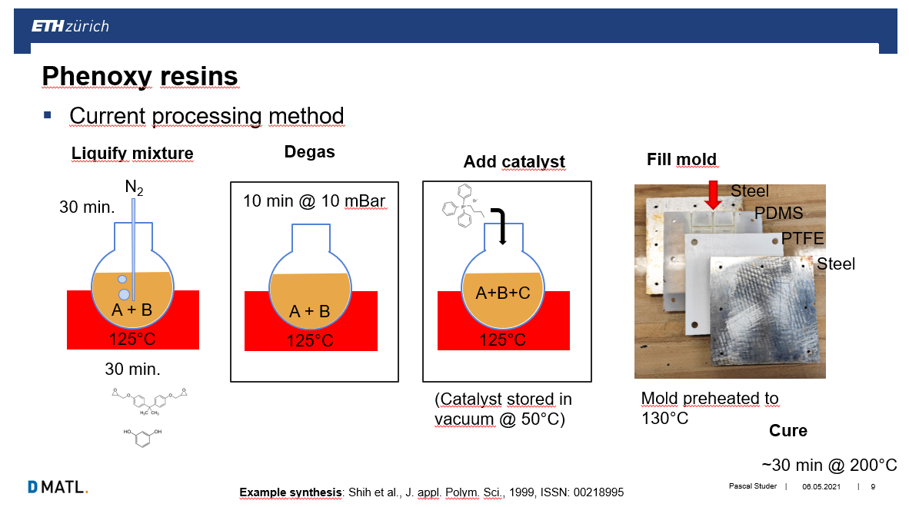
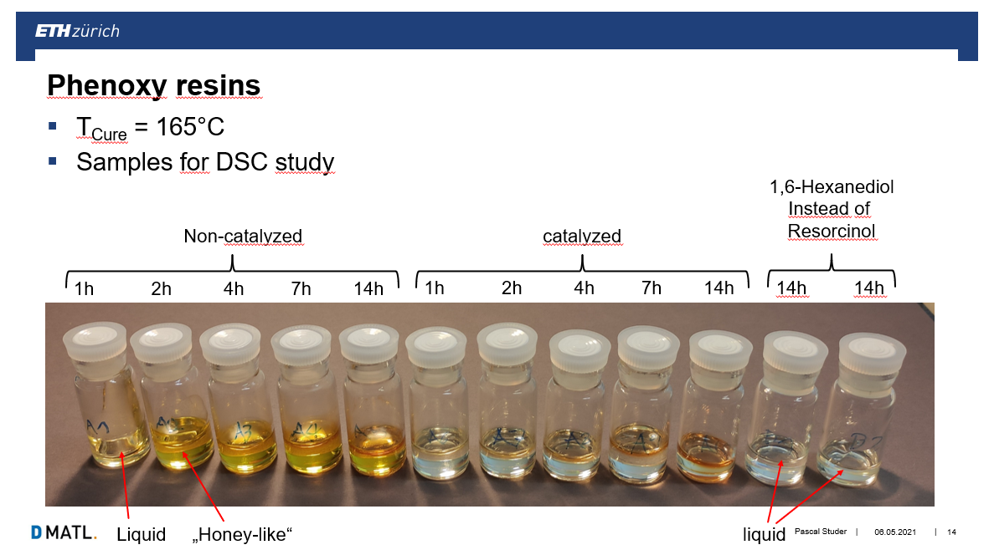
Example 1 : toughness
Four systems: CTD101K, MY750, Mix61, MSU-Twente, comparatively characterized in collaboration with ETHZ.
Characterization based for the moment only on mechanical properties, at ambient temperature and at cold.
MY750, followed by the Mix61, show much higher fracture toughness at cold than CTD101K.
We are also including in the comparison a new (fifth) system, developed by CTD in collaboration with FNAL.
We will ask ETHZ to measure the fracture toughness in the same way as for the other systems.
These systems will be comparatively challenged in SMC coils.
Scope: to confirm the leading role of fracture toughness and adhesion strength on magnets performance.
If confirmed: focus on the development of new resin systems keeping these parameters in mind + processability
The development of new systems is presently the main scope of the (2nd stage) collaboration with ETHZ.

Slide 8
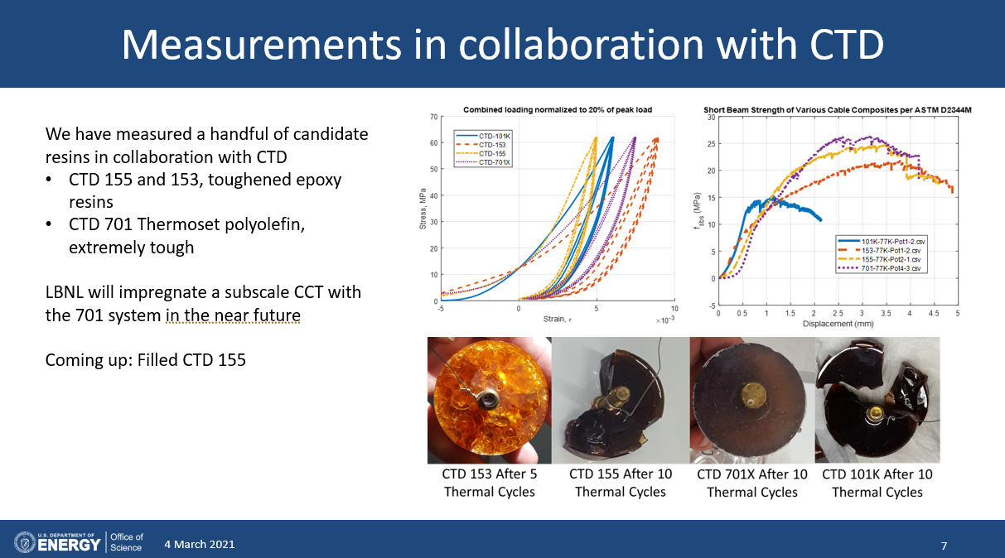
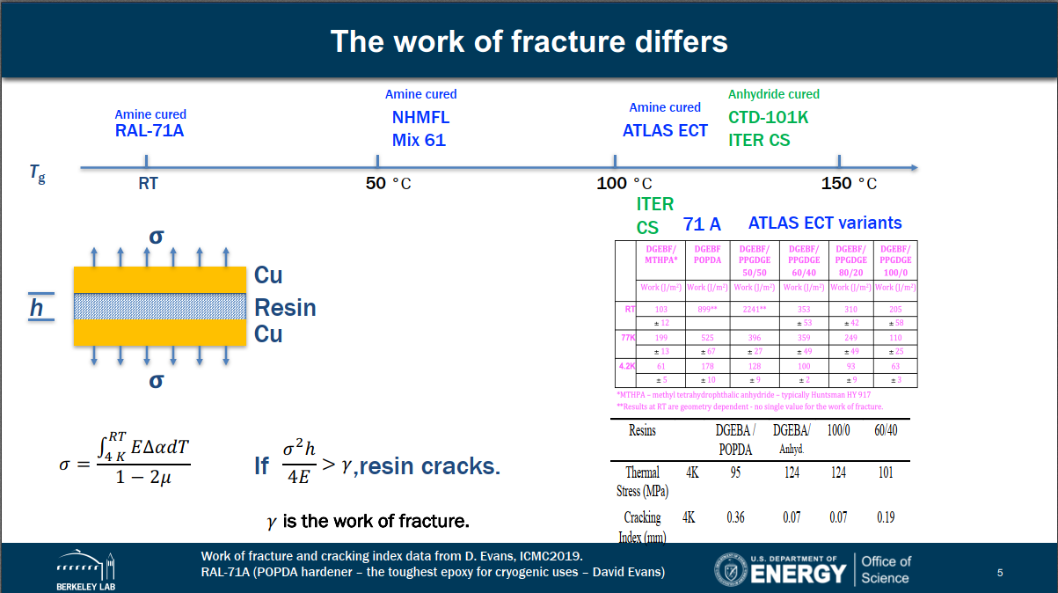
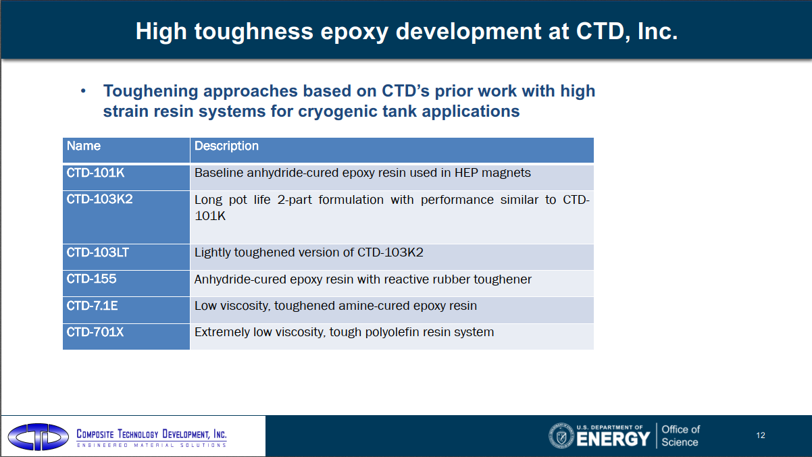
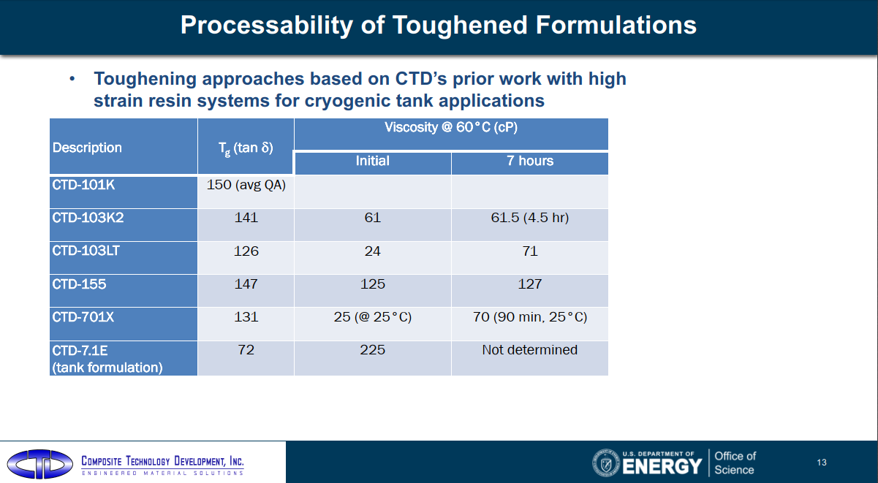
Example 1 bis : toughness at MDP
Steve(n) Krave, FNAL and Tengmin Shen, LBNL

Slide 9
Example 2 : adhesion
CERN is performing a characterization based on peel-off strength, shear strength, pull-off strength.
Present focus: definition of the samples design and preparation and test methods.
This requires several iterations to achieve reproducibility and exact knowledge of the sample structure and behaviour, because these resins are very fluid.
Program: characterization of the adhesion strength towards copper, stainless steel, glass tissue, polyimide, virgin and heat treated cable insulation, and also towards mica sheets employed in certain cases as “antistick” surfaces.
Definition of the methods to exploit experimental data into FEM models.

Slide 10
Example 3 : Radiation resistance
CERN is setting up a radiation test program for all these materials, conducted in different environments:
  ambient conditions,
  vacuum,
  cryogenic temperature.
We also intend to add dielectric tests, because in certain conditions we may have a dielectric damage without having a macroscopic mechanical degradation.

Slide 11
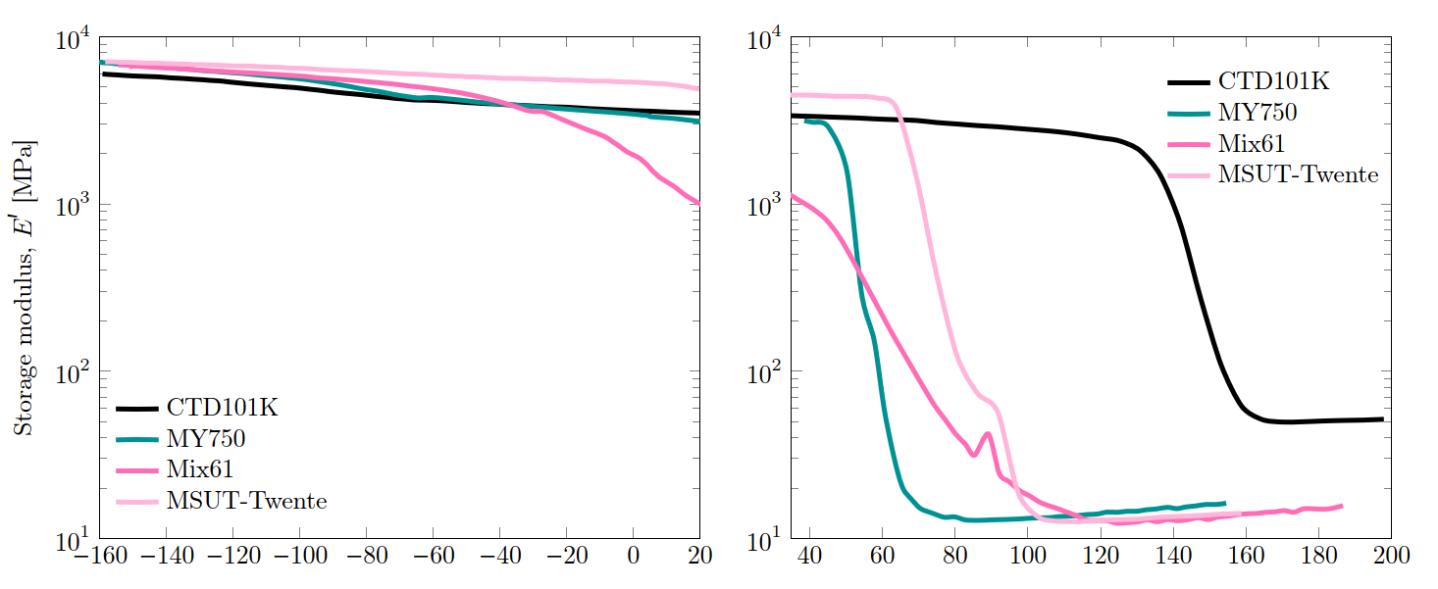
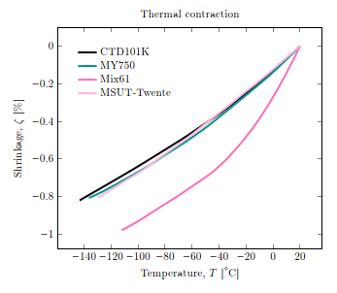
Example 4 : elastic modulus & thermal contraction
The elastic modulus of a pure resin heavily depends on temperature, converging to limited range at cold

Slide 12
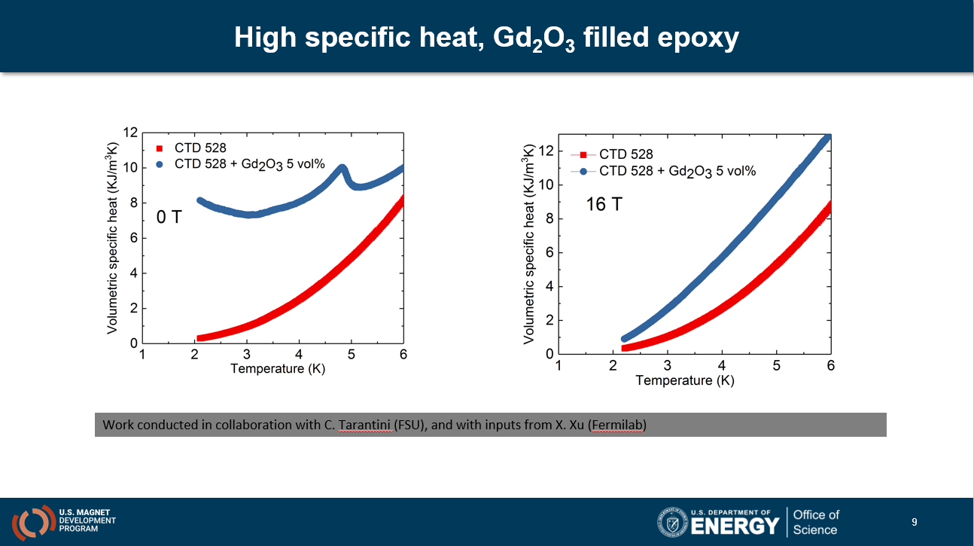
Example 5 : High specific heat
Steve(n) Krave, FNAL and Tengmin Shen, LBNL

Slide 13
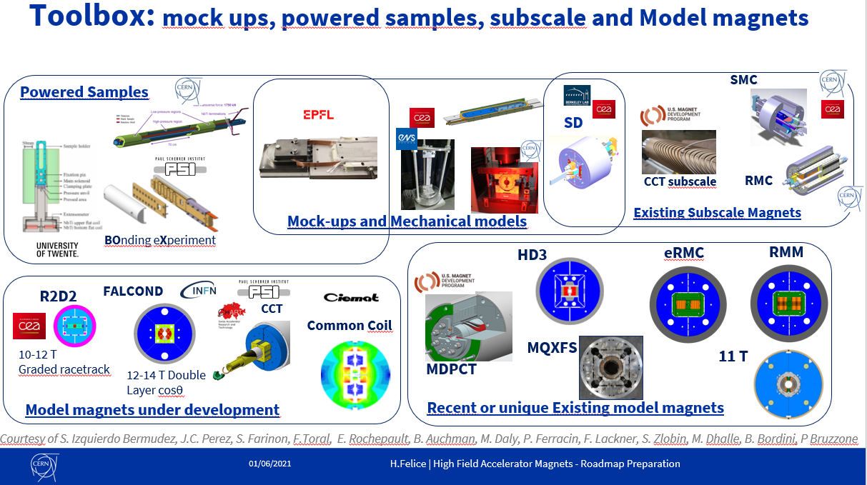
See talk of Hélène Felice

Slide 14
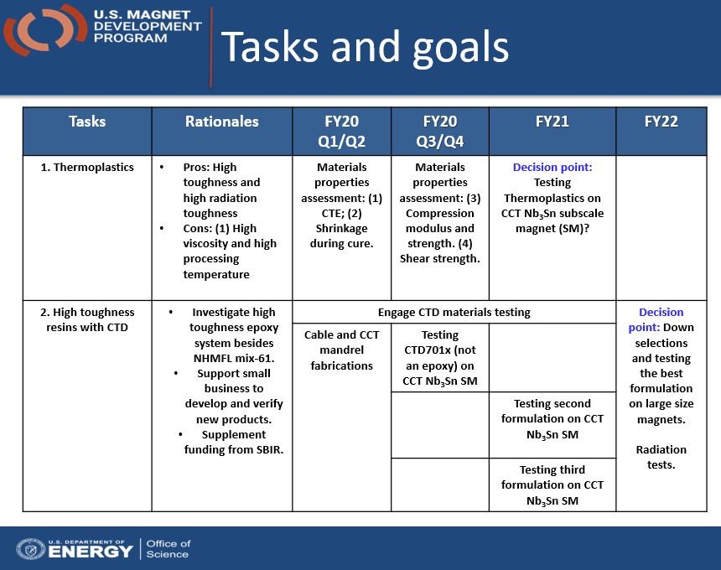
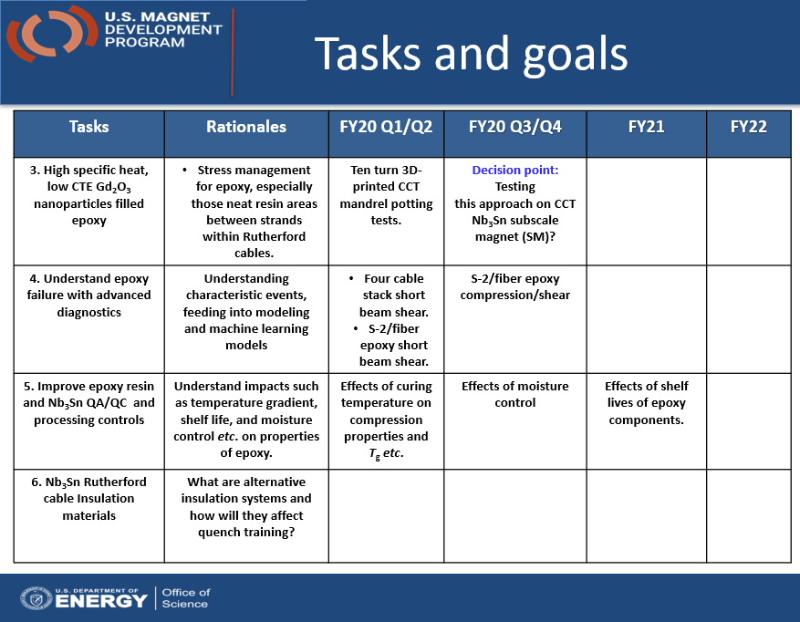
US-MDP
Steve(n) Krave, FNAL

Slide 15
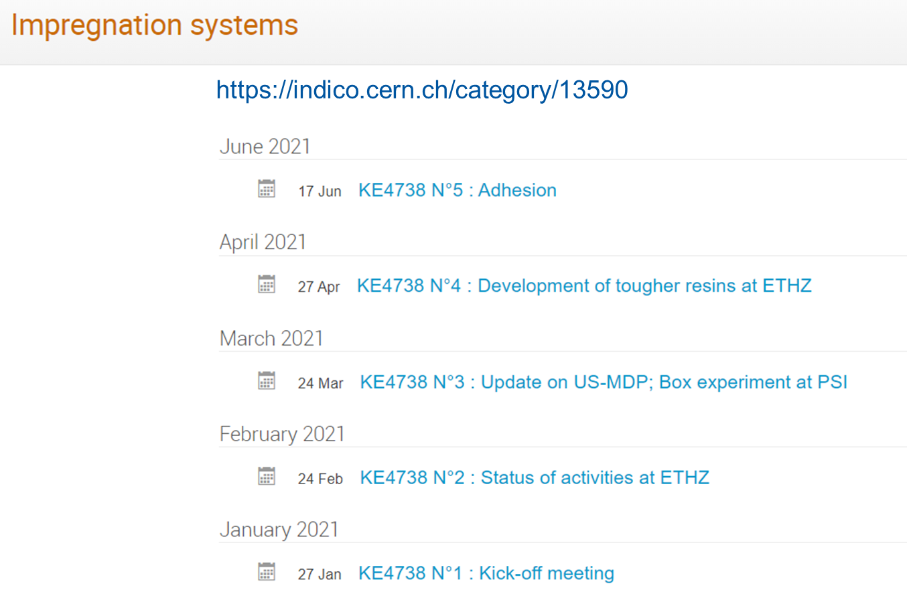
Constituting a “global program”
I do not believe that we shall “force” each partner to limit its action range: often “diversity” is key for success
However it is important to openly share information, and “combine efforts” where possible
A large amount of work is openly available but not easily accessible because not globally structured.
Very good, but not enough

Slide 16
In conclusion
R&D programs:
  already in place in EU and in the USA, to be reinforced
Key parameters:
  identify the parameters
  understand how to characterize them, and possibly implement in FE models
  measure the effect of these parameters with the appropriate tools of our toolbox
  develop new engineered systems (optimal parameters + processability)
Share & combine the results.
It is time to make magnets (Steve Gourlay)

