Slide 1










Proposals for a French contribution to the High Field Magnet Road-map
A.I Etienvre
Prepared with E. Rochepault, P. Vedrine, C. Lorin, T. Lecrevisse, P. Fazilleau,
P. Tixador, A. Badel, J. Vialle, F. Millet
25/05/2021

Slide 2
Outline
Development plan towards 16 T Nb₃Sn magnets at CEA
Development plan towards 20 T HTS magnets at CEA
Technological developments at CEA for HFM
Cryogenics developments at CEA for HFM
HTS Magnets at CNRS
Infrastructure and competencies at CEA

Slide 3
1. Development plan towards 16 T Nb₃Sn magnets at CEA

Slide 4
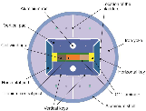
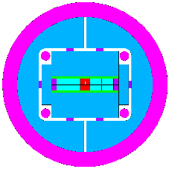
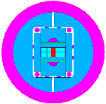
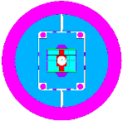
Nb3Sn Dipole Magnet strategy: CEA-CERN collaboration
CEA-CERN SMC 11T
Demonstrate
Nb₃Sn technology ≥ 12 T
+Grading
CEA-CERN R2D2
Demonstrate Grading ≥ 12 T
1.5 m, No bore
V. Calvelli et al., IEEE TAS 2021
+Flared ends
FD: Demonstrator
Grading + Flared-ends ≥ 14 T
1.5 m, No bore
+Aperture
CEA-CERN collaboration to be defined
Conceptual Designs proposed by CEA
F2D2 Short model
Grading + Flared-ends + Aperture = 16 T
1.5 m, 50 mm bore
E. Rochepault et al., IEEE TAS 2020

Slide 5
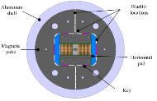
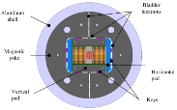
Nb3Sn Dipole Magnet strategy: CERN support
+Field
CERN SMC 11T
Demonstrate
Nb₃Sn technology ≥ 12 T
CERN ERMC
Record 16.5 T peak
1.5 m, No bore
J.C. Perez et al., IEEE TAS 2015
S. Izquierdo et al., IEEE TAS 2017
+Grading
+Aperture
CEA-CERN R2D2
Demonstrate Grading ≥ 12 T
1.5 m, No bore
CERN RMM (ongoing)
Demonstrate
aperture = 16 T
1.5 m, 50 mm bore
+Flared ends
+Flared ends
FD: Demonstrator
Grading + Flared-ends ≥ 14 T
1.5 m, No bore
CEA-CERN FRESCA2
Record 14.6 T in the bore
1.5 m, 100 mm bore
+Aperture
F2D2 Short model
Grading + Flared-ends + Aperture = 16 T
1.5 m, 50 mm bore
+Grading
G. Willering et al., IEEE TAS 2019

Slide 6
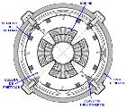
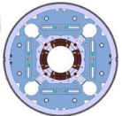
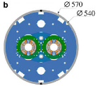

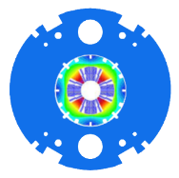

Nb₃Sn Quadrupole strategy: CEA-CERN collaboration
P. Ferracin et al., IEEE TAS 2019
CEA quadrupole
Gradient 210 T/m
Collared structure
Tested 2008 (coil fabrication issues)
CERN MQXF
Gradient 130 T/m
Pre-load studies
Large aperture (150 mm)
Improved coil fabrication
CERN 11T dipole
Collared structure
Double aperture
Small bending radius
Demonstrator
2 layers, single aperture
Gradient 340 T/m
Collared structure
Small bending radius
Quadrupole
F. Savary et al., IEEE TAS 2016
+Layers
Short model
4 layers, single aperture
Gradient >360 T/m
Collared structure
Small bending radius
CEA-CERN collaboration to be defined
Conceptual Designs proposed by CEA
C. Lorin et al., IEEE TAS 2019

Slide 7
2. Development plan towards 20 T HTS magnets

Slide 8
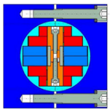
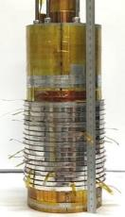
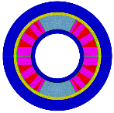
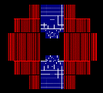
HTS dipole strategy: CEA-CERN collaboration
CEA-CERN Eucard1
Block-coils with tapes
No bore
5.4 T record
CEA-LNCMI Nougat solenoid
No-Insulation Rebco tapes
32.5 T as an insert in 2019
Quench behavior at
high field
M. Durante et al., IEEE TAS 2018
CEA-CERN Eucard2
Cos-theta coils
Roebel cable
40 mm bore
Test foreseen in 2021
Courtesy T. Lecrevisse and P. Fazilleau
Dipole config.
HTS Demonstrator ?
No-Insulation tapes stack
50 mm aperture
Accelerator-type
M. Durante et al., IEEE TAS 2020
+Current density
+No-insulation
Aperture
+Field quality
Eucard1 No-Insulation
No-Insulation tapes
Potential for 20 T @ 4.2 K
Or 16 T @ 20 K
CEA-CERN collaboration to be defined
Conceptual Designs proposed by CEA
See T. Lecrevisse presentation

Slide 9
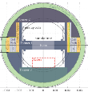
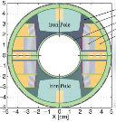
HTS dipole strategy: CERN Support
CEA-CERN Eucard1
Block-coils with tapes
No bore
5.4 T record in 2018
CERN Feather0
No bore
Roebel cable
Aperture
M. Durante et al., IEEE TAS 2018
CERN Feather2
Aligned-blocks
Roebel cable
40 mm bore
Insert test in 2021
CEA-CERN Eucard2
Cos-theta coils
Roebel cable
40 mm bore
Test foreseen in 2021
G. Kirby et al., IEEE TAS 2015
HTS Demonstrator ?
No-Insulation tapes
50 mm aperture
Accelerator-type
+Current density
+No-insulation
Eucard1 No-Insulation
No-Insulation tapes
Potential for 20 T @ 4.2 K
Or 16 T @ 20 K
Aperture
+field quality

Slide 10
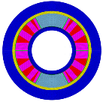
Options for Hybrid HTS/Nb₃Sn dipoles
Eucard2+Nb₃Sn?
Insertion in a Nb₃Sn dipole
Design studies done
with FRESCA2
CERN Feather2
Insert test in 2021
R2D2 hybrid?
Hybrid coils with
HTS/Nb₃Sn joints
HTS/Nb₃Sn Demonstrator ?
HTS “accelerator-type” cable
50 mm aperture

Slide 11
3. Technological Developments

Slide 12
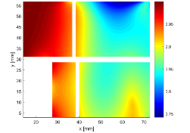
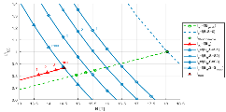
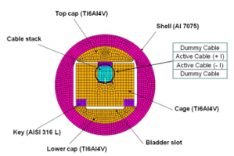
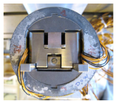


Nb3Sn conductor characterization
Ongoing CEA modelling activities:
Estimate « stress-induced current limits » of magnets using experimental constitutive laws + magnetic/mechanical FEM
CEA-CERN collaboration to be defined:
Characterization of FCC demonstrator cables
Derive constitutive law for future high field designs
E. Rochepault et al., submission to IEEE TAS
B. Bordini et al., IEEE TAS 2010

Slide 13
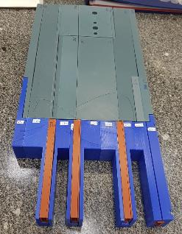
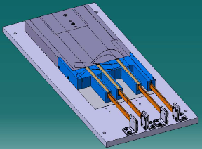
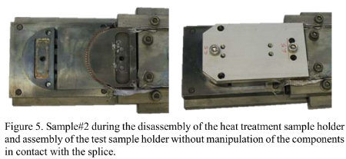
Nb3Sn Joints R&D
Ongoing CEA-CERN R&D: External joints
To be implemented in the R2D2 magnet
Ongoing EPFL-CERN R&D: Internal joints
→ Tested on short samples
CEA-EPFL-CERN collaboration to be defined :
To be tested in a future magnet
Courtesy V. D’Auria, EPFL/SPC

Slide 14
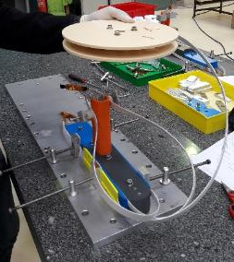
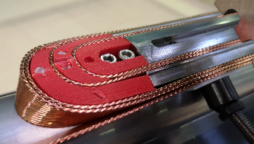
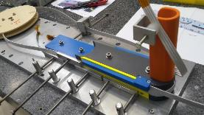
Nb3Sn Coil Fabrication R&D – Winding
Ongoing CEA-CERN R&D :
Winding 2 cable grades together (for R2D2)
Winding with small bending radius (quadrupoles)
CEA-CERN collaboration to be defined:
  Explore winding stability of FCC demonstrator cables
  Automation and reproducibility of the processes and methods
  Coil design for reproducible and robust manufacturing processes
C. Genot et al., IEEE TAS 2021

Slide 15
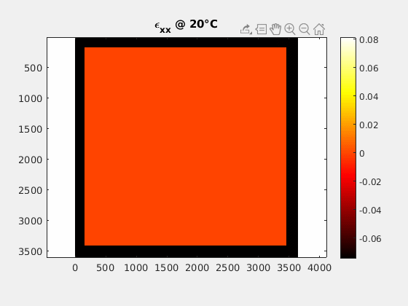
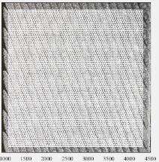
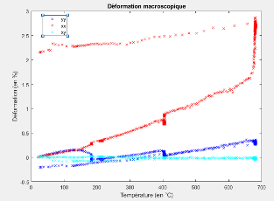
Nb3Sn Coil Fabrication R&D – Heat Treatment
Ongoing CEA-LMT (Université Paris-Saclay) R&D (PhD thesis):
  → Thermo-chemico-mechanical behavior of Nb₃Sn during Heat Treatment
CEA-CERN collaboration to be defined:
  New coil fabrication diagnostic
  Better control of the stress in the coils during production
Width [mm/m]
Courtesy M. Abdel Hafiz, CEA

Slide 16
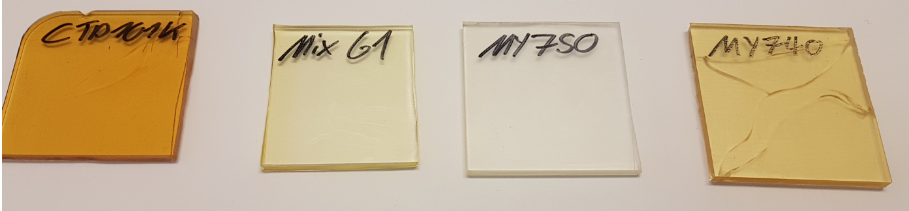
Nb3Sn Coil Fabrication R&D – Insulation
Ongoing CEA-ETHZ-CERN activity:
→ qualification of a resin with a high resistance at cold (‘F101’ Huntsman )
CEA contribution to ongoing CERN activities:
  Study different interfaces between coil and components
  Development of new insulation systems (resins, fibers etc.)
CEA-CERN collaboration to be defined:
  Test the high resistance resin in subscale coils or samples
Courtesy A. Brem, ETHZ

Slide 17
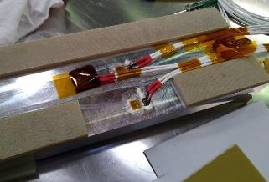
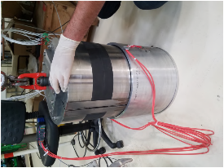
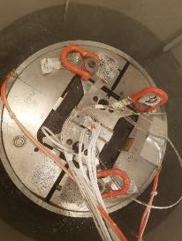
Materials and Structure R&D
Ongoing CEA-LMT (Université Paris-Saclay) activity :
Qualify magnet thermo-mechanical behavior
  During room-temperature pre-load
  During thermal cycles at cryogenic temperatures
CEA-CERN collaboration to be defined:
  Develop new measurement techniques at cold
  Improve the pre-load of magnets

Slide 18
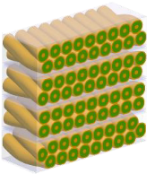
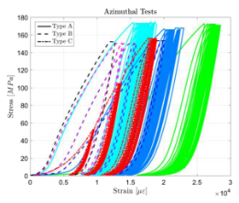
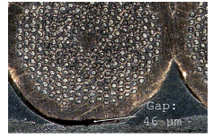
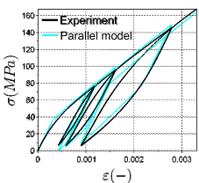
Modelling Nb3Sn magnets and materials
Ongoing CEA activities:
Detailed 3D Rutherford cable model (Cocascope)
”Stress-induced current limit” of magnets
Thermo-chemico-mechanical behavior during Heat Treatment
CEA contribution to other ongoing activities
Thermo-mechanical behavior during pre-load and thermal cycles
Adhesion/sliding behavior with interfaces (CHART, LBNL)
Courtesy F. Nunio and P. Manil, CEA
Courtesy G. Vallone, LBNL
Courtesy G. Lenoir, CERN
C. Fichera, IEEE TAS 2019

Slide 19
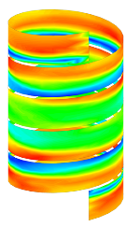
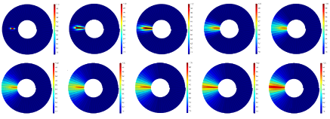
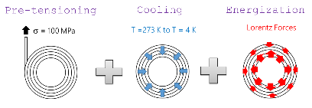
Modelling HTS magnets
Ongoing CEA activities:
Screening currents in tapes
Quench in No-Insulation or Metal-Insulation windings
Mechanical Stress in No-Insulation or Metal-Insulation windings
CEA-CERN collaboration to be defined
→ Validation of numerical models on magnets, sub-models and samples
Courtesy P. Fazilleau and G. Dilasser, CEA

Slide 20
4. Cryogenics Developments at CEA

Slide 21




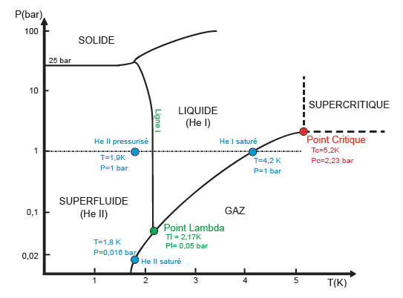



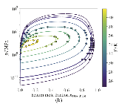
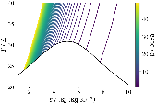
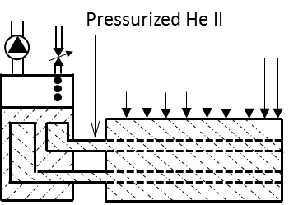
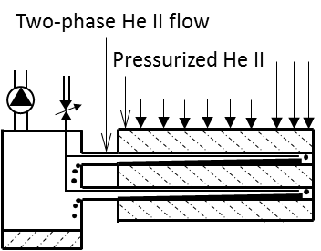
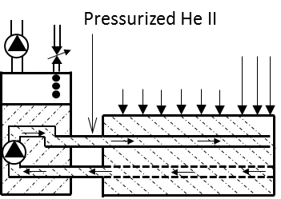
Cryogenics development for superconducting devices 1/2
Cooling architecture studies
Magnetic Refrigeration < 1.5K
Helium cooling (He, HeII, SHe) ~1.8 K to 6 K
New models for binary cryogenic mixture above 30 K
Conduction-cooled or forced-flow circulation
ADR process cycle (PRAB 2017)
Helium
Helium-Neon (JPCRD 2020)
HeII cooling options (Cryogenics 2018)

Slide 22

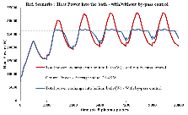

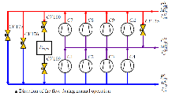
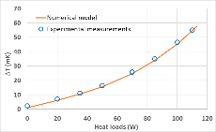

Cryogenics development for superconducting devices 2/2
Modeling, simulation and advanced control
Dynamic simulations of pulsed heat loads
Advanced control for stability and/or energy saving
Smoothing method demonstration (AIP 2014)
Model-based control (AIP 2014)
Estimated heat load validation (IEEE 2021)
Specific component development
HeII compact heat exchanger (IOP 2019)

Slide 23
5. Works on HTS magnets at CNRS Applied Superconductivity Group

Slide 24


HTS dipole magnet
Theoretical exploration of a stacked tape conductor magnet
Conductor (4 x 4 mm²):
20 x 4 mm REBCO 0.2 mm tape
(1 twist/turn)
402 mm
Transposition side
397 mm
Turn-to-turn transition side
J. Himbele
insert based on 46 turn staked cable has been designed
Fulfil the real requirements in terms of field value & quality
Rather low engineering current densities (650 MA/m²)
Mechanics at the limit but fits with little optimizations
Complicated coil ends especially
Homogeneous current distribution not fully solved
  Proposal: soldered tapes and partially isolated
  Simulation tools developed
Better tapes would significantly simplify the coil ends

Slide 25




Works on HTS magnets - BOSSE
BOSSE Project: REBCO isolated 1 MJ SMES
Double Pancake | 21
Serie turns | 178
R_{i} (mm) | 94.25
R_{e} (mm) | 120
Unit length (m) | 120.7
Total height (mm) | 814
L(H) | 2.79
Tape (isolated) | 12 mm SuperOx
I/J (A/A/mm²) | 850/525
B_{lg}/B_{tr} (T) | 11.5 / 4.2
σ (Mpa) | 400
18 kJ/kg
Status:
18/21 DP tested up to 860 A (rated val.)
1 DP with tape problem (isolation)
2 DP with problem (fabrication & test)
Issue with internal connexions
Knowledges and skills on designing, modeling, realization, protection and test of HTS magnets

Slide 26
6. Infrastructure and competencies

Slide 27



Existing infrastructure – coil fabrication at CEA Saclay
Nb₃Sn coil fabrication
  Winding machine for dipoles and quadrupoles
  Furnace for Nb₃Sn (coils up to 1.5 m)
  Impregnation bay
Assembly bench for bladders and keys mechanical structures
Innovative winding machine for HTS tapes
  Funding = 104 k€ via the FASUM Equipex (Université de Grenoble-Alpes).
  No-Insulation and co-winding alternatives.

Slide 28



STAARQ Test station at CEA Saclay
Commissioning ongoing
Technical characteristics:
  Useful diameter (magnet): 620 mm
  Useful length (magnet): 5 m
  Nominal current 13 kA
  Usefull weight (magnet) : 11 t
  Cryogenic power @ 1,9 K: 70 W
1st successful test of a numerical MSS:
  3 months running without failure
  Detection of all quenches during the test of the MQYYM magnet
  no false quench detection.
Courtesy J M Gheller, CEA
Courtesy P. De Antoni, CEA

Slide 29

Infrastructure: Equipex PACIFICS at CEA Saclay
French funding for accelerator infrastructures : Total funding ~10 M€, 4 axes
Axis #1: High performing magnets technology: high field superconducting magnets and high precision room temperature magnets → funding ~4 M€
R&D platforms
Manufacturing platform
for long magnets
Test facilities

Slide 30





400W at 1.8 K Test Facility at CEA-Grenoble
Possible cryogenic experiments from 1.5 K to 5 K
Roussel P, Girard A, Jager B, Rousset B, Bonnay P, Millet F, et al. The 400W at 1.8K Test Facility at CEA‐Grenoble. AIP Conference Proceedings 2006
Lagier B, Rousset B, Hoa C, Bonnay P. Experimental validation of advanced regulations for superconducting magnet cooling undergoing periodic heat loads. AIP Conference Proceedings 2014

Slide 31
Conclusion : many contributions to HFM development
Long-term experience with Nb₃Sn and HTS fabrication and tests
Integrated plans towards 16 T Nb₃Sn magnets and 20 T HTS magnets with subscales and demonstrators
Parallel technological developments and numerical modeling tools ongoing
CEA and CNRS internal R&D programs
CEA is consolidating and developing its infrastructure and competencies
CEA-CERN collaborations ongoing, future agreements to be defined, CNRS being involved.

