Slide 1
High Field Accelerator Magnet
R&D Programme
José Miguel Jimenez
Acknowledgments to L. Bottura, A. Devred and A. Ballarino for the preparation of the slides
Notes:
Good afternoon, my name is Luca Bottura, leader of the CERN Magnet Group, and it is a pleasure for me to present our proposed strategy for R&D on high-field accelerator magnets in the coming years, as we see it today from CERN

Slide 2
Reference Documents
Update of the European Strategy for Particle Physics, June 2020, CERN-ESU-013:
  […] the particle physics community should ramp up its R&D effort focused on advanced accelerator technologies, in particular that for high-field superconducting magnets, including high-temperature superconductors;
  Innovative accelerator technology underpins the physics reach of high-energy and high-intensity colliders […] The technologies under consideration include high-field magnets, high-temperature superconductors […];
  The particle physics community must further strengthen the unique ecosystem of research centres in Europe. In particular, cooperative programmes between CERN and these research centres should be expanded and sustained with adequate resources in order to address the objectives set out in the Strategy update;
Deliberation Document on the 2020 Update of the European Strategy for Particle Physics, 5 March 2020, CERN-ESU-014:
  This […] require(s) […] high- field magnets (assumed to be 16 Tesla in the current design) which are far from ready for series production.
  A focused, mission-style approach should be launched for R&D on high-field magnets (16 T and beyond); this is essential for a future hadron collider, to maximise the energy and to minimise the development time and cost. Development and industrialisation of such magnets based on Nb₃Sn technology, together with the high-temperature superconductor (HTS) option to reach 20 T, are expected to take around 20 years and will require an intense global effort.
EDMS: 2477846
Notes:
Based on the state-of-the-art and the conclusions drawn, we have identified three axis of work for the R&D to be performed in the next step. We wish on one side to push the Nb3Sn technology to its practical limit, both in terms of maximum performance as well as production scale, which implies on two axis:
On one side explore the limits and demonstrate the potential of Nb3Sn in terms of field reach. We have set a design target of 16 T, which should be intended as the direction of exploration, and not as a mandatory performance specification;
2) Develop magnets for a production scale (of the order of 1000 magnets) that goes beyond HL-LHC (of the order of 10 magnets). This will have to go through a first step that involves robust magnets, possibly simplified and optimized production and eventually reduction of cost. Target field for this direction of R&D is the value of 12 T reached at present by HL-LHC, which should be intended as the benchmark against which we will compare results, and again not as a mandatory performance specification.
As to the HTS:
3) We seek to explore the possibility offered by HTS to surpass LTS, by providing proof-of-principle of the technology for accelerator applications. In this case we set the target field to 20 T, well above the reach of Nb3Sn.
For clarity, the fields quoted are to be intended as operating fields, i.e. including engineering and operation margin.

Slide 3
HFM Goals (long term)
Demonstrate Nb₃Sn magnet technology for large scale deployment, pushing it to its practical limits, both in terms of maximum performance as well as production scale
  Demonstrate Nb₃Sn full potential in terms of ultimate performance (target 16 T)
  Develop Nb₃Sn magnet technology for collider-scale production, through robust design, industrial manufacturing processes and cost reduction (benchmark 12 T)
Demonstrate suitability of HTS for accelerator magnet applications, providing a proof-of-principle of HTS magnet technology beyond the reach of Nb₃Sn (target in excess of 20 T)
Implemented as a focused, innovative, mission-style R&D of collaborative nature
CERN-ESU-013
CERN-ESU-014
Notes:
Based on the state-of-the-art and the conclusions drawn, we have identified three axis of work for the R&D to be performed in the next step. We wish on one side to push the Nb3Sn technology to its practical limit, both in terms of maximum performance as well as production scale, which implies on two axis:
On one side explore the limits and demonstrate the potential of Nb3Sn in terms of field reach. We have set a design target of 16 T, which should be intended as the direction of exploration, and not as a mandatory performance specification;
2) Develop magnets for a production scale (of the order of 1000 magnets) that goes beyond HL-LHC (of the order of 10 magnets). This will have to go through a first step that involves robust magnets, possibly simplified and optimized production and eventually reduction of cost. Target field for this direction of R&D is the value of 12 T reached at present by HL-LHC, which should be intended as the benchmark against which we will compare results, and again not as a mandatory performance specification.
As to the HTS:
3) We seek to explore the possibility offered by HTS to surpass LTS, by providing proof-of-principle of the technology for accelerator applications. In this case we set the target field to 20 T, well above the reach of Nb3Sn.
For clarity, the fields quoted are to be intended as operating fields, i.e. including engineering and operation margin.

Slide 4
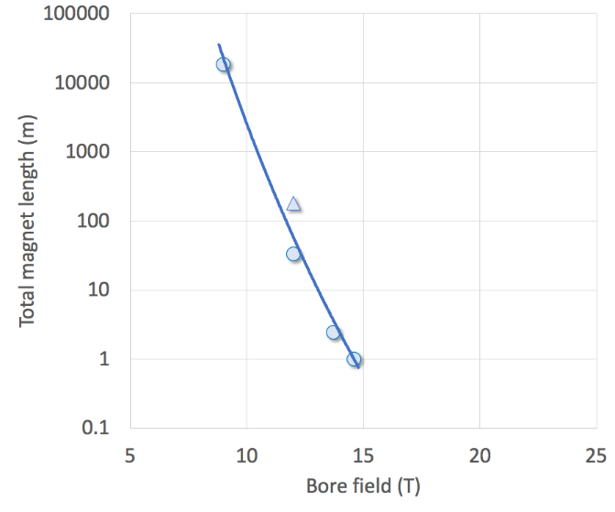
HFM Objectives
Development of robust and cost-efficient processes
LHC
Robust Nb₃Sn
HL-LHC QXF
Logical step for a next phase (2027-2034)
HL-LHC 11T
D20
Fresca2
MDPCT1
Ultimate Nb₃Sn
Exploration of new concepts and technologies
HTS
Notes:
This figure translates the three axes in graphical form, reporting the field generated by a dipole magnet on the horizontal axis, and the total length of magnets produced on the vertical axis.
The horizontal axis is the line of exploration of field limits, new concepts and technology
The vertical axis is the direction of series production, where a robust and efficient process is required.
The blue line represents magnets that have been produced to date. At one extreme is the LHC, with an ultimate field of 9 T and nearly 20 km of magnets installed in the accelerator tunnel. At the other extreme are single realizations such as FRESCA2 or MDPCTI, with field in excess of 14.5 T but single magnetic length of the order of 1 m. In the middle is HL-LHC, with a few magnets built that have reached field levels of 11 T (operation) to 12 T (ultimate).
The search for high fields will push the boundary along the horizontal axis, looking at Nb3Sn (red) and HTS (purple), over the scale of length typical of demonstrators and models (1 m or less)
At the same time, we wish to review results and develop the technology relevant for the production on large scale, i.e. from a few tens of m to (potentially) km of accelerator magnets (blue).
A key of the approach is that both lines proceed simultaneously, the shaded area, to achieve the objective set for the next 5 to 7 years, i.e. demonstrate that Nb3Sn can be used in a large scale accelerator and probe the potential of HTS. There is an obvious interaction among the lines, as many of the technologies are shared, and the results in each line can influence the progress along the other lines.
Finally, and logically, the next step of this R&D should be to take stock of both the push in maximum field and in production scale, to demonstrate on medium scale the maximum field that can be reached with Nb3Sn (green). But this is for the moment only a conjecture.

Slide 5
Conductors
Nb₃Sn Conductor
  Secure state-of-the-art wire and cable for the magnet program at affordable cost (including extensive characterization measurements).
  Pursue the FCC Conductor Development Program towards ultimate performance (new wire layouts and compositions, enhanced mechanical properties and reinforcements, magnetization and stability, means towards cost reduction for large scale production).
HTS Conductor
  Focus is on REBCO (exploit complementarity with US-MDP for Bi-2212).
  Match conductor (tape and cable) specifications to accelerator magnet needs, and revisit present wisdom (EuCARD -> EuCARD2 -> ARIES-> I-FAST -> …).
  Procure and develop tailored conductor and cable concepts for the magnet program.
Measurements
  Coordinate wire, tape and cable characterization, including material studies and advanced analytical techniques.
DRAFT

Slide 6
Nb₃Sn magnets
Robust Nb₃Sn Accelerator Magnet
  Design and demonstrate a long dipole magnet with robust performance in the range of 12T (HL-LHC performance benchmark).
  Strive to introduce cost-effective engineering solutions, suitable for large-scale production (o(10³) magnets).
Ultimate Nb₃Sn Magnet Technology
  Support construction of short and long Nb₃Sn magnets through a progression of basic R&D consolidated steps (e.g. SMC, RMC, eRMC, RMM) exploring design and technology variants.
  Explore alternatives and develop technology for magnets beyond HL-LHC, aiming at the highest practical operating field that can be reached with Nb₃Sn. The design target is set for 16 T (FCC-hh).
  Pursue FCC Magnet Development Program towards ultimate field, building and testing accelerator relevant Nb₃Sn dipole models (through high-visibility collaborations).
DRAFT

Slide 7
HTS magnets
HTS Magnet Technology
  Manufacture and test sub-scale and insert coils as a “R&D vehicle” and demonstration of operation beyond the reach of Nb₃Sn.
    Test the conductor and magnets in relevant conditions of field and forces (see experience gained through R&D on solenoids and small dipole inserts).
  Explore HTS magnet technology at field beyond Nb₃Sn, with a projected dipole field target of at least 20 T.
DRAFT

Slide 8
Cross-cutting R&D (1/2)
Engineering, Materials and Production Infrastructure
  Challenge the HFM magnet engineering concepts (towards simplicity, robustness and industrialization).
  Develop and characterize materials and composites relevant to HFM applications (including detailed material studies, advanced imaging and analytical techniques, material measurements and descriptions).
  Consolidate the modelling tools to complement short models magnets (constitutive equations and models adapted to the whole spectrum of electro-thermo-mechanical, cryogenics and thermo-physical properties relevant to HFM R&D).
HFM Magnet Protection
  Design the quench detection and protection of LTS and HTS high-field magnets beyond the state-of-the-art (HL-LHC), establishing physical limits and including new strategies, methods and tools.
DRAFT

Slide 9
Cross-cutting R&D (2/2)
HFM Test Infrastructure and Instrumentation
  Review existing diagnostic, instrumentation and test infrastructure as required by HFM R&D, and establish future needs.
  Coordinate instrumentation and test infrastructure development and upgrades and facilitate sharing of test resources within the scope of HFM R&D.
HFM Applications to Science and Society
  Evaluate and foster the scientific and societal impact of the HFM R&D, maintaining a tight connection with the HFM stakeholders.
DRAFT

Slide 10
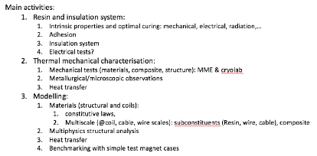
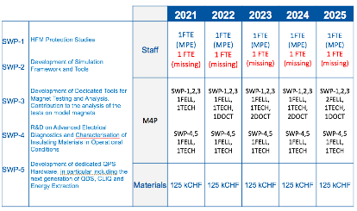
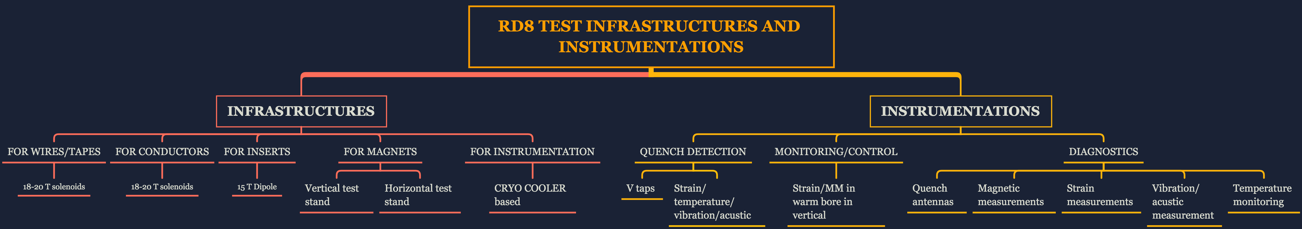
HFM Programme construction
TE-MSC: LTS and HTS
TE-VSC: Materials
TE-MPE: Protection
TE-MPE: Test Infrastructure and Instrumentation
Series of targeted meetings in the past 6 months
Notes:
This figure translates the three axes in graphical form, reporting the field generated by a dipole magnet on the horizontal axis, and the total length of magnets produced on the vertical axis.
The horizontal axis is the line of exploration of field limits, new concepts and technology
The vertical axis is the direction of series production, where a robust and efficient process is required.
The blue line represents magnets that have been produced to date. At one extreme is the LHC, with an ultimate field of 9 T and nearly 20 km of magnets installed in the accelerator tunnel. At the other extreme are single realizations such as FRESCA2 or MDPCTI, with field in excess of 14.5 T but single magnetic length of the order of 1 m. In the middle is HL-LHC, with a few magnets built that have reached field levels of 11 T (operation) to 12 T (ultimate).
The search for high fields will push the boundary along the horizontal axis, looking at Nb3Sn (red) and HTS (purple), over the scale of length typical of demonstrators and models (1 m or less)
At the same time, we wish to review results and develop the technology relevant for the production on large scale, i.e. from a few tens of m to (potentially) km of accelerator magnets (blue).
A key of the approach is that both lines proceed simultaneously, the shaded area, to achieve the objective set for the next 5 to 7 years, i.e. demonstrate that Nb3Sn can be used in a large scale accelerator and probe the potential of HTS. There is an obvious interaction among the lines, as many of the technologies are shared, and the results in each line can influence the progress along the other lines.
Finally, and logically, the next step of this R&D should be to take stock of both the push in maximum field and in production scale, to demonstrate on medium scale the maximum field that can be reached with Nb3Sn (green). But this is for the moment only a conjecture.

Slide 11
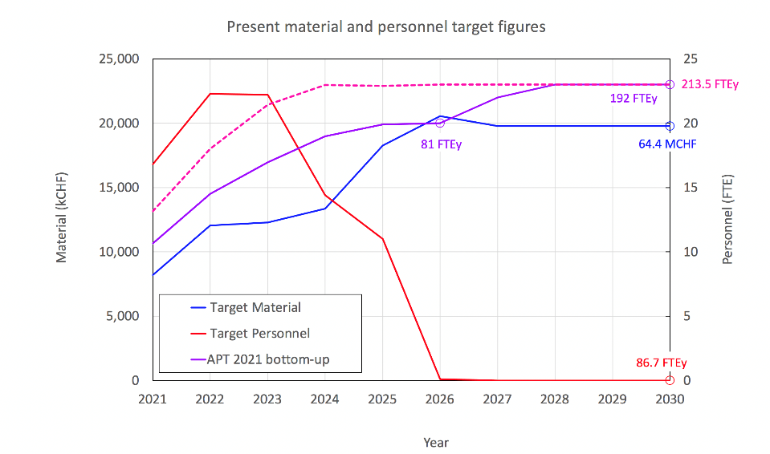
M+P – Target figures 2021-2030
+15 FTEy new P
Proposed P target 2021-2030

Slide 12
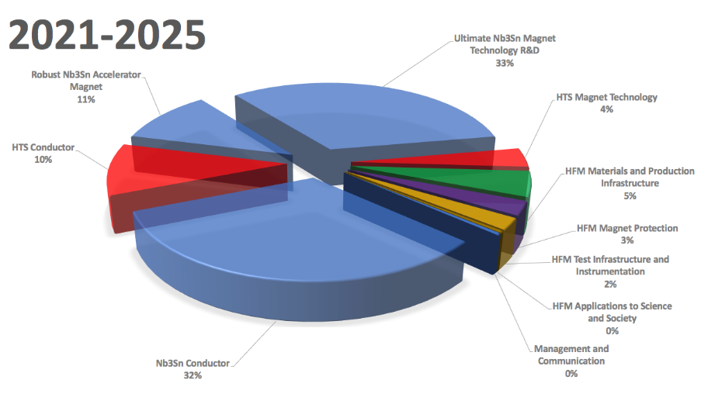
M Share among lines
LTS: 76 %
HTS: 14 %
Technologies: 10 %

Slide 13
Reminding the learning steps…
HFM work is on-going (from FCC collaborations), here we are reinforcing the effort, prioritizing magnet demonstrators, but we should not forget the results achieved and lessons learnt on the way
  HL-LHC 11 T full size magnet: 11.2 T in 60 mm
  FRESCA2: 14.6 T in 100 mm
  MDPCT1: 14.5 T in 60 mm
  eRMC01: 16.5 T peak
  Past and present initiatives and collaborations, including US-LARP, EU-CARE, HL-LHC, AUP, US-MDP, FCC R&D, EuroCirCol, EuCARD, VHFSMC, EuCARD2, ARIES, …
Notes:
I do not wish to conclude without reminding that HFM work is of course already ongoing ! Many spectacular results have been obtained, here a list of some I quoted already, and many lessons have been learnt in this process, also thanks to the coordinated effort of the whole community facilitated by the numerous networks and collaborations of which I list a few as an example. We wish to build upon these results and lessons learnt, to pave the way to the HEP experiments of the future through innovative magnet technology !

Slide 14
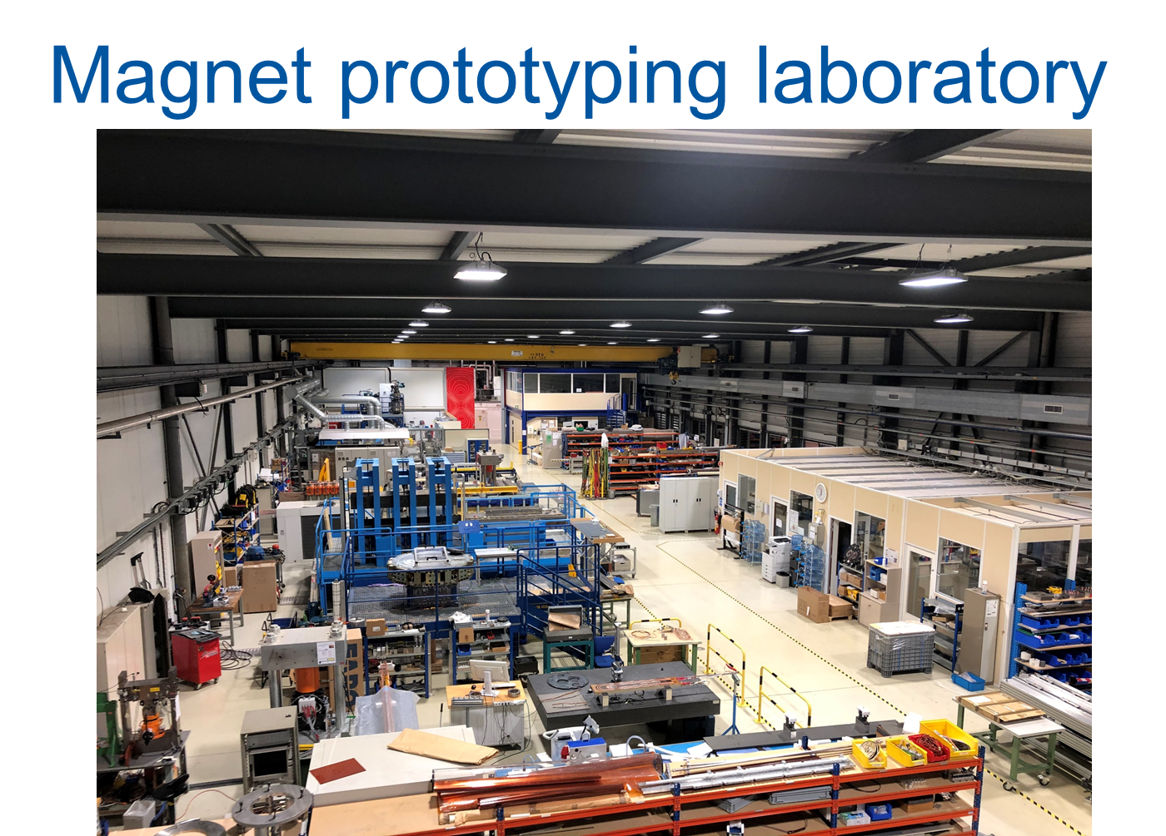
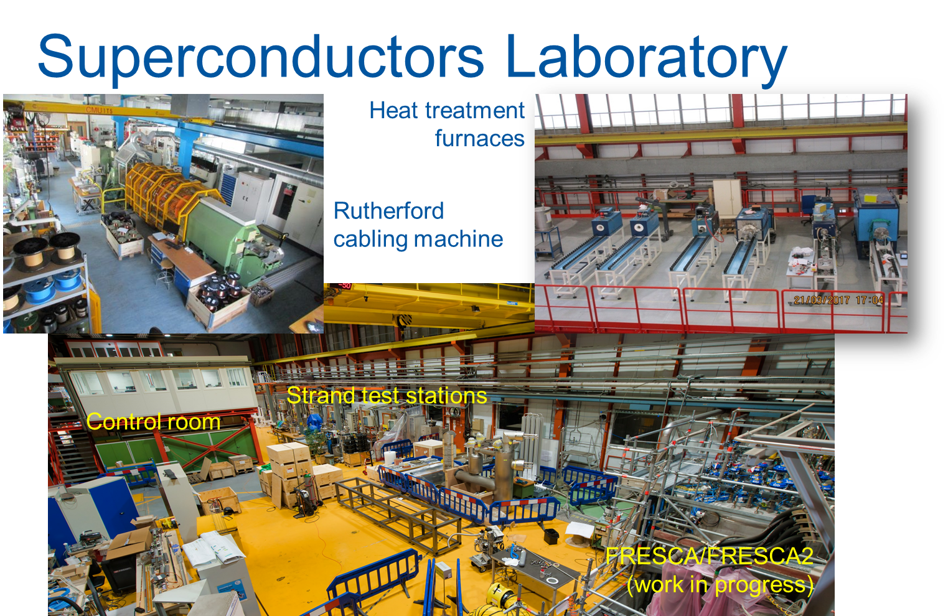
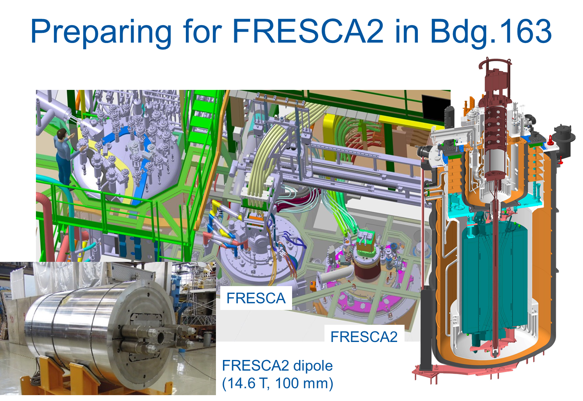
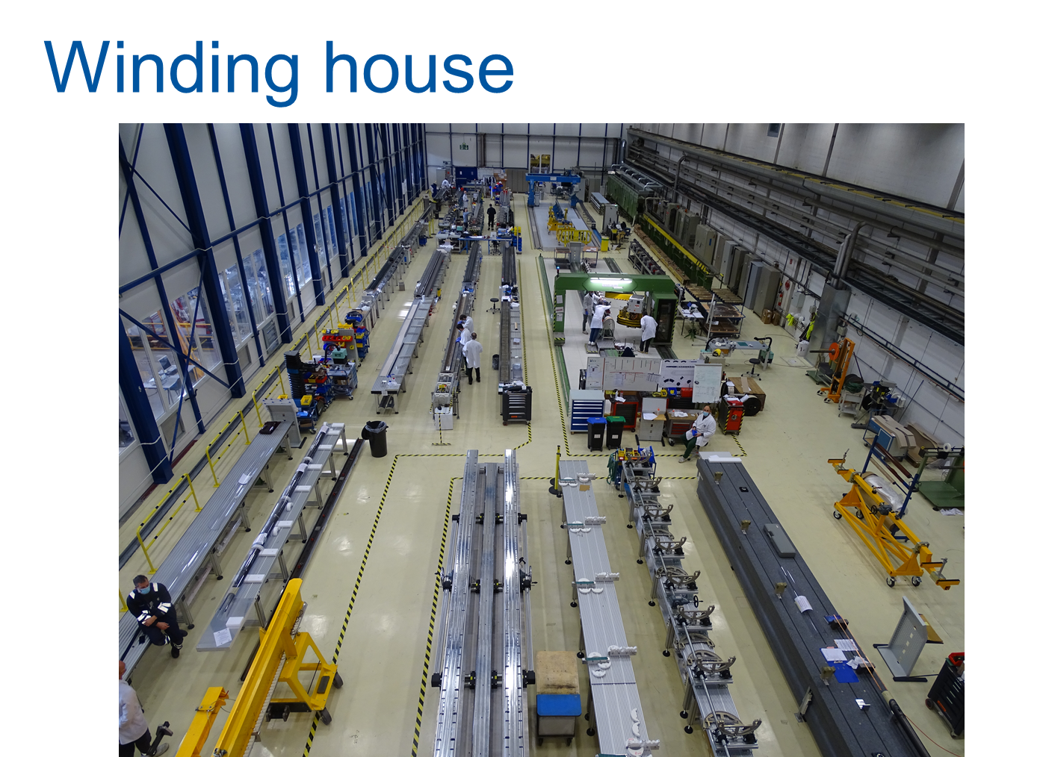
State-of-the-art infrastructures

Slide 15
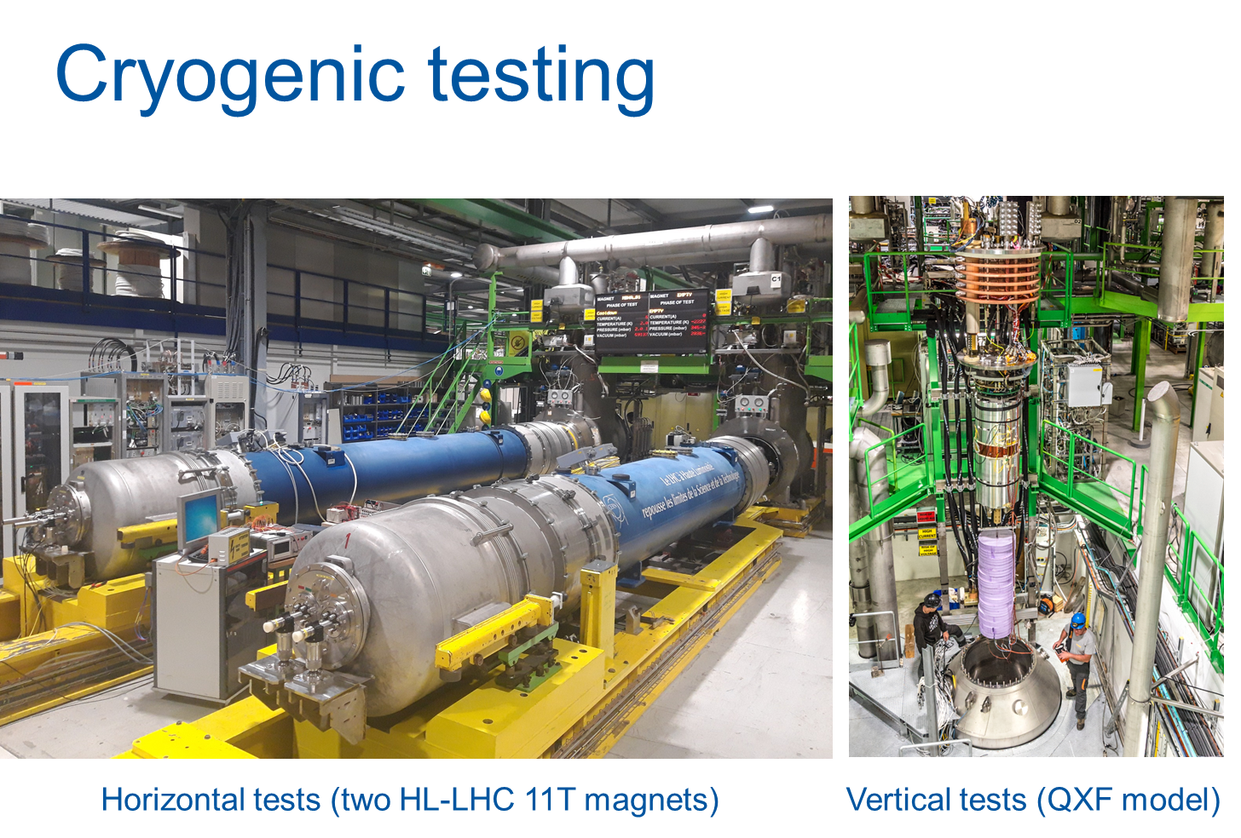
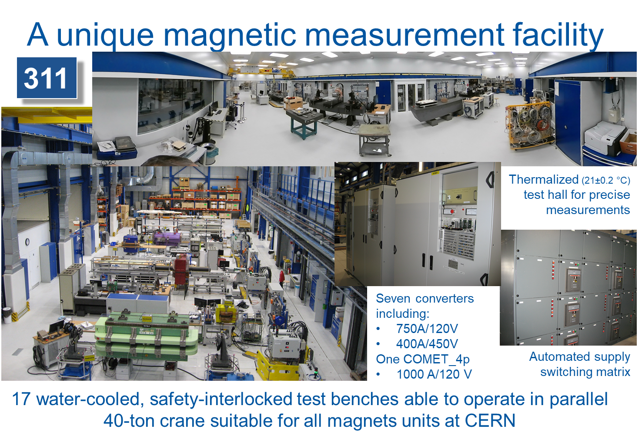
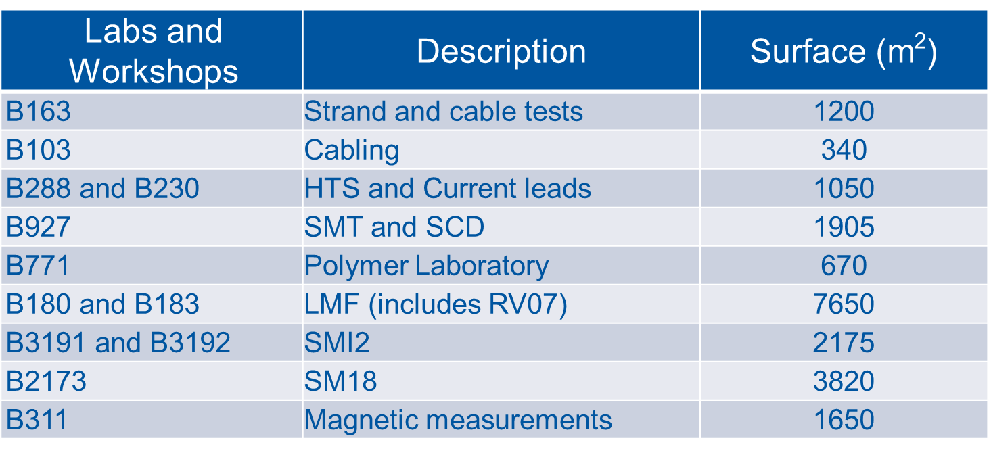
State-of-the-art infrastructures

Slide 16
CERN approach (1/2)
HFM is aimed at demonstrating the ultimate performances and industrialization potential of Nb₃Sn technology and suitability of HTS for accelerator magnets.
While ensuring a close follow-up on the conductor optimisation, CERN will focus on Nb₃Sn robust design, industrial manufacturing processes and cost reduction (benchmark 12 T) learning from the
HL-LHC program.
And consolidate the design and produce short Nb₃Sn magnets with higher performances (>14T) and HTS demonstrators;
Building a preliminary pragmatic program which includes both LTS and HTS. We expect to align with the LDG sponsored HFM Roadmap when published.

Slide 17
CERN approach (2/2)
The 5 years timeline imposes the use of conductors, cables, magnet concepts at maturity stage to expect approaching the HFM objectives and milestones.
Partners are needed to share the complex technical challenges, efforts and milestones.
Some scientific aspects and technical issues would need to be studied and further developed in complement of the HFM program priorities.
Final scope of HFM and specific contribution of the CERN magnet group is being finalised:
In a spirit of continuity with the on-going work, mainly initiated as part of the FCC-hh program,
Not closing the door to innovation, intentionally fostering and profiting from collaborations but remaining focused on the primary objectives: make demonstrators.
Intended to provide a seed to the EU-wide HFM and connect to the on-going global HFM efforts.

