Slide 1
The High Field Magnet Strategy in Spain
Jose M. Perez, CIEMAT,
June 3, 2021
Notes:
Counterfog - Se trata de un proyecto de 7PM de la UE enfocado al desarrollo de contramedidas tipo NRBQ. El proyecto evalúa tanto el desarrollo de sistemas fijos o móviles y su posible afectación a los humanos a través de la experimentación con animales.
2.- REMEX 2013, CURIEX-2013 o el último realizado @tomic2014 - Se tratan de ejercicios internacionales de simulación de emergencias, en los que la subdirección viene participando desde el 2013 y seguirá participando, suelen tener una periodicidad anual.

Slide 2
The High Field Magnet Strategy in Spain
Outline
I. Accelerator-related institutions in Spain
Accelerator Technologies. CIEMAT
tin
II. Background. Previous contribution on superconducting magnets
III. The Spanish High Field Magnet Program
Materials for HFM. CSIC-ICMAB
IV. The Superconducting material group at ICMAB
V. Activities of interest for HFM
VI. The Global Strategy on High Field Magnet

Slide 3
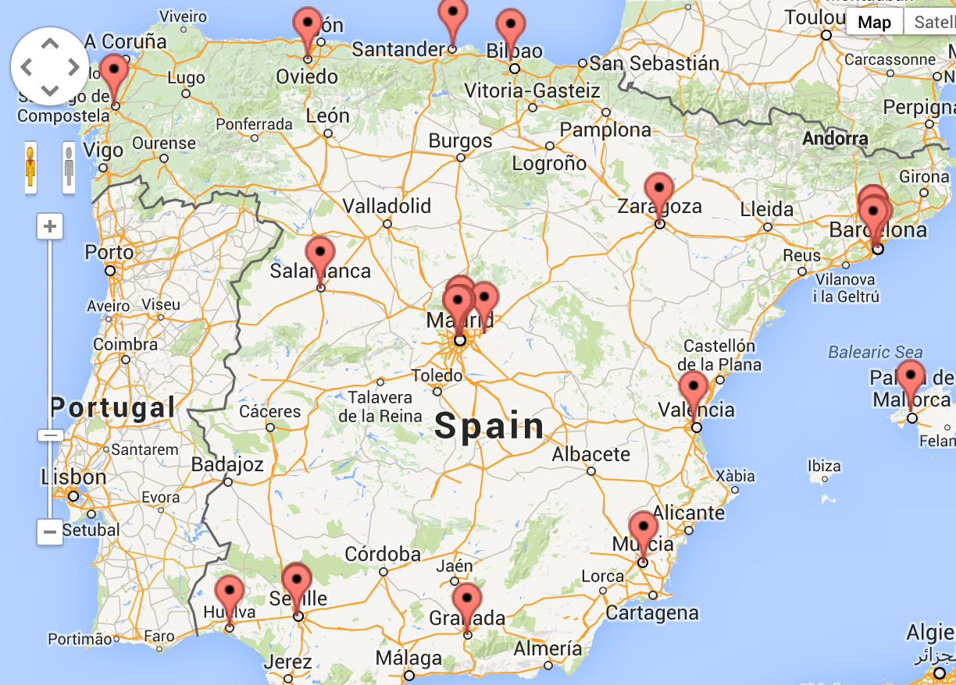
I. Accelerator-related institutions in Spain
Scientific activity on Particle Physics and Astroparticle Physics.
Instrumentation: detectors and computing
Institutes
IFIC
CIEMAT
IGFAE
UB
UCM
UGR
IFAE
IFT
UZ
IMZ
UIB
UPV
US
CNA
UAM
IEM
IFCA
UH
UO
USAL
IMB

Slide 4
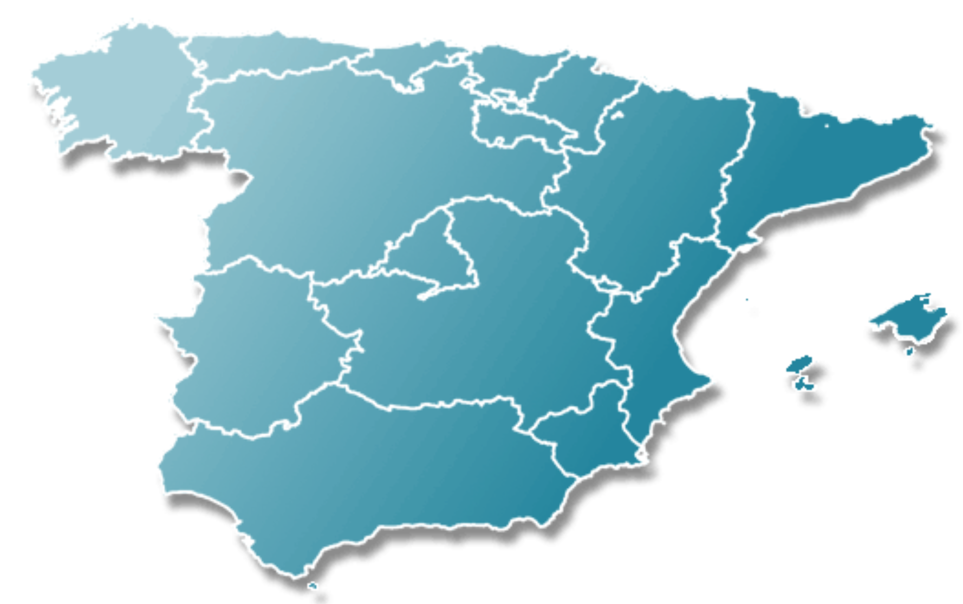
I. Accelerator-related institutions in Spain
Activity on Science, Technology and service providers related with accelerators
Material Sciences related with superconductivity
Developers on accelerator technology
1. ALBA-CELLS, Barcelona
2. CIEMAT, Madrid
3. CMAM – UAM, Madrid
4. CNA – CSIC – UA, Sevilla
5. ESS - Bilbao
6. IFIC (CSIC – UV), Valencia
7. DONES
8. ICMAB-CSIC-UAB
ESS-B
ESS-B
ESS-B
ICMAB
ALBA
CIEMAT
ALBA
CIEMAT
CMAM
IFIC
IFIC
CNA
Dones

Slide 5
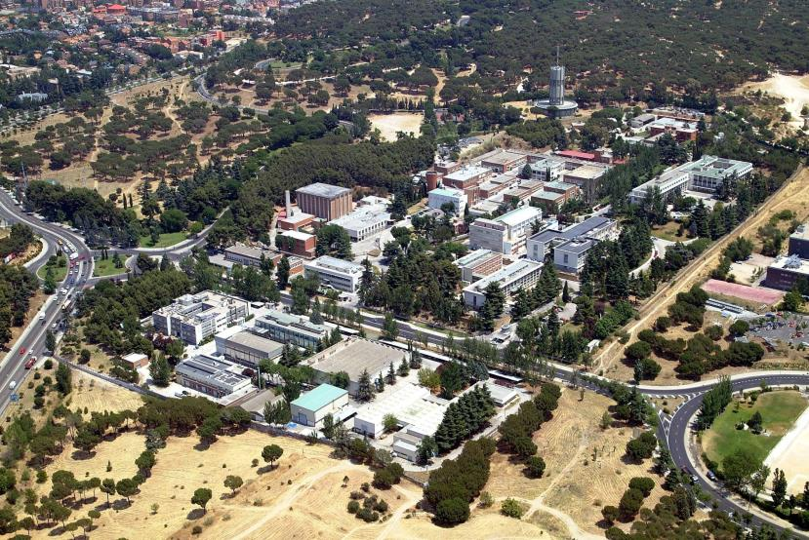
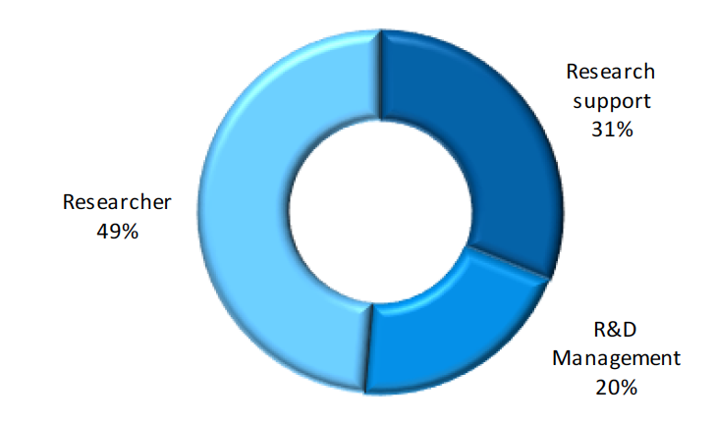
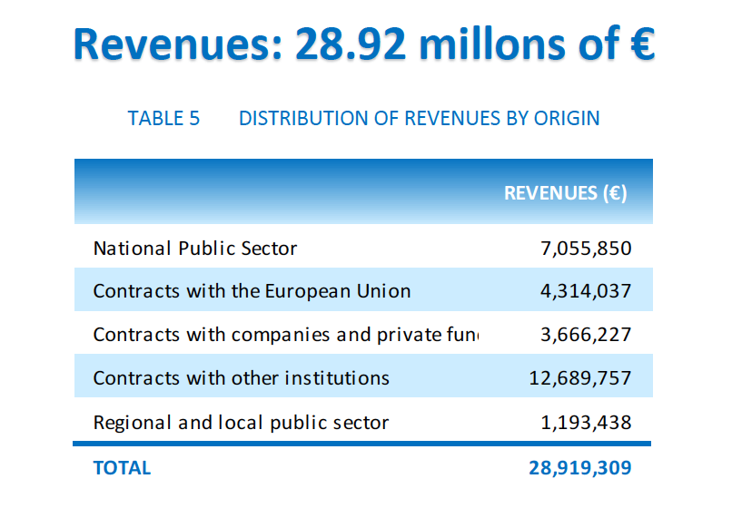
CIEMAT
1.1. Structure
Ministry of Science and Innovation
Director
General
Secretary General for Research
Carlos Alejaldre Losilla
S.G. Institutional Relations and Technology Transfer
S.G. de Safety and Facility Refurbishment
Secretary General
Julio Cárabe
López
Margarita Vila Pena
Lina Rodríguez Rodrigo
Dept. of Tecnology
Dept. of Environment
National Fusion Laboratory
Dept. of Energy
Dept. of Basic Research
Dept. of Biomedical Innovation
José Manuel Pérez Morales
Yolanda Benito Moreno
Joaquín Pedro Sánchez Sanz
Mercedes Ballesteros
Nicanor Colino Arriero
Juan Bueren
Personnel:
Total: 1250, incluided scientists, engineers, technicians, administrative staff and students.
(Accelerator related: ~20 FTE Dept. of Technology; ~10 FTE Fusion)
2019
Budget:
~100 M€ per year. Approximately, 75 M€ Govermental funds, 25 M€ income from competitive programs, contracts with companies and collaborations with institutions.

Slide 6
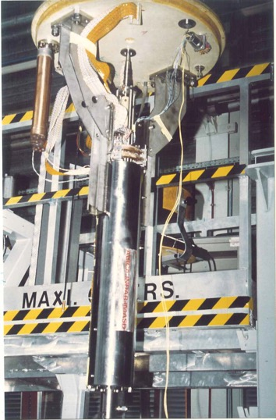
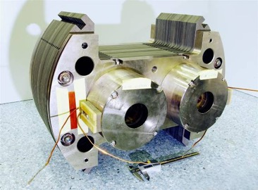
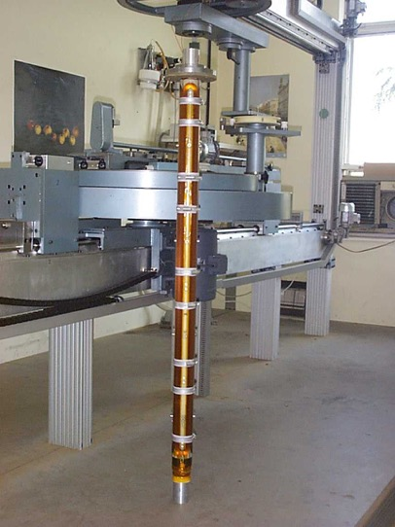
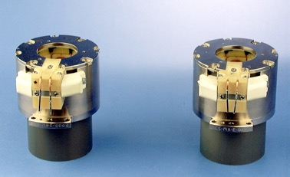
II. Background. Contributions to LHC
Since 1989, CIEMAT contributed in the design, construction and testing of several superconducting magnets for the LHC Project. In most cases with a significant industrial participation.
Twin Octupoles
The Tuning Quadrupole
Sextupole Correctors
The MQTL Trim Quadrupole
As a result, a company was awarded with two contracts for manufacturing more than 2.000 correctors (sextupoles & octupoles).

Slide 7





III. The Spanish High Field Magnet Program
In 2019, CIEMAT, CERN and CDTI signed a set of three collaboraboration agreements for the so-called High Field Magnet Program, PRISMAC.
The program PRISMAC is based on three contributions:
A small series (18 units+prototypes) of non-conventional magnets for HL-LHC, based on NbTi (MCBXF type)
The construction of a new laboratory at CIEMAT specifically for high field superconducting magnets prototyping and testing.
Contribution to the high field FCC magnet prototypes.
This program is the frame of the technical activities of CIEMAT on HFM for the next years.
The collaborations were signed for four years and can be extended up to another 4-years period. That means a stable and long-term commitment.
• KE3797/TE/HL-LHC. Development of MCBXFA & MCBXFB-type corrector magnets for the HL-LHC
• ADDENDUM FCC-GOV-CC-0130 / KE3920/TE. (MoU for the Future Circular Collider (FCC) Study

Slide 8

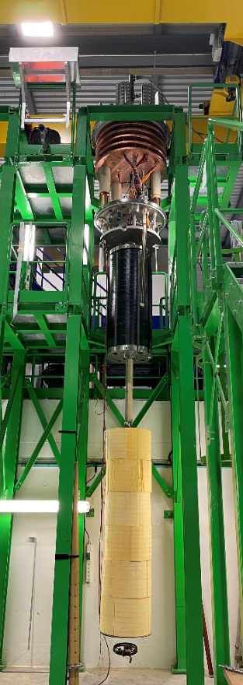
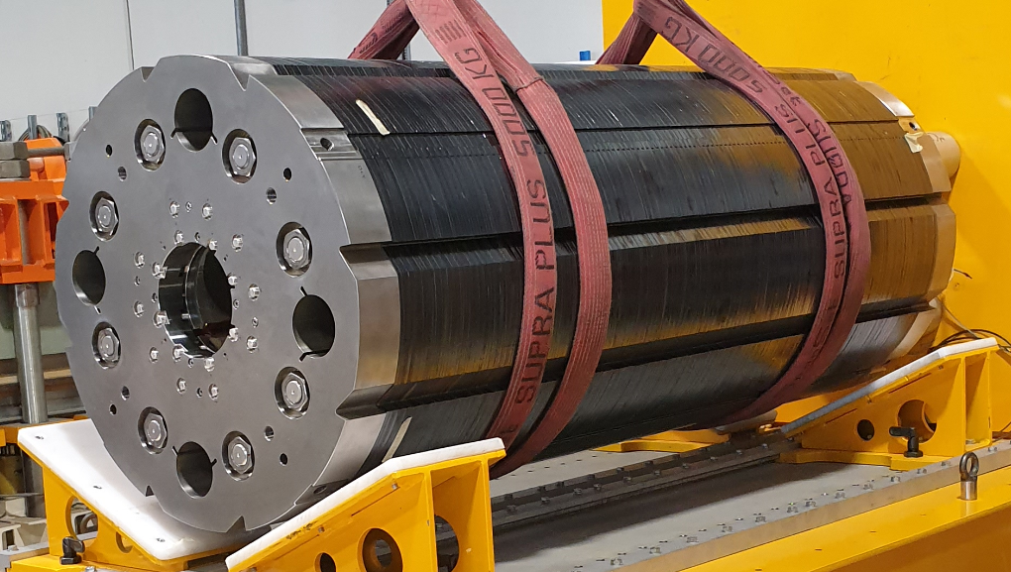
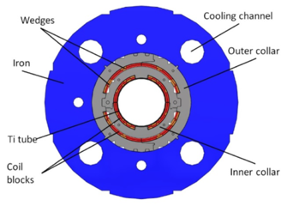
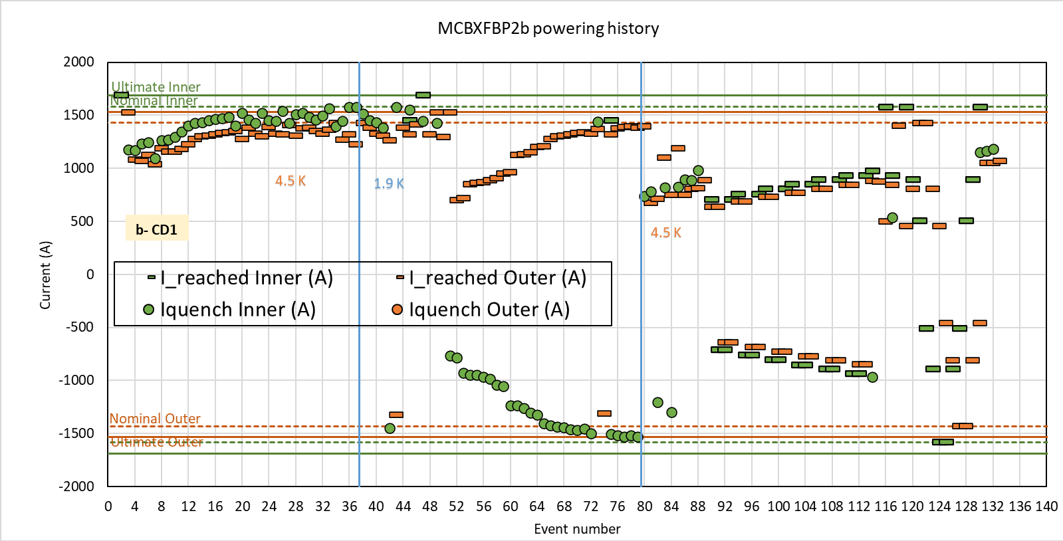
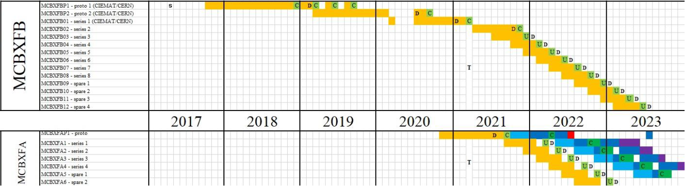
III. The Spanish High Field Magnet Program
1. The contribution proposed for HL-LHC:
Commitment:
An in-kind contribution for delivering
18+3 MCBXF-type orbit corrector superconducting magnets (shot: 11+1+2 prot; long: 6+1 prototype)
2 Short magnet prototypes manufactured and tested.
1 Long magnet prototype production ongoing.
First series magnet being produced.
Contract for 6 long and 11 short MCBXF magnets initiated in March 2021.

Slide 9
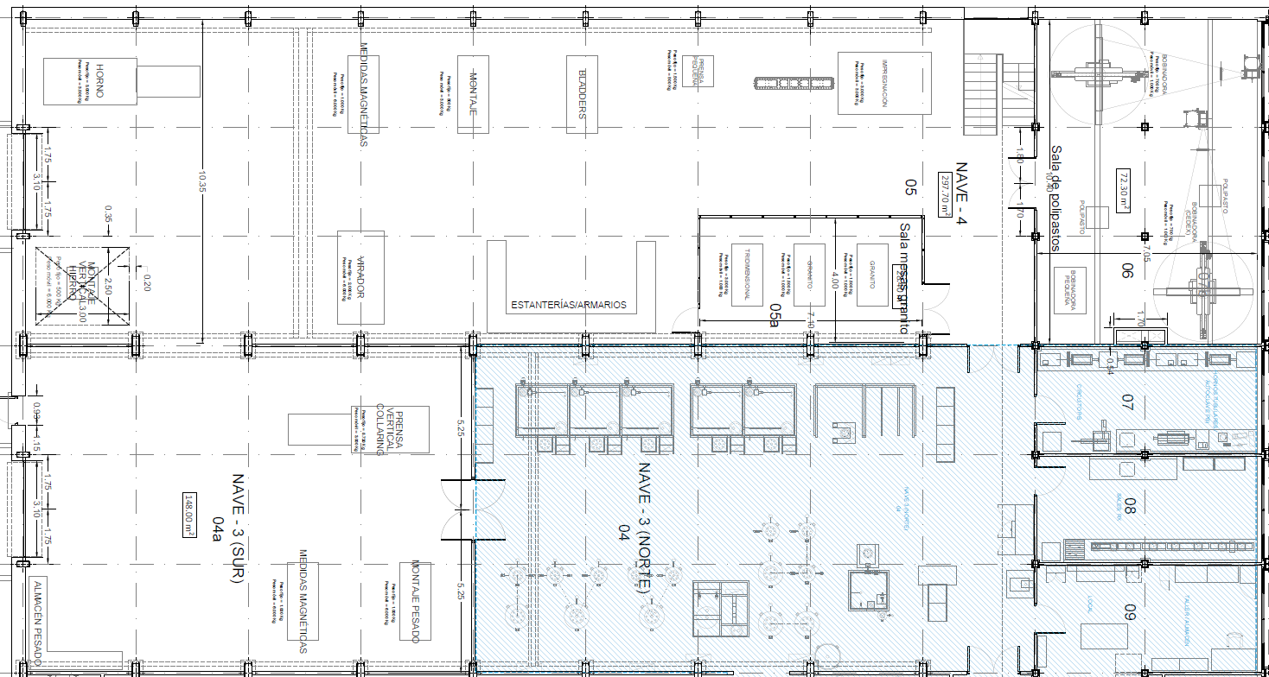
III. The Spanish High Field Magnet Program
2. CIEMAT high field SC magnet Laboratory
Magnetic measurements
Assembly
Impregnation
Winding
Furnace
44.6 m
20.5 m
Vertical assembly
Storage
CMM
Rotating tool
Winding area of 72m2 (2 winding machines)
CMM area of 29m
Assembly & storage area of 446m2
Collaring Press
Heavy assembly
Schedule: ready by June 2022.
Heavy storage
Magnetic measurements

Slide 10
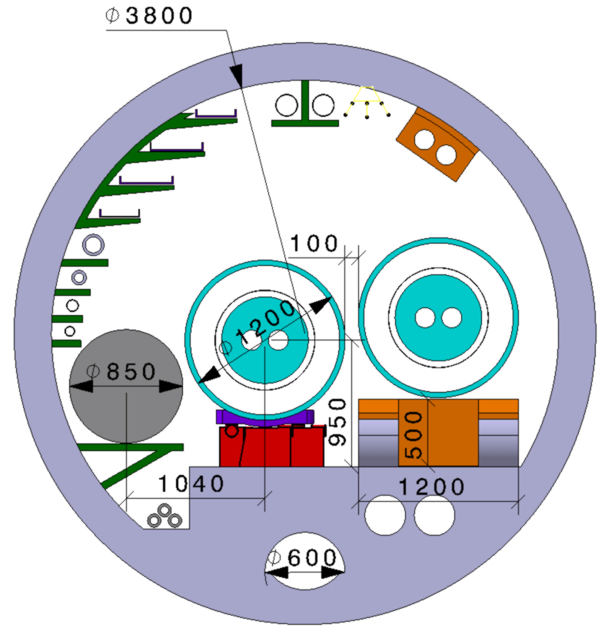

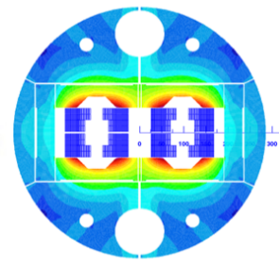
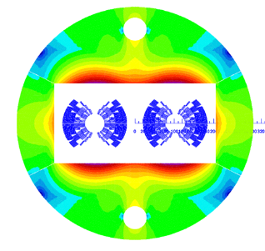
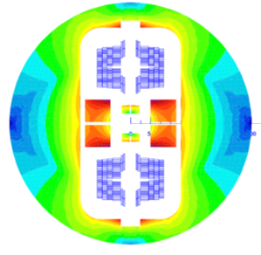
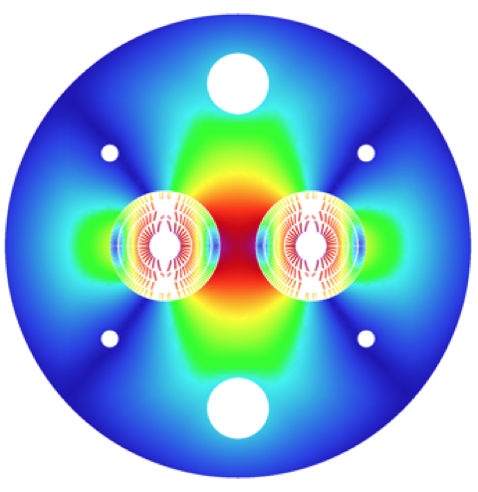


III. The Spanish High Field Magnet Program
CERN/EU program for 16 T dipole
A comparison study of different approaches:
 |  | blocks |  | cos(θ) |  | common coil
CCT
Very efficient use of superconductor
Simplified mechanics and manufacturing ?

Slide 11
III. The Spanish High Field Magnet Program
CERN/EU program for 16 T dipole
Our proposal is based on the following steps:
  Model magnet using RMC coils in common coil configuration.
  Revise the existing design of 16T common coil dipole magnet.
  Research on fabrication techniques: react-and-wind coils.
  Prototype of a high field magnet in common coil configuration.
Task | 2021 |  |  |  | 2022 |  |  |  | 2023 |  |  |  | 2024 |  |  |  | 2025
MCBXF series production
Laboratory construction
Laboratory commissioning
Model magnet with RMC coils in common coil confiig.
Revise 16T common coil dipole design
React and wind coils
Common Coil High field magnet prototype

Slide 12
III. The Spanish High Field Magnet Program
The direct investment of Spain in this program
1. CDTI. Via CDTI-CIEMAT Agreement (pilot funding tool).
Direct funds: 7 M€ (executed by CIEMAT)
2. Ministry of Science -CIEMAT Program
Direct funds executed by CIEMAT : 8.0 M€;
Own Personnel and in-kind: 2.9 M€.
Personnel involved:
Senior staff: 2 FTE
Researchers and engineers: 5 FTE
Technicians: 3 FTE
Admnistrative support: 1 FTE
Students: 2

Slide 13
The High Field Magnet Strategy in Spain
Outline
I. Accelerator-related institutions in Spain
Accelerator Technologies. CIEMAT
tin
II. Background. Previous contribution on superconducting magnets
III. The Spanish High Field Magnet Program
Materials for HFM. CSIC-ICMAB
IV. The Superconducting material group at ICMAB
V. Activities of interest for HFM
VI. The Global Strategy on High Field Magnet

Slide 14



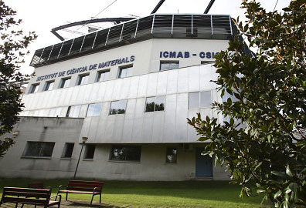
IV. ICMAB-CSIC:
A research Institute on advanced (nano)materials
Located at campus of Autonoma University of Barcelona
∼250 people, 60 Permanent scientific staff
14.5 M€ annual budget, 65% competitive funds
Awarded EXCELLENCE Severo Ochoa Institute
1 Research Line (out of 5) is on Superconductivity
Superconducting Group at ICMAB
∼ 25-30 researchers with 25 year of experience in High Temperature Superconductors
Interdisciplinary group of physicist, chemists, materials scientists and electrical engineers
Interest from fundamental knowledge on materials and science of superconductors to applied research of process scalabitliy, integration in devices and technology transfer
Low-cost high-throughput Coated Conductors manufacturing and Technology Transfer production
Advanced characterization:
          -16 T multipurpose cryomagnet system with a 50 mm bore
          -Mechanical-electrical properties with 2D/3D stress-strain maping setup
          -Multiphysics computational platform
          Coated Conductors integration in HFM and HEP
Notes:
Posem les research lines ?

Slide 15






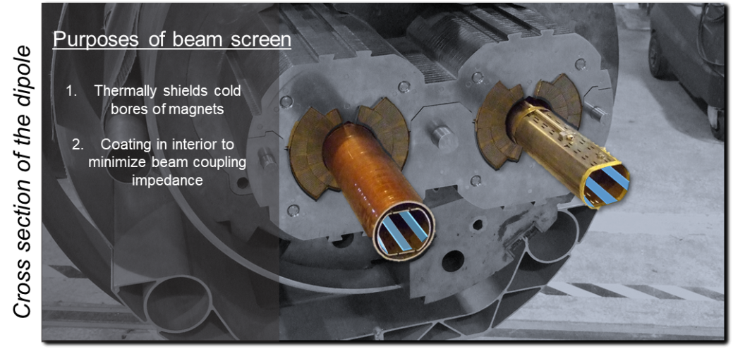




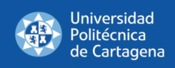

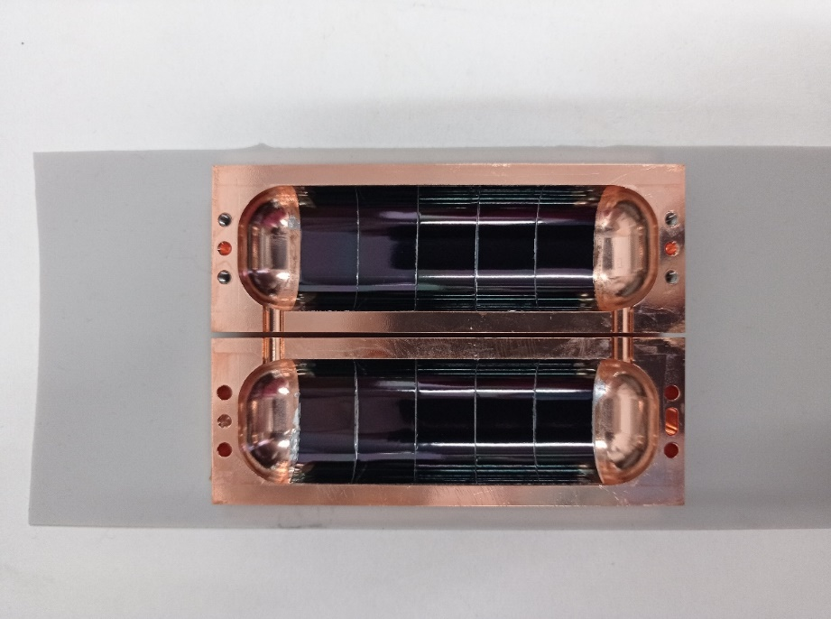
ICMAB on-going collaboration with HEP
- HTS beam screen for FCC-hh 2017-2023
-HTS benefit demonstrated:
  -Cover the inside of the 16 T magnets beam screen with striated HTS
  -Allow working at 50 K by the decrease of surface impedance
  -Ensure field quality and beam impedance demands
- Detecting Axions as Dark Matter candidate in RADES consortium (since 2020)
-HTS benefit demonstrated:
  Covering the inside of the RF cavity
  Increase of Quality-factor at high B
  Increasing cavity sensitivity: B² V Q_{cav}
-Interest for HTS RF cavities also received from muon collider community
RADES action cavity coverd by HTS

Slide 16
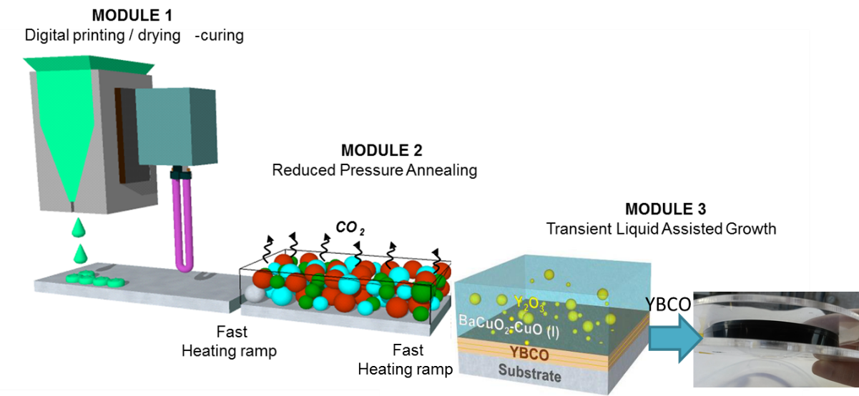

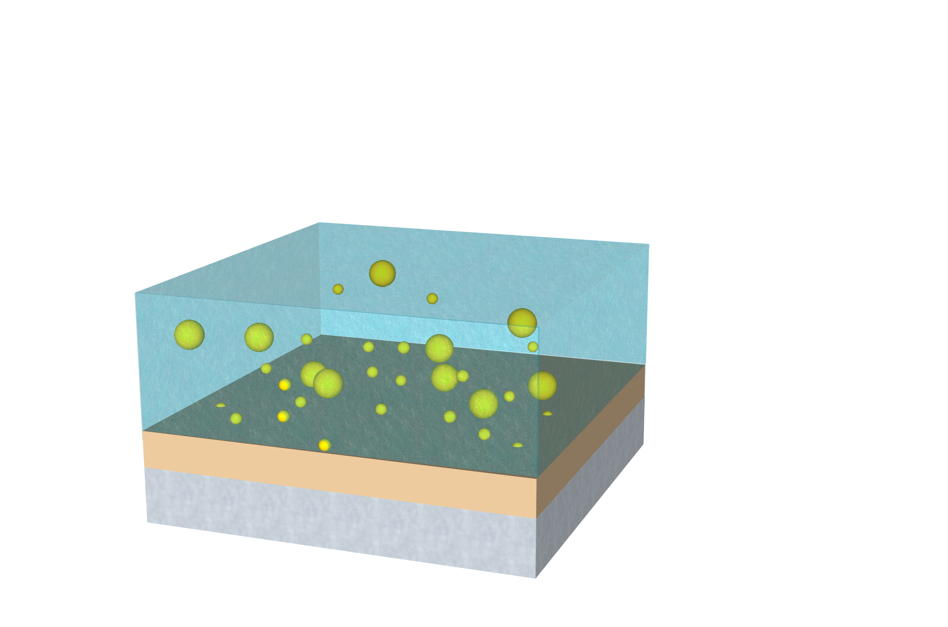
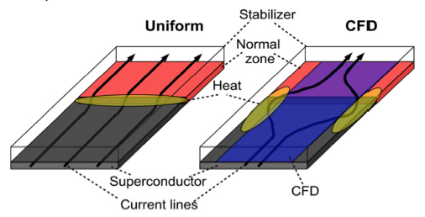
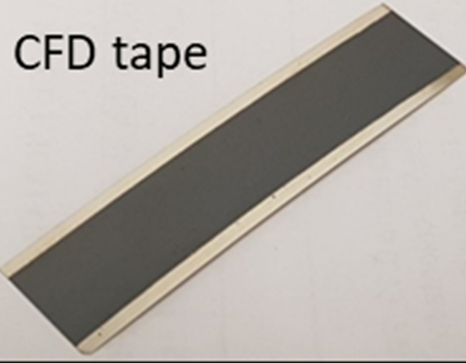
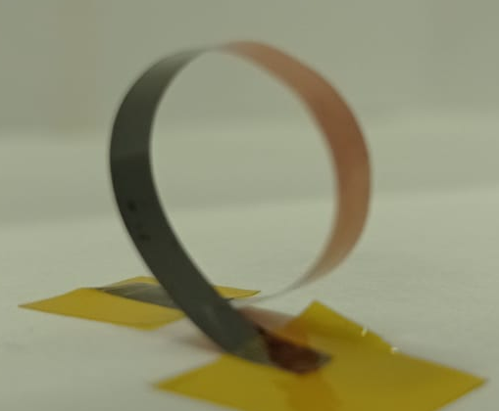
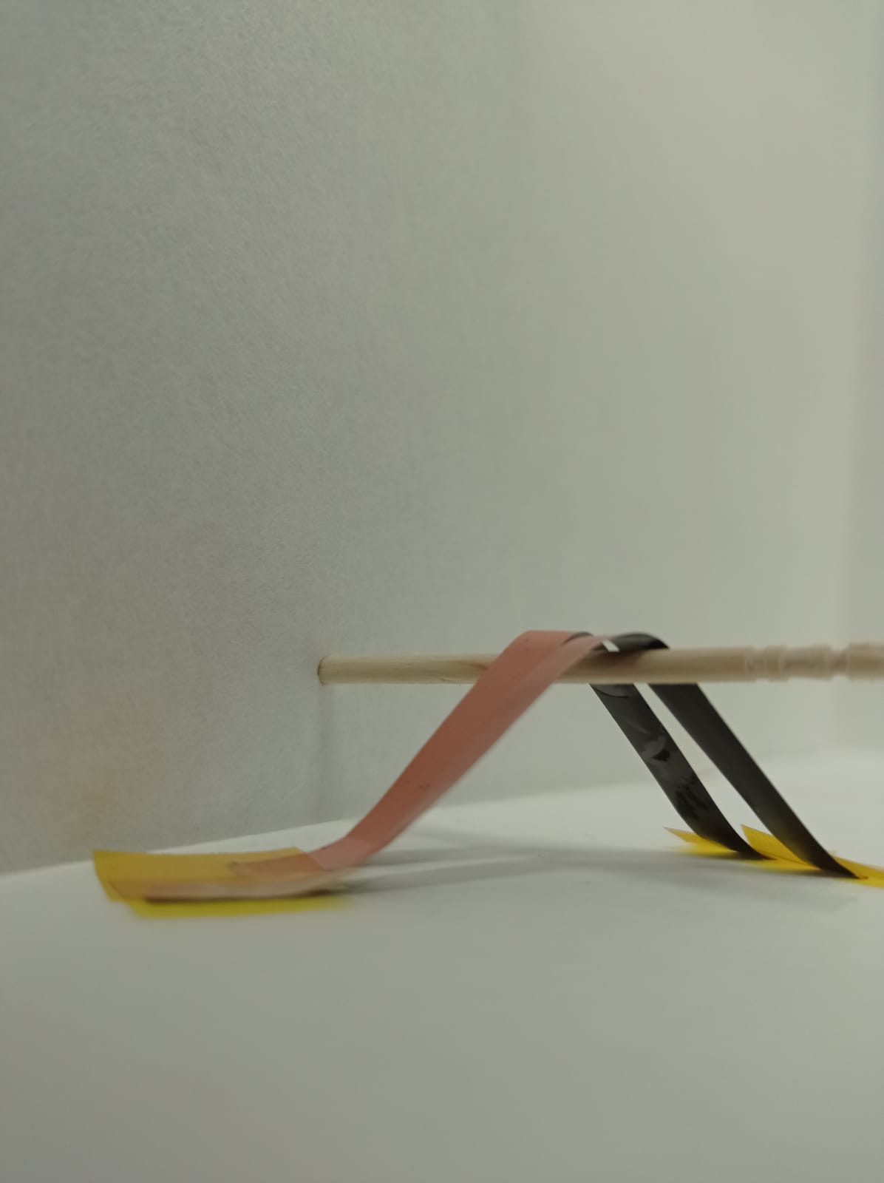
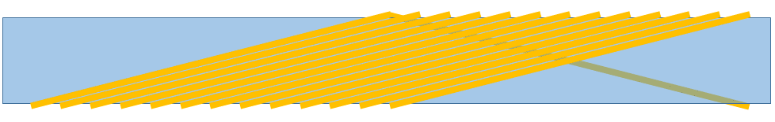
V. Activities of interest for HFM: Proposal
(related to High Temperature Superconducting Coated Conductors)
Low-cost high-throughput HTS coated conductors manufacturing
Use the expertise in delamination and current-flow-diverter (CFD) strategies to define novel and robust HTS conductors
Propose a HTS Rutherford like conductor strategy winding on a former
It would ensure transposition with reduced conductor cross section and bending radius below 1 mm is expected
Participate in the characterization of wires and conductors by offering characterization techniques and skills
Final HTS tape
Scheme of TLAG manufacturing
Nanocoatings of HTS for increased quench propagation
former
HTS Rutherford like assenbly
Multi wire strand is possible
Substrate-Less HTS 4mm wire

Slide 17
The High Field Magnet Strategy in Spain
Outline
I. Accelerator-related institutions in Spain
CIEMAT
tin
II. Background. Previous contribution on superconducting magnets
III. The Spanish High Field Magnet Program
ICMAB-CSIC
IV. The Superconducting material group at ICMAB
V. Activities of interest for HFM
VI. The Global Strategy on High Field Magnet

Slide 18
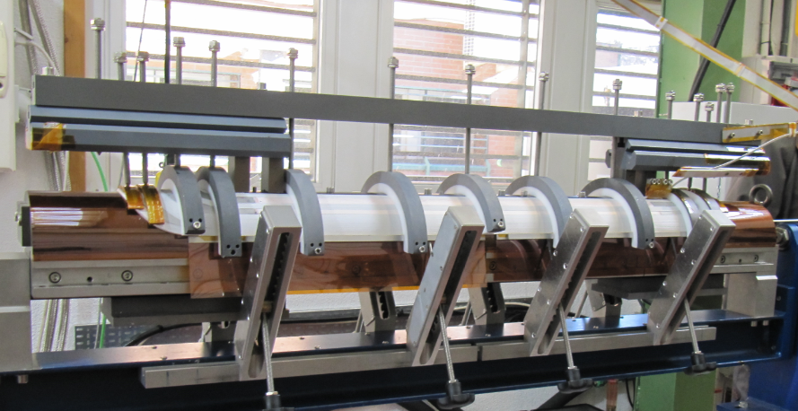
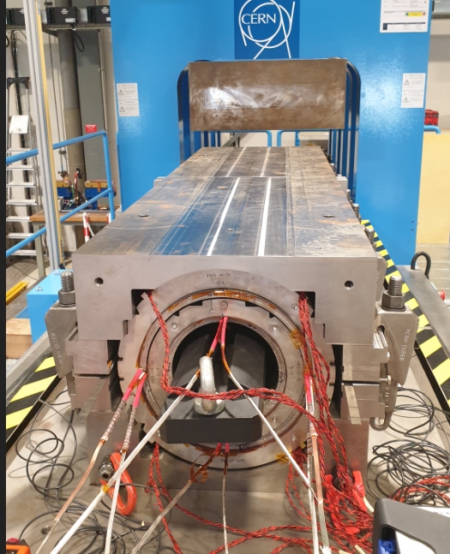
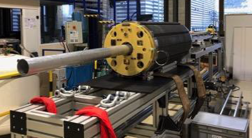
VI. The Global Strategy on High Field Magnet
The global strategy within the HFM program in Spain is based on
A technological contribution, with aims on
Expected industrial return
Translational implications
1. The technological contribution.
Main objective: being a key player on the EPP strategy.
Specific technical aims:
Contribute to HiLumi as inmediate prioritity: The MCBXFA-B series.
Develop own experimental capabilities of design, construction and testing on HFM
Target specific technologies: Common Coil, React & Wind, B&K.
Contribute to the HTS material program: low cost, robust HTS conductors

Slide 19
IV. The Global Strategy on High Field Magnet
2. Industrial return
A major aim to us: This program should help to consolidate the collaboration with industry, promoting the access of our collaborator industry to know-how and expertise that may facilitate its competitiveness in the construction phase of the next accelerator infrastructures.
3. Translational
Traslational applications of the HFM technology is a relevant secondary objective. In particular, on three aspects:
Medical Applications
Medical radio-isotopes, hadrontherapy
Other Scienfic fields
In particular, Fusion facilities
Energy and transport applications
In fields of main interest of national Strategic Programs (PNIEC)
4. Educational
Long-term collaboration with CERN on a trainee Program on accelerator fields and related infrastructures

Slide 20
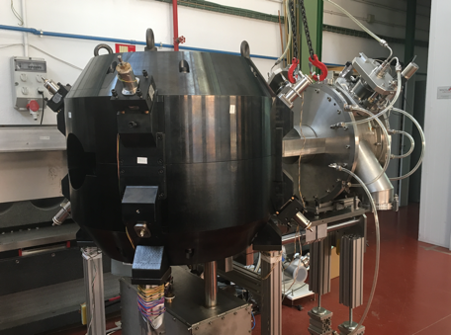
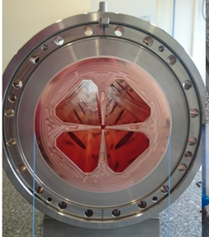
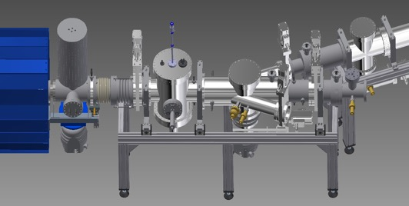
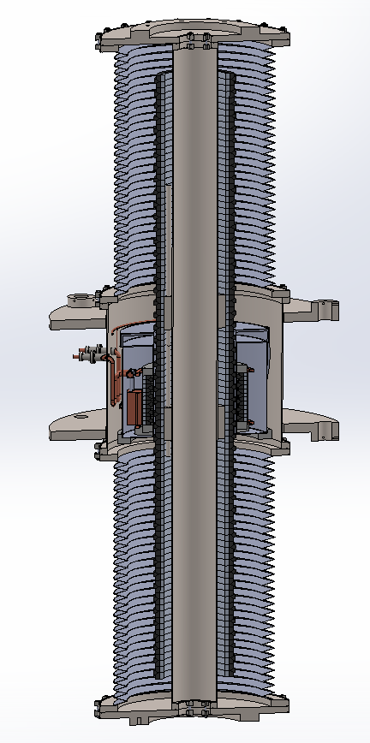
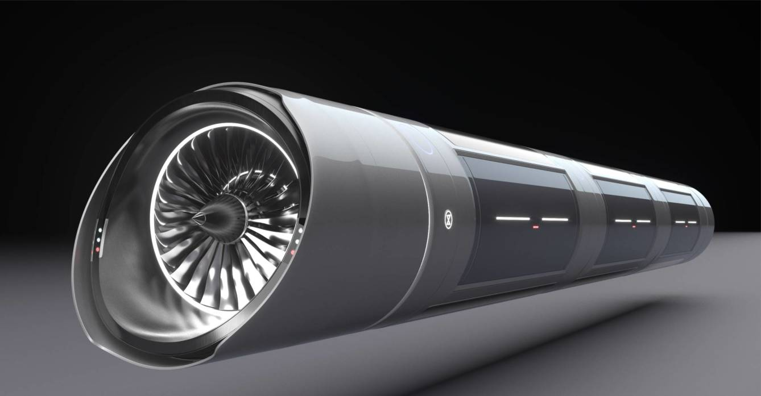
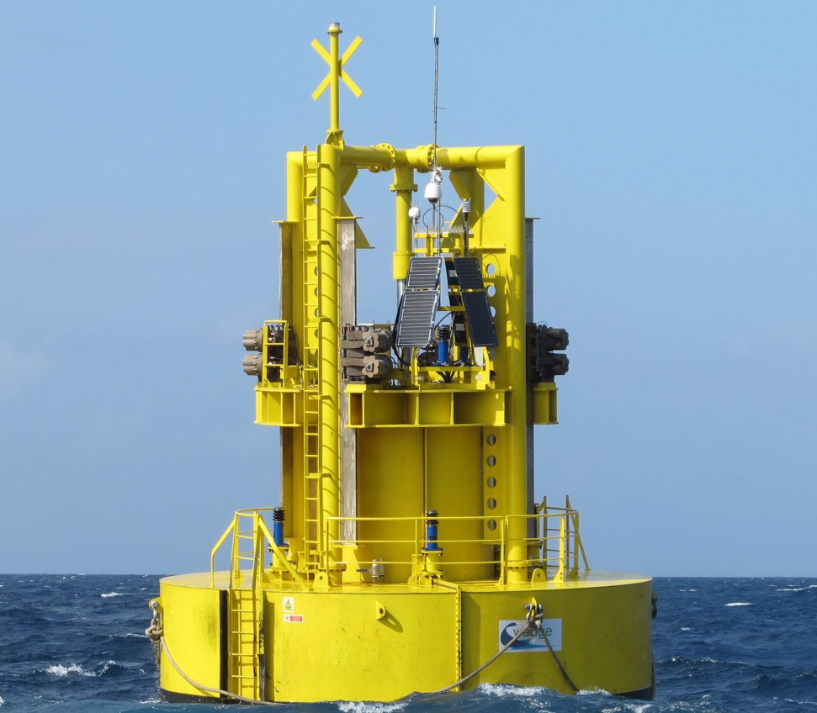
V. The Global Strategy on High Field Magnet
3. Translational
Medical
Ion Beam Therapy
PET Isotope production
Compact accelerators for research PET radioisotopes
Aim: C6+ ion-beam LINACs.
(CERN, HITRI-PLUS, ARIES, SEEIIST & National programs)
Energy and transport applications
(Examples of on-going discussions with industry and academia: a) Ultrafast Transportation System b) Ocean Energy Extraction Systems

Slide 21
VI. The Global Strategy on High Field Magnet
The global strategy within the HFM program in Spain is based on
A technological contribution, with aims on
Expected industrial return
Translational implications
Thank you very much
1. The technological contribution.
Main objective: being a key player on the EPP strategy.
Specific technical aims:
Contribute to HiLumi as inmediate prioritity: The MCBXFA-B series.
Develop own experimental capabilities of design, construction and testing on HFM
Target specific technologies: Common Coil, React & Wind, B&K.
Contribute to the HTS material program: low cost, robust HTS conductors

