Slide 1
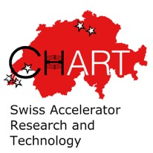
CHART HFM Strategy
B. Auchmann (CERN/PSI), L. Rivkin (CHART), C. Senatore (UniGE)
with input from L. Bottura (CERN), M. Calvi (PSI), M. Mebolt (ETHZ), K. Sedlak (EPFL-SPC), J. Smajic (ETHZ), T. Tervoort (ETHZ), D. Tommasini (CERN)
LDG HFM Roadmap Workshop, June 3rd, 2021.
Work supported by the Swiss State Secretariat for Education, Research and Innovation SERI.

Slide 2
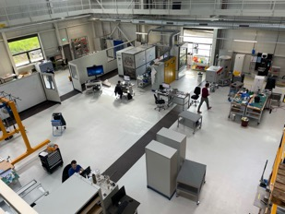
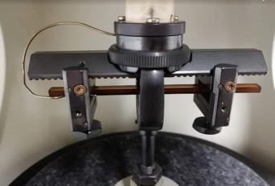
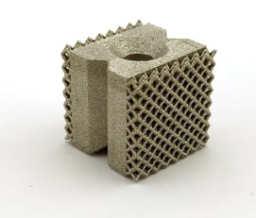
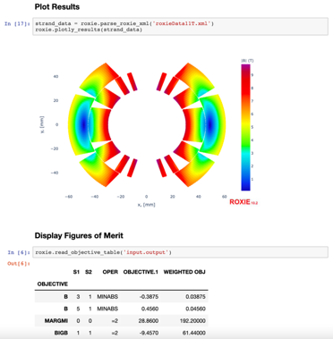
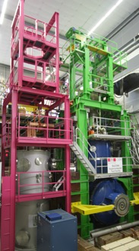
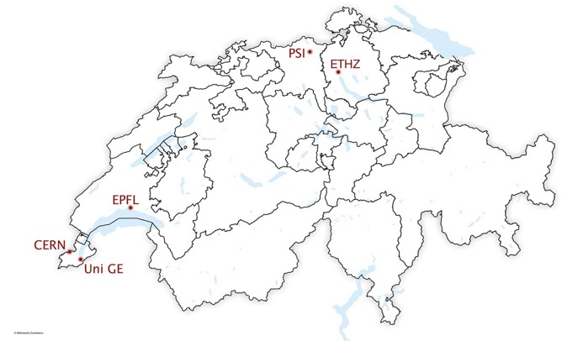

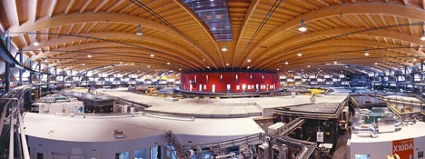

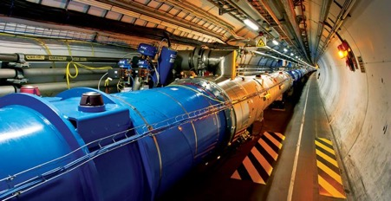


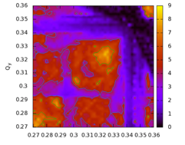
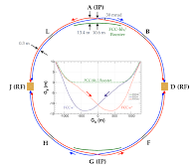



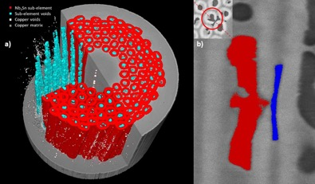
Switzerland – a Compact ASC Landscape

Slide 3
CHART – What, Who How?
Application for support of the Swiss Accelerator Research and Technology Initiative (2018):
  CHART, the Swiss Center for Accelerator Research and Technology,

Slide 4
CHART – What, Who How?
Application for support of the Swiss Accelerator Research and Technology Initiative (2018):
  CHART, the Swiss Center for Accelerator Research and Technology, was founded to support the future oriented accelerator project Future Circular Collider (FCC) at CERN

Slide 5
CHART – What, Who How?
Application for support of the Swiss Accelerator Research and Technology Initiative (2018):
  CHART, the Swiss Center for Accelerator Research and Technology, was founded to support the future oriented accelerator project Future Circular Collider (FCC) at CERN and the development of advanced accelerator concepts in Switzerland beyond the existing technology.

Slide 6
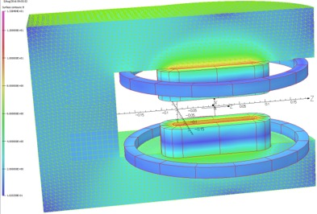
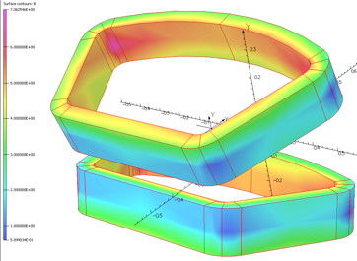
CHART – What, Who How?
Application for support of the Swiss Accelerator Research and Technology Initiative (2018):
  CHART, the Swiss Center for Accelerator Research and Technology, was founded to support the future oriented accelerator project Future Circular Collider (FCC) at CERN and the development of advanced accelerator concepts in Switzerland beyond the existing technology. […] The high field magnet R&D has strong synergies with PSI projects […]
For example:
  SuperBend magnets and undulators.
  Gantry magnets.
In return, CHART activities enjoy steadfast support from PSI magnet section.
SLS 2.0 Superbend
SC Gantry PSI
Courtesy Ciro Calzolaio

Slide 7


CHART – What, Who How?
CHART Members:
CHART Council (president H. R. Ott) approves projects and receives reports,
CHART Executive Board (chair L. Rivkin) implements and reports on progress.

Slide 8
CHART – What, Who How?
CHART Members:
CHART Council (president H. R. Ott) approves projects and receives reports,
CHART Executive Board (chair L. Rivkin) implements and reports on progress.
In CHART Applied Superconductivity we distinguish:
  Technology pillars, i.e., activities with substantial, dedicated infrastructure, where competences must be maintained over long enough time scales.
  Enabling technology R&D, i.e., focused R&D projects at competent laboratories and industrial partners, which re-use existing infrastructure, and employ PhD and post doc resources.
  Relationships between tech poles and enabling-tech laboratories must grow over long enough time scales in order to develop mutual understanding and intrinsic motivation.

Slide 9

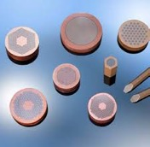
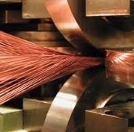
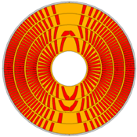
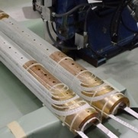
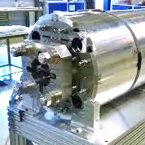
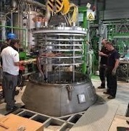

CHART – Technology Pillars
MagDev1
MagDev2
FCCee Injector
WireChar
WireDev
Strand / Tape
LTS and HTS strand/tape
R&D, Procurement, QA
Cable
Rutherford / Roebel production
Magnet Design
FCC-hh / HE-LHC conceptual and technical
Coil Manufacturing
Nb3Sn and HTS coils
Mechanical Assembly
Mechanical loading
Testing
LTS and HTS magnet tests
INJECTION
Notes:
UniGE has experience in rod-type internal tin wire manufacturing

Slide 10


CHART – Enabling Technology R&D
X-ray tomography
Billet manufacturing
Strand / Tape
LTS and HTS strand/tape
R&D, Procurement, QA
Cable
Rutherford / Roebel production
Magnet Design
FCC-hh / HE-LHC conceptual and technical
Coil Manufacturing
Nb3Sn and HTS coils
Mechanical Assembly
Mechanical loading
Testing
LTS and HTS magnet tests
INJECTION
Notes:
Grenoble, synchrotron and HMF
CERN
Manufacturing infrastructure
Modeling wire to cable performance

Slide 11


CHART – Enabling Technology R&D
MagNum
Sustainable design and analysis workflows
Multi-scale modeling
Strand / Tape
LTS and HTS strand/tape
R&D, Procurement, QA
Cable
Rutherford / Roebel production
Magnet Design
FCC-hh / HE-LHC conceptual and technical
Coil Manufacturing
Nb3Sn and HTS coils
Mechanical Assembly
Mechanical loading
Testing
LTS and HTS magnet tests
INJECTION
Notes:
Grenoble, synchrotron and HMF
CERN
Manufacturing infrastructure
Modeling wire to cable performance

Slide 12



CHART – Enabling Technology R&D
MagRes
Polymer R&D
Insulation and composite R&D
Splices and Joints
REBCO NI Coil Technology
Strand / Tape
LTS and HTS strand/tape
R&D, Procurement, QA
Cable
Rutherford / Roebel production
Magnet Design
FCC-hh / HE-LHC conceptual and technical
Coil Manufacturing
Nb3Sn and HTS coils
Mechanical Assembly
Mechanical loading
Testing
LTS and HTS magnet tests
INJECTION

Slide 13
CHART – Enabling Technology R&D
MagAM
Additive manufacturing
Coil interfaces
Process digitization QA/QC
Strand / Tape
LTS and HTS strand/tape
R&D, Procurement, QA
Cable
Rutherford / Roebel production
Magnet Design
FCC-hh / HE-LHC conceptual and technical
Coil Manufacturing
Nb3Sn and HTS coils
Mechanical Assembly
Mechanical loading
Testing
LTS and HTS magnet tests
INJECTION

Slide 14



CHART – Enabling Technology R&D
Subscale sample tests in background field
Quench Protection
Instrumentation and Signal Analysis
Strand / Tape
LTS and HTS strand/tape
R&D, Procurement, QA
Cable
Rutherford / Roebel production
Magnet Design
FCC-hh / HE-LHC conceptual and technical
Coil Manufacturing
Nb3Sn and HTS coils
Mechanical Assembly
Mechanical loading
Testing
LTS and HTS magnet tests
INJECTION

Slide 15
CHART – What, Who How?
Topics and FTEs of ongoing ASC projects in CHART:
  WireChar – SC wire and tape characterization (1 FTE)
  WireDev – Nb₃Sn wire development (3 FTE)
  MagDev1 – SC magnet development (8 FTE)
  MagRes – resin development (1 FTE)
  MagAM – additive manufacturing for coil components (1 FTE)
  MagNum – numerics for design and analysis (1 FTE)
  HTS Bulk Undulator – Bulk REBCO undulator technology (2 FTE)
  FCCee Injector – injector test at SwissFEL, incl. NI solenoid (1 FTE)
  Total: 18 FTE
Other ongoing CHART projects:
  FCC / LHC Lumi
  FCCee Beam Dynamics Simulation
  FCChh Stability
  FCC Geodesy
  FCC Geology 3D Model

Slide 16


CHART HFM Roadmap Strategy
Aim for innovative solutions to pressing problems.
Fast-track key technology R&D with academia and industry.
Use fast-turnaround subscale samples and coils as innovation funnel.
Stick to fast-turnaround paradigm when stepping up in unit length and coil size.
Benefit from existing infrastructure (UniGE: 21 T solenoid, rod-type internal tin wire manufacturing, EPFL-SPC: SULTAN, PSI: advanced analytics facilities).
Where required, invest in new infrastructure early to maximize its impact.
Strive to keep competencies and people on board across financing periods.
Increase the cross-linking among CHART members to reach our full potential as a vibrant, distributed research network.
Ensure optimal coordination with CERN and the international HFM effort.

Slide 17
LTS Driving Questions
How to increase the overall robustness and performance of Nb₃Sn technology in terms of
  increased field,
  increased yield of conforming coils,
  reduced magnet training to ultimate field, and
  resilience to operational and thermal cycles?
To which level can the magnetic field be pushed in an economical way?
How to reduce the manufacturing complexity and material cost?
Ultimate performance
Robustness
Cost

Slide 18

CHART LTS HFM Roadmap
2020
2021
2022
2023
2024
2025
2026
2027
ESPP Update
ESPP Update
1
2
3
CHART1
CHART2
CHART3
Infrastructure
MagDev Lab
LHe Testing Facility
Wire Development
Wire Lab Extension
Wire performance and robustness
100 m UL R&D wire
Enabling Technologies
Coil composite and interfaces
Manufacturing processes
Advanced Design Techniques
LTS Magnet R&D
Instrumentation and multi-messenger signal analysis
CD1
BOX Program
Subscale Program
Concept Study
Processes
Test
Coil
Fast-turnaround Demo Program 12+ T
14+ T Demo
Caveat: CHART3 is not today an approved program. The funding envelop will determine the possible
level of engagement, and a selection of activities may have to be made according to priorities.
Notes:
B. Auchmann can comment on the strategy details

Slide 19
HTS Driving Questions
We are limiting ourselves to REBCO tapes due to their availability from multiple suppliers, relative robustness, low infrastructure requirements, and the proven track record.
Cost is an issue, but not one that we expect to directly address in the coming years.
Driving questions:
Basic technology questions:
  Which aspects of tape technology need improving?
  cable-, coil-configuration, insulation, quench protection?
Route to high fields:
  hybrid HTS/LTS strategy, aiming for 20+T,
  or an HTS-only path towards 16+T?
Accelerator integration:
  How reach “accelerator quality” in terms
  of field quality for a 20+T accelerator?
  Operating temperature of an HTS-only accelerator?
How much progress can we achieve by the next strategy update?
Technologies
Route to high fields
Accelerator integration

Slide 20

CHART HTS HFM Roadmap
2020
2021
2022
2023
2024
2025
2026
2027
ESPP Update
ESPP Update
1
2
3
CHART1
CHART2
CHART3
Infrastructure
High-field HTS coil test facility
HTS Tape R&D
Pinning engineering to reduce anisotropy
Enabling Technologies
Insulation materials
Quench protection
HTS Magnet R&D
SuperBend Technology Demo
Cable and Insulation Technology
FCC-ee injector test, SC solenoid
HTS HFM Concept Study
5-T HTS Demo1
HTS HFM program
Accelerator Design
FQ in HTS accelerators
Caveat: CHART3 is not today an approved program. The funding envelop will determine the possible
level of engagement, and a selection of activities may have to be made according to priorities.
Notes:
B. Auchmann can comment on the strategy details

Slide 21
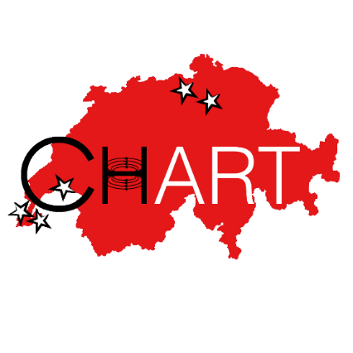


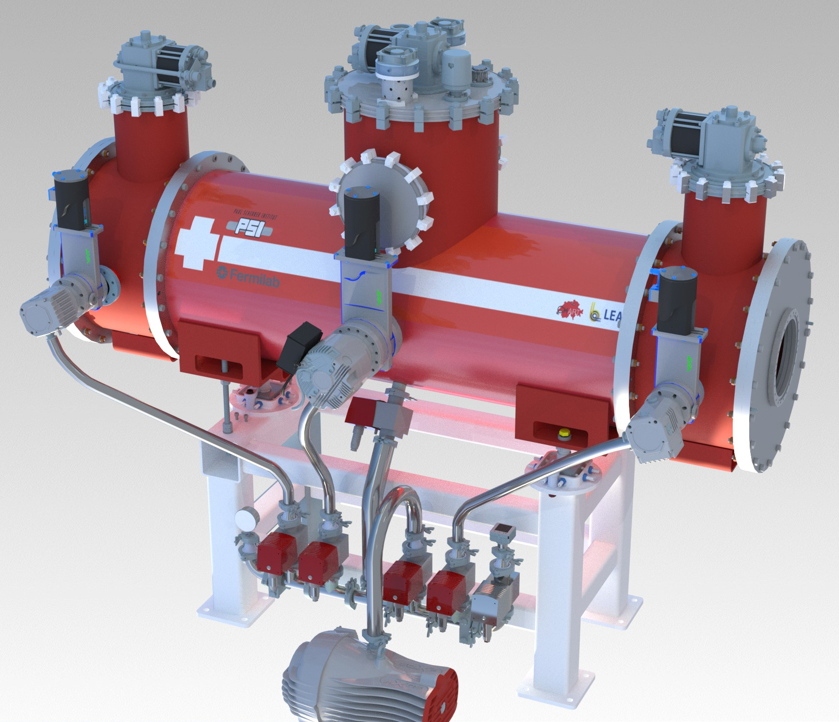
Bulk HTS undulator for iTOMCAT at SLS2
CHART1/2 Achievements
Marco Calvi, PSI

Slide 22
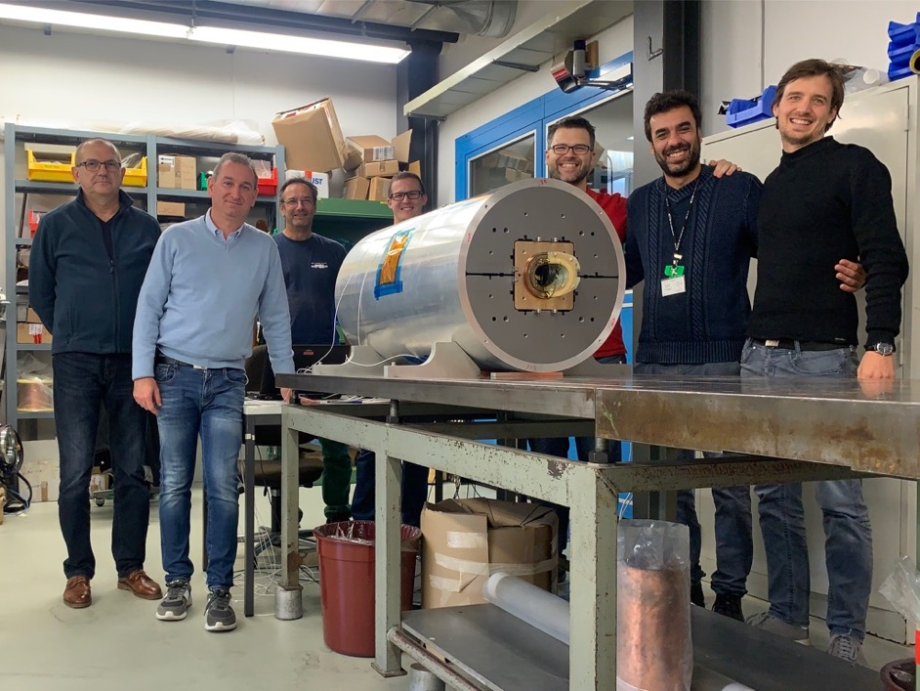
CHART1/2 Achievements
Completion of CD1 (Canted Dipole 1) technology demonstrator, designed and built at PSI.
Test at LBNL interrupted due to a cryoplant issue after first quench at 11.1 kA or 62.5% of short sample, 6 T in the bore.

Slide 23
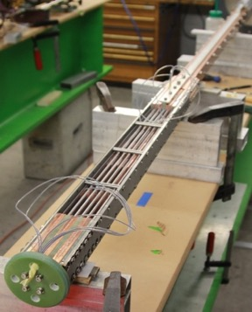
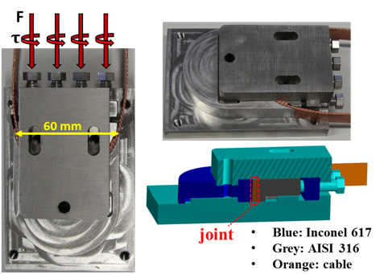
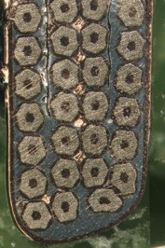
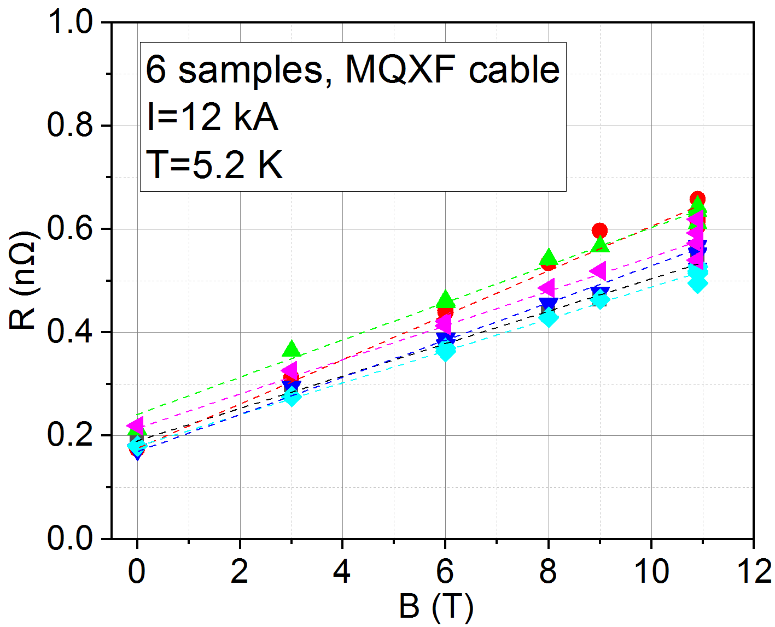
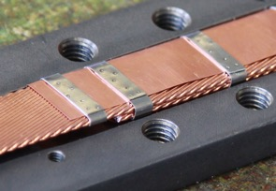
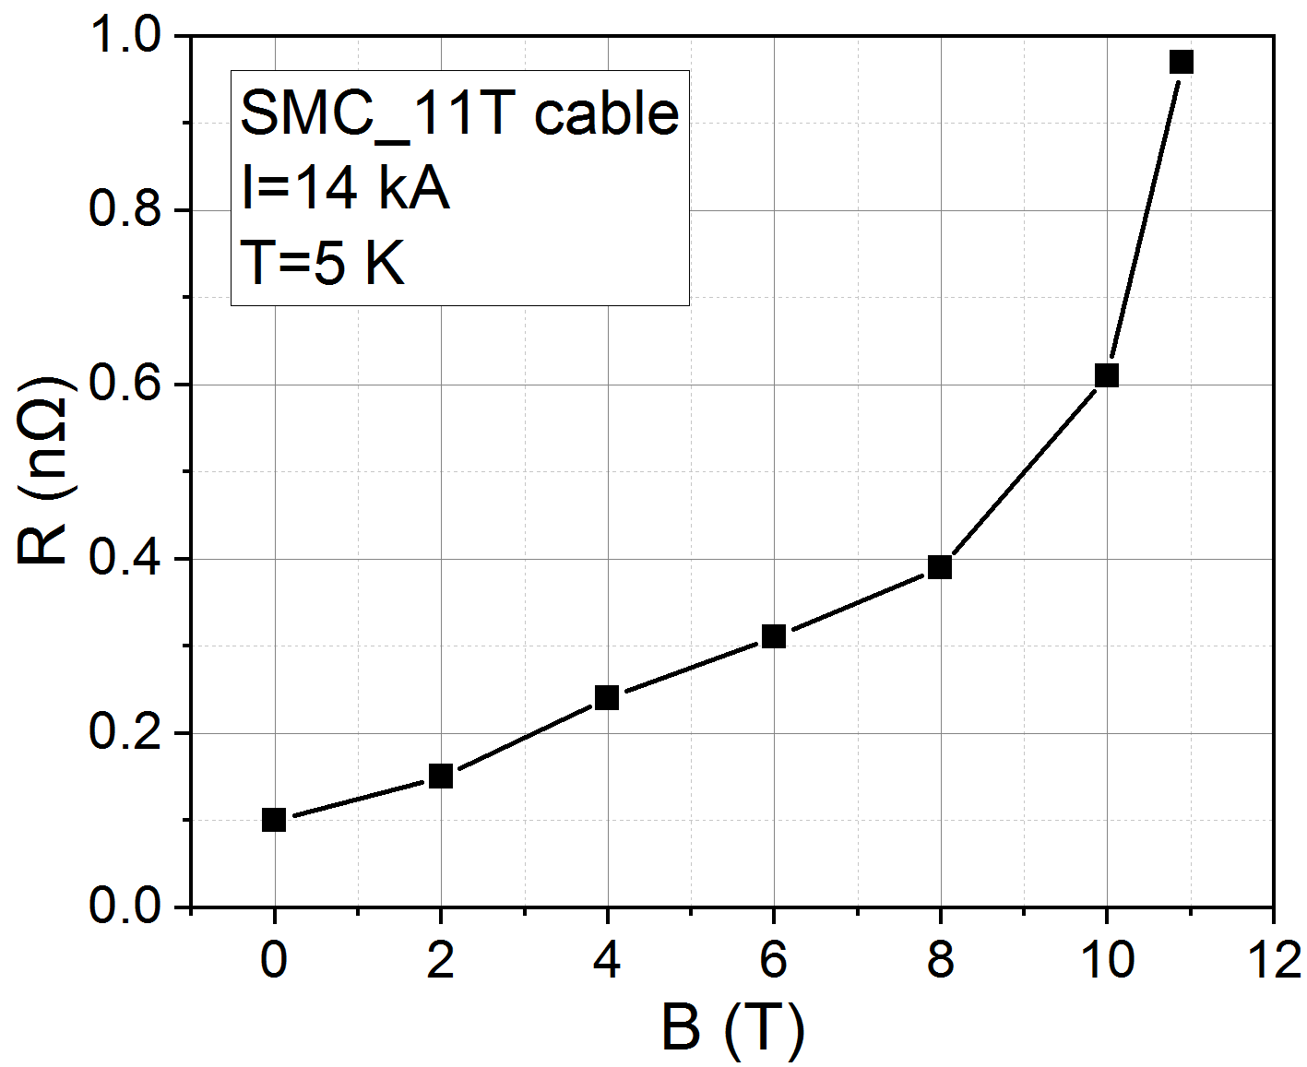
CHART1/2 Achievements
Demonstration of internal splices with R ≤ 1 nΩ at B≈10 T and I/I_{c}≥1/3
Two different solutions:
  soldered splices after heat treatment (1)
  diffusion-bonded bent splices during heat treatment (2)
(1)
(2)
[M. Kumar et al., Preliminary Tests of Soldered and Diffusion-Bonded Splices between Nb3Sn
Rutherford Cables for Graded High-Field Accelerator Magnets, IEEE Trans. on Appl. SC., 29(5), 2019.]
[V. D’Auria et al., Progress on Tests on Splices Between Nb3Sn Rutherford Cables for
Graded High-Field Accelerator Magnets, IEEE Trans. on Appl. SC., Vol 31(5), 2021]
Notes:
Studied intensely now at CEA to be used in graded block coils

Slide 24
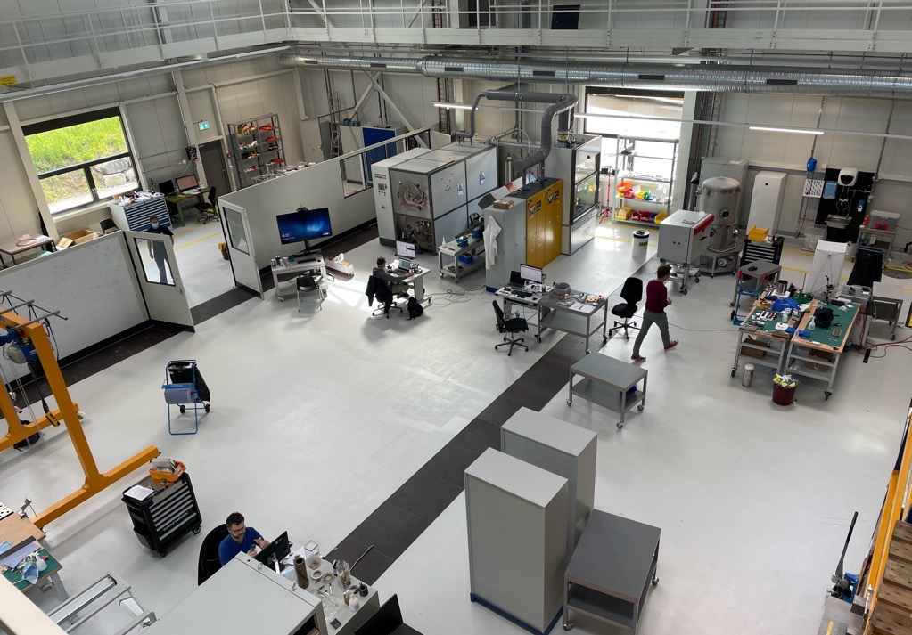
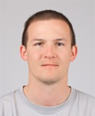
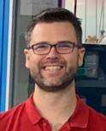


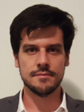
CHART1/2 Achievements
Christoph Hug
Technician
Michael Daly
LTS, BOX
André Brem
Materials
Jaap Kosse
REBCO
Douglas Martins
LTS
Ramping up of activities in new MagDev Lab at PSI (400 m2).
Missing items: winding table (order placed), impregnation system
(market survey), and assembly press (if needed).

Slide 25

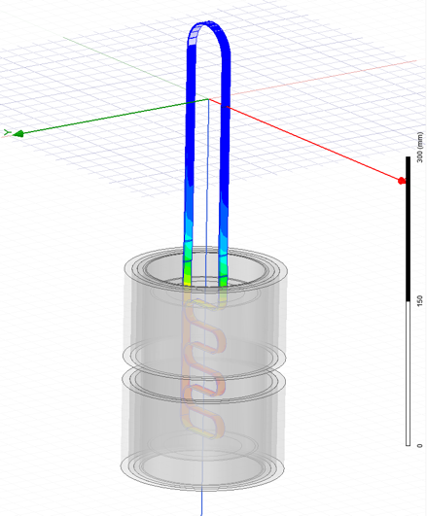

CHART1/2 Achievements
Pictures by M. Daly, S. Sidorov
BOX (BOnding eXperiment) program with uTwente has shown a wide variety of results,
from complete conductor degradation (no impregnation) to substantial training (epoxy) to
no-training (wax), with 10 BOX samples manufactured and 7 tested to date.
Notes:
LBNL is preparing a wax impregnated subscale CCT magnet

Slide 26

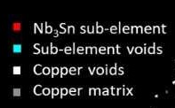
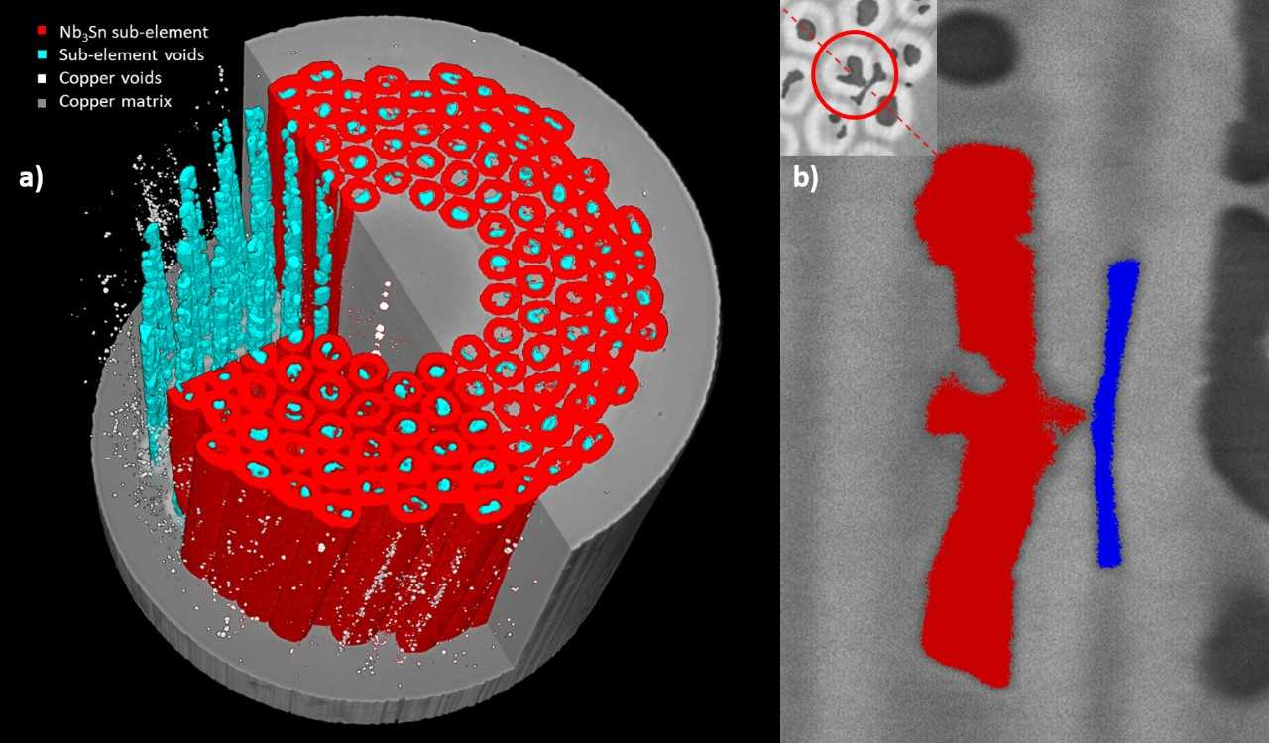
CHART1/2 Achievements
Void generated by Sn diffusion due to a leak in the sub-element.
Notes:
UNIGE is one of the few laboratories specialized in testing the electromechanical properties of technical superconductors under conditions relevant for magnet design. Recently, they developed a new tool to investigate the internal features of Nb3Sn superconducting wires, combining X-ray tomographic data with an unsupervised machine-learning algorithm, with a view to providing new insights to enhance the electro-mechanical performance of the wires. The tool is ideal for characterizing quantitatively the distribution and morphology of the components of superconducting wires, with a particular focus on the voids that are generated during the heat treatment necessary to form the Nb3Sn superconducting phase. Voids can be detrimental for the electro-mechanical performance as they act as stress concentrators. This tool paves the way for novel wire design, assisted by detailed Finite Element Models (FEM) at sub-element level, with the final goal being further optimization of wire properties relevant for use in future accelerator magnets.

Slide 27
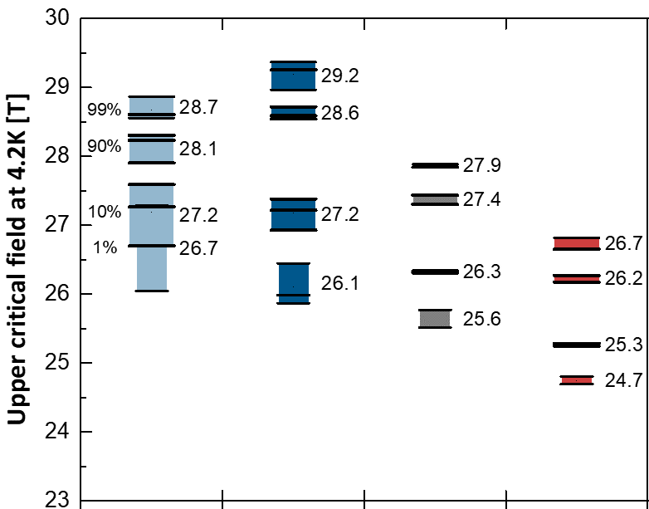
CHART1/2 Achievements
Grain refinement down to 50 nm in Nb₃Sn is achieved with the internal oxidation of Zr in ternary Nb-alloys containing Ta and Zr
The combined presence of Ta and Zr further increases the upper critical field up to ~29 T , i.e., to higher values than obtained for Nb7.5Ta
This is showing that it is possible to further improve the field performance of Nb₃Sn wires
Nb-1Zr
Nb-7.5Ta-1Zr
Nb-7.5Ta-2Zr
Nb-7.5Ta (ref)
F. Buta et al., J. Phys. Mater. 4 (2021) 025003
DOI: 10.1088/2515-7639/abe662
Notes:
Another peculiarity of the laboratories at UNIGE is the capability of manufacturing superconducting wires with the same processes as at industry. The goal of the running activity is the development of methods scalable at industrial level to implement internal oxidation (to refine the grain size and increase Jc) in wires produced by the internal Sn method.
Prototype wires with reduced number of filaments exhibit a significant grain refinement. But this is not the most surprising result. These wires with a combined presence of Ta (to enhance Bc2) and Zr (needed for the internal oxidation) exhibit record high upper critical fields. The highest measured value is 29 T at 4.2 K, which is about 1 T higher compared to industrial wires. The mechanism is still under investigation, but it is showing that it is possible to further improve the field performance of Nb3Sn.

Slide 28
Conclusion
CHART is a Swiss research network, active in the field of superconducting accelerator magnets, contributing to the international HFM project.
The HFM roadmap is based on
  strategic technology poles with substantial investment in infrastructure,
  and several (not too many!) strategic partners for focused and innovative enabling technology R&D.
In this framework, we shall
  Innovate, through fast-turnaround experimental and modeling work at the smallest possible scale;
  Focus on the most urgent R&D questions;
  Invest in unique capabilities through infrastructure, relationships, people!
  Collaborate with other laboratories, fields through the HFM project.
  [Points taken from S. Prestemon, US-MDP at State-of-the-Art Workshop.]

Slide 29
LTS R&D Topics
Conductor
  Grain refinement and artificial pinning
  Mechanical reinforcement
  Process scalability
Coil Composite and Interfaces
  Insulation materials
  AM tunable materials
  Bonded and sliding interfaces
Multi-Scale Testing and Simulation
  Wire tests, powered-cable tests, 10-stacks, mechanical models, small coils, technology demonstrators
  Sustainable and traceable in-depth multi-scale numerical analysis.
Processes and Manufacturing Infrastructure
  VPI, insulation cleaning, mold design, etc.
  Digitization of process QA/QC.
Fast-Turnaround Design and Manufacturing
  Stress-management approaches (CCT, SM-CT)
  Low-prestress compact coils
  Mirrors, small scales where possible and appropriate.
Instrumentation and Protection
  Electronics and signal processing
Test infrastructure
  Dedicated vertical test station.
  Multi-physics test facility for small-sample fast-turnaround R&D with 16 T background field and direct sample powering.
Green: activities that are already initiated in CHART2

Slide 30
HTS R&D Topics
Conductor
  Reduced tape anisotropy
Cable and Insulation Options
  Advanced insulation materials
  Cable manufacturing techniques
Multi-Physics and Multi-Scale Modeling and Experiments
  Homogenization of cable multiphysical behavior.
  Tightly integrated 2D and 3D electromagnetic-thermal-mechanical modeling.
  Test of small samples (tapes, cables, small racetracks, other) in 10+T background fields.
Integrated Conceptual Design
  Coil variants
  HTS-only vs. hybrid route
  Hybrid-magnet protection
Fast-Turnaround Design and Manufacturing of Coils/Magnets
  Round pancakes
  HTS SMC-type magnets
  Insert manufacturing
Instrumentation and Signal Analysis
  Distributed temperature sensing
  Multi-messenger detection
Test Infrastructure
  Outsert system for HTS high-field tests.
Green: activities that are already initiated in CHART2

Slide 31

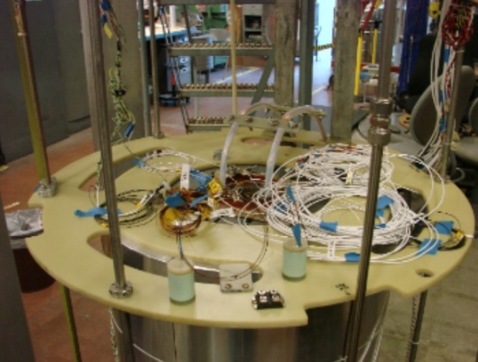
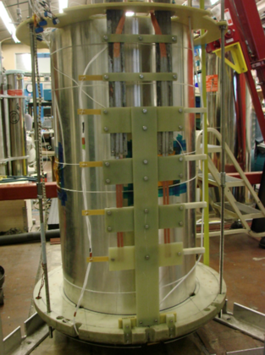
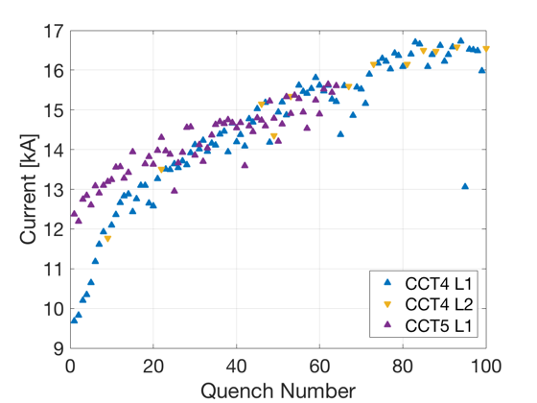
CD1 in Berkeley
CD1 construction was finished in Oct. 2019.
The magnet arrived (after problems in transit) in Feb. 2020.
The test preparation was interrupted by COVID 19 and resumed in Aug. 2020.
Magnet training has started! D. Arbelaez: “We reached 10.9 kA today after a number of ramps. The magnet is performing very well. I think most ramps did not end with a magnet quench but were tripped by oscillations in the system.”
We will learn more in the coming days. PSI has built a magnet that we can learn from!
LBNL provides the test and preparation. We cannot thank them enough for the generous collaboration over the past years.
All pictures and graph, courtesy D. Arbelaez, LBNL.

