Slide 1
Status of FCC-ee tuning studies
Tessa Charles
With thanks to: Andrey Abramov, Roderick Bruce, Michael Hofer, Maitreyee Moudgalya, Tobias Persson, Léon Van Riesen-Haupt, Bernahrd Holzer, Katsunobu Oide, Frank Zimmermann, and the rest of the the FCC-ee optics team

Slide 2
FCC-ee emittance tuning results
RMS misalignment and field errors tolerances:
  - Gaussian distributions truncated at 2.5 sigma.
  - 2 independent DX and DY misalignments for each end of the girder, and which are used to calculate DTHETA and DPHI.
2
Notes:
%$\epsilon_{x, \textrm{rms}} = 1.685$ nm rad \\
%$\epsilon_{y, \textrm{rms}} = 0.871$ pm rad \\
%$\frac{\epsilon_{y}}{\epsilon_{x}} = 0.0789$ $\%$ \\
\begin{table}[htb!]
\centering
\begin{tabular}{p{3cm}cccc}
\hline
Type & $\Delta$X & $\Delta$Y & $\Delta$PSI & $\Delta$S \\
& ($\mu$m) & ($\mu$m) & ($\mu$rad) & ($\mu$m)
\vspace{.1cm} \\
\hline
Arc quadrupole* & 50 & 50 & 200 & 50 \\
Arc sextupoles* & 50 & 50 & 200 & 50 \\
\hline
Dipoles & 100 & 100 & 200 & 500 \\
\hline
Girders & 100 & 100 & - & 500 \\
\hline
IR quadrupole & 75 & 75 & 100 & 75 \\
IR sextupoles & 75 & 75 & 100 & 75 \\
\hline
BPM** & 40 & 40 & 100 & - \\
\hline
\end{tabular}
\end{table}
---------
\begin{table}[htb!]
\centering
\begin{tabular}{p{3cm}cccccc}
\hline
Type & $\Delta$X & $\Delta$Y & $\Delta$PSI & $\Delta$S & $\Delta$DTHETA & $\Delta$DPHI \\
& ($\mu$m) & ($\mu$m) & ($\mu$rad) & ($\mu$m) & ($\mu$rad) & ($\mu$rad) \\
\vspace{.1cm} \\
\hline
Arc quadrupole* & 50 & 50 & 300 & 100 & 100 & 100 \\
Arc sextupoles* & 50 & 50 & 300 & 100 & 100 & 100 \\
\hline
Dipoles & 1000 & 1000 & 300 & 1000 & 0 & 0 \\
\hline
Girders & 150 & 150 & - & 1000 & 0 & 0 \\
\hline
IR quadrupole & 75 & 75 & 250 & 50 & 75 & 75 \\
IR sextupoles & 75 & 75 & 250 & 50 & 75 & 75 \\
\hline
BPM** & 40 & 40 & 100 & - \\
\hline
\end{tabular}
\end{table}
\begin{table}[htb!]
\centering
\begin{tabular}{p{3cm}cccccc}
\hline
Type & $\Delta$X & $\Delta$Y & $\Delta$PSI & $\Delta$S & $\Delta$THETA & $\Delta$PHI \\
& ($\mu$m) & ($\mu$m) & ($\mu$rad) & ($\mu$m) & ($\mu$rad) & ($\mu$rad) \\
\vspace{.1cm} \\
\hline
Arc quadrupole* & 50 & 50 & 300 & 100 & 100 & 100 \\
Arc sextupoles* & 50 & 50 & 300 & 100 & 100 & 100 \\
\hline
Dipoles & 1000 & 1000 & 300 & 1000 & 0 & 0 \\
\hline
Girders & 150 & 150 & - & 1000 & $\dagger$ & $\dagger$ \\
\hline
IR quadrupole & 75 & 75 & 250 & 50 & 75 & 75 \\
IR sextupoles & 75 & 75 & 250 & 50 & 75 & 75 \\
\hline
BPM** & 40 & 40 & 100 & - \\
\hline
\end{tabular}
\end{table}

Slide 3
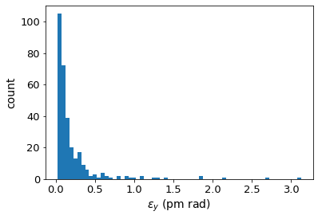
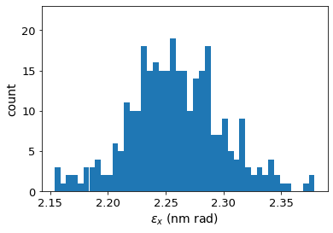
FCC-ee emittance tuning results
RMS misalignment and field errors tolerances:
ttbar (182.5 GeV) 4IP lattice, after correction strategy:
3
Notes:
%$\epsilon_{x, \textrm{rms}} = 1.685$ nm rad \\
%$\epsilon_{y, \textrm{rms}} = 0.871$ pm rad \\
%$\frac{\epsilon_{y}}{\epsilon_{x}} = 0.0789$ $\%$ \\
\begin{table}[htb!]
\centering
\begin{tabular}{p{3cm}cccc}
\hline
Type & $\Delta$X & $\Delta$Y & $\Delta$PSI & $\Delta$S \\
& ($\mu$m) & ($\mu$m) & ($\mu$rad) & ($\mu$m)
\vspace{.1cm} \\
\hline
Arc quadrupole* & 50 & 50 & 200 & 50 \\
Arc sextupoles* & 50 & 50 & 200 & 50 \\
\hline
Dipoles & 100 & 100 & 200 & 500 \\
\hline
Girders & 100 & 100 & - & 500 \\
\hline
IR quadrupole & 75 & 75 & 100 & 75 \\
IR sextupoles & 75 & 75 & 100 & 75 \\
\hline
BPM** & 40 & 40 & 100 & - \\
\hline
\end{tabular}
\end{table}
---------
\begin{table}[htb!]
\centering
\begin{tabular}{p{3cm}cccccc}
\hline
Type & $\Delta$X & $\Delta$Y & $\Delta$PSI & $\Delta$S & $\Delta$DTHETA & $\Delta$DPHI \\
& ($\mu$m) & ($\mu$m) & ($\mu$rad) & ($\mu$m) & ($\mu$rad) & ($\mu$rad) \\
\vspace{.1cm} \\
\hline
Arc quadrupole* & 50 & 50 & 300 & 100 & 100 & 100 \\
Arc sextupoles* & 50 & 50 & 300 & 100 & 100 & 100 \\
\hline
Dipoles & 1000 & 1000 & 300 & 1000 & 0 & 0 \\
\hline
Girders & 150 & 150 & - & 1000 & 0 & 0 \\
\hline
IR quadrupole & 75 & 75 & 250 & 50 & 75 & 75 \\
IR sextupoles & 75 & 75 & 250 & 50 & 75 & 75 \\
\hline
BPM** & 40 & 40 & 100 & - \\
\hline
\end{tabular}
\end{table}
\begin{table}[htb!]
\centering
\begin{tabular}{p{3cm}cccccc}
\hline
Type & $\Delta$X & $\Delta$Y & $\Delta$PSI & $\Delta$S & $\Delta$THETA & $\Delta$PHI \\
& ($\mu$m) & ($\mu$m) & ($\mu$rad) & ($\mu$m) & ($\mu$rad) & ($\mu$rad) \\
\vspace{.1cm} \\
\hline
Arc quadrupole* & 50 & 50 & 300 & 100 & 100 & 100 \\
Arc sextupoles* & 50 & 50 & 300 & 100 & 100 & 100 \\
\hline
Dipoles & 1000 & 1000 & 300 & 1000 & 0 & 0 \\
\hline
Girders & 150 & 150 & - & 1000 & $\dagger$ & $\dagger$ \\
\hline
IR quadrupole & 75 & 75 & 250 & 50 & 75 & 75 \\
IR sextupoles & 75 & 75 & 250 & 50 & 75 & 75 \\
\hline
BPM** & 40 & 40 & 100 & - \\
\hline
\end{tabular}
\end{table}

Slide 4
FCC-ee emittance tuning results
RMS misalignment and field errors tolerances:
  - Gaussian distributions truncated at 2.5 sigma.
  - 2 independent DX and DY misalignments for each end of the girder, and which are used to calculate DTHETA and DPHI.
4
Notes:
%$\epsilon_{x, \textrm{rms}} = 1.685$ nm rad \\
%$\epsilon_{y, \textrm{rms}} = 0.871$ pm rad \\
%$\frac{\epsilon_{y}}{\epsilon_{x}} = 0.0789$ $\%$ \\
\begin{table}[htb!]
\centering
\begin{tabular}{p{3cm}cccc}
\hline
Type & $\Delta$X & $\Delta$Y & $\Delta$PSI & $\Delta$S \\
& ($\mu$m) & ($\mu$m) & ($\mu$rad) & ($\mu$m)
\vspace{.1cm} \\
\hline
Arc quadrupole* & 50 & 50 & 200 & 50 \\
Arc sextupoles* & 50 & 50 & 200 & 50 \\
\hline
Dipoles & 100 & 100 & 200 & 500 \\
\hline
Girders & 100 & 100 & - & 500 \\
\hline
IR quadrupole & 75 & 75 & 100 & 75 \\
IR sextupoles & 75 & 75 & 100 & 75 \\
\hline
BPM** & 40 & 40 & 100 & - \\
\hline
\end{tabular}
\end{table}
---------
\begin{table}[htb!]
\centering
\begin{tabular}{p{3cm}cccccc}
\hline
Type & $\Delta$X & $\Delta$Y & $\Delta$PSI & $\Delta$S & $\Delta$DTHETA & $\Delta$DPHI \\
& ($\mu$m) & ($\mu$m) & ($\mu$rad) & ($\mu$m) & ($\mu$rad) & ($\mu$rad) \\
\vspace{.1cm} \\
\hline
Arc quadrupole* & 50 & 50 & 300 & 100 & 100 & 100 \\
Arc sextupoles* & 50 & 50 & 300 & 100 & 100 & 100 \\
\hline
Dipoles & 1000 & 1000 & 300 & 1000 & 0 & 0 \\
\hline
Girders & 150 & 150 & - & 1000 & 0 & 0 \\
\hline
IR quadrupole & 75 & 75 & 250 & 50 & 75 & 75 \\
IR sextupoles & 75 & 75 & 250 & 50 & 75 & 75 \\
\hline
BPM** & 40 & 40 & 100 & - \\
\hline
\end{tabular}
\end{table}
\begin{table}[htb!]
\centering
\begin{tabular}{p{3cm}cccccc}
\hline
Type & $\Delta$X & $\Delta$Y & $\Delta$PSI & $\Delta$S & $\Delta$THETA & $\Delta$PHI \\
& ($\mu$m) & ($\mu$m) & ($\mu$rad) & ($\mu$m) & ($\mu$rad) & ($\mu$rad) \\
\vspace{.1cm} \\
\hline
Arc quadrupole* & 50 & 50 & 300 & 100 & 100 & 100 \\
Arc sextupoles* & 50 & 50 & 300 & 100 & 100 & 100 \\
\hline
Dipoles & 1000 & 1000 & 300 & 1000 & 0 & 0 \\
\hline
Girders & 150 & 150 & - & 1000 & $\dagger$ & $\dagger$ \\
\hline
IR quadrupole & 75 & 75 & 250 & 50 & 75 & 75 \\
IR sextupoles & 75 & 75 & 250 & 50 & 75 & 75 \\
\hline
BPM** & 40 & 40 & 100 & - \\
\hline
\end{tabular}
\end{table}

Slide 5
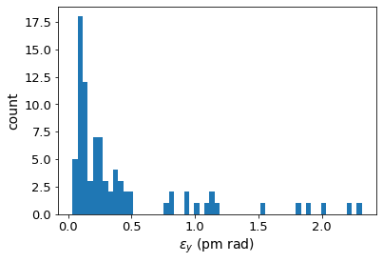
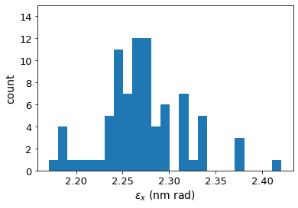
FCC-ee emittance tuning results
RMS misalignment and field errors tolerances:
ttbar (182.5 GeV) 4IP lattice, after correction strategy:
5
Notes:
%$\epsilon_{x, \textrm{rms}} = 1.685$ nm rad \\
%$\epsilon_{y, \textrm{rms}} = 0.871$ pm rad \\
%$\frac{\epsilon_{y}}{\epsilon_{x}} = 0.0789$ $\%$ \\
\begin{table}[htb!]
\centering
\begin{tabular}{p{3cm}cccc}
\hline
Type & $\Delta$X & $\Delta$Y & $\Delta$PSI & $\Delta$S \\
& ($\mu$m) & ($\mu$m) & ($\mu$rad) & ($\mu$m)
\vspace{.1cm} \\
\hline
Arc quadrupole* & 50 & 50 & 200 & 50 \\
Arc sextupoles* & 50 & 50 & 200 & 50 \\
\hline
Dipoles & 100 & 100 & 200 & 500 \\
\hline
Girders & 100 & 100 & - & 500 \\
\hline
IR quadrupole & 75 & 75 & 100 & 75 \\
IR sextupoles & 75 & 75 & 100 & 75 \\
\hline
BPM** & 40 & 40 & 100 & - \\
\hline
\end{tabular}
\end{table}
---------
\begin{table}[htb!]
\centering
\begin{tabular}{p{3cm}cccccc}
\hline
Type & $\Delta$X & $\Delta$Y & $\Delta$PSI & $\Delta$S & $\Delta$DTHETA & $\Delta$DPHI \\
& ($\mu$m) & ($\mu$m) & ($\mu$rad) & ($\mu$m) & ($\mu$rad) & ($\mu$rad) \\
\vspace{.1cm} \\
\hline
Arc quadrupole* & 50 & 50 & 300 & 100 & 100 & 100 \\
Arc sextupoles* & 50 & 50 & 300 & 100 & 100 & 100 \\
\hline
Dipoles & 1000 & 1000 & 300 & 1000 & 0 & 0 \\
\hline
Girders & 150 & 150 & - & 1000 & 0 & 0 \\
\hline
IR quadrupole & 75 & 75 & 250 & 50 & 75 & 75 \\
IR sextupoles & 75 & 75 & 250 & 50 & 75 & 75 \\
\hline
BPM** & 40 & 40 & 100 & - \\
\hline
\end{tabular}
\end{table}
\begin{table}[htb!]
\centering
\begin{tabular}{p{3cm}cccccc}
\hline
Type & $\Delta$X & $\Delta$Y & $\Delta$PSI & $\Delta$S & $\Delta$THETA & $\Delta$PHI \\
& ($\mu$m) & ($\mu$m) & ($\mu$rad) & ($\mu$m) & ($\mu$rad) & ($\mu$rad) \\
\vspace{.1cm} \\
\hline
Arc quadrupole* & 50 & 50 & 300 & 100 & 100 & 100 \\
Arc sextupoles* & 50 & 50 & 300 & 100 & 100 & 100 \\
\hline
Dipoles & 1000 & 1000 & 300 & 1000 & 0 & 0 \\
\hline
Girders & 150 & 150 & - & 1000 & $\dagger$ & $\dagger$ \\
\hline
IR quadrupole & 75 & 75 & 250 & 50 & 75 & 75 \\
IR sextupoles & 75 & 75 & 250 & 50 & 75 & 75 \\
\hline
BPM** & 40 & 40 & 100 & - \\
\hline
\end{tabular}
\end{table}
\begin{table}[htb!]
\centering
\begin{tabular}{p{3cm}cccccc}
\hline
Type & $\Delta$X & $\Delta$Y & $\Delta$PSI & $\Delta$S & $\Delta$THETA & $\Delta$PHI \\
& ($\mu$m) & ($\mu$m) & ($\mu$rad) & ($\mu$m) & ($\mu$rad) & ($\mu$rad) \\
\vspace{.1cm} \\
\hline
Arc quadrupole* & 50 & 50 & 300 & 150 & 100 & 100 \\
Arc sextupoles* & 50 & 50 & 300 & 150 & 100 & 100 \\
\hline
Dipoles & 1000 & 1000 & 300 & 1000 & 0 & 0 \\
\hline
Girders & 150 & 150 & - & 1000 & $\dagger$ & $\dagger$ \\
\hline
IR quadrupole & 100 & 100 & 250 & 200 & 100 & 100 \\
IR sextupoles & 100 & 100 & 250 & 200 & 100 & 100 \\
\hline
BPM** & 40 & 40 & 100 & - \\
\hline
\end{tabular}
\end{table}

Slide 6
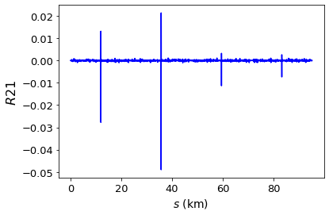
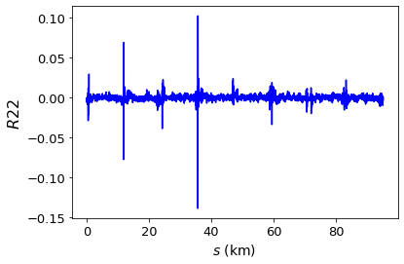
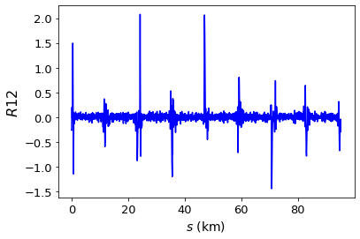
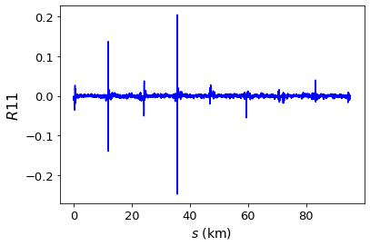
Coupling matrix elements
6

Slide 7


Beam-beating estimate
Calculating $\frac{σ_{x}}{σ_{x0}}$ and $\frac{σ_{y}}{σ_{y0}},$ is not so straight-forward.
Beam size in the presence of coupling (PRSTAB 14, 0340032):
There are a few options when determining the reference ${ σ}_{x0}$ and ${ σ}_{y0}.$
7

Slide 8
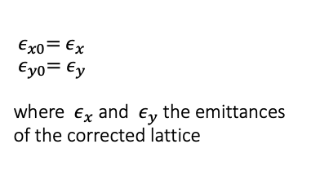
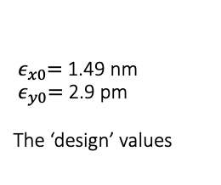
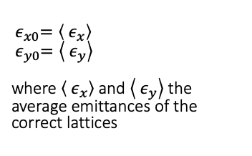
$${ ε}_{x0}={ ε}_{x} \\ { ε}_{y0}={ ε}_{y}$$ where ${ ε}_{x}$ and ${ ε}_{y}$ the emittances of the corrected lattice
Beam-beating reference
$${ σ}_{y} = { σ}_{y_errors}+{ σ}_{y_solenoid}+{ σ}_{y_beambeam}$$
Emittance tuning simulations
(distribution from earlier slide)
0.4 pm for ttbar (M. Koratzinos)
??
There are a few options when determining the reference values ${ σ}_{x0}$ and ${ σ}_{y0}:$
Option 1
Option 2
Option 3
$${ ε}_{x0}=\left\langle { ε}_{x}\right\rangle \\ { ε}_{y0}=\left\langle { ε}_{y}\right\rangle$$
where $\left\langle { ε}_{x}\right\rangle$and $\left\langle { ε}_{y}\right\rangle$the average emittances of the correct lattices
${ ε}_{x0}=$1.49 nm
${ ε}_{y0}=$ 2.9 pm
The ‘design’ values
8

Slide 9
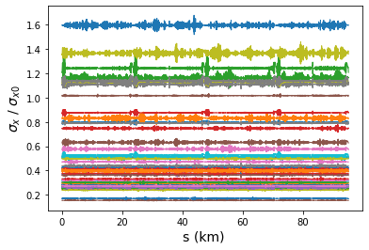
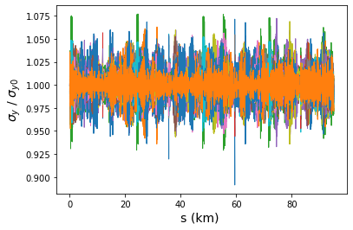
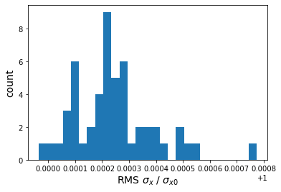
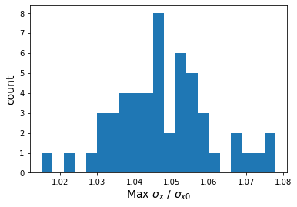
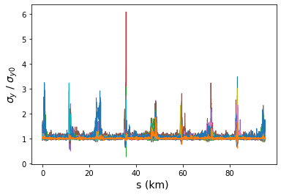
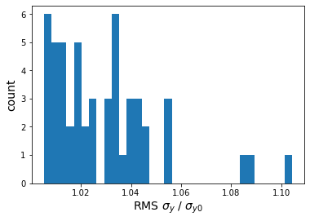
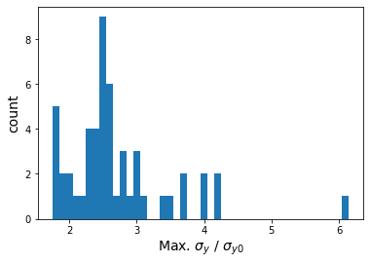
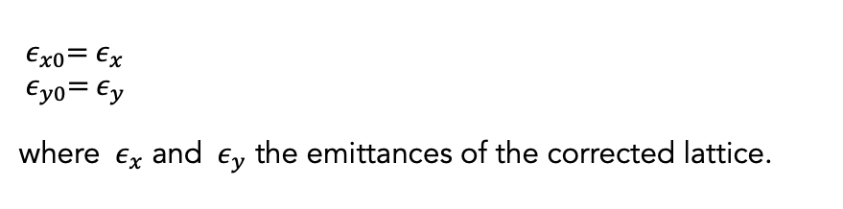
$${ ε}_{x0}={ ε}_{x} \\ { ε}_{y0}={ ε}_{y}$$ where ${ ε}_{x}$ and ${ ε}_{y}$ the emittances of the corrected lattice.
Option 1
9

Slide 10
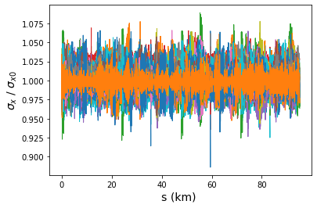
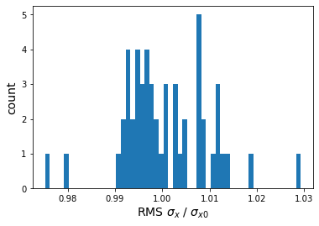
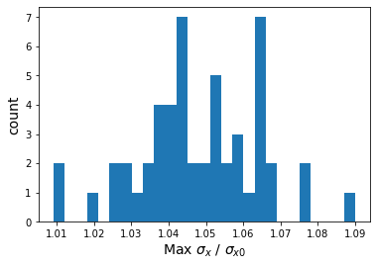
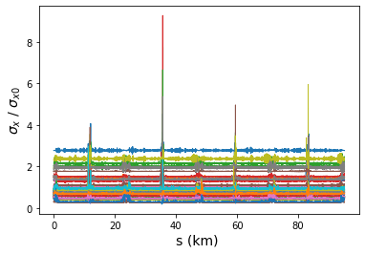
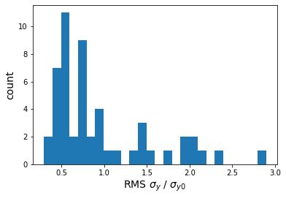
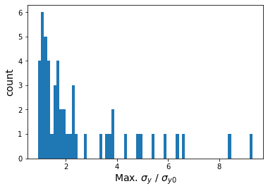
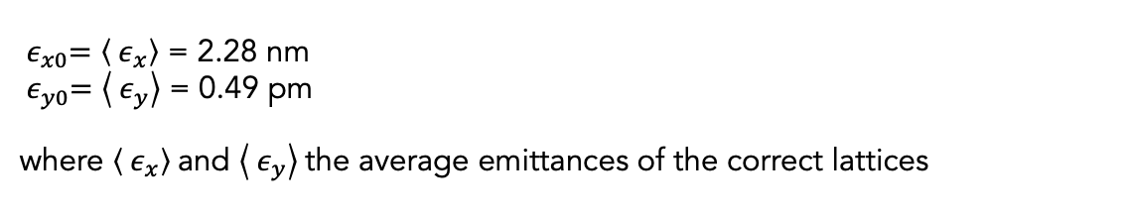
Option 2
${ ε}_{x0}=\left\langle { ε}_{x}\right\rangle$ = 2.28 nm
${ ε}_{y0}=\left\langle { ε}_{y}\right\rangle$ = 0.49 pm
where $\left\langle { ε}_{x}\right\rangle$and $\left\langle { ε}_{y}\right\rangle$the average emittances of the correct lattices
10

Slide 11
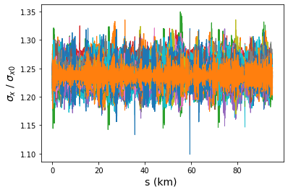
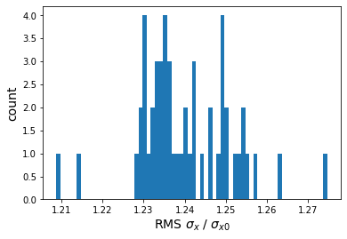
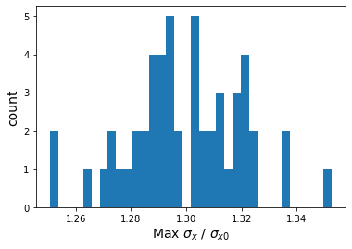
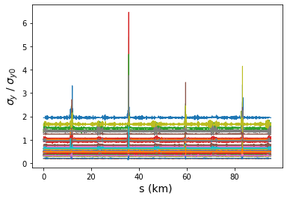
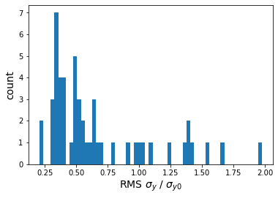
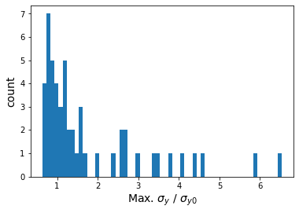

Option 3
${ ε}_{x0}=$1.49 nm
${ ε}_{y0}=$ 1 pm
The ‘design’ values
11

Slide 12
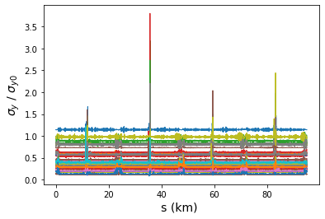
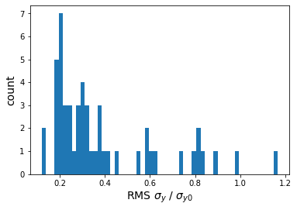
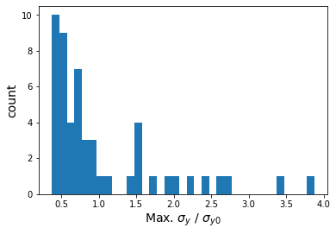

Option 3
${ ε}_{x0}=$1.49 nm
${ ε}_{y0}=$ 2.9 pm
The ‘design’ values
12

Slide 13

Conclusion
Global emittance tuning corrections achieve a median final vertical emittance of 0.23 pm and a horizontal emittance of 2.3 nm.
Beam size calculations shown using 3 different reference emittance values. Maximum values of $\frac{σ_{x}}{σ_{x0}}=1.1$ and $\frac{σ_{y}}{σ_{y0}}=10$, might be good first estimates. …but discussion continue…
13

Slide 14
FCC-ee emittance tuning results
RMS misalignment and field errors tolerances:
ttbar (182.5 GeV) 4IP lattice, after correction strategy:
14
Notes:
%$\epsilon_{x, \textrm{rms}} = 1.685$ nm rad \\
%$\epsilon_{y, \textrm{rms}} = 0.871$ pm rad \\
%$\frac{\epsilon_{y}}{\epsilon_{x}} = 0.0789$ $\%$ \\
\begin{table}[htb!]
\centering
\begin{tabular}{p{3cm}cccc}
\hline
Type & $\Delta$X & $\Delta$Y & $\Delta$PSI & $\Delta$S \\
& ($\mu$m) & ($\mu$m) & ($\mu$rad) & ($\mu$m)
\vspace{.1cm} \\
\hline
Arc quadrupole* & 50 & 50 & 200 & 50 \\
Arc sextupoles* & 50 & 50 & 200 & 50 \\
\hline
Dipoles & 100 & 100 & 200 & 500 \\
\hline
Girders & 100 & 100 & - & 500 \\
\hline
IR quadrupole & 75 & 75 & 100 & 75 \\
IR sextupoles & 75 & 75 & 100 & 75 \\
\hline
BPM** & 40 & 40 & 100 & - \\
\hline
\end{tabular}
\end{table}
---------
\begin{table}[htb!]
\centering
\begin{tabular}{p{3cm}cccccc}
\hline
Type & $\Delta$X & $\Delta$Y & $\Delta$PSI & $\Delta$S & $\Delta$DTHETA & $\Delta$DPHI \\
& ($\mu$m) & ($\mu$m) & ($\mu$rad) & ($\mu$m) & ($\mu$rad) & ($\mu$rad) \\
\vspace{.1cm} \\
\hline
Arc quadrupole* & 50 & 50 & 300 & 100 & 100 & 100 \\
Arc sextupoles* & 50 & 50 & 300 & 100 & 100 & 100 \\
\hline
Dipoles & 1000 & 1000 & 300 & 1000 & 0 & 0 \\
\hline
Girders & 150 & 150 & - & 1000 & 0 & 0 \\
\hline
IR quadrupole & 75 & 75 & 250 & 50 & 75 & 75 \\
IR sextupoles & 75 & 75 & 250 & 50 & 75 & 75 \\
\hline
BPM** & 40 & 40 & 100 & - \\
\hline
\end{tabular}
\end{table}
\begin{table}[htb!]
\centering
\begin{tabular}{p{3cm}cccccc}
\hline
Type & $\Delta$X & $\Delta$Y & $\Delta$PSI & $\Delta$S & $\Delta$THETA & $\Delta$PHI \\
& ($\mu$m) & ($\mu$m) & ($\mu$rad) & ($\mu$m) & ($\mu$rad) & ($\mu$rad) \\
\vspace{.1cm} \\
\hline
Arc quadrupole* & 50 & 50 & 300 & 100 & 100 & 100 \\
Arc sextupoles* & 50 & 50 & 300 & 100 & 100 & 100 \\
\hline
Dipoles & 1000 & 1000 & 300 & 1000 & 0 & 0 \\
\hline
Girders & 150 & 150 & - & 1000 & $\dagger$ & $\dagger$ \\
\hline
IR quadrupole & 75 & 75 & 250 & 50 & 75 & 75 \\
IR sextupoles & 75 & 75 & 250 & 50 & 75 & 75 \\
\hline
BPM** & 40 & 40 & 100 & - \\
\hline
\end{tabular}
\end{table}
\begin{table}[htb!]
\centering
\begin{tabular}{p{3cm}cccccc}
\hline
Type & $\Delta$X & $\Delta$Y & $\Delta$PSI & $\Delta$S & $\Delta$THETA & $\Delta$PHI \\
& ($\mu$m) & ($\mu$m) & ($\mu$rad) & ($\mu$m) & ($\mu$rad) & ($\mu$rad) \\
\vspace{.1cm} \\
\hline
Arc quadrupole* & 50 & 50 & 300 & 150 & 100 & 100 \\
Arc sextupoles* & 50 & 50 & 300 & 150 & 100 & 100 \\
\hline
Dipoles & 1000 & 1000 & 300 & 1000 & 0 & 0 \\
\hline
Girders & 150 & 150 & - & 1000 & $\dagger$ & $\dagger$ \\
\hline
IR quadrupole & 100 & 100 & 250 & 200 & 100 & 100 \\
IR sextupoles & 100 & 100 & 250 & 200 & 100 & 100 \\
\hline
BPM** & 40 & 40 & 100 & - \\
\hline
\end{tabular}
\end{table}

