Slide 1
Emit with tapering
The story of the closed orbit

Slide 2
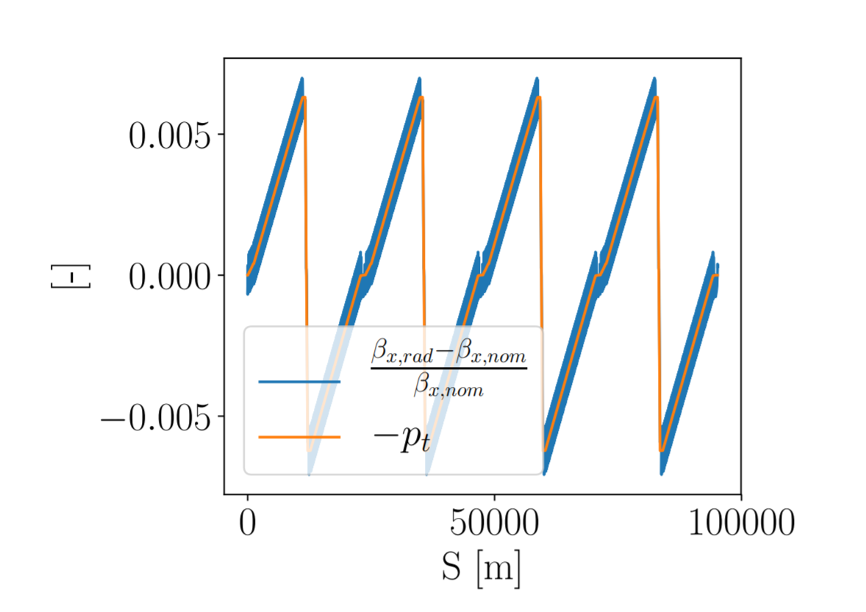
Large energy variation around the ring in the FCC-ee

Slide 3
Tapering
To compensate for the energy variation around the ring we need to:
  Change the strength for each magnet to the beam energy at that location
    Since a few years back we can change the strength of dipole without changing the angle, essential feature for this to work.
  The phase of the RF-cavities needs to be adapted as well
    Previously this was done by the tapering command
    Worked “well” in TWISS but than in emit complained.
    Went for a different approach where we allowed the tapering of the magnet to be on while matching
    User can then match the RF-phase (lag) as they see fit

Slide 4
With matching
To tell it is a line
beam, radiate=true;
MATCH, sequence=L000013, BETA0 = B.IP, tapering;
VARY, NAME=LAGCA1, step=1.0E-7;
VARY, NAME=LAGCA2, step=1.0E-7;
CONSTRAINT, SEQUENCE=L000013, RANGE=#e, PT=0.0;
jacobian,TOLERANCE=1.0E-14, CALLS=3000;
ENDMATCH;
twiss, file = "fcc_radiate.twiss", tapering;

Slide 5
Why emit did not work with the old tapering?
TWISS never checked if there was a longitudinally closed orbit
  So even if TWISS found a “closed orbit” it was not stable
This means that you can be on the wrong side of the RF. The default behavior (lag = 0) is for below transition!
  In the LHC mask the lag is set correctly to 0.5

Slide 6
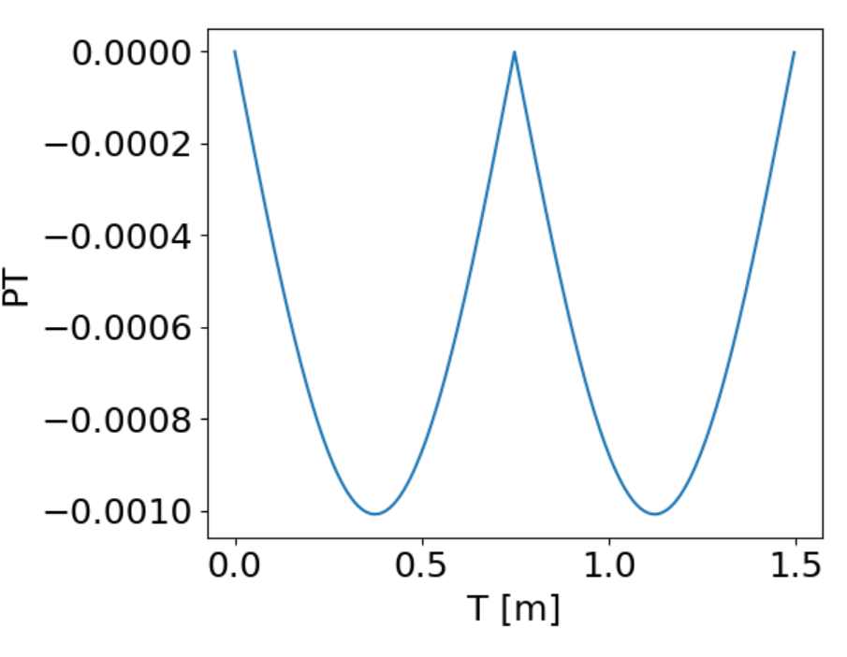
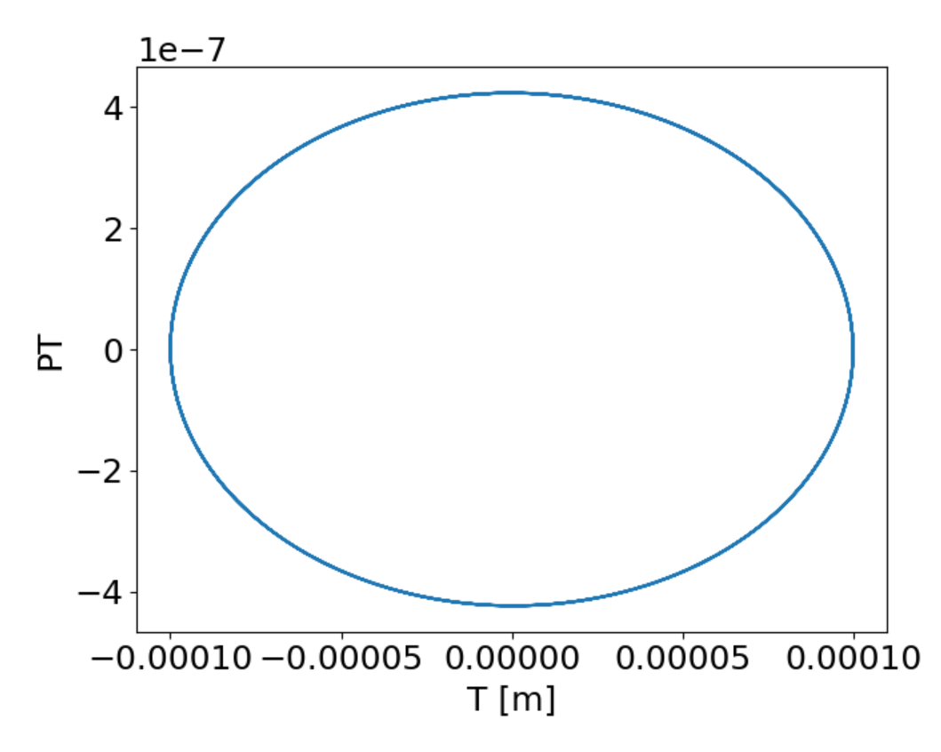
An example from the MAD-X test repository
use, sequence= lhcb1;
vrf400= 8.0; ! Qs=0.0057
track, dump;
start, t= 0.0001;
iteration: 1 error: 0.000000E+00 deltap: 0.000000E+00 orbit: 0.000000E+00 0.000000E+00 0.000000E+00 0.000000E+00 0.000000E+00 0.000000E+00
Change lag by 0.5

Slide 7
How can MAD-X find a closed orbit?
MAD-X (closed orbit routine in TWISS) stops when the coordinates after 1 turn is the same as the initial.
  In the LHC case the initial was (0,0,0,0,0,0) and since there was no longitudinal kick -> turn0 = turn1
  In the FCC-ee case it was either within the tolerance (turn0 ≈ turn1) or it didn’t converge but TWISS continues anyway

Slide 8
Change to MAD-X
Now there is a warning thrown if the orbit is not stable.
  This is checked from the eigenvalues of the one-turn matrix
  If they are not less than 1 (error of 10e-4 is allowed by default) than a warning is thrown :
++++++ warning: TWCLORB: Longitudinal plane might be unstable. Try change lag with 0.5. More information with the debug flag on.

Slide 9
Conclusion
The problem with emit was coming from the wrong lag of the RF-cavities
The FCC-ee lattice can be tapered through:
  The build-in tapering of the magnets
  Matching (where the tapering of the magnets are on)
A new check for the stability of the closed orbit has been implemented

