Slide 2
BRAN-D impact on ZDC
S. Mazzoni, BI
TREX 30 April 2021

Slide 3
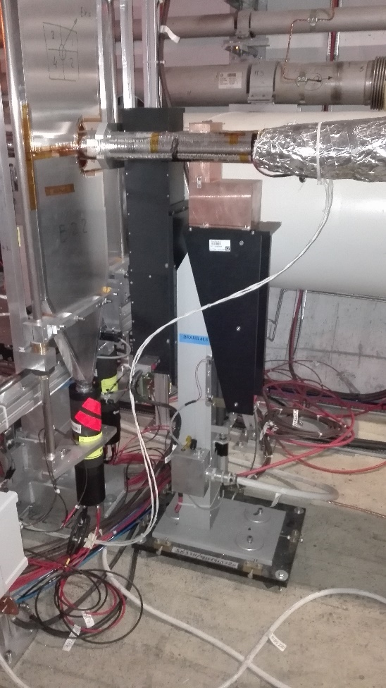
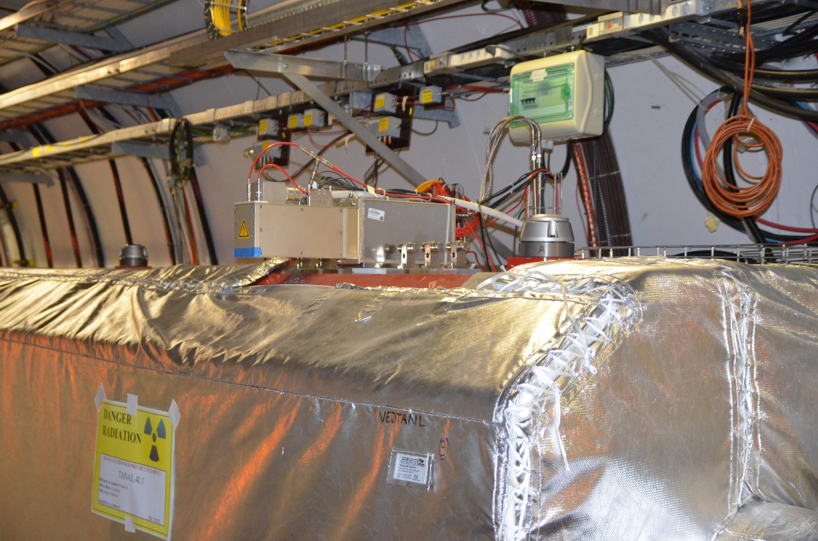
BRANs in Run 3
BRAN C
IP2/ IP8: “BRAN C” design based on Silica rods + PMTs (Cherenkov light).
  No functional modifications
  Motors for absorber insertion: checked by ML at pt 8, pt. 2 to be performed
IP1/IP5: “BRAN A” based on ionization chambers.
  No functional modifications
Right of IP1 (12) / Left of IP5 (45): replace BRAN A with “BRAN D” evolution of BRAN C. HL-LHC prototype to be tested in LHC Run #3
ZDC team (ATLAS): concern about impact of BRAN-D on ZDC
BRAN A

Slide 4
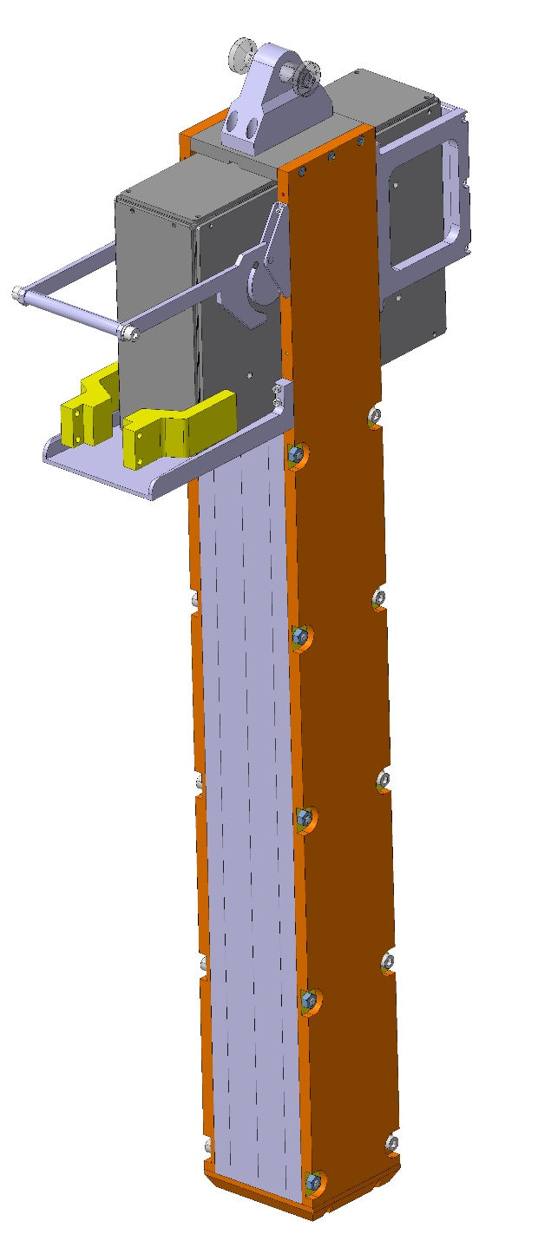
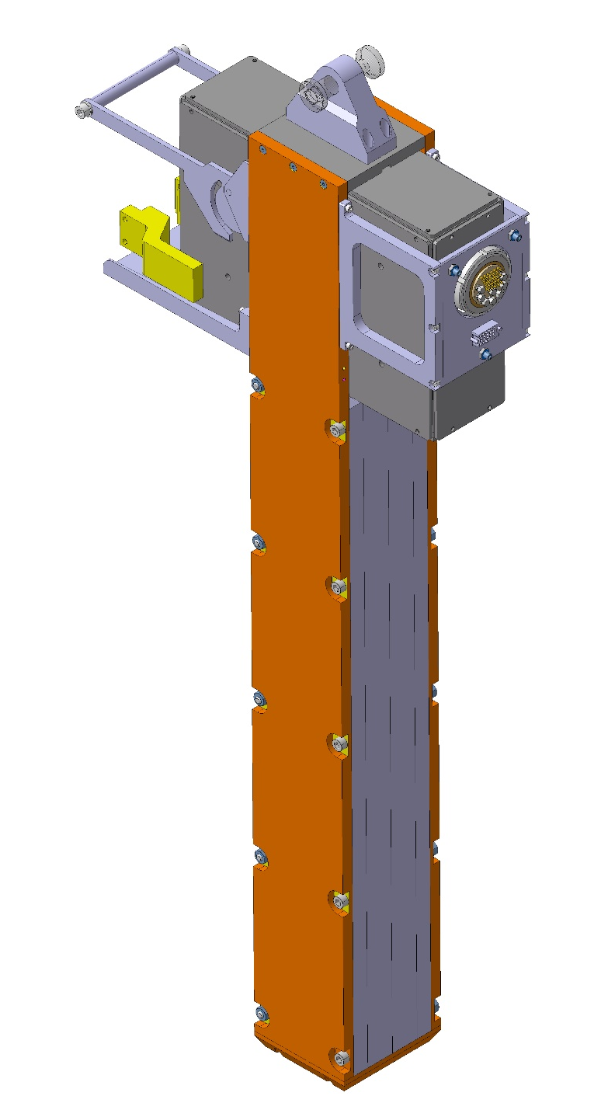
BRAN D
New design with two subsystems:
  Glass bars enclosure
  PMT box
Designed by CERN design office. Drawings signed and sent to main WS on July 20. Parts fabrication outsourced to Metalicone Technologies Ltd. (Israel) – received Feb 21
A few minor modifications
  copper C11000, 99.9% pure instead of C10200 oxygen free.
  AL6061 instead of AL6082, “almost identical”
  sub mm modification of threaded hole lengths

Slide 5
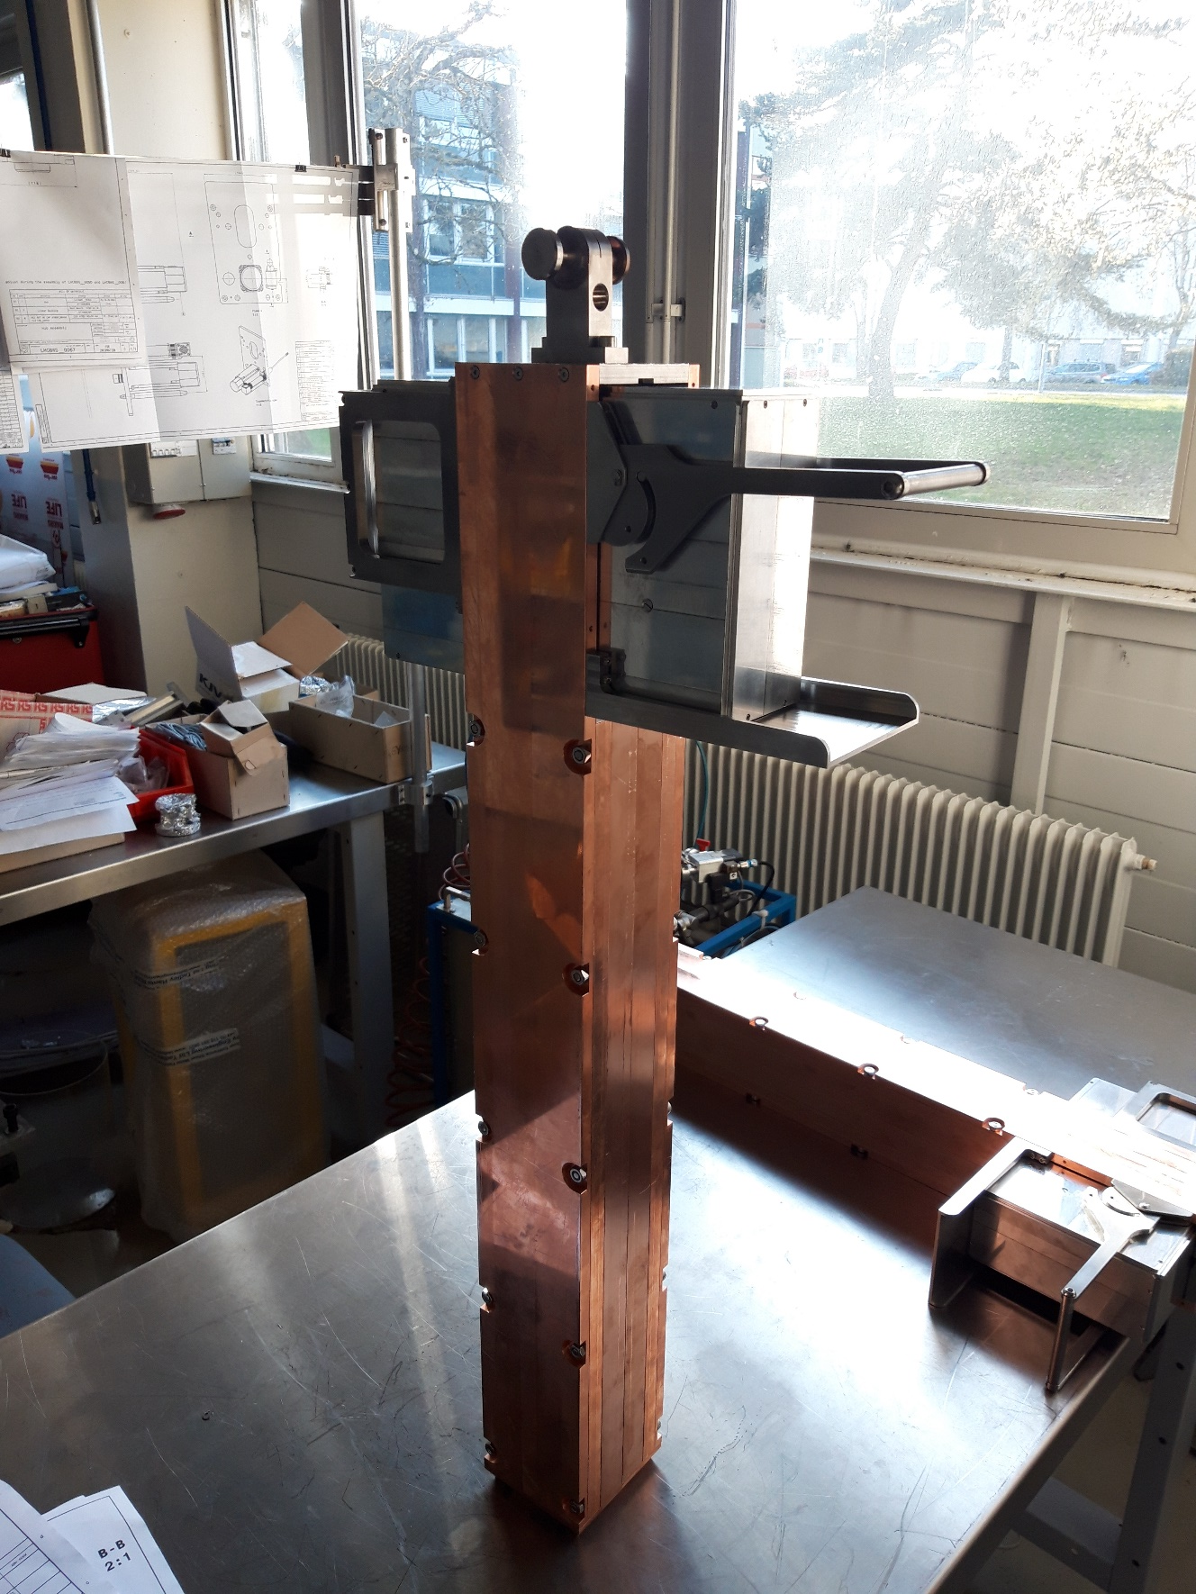
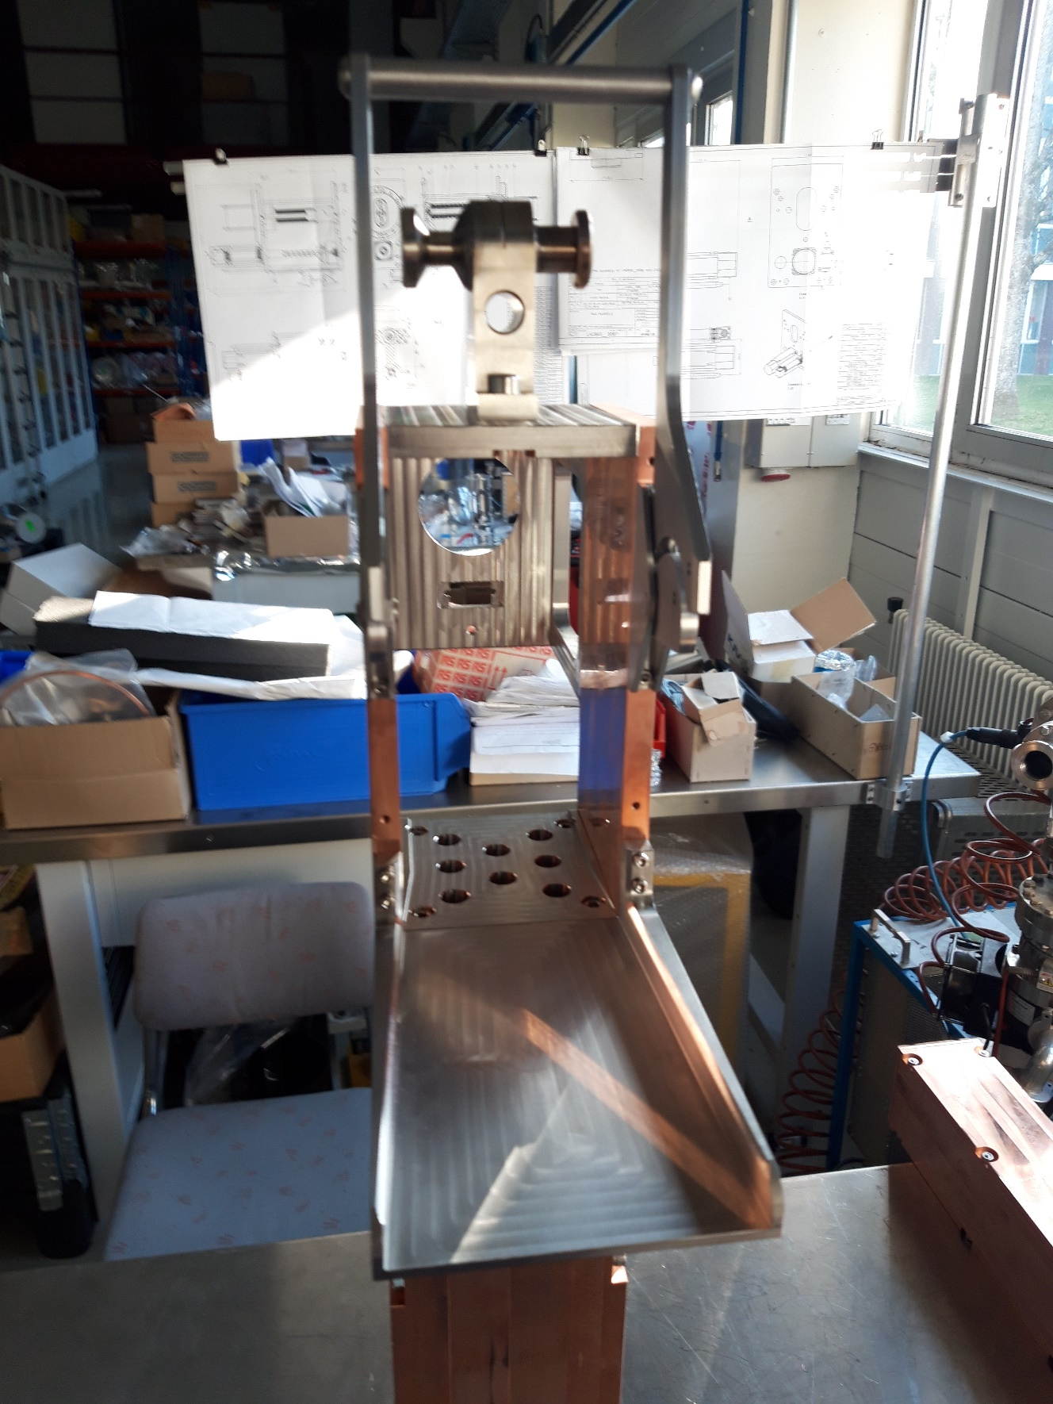
BRAN D

Slide 6
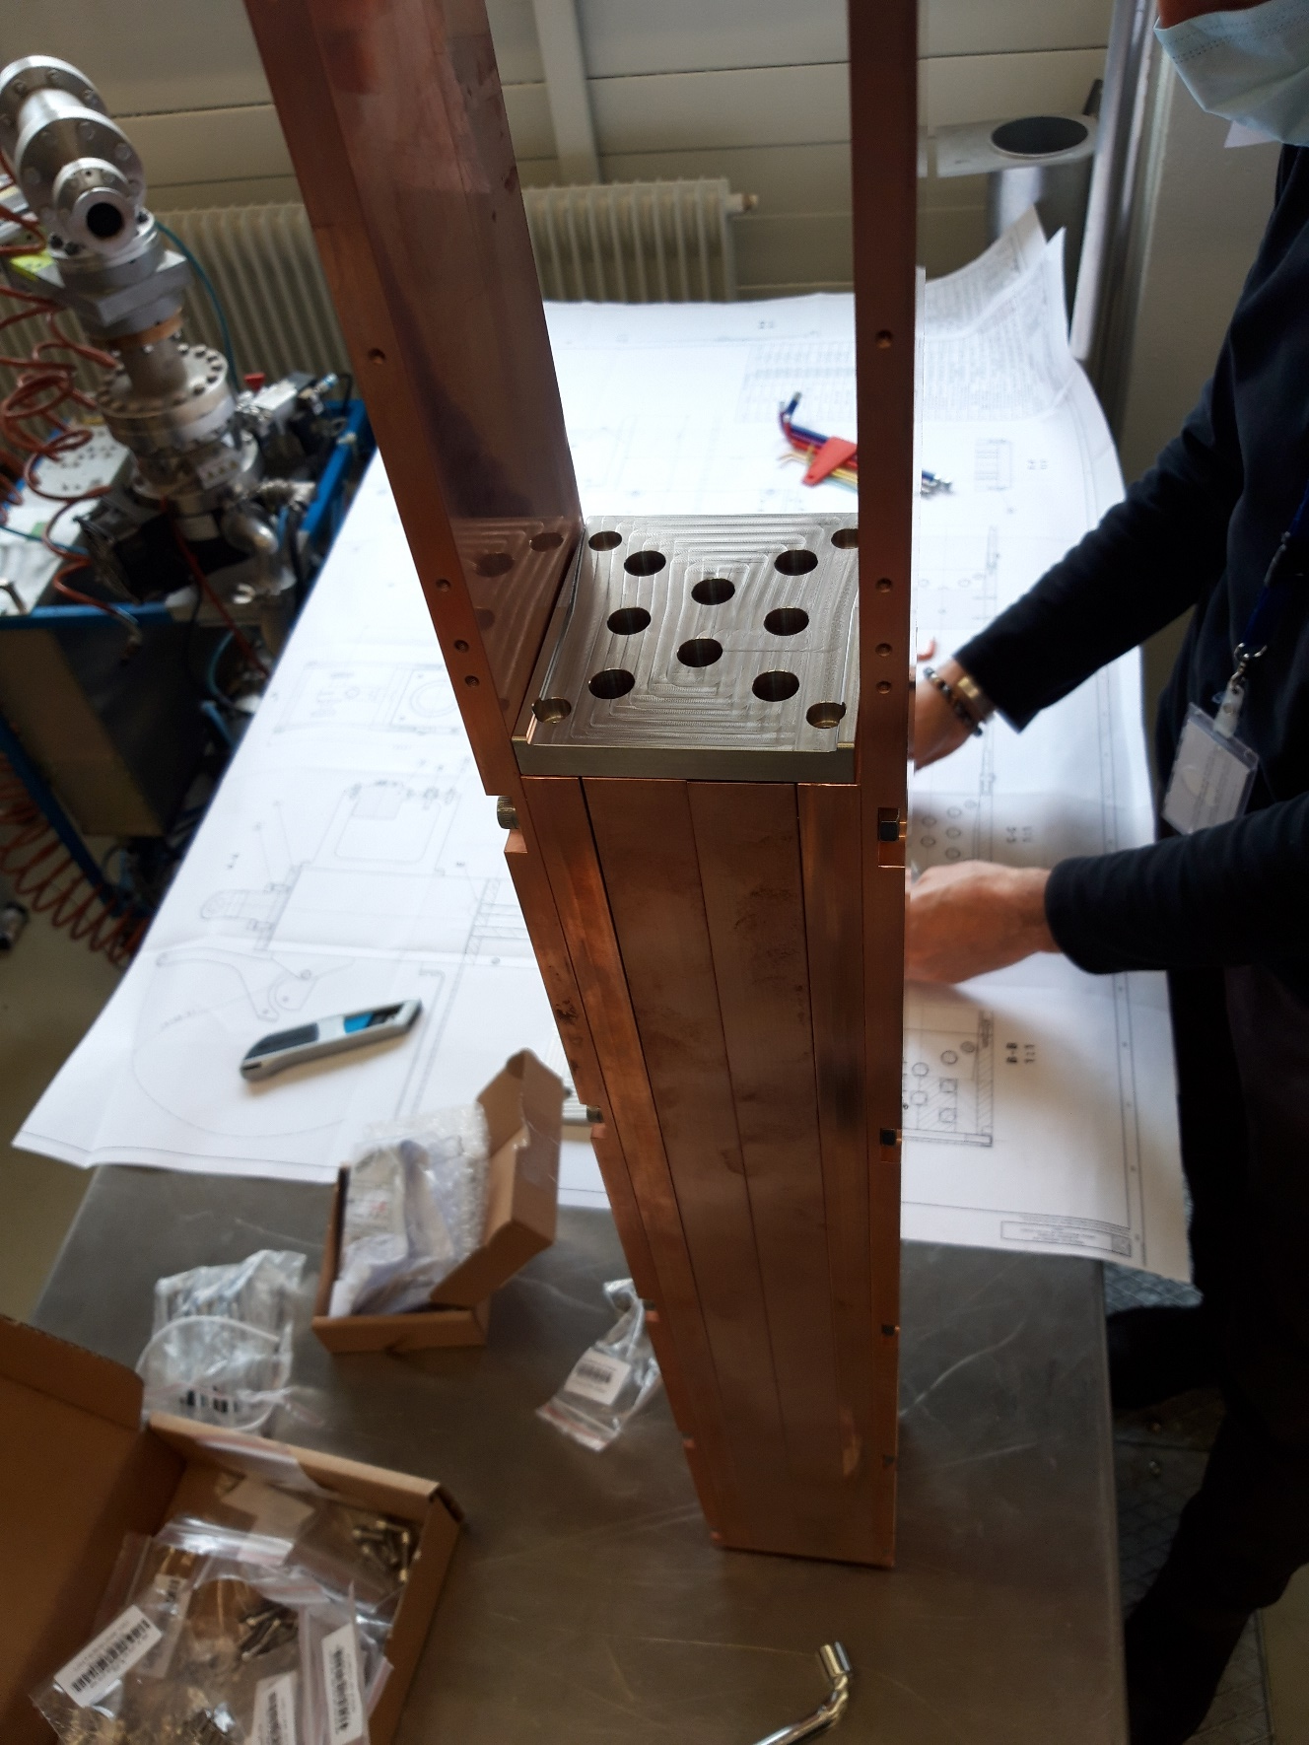
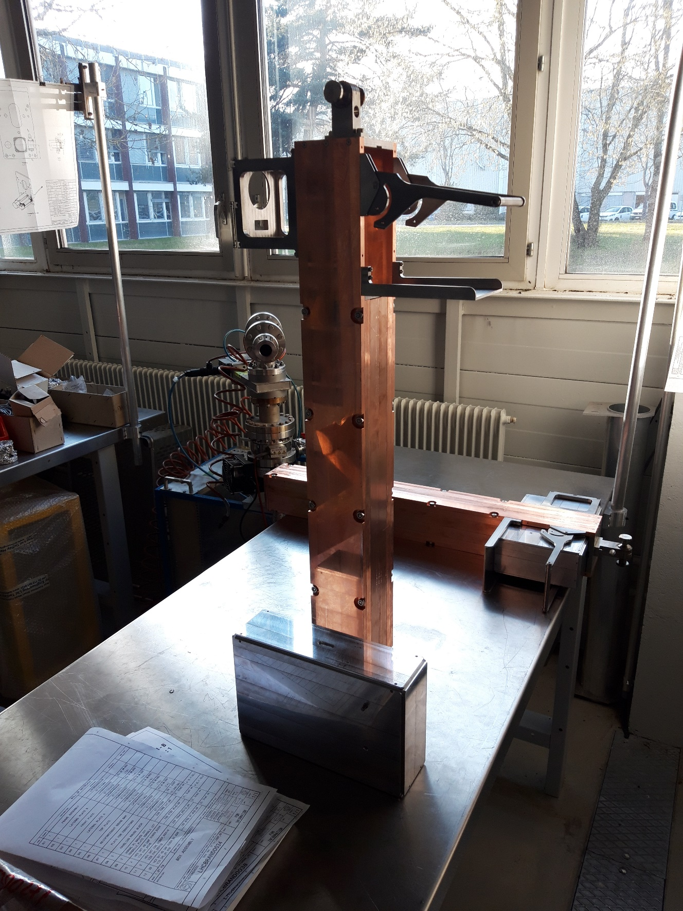
BRAN D

Slide 7
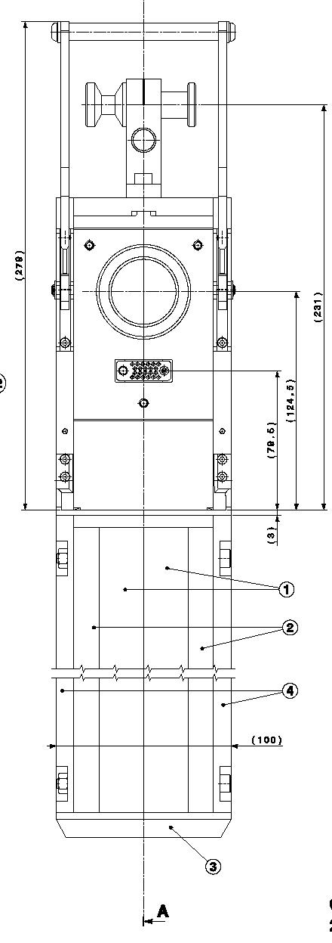
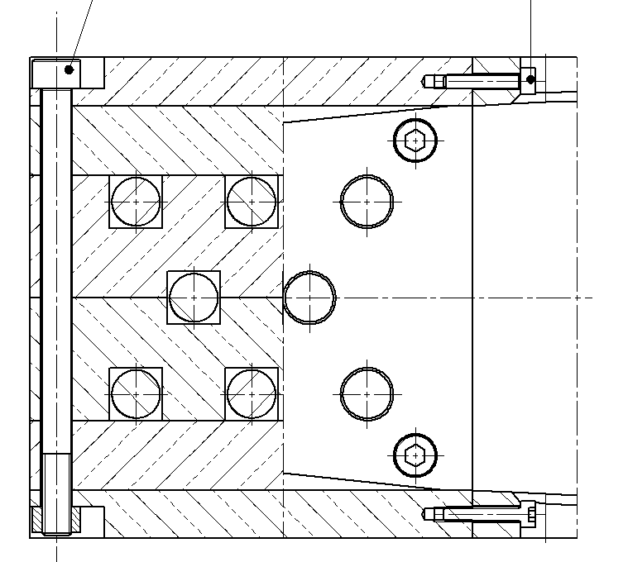
Glass bar assembly
Eight 603 mm x 10 mm dia Suprasil 3302, low OH, no H2 in a copper enclosure (100 x 100 mm)
Copper type C11000, 99.9% pure
Copper enclosure made of 6 slabs (next slide)
shower

Slide 8
Glass bar assembly
11
…
89 mm Cu + 10 mm SiO₂ (max)
11
78 mm Cu + 20 mm SiO₂ (max)
16.5
100 mm Cu
10
14.5
25.5
…
50
Equivalent thickness of BRAN-A:
42 mm Cu

Slide 9
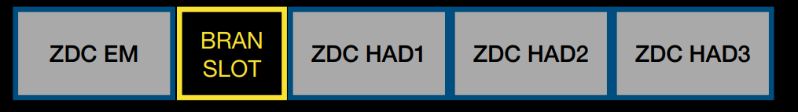
BRAN-D in IP1 TAN during HI runs
beam
Increased material budget affects ZDC HAD modules
EM / Hadronic shower peak position would not move significantly
Width of neutron peak increases
Asymmetry left / right (2022 HI run)

Slide 10

BRAN-D in IP1 TAN during HI runs
mitigation: replace 2 Cu slabs (2x14.5 mm) with Al
Resulting material budget:
71 mm Cu + 29 mm Al (+ 2x 10 mm dia fused silica bars)
Parts made by BI workshop, available end May
4x produced. Replacement not needed in IP5 TAN
11
10
14.5
25.5
…
50

Slide 11
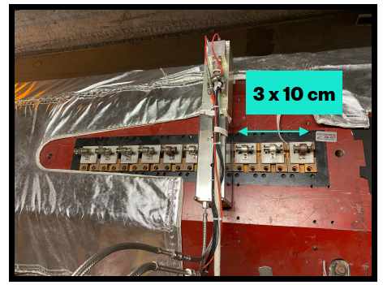
Position of BRAN-D during HI runs
request from ATLAS ZDC to move the BRAN-D approx. 40 mm away from the IP in sector 12 to accommodate new detector.
CMS ZDC: BRAN-D will stay in 2nd Cu block, same width (100 mm) or existing BRAN. Will perform check on site 1st week of May with ZDC team.

