Slide 1





Measurements of wakefields and bunch length with beam in linear electron accelerators: a case study at the CLEAR facility.
Antonio Gilardi
Acknowledgment: Roberto Corsini – Kyrre Sjobak – Wilfrid Farabolini – Andrea Latina – Pasquale Arpaia
Antonio Gilardi
Notes:
Hello to everyone.
I'm Antonio Gilardi and today I’m going to present the wakefield measurements in CLEAR.
Before to start I would like to acknowled: …..for the constant support and help

Slide 2
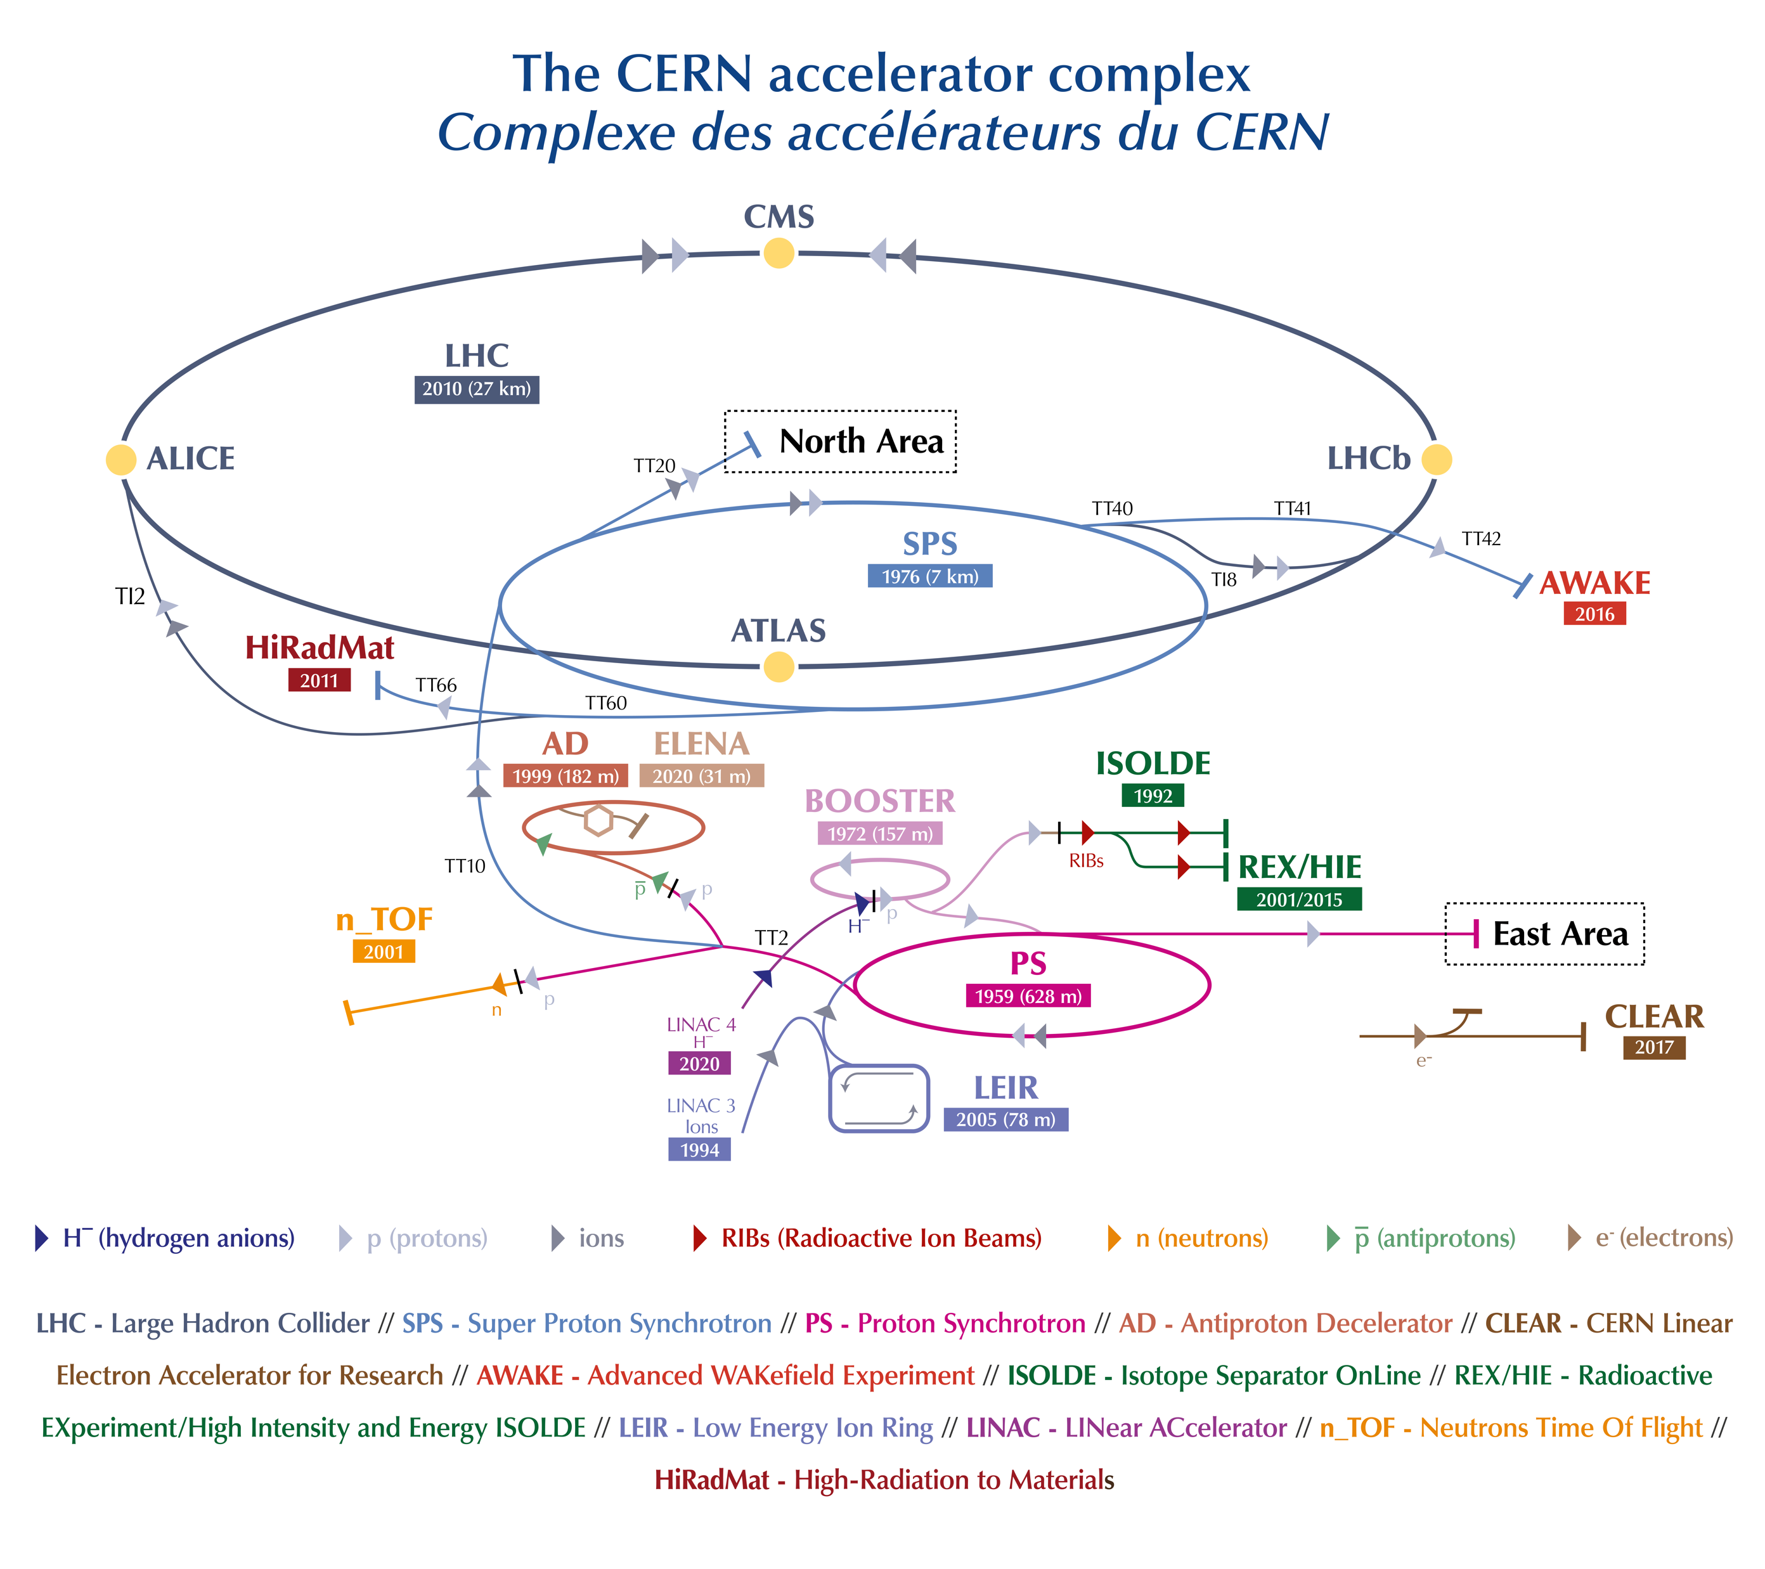
Outline
CLEAR (CERN Linear Electron Accelerator for Research)
Wakefields study
Background
Problem
Proposal
Results
Bunch length study
Background
Problem
Proposal
Results
Conclusions
Antonio Gilardi
Notes:
This is my outline, I will firstly give a brief introduction of CLEAR, the accelerator where I performed the whole activities.
Following; I will talk of the wakefield measurements carried our; about this topic I will briefly introduce a background then present the problem, the proposal and finally the results.
From the well-known picture on the side representing the overview of the CERN complex, you can already spot the CLEAR accelerator. It has the unique pecularity of being an indipendent LINAC.

Slide 3
Outline
CLEAR (CERN Linear Electron Accelerator for Research)
Wakefields study
Background
Problem
Proposal
Results
Bunch length study
Background
Problem
Proposal
Results
Conclusions
Antonio Gilardi
Notes:
This is my outline, I will firstly give a brief introduction of CLEAR, the accelerator where I performed the whole activities.
Following; I will talk of the wakefield measurements carried our; about this topic I will briefly introduce a background then present the problem, the proposal and finally the results.
From the well-known picture on the side representing the overview of the CERN complex, you can already spot the CLEAR accelerator. It has the unique pecularity of being an indipendent LINAC.

Slide 4

CERN Linear Electron Accelerator for Research (CLEAR)
The CLEAR beamline is 41 m long.
Web site →http://clear.web.cern.ch
https://clear.web.cern.ch/sites/clear.web.cern.ch/files/documents/CLEAR_proposal.pdf
CLEAR is a user facility at CERN, running parallel with the main CERN accelerator complex, with the primary goal of general R&D for future accelerators.
Antonio Gilardi
Notes:
This is the CLEAR layout, CLEAR is a user facility with the primary goal of general R&D for future accelerators.

Slide 5
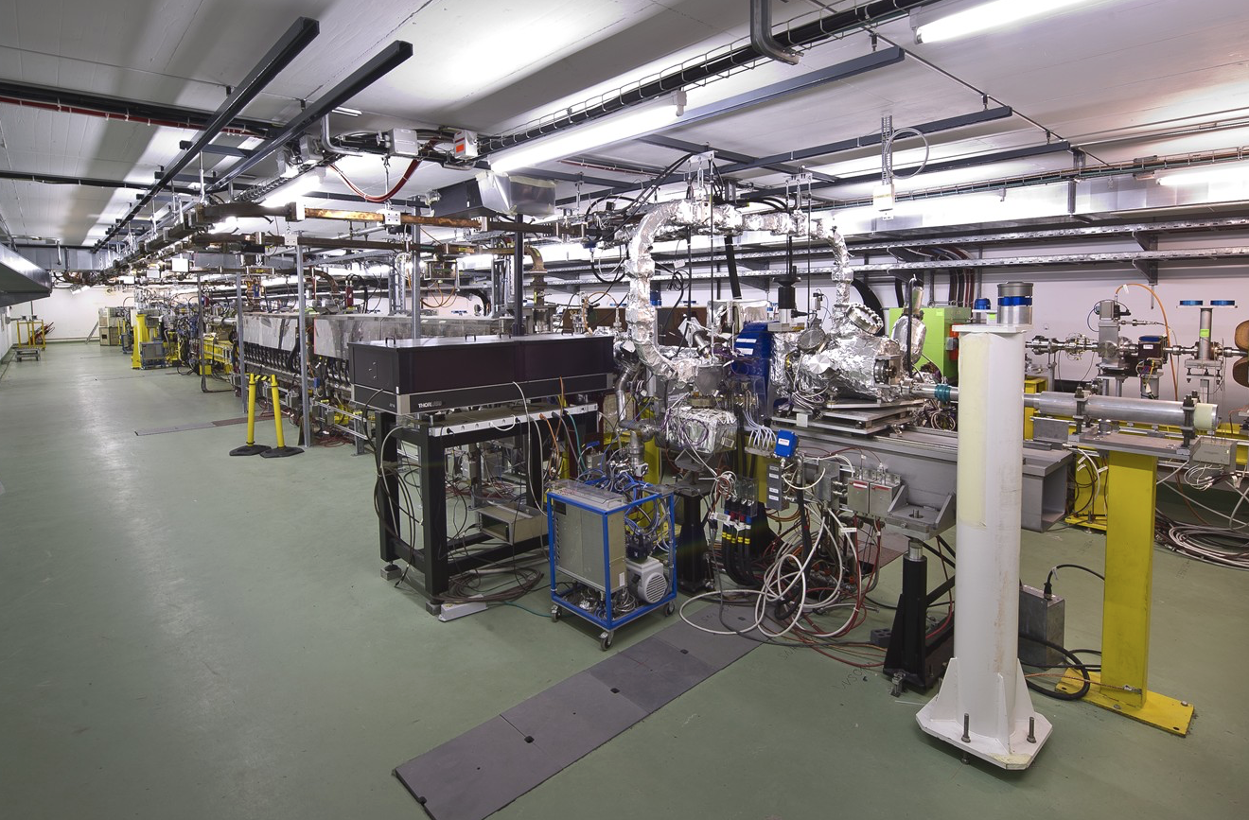
Antonio Gilardi
Notes:
This is the CLEAR layout, CLEAR is a user facility with the primary goal of general R&D for future accelerators.

Slide 6
Outline
CLEAR (CERN Linear Electron Accelerator for Research)
Wakefields study
Background
Problem
Proposal
Results
Bunch length study
Background
Problem
Proposal
Results
Conclusions & Future development
Antonio Gilardi
Notes:
This is my outline, I will firstly give a brief introduction of CLEAR, the accelerator where I performed the whole activities.
Following; I will talk of the wakefield measurements carried our; about this topic I will briefly introduce a background then present the problem, the proposal and finally the results.
From the well-known picture on the side representing the overview of the CERN complex, you can already spot the CLEAR accelerator. It has the unique pecularity of being an indipendent LINAC.

Slide 7
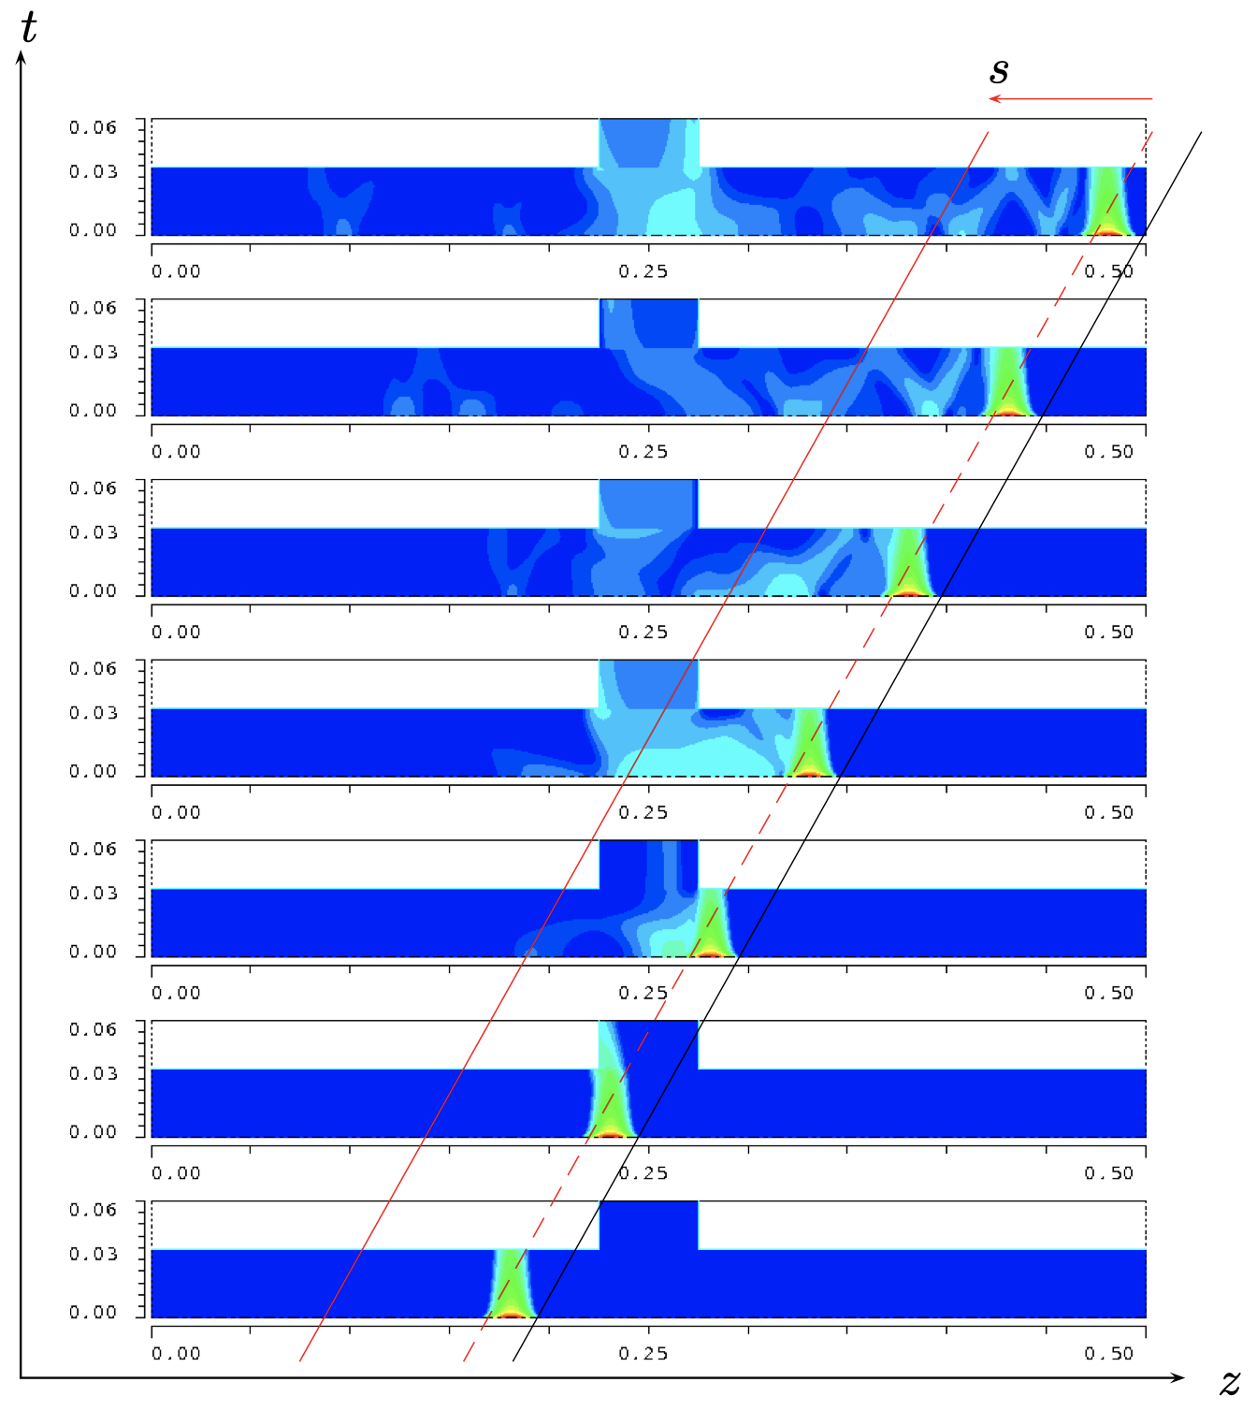
Wakefields study – Background
Antonio Gilardi
Notes:
This is an overview of the wakefield effects, you see a bunch that is passing from left to right in time from bottom to top left beyond a parasite field that can than remain trapped into the cavity and resonate.

Slide 8
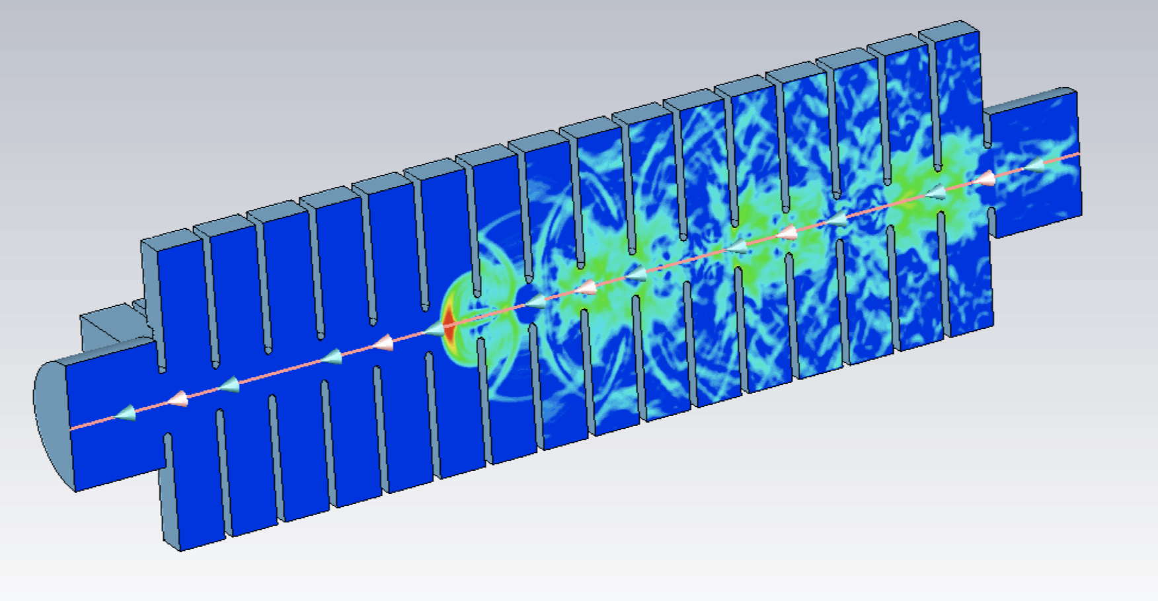
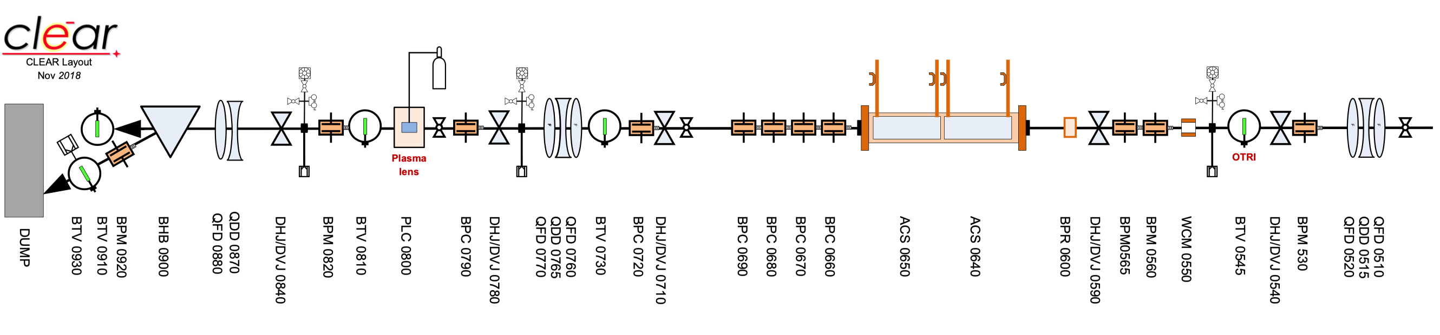
Wakefields study – Background
Bunch
Ideal trajectory
Real trajectory
Antonio Gilardi
Notes:
Another view of this effects of a bunch passing trougth a series of cavity like can be an accelerating strcutrue.
This effect can modify the beam trajectory and even a modification of few degrees in a long accelerator may cause the loss of the beam.
This is way the wakefield are one of the big concerns for the novel accelerators.

Slide 9
Wakefields study – Background
Bunch
Ideal trajectory
Real trajectory
Short-range → Intra bunch
Long-range → Between bunches
Antonio Gilardi
Notes:
We can distinguish between two type of wakefield....

Slide 10
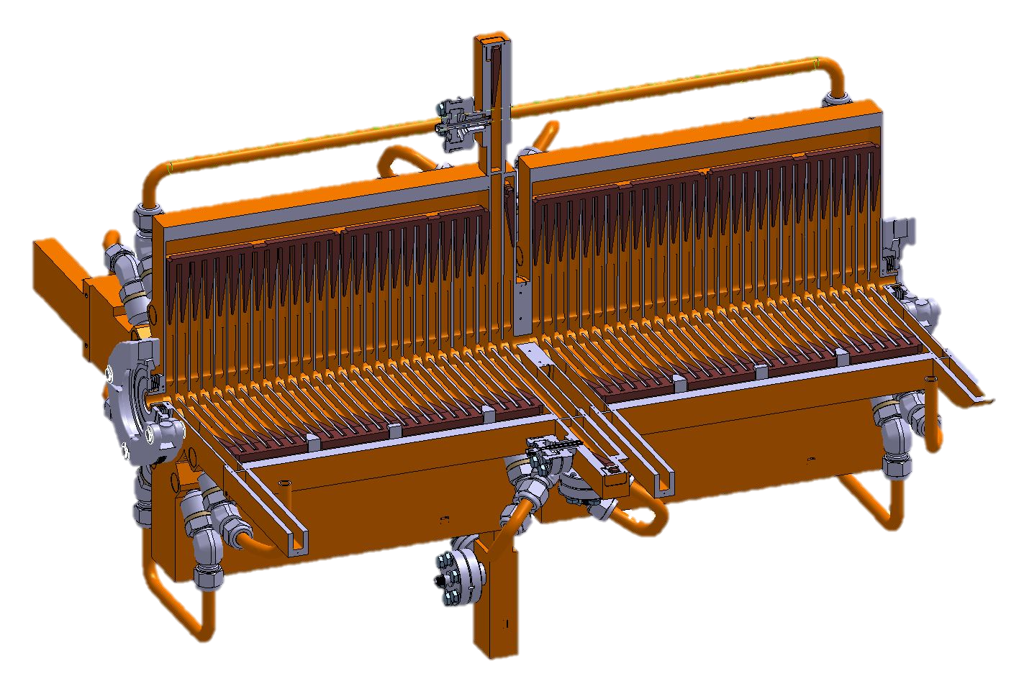
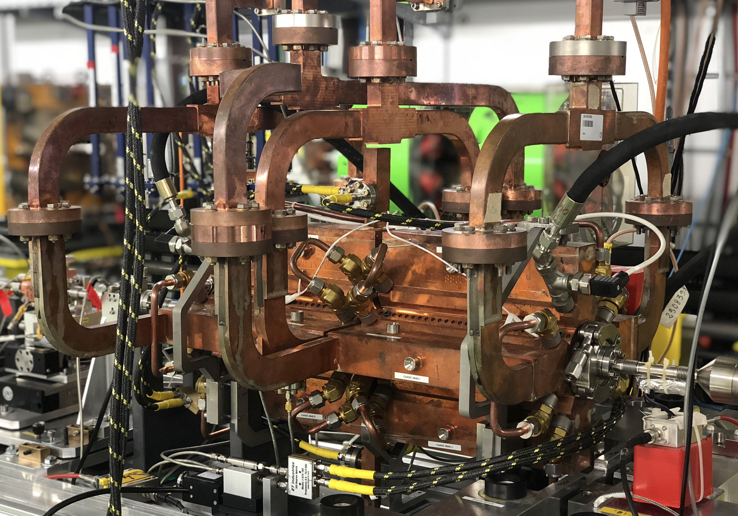
Wakefields study – Problem
100 MV/m – Compact LInear Collider (CLIC)
25 MV/m – CLEAR accelerating structure
Antonio Gilardi
Notes:
The whole wakefield study is carried out on the latest baseline prototype of accelerating structure for the future compact linear collider.
This structure presents several challenging parameters, starting from the accelerating gradient, that is 100MV/m and just to give a number to compare with, it is about 4 times the gradient of the accelerating structure currently installed in CLEAR.
In addition, the pipe aperture goes down to a 2mm.

Slide 11
Wakefields study – Problem
100 MV/m – Compact LInear Collider (CLIC)
25 MV/m – CLEAR accelerating structure
OTR screen
H/V Corrector magnets
Radiation monitors
Ideal trajectory
Real trajectory
YAG screen
CLIC
BPM
WFM
CLIC accelerating structure
Girder
iBPM
Chromox screen
Antonio Gilardi
Notes:
This is a simplified view of the experimental layout where we can see, two....

Slide 12
Wakefields study – Problem
OTR screen
H/V Corrector magnets
Radiation monitors
Ideal trajectory
Real trajectory
YAG screen
CLIC
BPM
WFM
CLIC accelerating structure
Girder
iBPM
Chromox screen
Antonio Gilardi
Notes:
The potential distructive effect that the wakefield can have was of course already well known during the design and installation times.
For this reason, two different devices were designed and installed for trying to estimate such effect and if needed to correct the trajectory.

Slide 13

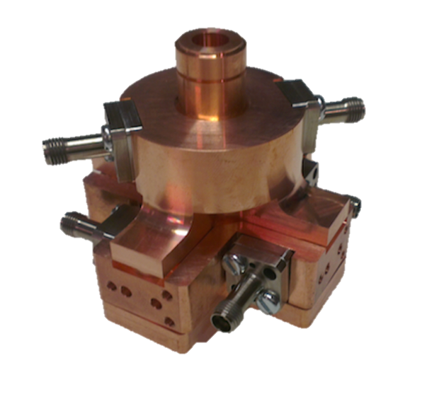
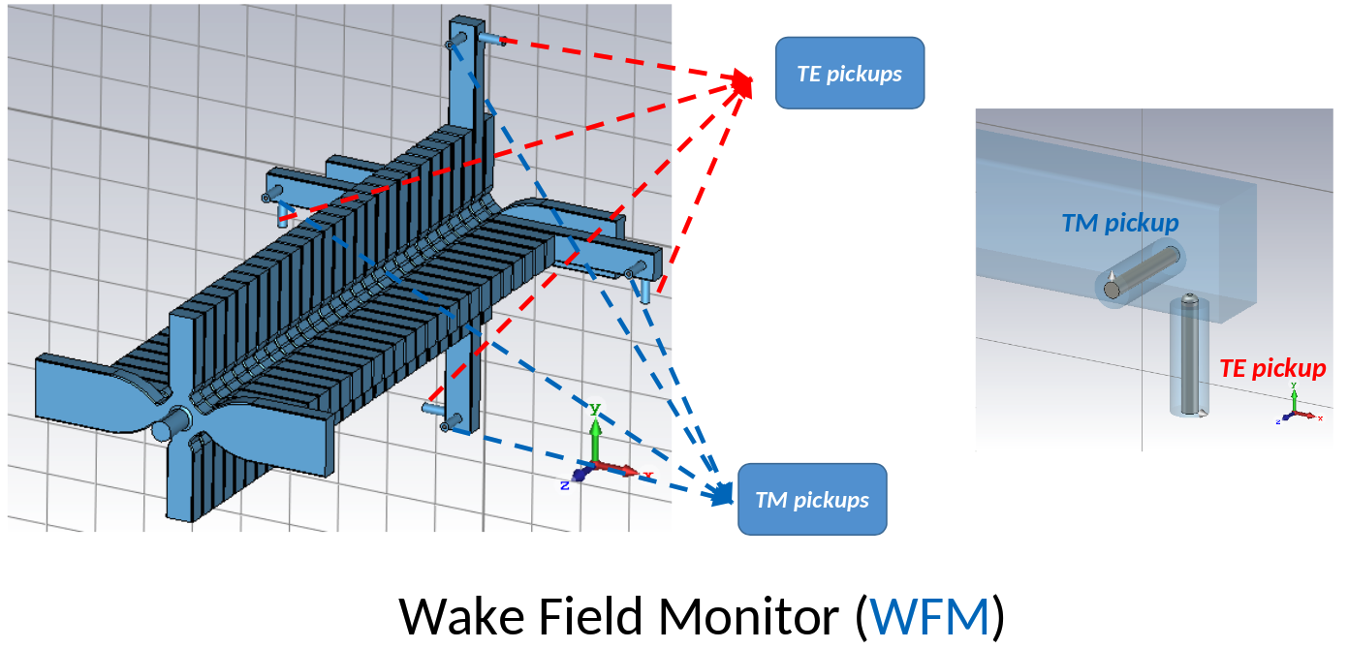
Wakefields study – Problem
OTR screen
H/V Corrector magnets
Radiation monitors
Ideal trajectory
Real trajectory
YAG screen
CLIC
BPM
WFM
CLIC accelerating structure
Girder
iBPM
Chromox screen
CLIC Beam Position Monitor (BPM)
Wake Field Monitor (WFM)
Antonio Gilardi
Notes:
I’m talking about the CLIC BPM and the WFM.
The WFM are antennas installed on an extended cell in the middle of the suprestrucutre while the CLIC BPM are a particulary performing cavity BPM with a design resolutions in the nanometare range.
Unfortunatly both this device are not yet operational and thus can not be used. Several studies are ongoing on this components.

Slide 14
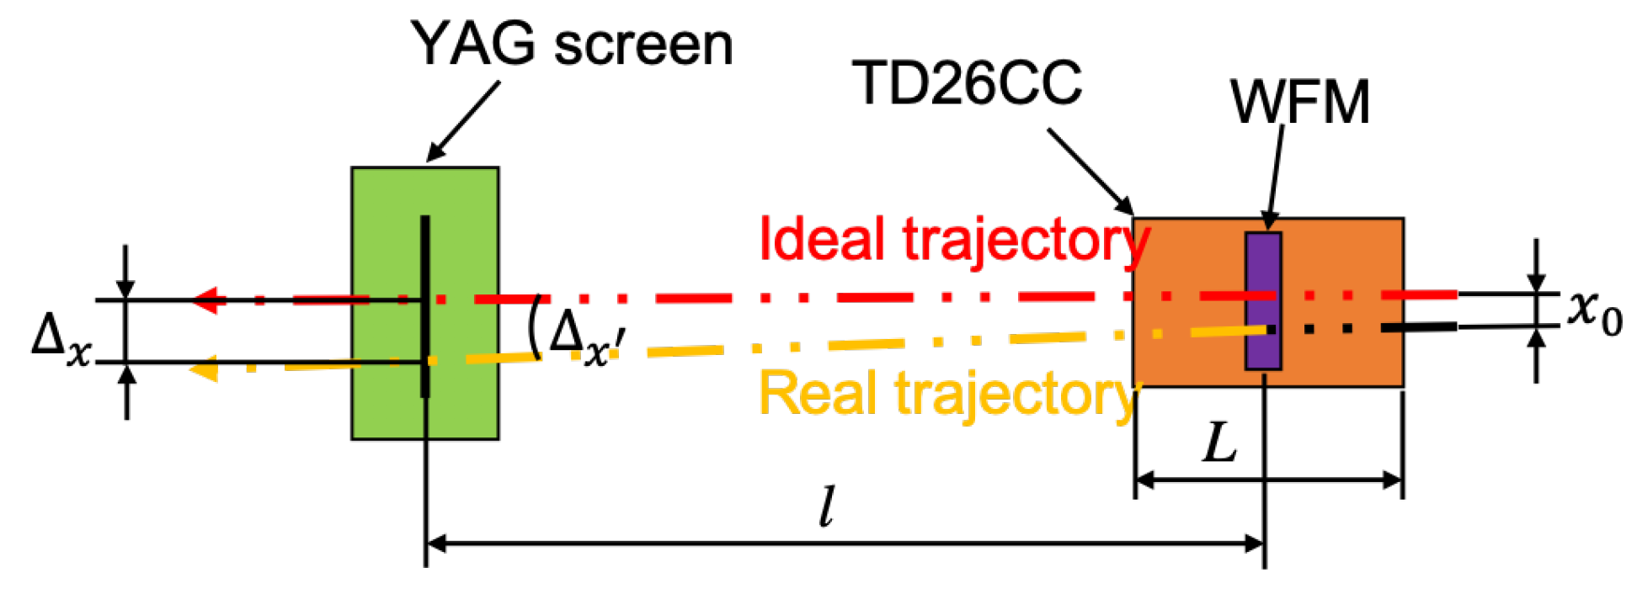
Wakefields study – Proposal
Antonio Gilardi
Notes:
The idea beyond the measurement methods is to study the effects of the wakefield estimating the different transverse kick that the beam recive while inducing a different displacement between the structure and the beam itself.
To do that, the beam centroid evolution while varyng the displacement is studied

Slide 15
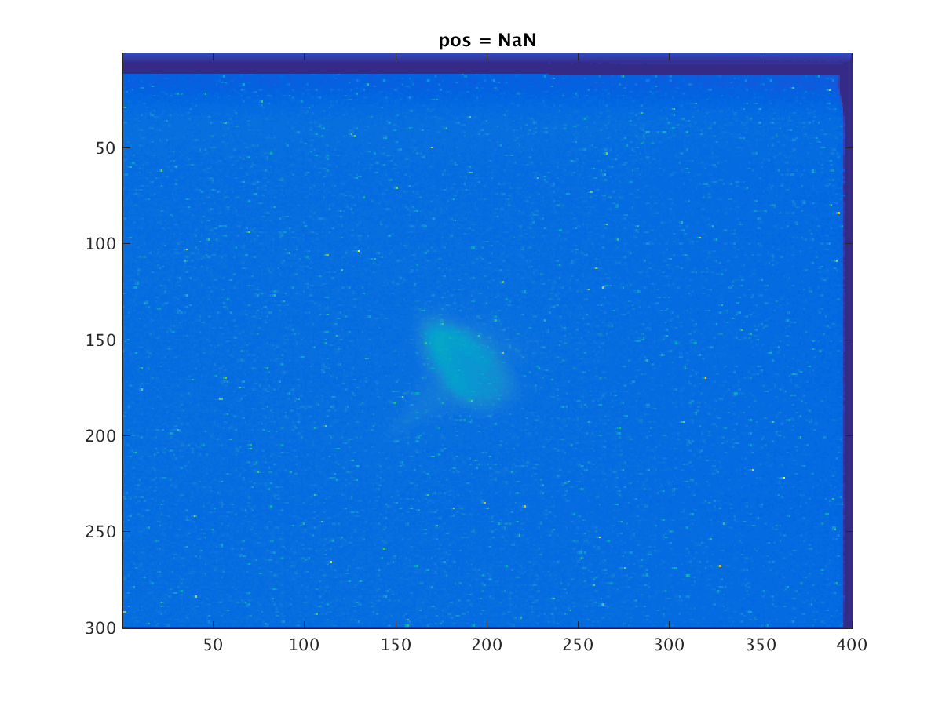
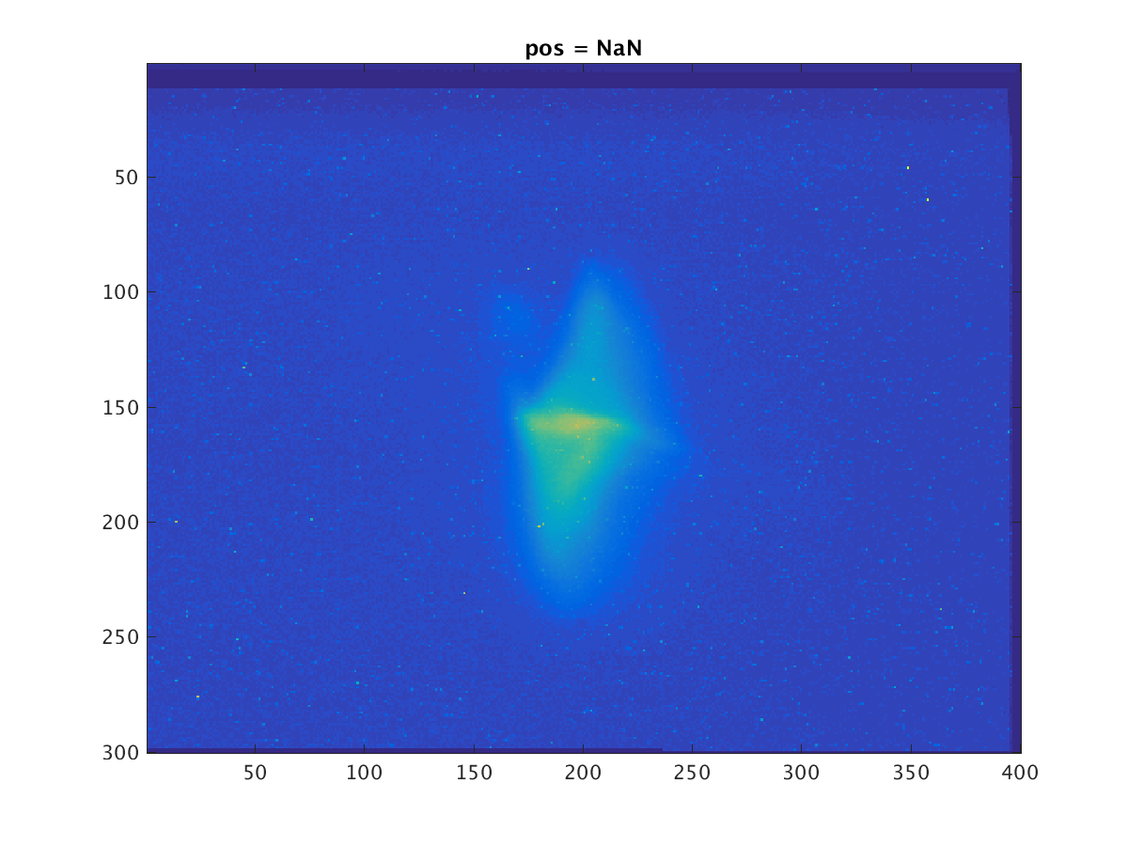
Wakefields study – Proposal
Before the accelerating structure
After the accelerating structure
Antonio Gilardi
Notes:
In this animations you see the same beam before and after the structure, thus you see the impact of the wakefield after the beam has passed trougth the accelerating structure.
From this, it is clear how much wakefield are impacting the the beam distribution and as a consequence, the beam centroids.

Slide 16
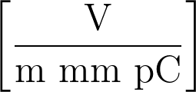
Wakefields study – Proposal
Under the assumption of:
Dominant dipolar component
(i.e., linear dependence with the displacement in the structure)
Linear dependence of the charge
Before the accelerating structure
After the accelerating structure
Antonio Gilardi
Notes:
Using the assumption of a linear response with the displacement and with the charge, it is possible to write the equations that describe the transverse voltage that affect the beam

Slide 17
Wakefields study – Proposal
Under the assumption of:
Dominant dipolar component
(i.e., linear dependence with the displacement in the structure)
Linear dependence of the charge
Before the accelerating structure
After the accelerating structure
Slope on the 2nd screen
Beam energy [MeV]
Beam charge [C]
Form factor (from simulation)
Antonio Gilardi
Notes:
Where the first terms is the .....

Slide 18
Wakefields study – Proposal
Move the structure
Beam screen
CLIC accelerating structure
Girder
Ideal trajectory
Beam
Real trajectory
Move the beam
Beam screen
Beam screen
CLIC accelerating structure
Girder
H/V Corrector magnets
Ideal trajectory
Beam
Real trajectory
Antonio Gilardi
Notes:
In order to change the displacement between the beam and the structure two possible strategies are available.
The first involve the movement of the accelerating structure around the beam, using a movable girder.
The second one uses correctors to scan around the position of the beam.
For practical reason, we have decided to use the second.

Slide 19
Wakefields study – Results
Between the wakefields simulations (Karl Bane’s formula) and from the measured data a discrepancy of an order of magnitude was found.
Antonio Gilardi
Notes:
And early results obtained comparing the simulations and the experimental data, a discrepancy of about a factor 10 was found.

Slide 20
Wakefields study – Results
Between the wakefields simulations (Karl Bane’s formula) and from the measured data a discrepancy of an order of magnitude was found.
Thanks to a first comparison with simulation a wrong calibration of the ICT in the CLEAR beam line was discovered.
This was corrected in spring 2019
16 bunch
1 bunch
10 bunches
Antonio Gilardi
Notes:
In addition from those measuraments an indication of having a linear trend with the charge per bunch was obtained, this was already pointing of a dominance from the short range wakefield.

Slide 21
Wakefields study – Results
- Single bunch
- Constant bunch length (4 ps)
Antonio Gilardi
Notes:
Following experimental campaign were carried our with single bunch with constant bunch length.

Slide 22
Wakefields study – Results
- Single bunch
- Constant bunch length (4 ps)
Slope =1
Under the assumption of:
Dominant dipolar component
Linear dependence of the charge
Antonio Gilardi
Notes:
From the centroid variations versus the imposed position, it can be seen that firstly, there is a wakefield impact, indeed we see that the slope is larger then one.
In addition, it can be seen that there is a linear trend in the centroid assessment.

Slide 23
Wakefields study – Results
Dominant dipolar component
- Single bunch
- Constant bunch length (4 ps)
Slope =1
Under the assumption of:
Dominant dipolar component
Linear dependence of the charge
Antonio Gilardi
Notes:
So, it is clear the domination of the dipolar component.

Slide 24
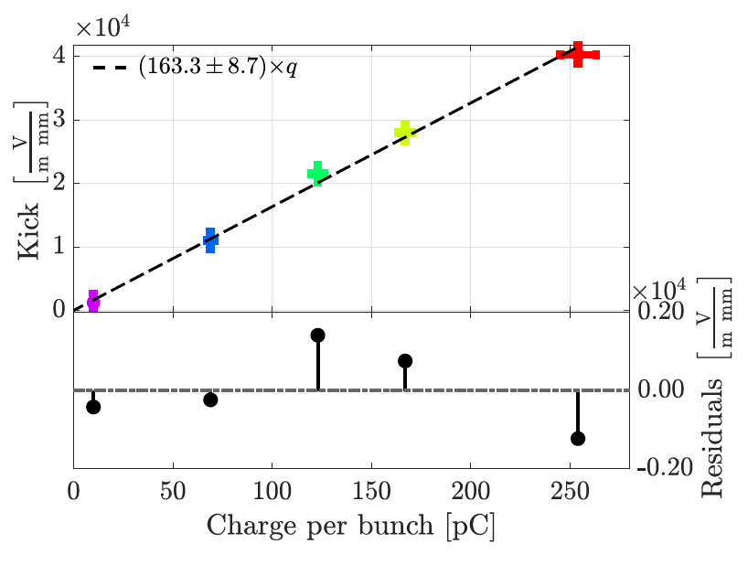
Wakefields study – Results
Dominant dipolar component
- Single bunch
- Constant bunch length (4 ps)
Slope =1
Under the assumption of:
Dominant dipolar component
Linear dependence of the charge
Antonio Gilardi
Notes:
Repeating the study for several charge per bunch, it is possible to obtain this results.
In this case it is clear the linear dependence with the charge.
Thus

Slide 25
Wakefields study – Results
Dominant dipolar component
- Single bunch
- Constant bunch length (4 ps)
Slope =1
Under the assumption of:
Dominant dipolar component
Linear dependence of the charge
Antonio Gilardi
Notes:
Also the second assumption use to write the formula that describe the transverse field was verified.

Slide 26
Wakefields study – Results
Dominant dipolar component
Linear dependence of the charge
- Single bunch
- Constant bunch length (4 ps)
Slope =1
Under the assumption of:
Dominant dipolar component
Linear dependence of the charge
Mixed number of bunches
Antonio Gilardi
Notes:
As a last comparison, to understand the type of wakefield; experimental campaigns with mixed number of bunches were performed.

Slide 27
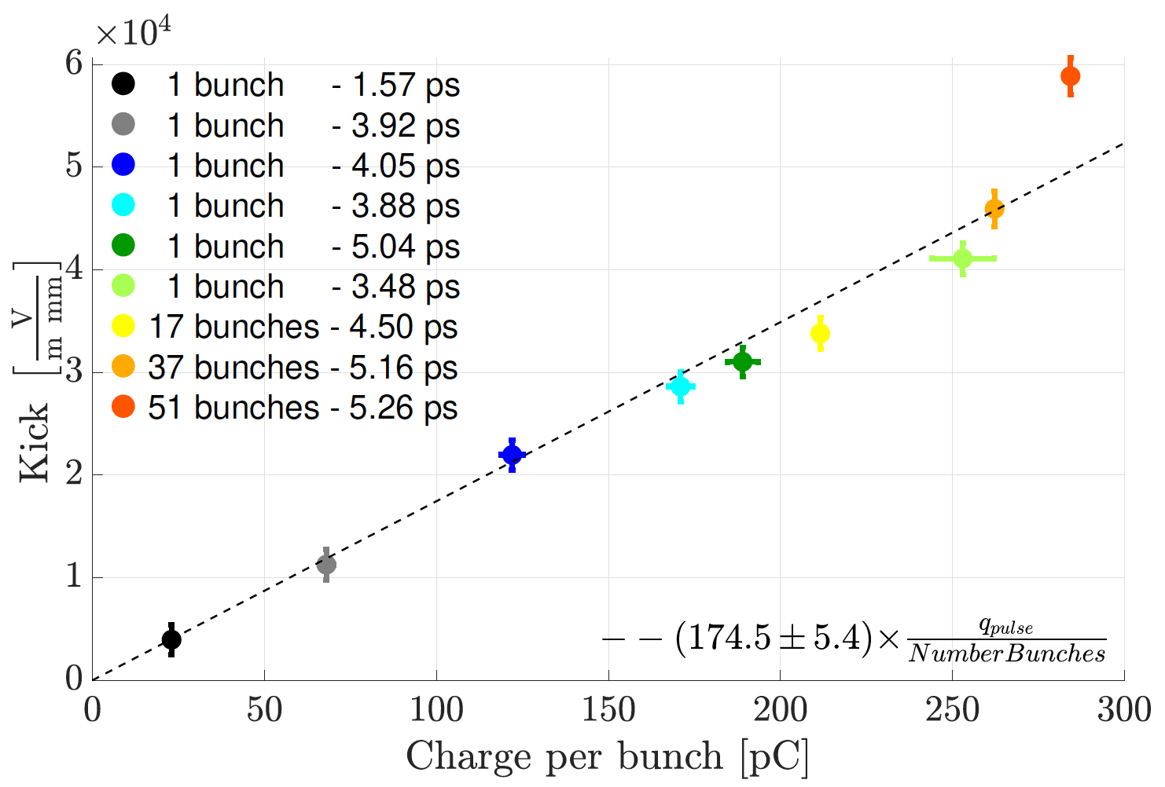
Wakefields study – Results
Dominant dipolar component
Linear dependence of the charge
- Single bunch
- Constant bunch length (4 ps)
Slope =1
Under the assumption of:
Dominant dipolar component
Linear dependence of the charge
Mixed number of bunches
Antonio Gilardi
Notes:
Plotting the results versus the charge per pulse and the charge per bunch; it is evident that there is a linear correlation with the charge per bunch.
This is clear indications that

Slide 28
Wakefields study – Results
Dominant dipolar component
Linear dependence of the charge
- Single bunch
- Constant bunch length (4 ps)
Slope =1
Under the assumption of:
Dominant dipolar component
Linear dependence of the charge
Mixed number of bunches
Dominated by short range wakefield
Antonio Gilardi
Notes:
we are dominated by the short range wakefield.

Slide 29
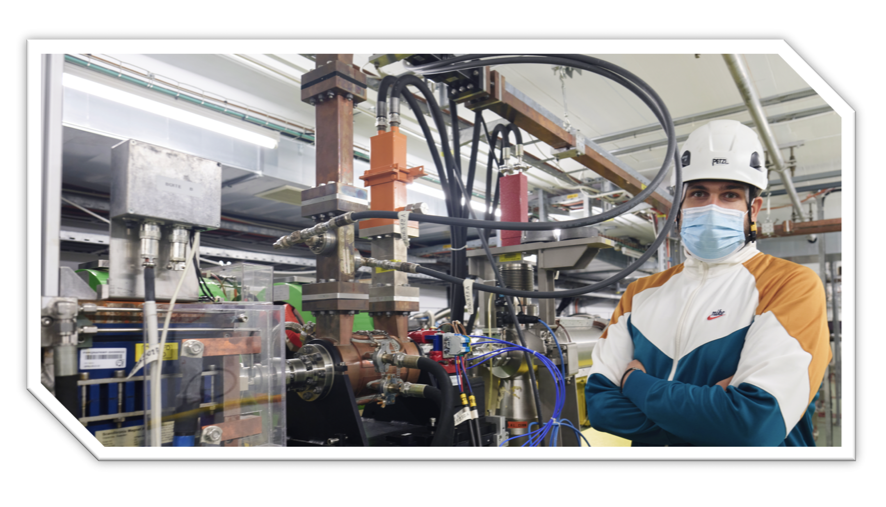
Outline
CLEAR (CERN Linear Electron Accelerator for Research)
Wakefields study
Background
Problem
Proposal
Results
Bunch length study
Background
Problem
Proposal
Results
Conclusions
Antonio Gilardi
Notes:
This is my outline, I will firstly give a brief introduction of CLEAR, the accelerator where I performed the whole activities.
Following; I will talk of the wakefield measurements carried our; about this topic I will briefly introduce a background then present the problem, the proposal and finally the results.
From the well-known picture on the side representing the overview of the CERN complex, you can already spot the CLEAR accelerator. It has the unique pecularity of being an indipendent LINAC.

Slide 30
Bunch length study – Background
Antonio Gilardi

Slide 31
Bunch length study – Background
Antonio Gilardi

Slide 32
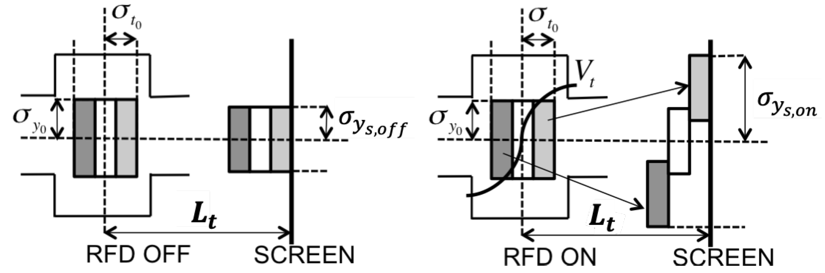
Bunch length study – Background
Antonio Gilardi

Slide 33
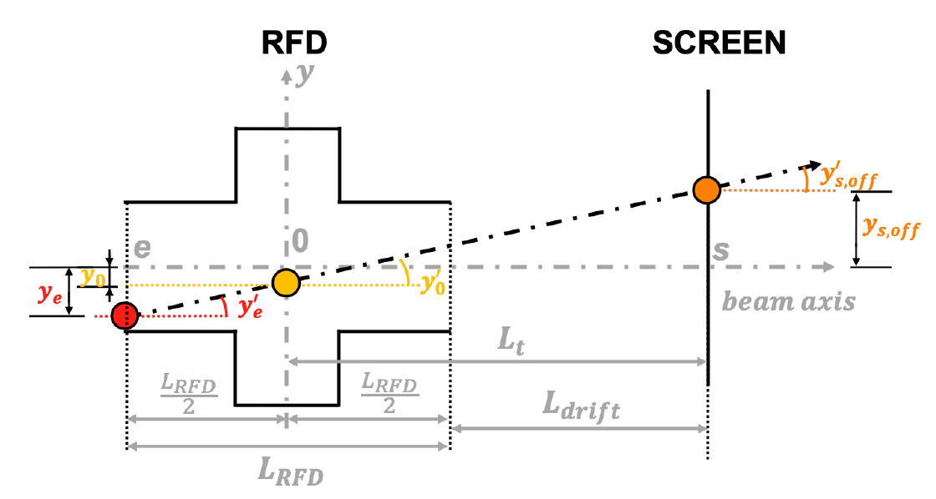
Bunch length study – Background
Antonio Gilardi

Slide 34



Bunch length study – Background
Spot size at the RFD center
Divergence at the RFD center
Correlations between spot size and.
divergence at the RFD center
Antonio Gilardi

Slide 35
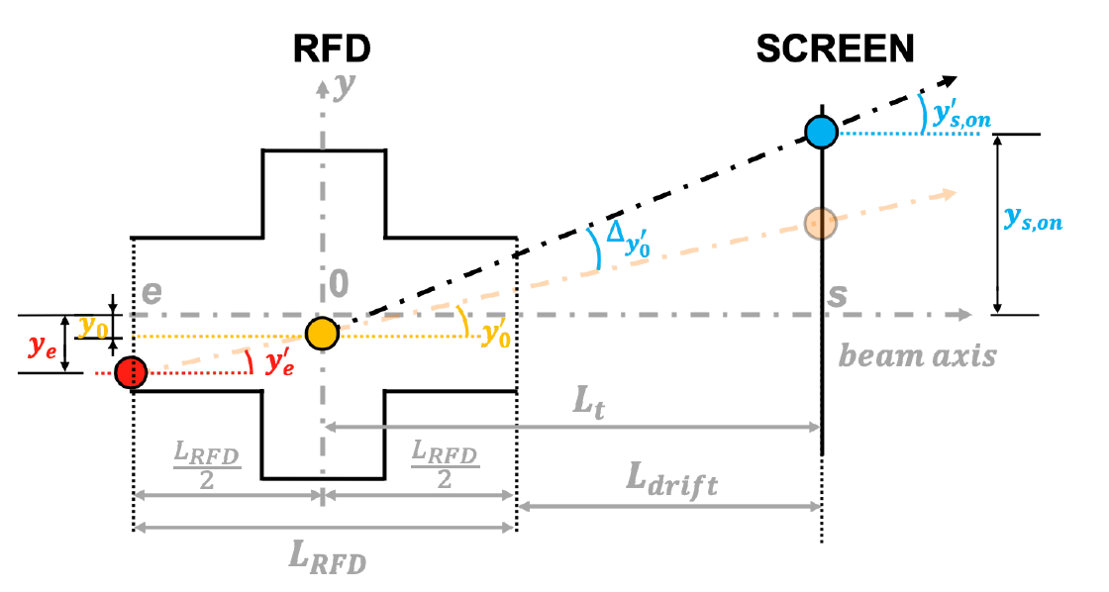
Bunch length study – Background
Antonio Gilardi

Slide 36




Bunch length study – Background
Neglecting the energy spread and energy chirp (correlations between energy and time) contributions.
Bunch length
Calibration factors related with RFD characteristics
Correlation between longitudinal and transverse particle position at the RFD center
Correlation between transverse divergence and longitudinal position at the RFD center
Antonio Gilardi

Slide 37
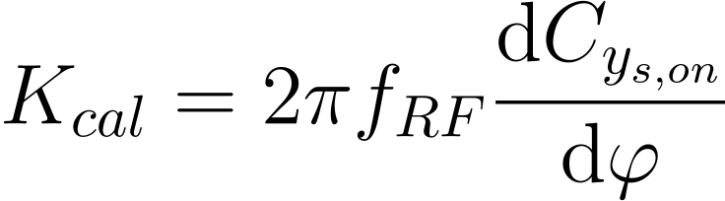



Bunch length study – Background
Main properties
, and are the RFD frequency, and phase respectively
1.
beam centroid ad the screen
The measurement is self-calibrated
Antonio Gilardi

Slide 38

Bunch length study – Background
Main properties
, and are the RFD frequency, and phase respectively
1.
beam centroid ad the screen
The measurement is self-calibrated
2.
RFD
Cancel the correlations between longitudinal position and transverse position/divergence
$$φ=0^{°}$$
ON
SCREEN
Antonio Gilardi

Slide 39

Bunch length study – Background
Main properties
, and are the RFD frequency, and phase respectively
1.
beam centroid ad the screen
The measurement is self-calibrated
RFD
2.
Cancel the correlations between longitudinal position and transverse position/divergence
$$φ={180}^{°}$$
ON
SCREEN
Antonio Gilardi

Slide 40
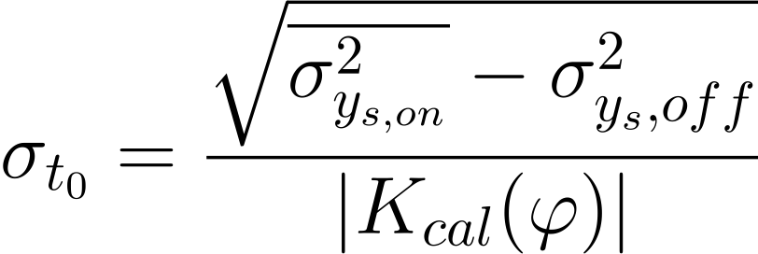
Bunch length study – Background
Main properties
, and are the RFD frequency, and phase respectively
1.
beam centroid ad the screen
The measurement is self-calibrated
RFD
2.
Cancel the correlations between longitudinal position and transverse position/divergence
$$φ={180}^{°}$$
ON
SCREEN
Antonio Gilardi

Slide 41
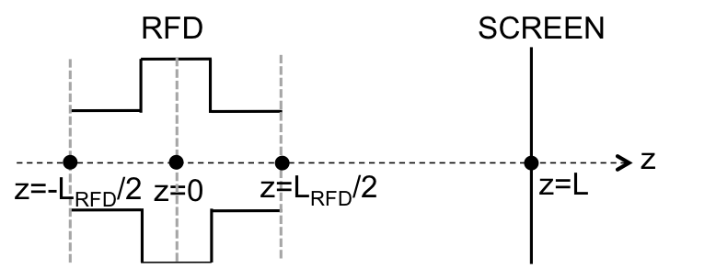


Bunch length study – Problem
1. Energy spread and Energy chirp
$$beam$$
$$axis$$
Antonio Gilardi
Notes:
The whole wakefield study is carried out on the latest baseline prototype of accelerating structure for the future compact linear collider.
This structure presents several challenging parameters, starting from the accelerating gradient, that is 100MV/m and just to give a number to compare with, it is about 4 times the gradient of the accelerating structure currently installed in CLEAR.
In addition, the pipe aperture goes down to a 2mm.

Slide 42



Bunch length study – Problem
1. Energy spread and Energy chirp
2. Correlations between longitudinal position and transverse position/divergence
$$beam$$
$$axis$$
$$beam$$
$$axis$$
$$beam$$
$$axis$$
Antonio Gilardi
Notes:
The whole wakefield study is carried out on the latest baseline prototype of accelerating structure for the future compact linear collider.
This structure presents several challenging parameters, starting from the accelerating gradient, that is 100MV/m and just to give a number to compare with, it is about 4 times the gradient of the accelerating structure currently installed in CLEAR.
In addition, the pipe aperture goes down to a 2mm.

Slide 43
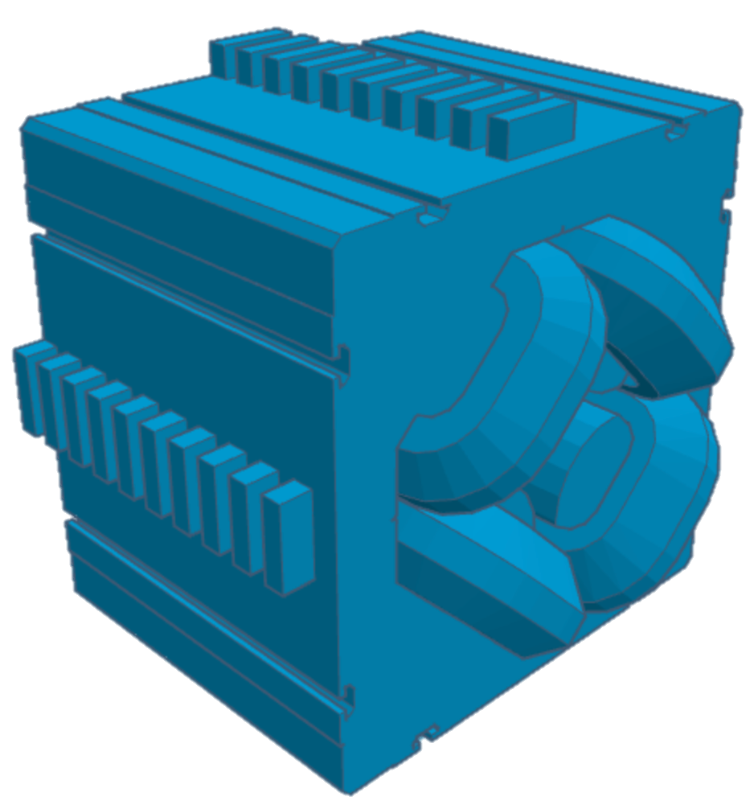
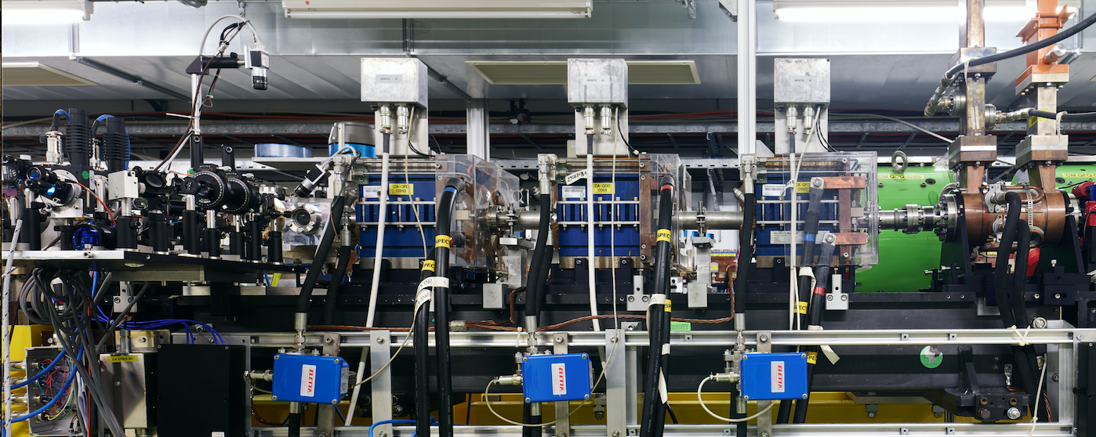
Bunch length study – Problem
1. Energy spread and Energy chirp
2. Correlations between longitudinal position and transverse position/divergence
$$beam$$
$$axis$$
$$beam$$
$$axis$$
$$beam$$
$$axis$$
3. Elements between the RFD and the screen
Conventional
QUADRUPOLES
Non-conventional
SCREEN
RFD
Antonio Gilardi
Notes:
The whole wakefield study is carried out on the latest baseline prototype of accelerating structure for the future compact linear collider.
This structure presents several challenging parameters, starting from the accelerating gradient, that is 100MV/m and just to give a number to compare with, it is about 4 times the gradient of the accelerating structure currently installed in CLEAR.
In addition, the pipe aperture goes down to a 2mm.

Slide 44
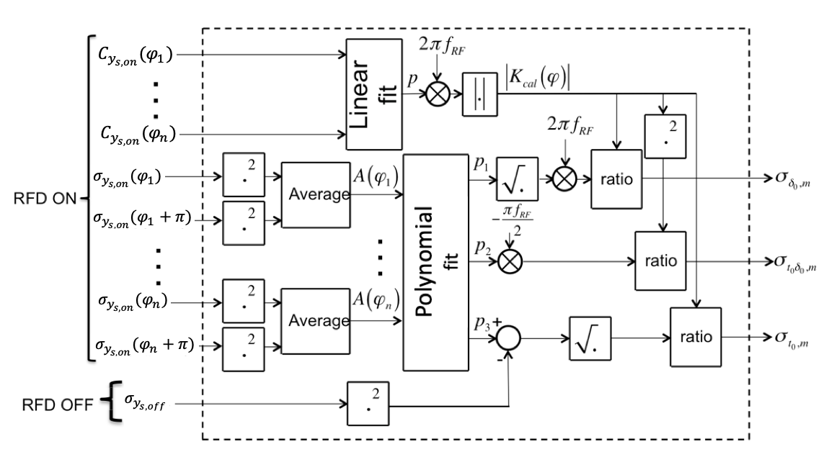
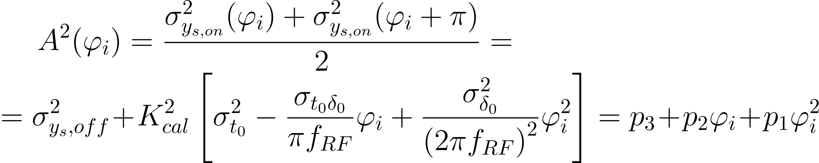
Bunch length study – Results 1
1. Energy spread and Energy chirp
Developed an analytical model to include these effects
Antonio Gilardi
Notes:
Regarding the energy chirp and spread, I developed a new model for performing the measurements including this effects and measuring them using a polynomial fit.
This approach was tested in simulations using FEL and Plasma beam like parameters obtaining a good agreement.

Slide 45
Bunch length study – Results 1
1. Energy spread and Energy chirp
Developed an analytical model to include these effects
FEL
PLASMA
Antonio Gilardi
Notes:
Regarding the energy chirp and spread, I developed a new model for performing the measurements including this effects and measuring them using a polynomial fit.
This approach was tested in simulations using FEL and Plasma beam like parameters obtaining a good agreement.

Slide 46
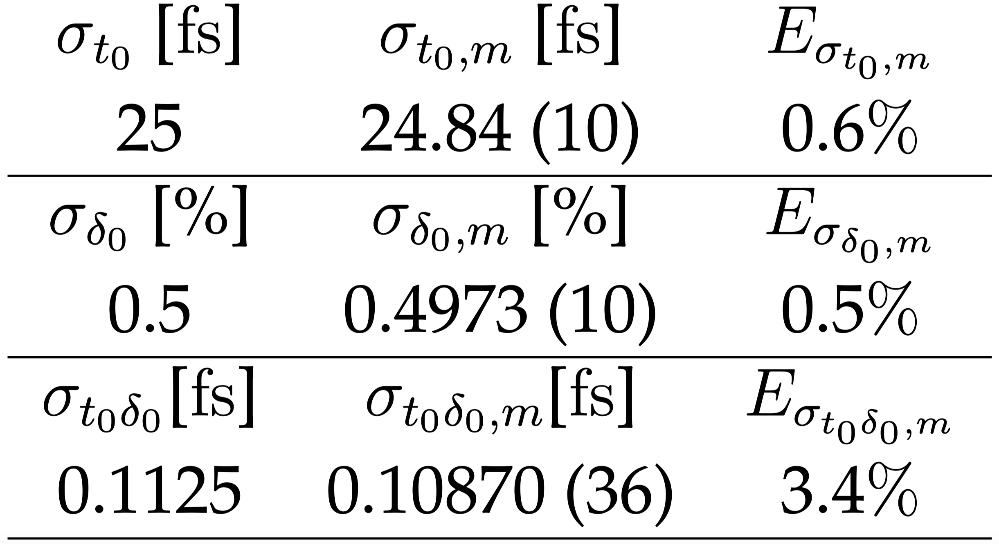
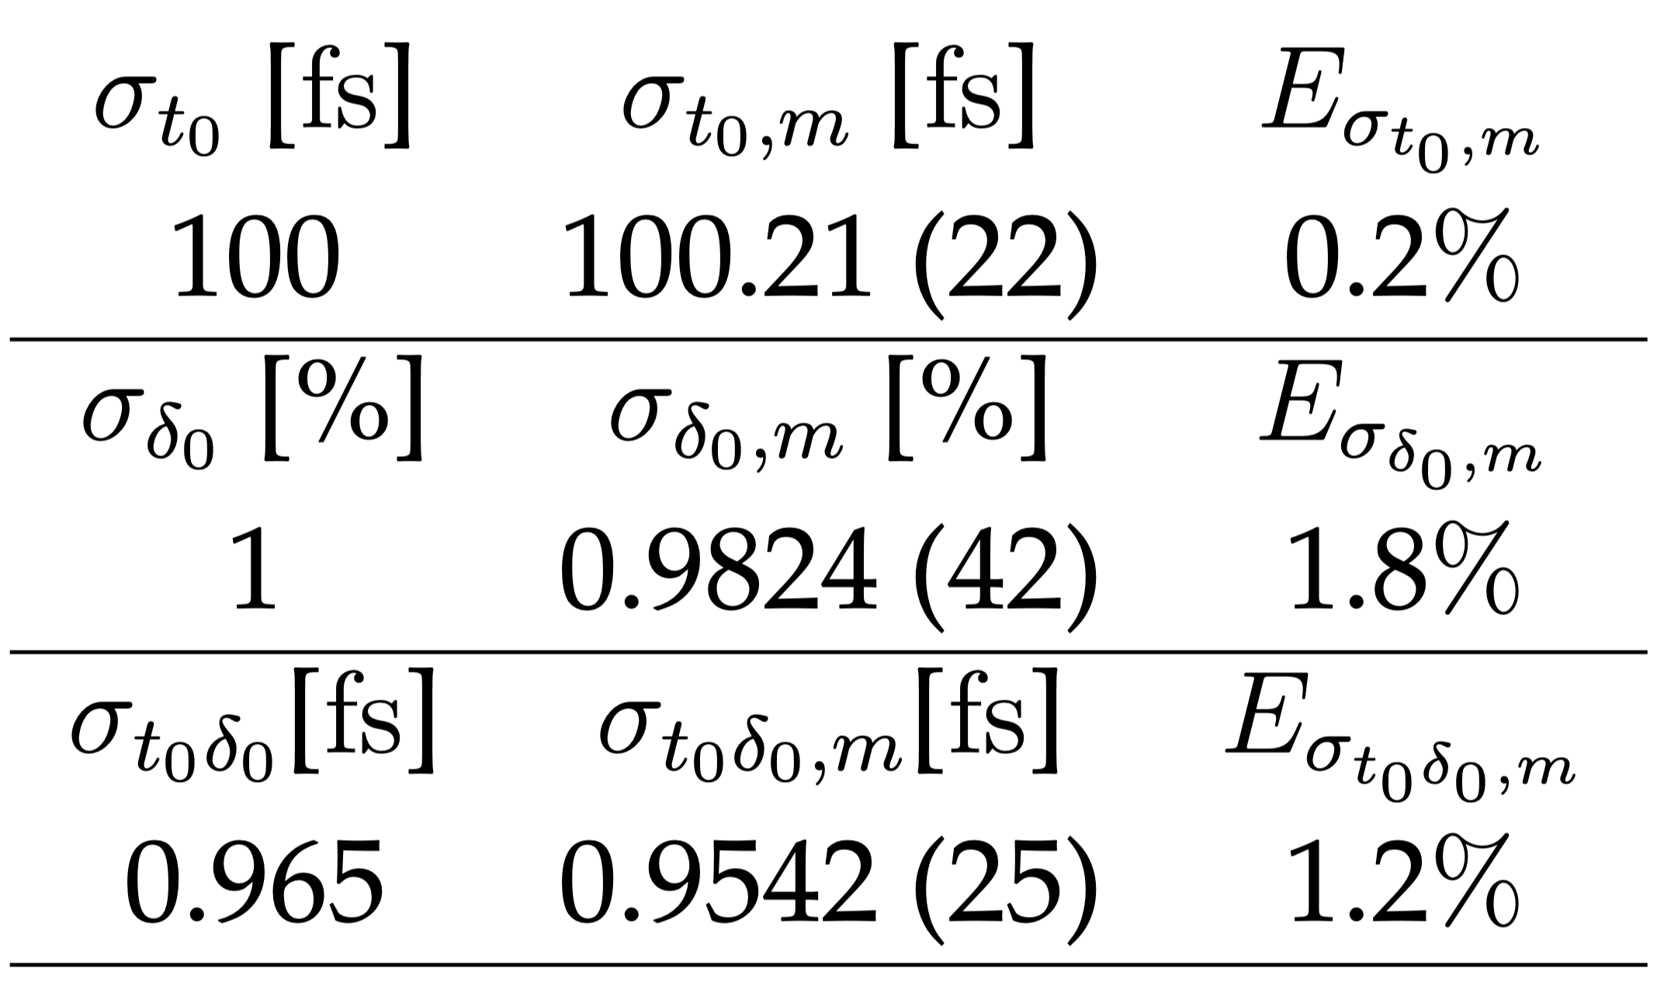
Bunch length study – Results 1
1. Energy spread and Energy chirp
Developed an analytical model to include these effects
FEL
PLASMA
Simulation results
Antonio Gilardi
Notes:
Regarding the energy chirp and spread, I developed a new model for performing the measurements including this effects and measuring them using a polynomial fit.
This approach was tested in simulations using FEL and Plasma beam like parameters obtaining a good agreement.

Slide 47
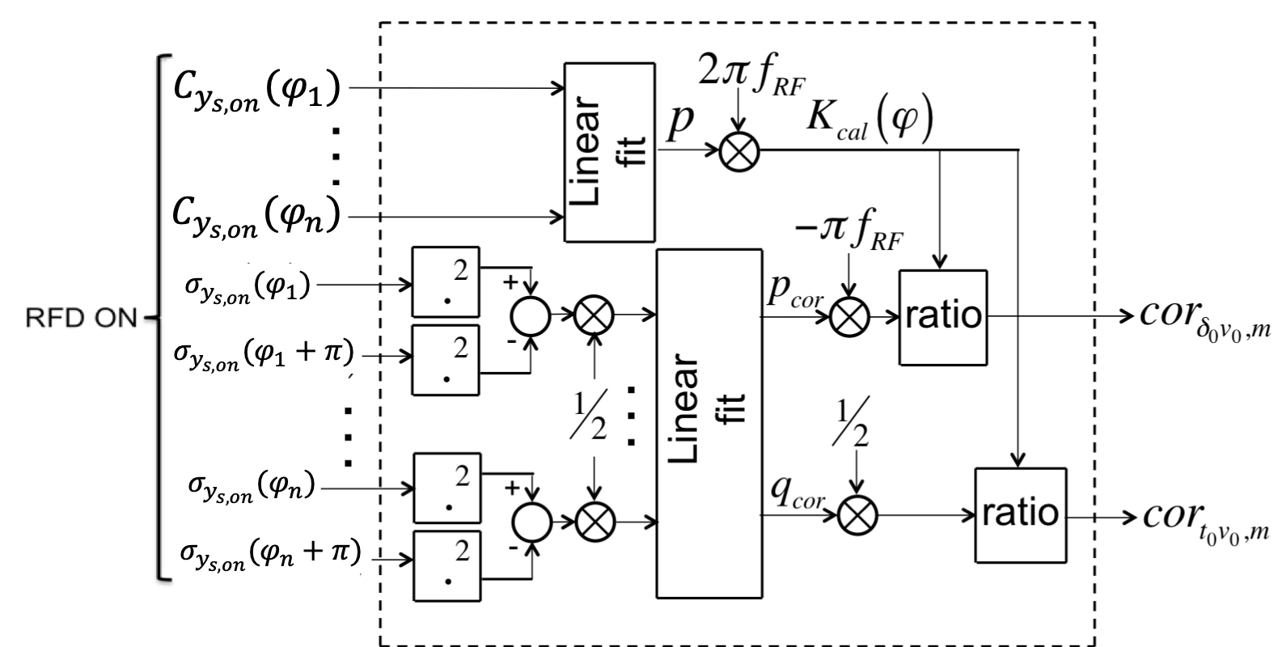
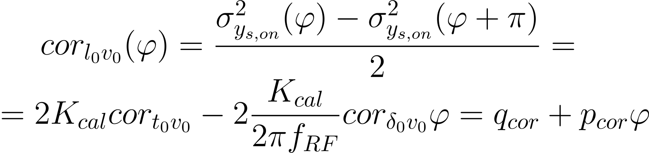


Bunch length study – Results 2
2. Correlations between longitudinal position and transverse position/divergence
Developed an analytical model to include these effects
FEL
PLASMA
Antonio Gilardi
Notes:
Similarly for the correlations, I developed a new measurement model that allows to retrieve information on this numbers.
Also this was tested using tracking simulations but this time we used realistic start to end simulation of the GBS LINAC operational at the the ELI-NP .
Also in this case really good results were obtained.

Slide 48
Bunch length study – Results 2
2. Correlations between longitudinal position and transverse position/divergence
Developed an analytical model to include these effects
FEL
PLASMA
Start2End simulations of a Compton source
Antonio Gilardi
Notes:
Similarly for the correlations, I developed a new measurement model that allows to retrieve information on this numbers.
Also this was tested using tracking simulations but this time we used realistic start to end simulation of the GBS LINAC operational at the the ELI-NP .
Also in this case really good results were obtained.

Slide 49
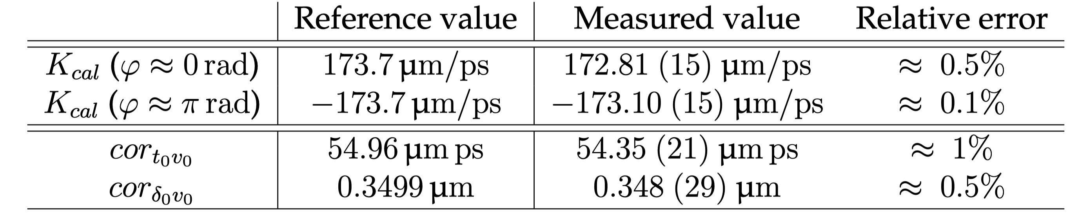
Bunch length study – Results 2
2. Correlations between longitudinal position and transverse position/divergence
Developed an analytical model to include these effects
FEL
PLASMA
Start2End simulations of a Compton source
Simulation results
Antonio Gilardi
Notes:
Similarly for the correlations, I developed a new measurement model that allows to retrieve information on this numbers.
Also this was tested using tracking simulations but this time we used realistic start to end simulation of the GBS LINAC operational at the the ELI-NP .
Also in this case really good results were obtained.

Slide 50
Bunch length study – Results 3
3. Elements between the RFD and the screen
I. Measurement validity assessment. II. Resolution performance. III. Uncertainty performance.
Antonio Gilardi
Notes:
The whole wakefield study is carried out on the latest baseline prototype of accelerating structure for the future compact linear collider.
This structure presents several challenging parameters, starting from the accelerating gradient, that is 100MV/m and just to give a number to compare with, it is about 4 times the gradient of the accelerating structure currently installed in CLEAR.
In addition, the pipe aperture goes down to a 2mm.

Slide 51
Bunch length study – Results 3
3. Elements between the RFD and the screen
I. Measurement validity assessment. II. Resolution performance. III. Uncertainty performance.
Antonio Gilardi
Notes:
The whole wakefield study is carried out on the latest baseline prototype of accelerating structure for the future compact linear collider.
This structure presents several challenging parameters, starting from the accelerating gradient, that is 100MV/m and just to give a number to compare with, it is about 4 times the gradient of the accelerating structure currently installed in CLEAR.
In addition, the pipe aperture goes down to a 2mm.

Slide 52
Bunch length study – Results 3
3. Elements between the RFD and the screen
I. Measurement validity assessment. II. Resolution performance. III. Uncertainty performance.
Good agreement between simulations with tracking code (ELEGANT) and theoretical derivation.
The feature of self-calibration is preserved
Possibility of removing the correlations between longitudinal position and transverse position/divergence
Same procedure for assessing the bunch length
Antonio Gilardi
Notes:
The whole wakefield study is carried out on the latest baseline prototype of accelerating structure for the future compact linear collider.
This structure presents several challenging parameters, starting from the accelerating gradient, that is 100MV/m and just to give a number to compare with, it is about 4 times the gradient of the accelerating structure currently installed in CLEAR.
In addition, the pipe aperture goes down to a 2mm.

Slide 53

Bunch length study – Results 3
3. Elements between the RFD and the screen
I. Measurement validity assessment. II. Resolution performance. III. Uncertainty performance.
Good agreement between simulations with tracking code (ELEGANT) and theoretical derivation.
The simulation results were verified versus actual measurement campaigns.
The feature of self-calibration is preserved
Possibility of removing the correlations between longitudinal position and transverse position/divergence
Same procedure for assessing the bunch length
Antonio Gilardi
Notes:
The whole wakefield study is carried out on the latest baseline prototype of accelerating structure for the future compact linear collider.
This structure presents several challenging parameters, starting from the accelerating gradient, that is 100MV/m and just to give a number to compare with, it is about 4 times the gradient of the accelerating structure currently installed in CLEAR.
In addition, the pipe aperture goes down to a 2mm.

Slide 54
Bunch length study – Results 3
3. Elements between the RFD and the screen
I. Measurement validity assessment. II. Resolution performance. III. Uncertainty performance.
Antonio Gilardi
Notes:
The whole wakefield study is carried out on the latest baseline prototype of accelerating structure for the future compact linear collider.
This structure presents several challenging parameters, starting from the accelerating gradient, that is 100MV/m and just to give a number to compare with, it is about 4 times the gradient of the accelerating structure currently installed in CLEAR.
In addition, the pipe aperture goes down to a 2mm.

Slide 55
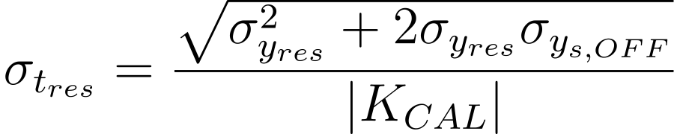
Bunch length study – Results 3
3. Elements between the RFD and the screen
I. Measurement validity assessment. II. Resolution performance. III. Uncertainty performance.
The smallest value of $σ_{y_{s,ON}}$, by definition, can be $σ_{y_{s,OFF}}+σ_{y_{res}}$
Where $σ_{y_{res}}$ is the so-called acquisition system resolution, determined by the imaging methodology (i.e., the screen technology, the camera used, and the measurement setup).
Antonio Gilardi
Notes:
The whole wakefield study is carried out on the latest baseline prototype of accelerating structure for the future compact linear collider.
This structure presents several challenging parameters, starting from the accelerating gradient, that is 100MV/m and just to give a number to compare with, it is about 4 times the gradient of the accelerating structure currently installed in CLEAR.
In addition, the pipe aperture goes down to a 2mm.

Slide 56
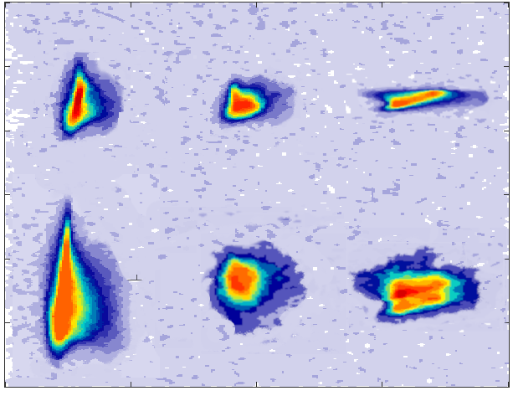



Bunch length study – Results 3
3. Elements between the RFD and the screen
I. Measurement validity assessment. II. Resolution performance. III. Uncertainty performance.
The smallest value of $σ_{y_{s,ON}}$, by definition, can be $σ_{y_{s,OFF}}+σ_{y_{res}}$
Where $σ_{y_{res}}$ is the so-called acquisition system resolution, determined by the imaging methodology (i.e., the screen technology, the camera used, and the measurement setup).
Simulations
Measurements
$$f<0$$
$$f=∞$$
$$f>0$$
Measurements
RFD OFF
Vertical axis [mm]
RFD ON
1mm
Horizontal axis [mm]
Antonio Gilardi
Notes:
The whole wakefield study is carried out on the latest baseline prototype of accelerating structure for the future compact linear collider.
This structure presents several challenging parameters, starting from the accelerating gradient, that is 100MV/m and just to give a number to compare with, it is about 4 times the gradient of the accelerating structure currently installed in CLEAR.
In addition, the pipe aperture goes down to a 2mm.

Slide 57
Bunch length study – Results 3
3. Elements between the RFD and the screen
I. Measurement validity assessment. II. Resolution performance. III. Uncertainty performance.
Antonio Gilardi
Notes:
The whole wakefield study is carried out on the latest baseline prototype of accelerating structure for the future compact linear collider.
This structure presents several challenging parameters, starting from the accelerating gradient, that is 100MV/m and just to give a number to compare with, it is about 4 times the gradient of the accelerating structure currently installed in CLEAR.
In addition, the pipe aperture goes down to a 2mm.

Slide 58
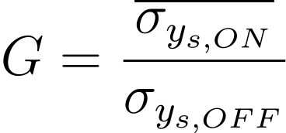
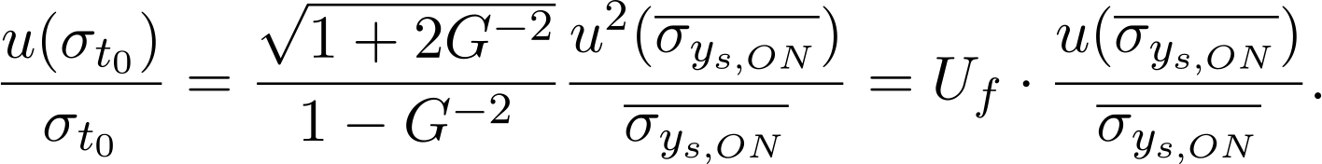
Bunch length study – Results 3
3. Elements between the RFD and the screen
I. Measurement validity assessment. II. Resolution performance. III. Uncertainty performance.
Using the uncertainty propagation on the bunch length formula, defining the G-factor as
The relative uncertainty on the bunch length can be written as:
Antonio Gilardi
Notes:
The whole wakefield study is carried out on the latest baseline prototype of accelerating structure for the future compact linear collider.
This structure presents several challenging parameters, starting from the accelerating gradient, that is 100MV/m and just to give a number to compare with, it is about 4 times the gradient of the accelerating structure currently installed in CLEAR.
In addition, the pipe aperture goes down to a 2mm.

Slide 59
Bunch length study – Results 3
3. Elements between the RFD and the screen
I. Measurement validity assessment. II. Resolution performance. III. Uncertainty performance.
Using the uncertainty propagation on the bunch length formula, defining the G-factor as
Without additional focusing element
The relative uncertainty on the bunch length can be written as:
The results were validated using tracking code simulations (ELEGANT) -- good agreement.
With focusing element
Antonio Gilardi
Notes:
The whole wakefield study is carried out on the latest baseline prototype of accelerating structure for the future compact linear collider.
This structure presents several challenging parameters, starting from the accelerating gradient, that is 100MV/m and just to give a number to compare with, it is about 4 times the gradient of the accelerating structure currently installed in CLEAR.
In addition, the pipe aperture goes down to a 2mm.

Slide 60
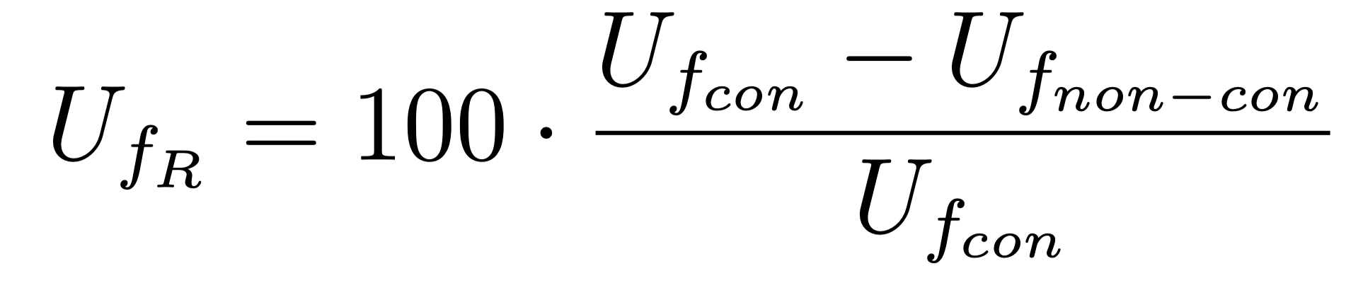
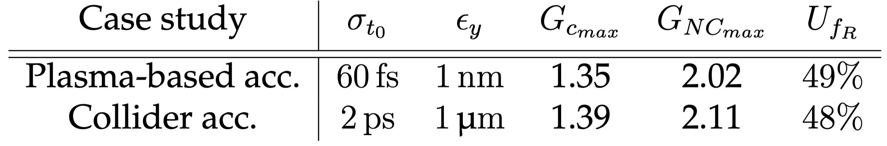
Bunch length study – Results 3
3. Elements between the RFD and the screen
I. Measurement validity assessment. II. Resolution performance. III. Uncertainty performance.
Using the uncertainty propagation on the bunch length formula, defining the G-factor as
Without additional focusing element
The relative uncertainty on the bunch length can be written as:
The results were validated using tracking code simulations (ELEGANT) -- good agreement.
With focusing element
Antonio Gilardi
Notes:
The whole wakefield study is carried out on the latest baseline prototype of accelerating structure for the future compact linear collider.
This structure presents several challenging parameters, starting from the accelerating gradient, that is 100MV/m and just to give a number to compare with, it is about 4 times the gradient of the accelerating structure currently installed in CLEAR.
In addition, the pipe aperture goes down to a 2mm.

Slide 61
Outline
CLEAR (CERN Linear Electron Accelerator for Research)
Wakefields measurements
Background
Problem
Proposal
Results
Bunch length study
Background
Problem
Proposal
Results
Conclusions
Antonio Gilardi
Notes:
This is my outline, I will firstly give a brief introduction of CLEAR, the accelerator where I performed the whole activities.
Following; I will talk of the wakefield measurements carried our; about this topic I will briefly introduce a background then present the problem, the proposal and finally the results.
From the well-known picture on the side representing the overview of the CERN complex, you can already spot the CLEAR accelerator. It has the unique pecularity of being an indipendent LINAC.

Slide 62
Conclusions
Wakefield
The proposed measurement method, which uses a beam screen, was validated; in both single bunch and multi bunch operation.
The assumption of the dominant dipolar component was demonstrated.
The assumption of linear dependence with the charge was demonstrated.
The wakefields affecting the CLIC structure were characterized and assessed. The results are consistent with what is expected from the analytical formulas.
Bunch length
A novel measurement procedure for investigating the correlations between longitudinal position and transverse position/divergence was developed.
A novel measurement procedure for investigating Energy spread and Energy chirp was developed.
The novel layout's validity, including the focusing element to perform the bunch length measurement, was assessed.
Really promising resolution and uncertainty enhancements were studied.
Antonio Gilardi
Notes:
This bring me to the conclusions:…..

Slide 63
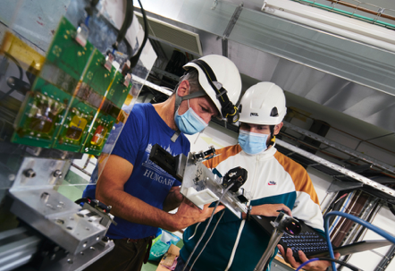
Thanks for your attention
Antonio Gilardi

Slide 64
Backup slides

Slide 65
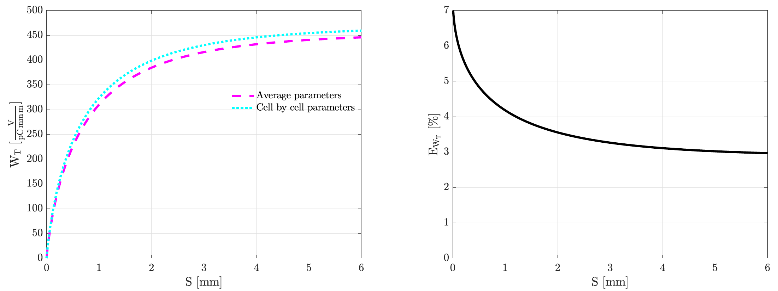
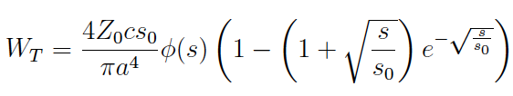

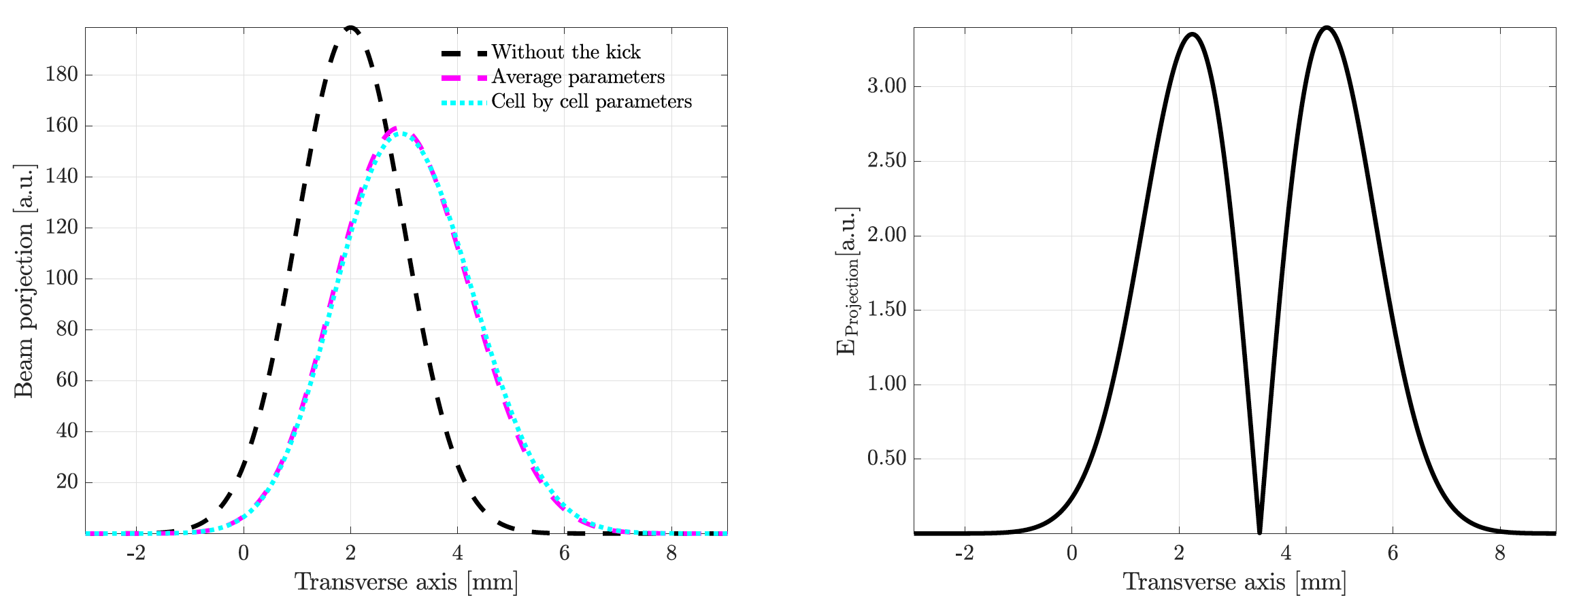
Wakefields - Simulations
Notes:
Following experimental campaign were carried our with single bunch with constant bunch length.

Slide 66
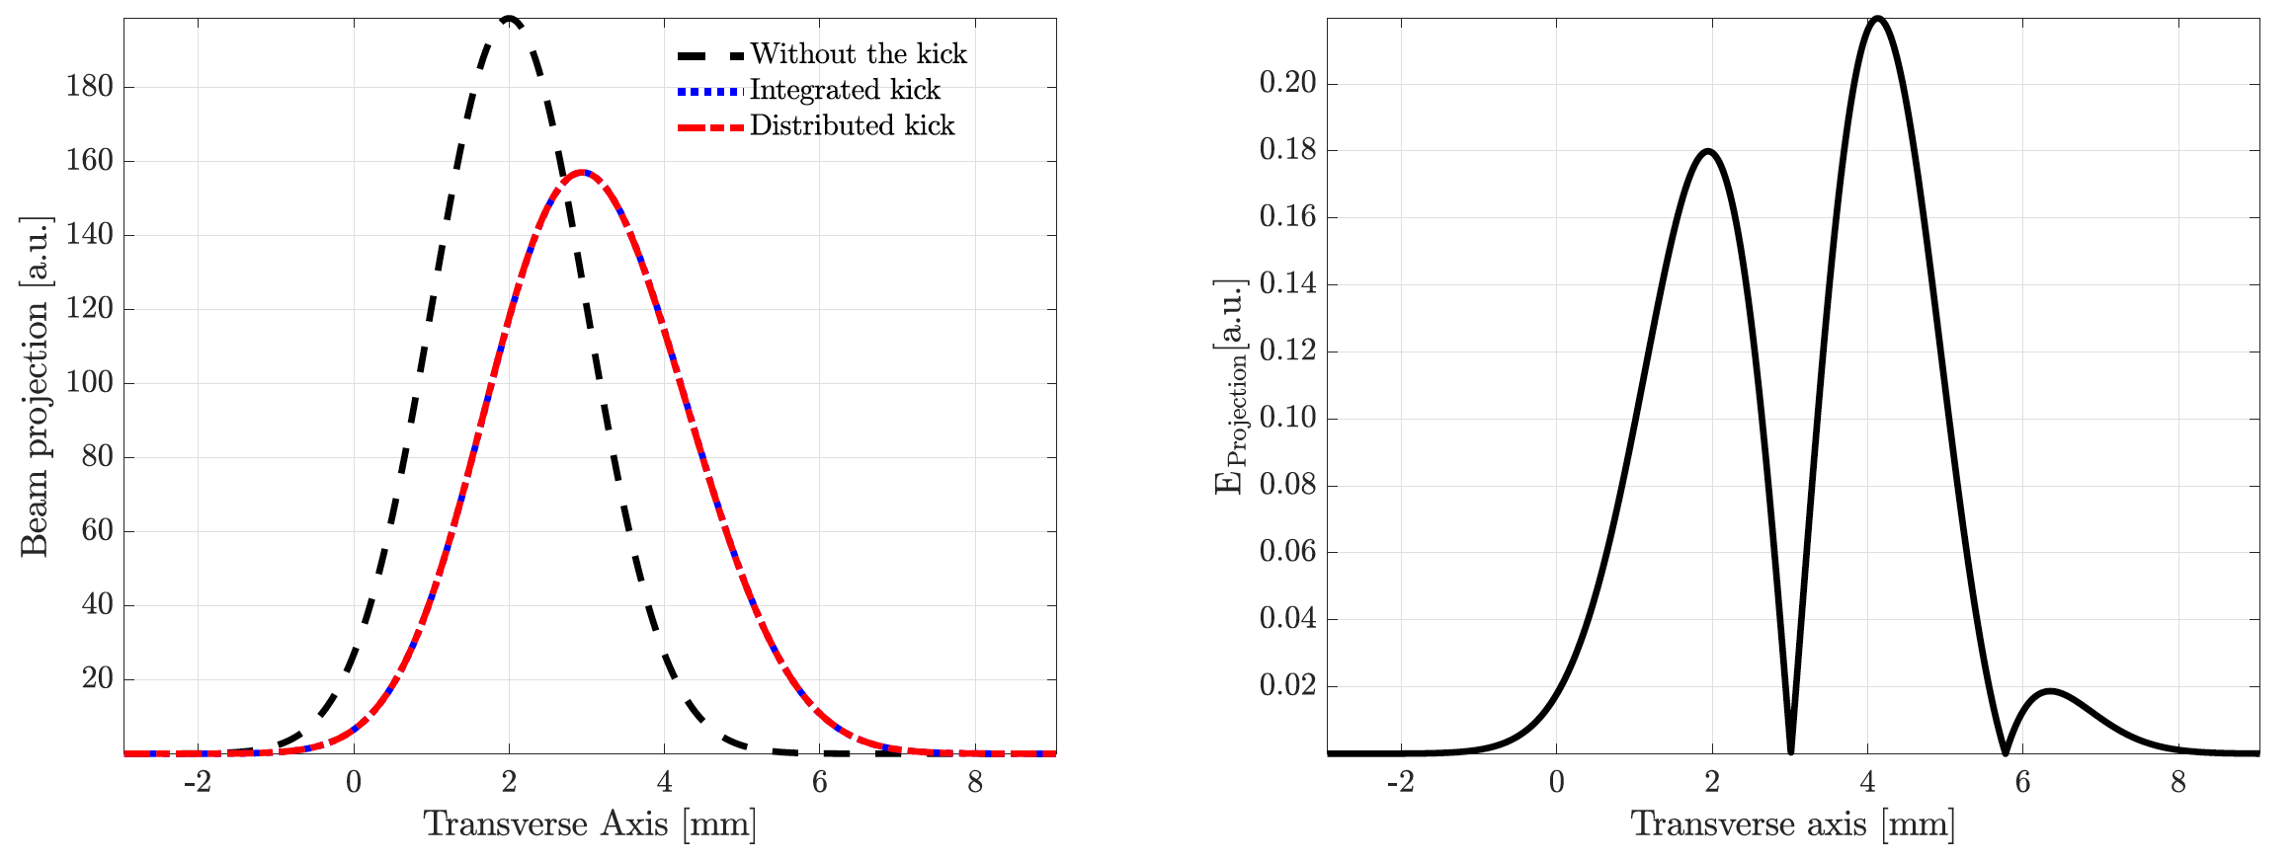
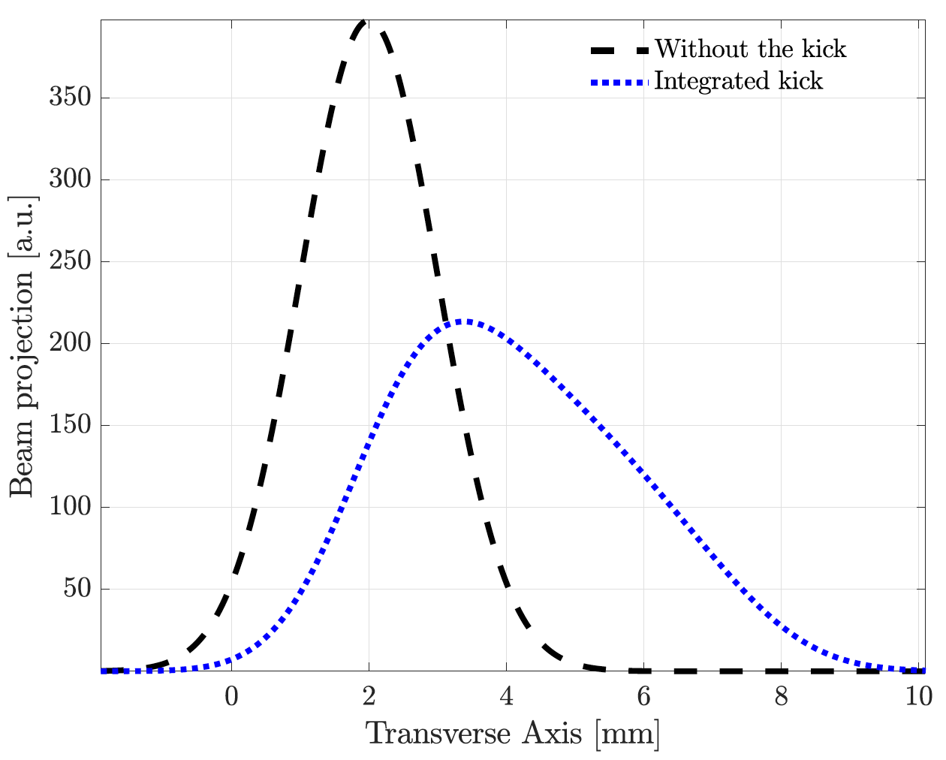
Wakefields - Results
Offset = 1 mm
Bunch Length = 4 ps
Charge = 500 pC
Offset = 1 mm
Bunch Length = 4 ps
Charge = 1nC
Notes:
Following experimental campaign were carried our with single bunch with constant bunch length.

Slide 67
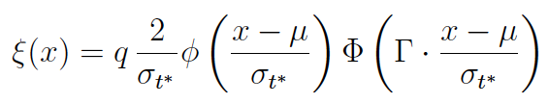
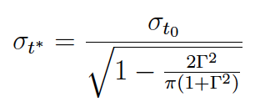
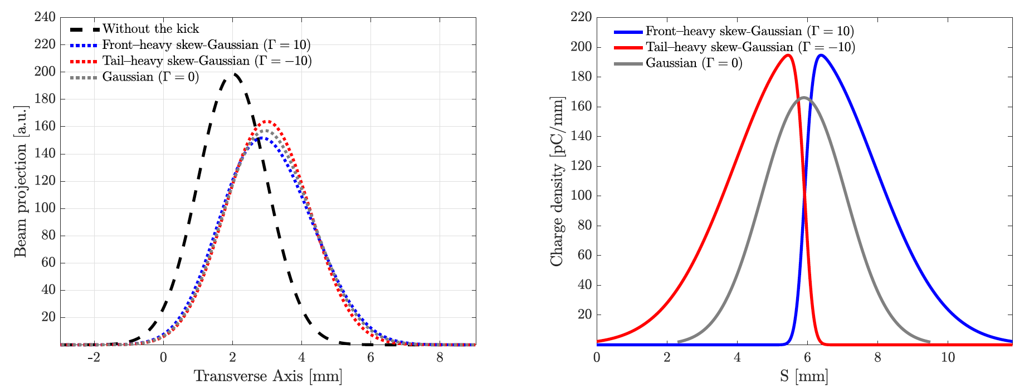
Wakefields - Results
Notes:
Following experimental campaign were carried our with single bunch with constant bunch length.

Slide 68
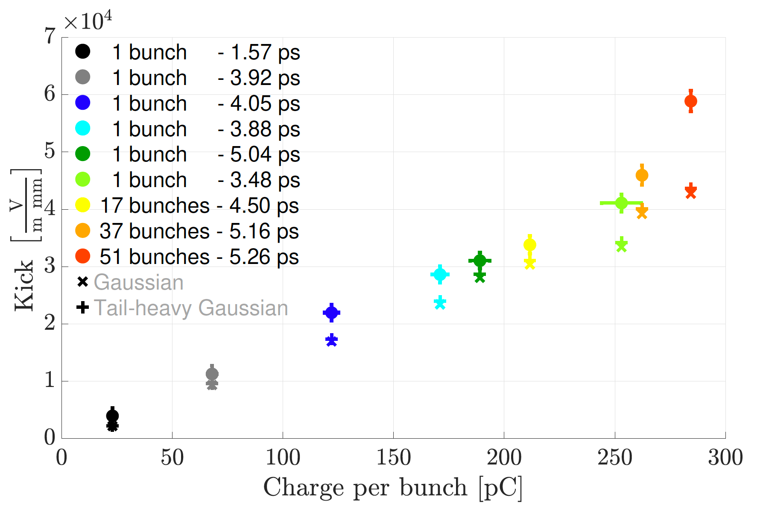

Wakefields - Results
Notes:
we are dominated by the short range wakefield.

Slide 69
Wakefields - Results
Beam screen
Beam screen
CLIC accelerating structure
H/V Corrector magnets
Girder
Ideal trajectory
Beam
Real trajectory
Horizontal
Vertical
Screen before the accelerating structure
4 lines
Projection of the integrated beam image over 10 acquisitions.
Projection of the beam image computed shot by shot and then averaged.
Gaussian fit of the integrated beam image over 10 acquisitions.
Gaussian fit of the beam image computed shot by shot and then averaged.
Screen after the accelerating structure
Calibration of bump accuracy about 1%
Notes:
the presence of 4 lines that indeicate the 4 different ways used for assessing the centroids.
The four different strageies are used in order to take into account the possibilities of non-gaussian beam and at the same time to have additional information on the reproducibility.
The results show a good accuracy and reproducibility in both plane.

Slide 70
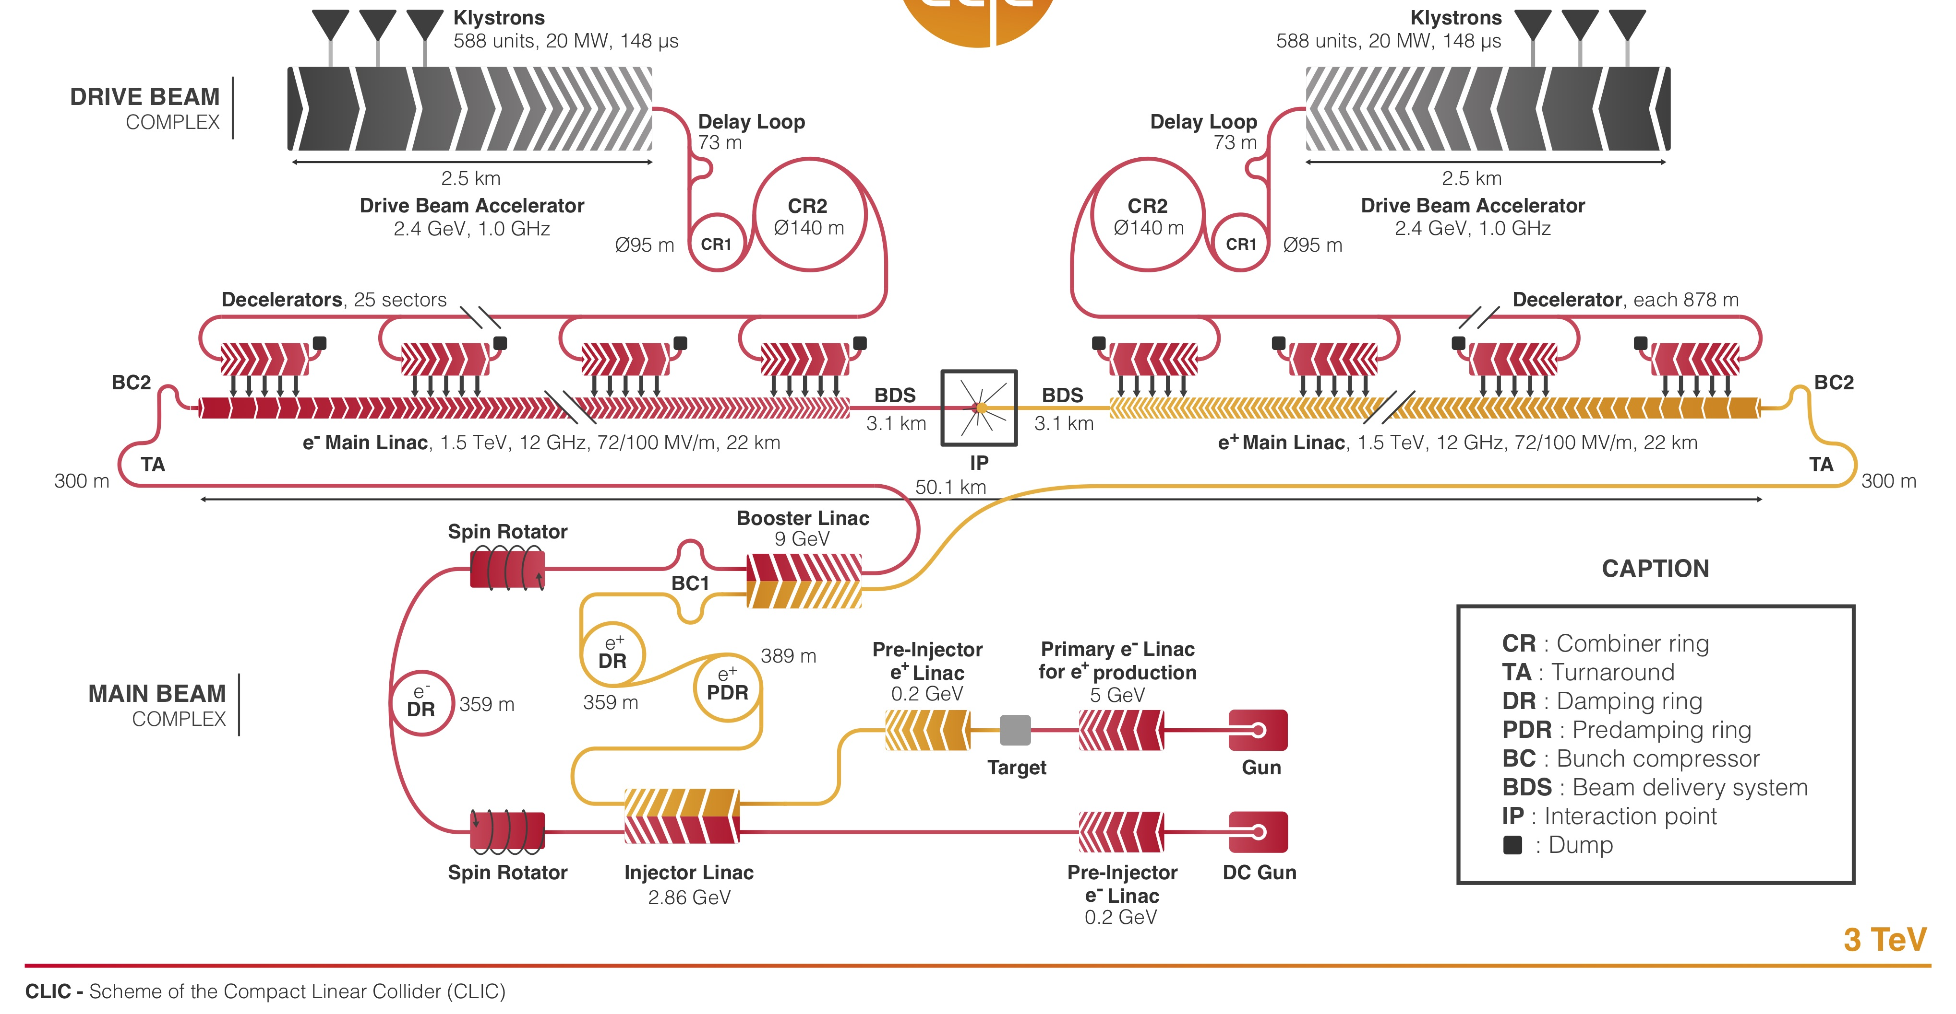
Innovative concept of two different beam
Probe beam:
Feed RF power in the ACcelerating Structure (ACS)
Test beam:
To carry out experiment!

Slide 71
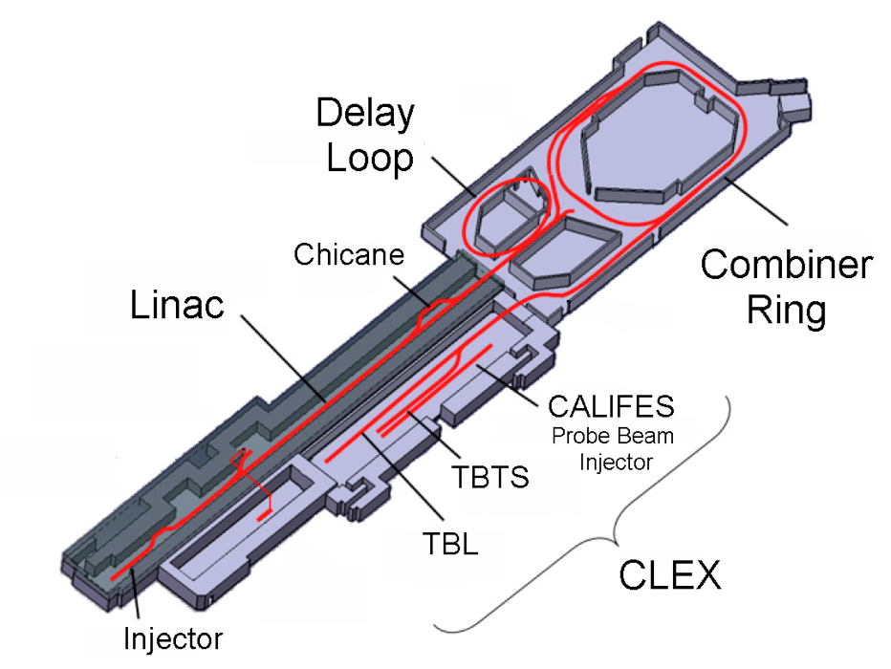
CTF3 has addressed and solved the vast majority of CLIC issues related to drive beam generation, power production and two-beam acceleration.
A new machine is needed (CLEAR) to maintain local testing capability at CERN for CLIC instrumentation and high-gradient structure testing with beam (alongside with other non-CLIC activities).
First beam – June 2003
Last beam – December 2016

Slide 72
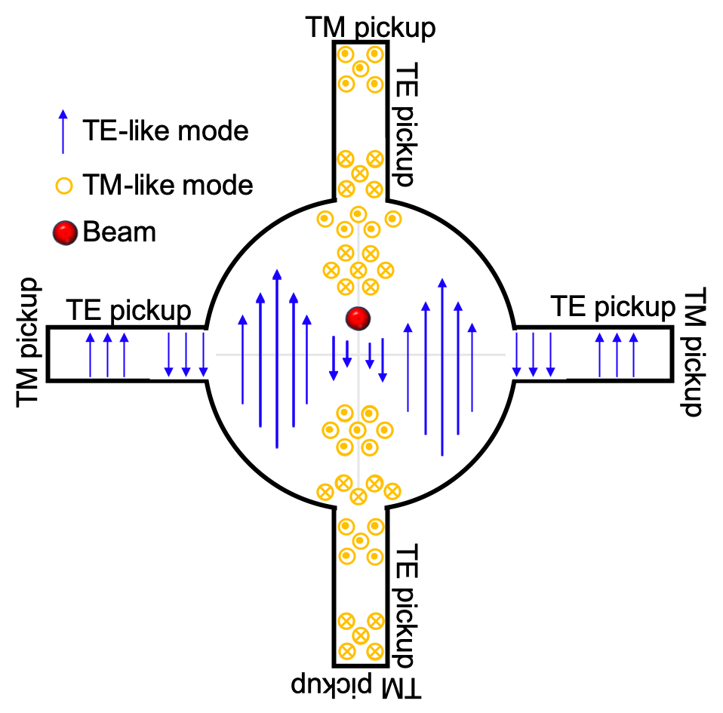



Wakefields study - WFM
WakeFieldMonitor operating principle
WakeFieldMonitor setup
Preliminary results performed at different charge to assess the electric center of the structure.
Log detector signals
Previous research experience – Antonio Gilardi
Notes:
In collaboration with the University of Oslo, I also developed further the WFM. Just as an introduction, the operating principle is straight forward. In the first accelerating cell of the second structure of the superstructure there are 8 sensing antennas to pick a TM and TE like modes that then are transferred into dome hybrids and after a filtering and a limiters stage are acquired from a log detector.
On this topic, firstly I realize that there was an issues with length matching cabling. So firstly I spent a bit of time to refurbish the experimental setup then a full characterization of the transfer line was developed and and this allows us to calibrate the response of the log detector.
Recent results are showing that this device is starting to be operational and there are we are confident that in the future it can be used for absolute electrical center identification

Slide 73

N = 10 M = 15

Slide 74
H-Mover
1
H-Mover
2
CLIC ACCELERATING STRUCTURE
CLIC STRUCTURE
BEAM
GIRDER
Move the structure
V-Left-Mover
1
V-Left-Mover
2
CLIC accelerating structure
Beam screen
GIRDER
V-Right-Mover
2
Ideal trajectory
V-Right-Mover
1
BEAM
Real trajectory
Mechanical constraints impose a correlation while moving.
Notes:
The first one relies on the movimentation of the whole accelerating structure that is positioned on a movable girder.
Unfortunately, during an experimental campaign to verify the system, it was found that while imposing a vertical movement the structure after a certain region was moving with an angle also in horizontal.
As a consequence this method was not used.

Slide 75
- Single bunch
- Constant bunch length (4 ps)
Dominant dipolar component
Linear dependence of the charge
Under the assumption of:
Dominant dipolar component
Linear dependence of the charge
Dominant dipolar component
- Multi bunch (20 bunches)
- Different bunch length
Linear dependence of the charge
Notes:
For this reason, several simulations campaign were carried out in order to compensate the impact of the different bunch length.
The result, correcting for the bunch length shows a better linearity.

Slide 76

Dominant dipolar component
- Single bunch
- Constant bunch length (4 ps)
Linear dependence of the charge
Under the assumption of:
Dominant dipolar component
Linear dependence of the charge
Dominant dipolar component
- Multi bunch (20 bunches)
- Different bunch length
Linear dependence of the charge
Linear dependence of the charge
Notes:
For this reason, several simulations campaign were carried out in order to compensate the impact of the different bunch length.
The result, correcting for the bunch length shows a better linearity.

Slide 77



Slide 78





