Slide 1



Progress of the HL-LHC CCT magnets in China
IHEP, IMP, BAMA
China
HL-LHC WP3 meeting – April 27 2021

Slide 2
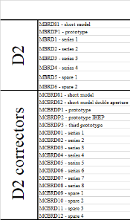
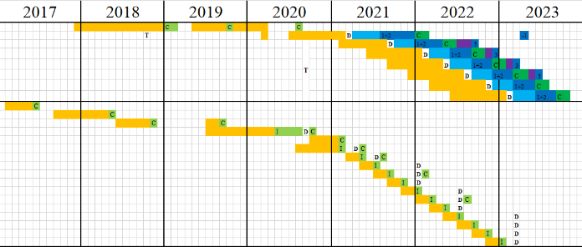
Present Schedule
The unexpected performance of 01-Aperture 2 (very slow training, limited to ~300 A at 4 K), and the change of yoke keys from hybrid to Stainless steel, caused 2-3 months delay of the schedule.
Assembly of the 1st series magnet to be completed by early May 2021, with 01-Aperture 1 (dry wind plus 5bar VPI) and practice coil (wet wind plus 5bar VPI).
Fabrication of the coils for the 2nd series magnet has been started with New VPI procedure (wet wind plus 5bar VPI).
2-3 months delay

Slide 3
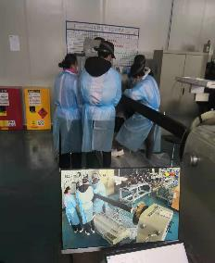
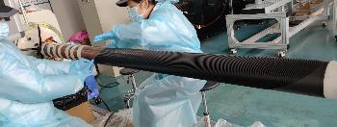

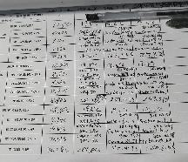
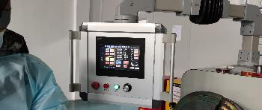
March 1, 2021
Started 02-Aperture 1 coil winding with wet winding process
Testing viscosity of the CTD-101K
to optimize parameters for wet winding process

Slide 4
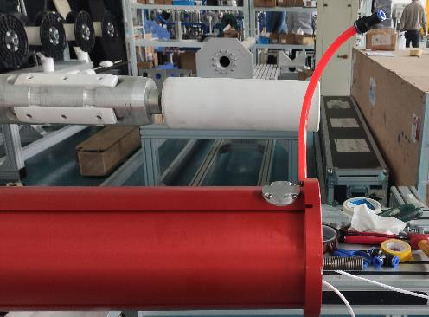
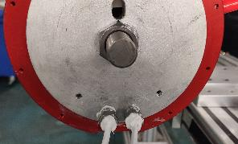
March 15 -18, 2021
Making joints, assembling outer cylinder.

Slide 5
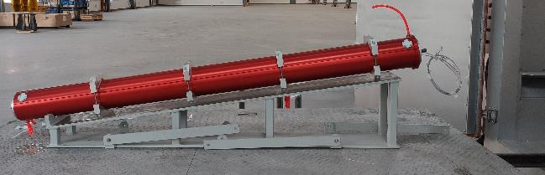
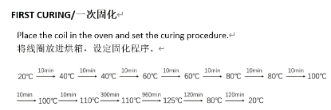
March 22-29, 2021
Finished first curing
5 bar VPI delayed due to the
Problem of the furnace pump,
to be carried out soon.

Slide 6
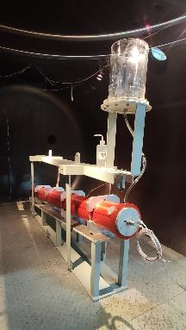
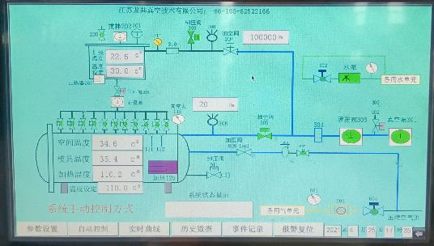
APR 25, 2021
Start VPI (02-Aperture-01)

Slide 7
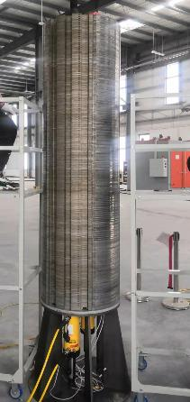
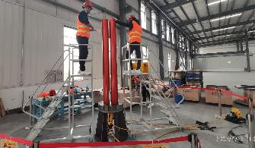
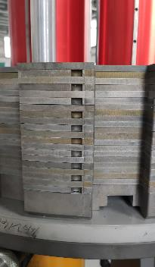
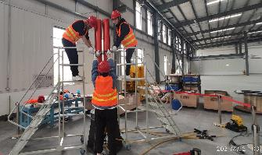
APR 12-19, 2021
Assembly of the 1st series magnet

Slide 8
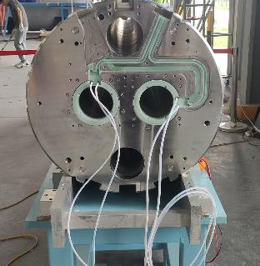
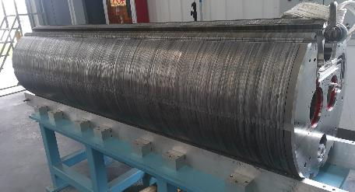
APR 20-26, 2021
Assembly of the 1st series magnet

Slide 9

Plan from now
01-Aperture 2 has been shipped to CERN for the test at 1.9K and cut open to find out the reason of the unusual performance.
Early May, 2021 The S01 magnet ready for test
June 2021 The S01 Magnet ready for delivery to CERN
Early May, 2021 02-Aperture 1 (with wet wind process) ready for stand-alone test.
Early May, 2021 Start to fabricate 02-Aperture 2 (with wet wind process).

Slide 10
Thanks for your attention

