Slide 1
Cherenkov BLM tests in CLEAR
April 2021
30/04/21
S. Benitez, E. Effinger, E. Lima, B. Salvachua

Slide 2
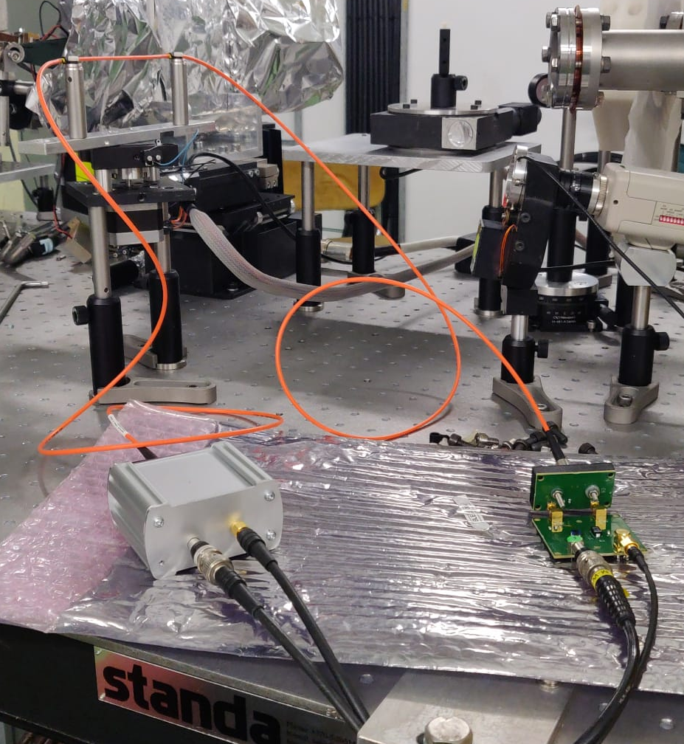
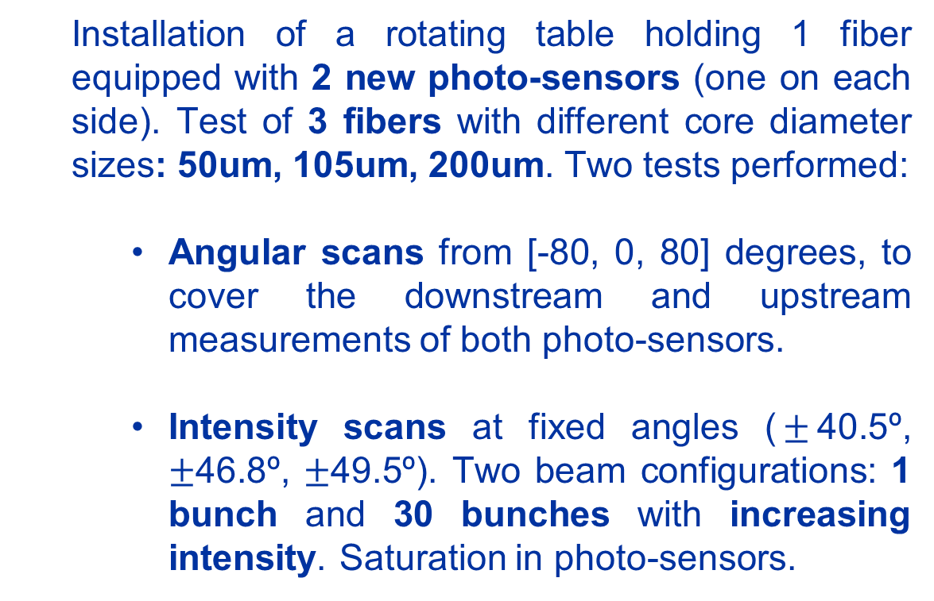
Goals of the last two weeks (first tests)
  Installation of a rotating table holding 1 fiber equipped with 2 new photo-sensors (one on each side). Test of 3 fibers with different core diameter sizes: 50um, 105um, 200um. Two tests performed:
    Angular scans from [-80, 0, 80] degrees, to cover the downstream and upstream measurements of both photo-sensors.
    Intensity scans at fixed angles ($±$40.5º, $±$46.8º, $±$49.5º). Two beam configurations: 1 bunch and 30 bunches with increasing intensity. Saturation in photo-sensors.

Slide 3
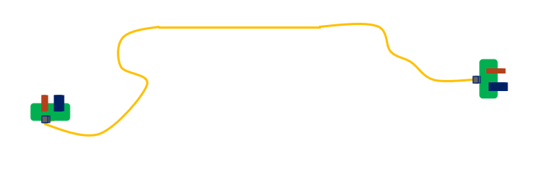
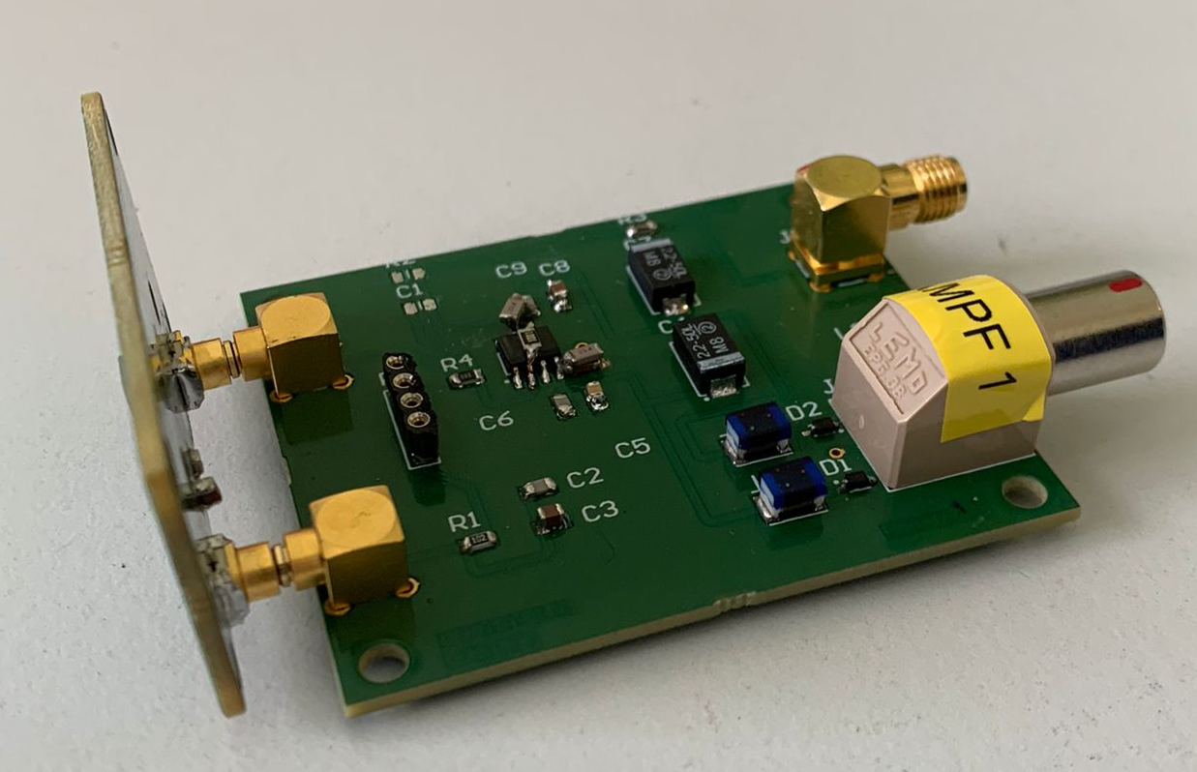
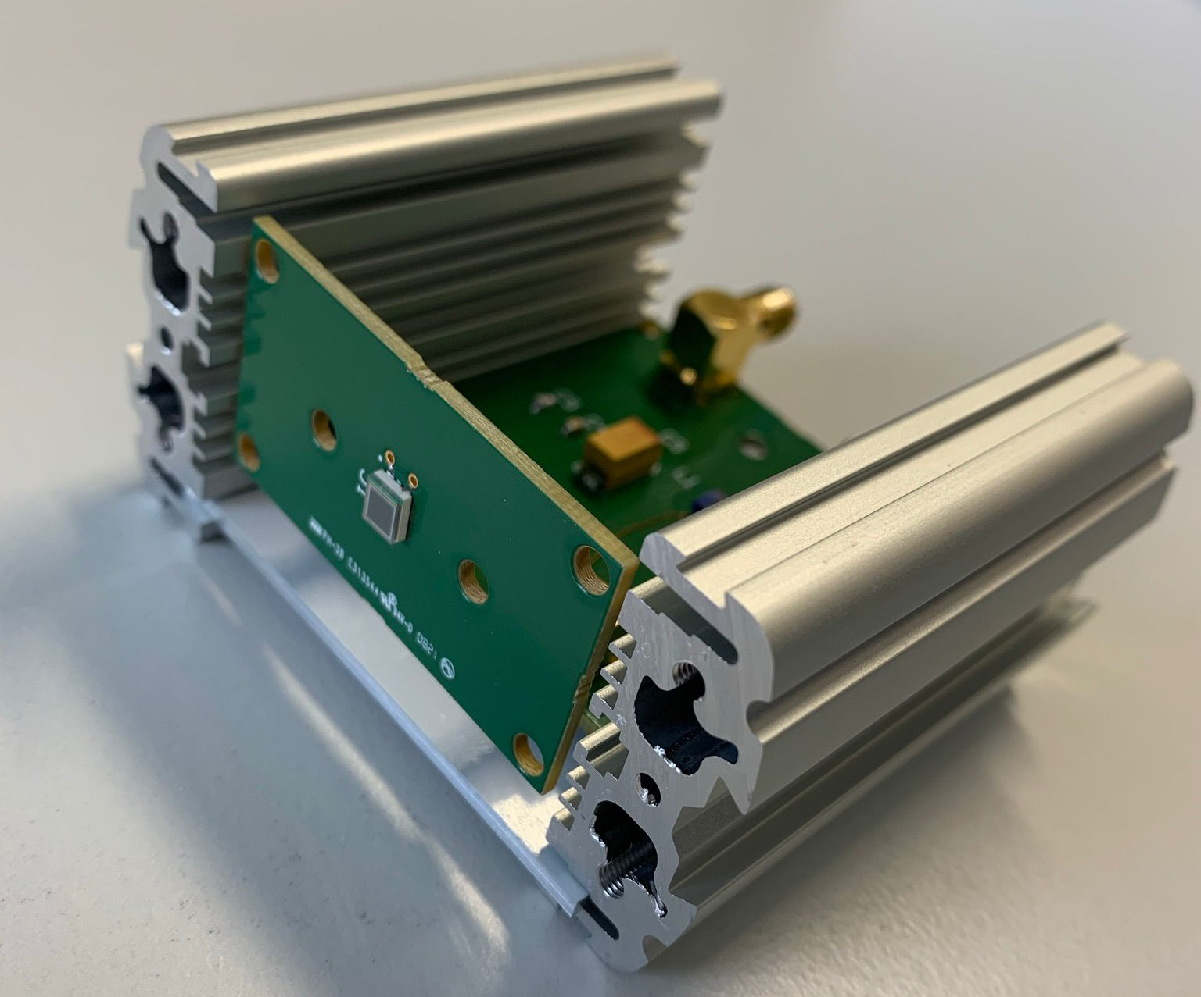
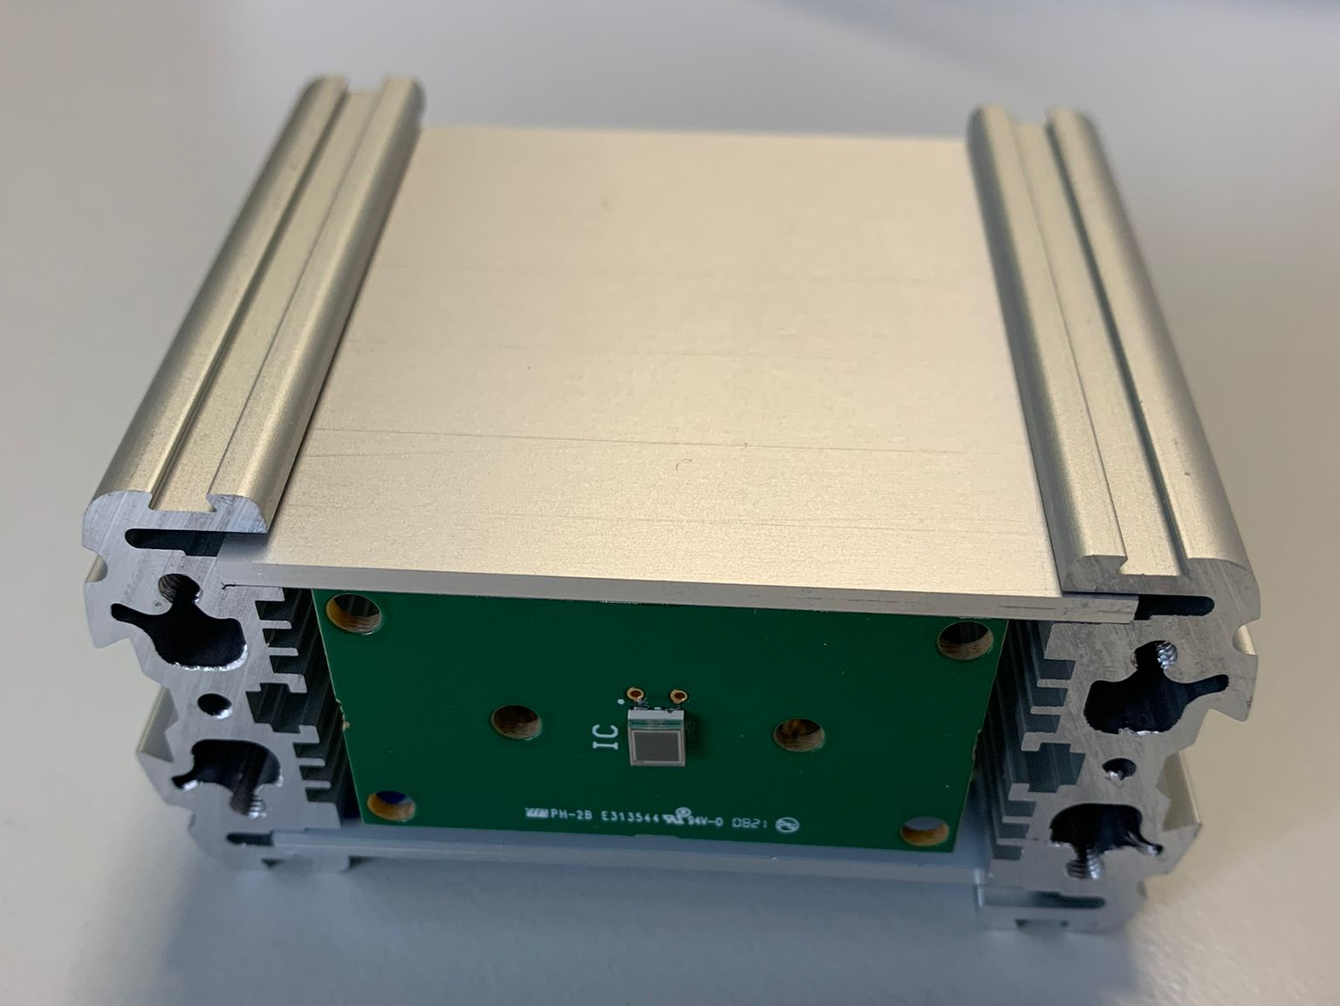
New Electronics
SiPM 2-Downstream
Optical Fibre
Same configuration as the previous test (2020)
New readout circuit design
New casing design. Handier device.
Two schematics to be tested (1 without amplifier & 1 with transimpedance amplifier)
Two different SiPMs (Hamamatsu S14160-3010PS, -3015 PS)
SiPM 1-Upstream

Slide 4
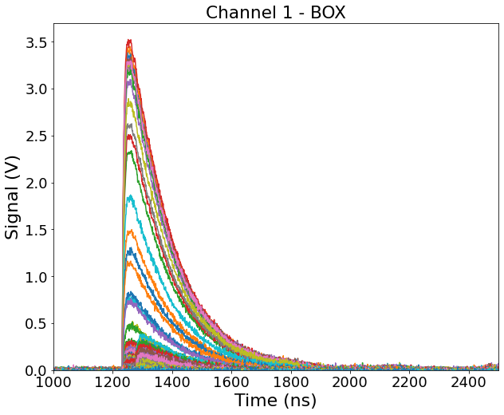
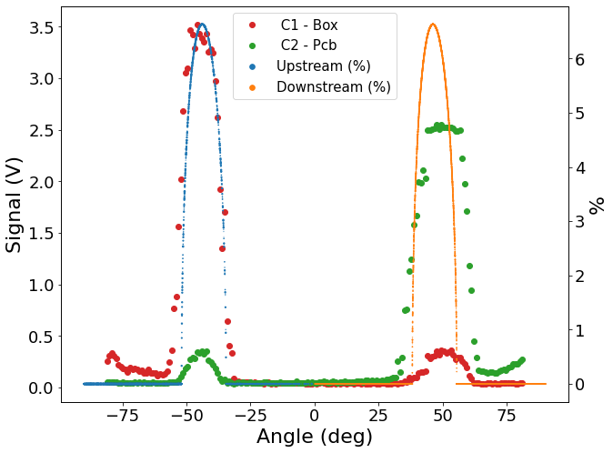
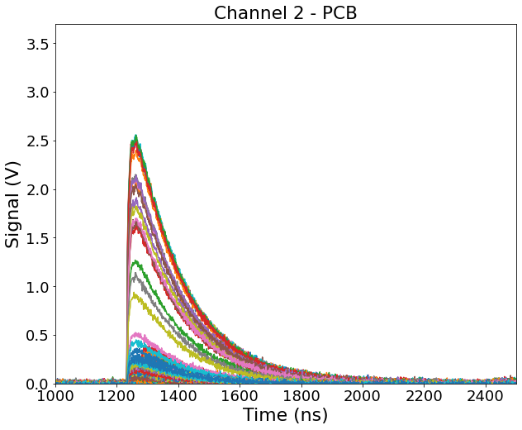
Angular scan: first results
Saturation
Expected signal for negative angles
Fixed intensity at 20 pC* – 1 Bunch per angle
105 µm
Reflected signal in positive angles
*It fluctuates due to the single bunch shot

Slide 5
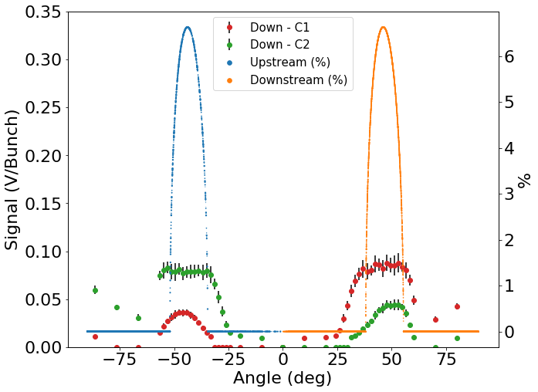
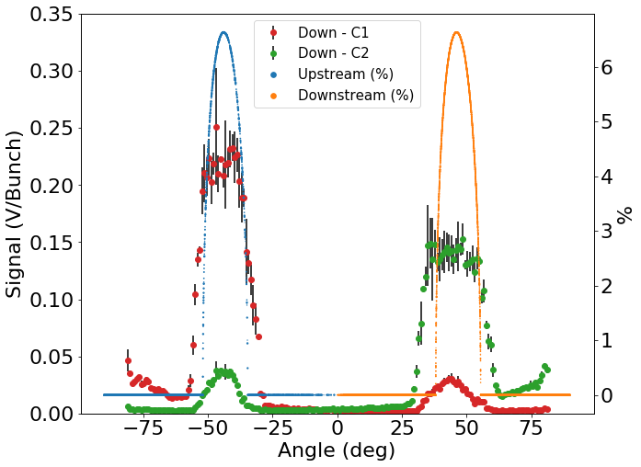
Results comparison: tests 2020 Vs. tests 2021
Fixed intensity at 20 pC* – 1 Bunch per angle
Apr - 2021
Beam “vibrations in the position”
Nov - 2020
*It fluctuates due to the single bunch shot

Slide 6
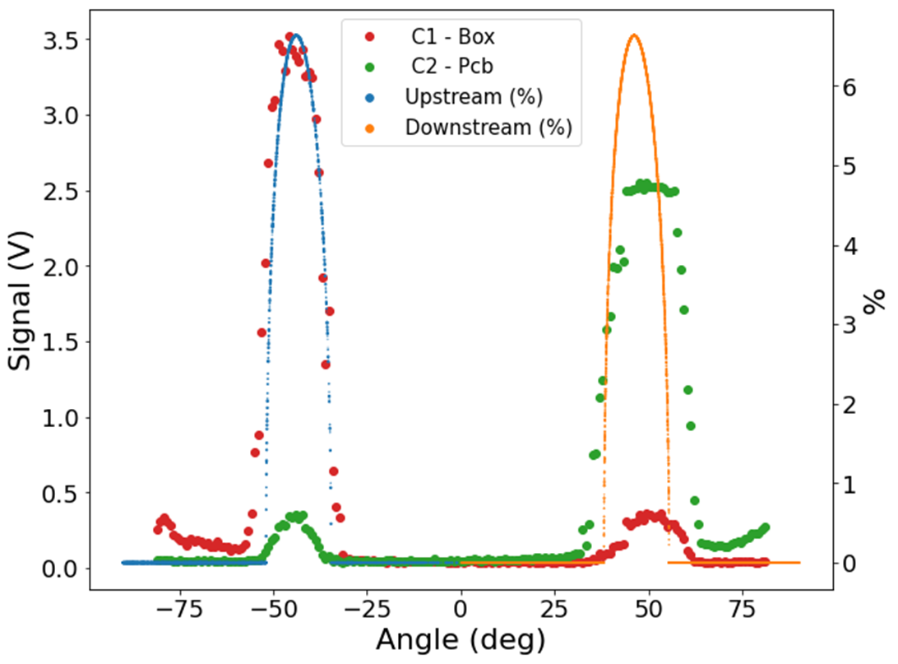

Intensity scan: short description
Different fixed angles ($±$40.5º, $±$46.8º, $±$49.5º).
Two beam configurations with increasing intensities:
    1 Bunch: from 5-10 pC to 200 – 300 pC.
    30 Bunches: from 10 pC to 3 nC.
46.8º
40.5º
49.5º

Slide 7
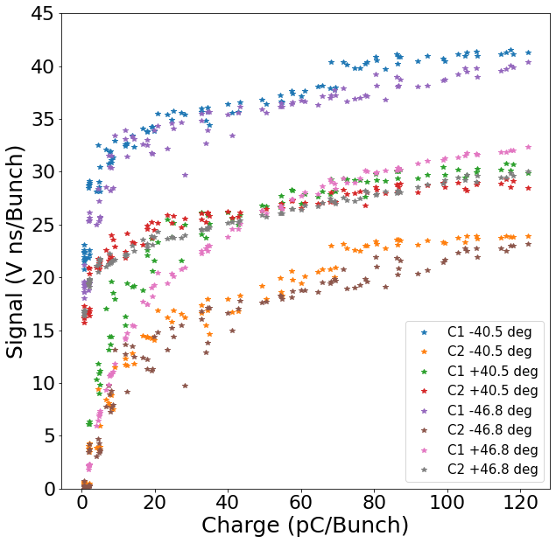
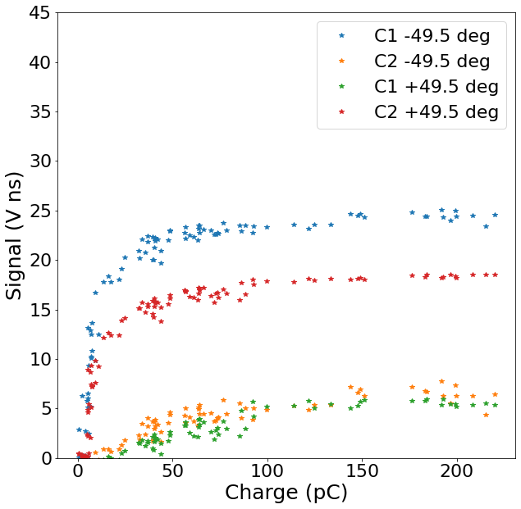
Intensity scan: first results
30 bunches setup
1 bunch setup
105 um fiber
105 um fiber

Slide 8
Considerations for further tests
Channels in CLEAR. C1 <—> C2. Crosscheck.
Vibration of the beam position.

Slide 9
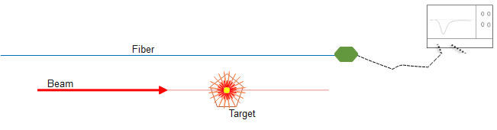

Next week test: Target test
Also, we would like to measure the background noise
Wilfrid’s proposal:
We will implement a moving target to approach to the best point of detection on the fiber.
Also, it will be possible to study the dependency on the distance between the fiber and the impact point.
Two different targets: 0.5 and 2.0 cm of thickness, both copper material.

Slide 10
Back up slides

Slide 11
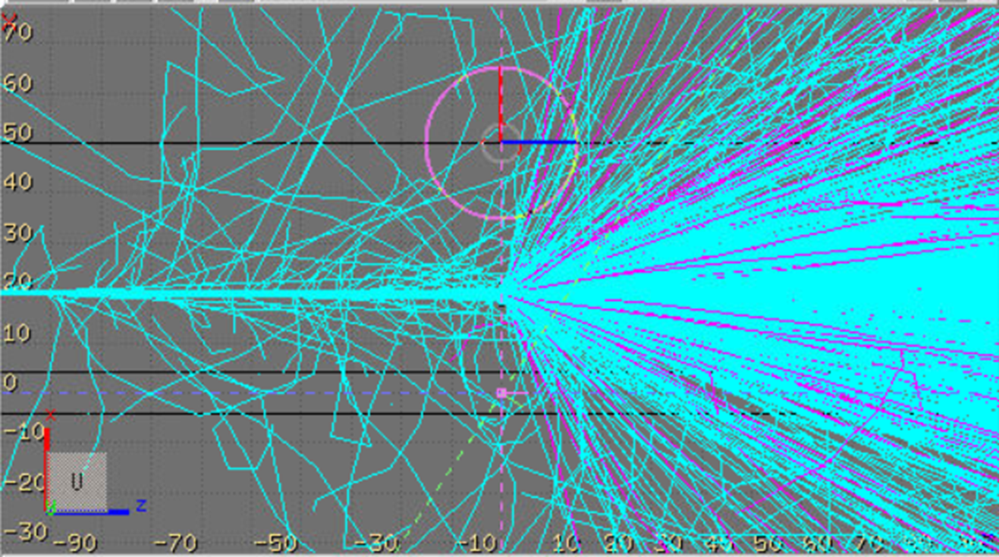
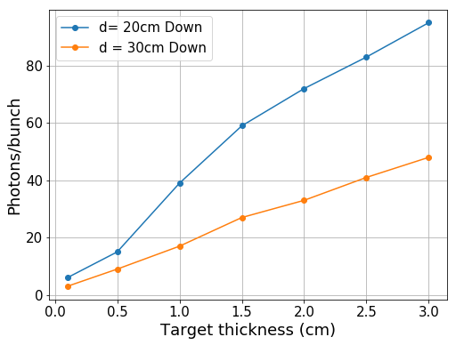
Simulations: Target thickness selection
Fiber of 200 um diameter
100 M particles simulated
Target thickness: 1-3 cm.
Target material: copper (?)
Distance fiber-interaction: 20 cm

