Slide 1
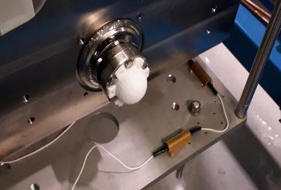
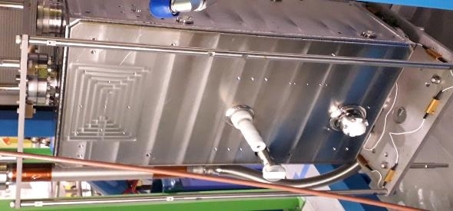
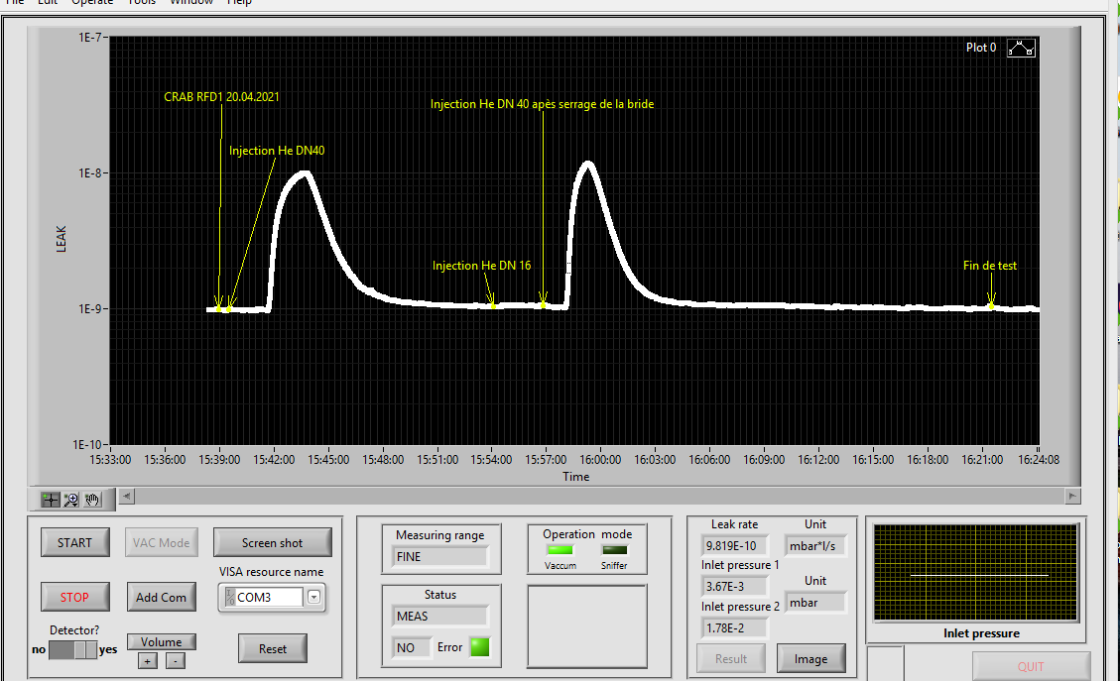
Leak in RFD1-DC
Fuite sur DN 40
Fuite sur DN 40

Slide 2
HL-LHC follow-up/ Couplers
HOM couplers: drawing folders to be Released: URGENT!
Gasket drawings for HHOM and Pick-up/VHOM. New version created with material CuOFE, to be released.
RFD HOM Couplers | CDD number | Drawing folder
H-HOMC feedthrough | LHCACFHC0324 | 2266941
H-HOMC | LHCACFHC0151 | 2302298
V-HOMC | LHCACFHC0322 | 2271762
Field antenna | LHCACFHC0321 | 2266953
Drawing ref. | Status
LHCACFHC0259 | Released DN40 special
LHCACFHC0261 | Released DN100

Slide 3
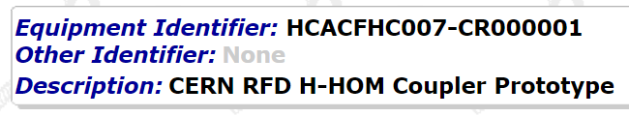
HL-LHC follow-up/ MTF
Missing reports in MTF:
 | Docs to be uploaded in MTF
H-HOMC | RF measurements report (test box) (James). EDMS 2506309
H-HOM | Leak test report HCACFHC007-CR000002
VHOM 45 | Leak test report HCACFHC006-CR000004
Field antenna 47 | Leak test report HCACFPU004-CR000004
HHOM feedthrough | Leak test report – No reference on the piece?

Slide 4
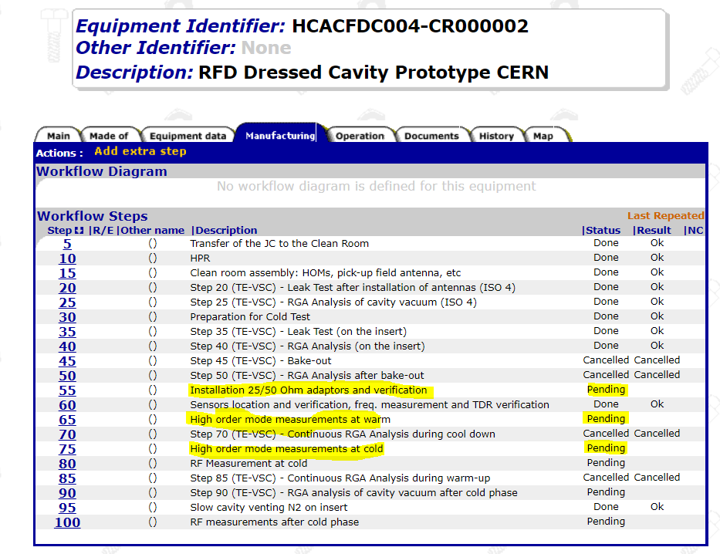
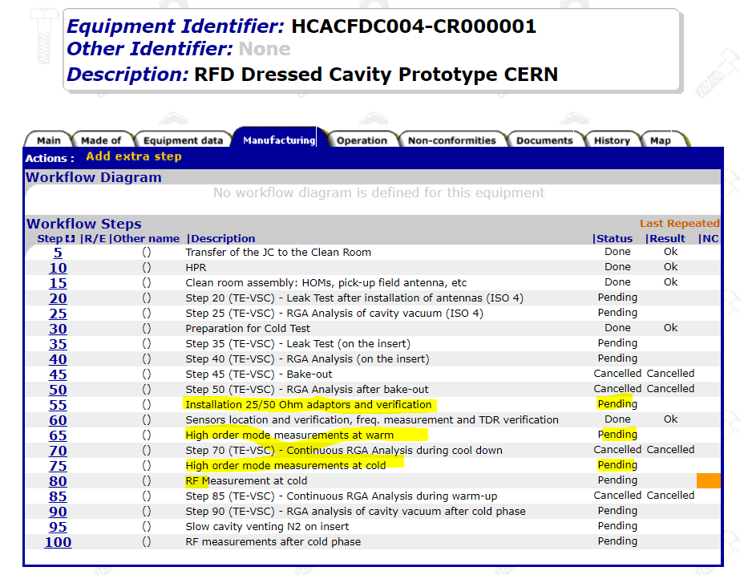
HL-LHC follow-up/ MTF
Create a NCR for the RFD2_DC adaptor. URGENT!
  Template for NCR: EDMS 1501109
Reports for RFD2-DC and RFD1-DC MTF:
  Step 55 Installation adaptors and verification
  Step 65 High order mode measurement at warm
  Step 75 High order mode measurement at cold

Slide 5
HL-LHC follow-up
Documents needed for UK:
  James: Post transport qualification of HOMs. Document to be uploaded in EDMS 2507161
  Sebastian: instruction for assembly of adaptors on the cavity in UK.
Eric: Engineering spec for FPC. to be finalized before starting fabrication.
Eric/James: CRAB CAVITY HOMs- DETAILS and QUALIFICATIONS : https://edms.cern.ch/document/2488213/0.9 URGENT!
Eric: Comments to WP4 Cryomodule engineering spec :EDMS 2043014
Antoine/ Agibail: To upload documentation in EDMS and MTF for the SPS RFD FPC
New request (email 07/04 from Luca Dassa): To provide the 3D model of HOM coupler for DQW cavity to Luca Dassa to verify if we can use material in stock at CERN with lower yield strength

Slide 6
HL-LHC follow-up/ AUP
Documents from AUP uploaded in EDMS to be reviewed by WP4, related to couplers:
AUP ANCILLARIES
AUP DOCUMENTATION | REFERENCE | N.EDMS | VERSION | STATUS
RFD HHOM Suppressors
Manufacturing drawings
Manufacturing drawings H-HOM suppressor |  | 2402596 |  | In work- to be reviewed by CERN
Manufacturing drawings HHOM Feedtrhough |  | 2414230 |  | In work- to be reviewed by CERN
Manufacturing procedures
AUP Acid Etching at the chemical Fume Hood procedure |  | 2365955 |  | In work- to be reviewed by CERN
AUP cavity components and parts degreassing procedure |  | 2365964 |  | In work- to be reviewed by CERN
High Sensitivity Vacuum leak check requirements |  | 2407362 |  | In work- to be reviewed by CERN
Manufacturing inspection plan : RFD cavity Horizontal HOM Damper |  | 2379706 |  | In work- to be reviewed by CERN
Inspection test procedure
 |  |  |  | Not received
Qualifications
 |  |  |  | Not received
RFD VHOM Suppressors
Manufacturing drawings
Manufacturing drawings V-HOM suppressor |  | 2402597 |  | In work- to be reviewed by CERN
Manufacturing procedures
AUP Acid Etching at the chemical Fume Hood procedure |  |  |  | In work- to be reviewed by CERN
AUP cavity components and parts degreassing procedure |  |  |  | In work- to be reviewed by CERN
High Sensitivity Vacuum leak check requirements |  |  |  | In work- to be reviewed by CERN
Manufacturing inspection plan : RFD cavity vertical HOM Damper |  | 2419694 |  | In work- to be reviewed by CERN
Inspection test procedure
 |  |  |  | Not received
Qualifications
 |  |  |  | Not received
RFD Pick-up Field Antenna
Manufacturing drawings
Manufacturing drawings Pick-up Field Antenna |  | 2402598 |  | In work- to be reviewed by CERN
Manufacturing procedures
Manufacturing inspection plan : RFD cavity field antenna |  | 2419695 |  | In work- to be reviewed by CERN
AUP Acid Etching at the chemical Fume Hood procedure |  | 2365955 |  | In work- to be reviewed by CERN
AUP cavity components and parts degreassing procedure |  | 2365964 |  | In work- to be reviewed by CERN
High Sensitivity Vacuum leak check requirements |  | 2407362 |  | In work- to be reviewed by CERN

Slide 7
HL-LHC follow-up/ AUP
Nuria: Share MIP with AUP:
  HHOM : done.
  VHOM : waiting for MME to modify the drawing ref.
  Field antena :waiting for MME to modify the drawing ref.
  Feed through HHOM :waiting for MME to modify the drawing ref.

