Slide 1

Tooling for transfer RFD FPC from test box to outer pipe
SY
Accelerator Systems department Radio-Frequency
Antoine.boucherie@cern.ch on behalf of SY-RF-AC
29/03/2021

Slide 2
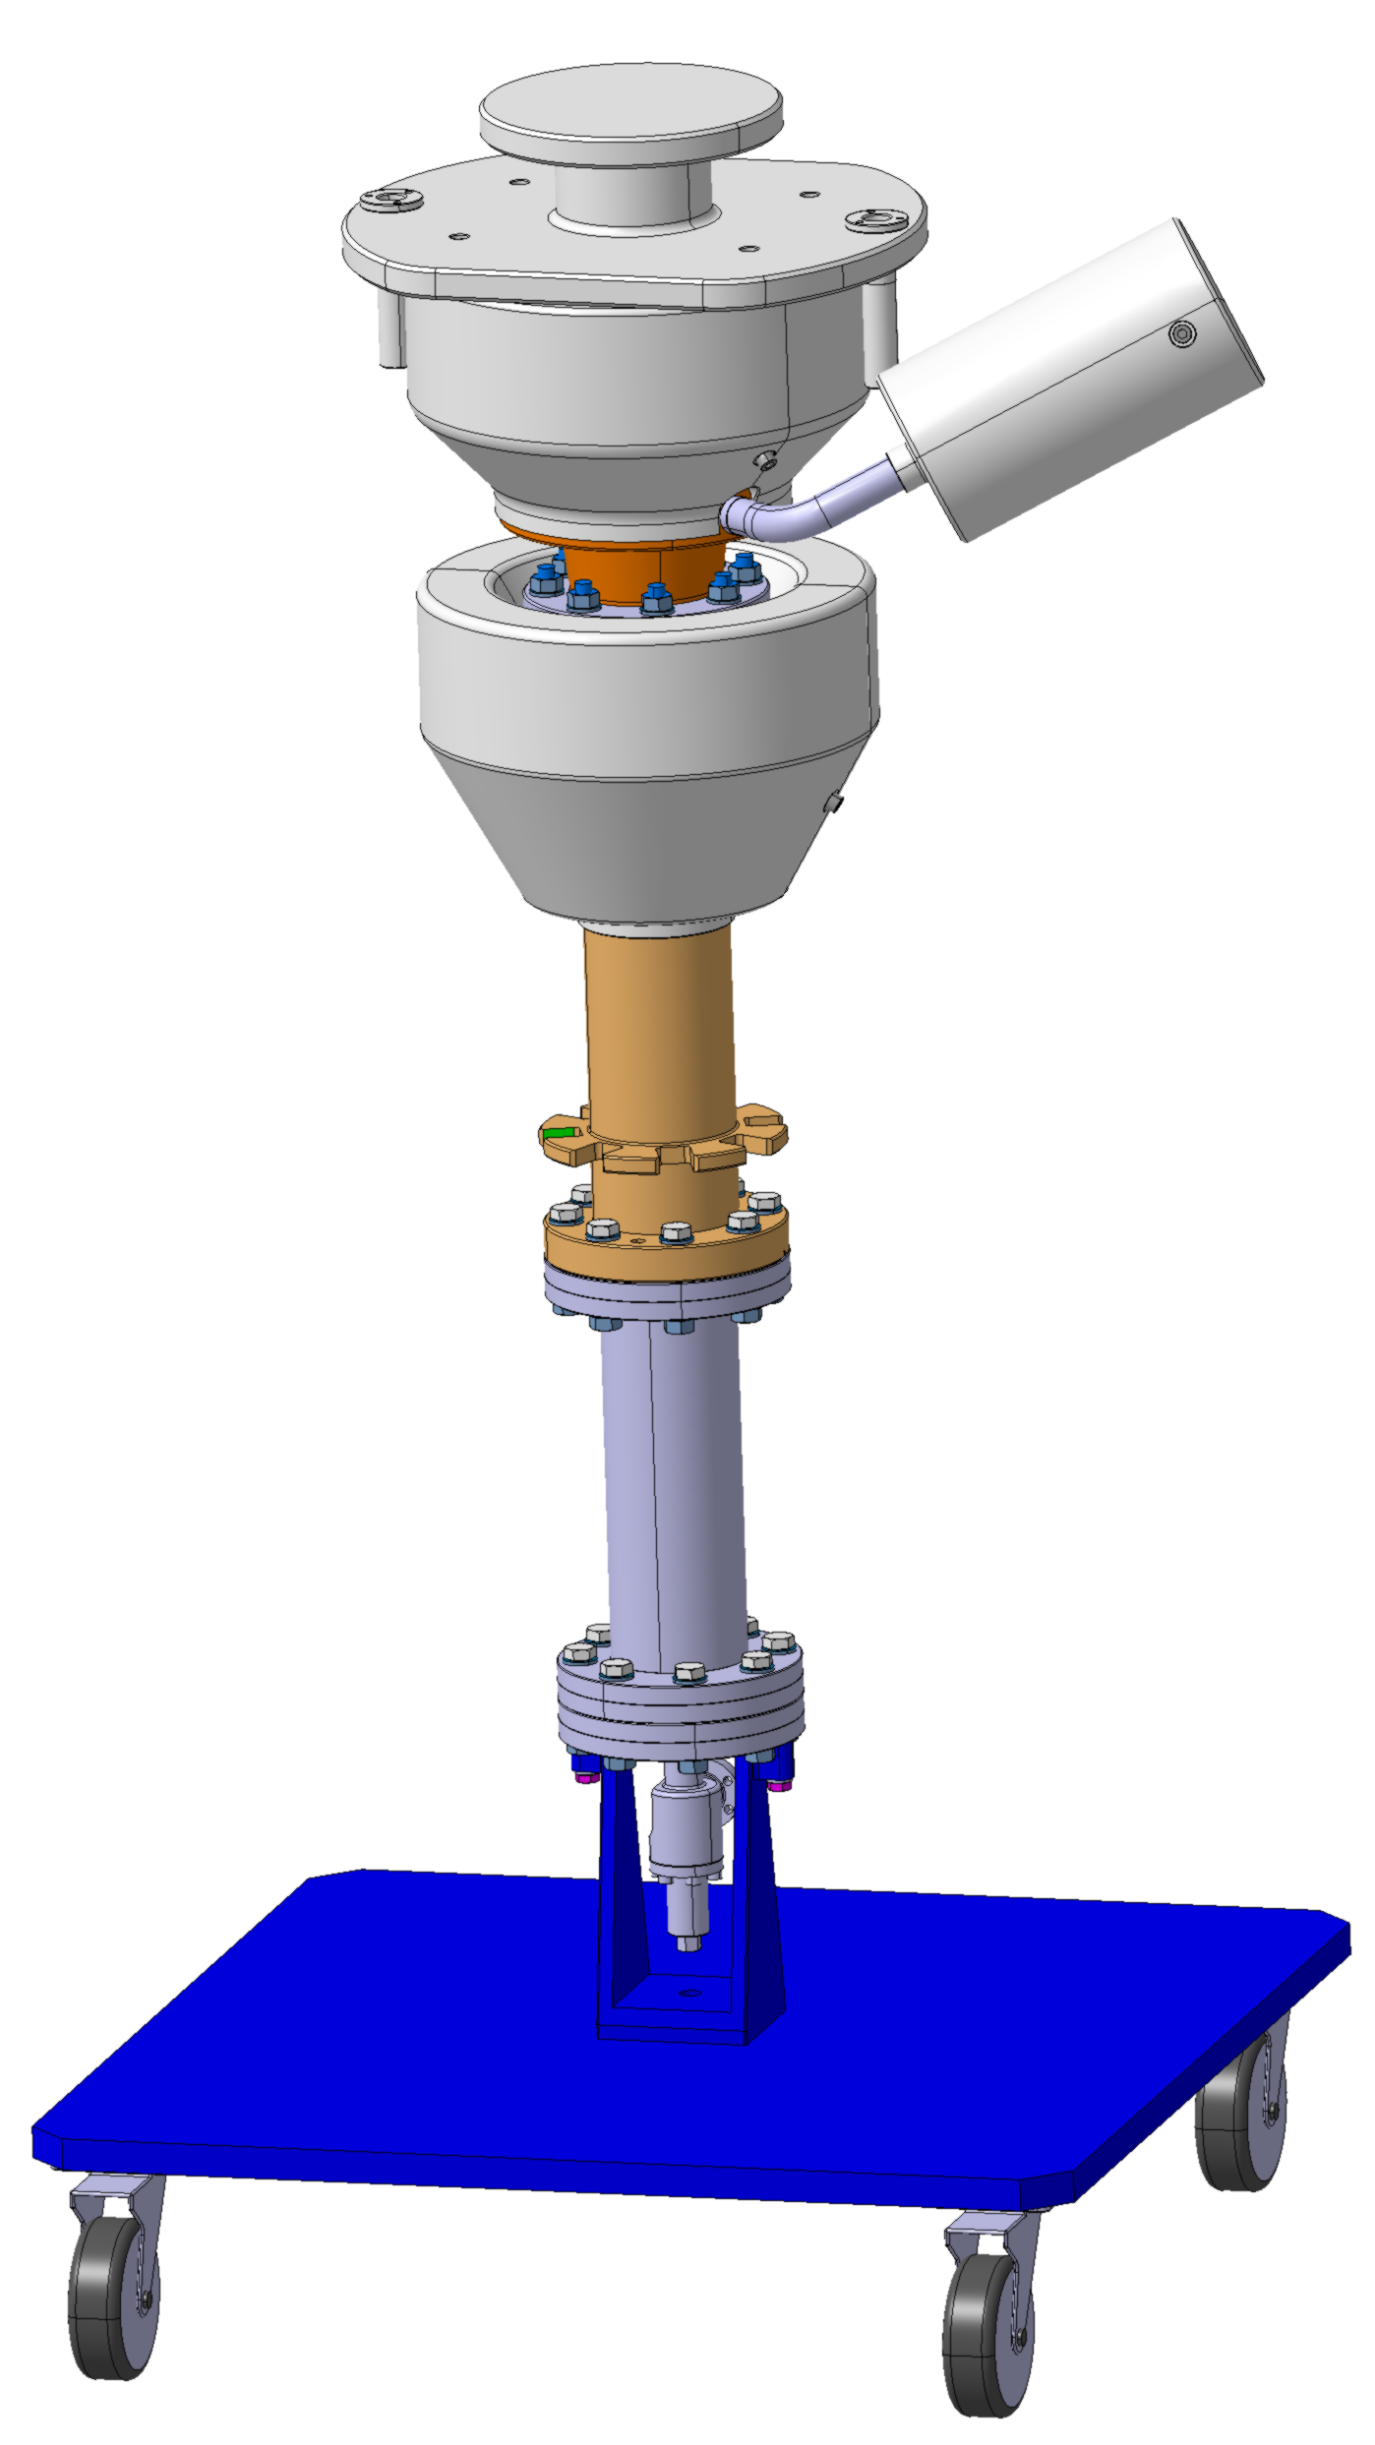
Flipbook: FPC RFD Mounting
Location : CLEAN ROOM CERN ISO4
VACUUM TRANSFER CHAMBER
LHCACFMC0208

Slide 3
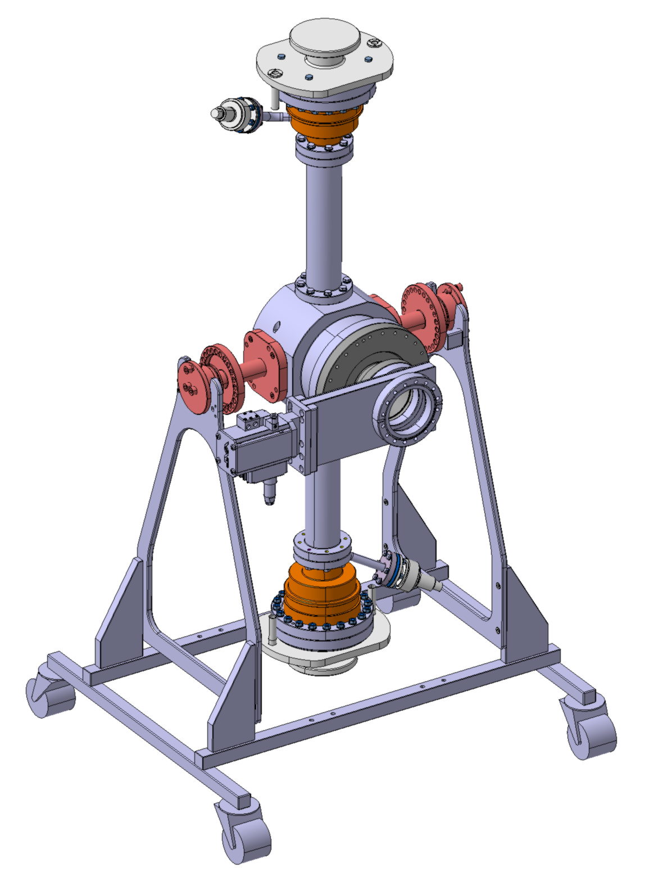
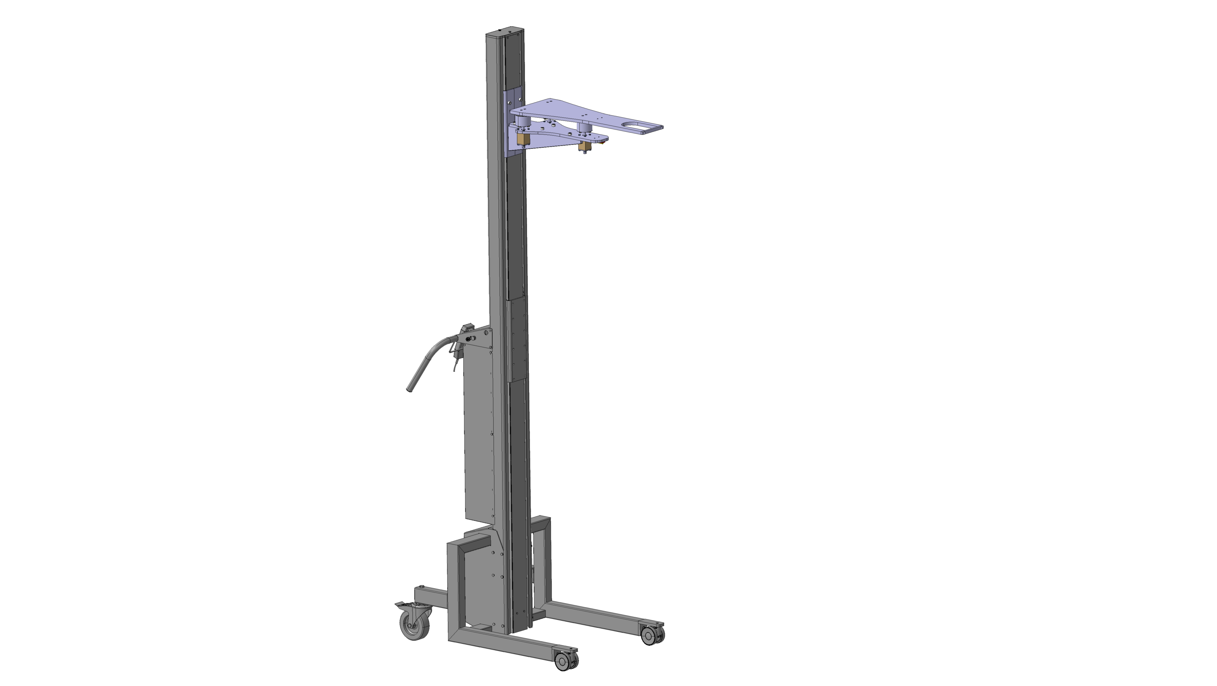
Flipbook: FPC RFD Mounting
Removing FPC from test box
Slow venting with nitrogen ( N2 60 )
CRAB FPC RDF TEST BOX ASSEMBLY
LHCACFMC0215
CERN LIFTER
ST1340765_01

Slide 4
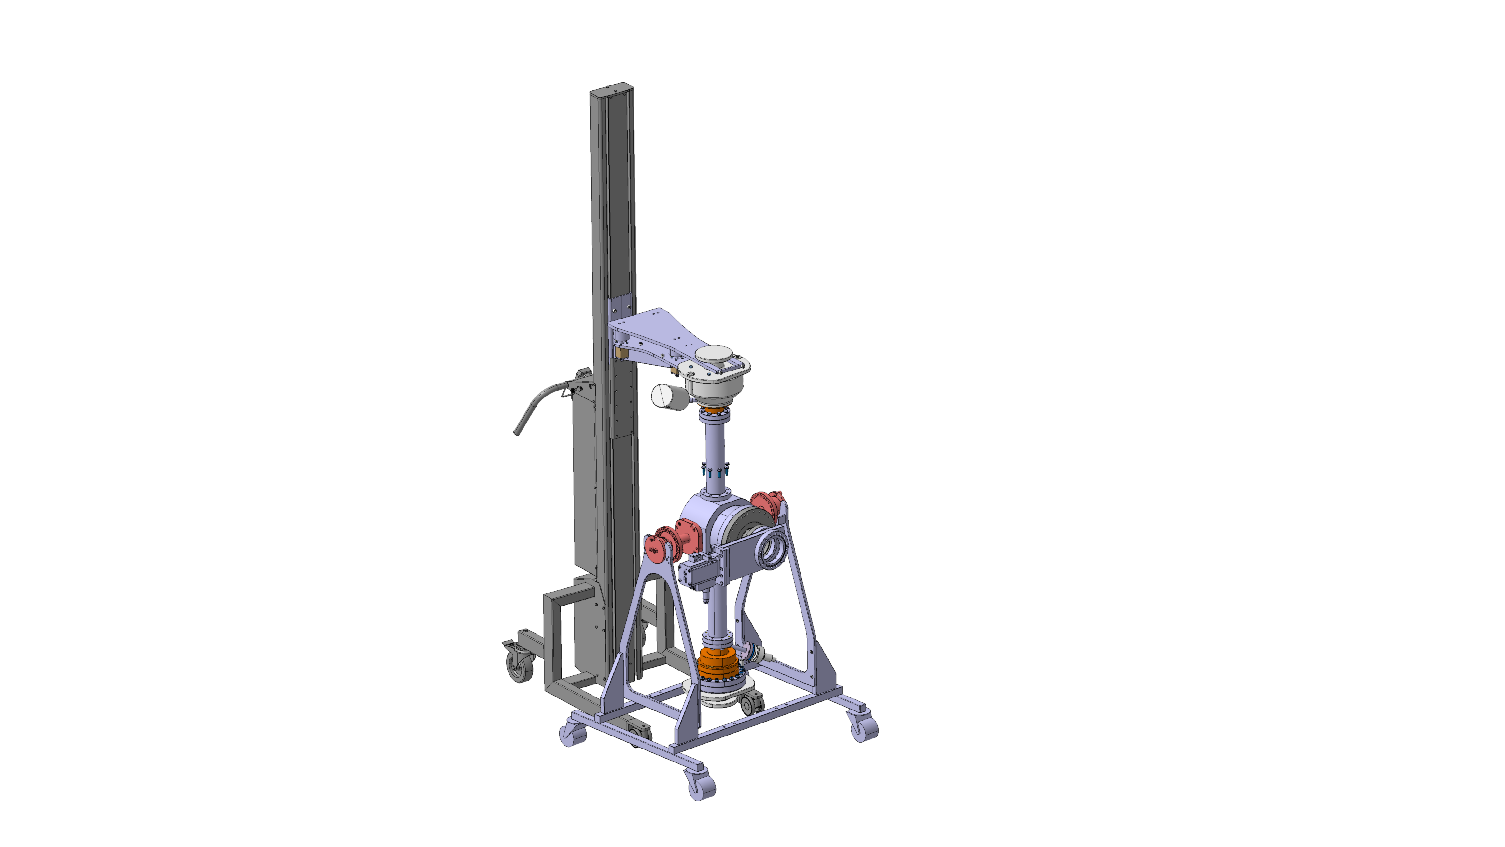
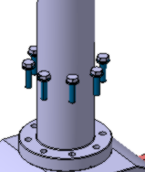
Flipbook: FPC RFD Mounting
Removing FPC from test box

Slide 5
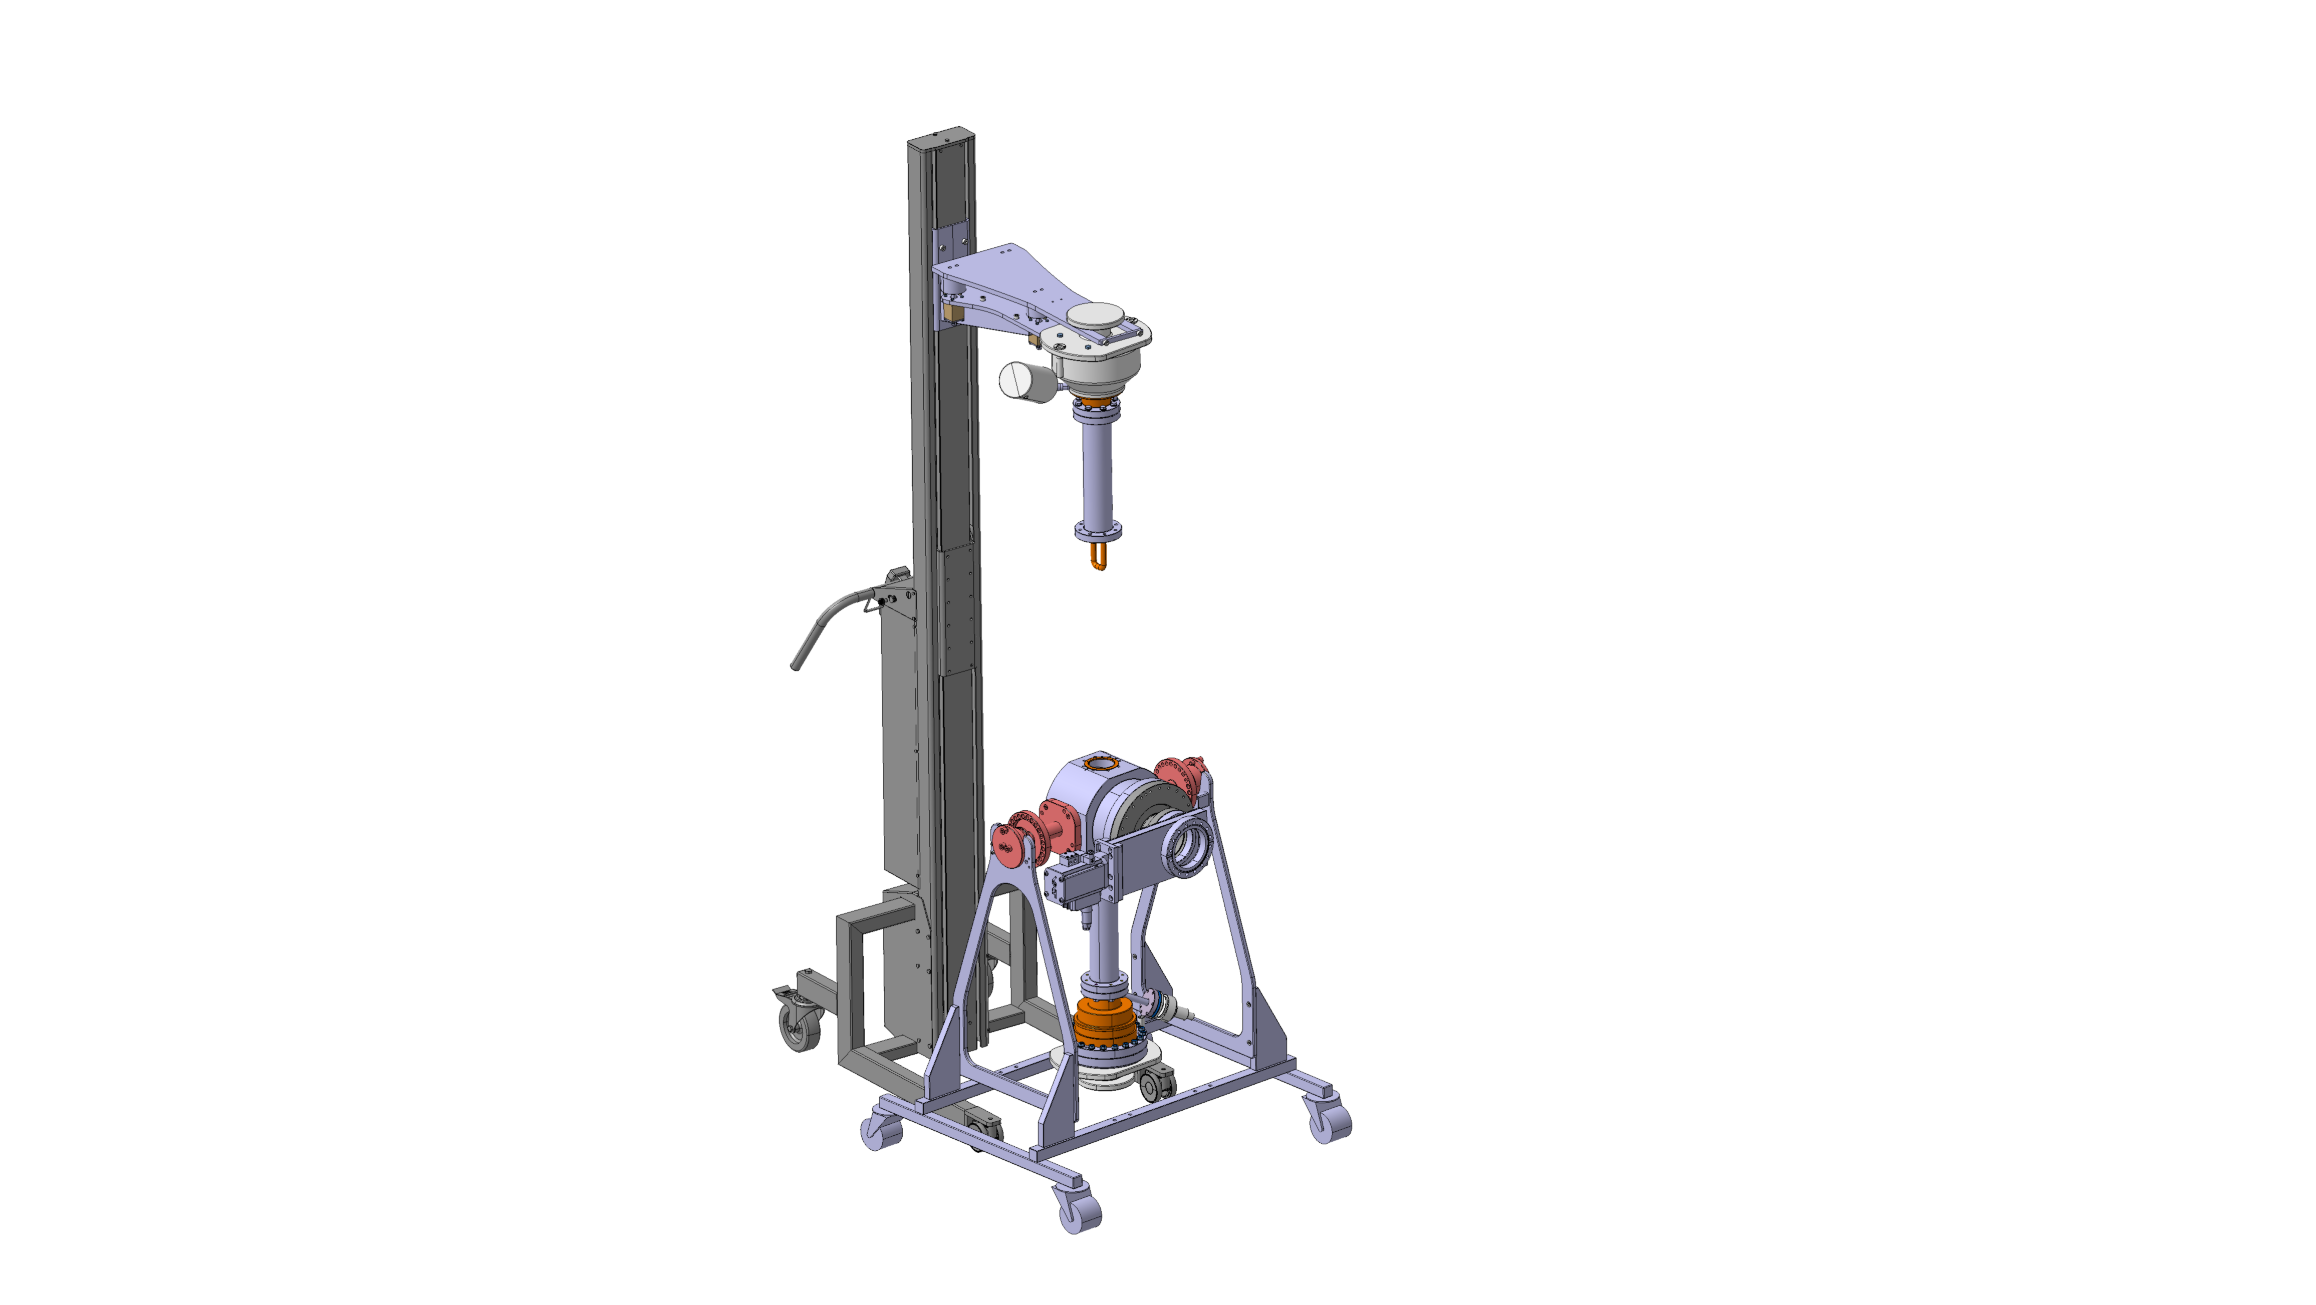
Flipbook: FPC RFD Mounting
Removing FPC from test box

Slide 6
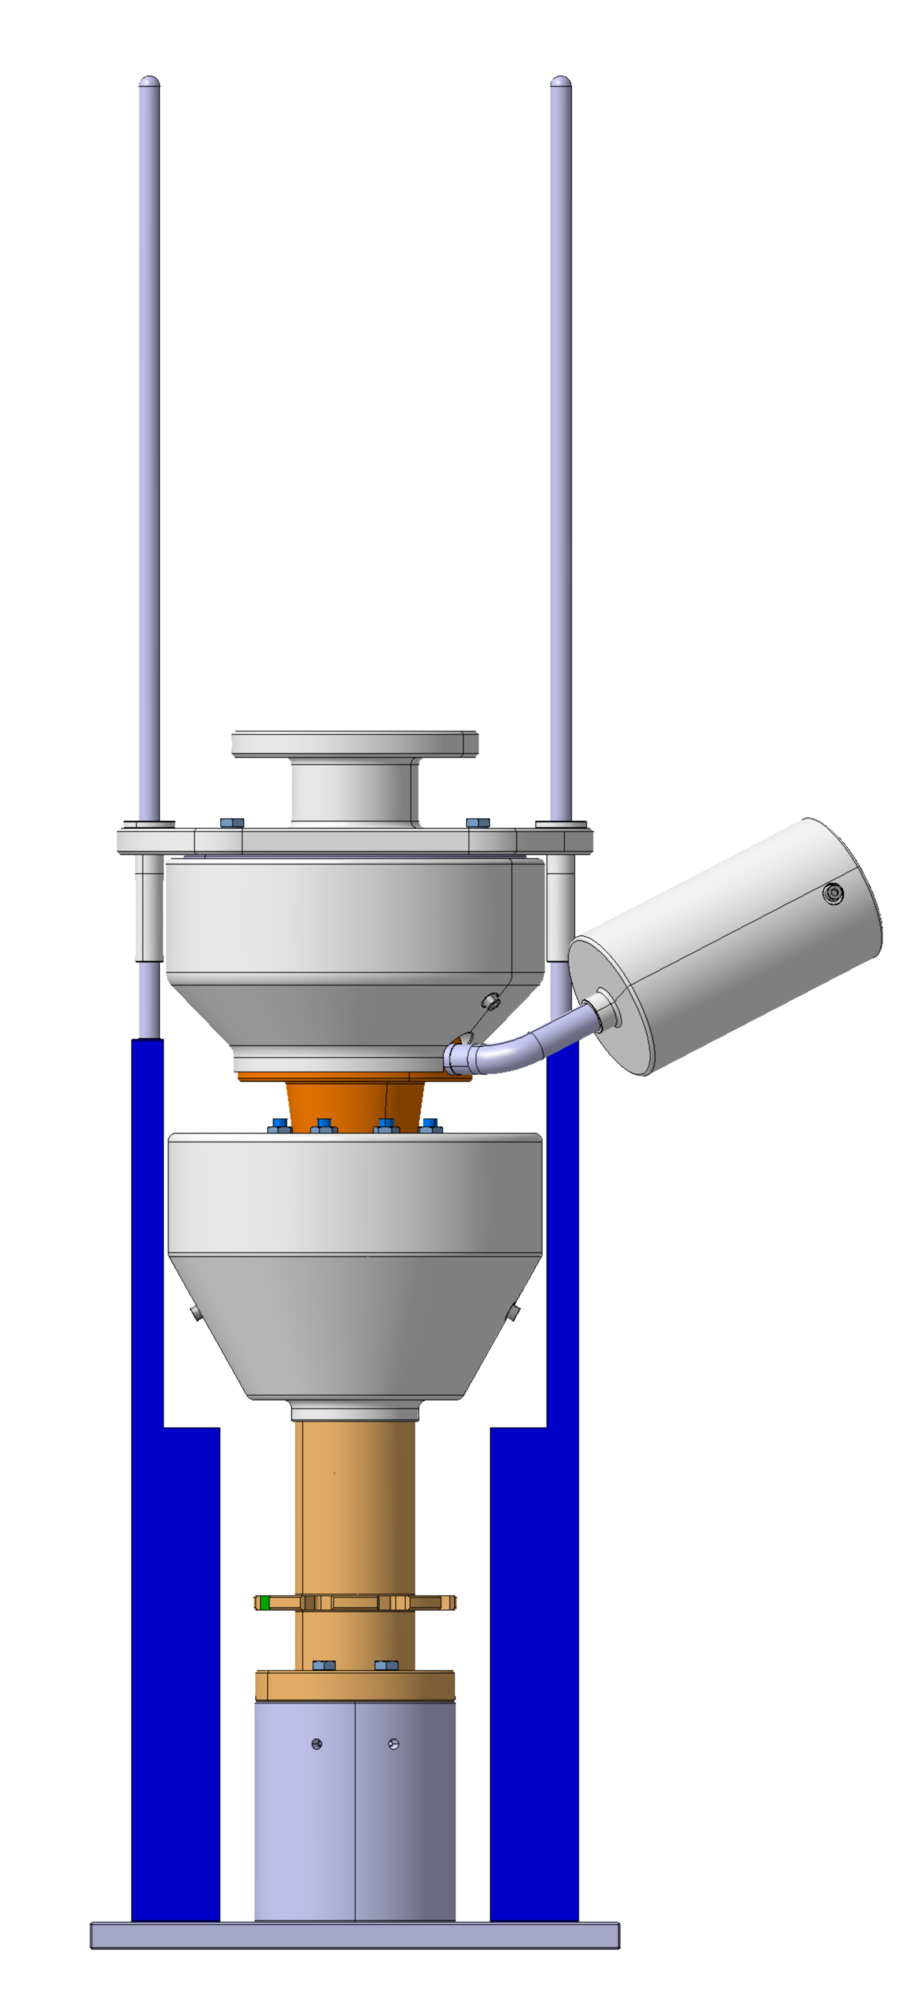
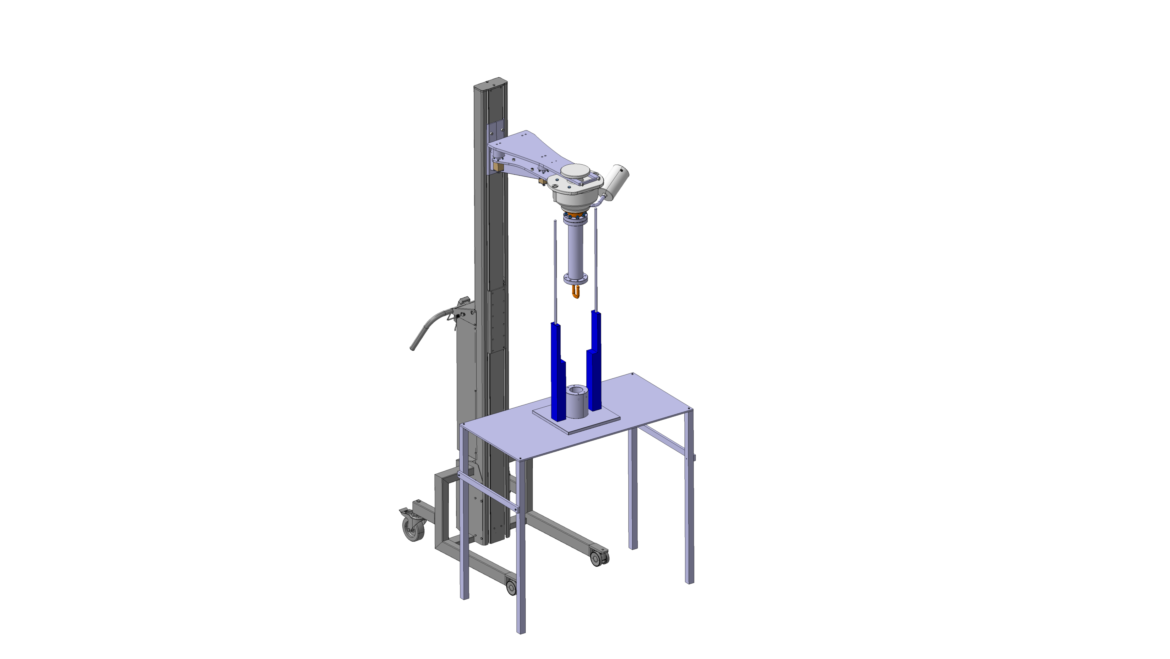
Flipbook: FPC RFD Mounting
Removing FPC from test box pipe
CLEAN ROOM TOOLING
LHCACFMC0212

Slide 7
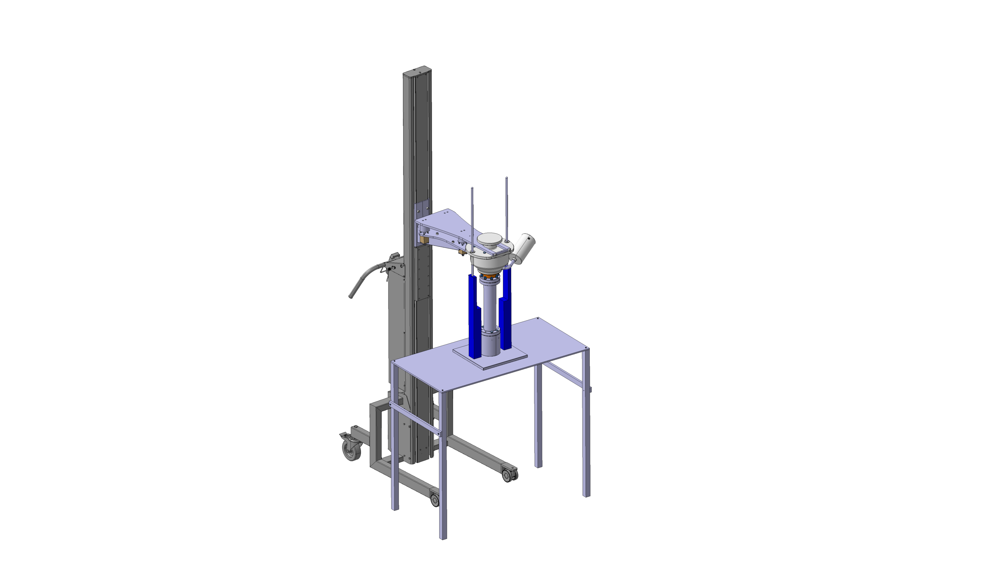
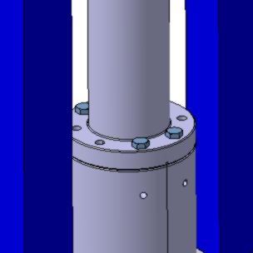
Flipbook: FPC RFD Mounting
Removing FPC from test box pipe
Install 4 screws
ISO 4017_M840-A4

Slide 8

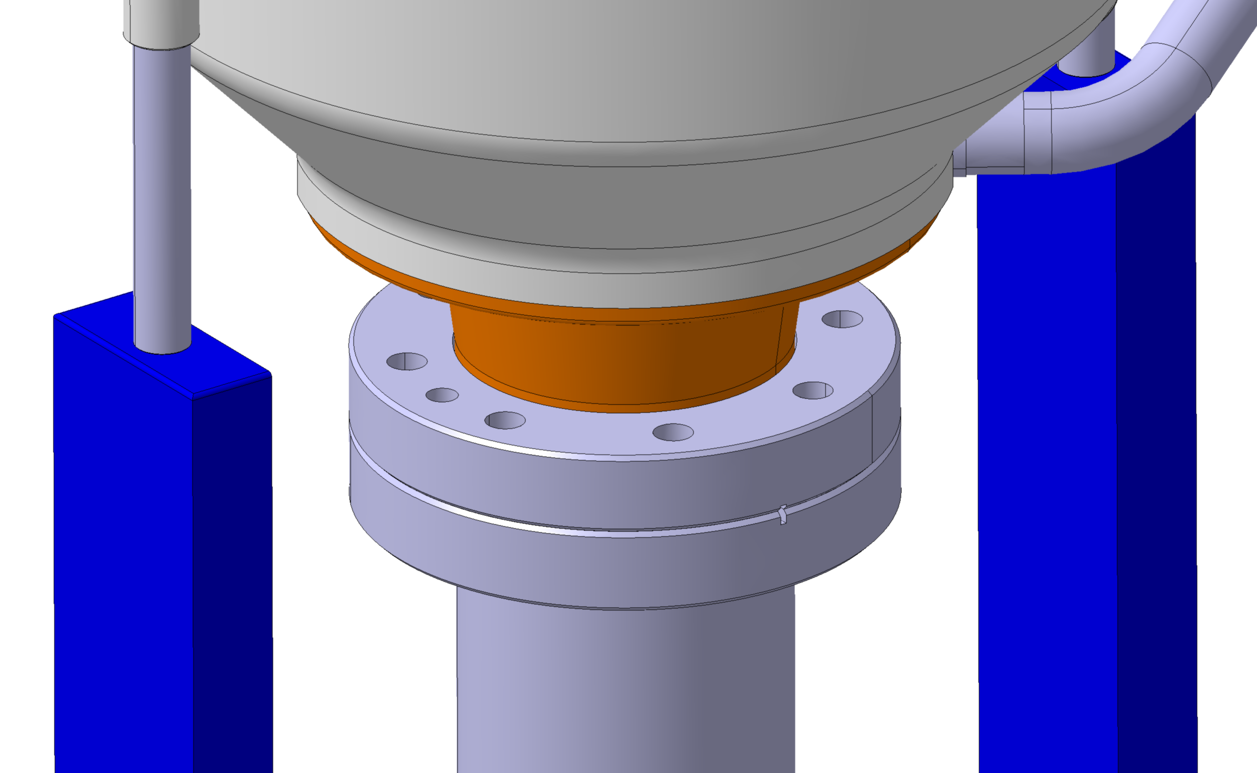
Flipbook: FPC RFD Mounting
Removing FPC from test box pipe
Remove body screws

Slide 9
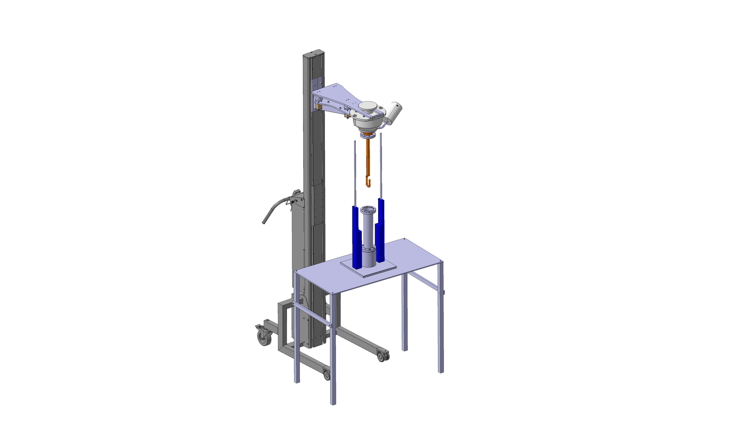
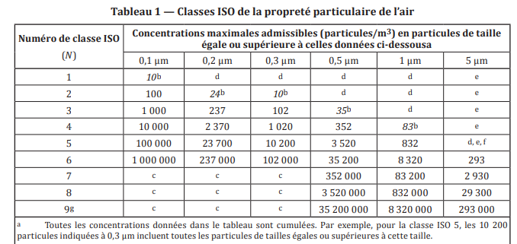

Flipbook: FPC RFD Mounting
Removing FPC from test box pipe
Remove false outer pipe
Clean antenna with nitrogen
according to ISO 4

Slide 10
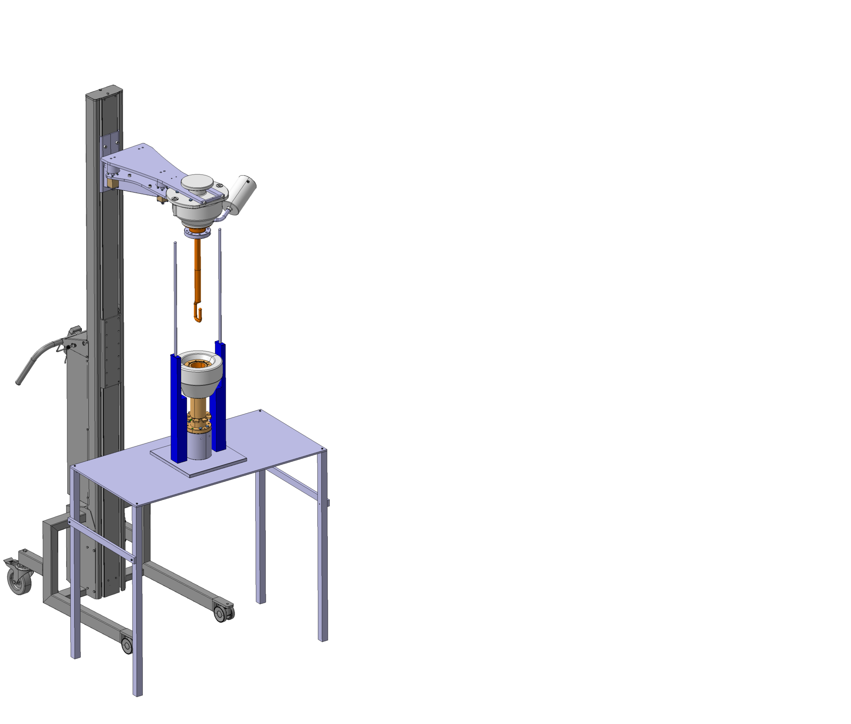
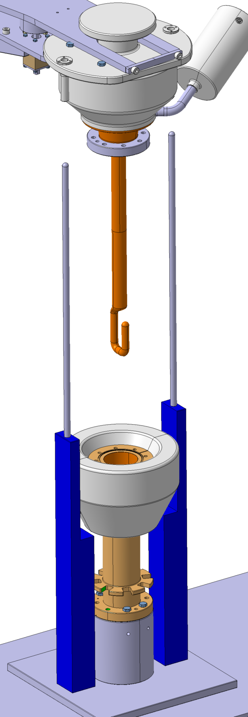
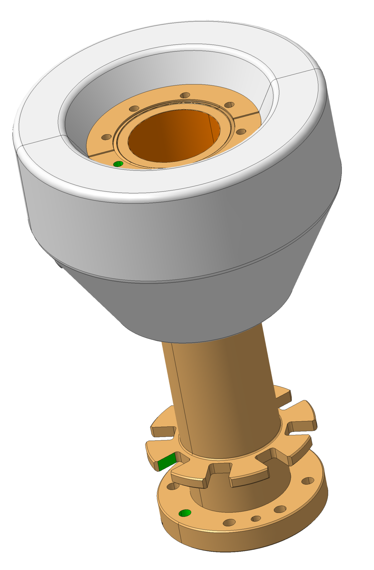
Flipbook: FPC RFD Mounting
Assembly FPC with outer pipe
OUTER TUBE BELLOWS COMPRESSED
( already rinsed by low pressure clean water ISO 4 )
LCHACFMC0235
Alignment M8 outer tube on support.

Slide 11
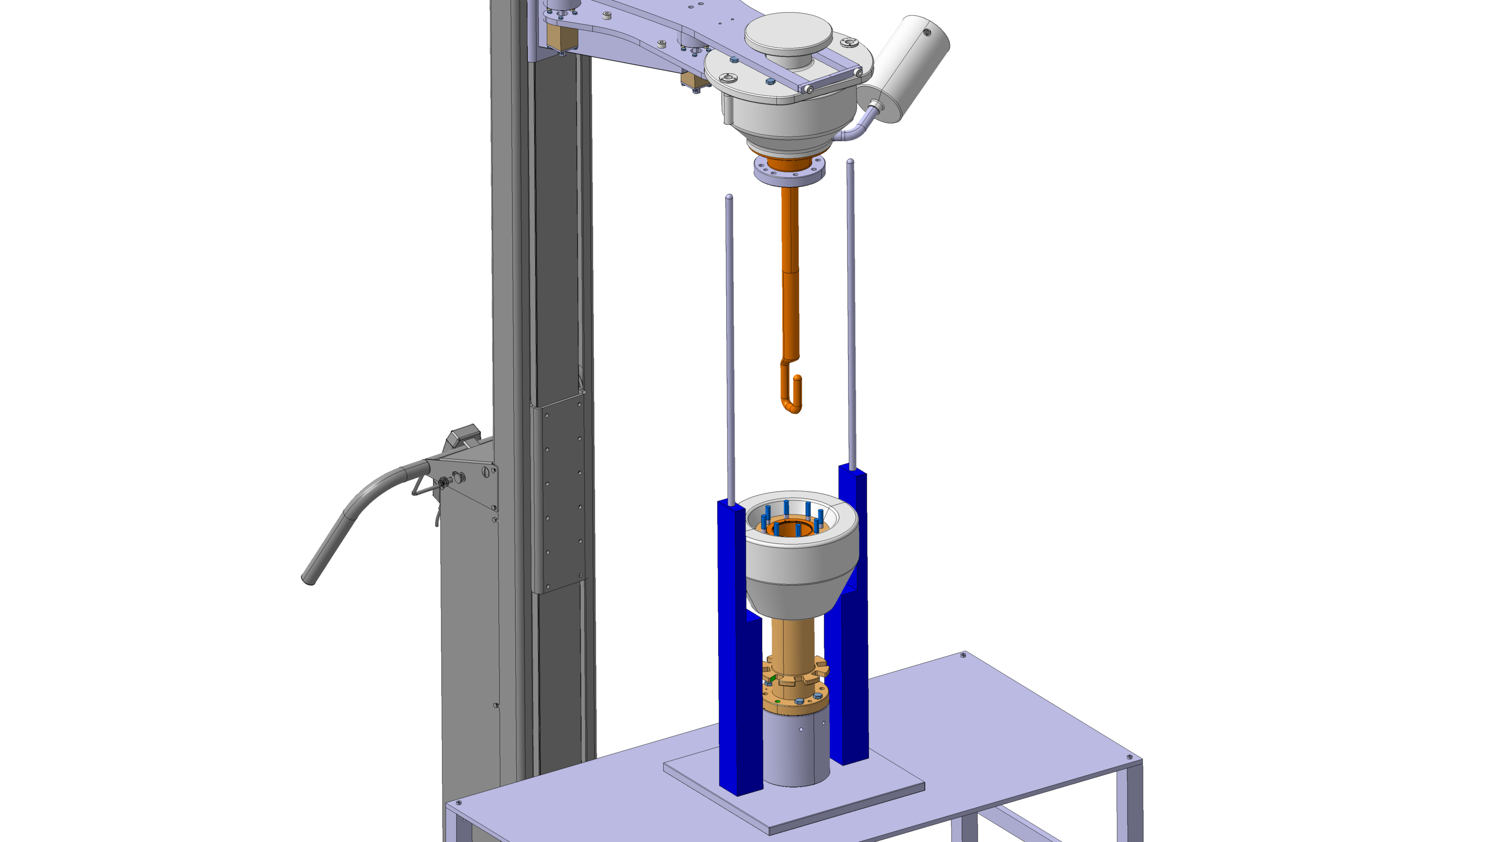
Flipbook: FPC RFD Mounting
Assembly FPC with outer pipe
Mount RFC seal and M8X30 silver stud

Slide 12
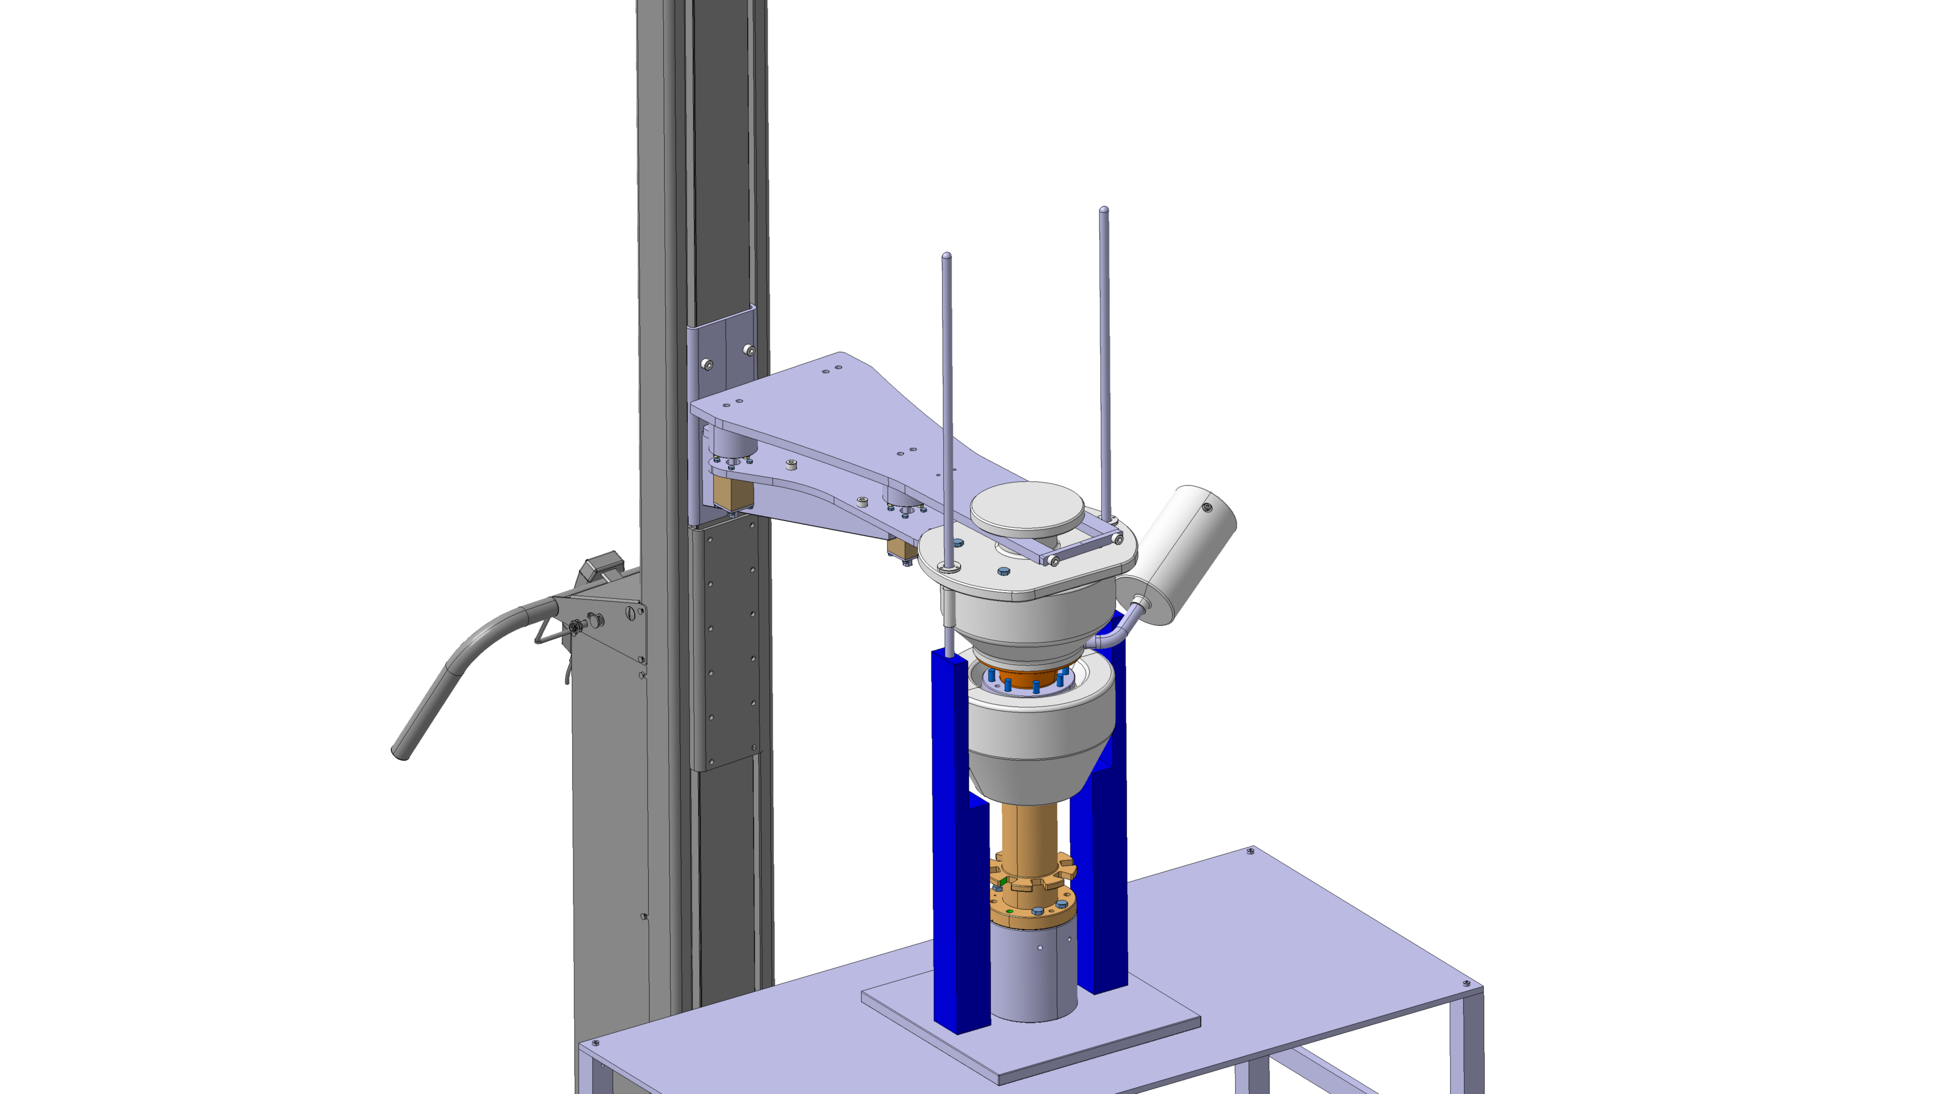
Flipbook: FPC RFD Mounting
Assembly FPC with outer pipe

Slide 13

Flipbook: FPC RFD Mounting
Assembly FPC with outer pipe
Mount washers and nuts M8

Slide 14

Flipbook: FPC RFD Mounting
Assembly FPC with outer pipe
Remove screws

Slide 15
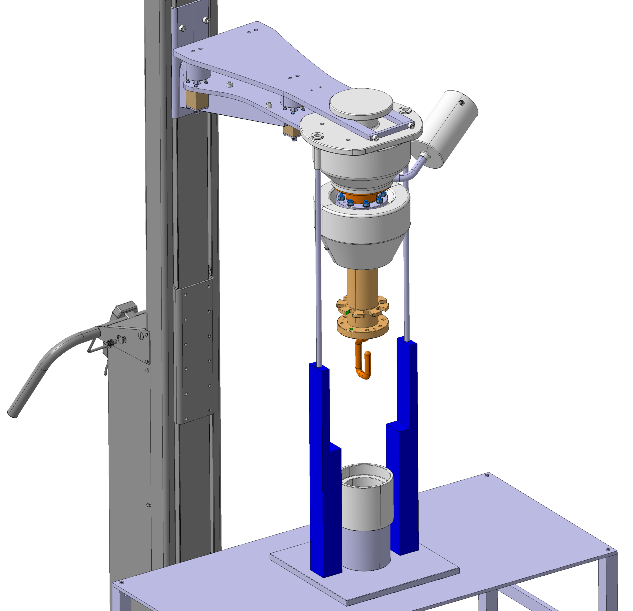

Flipbook: FPC RFD Mounting
Assembly FPC with outer pipe
Add the spacer
ST1425694_01

Slide 16
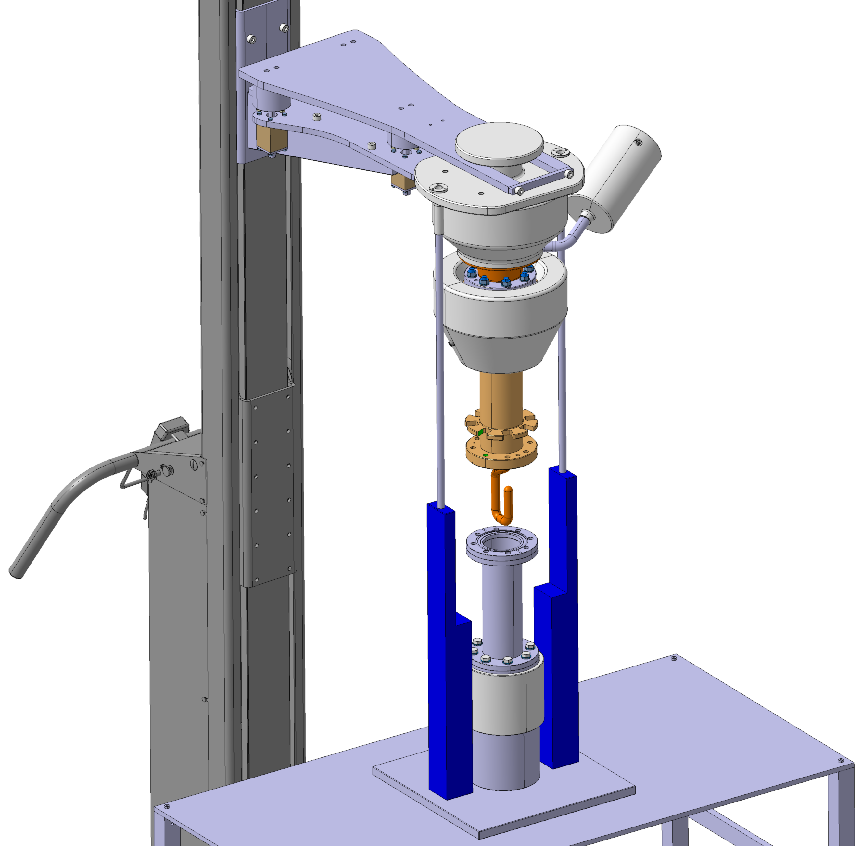
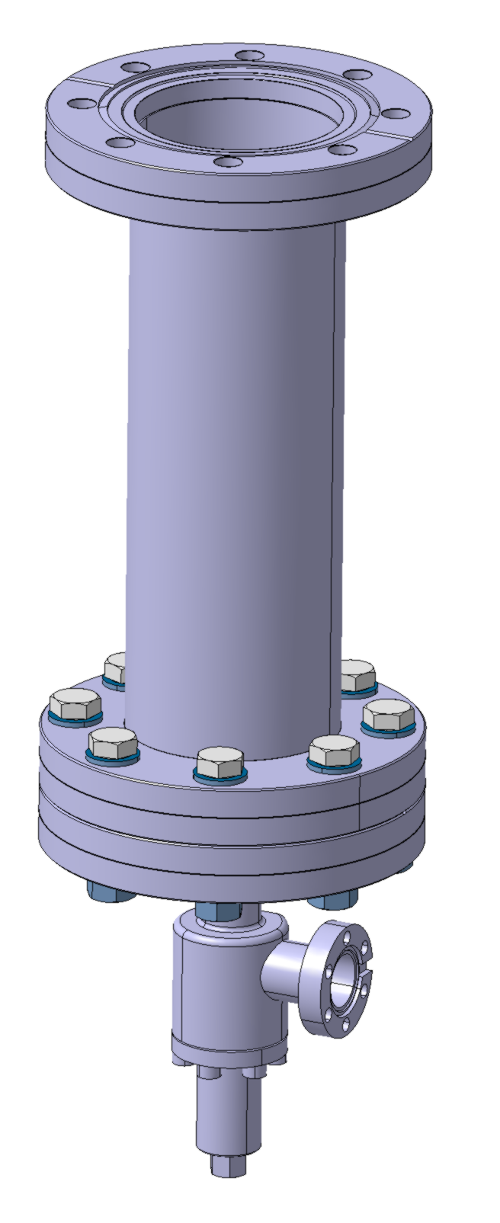
Flipbook: FPC RFD Mounting
Assembly FPC with vacuum chamber
Add the vacuum chamber DN63

Slide 17

Flipbook: FPC RFD Mounting
Assembly FPC with vacuum chamber
Mount DN63 standard seal

Slide 18
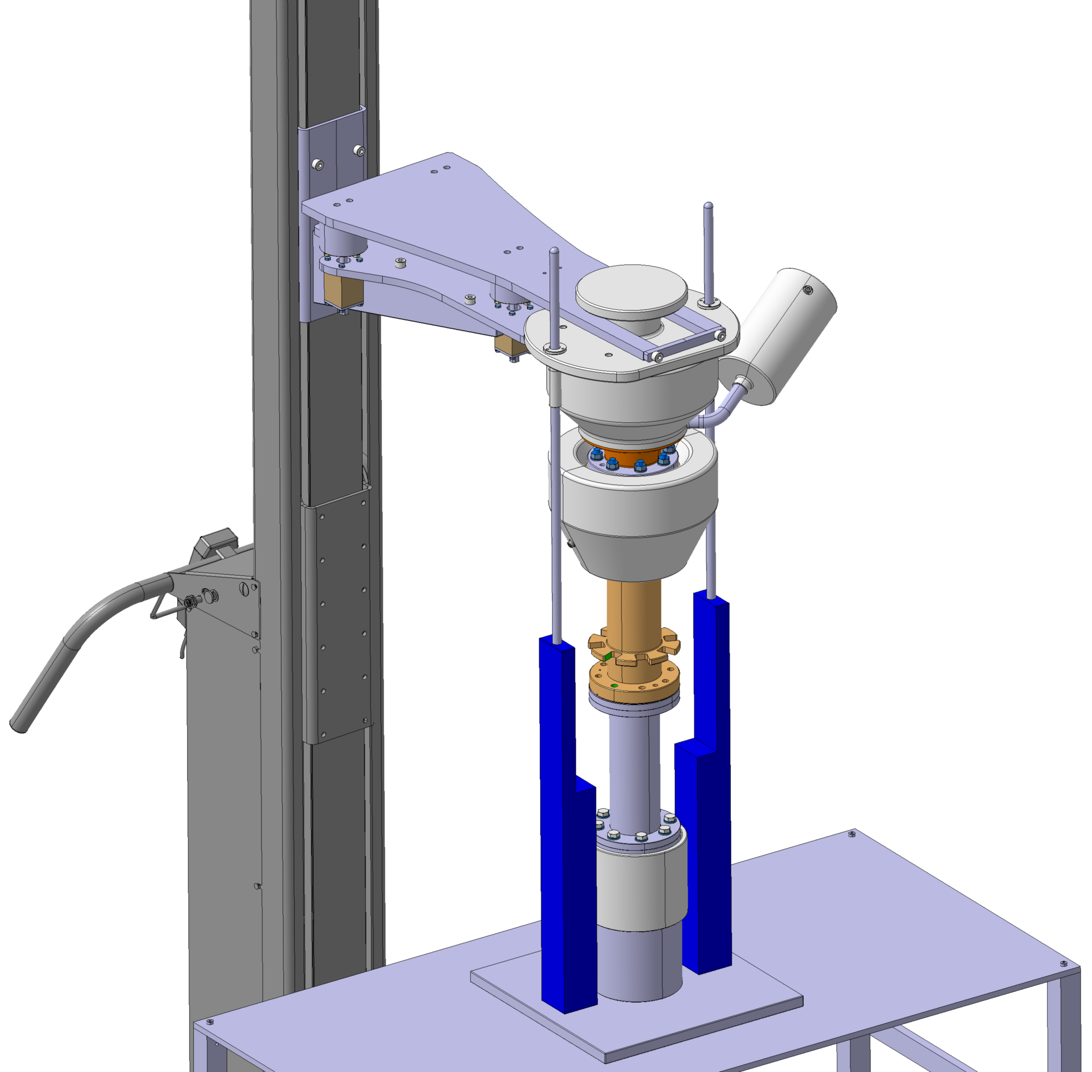
Flipbook: FPC RFD Mounting
Assembly FPC with vacuum chamber

Slide 19

Flipbook: FPC RFD Mounting
Assembly FPC with vacuum chamber
Mount UHV DN63 BOLTS

Slide 20
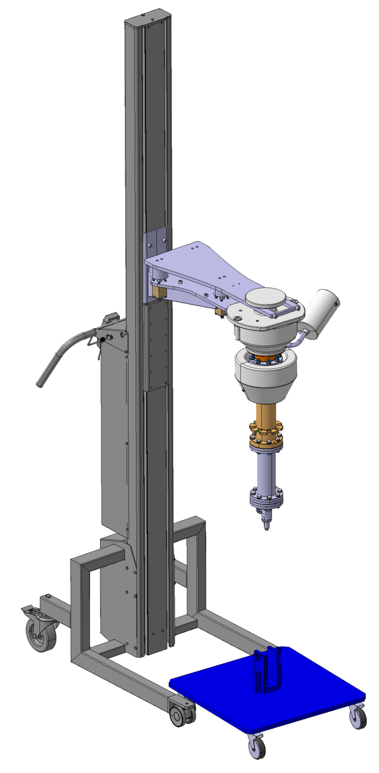
Flipbook: FPC RFD Mounting
Assembly FPC with trolley

Slide 21
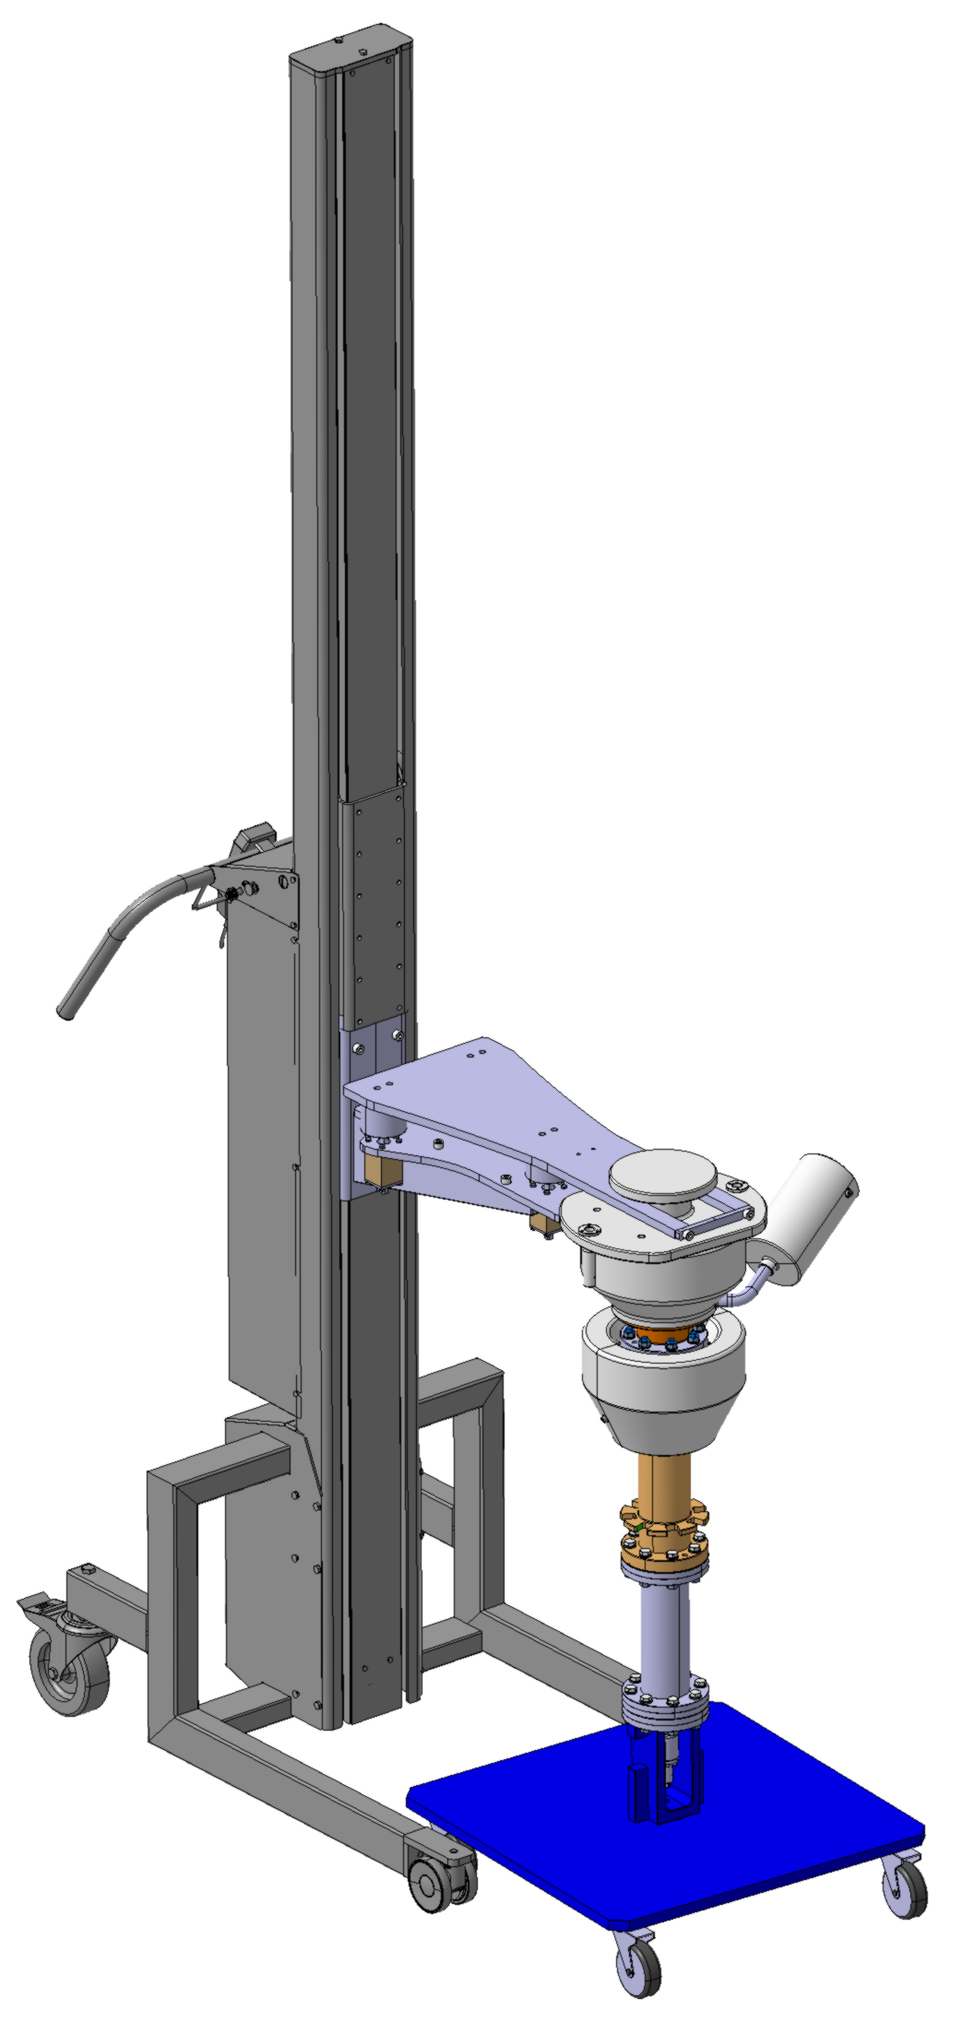
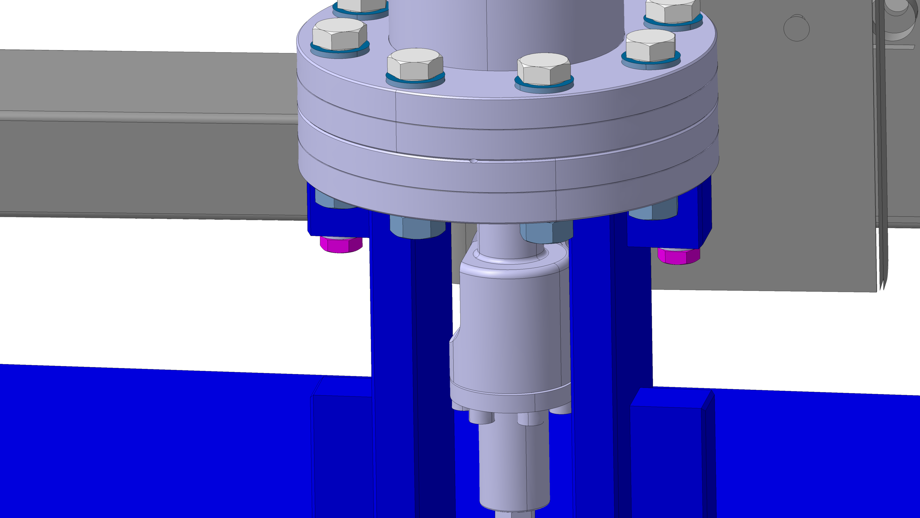
Flipbook: FPC RFD Mounting
Assembly FPC with trolley
Mount 2 x M8x35 and washer

Slide 22
Flipbook: FPC RFD Mounting
Assembly FPC with vacuum chamber
Ready for helium leak test inside clean room
Double plastic bag before extract the assembly from the clean room
VACUUM TRANSFER CHAMBER
LHCACFMC0208

