Slide 1

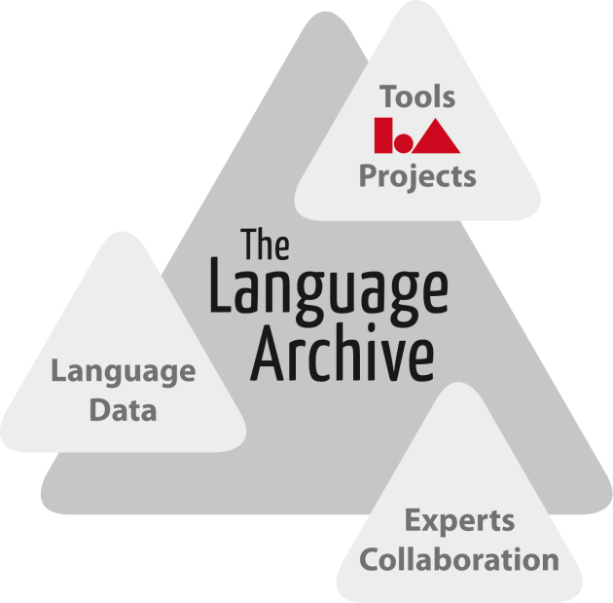
Riding the wave
After the EU HLEG Report
Vision (and Reality) about accessing Research Data
Peter Wittenburg, (Krister Linden)
The Language Archive - Max Planck Institute for Psycholinguistics
Nijmegen, The Netherlands

Slide 2
Outline
Group and Motivation
The Research Data World
Opportunities and Challenges
Collaborative Data Infrastructure
Other Relevant Aspects
Vision 2030
Action Points

Slide 3
EC DG InfSo invited 11 experts and 12 contributors to 6 meetings
Chair: John Wood; Rapporteur: David Giaretta; Members: Thomas Andersson ; Achim Bachem; Christoph Best ; Françoise Genova ; Diego R. Lopez; Wouter Los; Monica Marinucci; Laurent Romary; Herbert Van de Sompel; Jens Vigen; Peter Wittenburg; DG InfSo Representatives: Konstantinos Glinos; Carlos Morais-Pires;
HLEG and Motivation
Goals
  come up with a vision 2030 for the management of research data as a
  guideline for future actions of the EC
  discuss all relevant aspects around “data” in an unbiased manner
  accelerate measures to take care of our data and to remain competitive
Motivation
  enormous increase in scale and complexity
  not only summarize what some of us already know or are doing, but
  facilitate a systematic and global approach and push ahead actions
  knowledge is power - data has a value although difficult to quantify

Slide 4
Digital Agenda for Europe the policy context
DAE is one of the flagships of “Europe 2020: a strategy for smart, sustainable and inclusive growth”

Slide 5
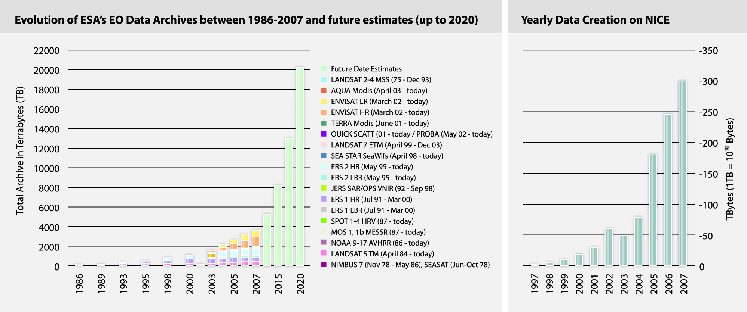
Trends are Known
“A fundamental characteristic of our age is the raising tide of data – global, diverse, valuable and complex. In the realm of science, this is both an opportunity and a challenge.”

Slide 6
Outline
Group and Motivation
The Research Data World
Opportunities and Challenges
Collaborative Data Infrastructure
Other Relevant Aspects
Vision 2030
Action Points

Slide 7
Research Data World
Knowledge Cycle is changing
it’s increasingly automatic
also manual operations (crowd sourcing)
analysis
enrichment
temporary
data
referable
data
citable
publication
increasing
volumes
raw data
description
registration
preservation
Exabyte scale and millions of related files of different types create
unseen complexity - deal with a new quality
much relevant data is and will not be registered
(80 % of recordings about languages and cultures are endangered)

Slide 8
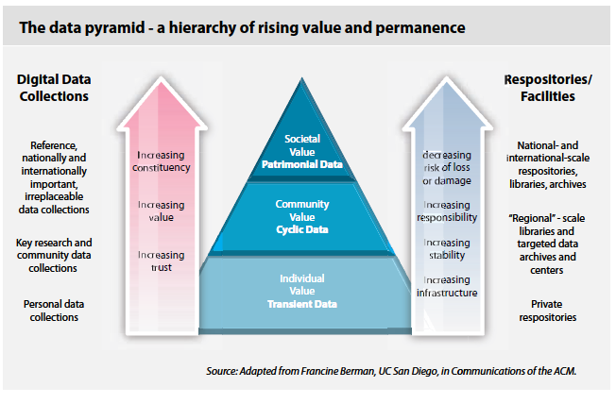
Berman’s classification
this is the data we need to take care of
but do we know which data will be of relevance for future generations?

Slide 9
Research Data World
some interesting aspects
  lossless separation of content and carrier in the digital domain
  changes the world - some speak about a revolution comparable with
  the invention of book printing
  data creators are not known personally to data users anymore - we need
  to solve the trust problem
  there is no doubt: data accessibility changes nature, pace and direction
  of research
  diversity in many dimensions is the dominant feature of scientific
  information and this will probably increase due to the inherent
  innovation forces
  technology allows to include the citizens in different roles - also as
  contributors, increasing volume and complexity
  increasing pressure towards open access

Slide 10
Outline
Group and Motivation
The Research Data World
Opportunities and Challenges
Collaborative Data Infrastructure
Other Relevant Aspects
Vision 2030
Action Points

Slide 11
Opportunities and Challenges
virtual integration
  integrating large data sets across disciplines and countries to
  create new insights
  recombining data to virtual collections from different perspectives
  sufficient data as basis for holistic modeling and understanding
  data intensive science: find correlations and draw inferences not
  constraint by pre-assumptions - huge amounts of data not used
tackling the grand challenges resulting from human activities
  climate change, sustainable energy, stability health, etc.
  stability of our societies and minds given the innovation, changes,
  globalization and migration
facilitating the many “small research questions” driven by
scientific curiosity
relieve researchers from data management and curation efforts

Slide 12
Opportunities and Challenges
however there are quite some hurdles to overcome
  need to change culture and researchers minds to deposit data
  need to establish trust at depositor’s and user’s side
  trust has to do with data quality, integrity and authenticity
  need to convey context and provenance to allow users to understand
  need new responsibilities and new mechanisms to solve
  data curation, preservation, organization and granting access
  without ignoring security and ownership principles
  need incentives for researchers to deposit in proper quality so that
  data publication helps in career and reputation building

Slide 13
Outline
Group and Motivation
The Research Data World
Opportunities and Challenges
Collaborative Data Infrastructure
Other Relevant Aspects
Vision 2030
Action Points

Slide 14
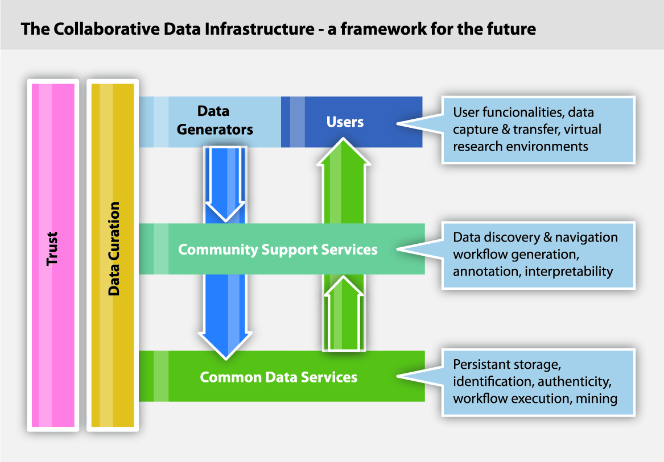
Collaborative Data Infrastructure
obviously we need a new layer of responsibility:
a systematically constructed and global data infrastructure
some already working on data organizations - piecemeal, fragmented
we call it a Collaborative Data Infrastructure open for many players and
heterogeneity based on an abstract architecture and proper APIs
so many researchers from different disciplines and with different interests
need experts close to the communities knowing the methods, traditions and cultures
(research infrastructures)
CLARIN, CESSDA, DARIAH, LifeWatch, ENES, EPOS, etc.
need a layer to take care about all common, cross-discipline services
EUDAT, OpenAIRE, D4Science, etc.
are faced with large heterogeneity
need an architecture

Slide 15
Collaborative Data Infrastructure
some requirements/characteristics
  balance flexibility and reliability, secureness and openness, local
  operation and global integration, affordability and high performance
  integration and interoperability require standards and agreements
  nevertheless CDI may not hinder flexibility and openness
  CDI needs to preserve data, protect integrity, detect unauthorized
  alterations, give access to everyone, define levels of access, help in
  understanding and querying and protect privacy
  CDI needs to be scalable and offer redundancy
  common services layer to be cross-discipline and cross-border
  there is no one technology that fits all - but fragmentation is inimical
  distributed based on organic processes - not one central organization
  need to define interoperability:
  can only be at data object and not at data content level
let’s not look in detail
will not be trivial to achieve

Slide 16
Collaborative Data Infrastructure
Climatology
coming there is a step-wise
and layered process requiring
some time and proper
abstractions - but needs to be
driven bottom-up
don’t have to start from scratch!
Biology
Astronomy
Chemistry
History
Astronomy
History
Earth Science
Biology
Researcher 2
Earth Science
Common Science Data Infrastructure
Researcher 1
Community Support Services
Chemistry
Data Services
Aggregation in broad disciplines
Non Scientific World
Earth Observation
Climatology
Crystallography
Ground Truth
Bio-chemistry
Earth Science
Physical chemistry
but success depends on
careful, coordinated and
agile planning
Separate disciplines

Slide 17
Outline
Group and Motivation
The Research Data World
Opportunities and Challenges
Collaborative Data Infrastructure
Other Relevant Aspects
Vision 2030
Action Points

Slide 18
Other Relevant Aspects
funding
  need to understand data as a socio-economic treasure in a competitive
  domain - at the end research is about global competition
  need proper business models - who is paying, which data is free, etc.
  governments will have to reserve funds for data management
quality and impact
  need to measure quality and impact, which metrics are meaningful
  need to reward contributors
management/curation skills
  need a new type of experts: data scientists
power researchers
  resulting CDI will be complex as the data world will be
  need to educate and train a new generation of power users
ecology
  uncontrolled copying of data sets is not ecological
  need to take care of green computing principles

Slide 19
Outline
Group and Motivation
The Research Data World
Opportunities and Challenges
Collaborative Data Infrastructure
Other Relevant Aspects
Vision 2030
Action Points

Slide 20
Vision 2030
All stakeholders, from scientists to national authorities to general public are aware of the critical importance of preserving and sharing reliable data produced during the scientific process.
Researchers and practitioners from any discipline are able to find, access and process the data they need. They can be confident in their ability to use and understand data and they can evaluate the degree to which the data can be trusted.
Producers of data benefit from opening it to broad access and prefer to deposit their data with confidence in reliable repositories. A framework of repositories work to international standards, to ensure they are trustworthy.

Slide 21
Vision 2030
Public funding rises, because funding bodies have confidence that their investments in research are paying back extra dividends to society, through increased use and re-use of data.
The innovative power of industry and enterprise is harnessed by clear and efficient arrangements for exchange of data.
The public has access and can make creative use of the huge amount of data available; it can also contribute to the data store and enrich it.
Policy makers can make decisions based on solid evidence, and can monitor the impacts of these decisions.
Global governance promotes international trust and interoperability.

Slide 22
Outline
Group and Motivation
The Research Data World
Opportunities and Challenges
Collaborative Data Infrastructure
Other Relevant Aspects
Vision 2030
Action Points

Slide 23
Action Points
HLEG requests
  need a CDI
  earmark additional funds
  develop new ways to measure data value and reward researchers
  train a new generation of data scientists and broaden understanding
  think green
  establish a high level coordination group
Recent Developments
  EUDAT got funds to work on CDI (15 communities, 8 centers)
  work on establishing a Data Access and Interoperability Task Force
    DAITF part of a rich landscape (IETF, ITU, OAI, ISO/IEC, etc.)
    example: ITU has signed an agreement to collaborate on a
  Digital Object Architecture

Slide 24
Thanks for your attention.

