Slide 1
Epoxy Chemistry
Research update
27. April 2021
Pascal Studer
Laboratory for Soft Materials
Notes:
Small update over chemistry work on epoxies

Slide 2
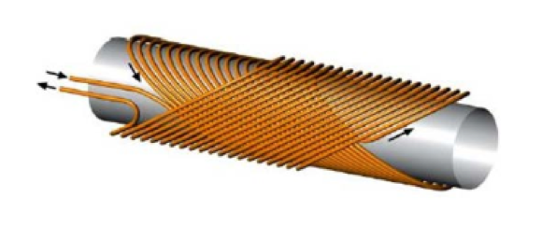
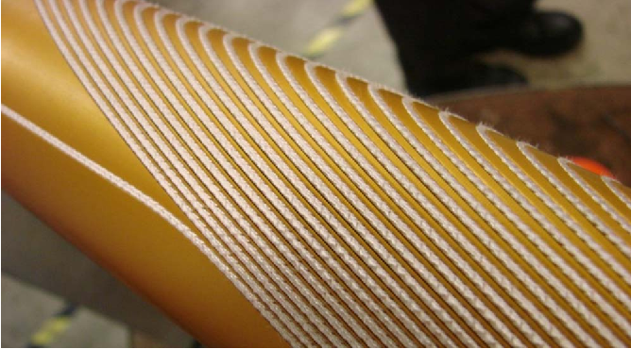
Superconducting electromagnets
Intro
Particles guided by magnetic fields
  Electromagnets, Lorentz force
  Operated in the superconducting state at very low temperatures
  Superconductor: NbTi / Nb₃Sn
CHART
  Swiss Accelerator Research and Technology
  Collaboration CERN,ETH, EPFL
  Future:
    FCC Collider from 2040, 100km circumference (LHC 27km)
    2061: Canted cosine theta Nb₃Sn coils for accelerating protons
resulting B-field direction
Particle trajectory

Slide 3
Current research topics
Characterisation of Araldite CY192-1 / HY918 system
Phenoxy resins
  Linear polymers which potentially exhibit high fracture toughness at cryogenic temperatures
High Tg-epoxy (Tg > 140°C)
  For engineering a specific epoxy composite with UHMWPE
High K_{1c}-epoxy by adding reactive diluents to high Tg epoxy

Slide 4
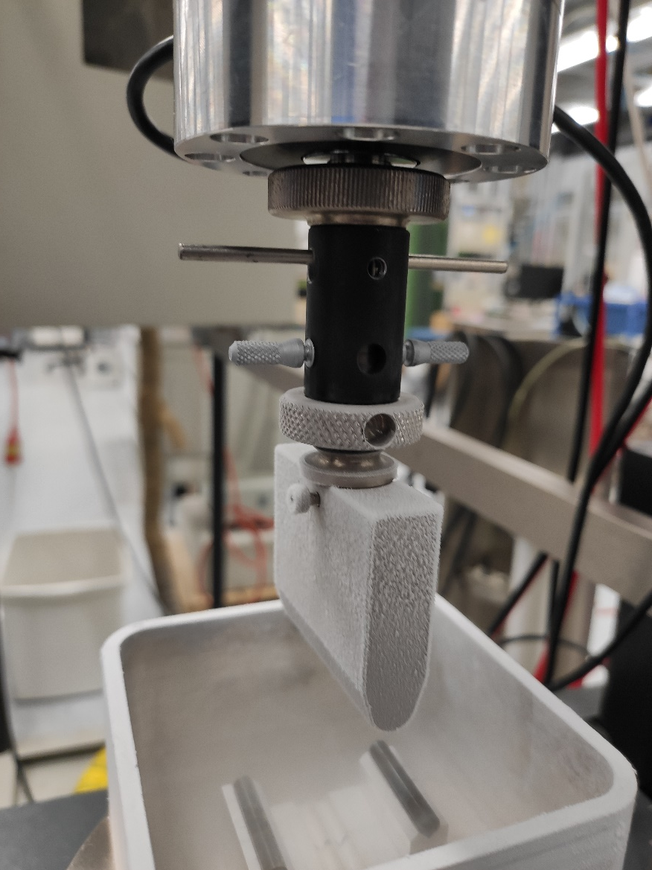
Araldite CY192-1 / HY918
T_{g}: 89°C by DSC (inflection point)
Fracture toughness: KIc
  Significant increase at lower temperature, but still low compared to MY750!
RT | LN2
0.87 | 2.79
0.92 | 2.07
0.86 | 2.57

Slide 5
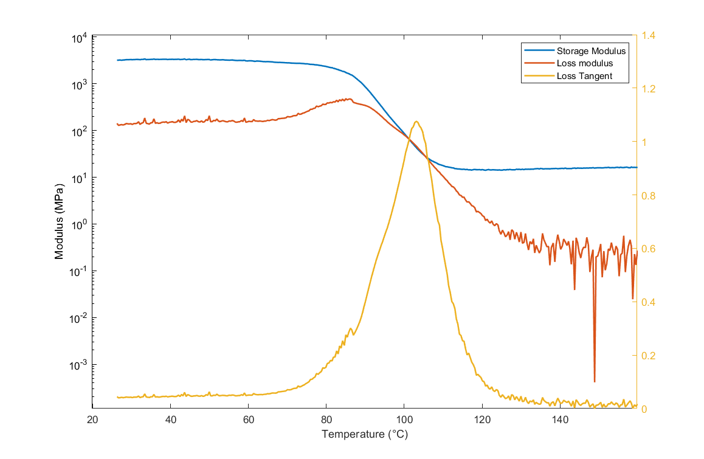
Araldite CY192-1 / HY918
DMTA
  3-point bending, 1 Hz, 0.02% strain, 2°C/min
  E‘ at 25°C: 3.2 GPa
  Tg from max(tanδ ): 103°C
Flexural bending:
  E‘ at 25°C: 3.06 GPa

Slide 6
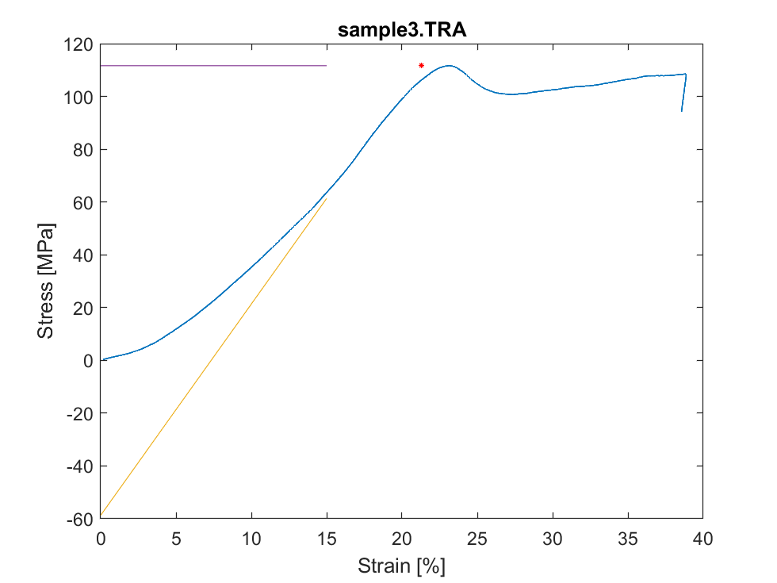
Araldite CY192-1 / HY918
Compression testing at 0.1s⁻¹
  Brittle fracture in LN2
  At RT:
Yield strain (%) | Yield stress (Mpa)
22.1 | 116.3
21.3 | 111.6
20.3 | 109.0

Slide 7
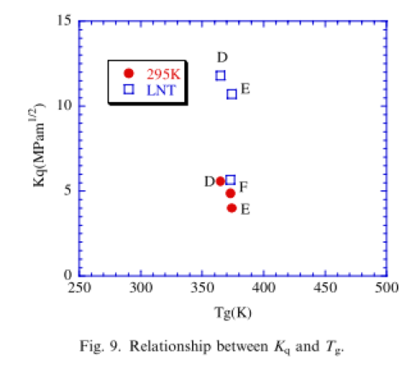
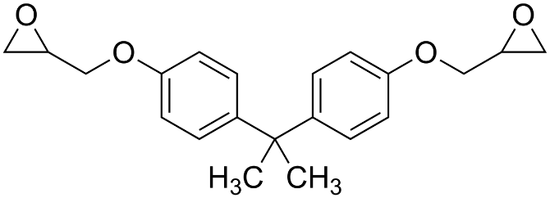
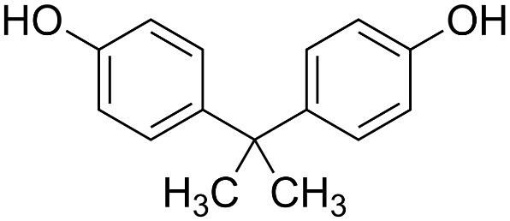
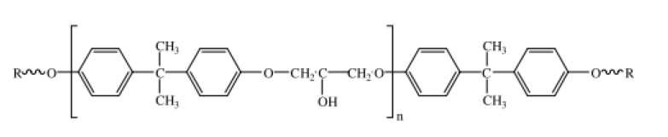
Phenoxy resins
Phenoxy resins are mainly linear
  Increased fracture toughness at cryogenic temperatures
D: DGEBA + BPA
E: DGEBiphenyl + BPA
F: Novolac + BPA
DGEBA
BPA
Health
Hazard!
Epoxies for cryogenic use: Ueki et al., Cryogenics, 2004, DOI: 10.1016/j.cryogenics.2004.07.002
Notes:
Reaction of DGEBA with a diol, here BPA, to give linear polymer
Equimolar amounts
High K1c at liquid nitrogen temperature, reason why

Slide 8
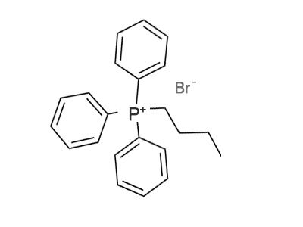
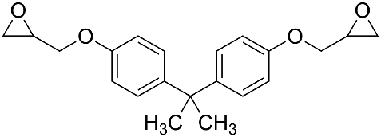
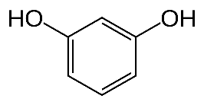
Phenoxy resins
Lower melting point (110°C)
Less toxic
Lower viscosity
Starting system
  Example: 14.72g DGEBA, 4.74g RSO, ~6.8mg catalyst
  A and B: equimolar amount
Hardener
Resorcinol (RSO)
(B)
Latent catalyst
Butyl triphenyl phosphonium bromide
(C)
Resin
DGEBA
(A)
1 : 1
Example synthesis: Shih et al., J. appl. Polym. Sci., 1999, ISSN: 00218995
Notes:
No glovebox, health concerns → I use resorcinol instead of BPA
RSO is a solid at room temp, but less toxic.
The only paper I found, they used also a catalyst in the reaction, which I also used from the beginning
The catalyst is a phosphonium bromide
According to some research, acts as Lewis acid, coordinates to O of epoxide, making the adjacent carbon atom more susceptible to nucleophilic attack
The catalyst becomes much more active at elevated temperatures

Slide 9

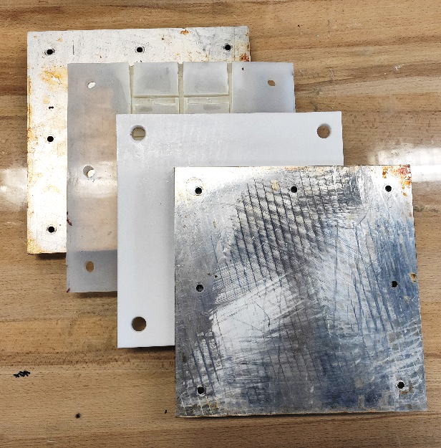
Phenoxy resins
Current processing method
Liquify mixture
Degas
Add catalyst
Fill mold
N₂
Steel
30 min.
10 min @ 10 mBar
PDMS
PTFE
Steel
A+B+C
A + B
A + B
125°C
125°C
125°C
30 min.
(Catalyst stored in vacuum @ 50°C)
Mold preheated to 130°C
Cure
~30 min @ 200°C
Example synthesis: Shih et al., J. appl. Polym. Sci., 1999, ISSN: 00218995
Notes:
Mix resin and hardener under nitrogen bubbling at 125°C to melt the hardener, which has a melting point of 110°C
I degas the mixture for 10 minutes at 10 mbar
Add the catalyst
Then, fill the mold, which is preheated to 130°C
- Curing reaction 15 mins (DSC) @ 200°C
- Quite brittle product, probably low molecular weight

Slide 10
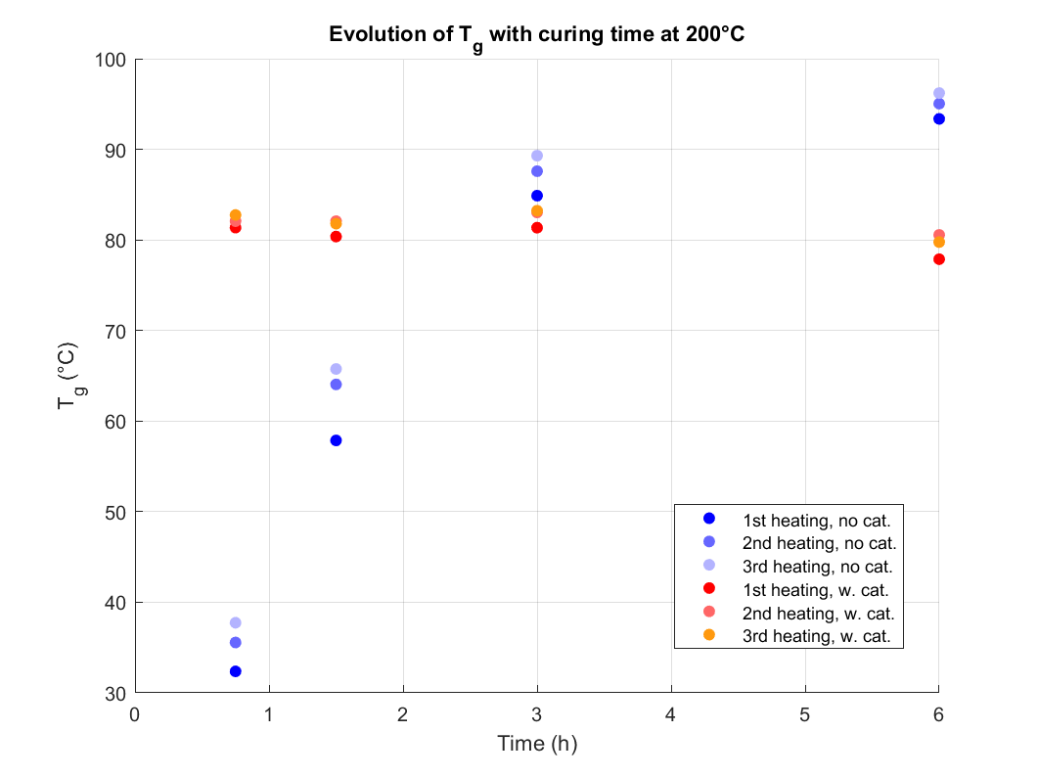
Phenoxy resins
Results
  Effect of catalyst on curing times
  More catalyst results in higher Tg
With catalyst
Without catalyst
Notes:
Reaction is also possible without catalyst, but takes much longer
Right side; experiment where I stopped the curing reaction of samples in glass vials after certain times and run DSC to determine Tg, indicative of degree of cure
Reaction without catalyst takes much longer, but results in higher Tg
Not forced to use a catalyst, so I continued without catalyst
Samples made without catalyst also feel tougher

Slide 11
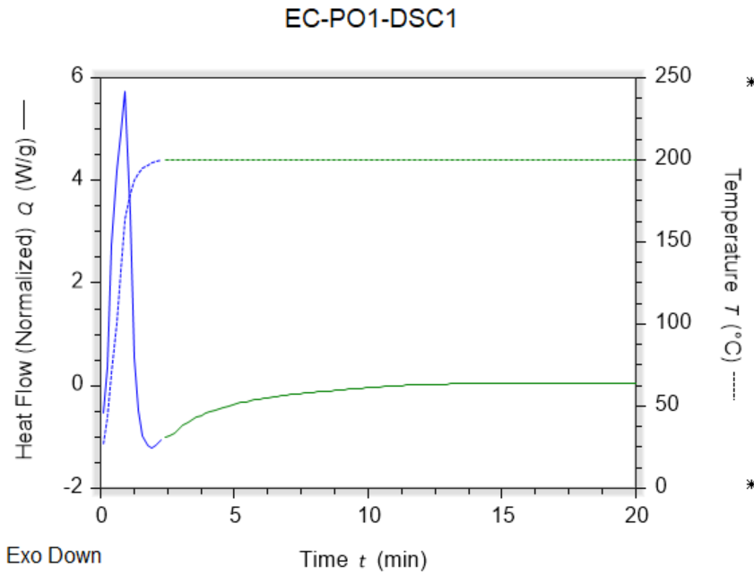
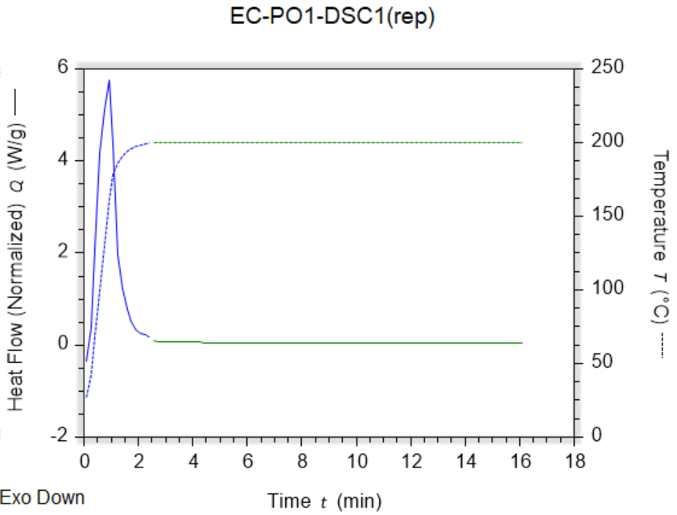
Phenoxy resins
DSC: Short curing time with catalyst: Approx. 15 min.
1st measurement
Repetition (same sample)
~15 min.
Notes:
The use of resorcinol instead of bisphenol a has three reasons:
1. Resorcinol has a lower melting point, 110°C instead of 168°C for BPA
Bisphenol A is a health hazard to be taken serious
The smaller molecule of resorcinol results in a lower processing viscosity

Slide 12
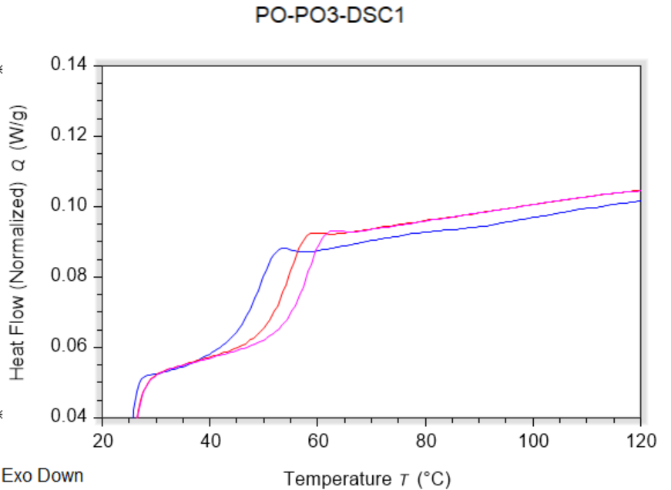
Phenoxy resins
Results
  DSC ramp on cured sample: Tg ~ 50°C, probably low molecular weight
Notes:
The use of resorcinol instead of bisphenol a has three reasons:
1. Resorcinol has a lower melting point, 110°C instead of 168°C for BPA
Bisphenol A is a health hazard to be taken serious
The smaller molecule of resorcinol results in a lower processing viscosity

Slide 13
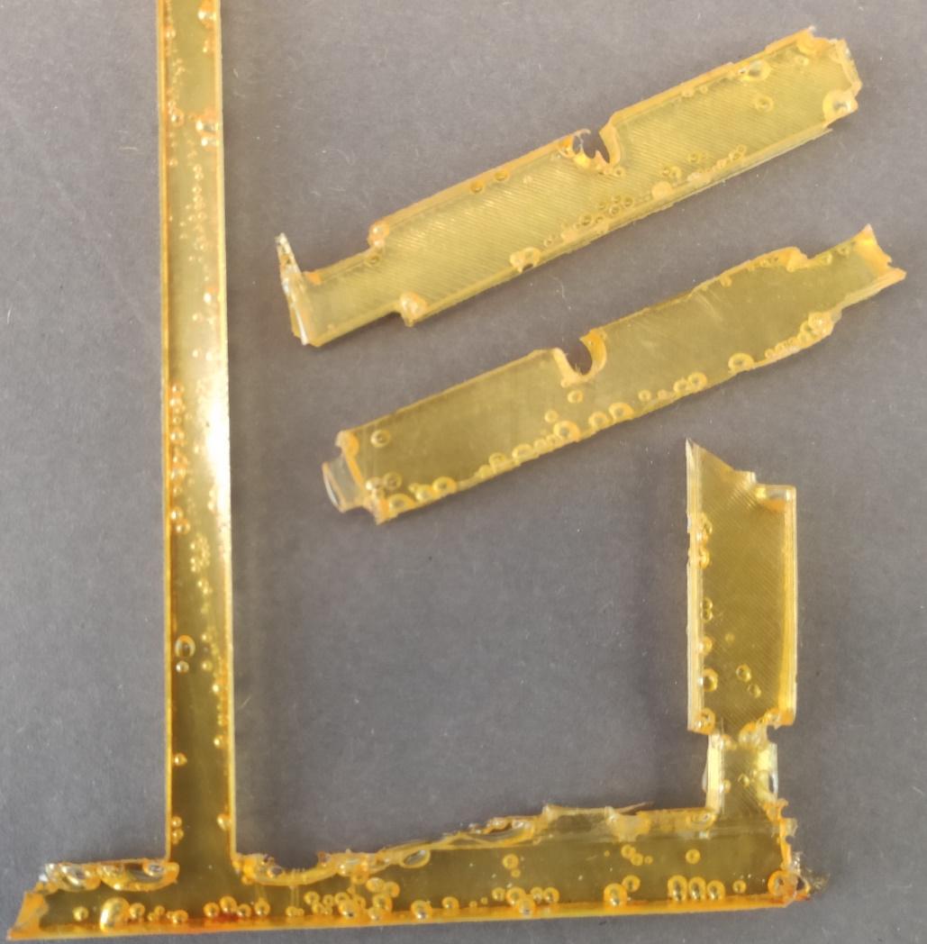
Phenoxy resins
Problem: Bubbles in the samples
  Water bubbles due to condensation of hydroxy-groups?
    No, mass loss during curing insignificant
      4.0 Mass. ‰ without catalyst
      1.9 Mass. ‰ with catalyst
  Catalyst interaction with PDMS mold?
    No, samples cured without catalyst also have bubbles!
    Without catalyst: Longer curing time (~6h)
  Residual gas in the mixture?
    Probably no
      When degassing at 10mbar, first strong bubbling, then less and less
      Going to lower pressures, mixture begins boiling
      Resorcinol: Vapour pressure P=3.35 mBar @ 125°C (Antoine Equation)
Trying a lower curing temperature…
Notes:
Bubbles, different explanations
But don‘t know why yet
We think that the PDMS mold reacts with one of the components or is already decomposing
Small stop here, for suggestions or questions

Slide 14
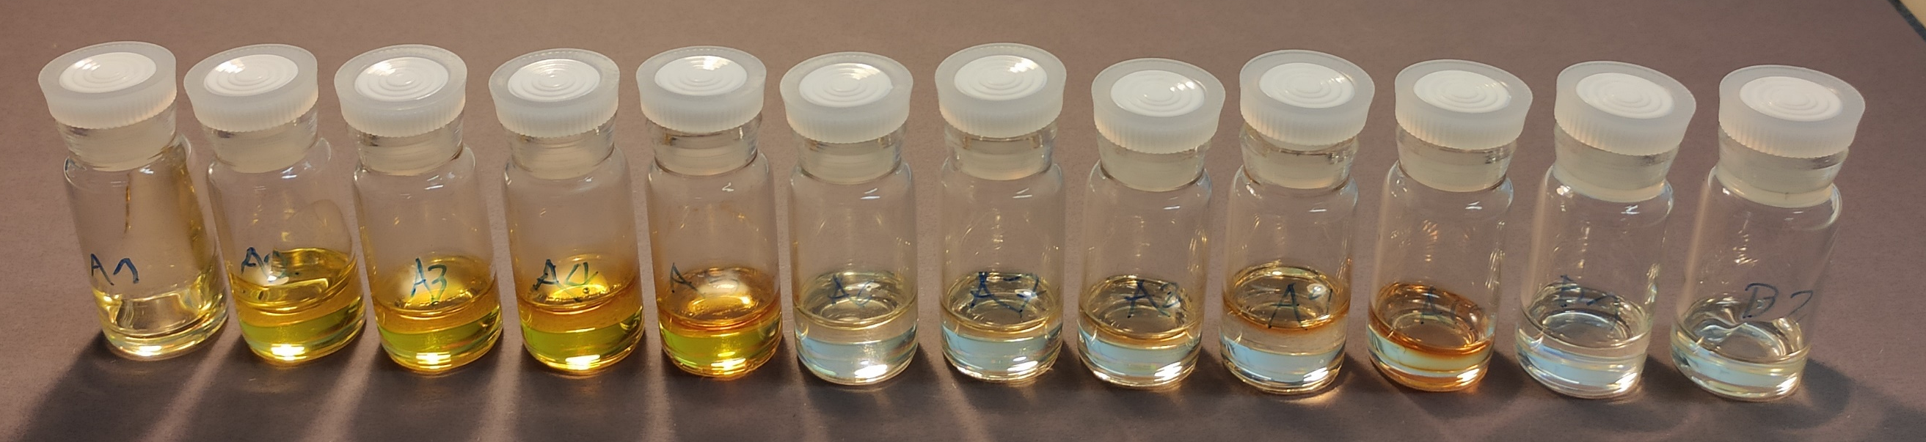
Phenoxy resins
T_{Cure} = 165°C
Samples for DSC study
1,6-Hexanediol
Instead of
Resorcinol
Non-catalyzed
catalyzed
1h 2h 4h 7h 14h
1h 2h 4h 7h 14h 14h 14h
Liquid „Honey-like“ liquid
Notes:
Reaction is also possible without catalyst, but takes much longer
Right side; experiment where I stopped the curing reaction of samples in glass vials after certain times and run DSC to determine Tg, indicative of degree of cure
Reaction without catalyst takes much longer, but results in higher Tg
Not forced to use a catalyst, so I continued without catalyst
Samples made without catalyst also feel tougher

Slide 15
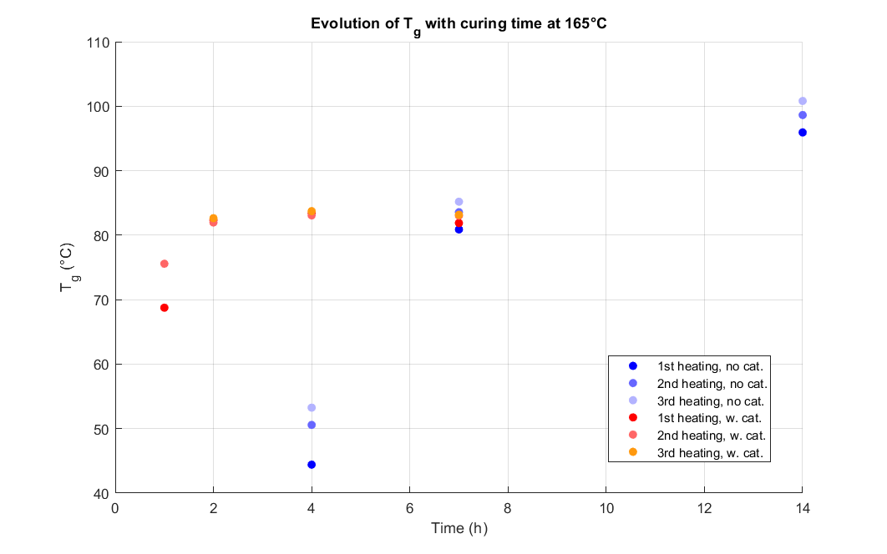
Phenoxy resins
T_{Cure} = 200°C T_{Cure} = 165°C → almost no bubbles!
Notes:
Reaction is also possible without catalyst, but takes much longer
Right side; experiment where I stopped the curing reaction of samples in glass vials after certain times and run DSC to determine Tg, indicative of degree of cure
Reaction without catalyst takes much longer, but results in higher Tg
Not forced to use a catalyst, so I continued without catalyst
Samples made without catalyst also feel tougher

Slide 16
Phenoxy resins – characterization
Single-etch notch bend specimens
  W x H x L ~ 5mm x 9mm x 40mm
  Tested with 200N loadcell @ Zwick
Calculated KIc values (MPa*m^{0.5})
RT | LN2
1.09 | 1.62
1.23 | 1.55
0.86 | 1.46
1.08 | 1.46
0.63
Notes:
Reaction is also possible without catalyst, but takes much longer
Right side; experiment where I stopped the curing reaction of samples in glass vials after certain times and run DSC to determine Tg, indicative of degree of cure
Reaction without catalyst takes much longer, but results in higher Tg
Not forced to use a catalyst, so I continued without catalyst
Samples made without catalyst also feel tougher

Slide 17
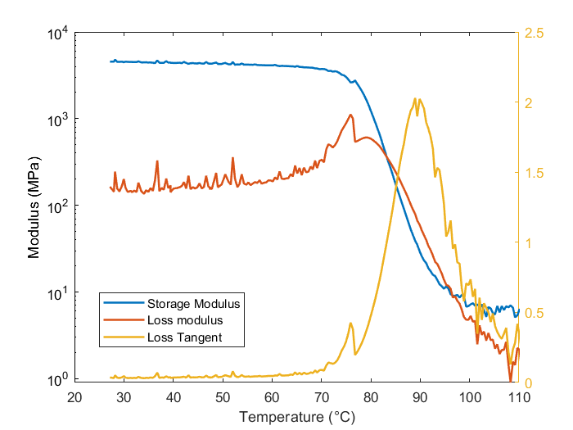
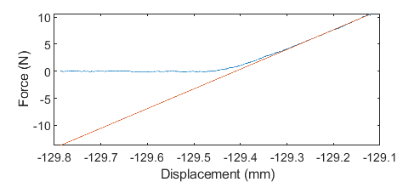
Phenoxy resins – characterization
Bending specimens
  W x H x L ~ 4mm x 3mm x 40mm
DMTA with ARES-G2
  1 Hz
  0.005 % strain amp.
  Temperature sweep @ 3°C/min
Flexural modulus with Zwick
  E‘ @ RT: 3.4 Gpa
  W x H x L ~ 5mm x 5mm x 60mm
E‘ ~ 4.5 GPa
Notes:
Reaction is also possible without catalyst, but takes much longer
Right side; experiment where I stopped the curing reaction of samples in glass vials after certain times and run DSC to determine Tg, indicative of degree of cure
Reaction without catalyst takes much longer, but results in higher Tg
Not forced to use a catalyst, so I continued without catalyst
Samples made without catalyst also feel tougher

Slide 18
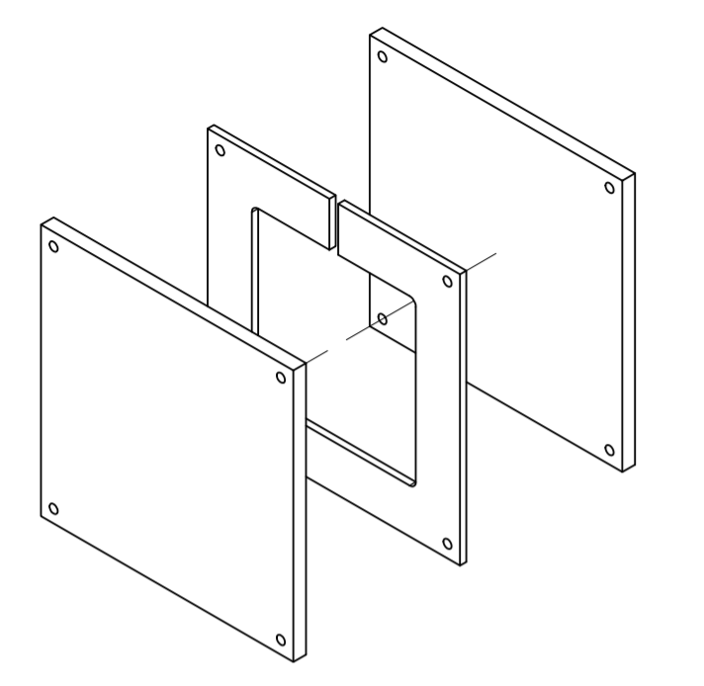
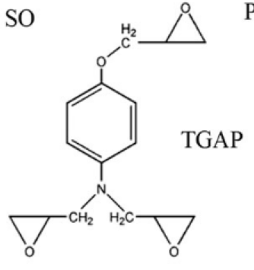
Phenoxy resins – Continuation
Lower Tg (~80°C) compared to samples cured in glass vial (~100°C)
Modulus seems dependent on sample dimensions
Still some bubbles, especially in thin samples
Dimension tolerances of samples could be better
Fracture toughness much lower than expected
→ move away from silicone mold
→ make PTFE mold for plates for water-jet cutting, design in progress
Notes:
Reaction is also possible without catalyst, but takes much longer
Right side; experiment where I stopped the curing reaction of samples in glass vials after certain times and run DSC to determine Tg, indicative of degree of cure
Reaction without catalyst takes much longer, but results in higher Tg
Not forced to use a catalyst, so I continued without catalyst
Samples made without catalyst also feel tougher

Slide 19
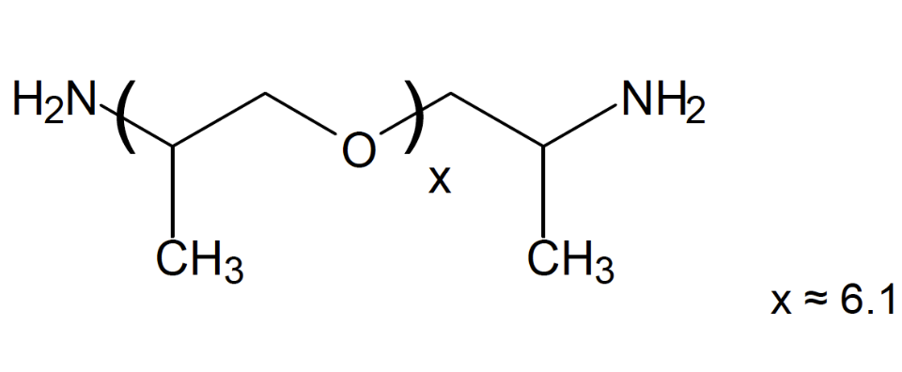
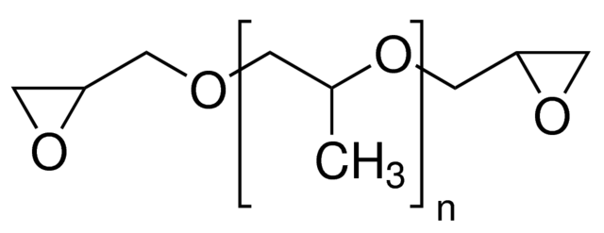
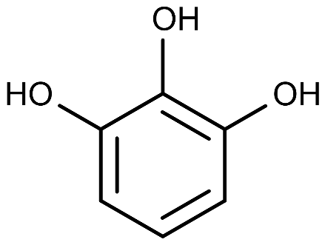
Phenoxy resins – Continuation
Advantage of phenoxy chemistry: Long curing time
Imitate the network structure of tough resins
  Use long difunctional monomers in network
  Or slightly crosslink the linear network using TGAP (trifunctional)
DGEBA (F=2)
Jeffamine (F=4)
Epoxy cured
With Jeffamine
Phenoxy
pendant
Pyrogallol (F=3)
Poly(propylene glycol) diglycidyl ether (F=2)
Notes:
Reaction is also possible without catalyst, but takes much longer
Right side; experiment where I stopped the curing reaction of samples in glass vials after certain times and run DSC to determine Tg, indicative of degree of cure
Reaction without catalyst takes much longer, but results in higher Tg
Not forced to use a catalyst, so I continued without catalyst
Samples made without catalyst also feel tougher

Slide 20
High T_{g} epoxy composite
Idea
Materials
  UHMWPE particles:
    Mitsui Mipelon PM-200
    Particle size ~10 microns
    Melting point: 140°C
  High Tg epoxy
    To be synthesized
UHMWPE
Epoxy
Melting
Pre-stressed
material
Notes:
In the next approach, main goal is to synthesize an epoxy composite with Tg higher than 140°C
The filler material, uhmwpe
Uhmwpe particles expand when molten
If the whole material is in a confined space, the expansion of particles upon melting would lead to compressive stress in the structure, given that epoxy is still below Tg

Slide 21
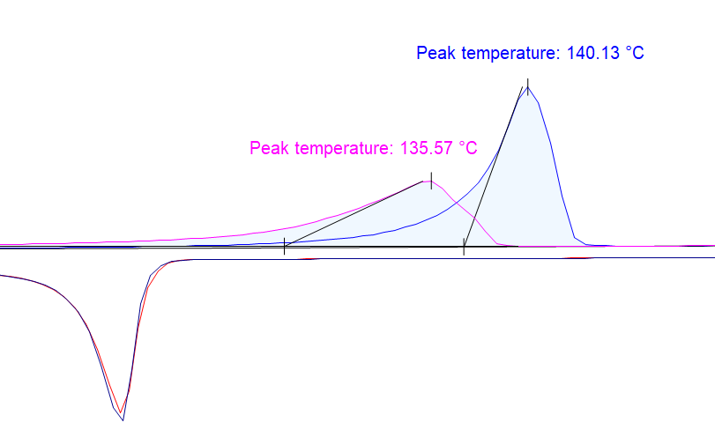

High T_{g} epoxy composite
Shrinkage of epoxy: About 1% over 200K
DSC of the UHMWPE powder
Calculations
p_{c} = 1.004 g/cm3
p_{a} = 0.853 g/cm3
∆c = 0.22
1.28% linear expansion (melting)
α_{PE} = 108*10⁻⁶ K⁻¹
∆T = 200K
→ 2.16% linear thermal expansion over 200K
Q (endo up)
T
Crystallinity: Drops from 69% to 47% upon melting
(Heat of melting: 186 J/g)
∆c = 0.22

Slide 22
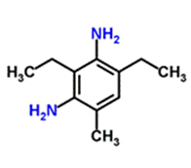
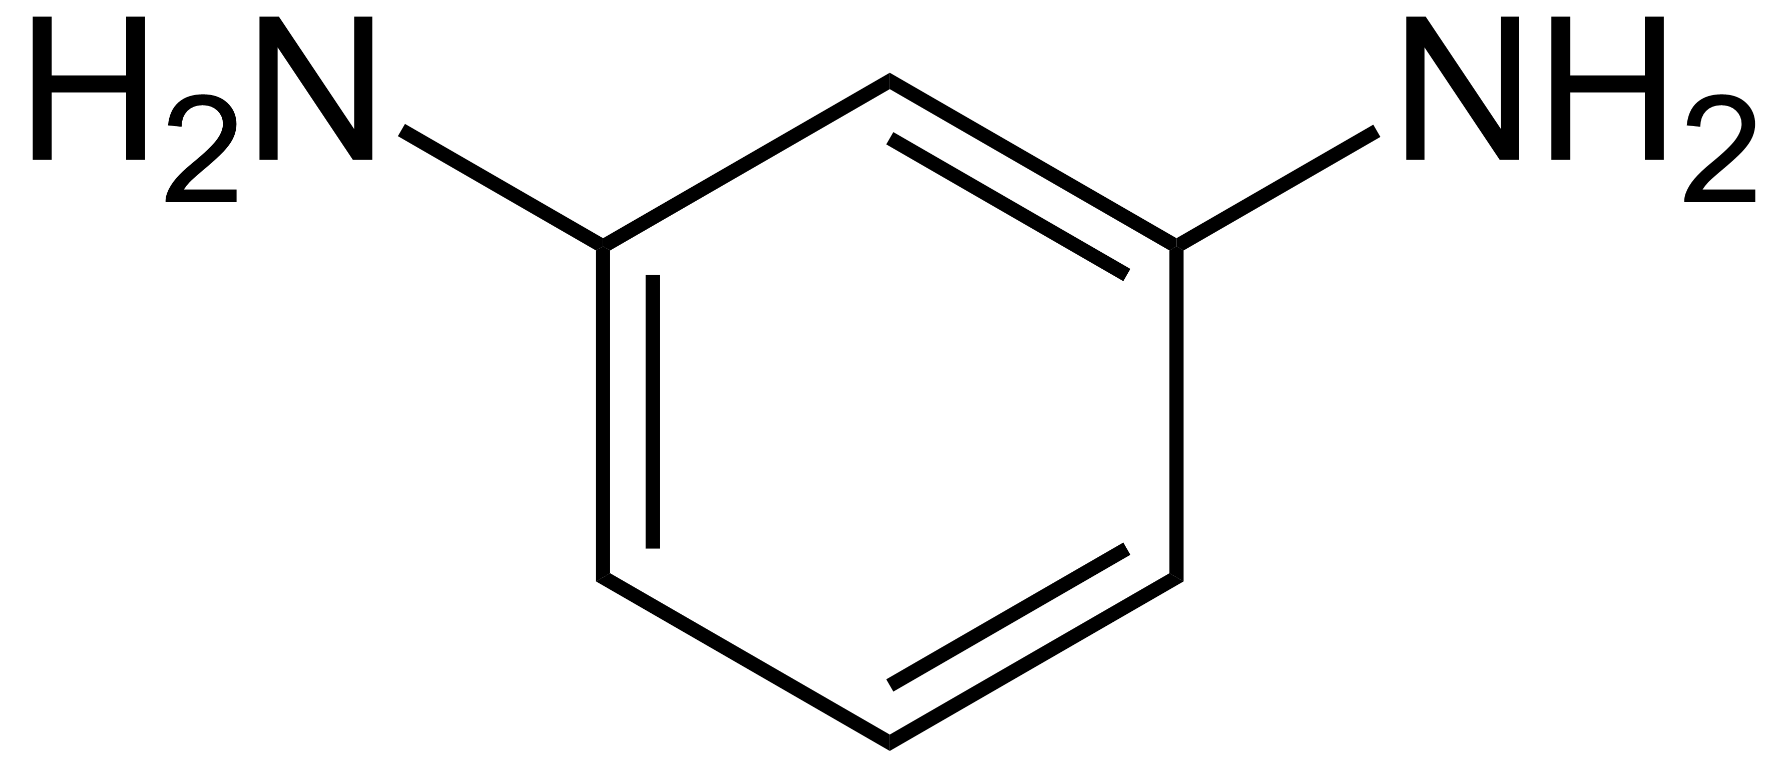
High T_{g} epoxy composite
Composition from reference paper
  DGEBA 100 pHr
  TGAP 20 pHr
  DETDA 34 pHr
  Miscible at 40°C, curing cycle: 100°C 60 min, 150°C 90 min., 177°C 120 min.
  Tg: 200°C
Materials I have in the lab
  DGEBA
  TGAP
  m-phenylenediamine
Melts at 64-66°C
References
Jin-Woo et al., J. Appl. Polym. Sci., 2012, DOI: 10.1002/app.38040
Notes:
I have pure DGEBA and m-phenylenediamine, both need to be molten, hope is that the curing is not too fast when I mix them for example at 60°C
I cannot use the curing cycle shown above, since the temp should not exceed the melting point of UHMWPE particles during curing, So I will not exceed 130°C
Would it be possible to use the MY750 resin from huntsman? It is liquid at RT
Does Huntsman provide DETDA

Slide 23
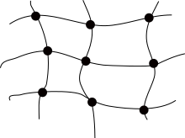
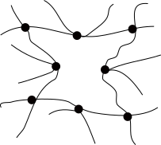
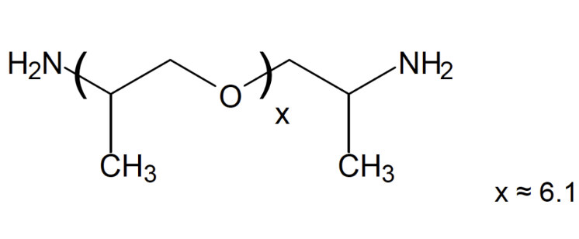
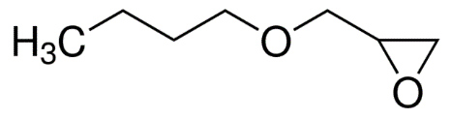
High KIc epoxy
Important research findings
  The toughness increases with increasing topological distance between crosslinks
  Approach: Reactive diluents, RESD, long-chain monomers such as Jeffamine
Euclidean distance
Topological distance
Reaction in presence of solvent,
Then drying
References
RESD; network topology: Sharifi et al., J. Mater. Chem., 2014, DOI: 10.1039/c4ta03051f
Reactive diluents: Jin-Woo et al., J. Appl. Polym. Sci., 2012, DOI: 10.1002/app.38040
Notes:
The topological distance also correlates with the apparent molecular weight between crosslinks as derived by rubber elasticity theory. A higher storage modulus above Tg (in the rubbery plateau) results in a lower calculated molecular weight between crosslinks.
Hypothesis: A higher topological distance between crosslinks results in a lower strain needed until covalent bonds must break → more energy can be dissipated before crack propagates

Slide 24
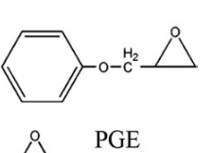
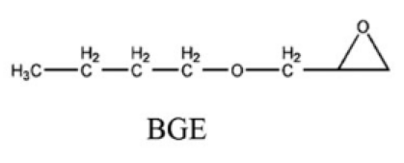
Idea for a epoxy with high fracture toughness
Start from a known high Tg resin: DGEBA, TGAP and DETDA
  Change network structure with reactive diluents, e.g. butylglycidylether, BGE
  Increases toughness of network
Lowers Tg
Does not affect Tg much

Slide 25
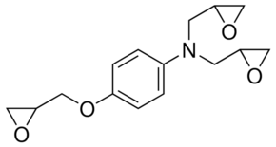
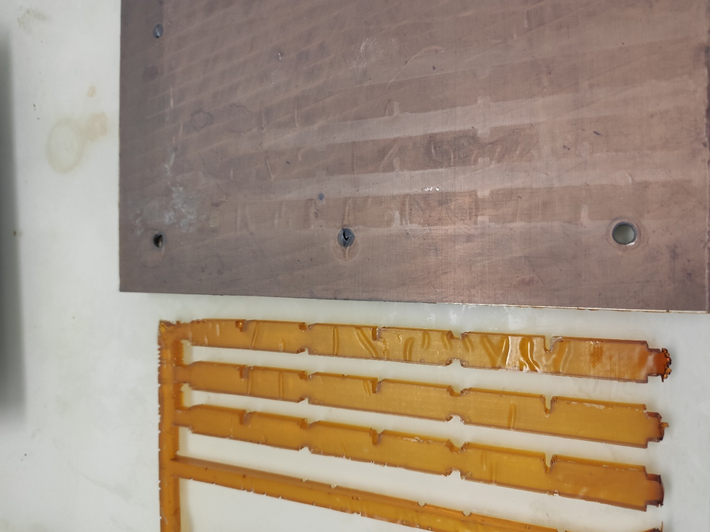
First result
Materials:
  Araldite MY750 DGEBA, ~5.3 equiv/kg 100 pHr
  TGAP: Tri-glycidyl p-aminophenol 20 pHr
  BGE: Butyl glycidyl ether 10 pHr
  MPD: M-phenylene diamine 22 pHr
Procedure
  Degassing at 75°C 10 min 10 mbar
  Curing: 100°C 60 min, 150°C 90 min, 177°C 120 min
Samples feel tough, testing to be done
Wrinkles on samples, from PTFE foil,
PTFE foil only wrinkled where sample was
Order thicker PTFE foil (this was 170g/m2)
Which kind available at PSI?

