Slide 1
LHC Sequencer Task
Kick Off Meeting
kick off meeting

Slide 2
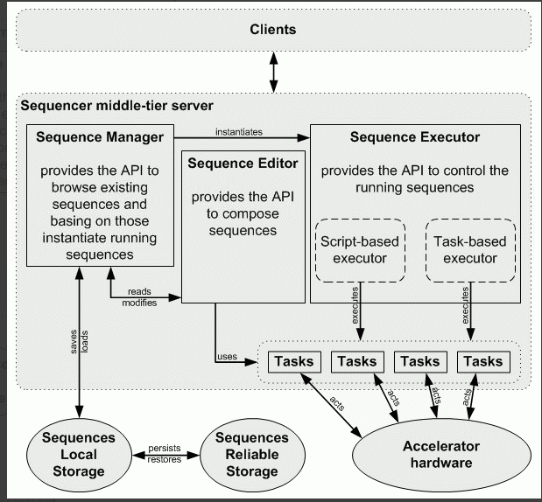
LHC Sequencer Principles

Slide 3
Types of sequences
Task based engine
  It is possible to assign on-error behavior to each task
  It is possible to easily run several tasks in parallel
  It is possible to easily jump from task to task
  It is possible to execute arbitrary task out of the sequence order
  It is impossible to use common programmatic structures like if-else, loops, try-catch-finally blocks.
  It is impossible to use variables as in programmatic languages. (However it is possible to use parameters which are defined before the sequence has started)
Script based engine.
  It is possible to use the full power of Java language: ** variables** constructs (if-else, loops, try-catch-finally blocks)*** type checking
  It is impossible to assign special on-error behavior to particular "task" since the notion of task is not even clear.
  It is impossible to jump from "task" to "task".
  It is not that easy (but possible) to run several activities in parallel.

Slide 4
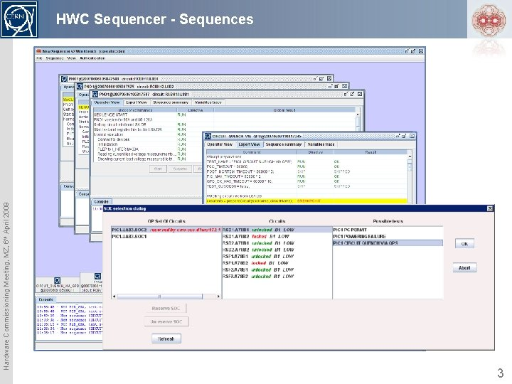
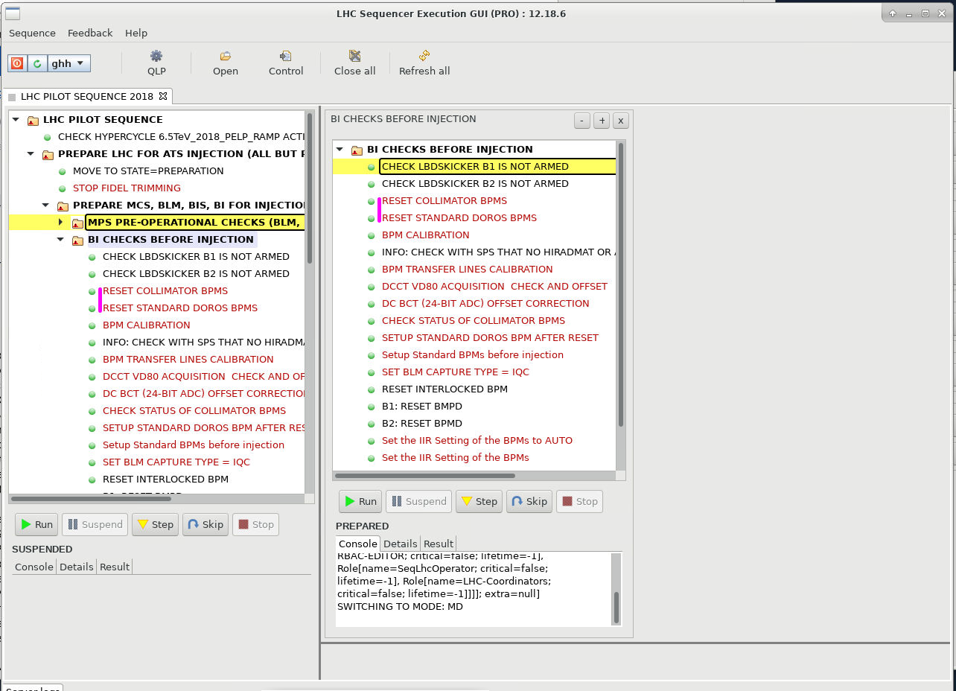

Slide 5
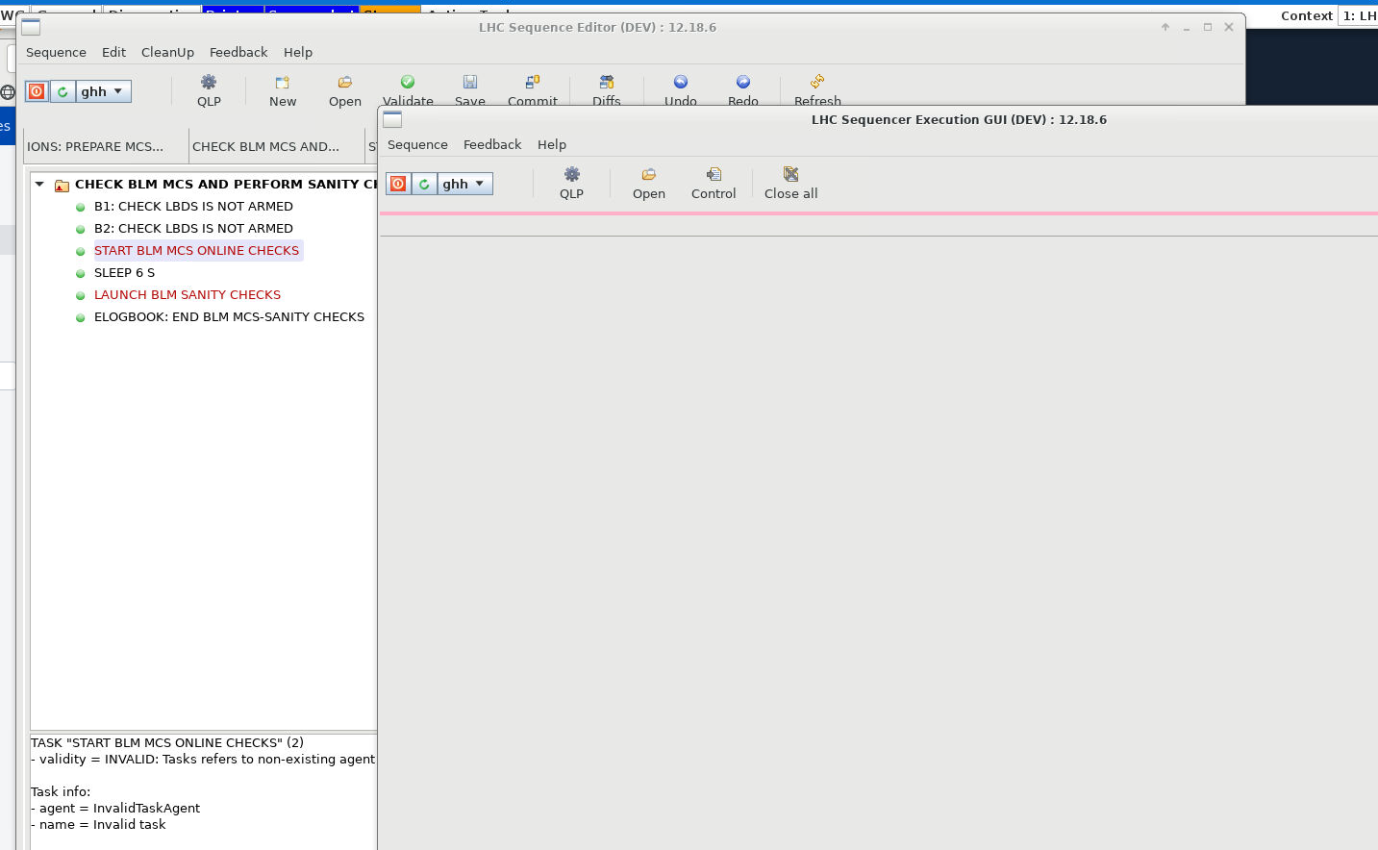
Sequence editor

Slide 6
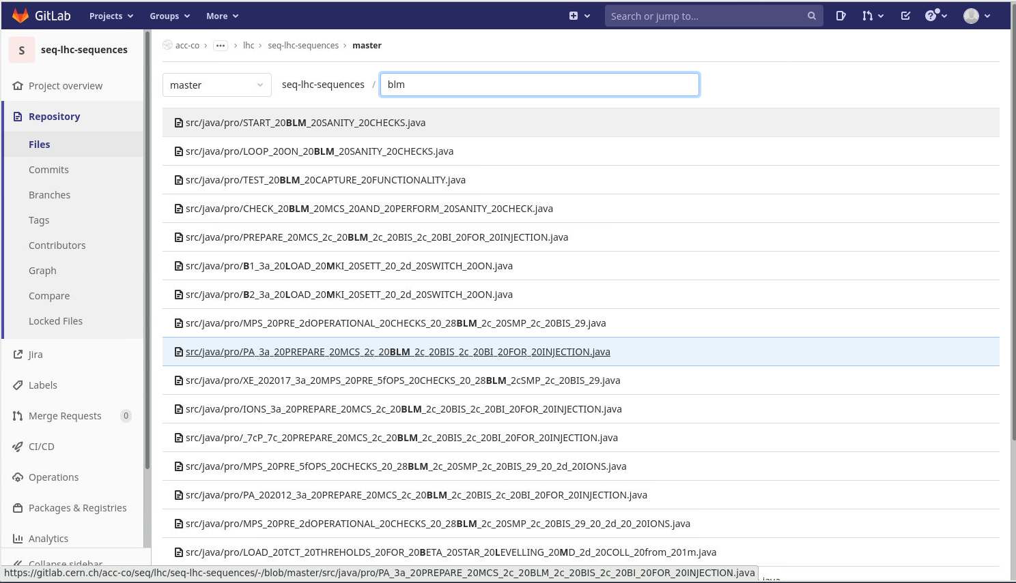
Not straightforward to find the correct sequence

Slide 7
https://gitlab.cern.ch/acc-co/seq/task
https://gitlab.cern.ch/acc-co/seq/task/seq-task-blm
https://gitlab.cern.ch/acc-co/seq/task/seq-task-bpm
BQM ?
abort Gap
https://gitlab.cern.ch/acc-co/seq/task/seq-task-bi/-/tree/master/src/java/cern/bi/sw
  db/utils
  fesa
  mail
  seq/tasks
  utils

Slide 8
Roadmap
Find if we have some sequences specifically used or written by BI
Identify the sequences used by OP and the task used in those (OP(Jorg) & CO(Roman))
Identify those tasks and regroup the redundant one
Compile the tasks (post LS2 changes)
Identify new ones
Set up a test procedure
Test those tasks (Sequencer Dev)
Deploy and validate with OP
Retrieve and follow documentation
Split the work (by topics, by equipment, …)
Work together

