Slide 2
Modulator solutions for muon cooling RF testing
J. Parra-Lopez & D. Aguglia
EPC
28th April 2021

Slide 3
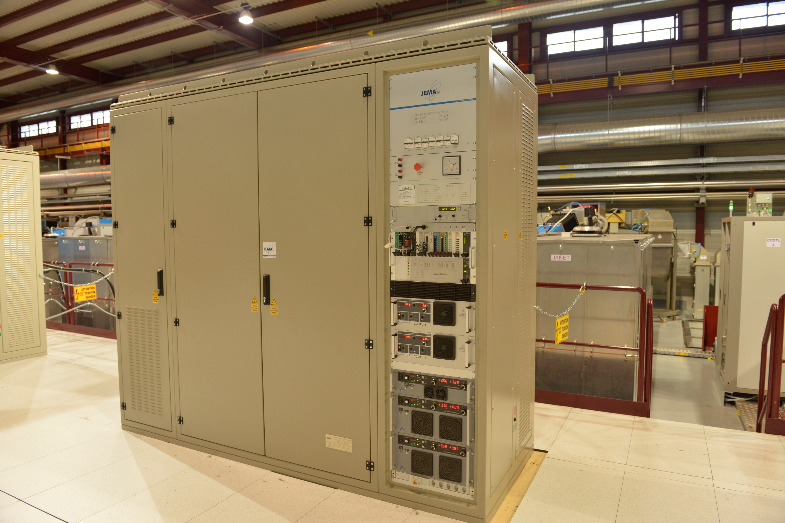
L4 full power modulator
Spec | Value
Voltage | 110 kV
Current | 50 A
Peak power | 5.5 MW
Pulse length | 1.8 ms
Rep. rate | 2 Hz
Cost | 300 kCHF
Preferred solution because standard operation with CERN controls (15 in operation at CERN)
14 units installed in L4
1 unit in RF test stand in bld. 112
L4 missing a spare – discussions ongoing for a solution…
Could be used in muon test facility and be a spare in case of need in L4
Muon could partially contribute to it

Slide 4
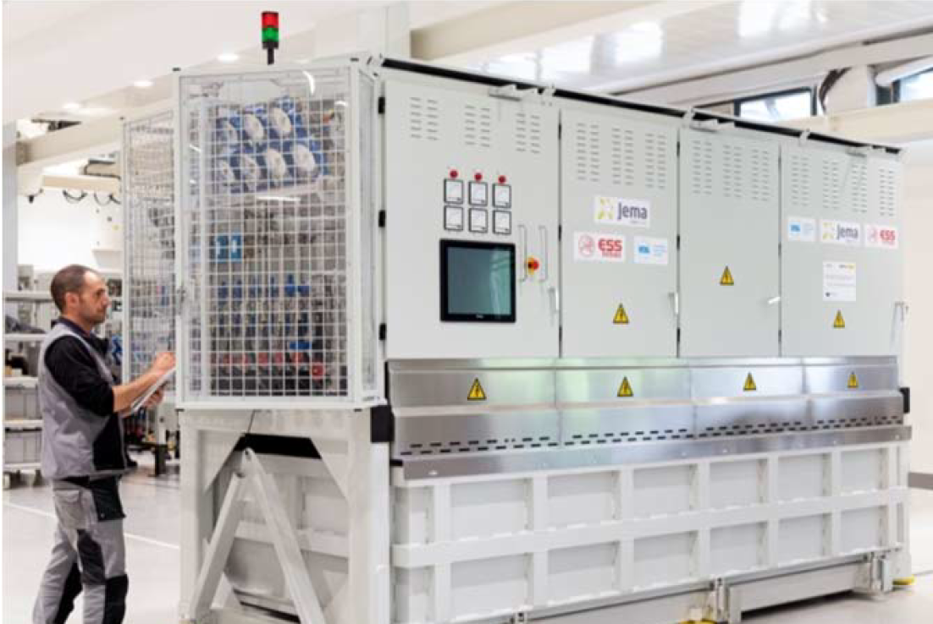
ESS prototype modulator
Spec | Value
Voltage | 115 kV
Current | 100 A
Peak power | 11.5 MW
Rep. rate | 14 Hz
Pulse length | 3.5 ms
Cost | In kind/ collab.?
ESS has an unused prototype modulator (ESS design)
Turn key system for CERN (control to be evaluated) – always difficult / costly to operate for CERN
ESS could contribute lending/transferring it & operating it (in collaboration with EPC)
Water cooling needed
No anode powering
No spares!

Slide 5
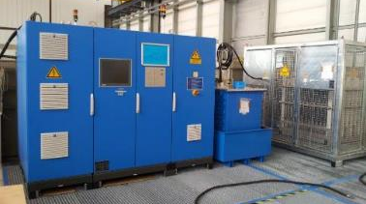
ESS pre-prototype modulator
Spec | Value
Voltage | 115 kV
Current | 25 A
Peak power | 2.9 MW
Rep. rate | 20 Hz
Pulse length | 2.5 ms
Cost | installation
CERN has/owns an unused pre-prototype modulator used to test ESS cavities at CERN
Turn key system – always difficult / costly to operate for CERN
Water cooling needed
No anode powering
No spares!

Slide 6
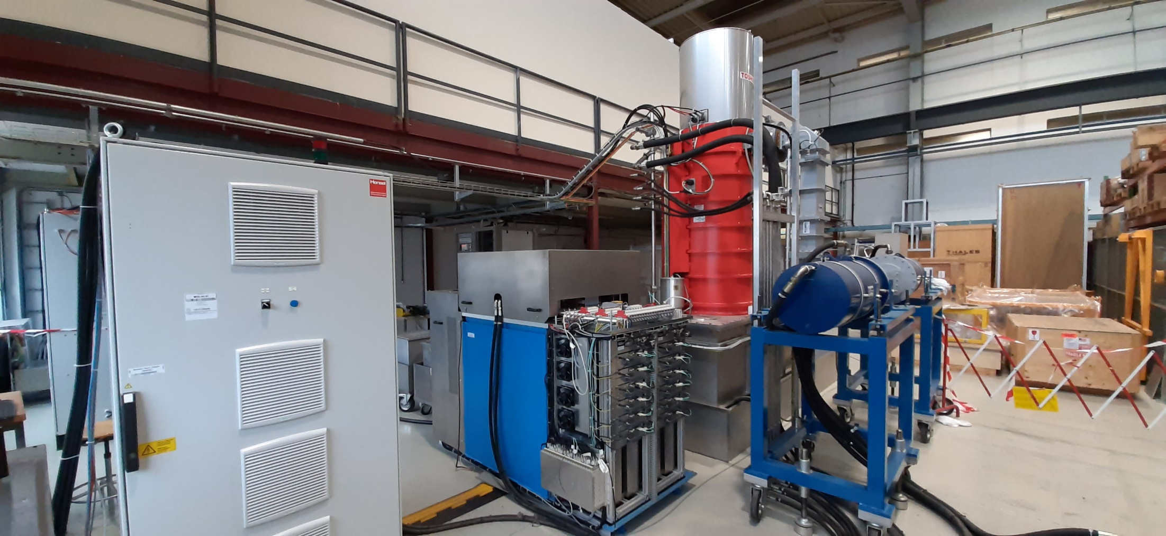
CLIC L-Band prototype modulator
Modulator installed in 112 for CLIC RF L-band klystron tests
Turn key system – always difficult / costly to operate for CERN
Today issues in restarting the system – commissioning not finished yet
Water cooling needed
No anode powering
No spares!
Spec | Value
Voltage | 170 kV
Current | 160 A
Peak power | 29 MW
Rep. rate | 50 Hz
Pulse length | 0.14 ms
Cost | installation

Slide 7
Conclusion
EPC wants to push for a L4 modulator solution.
  Muon collider could partially contribute in the costs
  Solution still to be discussed/announced to other L4 stakeholders
ESS prototype could be an acceptable solution, potentially less expensive
  EPC could accept this if ESS implication in its operation
Other presented solutions not supported by EPC

