Slide 1
Short pulse cavity proposal
Apr 28, 2021

Slide 2
Part 1: benefit of short pulse for breakdown mitigation

Slide 3
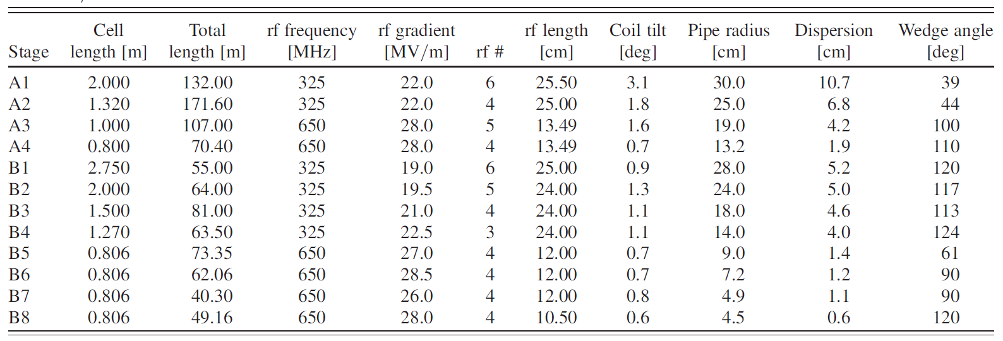

Selected cavity parameters
Rectilinear channel contains some of the most challenging cavity designs in terms of required RF gradient and B-field
Before bunch merge
After bunch merge
Rectilinear cooling channel RF cavities
B=13 T needed!
Assumed cavity properties:
  $f=650 MHz$, $V_{acc}=2.94 MV, φ=41 deg$
  ${\left(\frac{R}{Q}\right)}^{linac}=75 Ω$
  $Q_{0}=G\sqrt{\frac{2σ}{μ_{0}ω}}≈30000$for copper
  $Q_{L}=\frac{Q_{0}}{2}=15000$ for $β=1$ coupling in the absence of the beam
  $$t_{fill}=\frac{2Q_{L}}{ω}≈7 μs$$

Slide 4
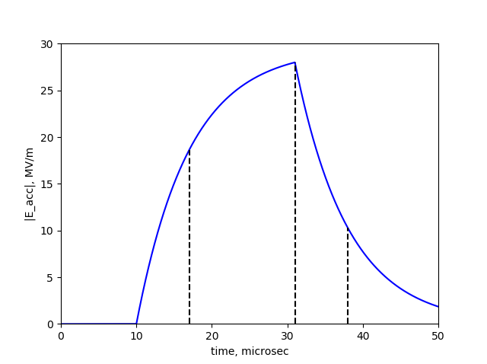



Side note: beam loading
For cavities after the beam merge: Beam loading must be made insignificant since cavity cannot be filled in time as short as a few ns.
For cavities before the bunch merge: beam loading could be significant but it requires very strongly over-coupled cavity that can fill up in time comparable to 60 ns train length.
Beam pulse (not to scale)
$$t_{fill}$$
$$t_{fill}$$
Subject of this presentation: even if beam loading is insignificant, it is beneficial to reduce the RF pulse time to mitigate the breakdown
For the chosen 650 MHz cavity:
Assume that there is one recombined bunch with ${10}^{12}×21≈2×{10}^{13}$ muons. Energy taken by the bunch from the cavity is $∆U={Q V}_{acc}\cos\left(φ\right)=7.1 J$. The energy stored in the cavity before the bunch is $U=\frac{V_{acc}^{2}}{ω\frac{R}{Q}}=28.2 J.$ Variation in gradient along the bunch is 13%.

Slide 5
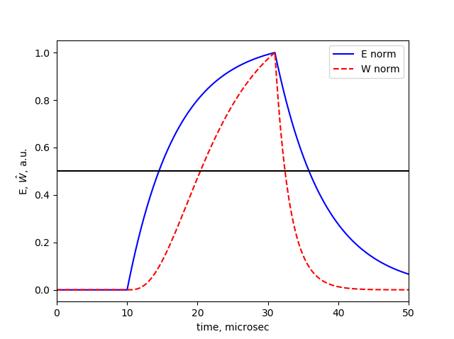


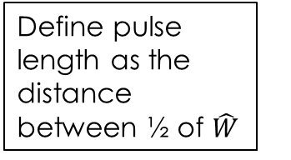
What is $t_{pulse}$ for selected cavity?
We are in an unusual situation: $t_{pulse}$ is defined not by the flat-top time, but by the cavity fill time. How do we define $t_{pulse}$ for a non-rectangular pulse?
If we want to study breakdown, the pulse is defined not by the cavity’s $E(t)$, but by the beamlet heat generation $W(t)$, which results in a narrower pulse.
Define pulse length as the distance between ½ of $\hat{W}$
Max/2
For the selected cavity with $t_{fill}=7 μs$, a sensible $t_{pulse}$ would be $12 μs$ (see Appendix 1)

Slide 6





Can we neglect heat diffusion?
Typically, the size of the heated region is greater than $100 μm$ in radius and depth.
For $t_{pulse}=12 μs$, the heat diffusion length in copper is $δ=\sqrt{αt_{rf}}=37 μm$
For short pulses $t_{pulse}<10 μs$, diffusion length becomes much smaller than the size of the heated region, and diffusion can be neglected.
Typical size of the heated region
$$>100μm$$
$$>100μm$$
Heated region
$$e^{−}$$
$$δ$$
copper
We do not absolutely need this assumption. It merely simplifies the T-rise estimate and gives useful scalings applicable to any cavity

Slide 7
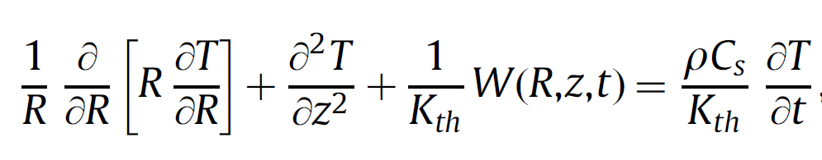






Simplified temperature rise model
          If we neglect the heat diffusion, the heat equation becomes:
$$\frac{∂T}{∂t}=\frac{W}{ρC_{s}}$$
Heat equation with diffusion
Dissipated power density
Density
Specific heat
Emitted current (strongly dependent on surface field)
$W= \frac{I}{e(πR_{f}^{2})}\frac{dE}{dz}=\frac{B^{2}I^{1/3}}{eπξ}\frac{dE}{dz}$
Stopping power
Magnetic field
$$ΔT$$
No diffusion
diffusion
$$∆T=\frac{1}{ρC_{s}}\frac{B^{2}I^{1/3}}{eπξ}\frac{dE}{dz}t_{pulse}$$
    Key points:
    $∆T$ is linear with $t_{pulse}$
    For a fixed $∆T$ and electric gradient, max operating B-field scales as $\frac{1}{\sqrt{t_{pulse}}}$
$$\sim 10 μs$$
$$t_{pulse}$$

Slide 8
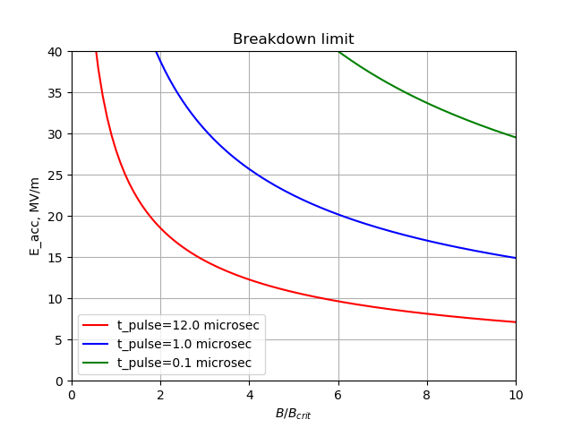


Benefit of a short pulse
Assumption: $\hat{W}∝E^{3.37}$ for the 650 MHz cavity – same as for the 805 MHz pillbox
$×11$ increase in B
$×4$ increase in E
Cavity-dependent value (need simulations)
Going to 100 ns pulse would dramatically improve cavity performance

Slide 9
Part 2: how to achieve short pulse

Slide 10
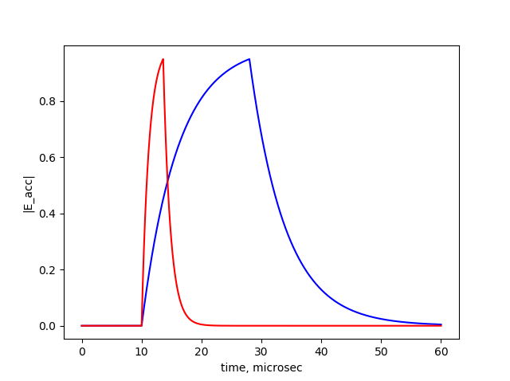




How to achieve shorter RF pulse
Method 1: lower $Q_{0}→Q_{0}/α$
  $t_{fill}$ decreases by factor $α$
  Required $P_{source}$ increases by factor $α$
method 2 is more efficient
Over-coupled cavity:
Method 2: over-coupled cavity with $β≫1$
  $t_{fill}$ decreases by factor $α=\frac{1+β}{2}$
  Required $P_{source}$ increases by factor $\frac{{\left(1+ β\right)}^{2}}{4β}≈α/2$
  The energy consumption per pulse scales as $t_{pulse}P_{source}∝\frac{1+ β}{2β}$ - we save a factor of 2 in energy for $β≫1$
$$β=1$$
$$β=10$$

Slide 11
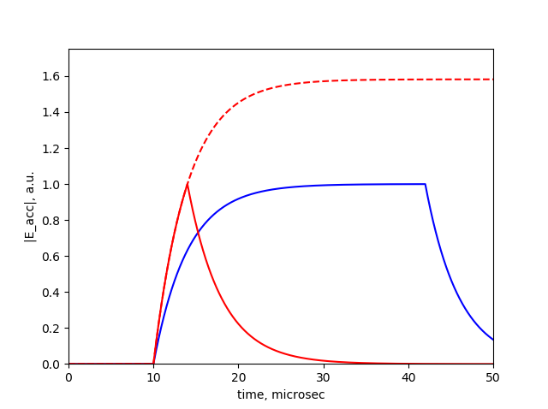


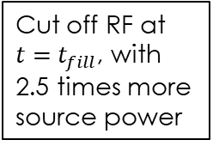
How to achieve shorter RF pulse
Method 3: triangular pulse
  It is beneficial to cut off the input power at $t=kt_{fill}$ before the steady state is reached, resulting in a triangular pulse.
  Required power scaling with the pulse time is more complicated (see Appendix 3)
Triangular pulse:
Cut off RF at $t={ t}_{fill}$, with 2.5 times more source power
Cut off RF at $t=8{ t}_{fill}$
Other ideas:
  Rapid phase switch to accelerate the field decay?
  Muon acceleration in a pulse compressor cavity?
For now, let’s focus on methods 2 and 3

Slide 12




How much power is needed to achieve shorter pulse
Assume that we use two techniques to shorten the pulse:
Over-coupled cavity ($β≫1)$
Triangular pulse (cut off input power at $t=k t_{fill}$)
Optimal $k=1.3$ for $β≫1$ (see Appendix 3)
3.8 MW (minimum $P_{in}$ for required $V_{acc}$: $β=1, k=∞$)
Then for $β≫1$:
$$P_{source}≈P_{0}×0.47 β$$
$$t_{pulse}≈1.22\frac{t_{fill0}}{β}$$
For $β=85, t_{pulse}=100 ns, P_{source}=150 MW$ – feasible with a power compressor. Potential problem: right after the pulse $P_{ref}=4P_{source}=600 MW$ – can lead to breakdown in couplers?
$$7 μs$$

Slide 13
Avoiding coupler breakdown with multiple input couplers
RF source
Multiple input couplers: each coupler carries only a fraction of the needed input power
Problem: $$$
Compr
Compr
Compr
Compr
Compr

Slide 14

Conclusions
Beam loading needs to be estimated for each cavity. If significant, we must keep the pulse time very short to keep constant gradient, regardless of breakdown issues.
Even if beam loading is not significant, we might still want to make the pulse time as short as possible to mitigate the breakdown
For a fixed accelerating gradient, the maximum operational magnetic field roughly scales as $B∝\frac{1}{\sqrt{t_{pulse}}}$
The short pulse necessarily demands higher input power. The limit to the input power would be the source / compressor cost, and the breakdown limit in the couplers.

Slide 15
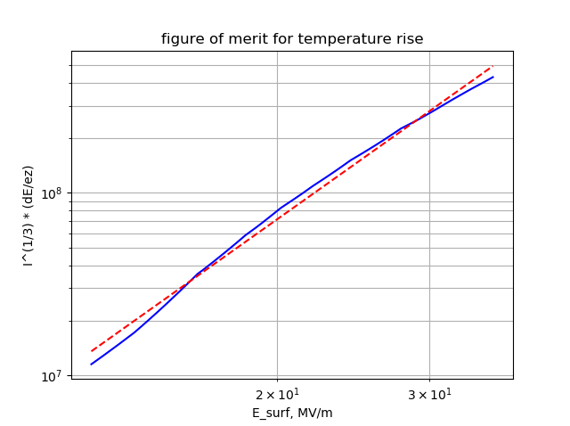





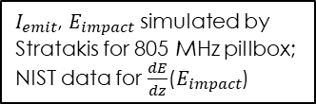
Appendix 1: $t_{pulse}$ definition
For our purposes, the pulse length $t_{rf}$ is defined by beamlet heat generation $\hat{W}\left(t\right)$ and not by $E(t)$: $\hat{W}=\frac{W}{B^{2}}eπξ=I^{1/3}\frac{dE}{dz}$
$I_{emit}$, $E_{impact}$ simulated by Stratakis for 805 MHz pillbox;
NIST data for $\frac{dE}{dz}$($E_{impact}$)
Define pulse length as the distance between ½ of $\hat{W}$
Max/2
fit: $\hat{W}∝E^{3.37}$
The shape of the $\hat{W}$ pulse is narrower than the E-pulse. If $\hat{W}∝E^{p}$ and the RF is cut off at $t=kt_{fill}$, the pulse duration $t_{pulse}=t_{fill}(k+ln⁡(2^{1/p}−1+e^{−k}))$. E.g. for $k=3, p=3.37$, $t_{pulse}=1.72 t_{fill}$.
Assumption: $\hat{W}∝E^{3.37}$ for the 650 MHz cavity – same as for the 805 MHz pillbox. Then pulse length is $12 μs$ for $t_{fill}=7 μs$

Slide 16
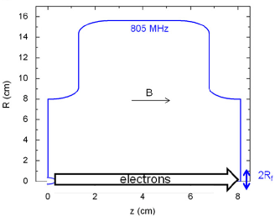
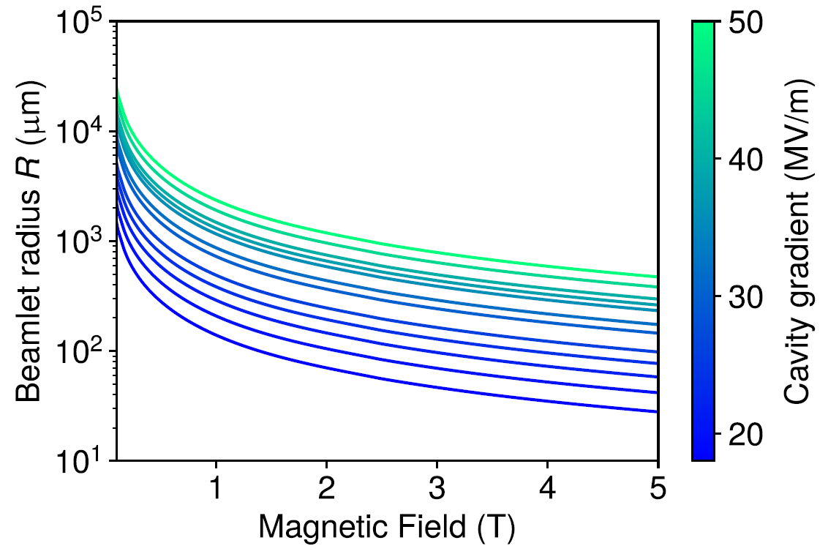
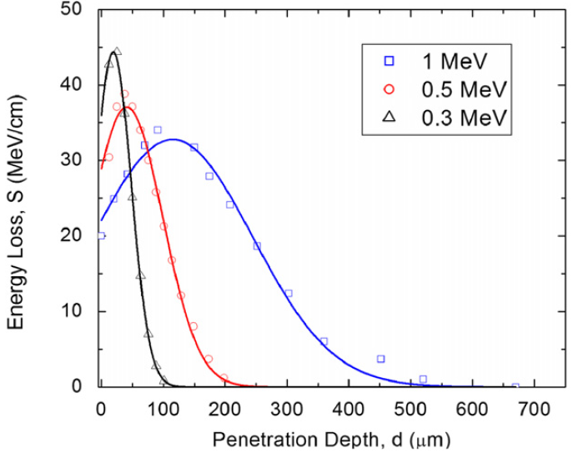

Appendix 2: size of the heated region
For each cavity, beam tracking simulation are required to estimate the size of the heated region. Here are the results for the 805 MHz pillbox simulated by Stratakis, Bowring, etc:
Cavity-dependent constant
$$R= ξ\frac{I^{1/3}}{B}$$

Slide 17
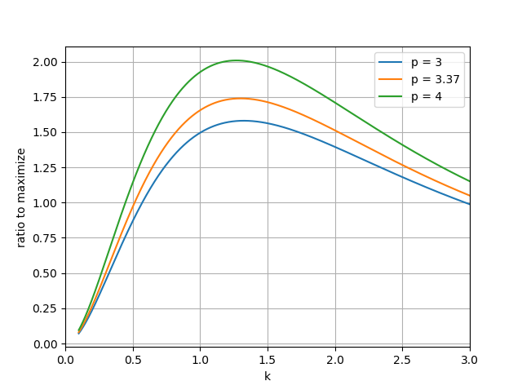




Appendix 3: Optimal $k$
The pulse time and the required power are defined by two parameters: $β$ and $k$:
$$\frac{P}{P_{0}}=\frac{{\left(1+ β\right)}^{2}}{4β{\left(1 −e^{−k}\right)}^{2}}$$
$$\frac{t_{pulse}}{t_{fill0}}=\frac{2}{1+β}\left(k+\ln\left(2^{1/p}−1+e^{−k} \right)\right)$$
$p$ is the dependence of heat generation on gradient $\hat{W}∝E^{p}$
In the regime $β≫1$, we can find the optimal $k$ that maximizes the gain in $t_{pulse}$ over the gain in power. For $p=3.37, k_{opt}=1.3$

