Slide 1





MUOGRAPHY AND GEOLOGY – DOES IT MATTER WHICH CONTINENT YOU STAND ON?
Kuusiniemi, P., Holma, M., Loo, K. & Enqvist, T.
This activity was funded by the Accelerator Programme from the EIT RawMaterials, funded by the EIT, a body of the European Union supported under the Horizon 2020 research and innovation programme
All rights reserved © by Muon Solutions 2021

Slide 2

Introduction
Q: Does it matter which continent you stand on? We found this an interesting question and conducted a relatively extensive simulation in order to understand how this question can be approached
Tools:
  Extensive Air Showers (EAS):
    CORSIKA (proton for simplicity)
      Muon angular and energy distributions on the ground level
    Single muons (energy and angular distributions) can also be taken from Gaisser-like formula
      One example is Guan et al.¹ that has improved parametrization for the low-energy part
  Muon propagation:
    MMC code²
      Based on parametrization (unlike GEANT4)
      Simple to simulate very high-energy muons
    Geant4 (version 10.5.1)
      Standard tool for muon propagation in the material
      Validate MMC results
  ¹Guan et al. A parametrization of the cosmic-ray muon flux at sea-level. arXiv:1509.06176v1 [hep-ex] 21 Sep 2015.
  ²Chirkin, D. & Rhode,W., Propagating leptons through matter with Muon Monte Carlo (MMC). arXiv:hep-ph/0407075v3 3 Aug 2016.
All rights reserved © by Muon Solutions 2021

Slide 3
Introduction
Five different types of real-world continental and oceanic crustal and mantle materials were simulated
  Studied continental geological models were:
    1) upper continental crust
    2) bulk continental crust
    3) lower continental crust
    4) oceanic crust
    5) oceanic upper mantle
  In addition, we simulated water and standard rock for comparison
All rights reserved © by Muon Solutions 2021

Slide 4
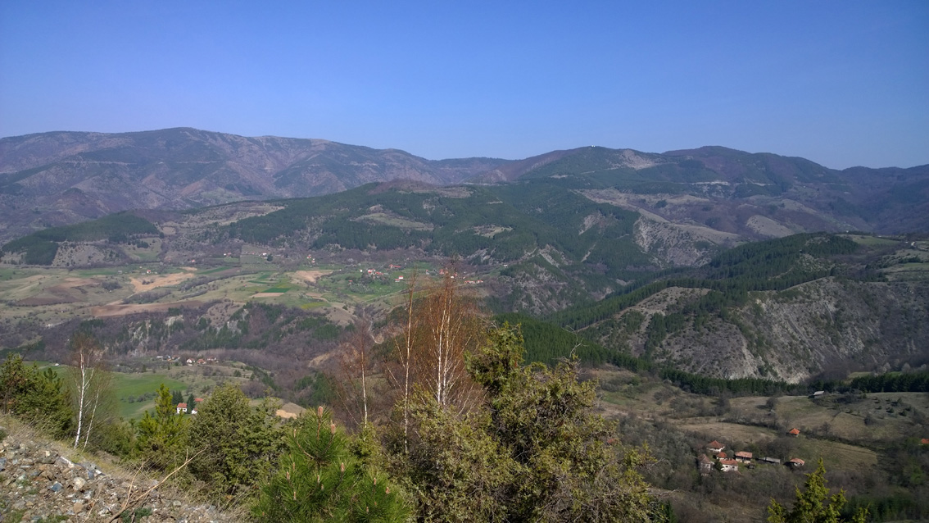
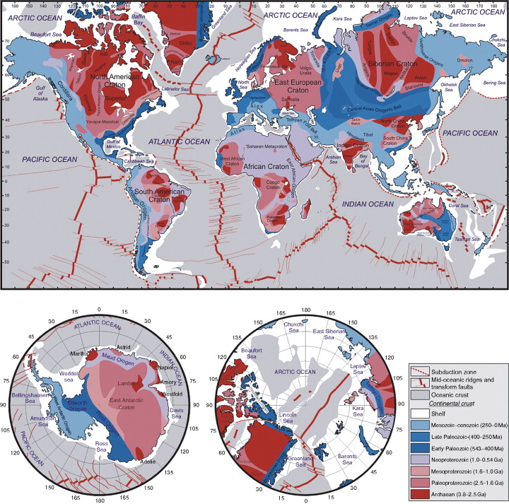
Geological background
Earth’s crust is a collage of rock domains of different age and composition
Due to tectonic forces and different levels of erosion, also crustal depth varies from place to place
Hence, from the viewpoint of simulations, it indeed matters where exactly muography is applied to
Local (geological) details may vary significantly
Our work will provide the first-level approximations of muon propagation simulations in global scale. However, local geology may still require knowledge of the local average rock compositions
All rights reserved © by Muon Solutions 2021

Slide 5
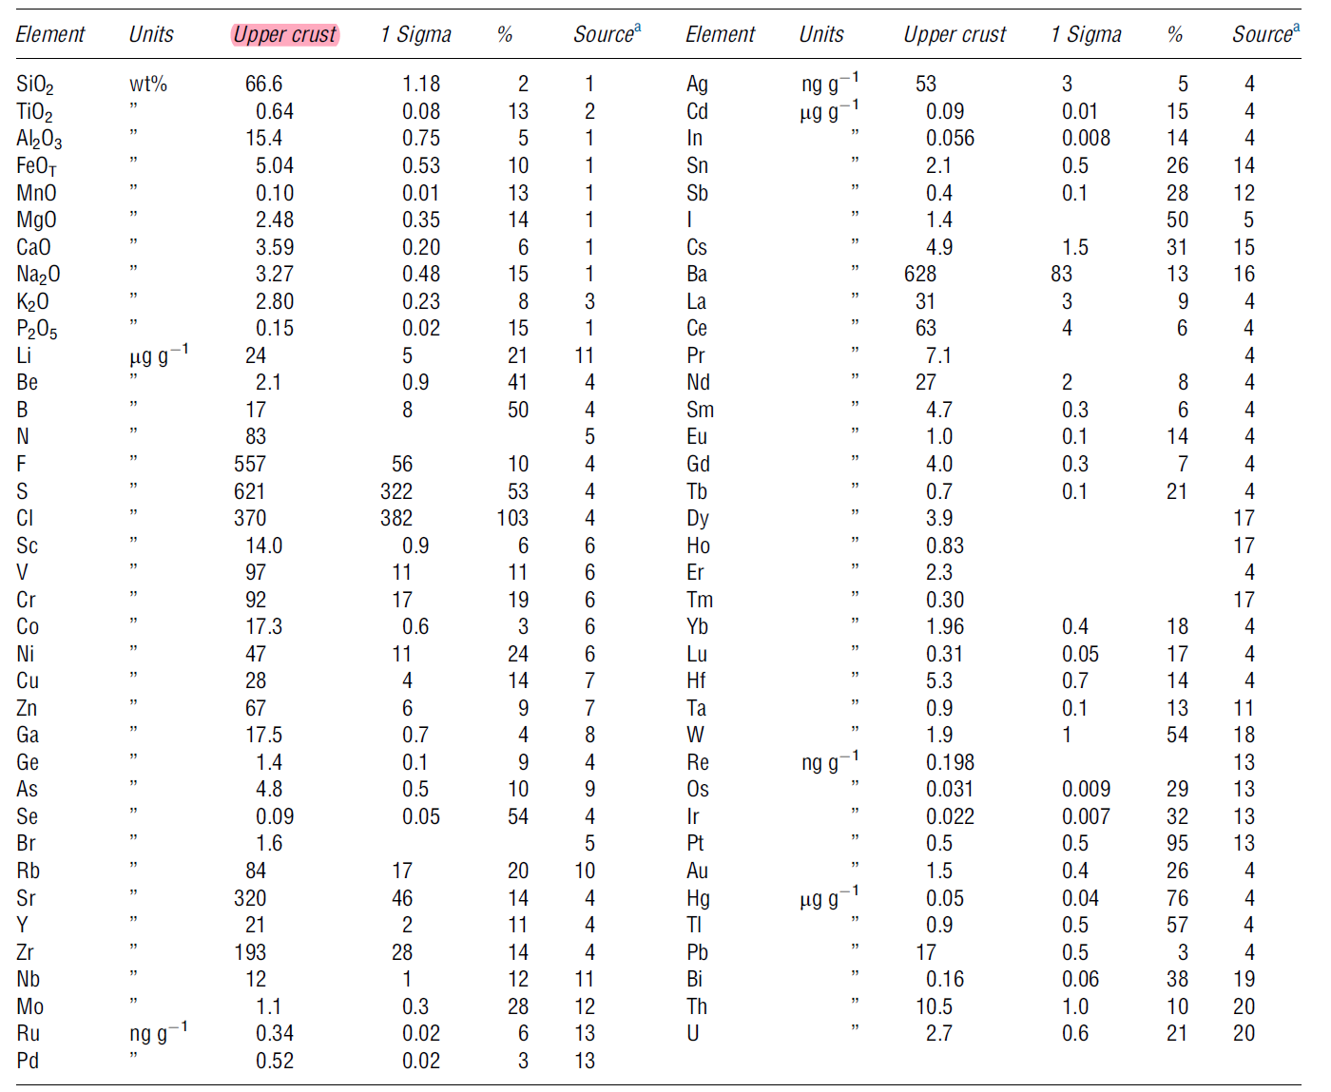
An example: Average upper-crustal composition
Several compositional models have been proposed for the upper continental crust. The example given here is the upper-crustal model we used
Recommended composition of the upper continental crust (Rudnick & Gao, 2014)
The main components of rock geochemical data are presented as oxides
All rights reserved © by Muon Solutions 2021

Slide 6
The five geological models
All rights reserved © by Muon Solutions 2021

Slide 7
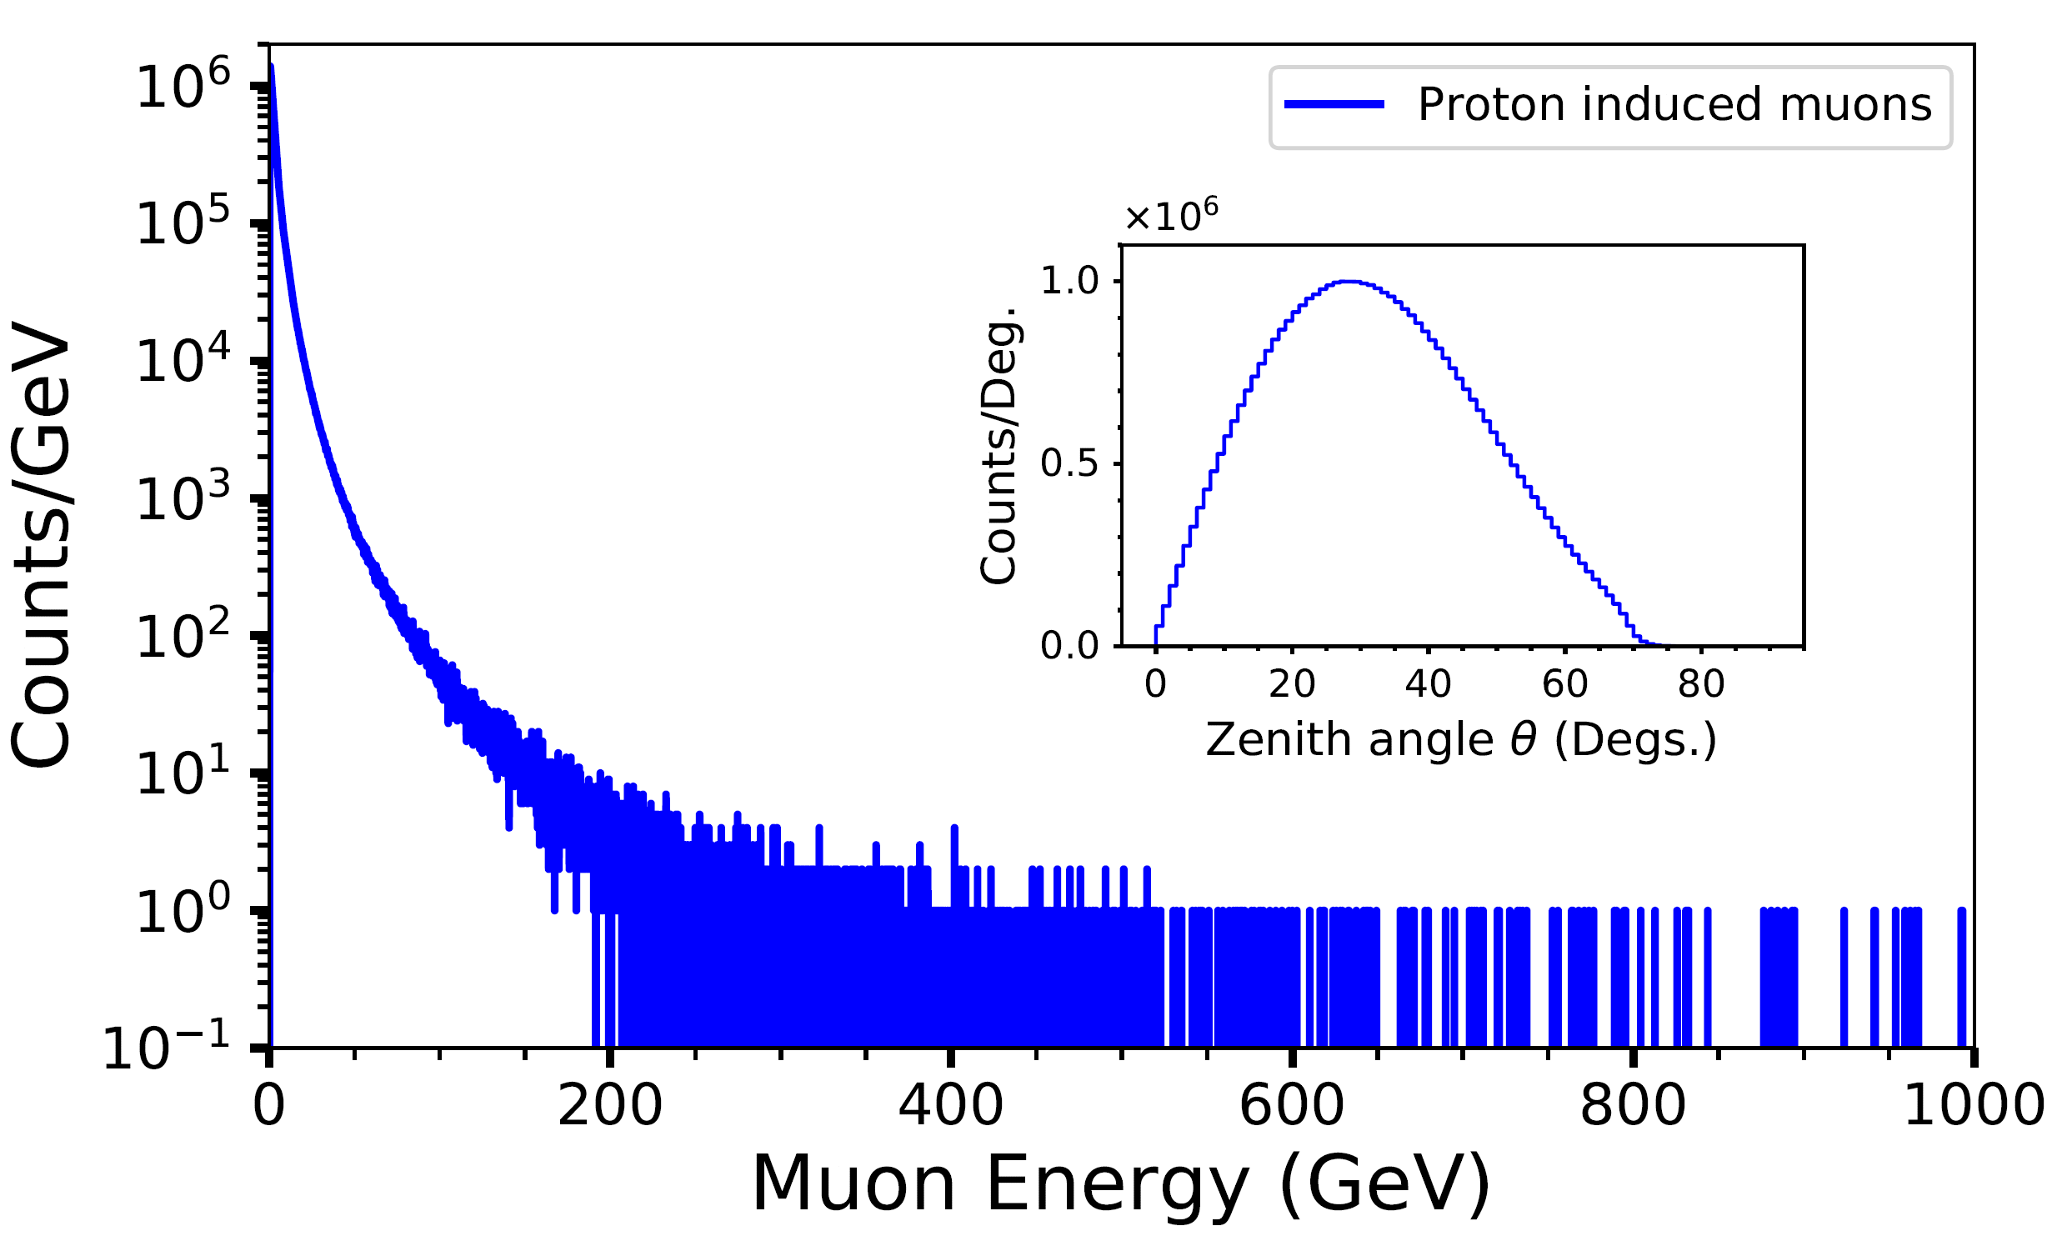
Results
Fig. 1. Simulated muon energy and angular distributions (zenith angle, inset) for 10⁸ proton-induced extensive air showers according to the CORSIKA cosmic-ray software package (Heck et al., 1998)
The initial energies for proton-primaries range from 1.3 GeV to 10⁷ GeV with the spectral index of -2.7
∼80% of primaries producing muons most relevant in muography are protons (mainly those below the knee energies)
A simple rule of thumb for the standard rock: 10 GeV gets to 20 m, 100 GeV to 150 m and 1000 GeV to 1000 m
Muons in those of the latter are scarce

Slide 8
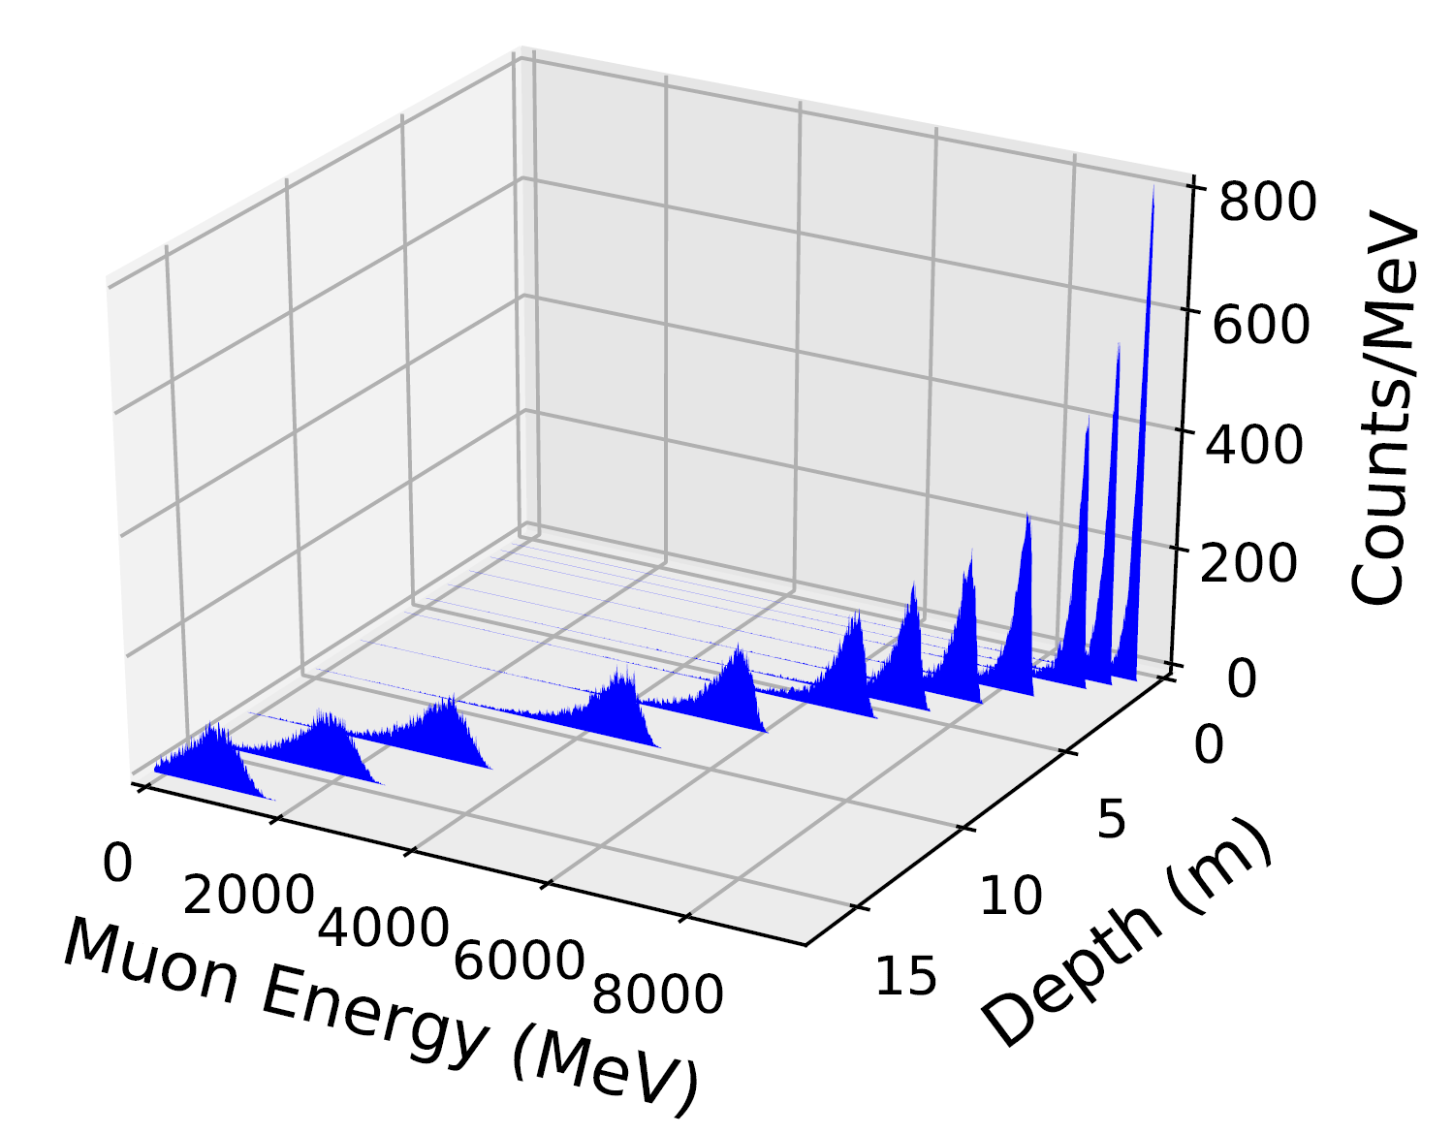
Results
Fig. 2. Simulated muon energy distributions of initially 10 GeV muons at twelve different (for clarity not equally divided) depths in standard rock
Simulations have been performed with the Geant4 software package

Slide 9
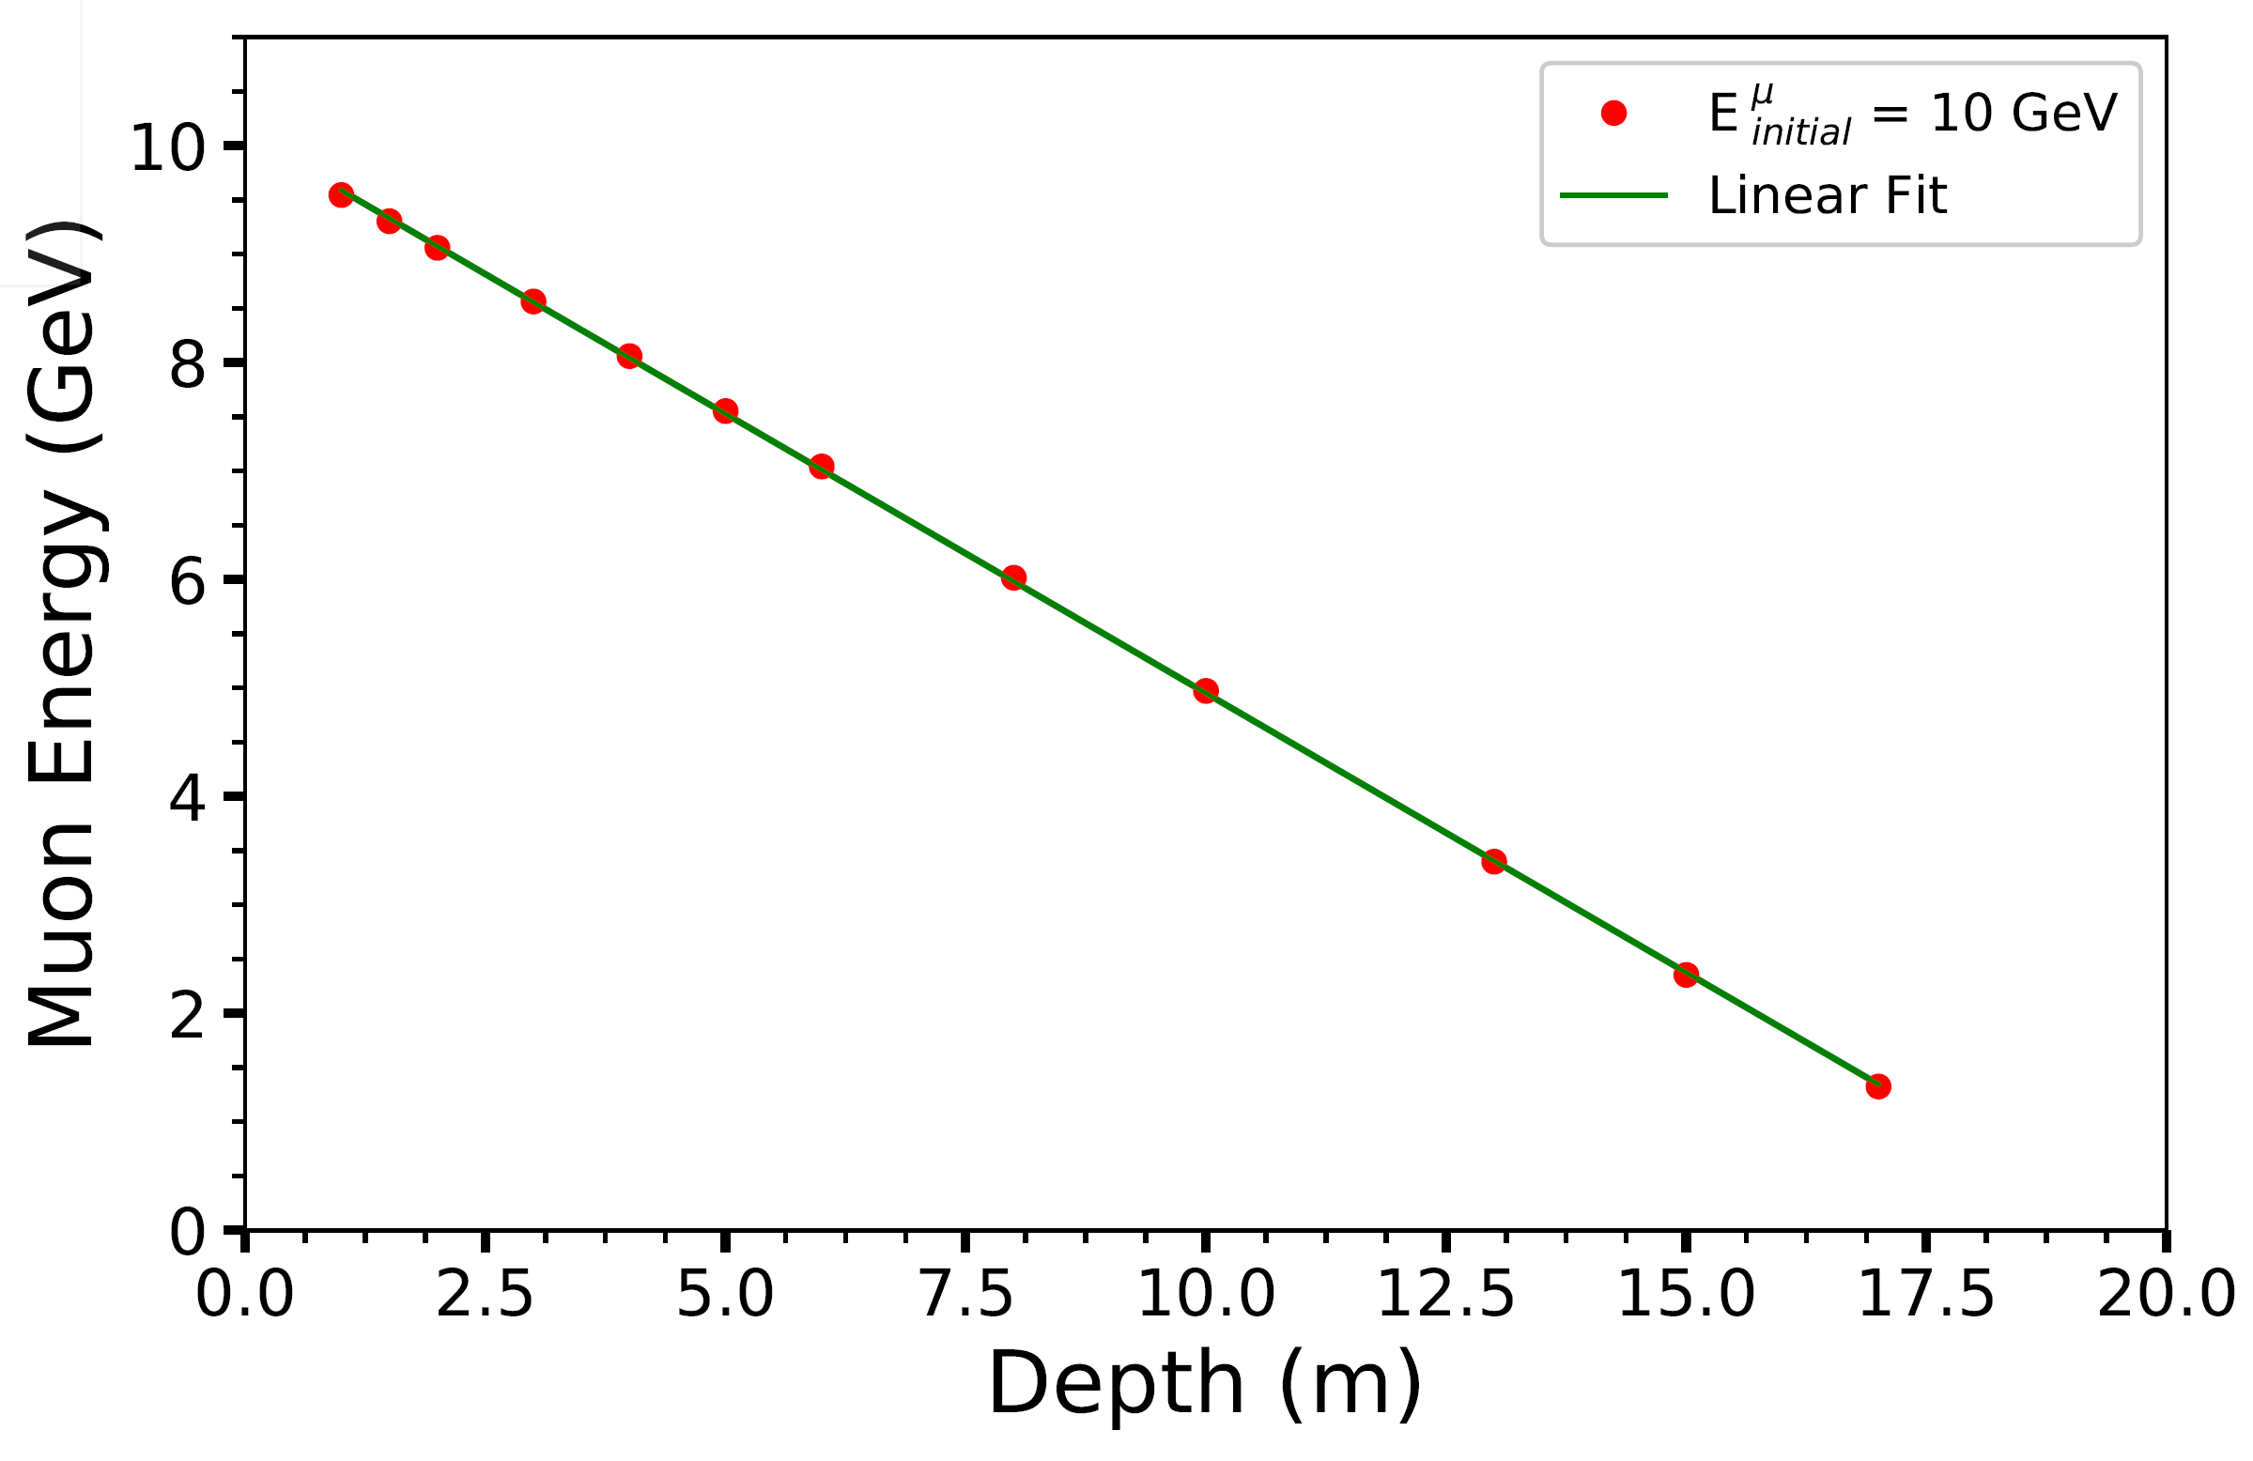
Results
Fig. 3. Simulated means of energy distributions of initially 10 GeV muons at twelve different depths in standard rock (red dots) together with a linear fit (green line)
Prior to their decay these muons have lost ∼90% of their initial energy at the end of their path
However, a small fraction is lost all the time as soon as the muons hit the ground

Slide 10
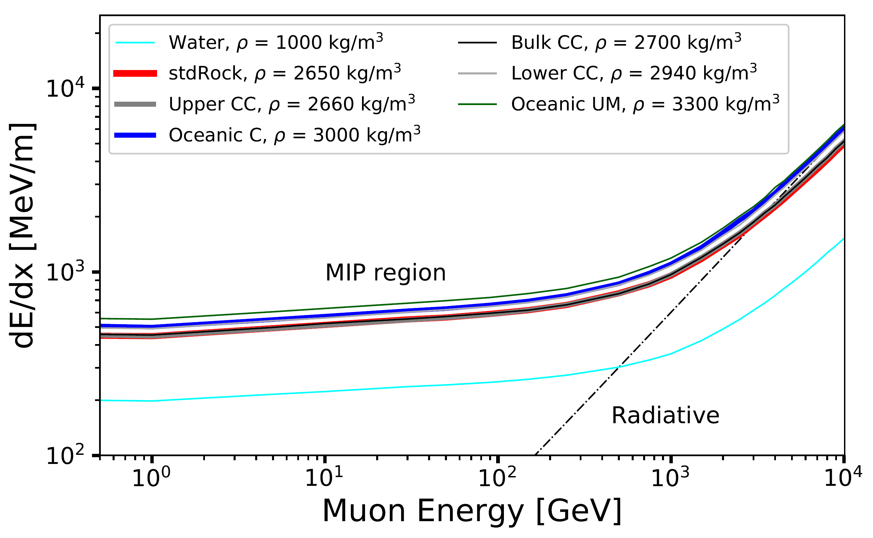
Results
Fig. 4. Simulated muon stopping powers, i.e., energy losses per unit distance, in five earth continental materials
Water and standard rock are plotted for comparison
Simulations have been performed with the Geant4 software package
The MIP region (minimum ionizing particle), the stopping power is only weakly sensitive to the energy or speed of the particle) is indicated
The dashed line indicates the radiative component that enters increasingly in at high muon energies

Slide 11
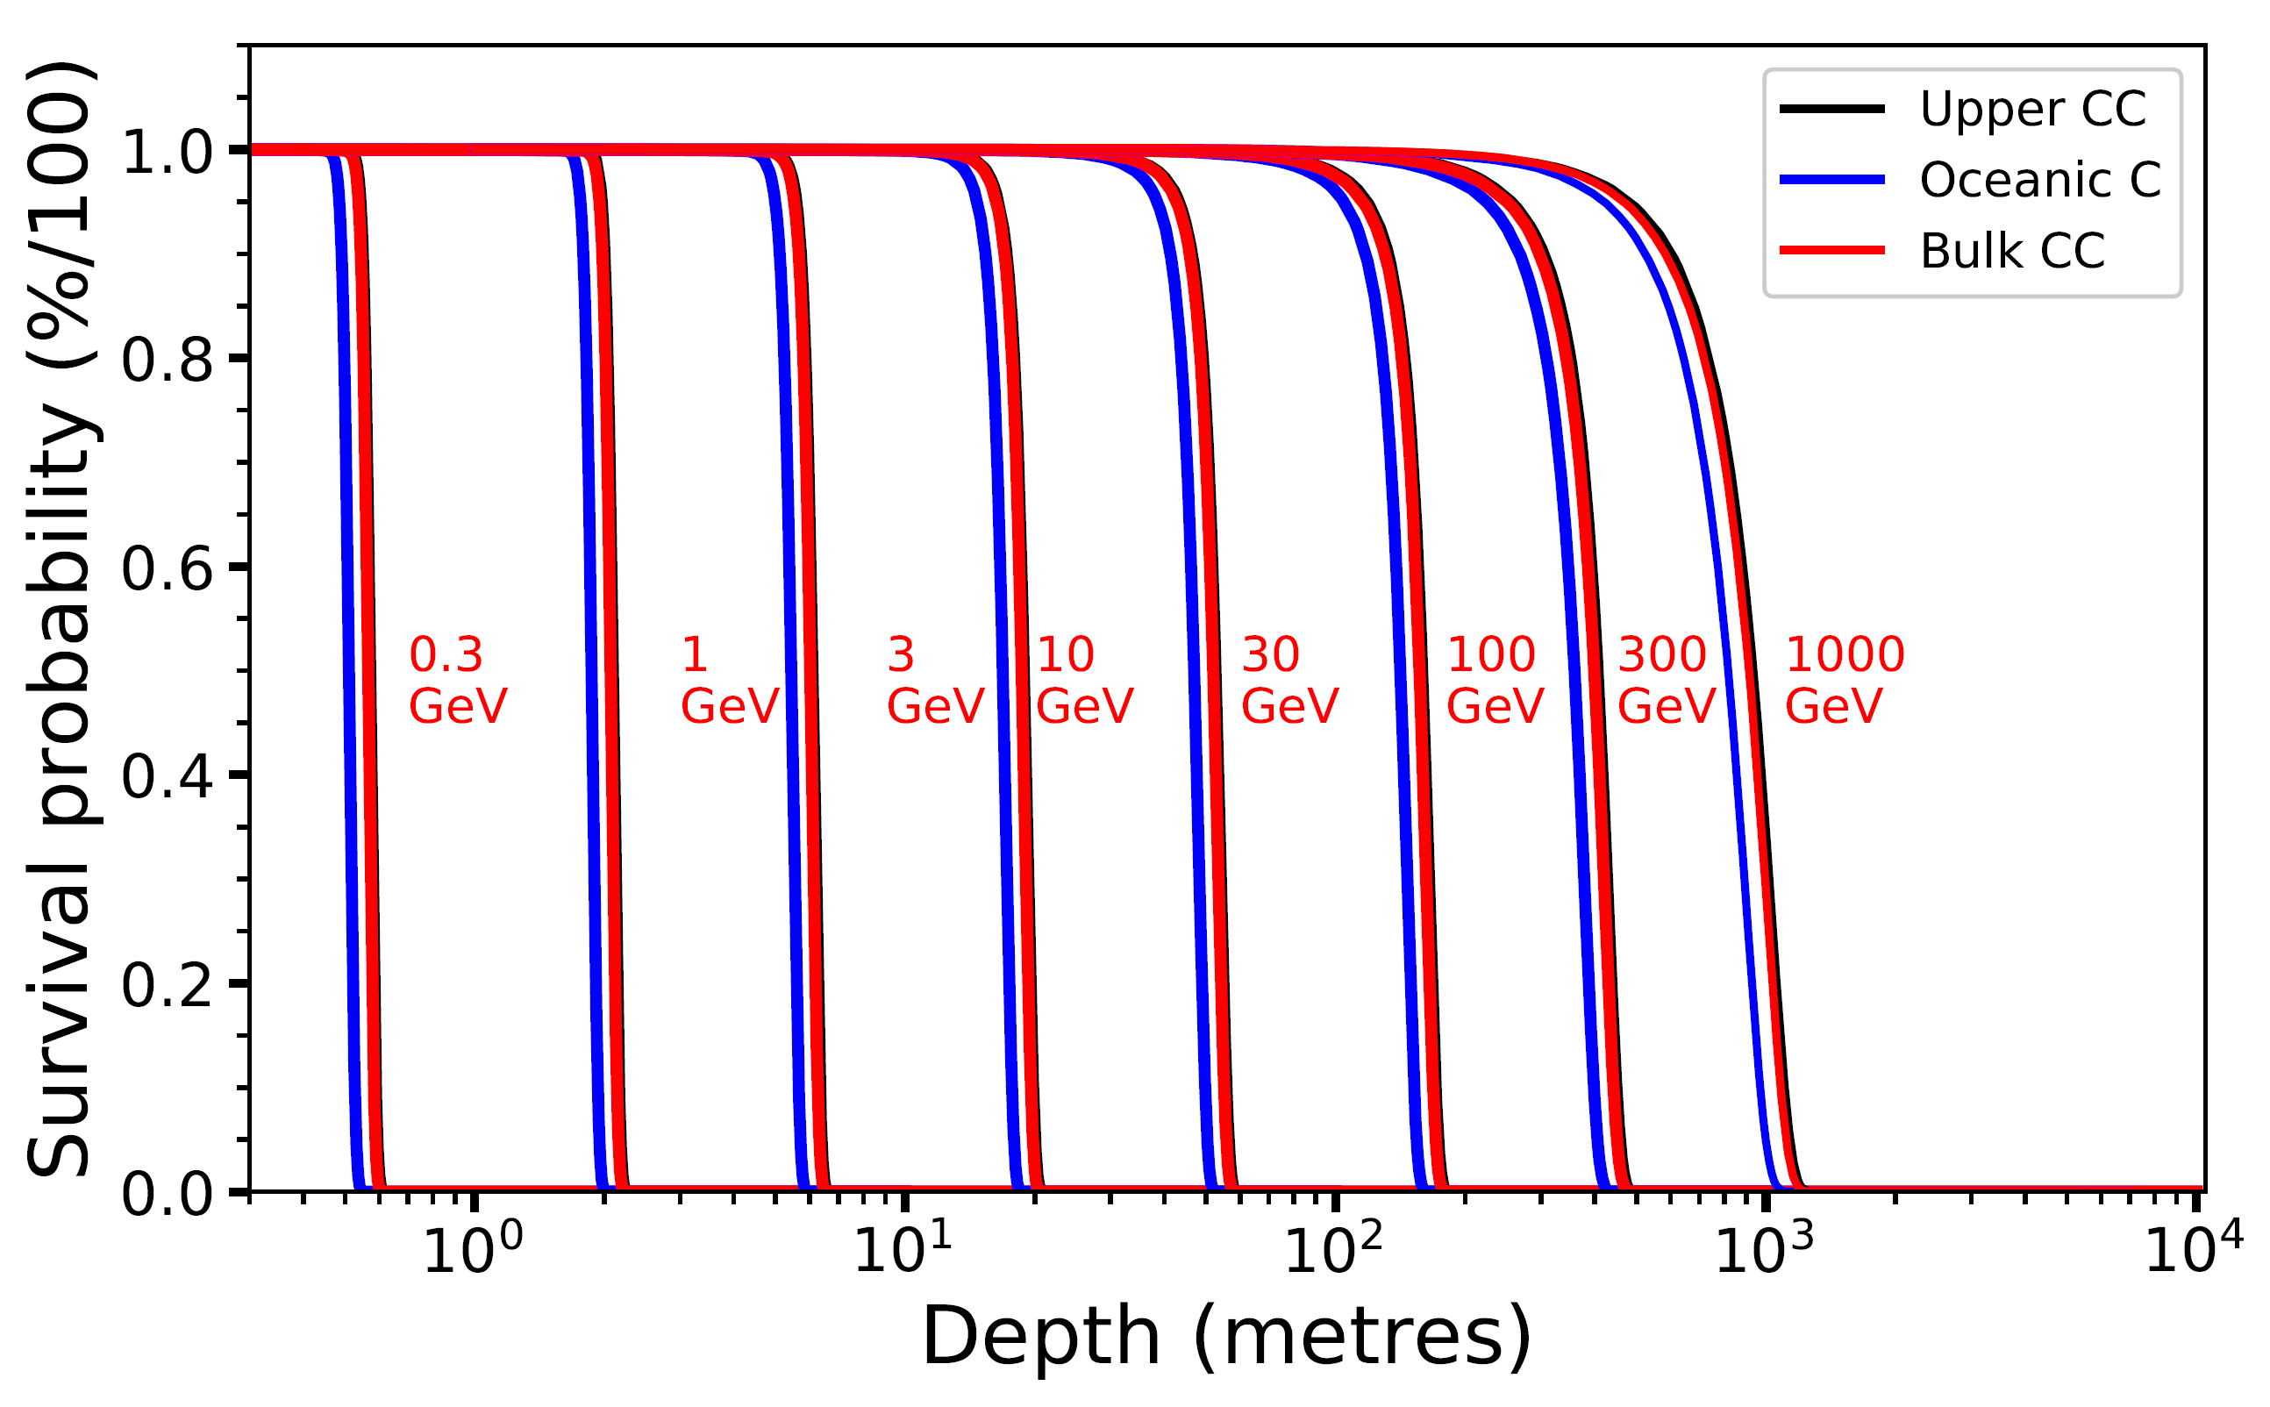
Results
Fig. 5. Simulated muon survival probabilities as a function of depth for three common layers of the earth’s crustal materials for selected (logarithmic) muon energies
The number was limited to three for clarity
One notes that ’Upper CC’ almost overlaps with ’Bulk CC’ although the former get generally slightly deeper
The simulations have been carried out using the Geant4 software package
A simple rule of thumb: 10 GeV muons get to 20 m, 100 GeV to 150 m and 1000 GeV to 1000 m of standard rock
The shape of the curves is not constant (the deeper the muons get the broader is the energy distribution)
The probability is actually not 1 till it begins to collapse but a small fraction (of muons) is lost once the muons hit the ground

Slide 12
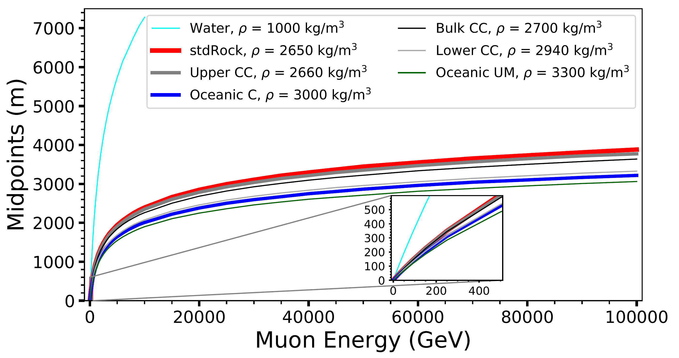
Results
Fig. 6. Muon ranges (mid-points) for five common earth continental materials
Those of water and the standard rock for comparisons
Simulated with the Geant4 (Allison et al., 2016) software package
One notes that the range in water is significantly longer than that of any given solid material

Slide 13
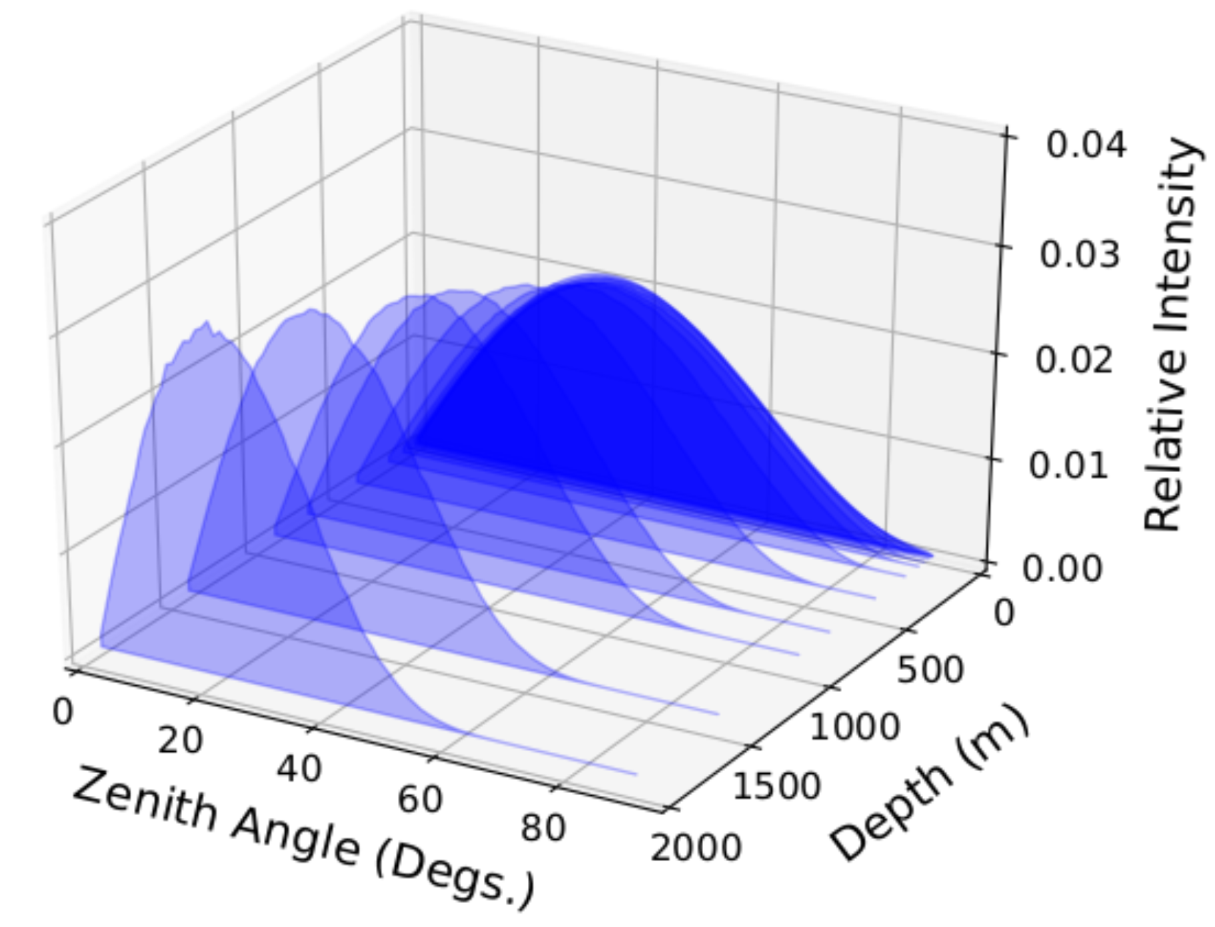
Results
Fig. 7. Simulated muon angular (zenith) distributions of standard rock at the selected twelve depths
Note that for clarity the area of each distribution is normalized to 1
This (obviously) results from initial muon energy distribution which is not flat (and of geometry)
The distribution is proportional to cos^{n}θ where n is close to 2 on the ground but for large depths, the exponent n gets very large
Note that parameter n in cos^{n}θ determines the width of the distribution

Slide 14
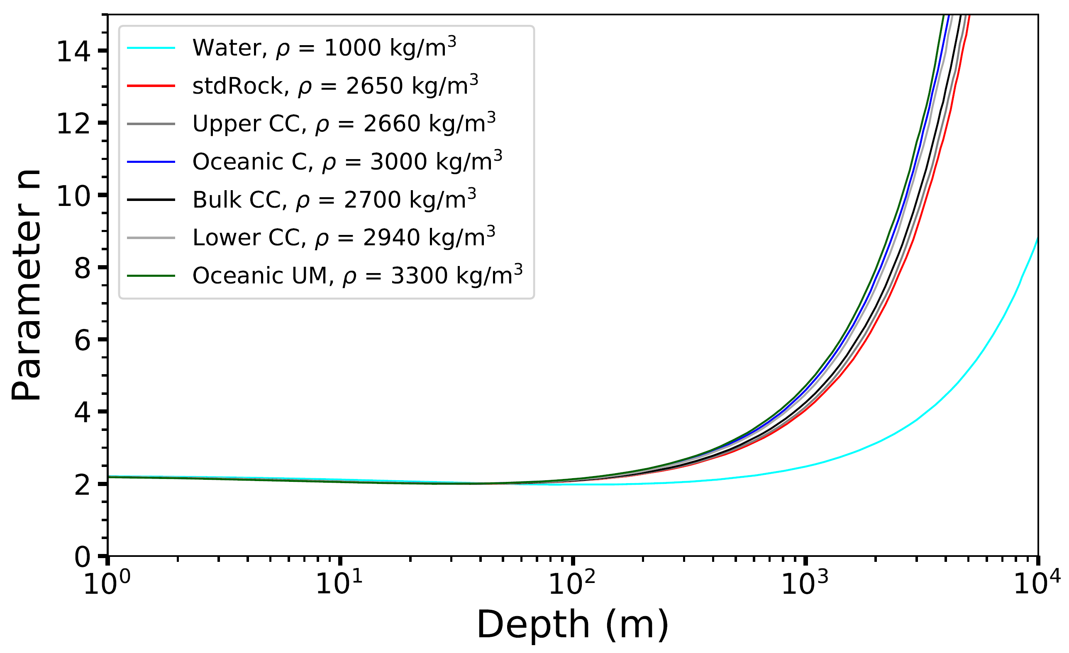
Results
Fig. 8. Simulated (MMC) parameter n of cos^{n}θ fitted at different depths for a thick column of rocks
Those of standard rock and water are for comparison.
The parameter n is clearly density dependent and increases faster with higher densities
However, below 100 m it seems constant regardless of density

Slide 15
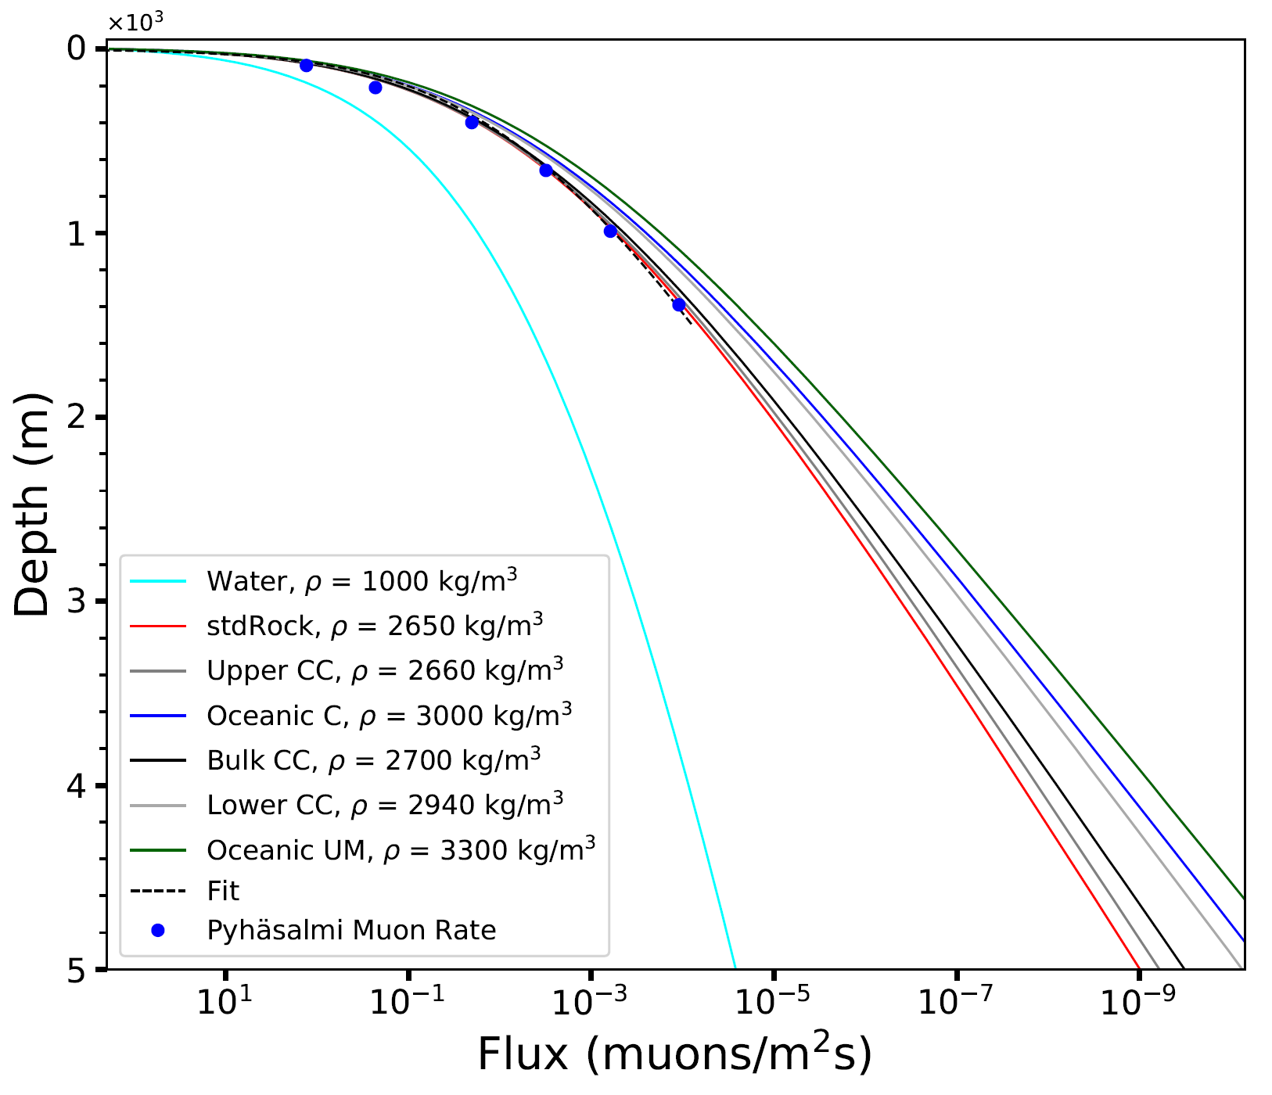
Results
Fig. 9. Simulated and measured relation between the depth (in metres) and the muon rate in five continental materials
Water and standard rock are for comparison
Simulations have been performed using the approach by Chirkin and Rhode (2016), or the MMC code, while the experimental data for the Pyhäsalmi mine are from Enqvist et al. (2005)

Slide 16
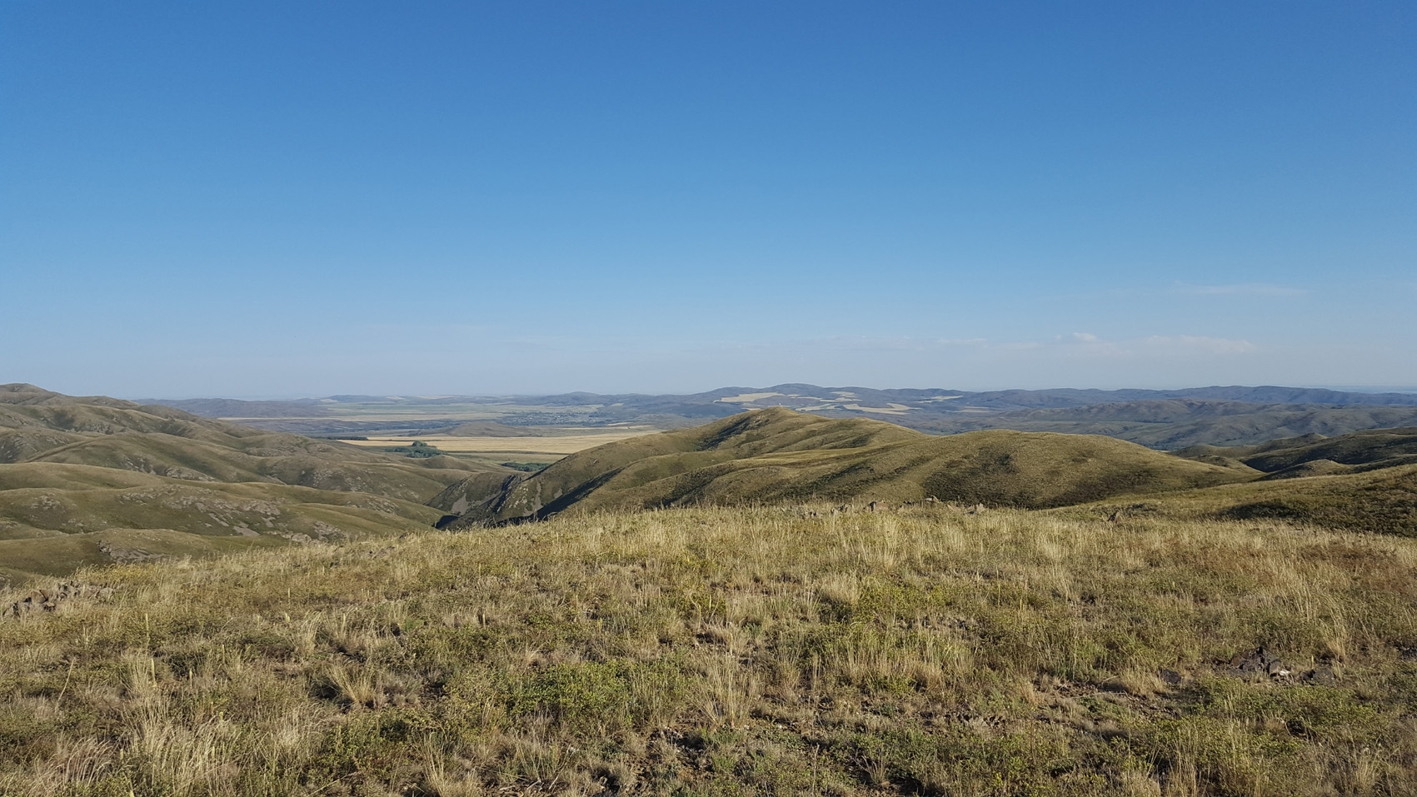
Conclusions
Different materials result in significantly different muon distributions and rates
Cannot be neglected in muographic surveys
Standard Rock is actually a not-so-good example of a common (“standard”) rock
Energy loss is surprisingly linear practically till muons decay
Angular distribution (∼cos^{n}θ) is somewhat surprising
  Down to 100m practically constant and independent on density/material
  May be useful to remember in, e.g., groundwater studies
We are preparing a longer paper to be published next year
  Stay tuned!

Slide 17
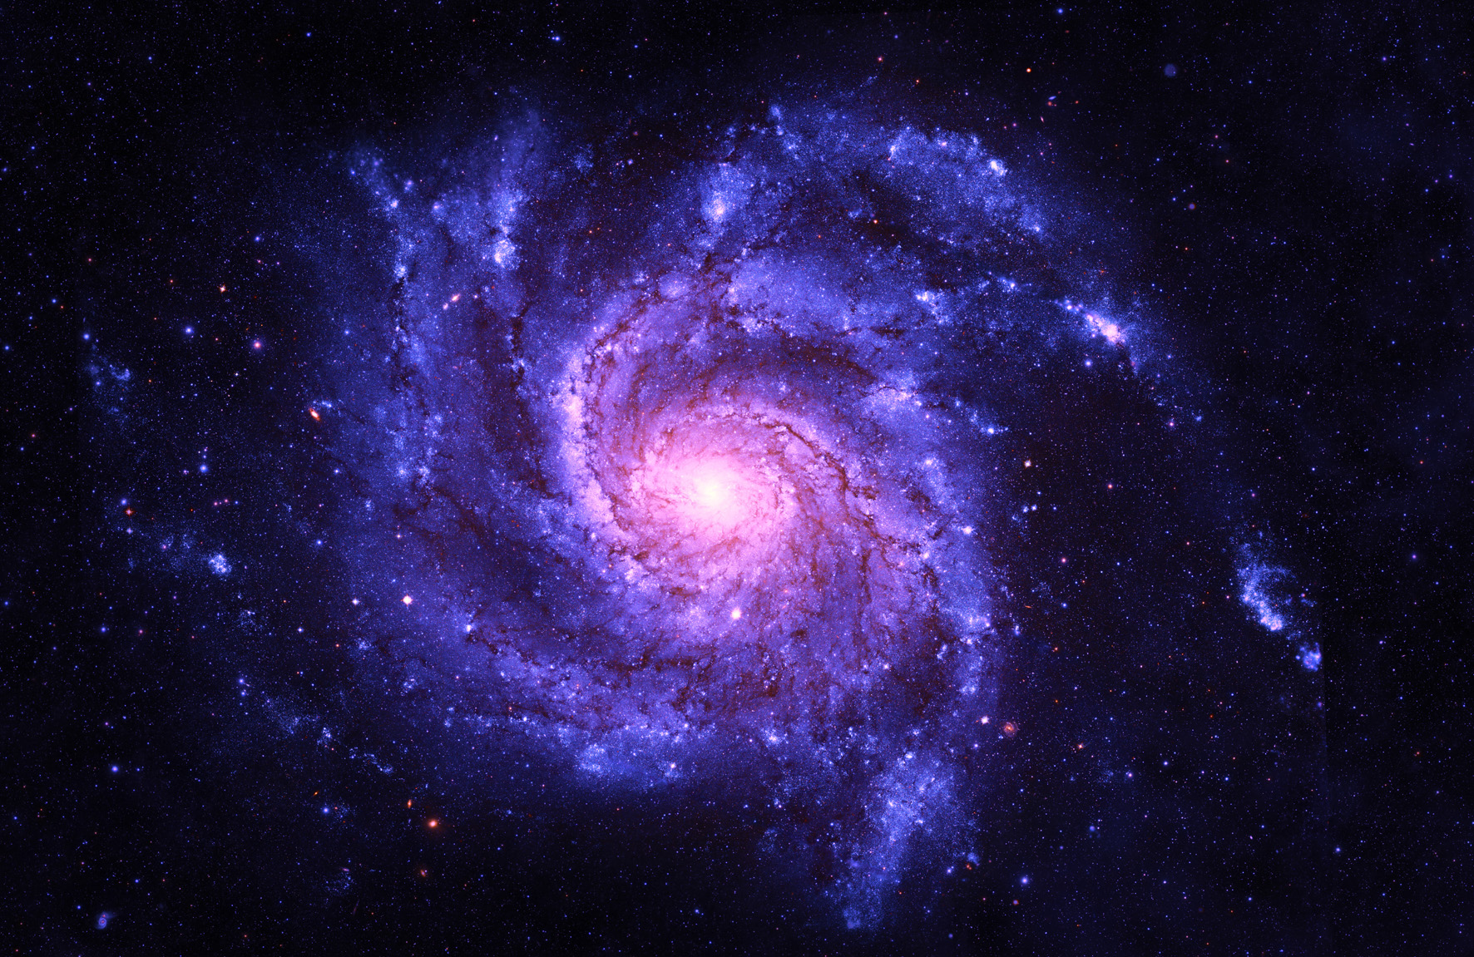

Thank you !
All rights reserved © by Muon Solutions 2021

Slide 18







Team
CEO
Marko Holma
Instruments
Pasi Kuusiniemi
Physics
Timo Enqvist
Simulations
Kai Loo
Collaborations
Jari Joutsenvaara
Electronics
Antto Virkajärvi
Finance Advisor
Marko Aittola
Geologist
Physicist
Physicist
Physicist
Physicist
Engineer
Planetary
Geologist
All rights reserved © by Muon Solutions 2021

