Slide 1
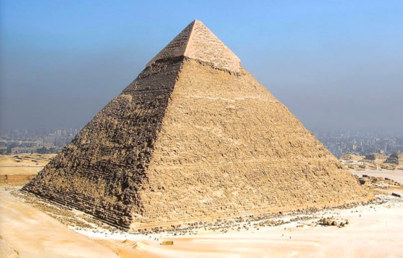
Novel Muon Tomography Detector for the Pyramids
Muography 2021
November 24-26, 2021
Richard Kouzes¹, Alain Bonneville^{1,2}, Azaree Lintereur³, Ayman Mahrous⁴, Isar Mostafanezhad⁵, Ben Rotter⁵, Ryan Pang⁵, Farjana Snigdha⁵, Michael Tytgat⁶, Yasser Assran⁷, Shereen Aly⁸, Basma ElMahdy⁹
¹Pacific Northwest National Laboratory (Richland, WA), ²Oregon State University (Corvallis, OR), ³Penn State University (State College, PA), ⁴Egypt-Japan University of Science and Technology (Alexandria, Egypt), ⁵Nalu Scientific (Honolulu, HW), ⁶Ghent University (Ghent, Belgium), ⁷The British University in Egypt (Cairo, Egypt), ⁸Helwan University and Canadian International College (Cairo, Egypt), ⁹Helwan University and The British University in Egypt
Some of this work was sponsored by the U.S. Department of Energy Office of Fossil Energy
PNNL-SA-166923
Notes:
20 minutes Abstract— Cosmic-ray muons, which impinge upon the Earth at a rate of approximately 160 muons·m⁻²·s⁻¹, can be used to image the density of geological and man-made materials located above a muon detector. The detectors used for these measurements must be capable of determining both the muon rate and angle of incidence. Applications of this capability include geological carbon storage, natural gas storage, enhanced oil recovery, compressed air storage, oil and gas production, tunnel detection, and detection of hidden rooms in man-made structures, such as the pyramids. For these applications the detector must be small, rugged, safe and have operational characteristics which enable use in remote locations, such as low power requirements. A new muon detector design has been constructed to make measurements on the Khafre pyramid to look for unknown voids that might exist in the structure. The new detector design uses plates of scintillator with fiber optic readout to obtain position information. This design will meet the operational requirements, while also providing a geometry which can be modified for different measurement conditions. 15-minute presentation

Slide 2
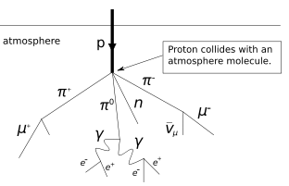
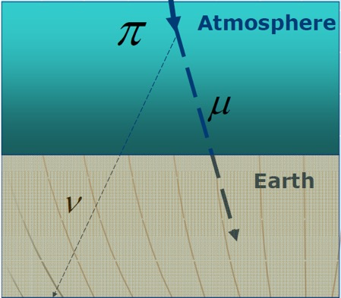
Cosmic Ray Muons
Fundamental particle (lepton) t_{1/2}=1.56 μs
Similar to electrons: 207 times an electron mass, or 105.7 MeV/c²
Created when high energy cosmic rays hit the atmosphere
160 muons/m²/s at sea level
Average energy is ~6 GeV
Muons lose about 2 MeV/g/cm²
Muons deposit ~2 MeV in 1 cm of plastic

Slide 3
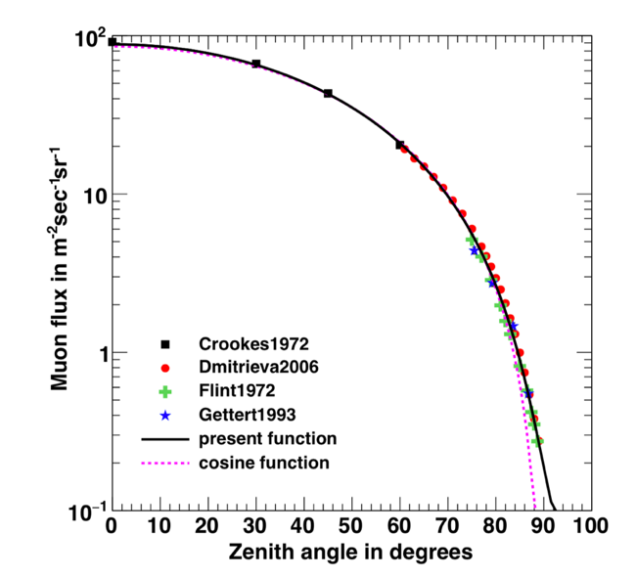
Muon Distributions
Muons span a wide energy range (MeV to TeV+)
Follow ~cos² distribution
Flux is impacted by the weather and solar activity
Sea level energy plot from CRY (Hagmann UCRL-TM-229452 )
Sea level angular plot from (Shukla 2018)

Slide 4
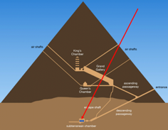
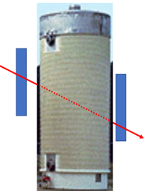
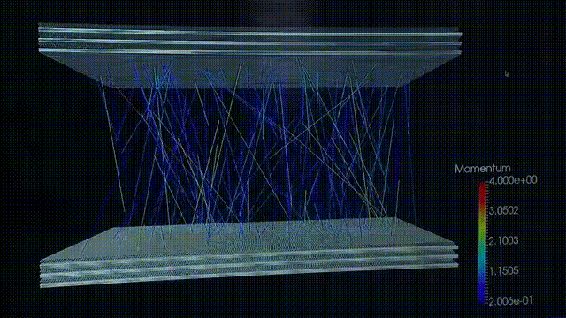
Muon Detection Applications
Muon detection has a wide range of applications
Background rejection for low-background experiments
  Neutrino detection
  Dark matter experiments
  Neutrinoless double beta decay
High energy physics basic research
Tomography using muons
  Volcanoes
  Pyramids (Khufu already imaged)
  Tunnel detection
  Underground storage
  Spent fuel storage
  Vehicle imaging for homeland security
Pyramids
Spent Fuel
Safeguards
Vehicle Inspection
From https://decisionsciences.com/our-product/#technology

Slide 5
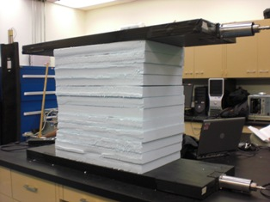
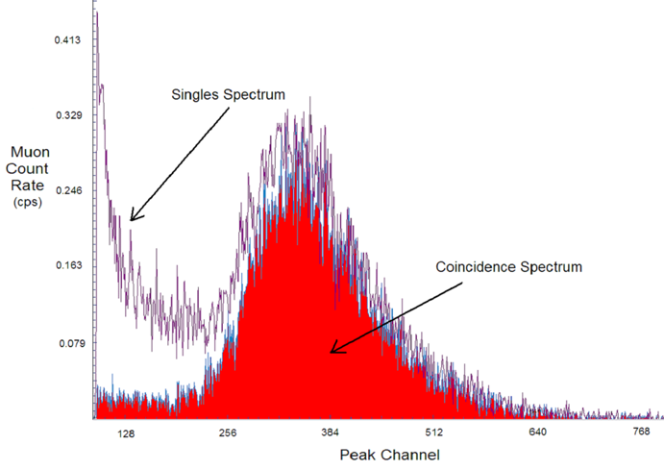
Muon Detection
Muons create ionization in the detector medium.
Coincidence removes background from gamma rays
Example of two polyvinyl toluene (PVT) panels
PVT scintillators
PMTs

Slide 6
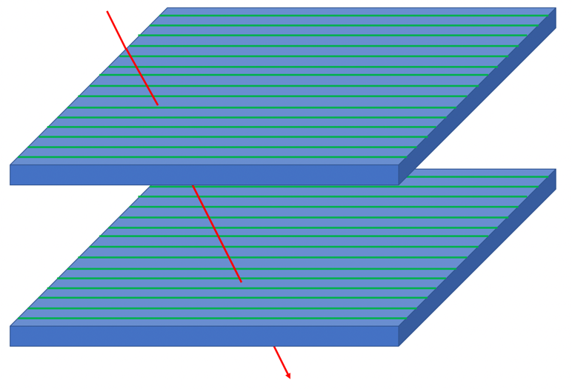
Muon Tomography Trajectory
  To determine the muon direction, the x and y muon interaction positions must be detected for at least two points separated vertically in space
  Angular resolution is determined by x and y resolution and spacing between detection planes
muon
(x₁,y₁)
spacing
z
y
(x₂,y₂)
x

Slide 7
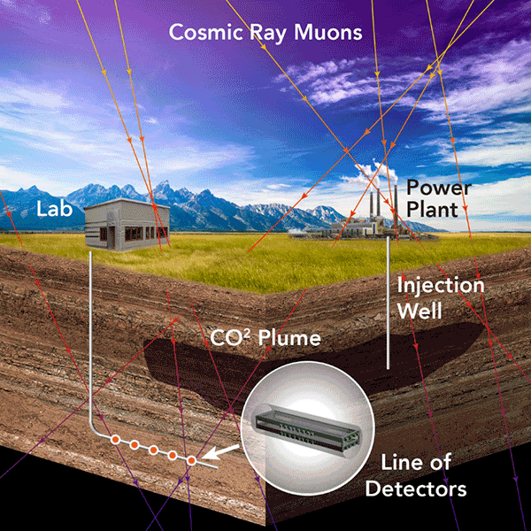
Previous Project: Borehole Detector
Develop muon detector capable of fitting in boreholes to perform density tomography of geological structures.
Create an efficient inversion method that incorporates muon trajectories and data generated by seismic and gravity techniques.
Chain of detectors to monitor muon flux over decades
Simple and rugged
Withstand severe environmental conditions
Example of deployment of muon detectors in a deep well to monitor density variations in a geological formation used to store CO₂.

Slide 8
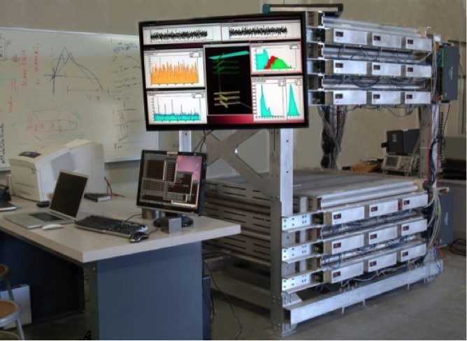
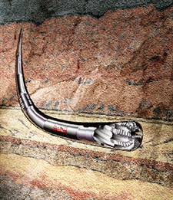

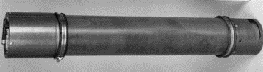
Detector Design: The Size Challenge
5 to 8”
(13 to 20 cm)
3.3 ft. long (~1 m)
LANL Gas Tube Mini Muon Tracker (MMT)
From a lab size detector….
…to a borehole detector.

Slide 9
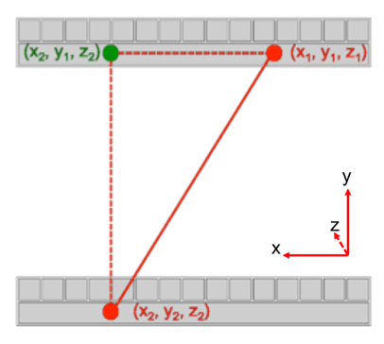
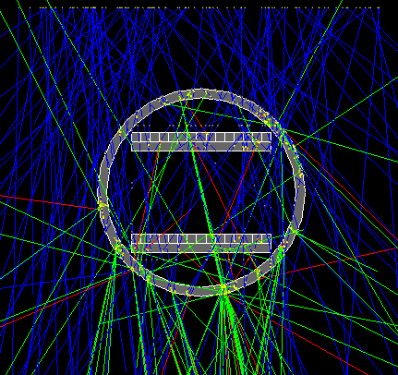
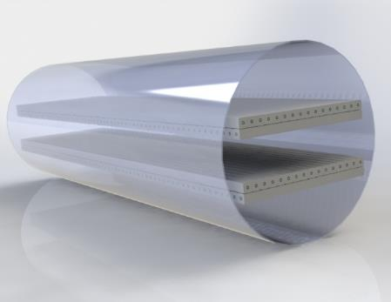
Borehole Detector Design
Miniaturization of the detector elements and electronics
Goal: detect 1% change in CO₂ density per year
Must fit in a borehole (~6 inches ~16 cm)
Must survive temperature > 45℃ & pressure > 10 MPa
Detector components
Polystyrene plastic scintillator rods
Optical fibers (Saint-Gobain BCF-922)
SiPM readout

Slide 10
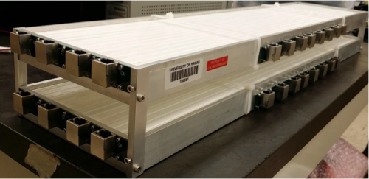
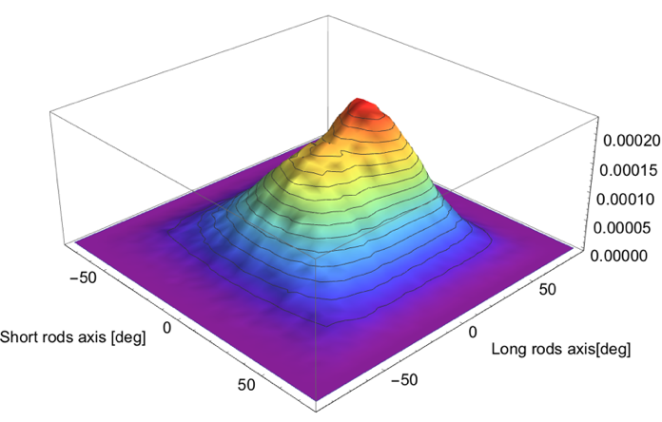
Prototype Underground Lab Test Data
Polystyrene rods
Active area ~15x30 cm
Above ground
Below ground
Detector underground next to stairwell.

Slide 11
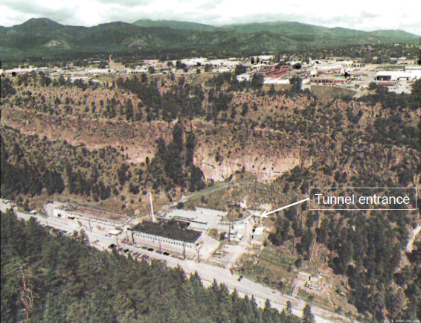
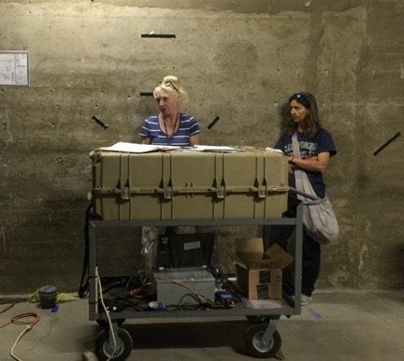
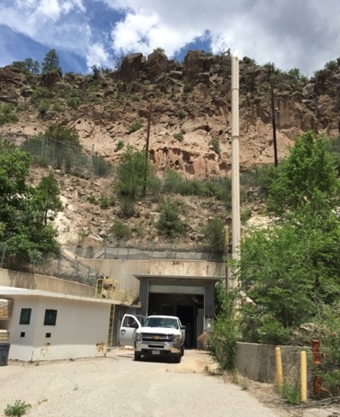
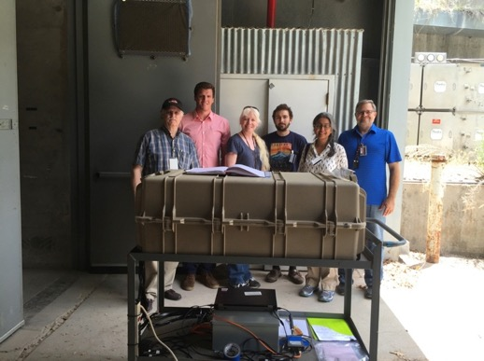
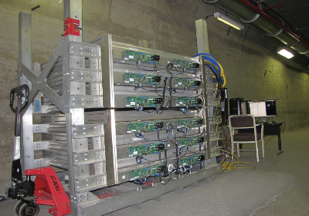
Tests of Muon Detectors at LANL Tunnel Facility
Borehole Muon Detector
Mini Muon Tracker
Mini Muon Tracker
Notes:
LANL Participants:
C. Rowe
E. Guardincerri
M. Durham
UNM collaborators
M. Roy
M. Dichter

Slide 12
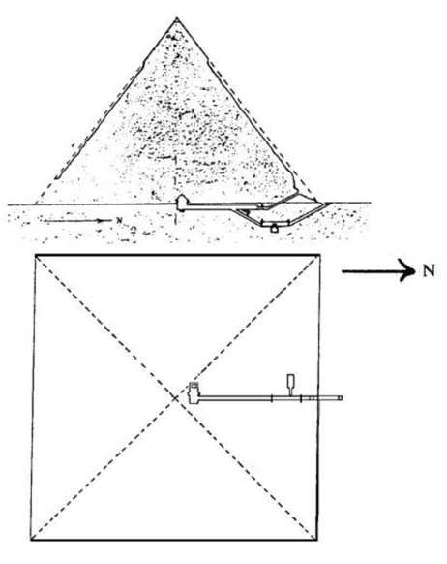
New Project: Pyramid Tomography
Detector design (inspired by borehole design) requirements:
  Assembly must be less than 1 meter cubed in size
  Light enough to be easily hand transported
  No toxic, flammable or asphyxiating gases
Pyramid of Khafre
  215.3 m base
  136.5 m high
From http://guardians.net/egypt/pyramids/Khafre/KhafrePyramid.htm

Slide 13
Muon Pyramid Detector Design
Detector specifications
  Polyvinyl toluene (PVT) scintillator with fiber readout
  SiPM readout (only low voltage required)
  Position resolution of better than 5 mm
  61 cm by 61 cm square active area in two panels
  Variable angular resolution by changing panel spacing between 20 cm and 100 cm
Components
  PVT scintillator with orthogonal fiber optics on opposite sides (from Eljen Technology)
  Custom PC boards (by Nalu Scientific) to mount SiPMs (from Hamamatsu) at one end of each fiber
  Commercial digitizer electronics (from CAEN)
  Controlled by a laptop with custom software
  Mounted in cases and support frame

Slide 14
Muon Detector Concept
PVT slab: 61 cm x 61 cm x 2 cm
Wavelength shifting optical fibers (2 mm) spaced at 1 cm embedded in both faces in orthogonal directions
fibers
PVT

Slide 15
Muon Detector Concept
Muon deposits about 4 MeV in the 2-cm thick PVT slab producing scintillation light
muon
fibers
scintillation
PVT

Slide 16
Muon Detector Concept
Small amount of scintillation light is transported to the fibers
Black coating reduces reflections to improve localization
muon
fibers
scintillation
PVT

Slide 17
Muon Detector Concept
Fibers wavelength shift the light and transport it to the SiPMs
SiPMs generate electrical pulses proportional to light collected
muon
fibers
scintillation
PVT
Muon position is extrapolated based on signal size on all hit fibers

Slide 18
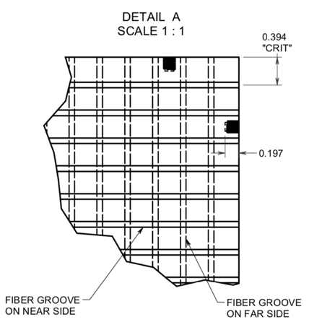
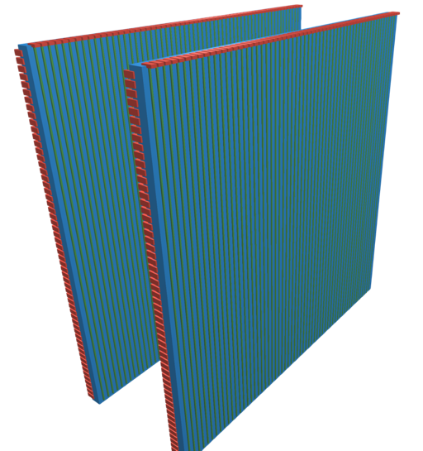
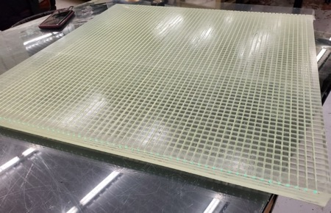
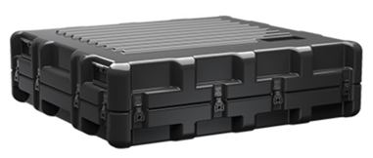
Muon Detector Construction
Orders for components made
PVT, SiPMs and electronics sent to Nalu
Nalu made a custom PC board to mount SiPMs
Vendors to ship components to Egypt for final assembly

Slide 19
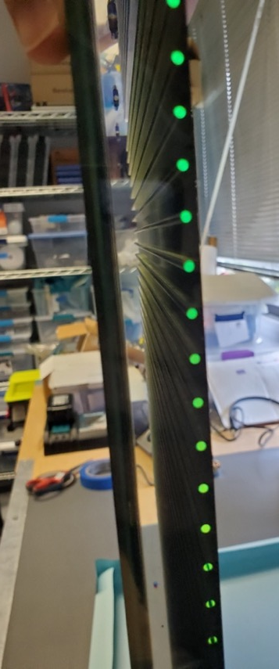
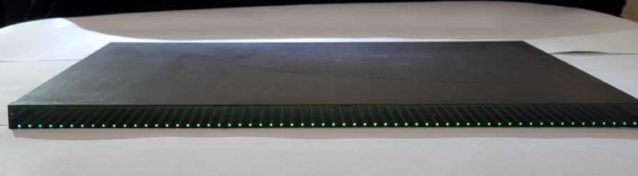
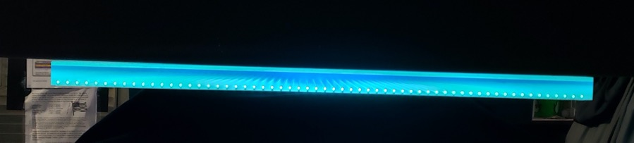
Muon Detector Scintillator
Scintillator fabricated and delivered
Fibers spaced at 1 cm
Interpolation should give < 5mm position information

Slide 20
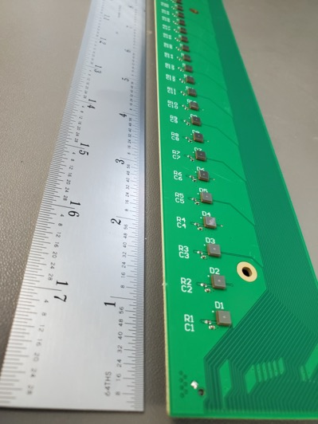
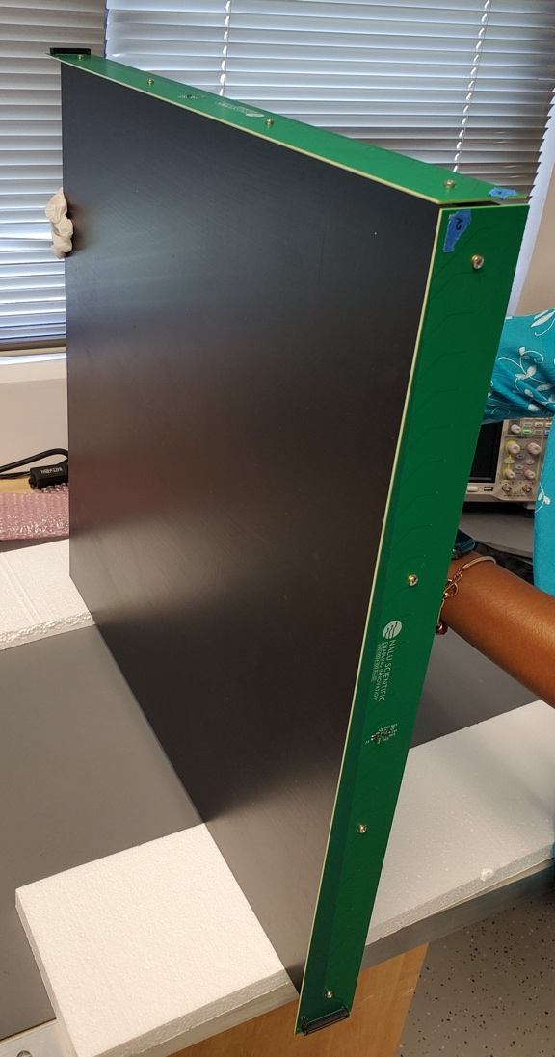
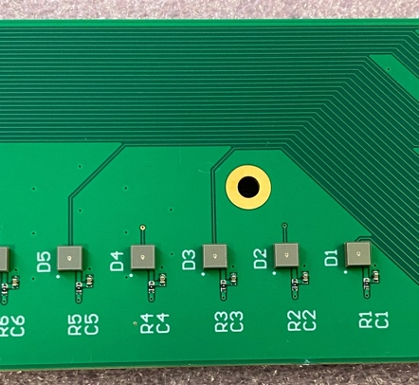
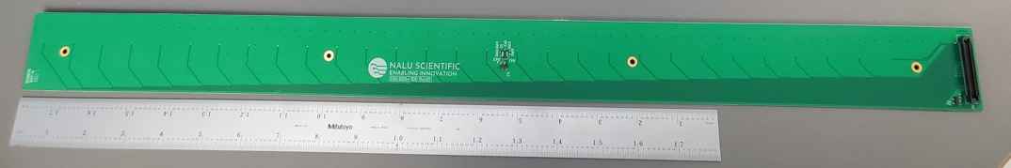
Muon Detector SiPM Board
Printed circuit boards delivered
All SiPMs functional

Slide 21
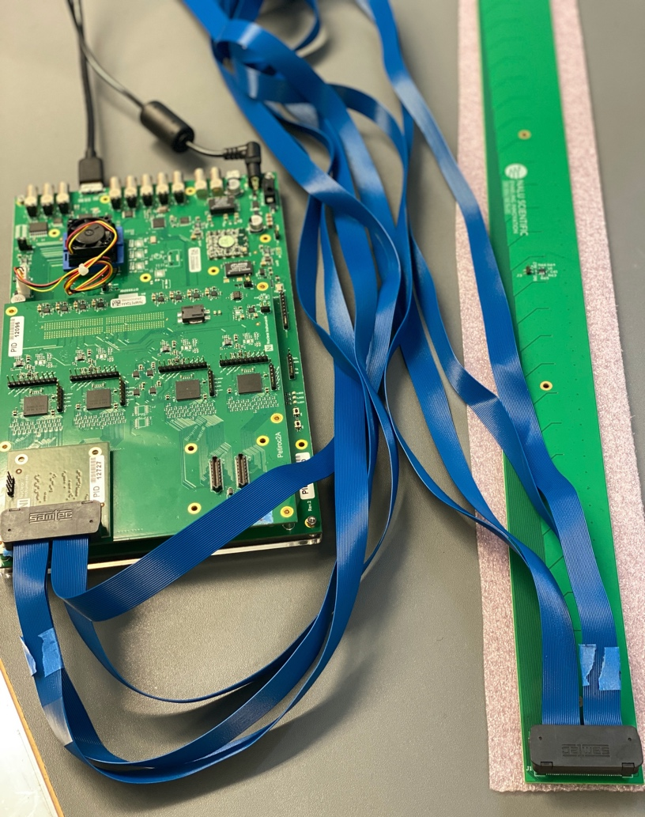
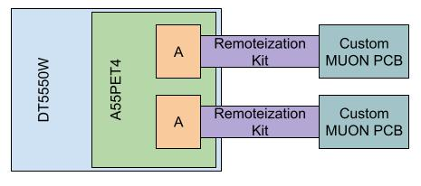
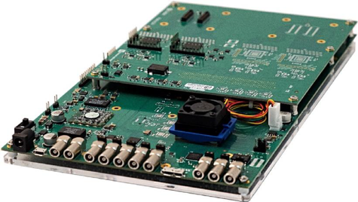
Muon Detector Electronics
CAEN electronics delivered
  DT5550W motherboard
  A55PETx piggy board
  SCI-5550W readout software
Electronics testing underway
Detector being assembled

Slide 22
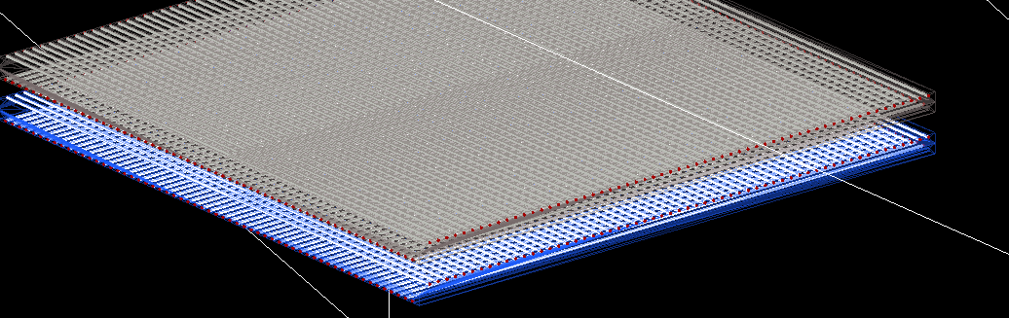
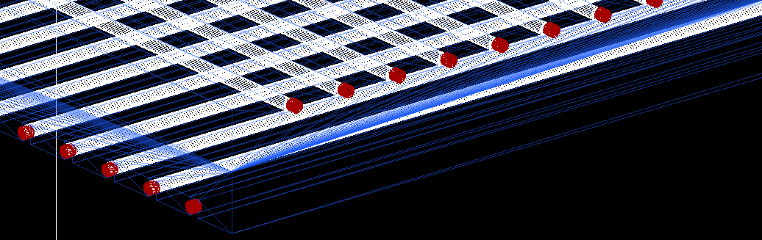
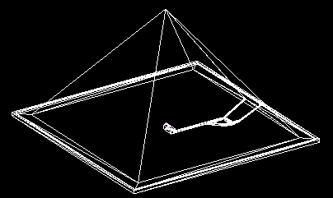
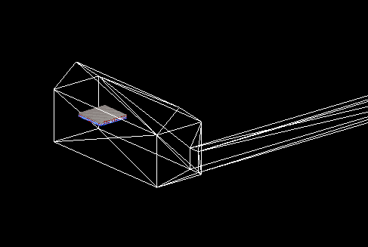
Simulations
Simulations are being made of the muon detector for tomography in the Khafre pyramid

Slide 23
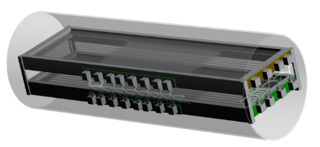
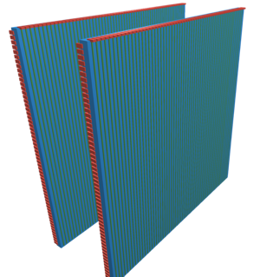
Results and Next Steps
Components for the detector are in hand
Detector assembly and testing done at Nalu Scientific
Components in transit to Egypt
Final assembly and testing will be performed at EJUST in Egypt
The detector should be fully operational early in calendar year 2022
Pyramid measurements to be made in 2022

Slide 24
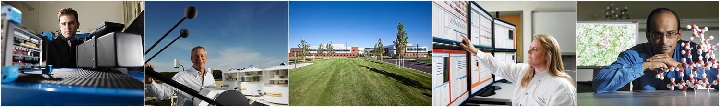
Pacific Northwest National Laboratory
Questions
Project Collaborators: Alain Bonneville^{a,i}, Richard T. Kouzesª, Jared Yamaokaª, Charlotte Rowe^{b}, Elena Guardincerri^{b}, J. Matthew Durham^{b}, Christopher L. Morris^{b}, Daniel C. Poulson^{b}, Kenie Plaud-Ramos^{b}, Deborah J. Morley^{b}, Jeffrey D. Bacon^{b}, James Bynes^{c}, Julien Cercillieux^{c}, Chris Ketter^{c}, Khanh Le^{c}, Isar Mostafanezhad^{c j}, Gary Varner^{c}, Joshua Flygare^{d}, Azaree T. Lintereur^{d}, Ayman Mahrous^{e}, Bjorn Paulsson^{f}, Nedra Bonal^{g}, Robert Mellors^{h}, George Chapline^{h}, Ben Rotter ^{j}, Ryan Pang ^{j}, Farjana Snigdha ^{j}, Michael Tytgat^{k}, Yasser Assran^{l}, Shereen Aly^{m}, Basma ElMahdy^{n}
ª Pacific Northwest National Laboratory, Richland WA ^{h} Lawrence Livermore National Laboratory, Livermore, CA
^{b} Los Alamos National Laboratory, Los Alamos, NM ^{i} Oregon State University, Corvallis, OR
^{c} University of Hawaii at Manoa, Honolulu, HI ^{j} Nalu Scientific
^{d} Pennsylvania State University, State College, PA ^{k} Ghent University, Ghent, Belgium
^{e} EJUST, Cairo, Egypt ^{l} The British University in Egypt, Cairo, Egypt
^{f} Paulsson Inc. ^{m} Helwan University and Canadian International College, Cairo, Egypt
^{g} Sandia National Laboratory, Albuquerque, NM ^{n} Helwan University and The British University in Egypt

