Slide 1






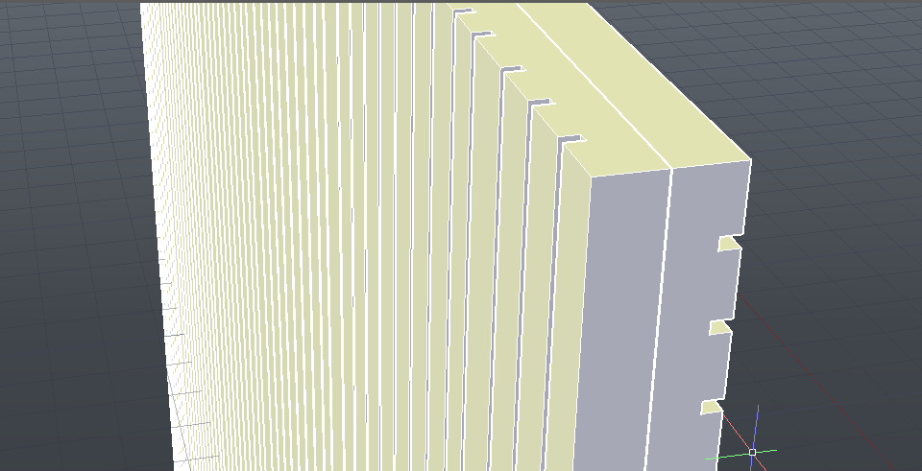
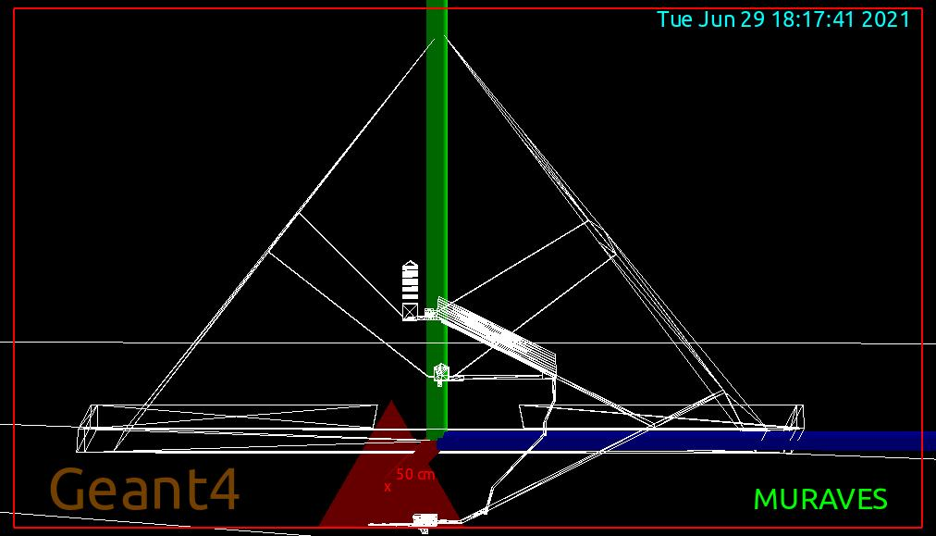
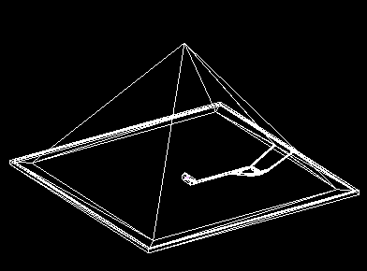
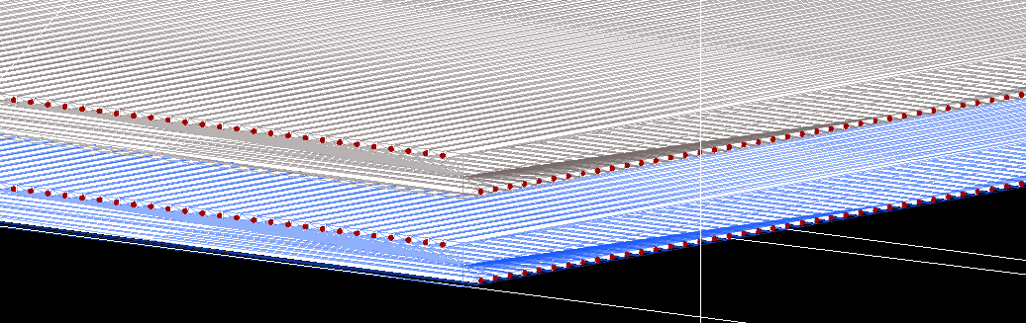
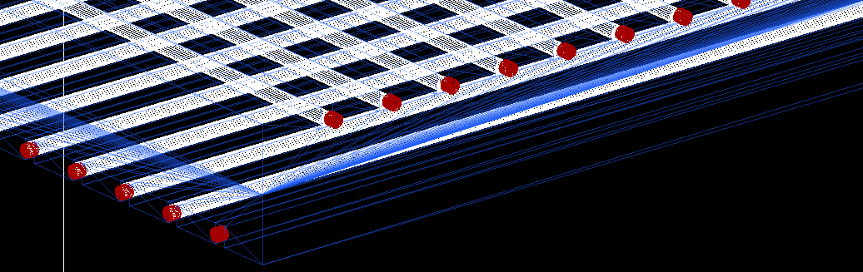
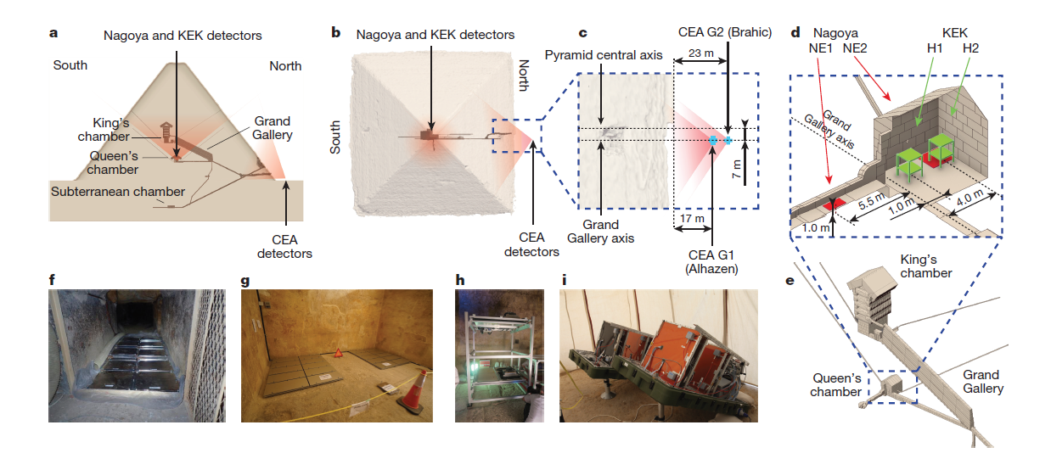
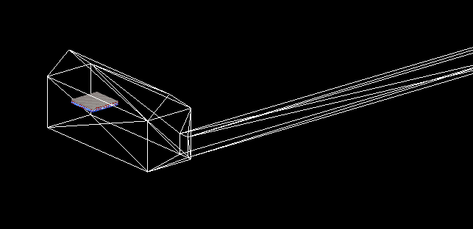
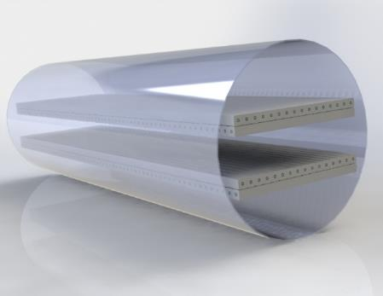
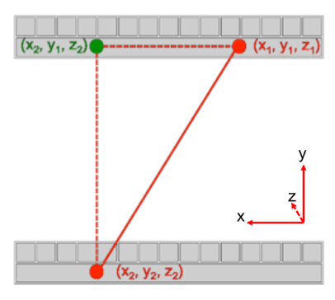
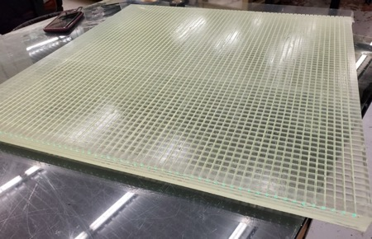
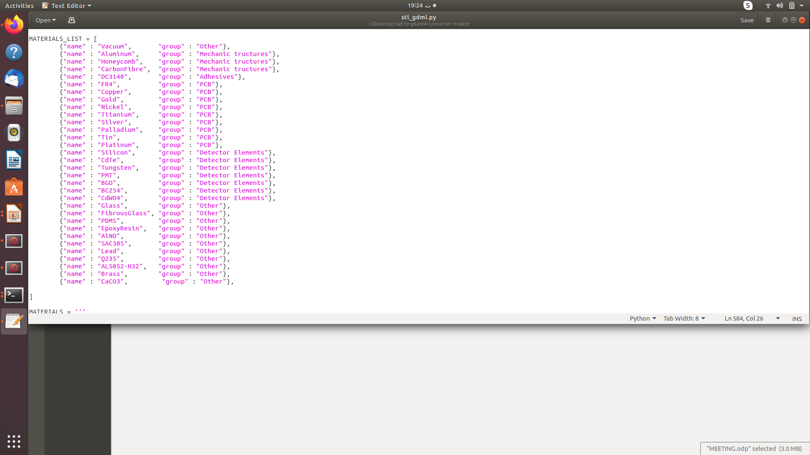
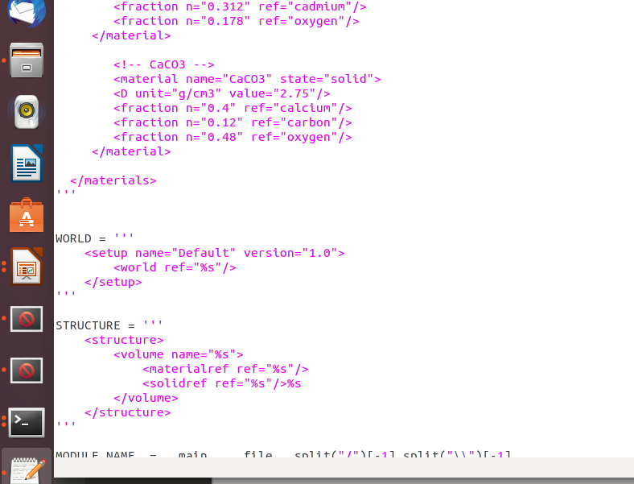
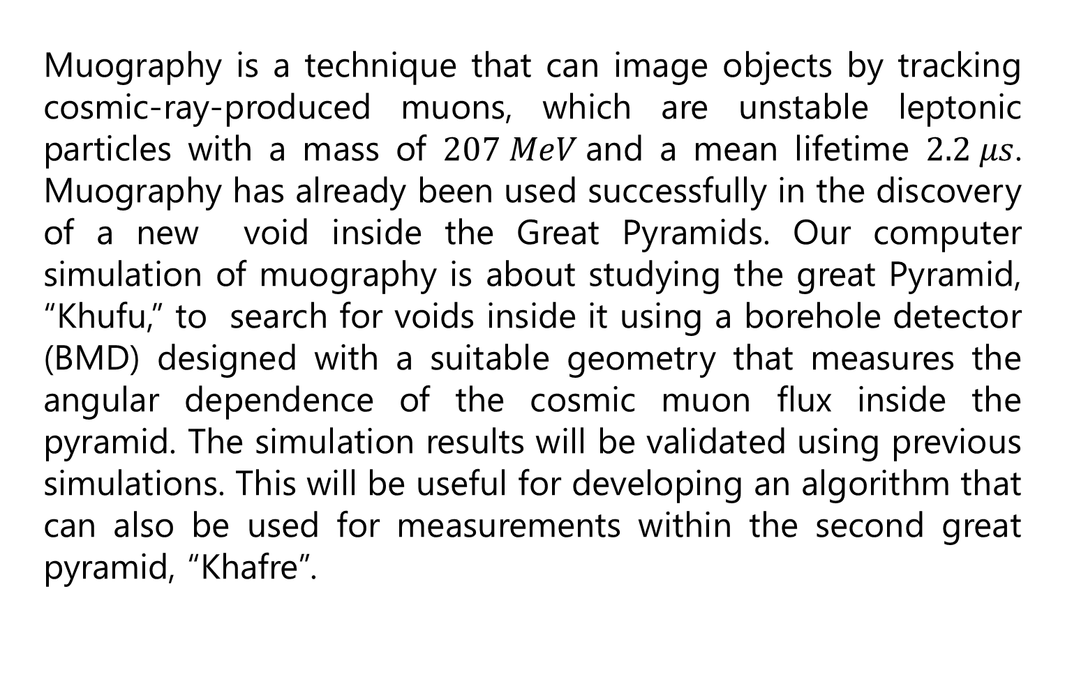
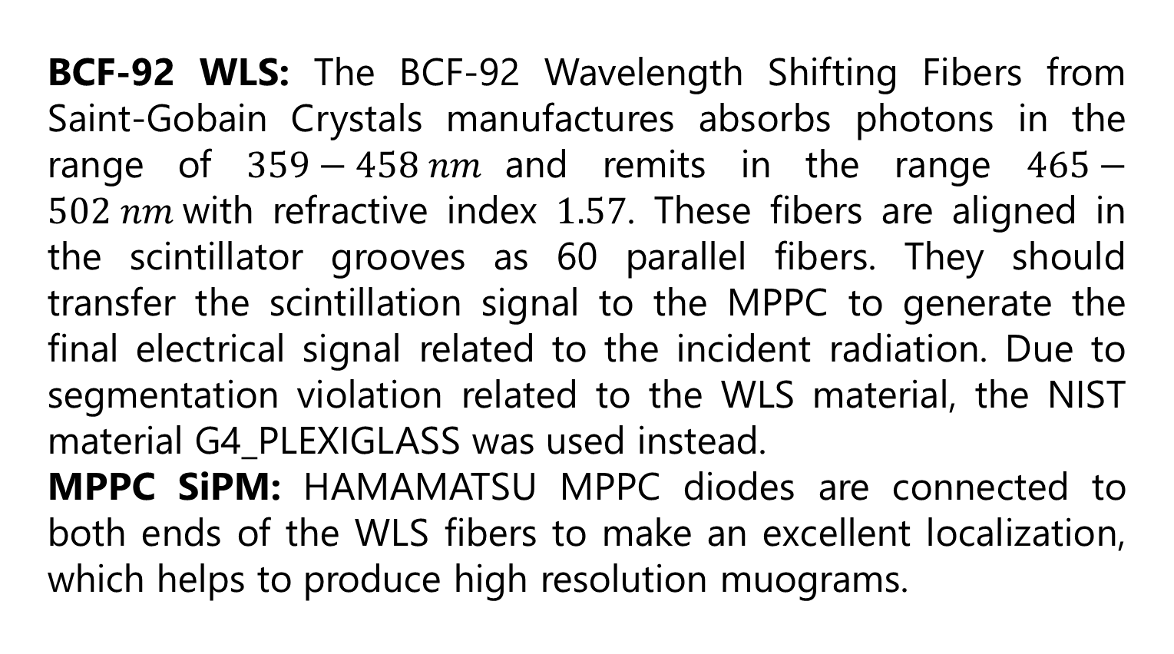
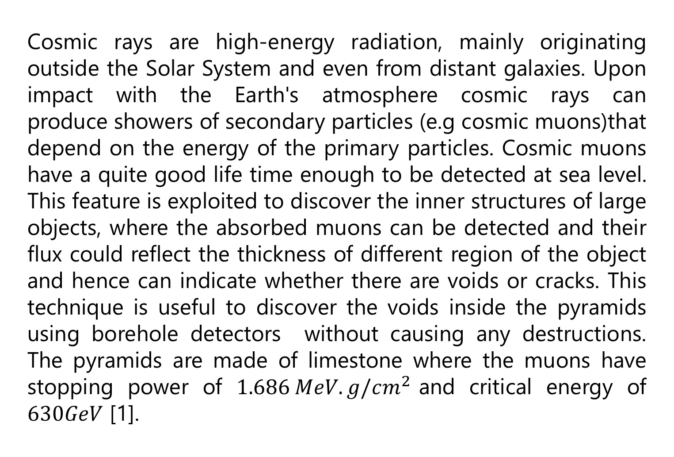
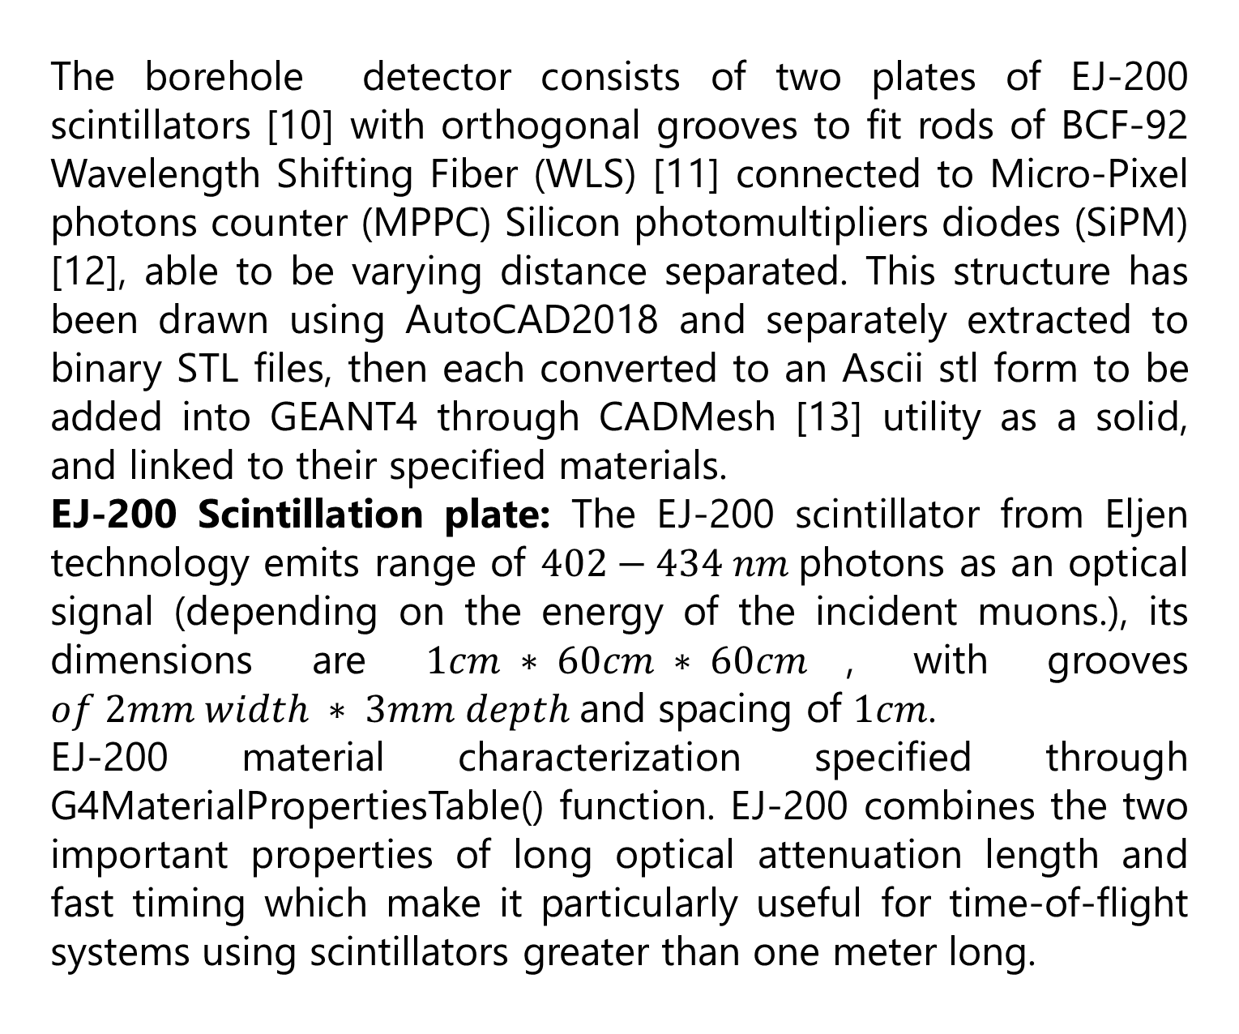
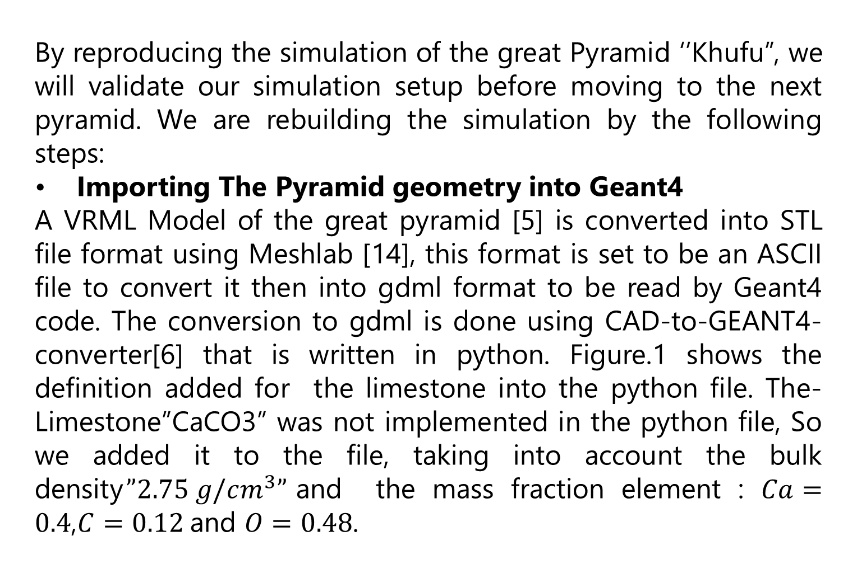
Simulation Studies for Muography of the Pyramids
Shereen Aly^{1,2}; Basma ELMahdy^{1,3}; Michael Tytgat⁴; Ayman Mahrous⁵; Yasser Assran^{3,7}; Richard Kouzes⁶; Muhammed N.Yaseen¹
¹Helwan University ,²Canadian International College, ³The British University in Egypt, ⁴Ghent University, ⁵Egypt-Japan for Science and Technology, ⁶Pacific Northwest National Laboratory (Richland, WA), ⁷Suez University
Abstract
Importing GDML format into Geant4:
Figure.2 shows the out put of the gdml format visualized by the GUI of Geant4, showing the inner structure of the great pyramid ”Khufu”
Muography is a technique that can image objects by tracking cosmic-ray-produced muons, which are unstable leptonic particles with a mass of $207 MeV$and a mean lifetime $2.2 μs$. Muography has already been used successfully in the discovery of a new void inside the Great Pyramids. Our computer simulation of muography is about studying the great Pyramid, “Khufu,” to search for voids inside it using a borehole detector (BMD) designed with a suitable geometry that measures the angular dependence of the cosmic muon flux inside the pyramid. The simulation results will be validated using previous simulations. This will be useful for developing an algorithm that can also be used for measurements within the second great pyramid, “Khafre”.
Figure.5 AutoCad structure for the simulated EJ-200 scintillation plate
BCF-92 WLS: The BCF-92 Wavelength Shifting Fibers from Saint-Gobain Crystals manufactures absorbs photons in the range of $359−458 nm$and remits in the range $465−502 nm$with refractive index $1.57$. These fibers are aligned in the scintillator grooves as 60 parallel fibers. They should transfer the scintillation signal to the MPPC to generate the final electrical signal related to the incident radiation. Due to segmentation violation related to the WLS material, the NIST material G4_PLEXIGLASS was used instead.
MPPC SiPM: HAMAMATSU MPPC diodes are connected to both ends of the WLS fibers to make an excellent localization, which helps to produce high resolution muograms.
Introduction
Figure.2 inner structure of Khufu’s pyramid
Cosmic rays are high-energy radiation, mainly originating outside the Solar System and even from distant galaxies. Upon impact with the Earth's atmosphere cosmic rays can produce showers of secondary particles (e.g cosmic muons)that depend on the energy of the primary particles. Cosmic muons have a quite good life time enough to be detected at sea level. This feature is exploited to discover the inner structures of large objects, where the absorbed muons can be detected and their flux could reflect the thickness of different region of the object and hence can indicate whether there are voids or cracks. This technique is useful to discover the voids inside the pyramids using borehole detectors without causing any destructions. The pyramids are made of limestone where the muons have stopping power of $1.686 MeV.g/cm^{2}$and critical energy of $630GeV$ [1].
2.Khafre Pyramid simulation
Our simulation produces the muon-map of Khafre pyramid, then studying the BMD detector performance.
As far as we know, the interior design of this pyramid, Figure.3, contains two entrances lead to the burial chamber, with known structures and dimensions [7, 8].
Figure.6 Geant4 simulated grid of WLS and MPPC
Outlook
Study the muon transportation through Khafre pyramid
Digitize the signals in the SiPM to match the real measured detector signals
Develop track reconstruction code for the borehole detector
Conclusion
Figure.1 Muon detectors installed for Khufu’s Pyramid. a, Side view of the pyramid, with sensor positions and indicative field of view. b, Top view. c, Close view of the position of the gas detectors Brahic and Alhazen (CEA). d, Orthographic view of Queen’s chamber with nuclear emulsion films (Nagoya University, red positions NE1 and NE2) and scintillator [4]
In this project we aim to search for new voids inside the pyramids of Giza using the muography technique. The Great Pyramid is simulated starting with the VRML model, which shows the inner structure of the pyramid. Our borehole detector is also simulated and will be placed inside the pyramid. The cosmic ray muons flux will be simulated using the CRY cosmic ray generator.
Figure.3 STL Khafre pyramid structure,
For revelling any other hidden voids within this pyramid, BMD detector would be added in the Burial chamber as shown in Figure.4
References
[1] D. E. Groom, N. V. Mokhov, and S. I. Striganov, “MUON STOPPING POWER AND RANGE TABLES 10 MeV–100 TeV,” At. Data Nucl. Data Tables, vol. 78, no. 2, pp. 183–356, Jul. 2001, doi: 10.1006/ADND.2001.0861.
[2] S. Agostinelli et al., “GEANT4 - A simulation toolkit,” Nucl. Instruments Methods Phys. Res. Sect. A Accel. Spectrometers, Detect. Assoc. Equip., vol. 506, no. 3, 2003, doi: 10.1016/S0168-9002(03)01368-8.
[3] C. Hagmann, D. Lange, J. Verbeke, and D. Wright, “Cosmic-ray Shower Library (CRY),” 2012. [Online]. Available: http://nuclear.llnl.gov/simulation.
[4]Morishima, Kunihiro; Kuno, Mitsuaki; Nishio, Akira; Kitagawa, Nobuko; Manabe, Yuta; Moto, Masaki; Takasaki, Fumihiko; Fujii, Hirofumi; Satoh, Kotaro (2017-11-02). "Discovery of a big void in Khufu's Pyramid by observation of cosmic-ray muons". Nature. 552 (7685): 386–390. arXiv:1711.01576
[5] “UM-VRL: The Great Pyramid of Khufu.” ://websites.umich.edu/~vrl/project/pyramid/ (accessed Nov. 24, 2021).
[6] “tihonav/cad-to-geant4-converter: A light-weight tool for converting CAD drawings into the GDML format.” https://github.com/tihonav/cad-to-geant4-converter (accessed Nov. 25, 2021).
[7] “File:Pyramid of Khafre.stl - Wikimedia Commons.” ://commons.wikimedia.org/wiki/File:Pyramid_of_Khafre.stl (accessed Nov. 24, 2021).
[8] “Pyramid of Khafre - Wikipedia.” ://en.wikipedia.org/wiki/Pyramid_of_Khafre (accessed Nov. 24, 2021).
[9] J. Flygare, A. Bonneville, R. Kouzes, J. Yamaoka, and A. Lintereur, “Muon borehole detector design for use in 4-D density overburden monitoring,” IEEE Trans. Nucl. Sci., vol. 65, no. 10, pp. 2724–2731, Oct. 2018, doi: 10.1109/TNS.2018.2869196.
[10] “Scintillating Fiber | Saint-Gobain Crystals.” https://www.crystals.saint-gobain.com/products/scintillating-fiber (accessed Nov. 24, 2021).
[11] “Multi-Pixel Photon Counters (MPPCs/SiPMs) | Hamamatsu Photonics.” https://www.hamamatsu.com/eu/en/product/optical-sensors/mppc/index.html (accessed Nov. 24, 2021).
[12]“EJ-200, EJ-204, EJ-208, EJ-212 - Plastic Scintillators - Eljen Technology.” https://eljentechnology.com/products/plastic-scintillators/ej-200-ej-204-ej-208-ej-212 (accessed Nov. 24, 2021)
[13] C. M. Poole, I. Cornelius, J. V. Trapp, and C. M. Langton, “A CAD interface for GEANT4,” Australas. Phys. Eng. Sci. Med., vol. 35, no. 3, pp. 329–334, Sep. 2012, doi: 10.1007/S13246-012-0159-8
[14] “MeshLab.” https://www.meshlab.net/ (accessed Nov. 25, 2021)..
Figure.2 Lift: Data relative to simulation (including known structure. Right: The new void discovered in Khufu pyramid [4]
In order to do the same with the second great pyramid a monte-carlo simulations are used as a starting point for our study. The Geant4 full simulation tool [2] is used to simulate the pyramid and the detector, while the CRY generator [3] will be used to simulate the cosmic ray flux through the pyramid and the detector setup.
Figure.4 Geant4 simulated BMD inside the buiral chamber of Khafre pyramid.,
1.Rebuilding Khufu pyramid simulation
3.Detector simulation
By reproducing the simulation of the great Pyramid ‘’Khufu”, we will validate our simulation setup before moving to the next pyramid. We are rebuilding the simulation by the following steps:
Importing The Pyramid geometry into Geant4
A VRML Model of the great pyramid [5] is converted into STL file format using Meshlab [14], this format is set to be an ASCII file to convert it then into gdml format to be read by Geant4 code. The conversion to gdml is done using CAD-to-GEANT4-converter[6] that is written in python. Figure.1 shows the definition added for the limestone into the python file. The- Limestone”CaCO3” was not implemented in the python file, So we added it to the file, taking into account the bulk density$”2.75 g/cm^{3}”$and the mass fraction element : $Ca=0.4$,$C=0.12$and $O=0.48$.
Figure.2. the borehole detector [9]
The borehole detector consists of two plates of EJ-200 scintillators [10] with orthogonal grooves to fit rods of BCF-92 Wavelength Shifting Fiber (WLS) [11] connected to Micro-Pixel photons counter (MPPC) Silicon photomultipliers diodes (SiPM) [12], able to be varying distance separated. This structure has been drawn using AutoCAD2018 and separately extracted to binary STL files, then each converted to an Ascii stl form to be added into GEANT4 through CADMesh [13] utility as a solid, and linked to their specified materials.
EJ-200 Scintillation plate: The EJ-200 scintillator from Eljen technology emits range of $402−434 nm$photons as an optical signal (depending on the energy of the incident muons.), its dimensions are $1cm ∗ 60cm ∗ 60cm$, with grooves $of 2mm width ∗ 3mm depth$and spacing of $1cm$.
EJ-200 material characterization specified through G4MaterialPropertiesTable() function. EJ-200 combines the two important properties of long optical attenuation length and fast timing which make it particularly useful for time-of-flight systems using scintillators greater than one meter long.
Figure.1:Screenshot of implementing the limestone in the python code

