Slide 1

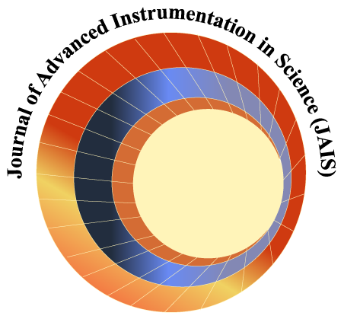

International Workshop on
Cosmic-Ray Muography
Ghent University, Belgium
November 24-26, 2016
Organized and supported by

Slide 2

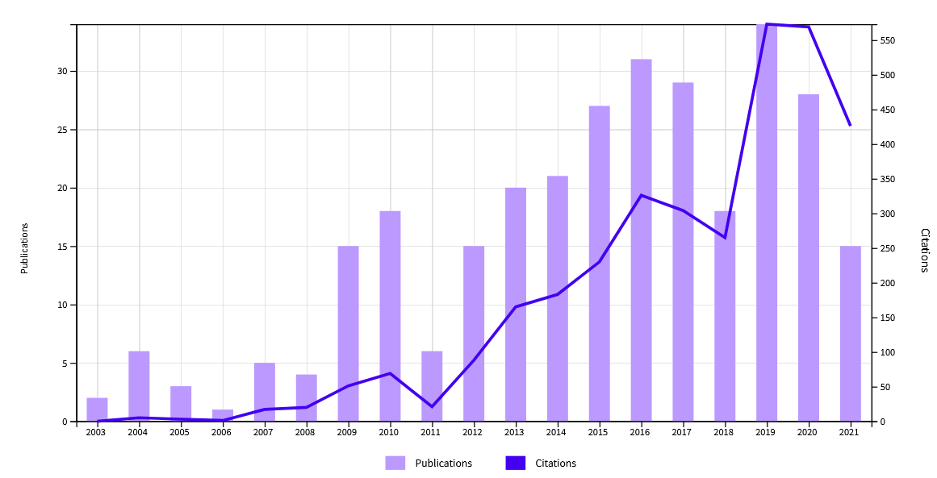
Cosmic-Ray Muography
Increasing amount of involved research groups around the world, of publications, applications, companies …
Bring the community together in a multiday event (2.5 days is even a bit short as it turns out …)
Web of Science
Lynkeos Technology Ltd.
Foster collaboration & education
Too bad for Covid-19 of course …
Can Muography2021 fix the dip in 2021 ? ☺

Slide 3
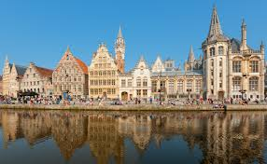
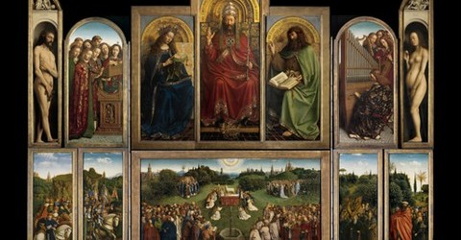
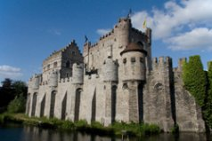
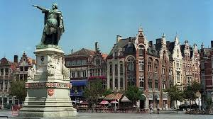
Ghent
Ghent is the capital and largest city of the East Flanders province. The city started as a Celtic settlement at the confluence of the Rivers Scheldt and Leie. In the late Middle Ages, due to the textile trade, the city became one of the largest and richest cities of northern Europe with some 50000 people in 1300. Today it is a busy city with a port and Ghent University ☺
Your list of "things to see" should include the medieval Gravensteen Castle, the belfry, the cathedral with the famous painting of the brothers Van Eyck "The Adoration of the Mystic Lamb", the St. Nicolas Church, the three beguinages, monasteries, etc
Notes:
The city prospered due to the textile trade, and was one of the largest cities in Western Europe. Visiting kings envied the cultural patrimony and had to cope with the stubborn nature of citizens that strongly defended their autonomy. The city has evolved from a variety of settlements on the banks of the River "de Leie" and "de Schelde".
The city nearly equals Bruges when it comes to the number of museums, canals and bars. It offers a larger variety when it comes to contemporary art, theatres, and concert halls. Your list of "things to see" should include the medieval Gravensteen Castle, the belfry, the cathedral with the famous painting of the brothers Van Eyck "The Adoration of the Mystic Lamb", the St. Nicolas Church, the three beguinages, monasteries, etc.

Slide 4
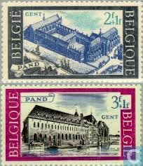
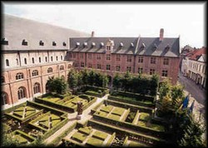
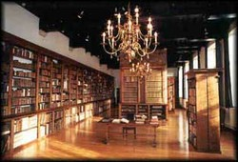
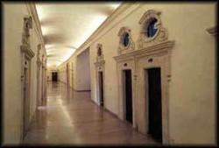
“Het Pand”
"Het Pand“ is a former Dominican monastery, located in the historical centre of the city, on the banks of the river "Leie". The oldest parts of the building date from the 13th century. During five centuries it was extended and refashioned in different styles by different owners. In 1956 the building was put on the list of classified premises. When the UGent acquired the building, its renovation and restoration took from 1971 until 1991. Since then, "Het Pand" has been offering a wide range of possibilities for the organization of scientific congresses and cultural events.
"Het Pand" houses some valuable collections, such as the rich ethnographical and archaeological collections of the university, the Museum for the History of Medicine, full-size photographs of paintings of Brueghel and Early Flemish Masters, and an interesting collection of stained glass.
Notes:
Het Pand is an old Dominican monastery located in the heart of the city on the banks of the river Leie, near the medieval port with the guildhalls as its remnants.
In 1201 a hospital was established next to Saint Michael's Chapel by Canon Utenhove. By 1225 the institute had become too small, and it was decided to construct a new one close to the Bijloke .By that time the first Dominicans had arrived in Ghent. By the agency of the then counts of Flanders, Ferdinand of Portugal and Johanna of Constantinople, the Dominicans were allocated the old hospital to serve as their new settlement.
The year 1228 is considered to be the official date of establishment of the monastery in Ghent. The monks were very actively constructing, and very soon they started building a fully fledged monastery. By 1240 the construction of a church was launched, and it was finished after 25 years. During the period 1325-75 the wing at the river Leie was constructed, with a sacristy, a priory, the refectory and the chapter house, a brewery and a kitchen. All over the first floor was a spacious dormitory.The corridors of the courtyard date from the 15th century, and were constructed in different periods.
In 1473 Margaret of York, spouse of Charles the Bold, laid the first stone of the street wing or library wing, which was the most important extension of the monastery. In the beginning of the 16th century the construction of the middle wing was started, using sandstone for the ground floor and bricks for the upper, and applying the Tudor arch.
The Iconoclastic Fury of 1556 brought hard times for the building. The Calvinists threw all the library books in the Leie. After a brief period of peace, in 1578the Calvinists took over the city again. The monastery was used as a Calvinist university until 1584.In 1651 the old Utenhove hospital was being pulled down and its foundations were used to construct a new hostel which was to be arranged to serve as a guest wing. The north-eastern part of the premise, with the priory and the pharmacy, was refurbished 1780-81 in Louis XVI-style, using stucco and decorative painting. The establishment of the monastery is thus spread over more then 5 centuries, the countless extensions and modifications show the busy activity of the order in the inner city.
In 1796, after the French Revolution; the monastery was closed and sold in lots. The fathers were able to purchase the building with the help of an agent. They let some part of the building to get some income, but still they were forced to sell the property in 1823, with the consent of Pope Leo XII.
The new civil owner, exploiting the rising need of housing occasioned by the speeding industrialization of the city, introduced intermediate floors and partitions. In this way, some two hundred rooms became available for those with little means, while the large rooms such as the sacristy and the chapter house were being used as depots for wine and the refectory became a 'Bazar', a market of furniture.In 1860, the church was demolished. Plans were being made to build a bridge across the river, and an avenue to connect the Volderstraat and its prestigious Aula with the Coupure, where the better class citizens lived. These plans were never realized.
In view of the world exhibition of 1913, some restoration was done at the Leie front in 1912. The building affected by age had deteriorated in such a way that it became untenable after the Second World War. It was prone to be demolished.
But the Decree of 29.10.1956 put the building on the list of classified premises, and the owner went searching for a potential buyer. It was a surprise when the Board of Management of the University of Ghent decided to acquire the building, They were very much convinced of its value, and the transaction took place on January 25, 1963. It was decided to arrange 'Het Pand' as the cultural center of the university, and the Direction of the Buildings was entrusted with its renovation and restoration. Works were started in 1971 and accomplished in 1991.

Slide 5

Some Practicalities: local
Please follow all covid safety measures and wear your face masks at all times when inside the conference center
Coffee breaks will be served in the Kloostergang
Sandwich lunch foreseen for today (Wednesday); on Thursday/Friday participants are free to take lunch in the city center
from the main entrance of the building, go left to the end of the corridor (ladies ground floor, gents first floor)
Wifi in the room: Eduroam; extra guest account (UGentGuest):
    Login: guestTpand; passwd: 9RLXhzZA

Slide 6
Some Practicalities: Zoom
Please use your full name when entering the Zoom room
Mute your microphone during the talks
During the discussion after each talk, “raise your hand” on Zoom when you would like to ask a question and wait for the session chair to call your name
It’s nice to see faces (certainly without mask …), so feel free to turn your camera on

Slide 7
Poster Session
The poster session on Thursday, 3:30-4:15pm will be organized online on Zoom
Poster presenters, if not done yet, please upload your poster as soon as possible such that people have a chance to go through beforehand
During the poster session, every poster will have its own Zoom breakout room; all poster presenters are asked to join their corresponding breakout room to discuss their contribution
Participants can freely move from one breakout room to the other to see all posters and ask questions

Slide 8
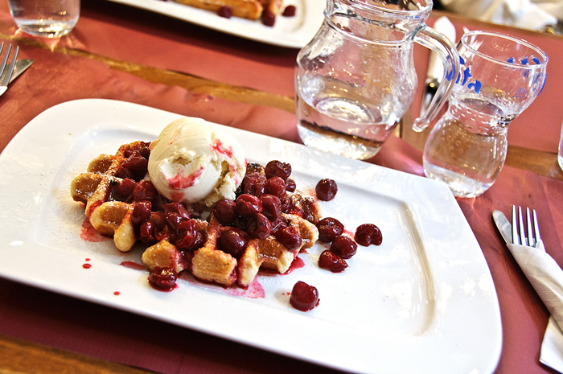
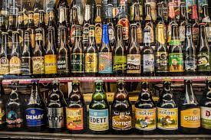
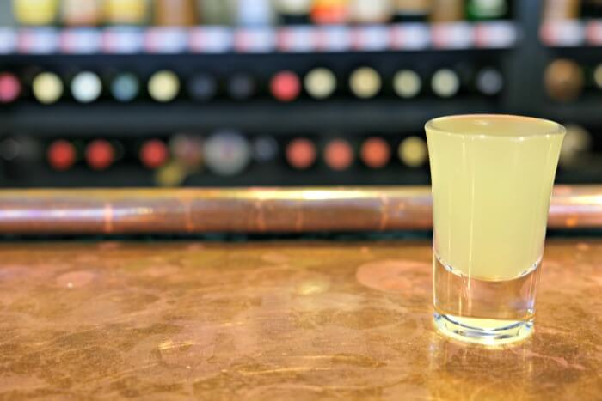

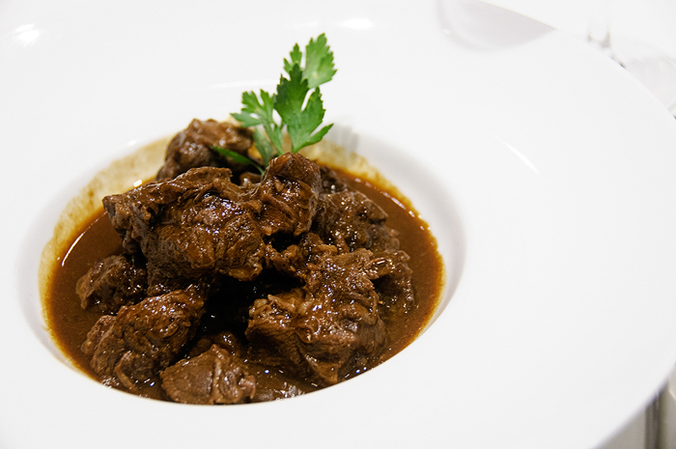

Enjoy …
Enjoy this workshop and the city of Ghent !

