Slide 1
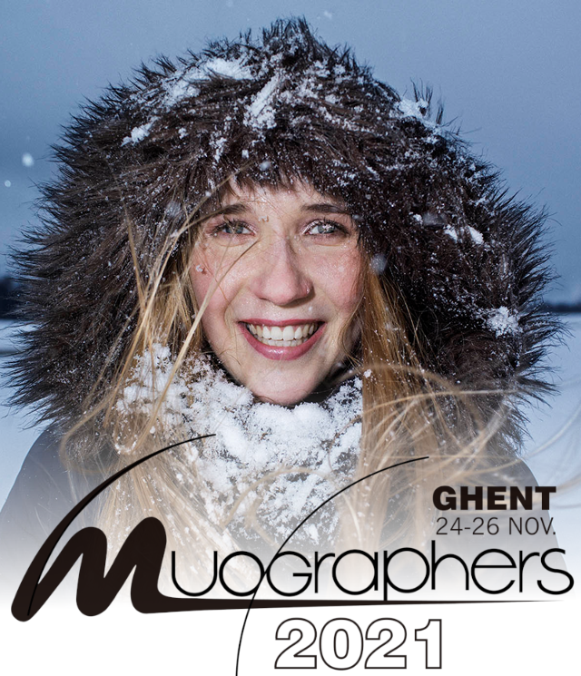

Thoughts about an ideal validation environment for muography applications
Jari Joutsenvaara
Kerttu Saalasti Institute
University of Oulu, Finland

Slide 2
Contents
Introduction
What is muography?
Validation and verification environment
Possibilities at Callio Lab, and the University of Oulu
  Basic needs for a macroscale environment
  Possibilities of a microscale environment

Slide 3
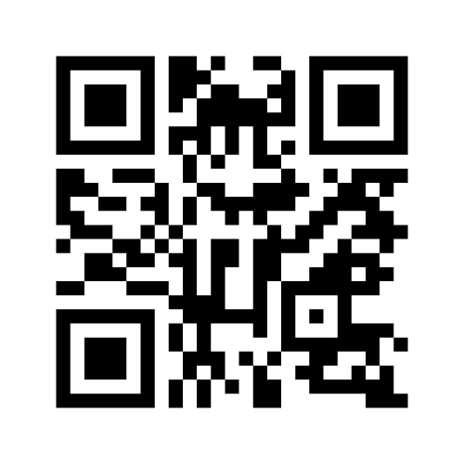
I have tried to look at the question of the ideal validation environment for muography from both a facility provider and a user point of views. However, your thoughts would warmly welcomed.
Have your say at https://www.menti.com/u6sy7p5o75

Slide 4
Muography is an imaging technique to observe density anomalities within volumes

Slide 5


  Basic needs for a macroscale environment
Digital Elevation Model

Slide 6

  Basic needs for a macroscale environment
Digital Elevation Model

Slide 7

  Basic needs for a macroscale environment
Accurate mine models

Slide 8
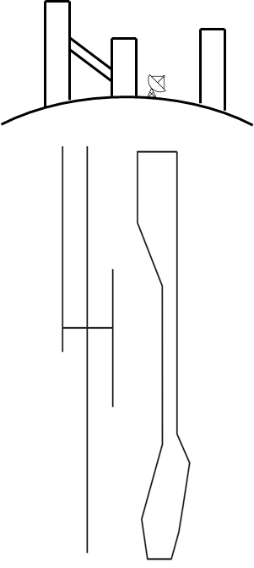
  Basic needs for a macroscale environment
Well-known geology

Slide 9


  Basic needs for a macroscale environment
Access to various depths

Slide 10
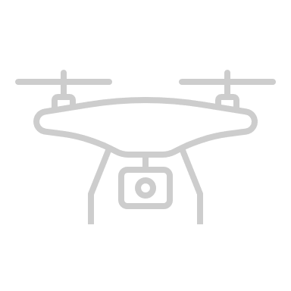

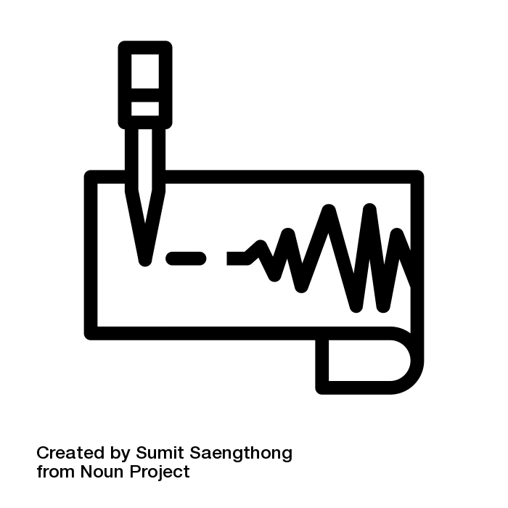

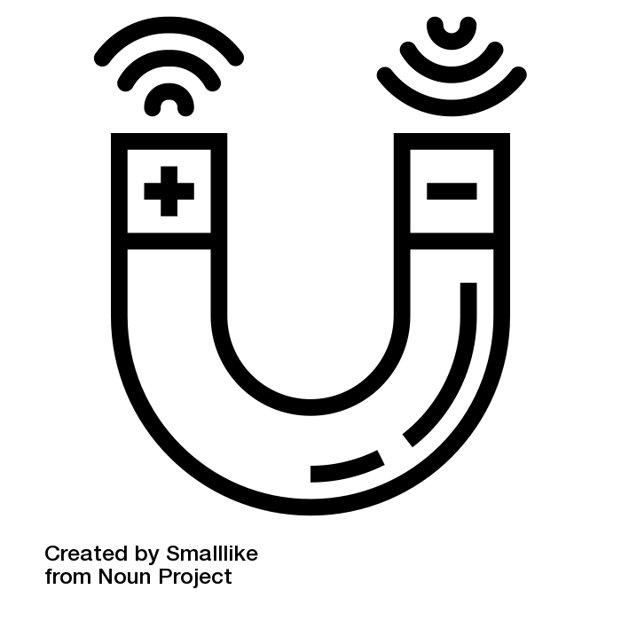
  Basic needs for a macroscale environment
Accompanying geophysical data

Slide 11




  Basic needs for a macroscale environment
Weather data

Slide 12












  Basic needs for a macroscale environment
Onsite infrastructure

Slide 13

100+ m³
  Possibilities of a microscale environment
10 m³
m³
Known, controllable high-contrast targets

Slide 14

  Possibilities of a microscale environment
Possibilities for “rapid” near surface prototyping

Slide 15
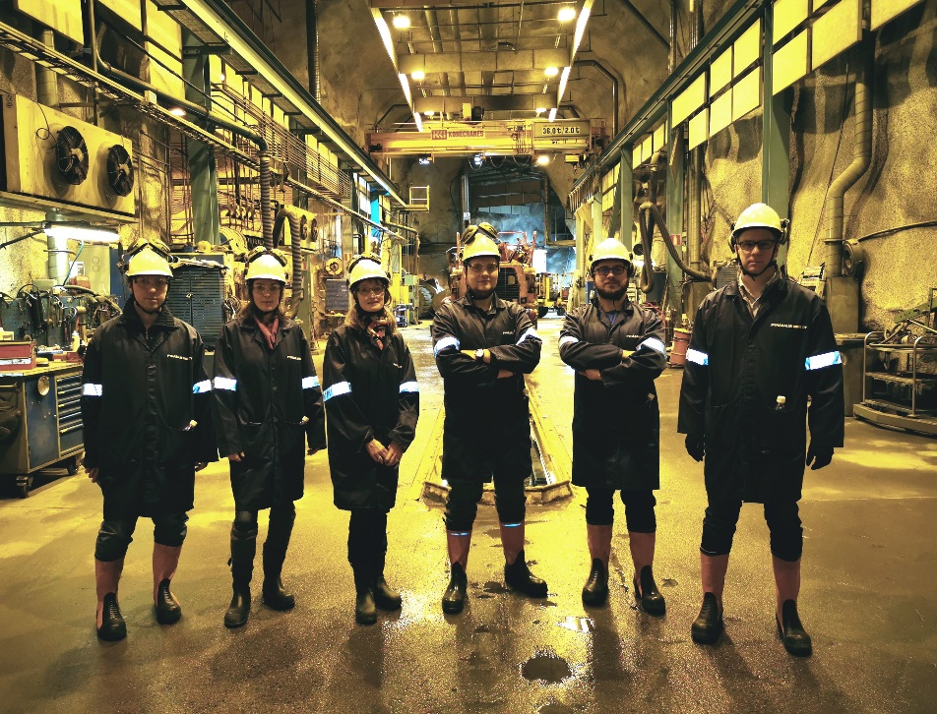
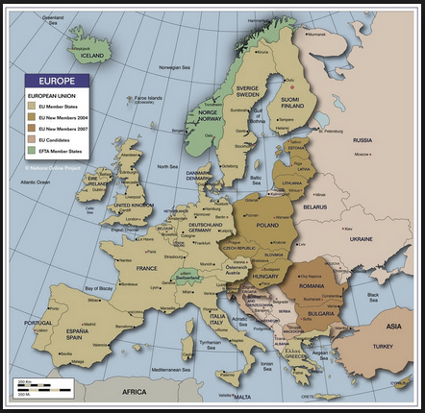
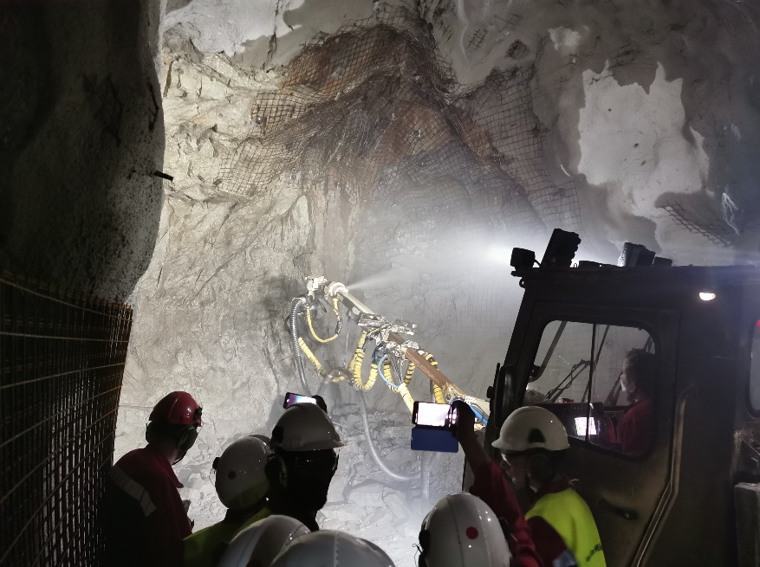
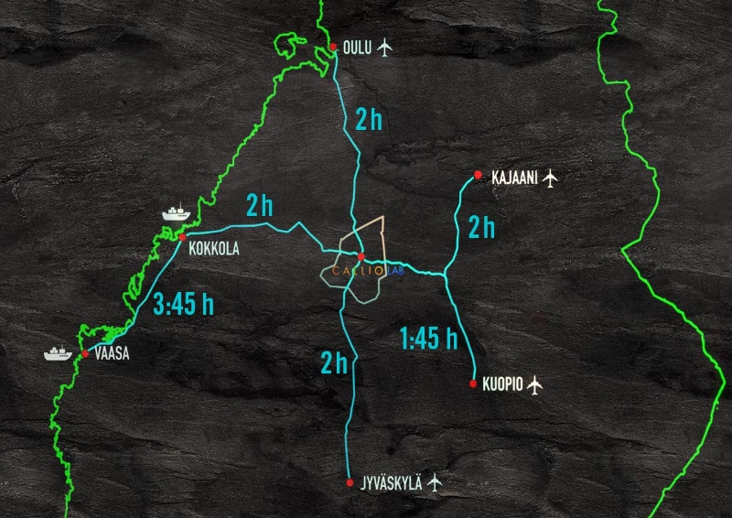
Possibilities at Callio Lab

Slide 16


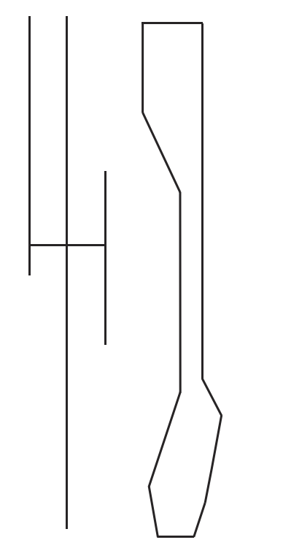
Unique 1.4 km (~4.1 kmwe)deep mine with flat overburden.
Access to all levels through 11.7 km long incline
Well-known & documented geology and mine model
Accompanying geophysical datasets
Electricity and safety remote access capable network available
Soon 24/7 accessibility
Research coordinated by Kerttu Saalasti Institute, University of Oulu
Possibilities at Callio Lab
We offer coordination, cooperation, networking and facilitation

Slide 17
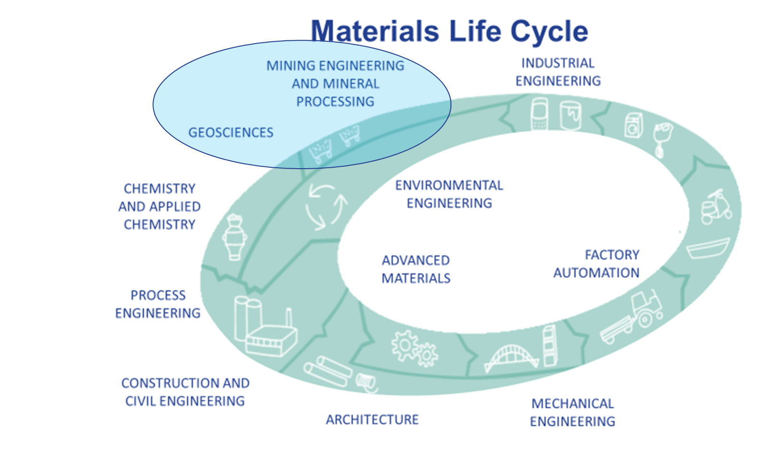
Possibilities at Callio Lab, and at the University of Oulu
Muography becoming an integrated part of research and education

Slide 18
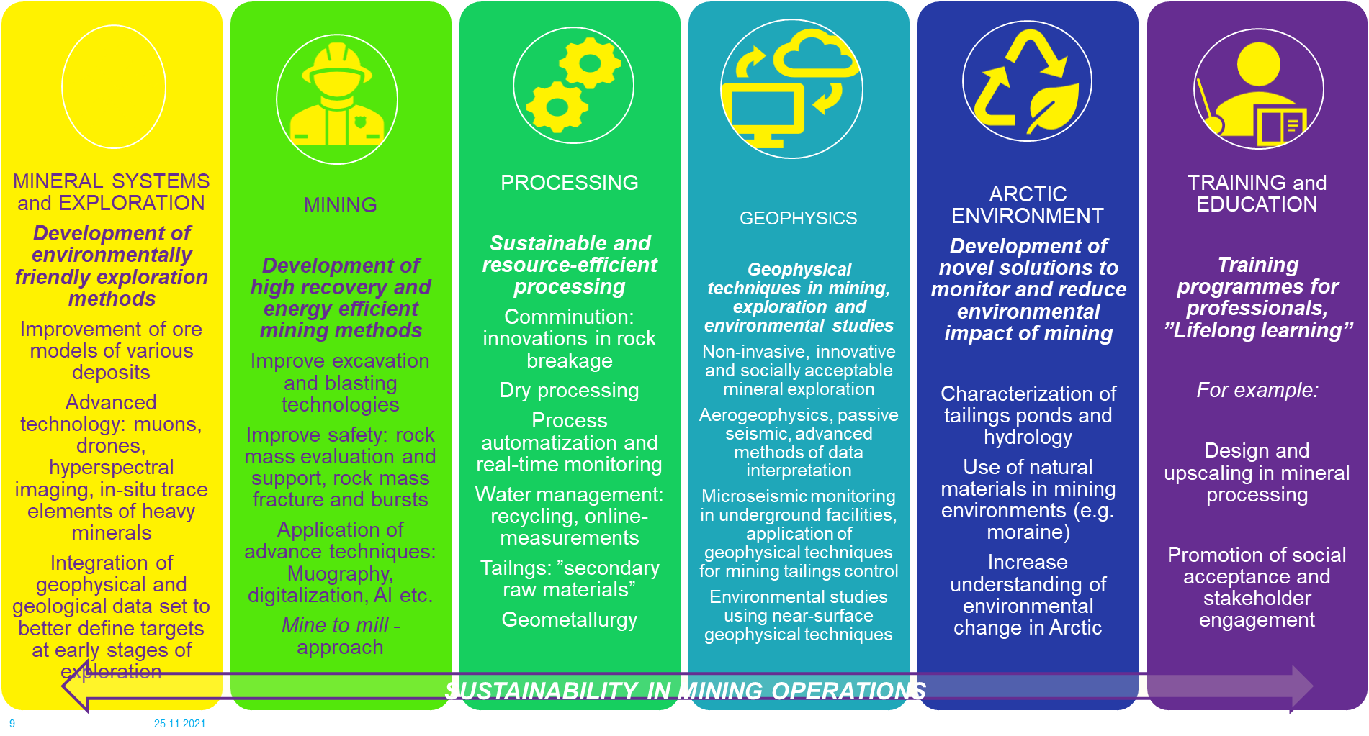
Possibilities at Callio Lab, and at the University of Oulu
Muography becoming an integrated part of research and education

Slide 19
Possibilities at Callio Lab, and at the University of Oulu
Open for research, education, outreach and project-based cooperation
Muography becoming an integrated part of research and education

Slide 20
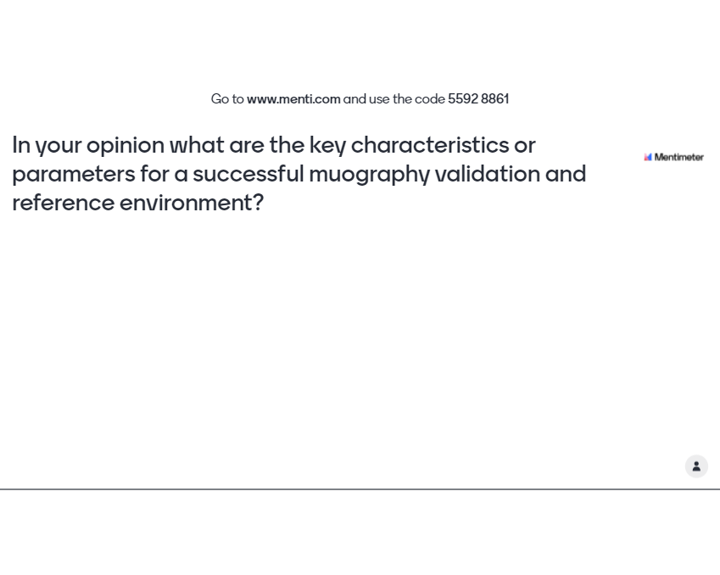
And what were your considerations for ideal validation environment for muography applications

Slide 21

Questions?

Slide 22
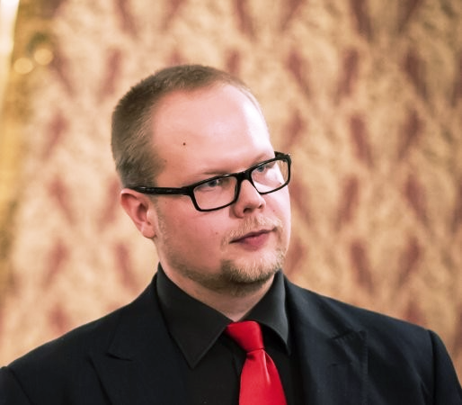

Mr. Jari Joutsenvaara
Callio Lab Research coordinator
KSI, University of Oulu
Tel. +358 40 5569396
Jari.Joutsenvaara@oulu.fi
contact@calliolab.com
Thank you!
www.oulu.fi/ksi
www.oulu.fi/ksi-eng/rex
www.calliolab.com

