Slide 1
NbTi Round Busbars for Powering the HL-LHC Inner Triplets:
a Study Analysis
G. Succi, B. Bordini, D. Baffari

Slide 2
Contents
Introduction
The 2 kA and 18 kA busbars
THEA model
Results
Current dump and validation time
Quench stoppers
To resume and conclusions

Slide 3
Contents
Introduction
The 2 kA and 18 kA busbars
THEA model
Results
Current dump and validation time
Quench stoppers
To resume and conclusions

Slide 4
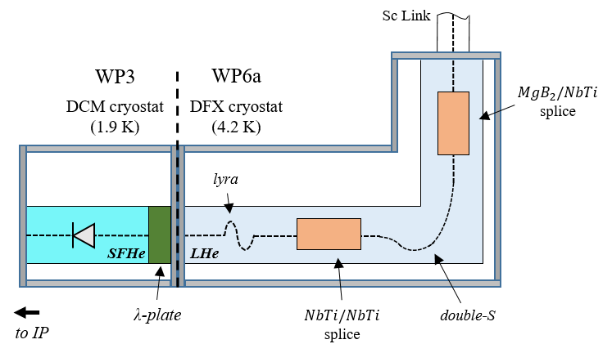
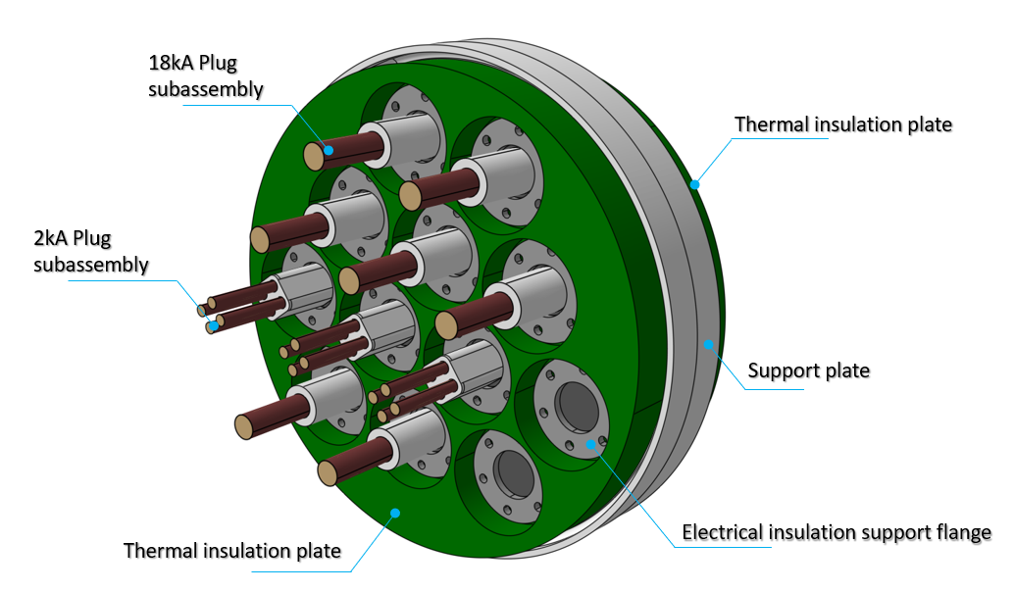
Introduction
The Inner Triplet (IT) magnets are powered by the following set of subsystems: Sc link, DFX (Distribution FeedBoX), DCM (D1 to DFX Connection Module), N lines, and the NbTi magnet leads.
λ plate
Courtesy: Y. Leclercq
19 busbars are routed through the DFX.
The λ-plate (plug) assures electrical continuity for the powering, but hydraulic discontinuity between the LHe and SFHe volumes of the DFX and of the DCM.

Slide 5
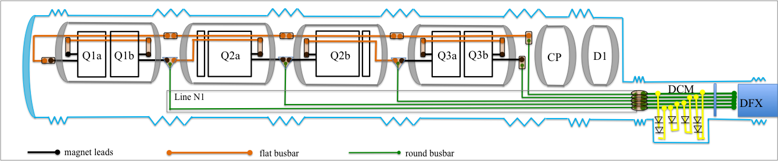
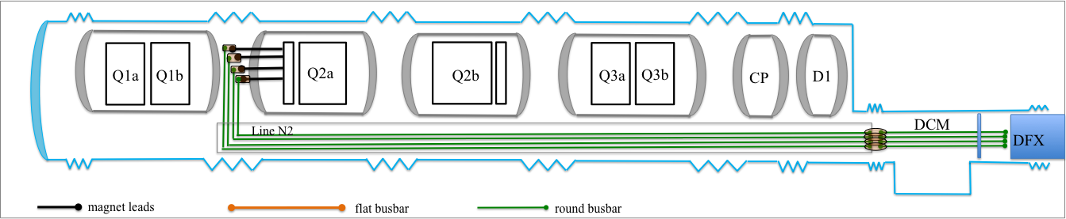
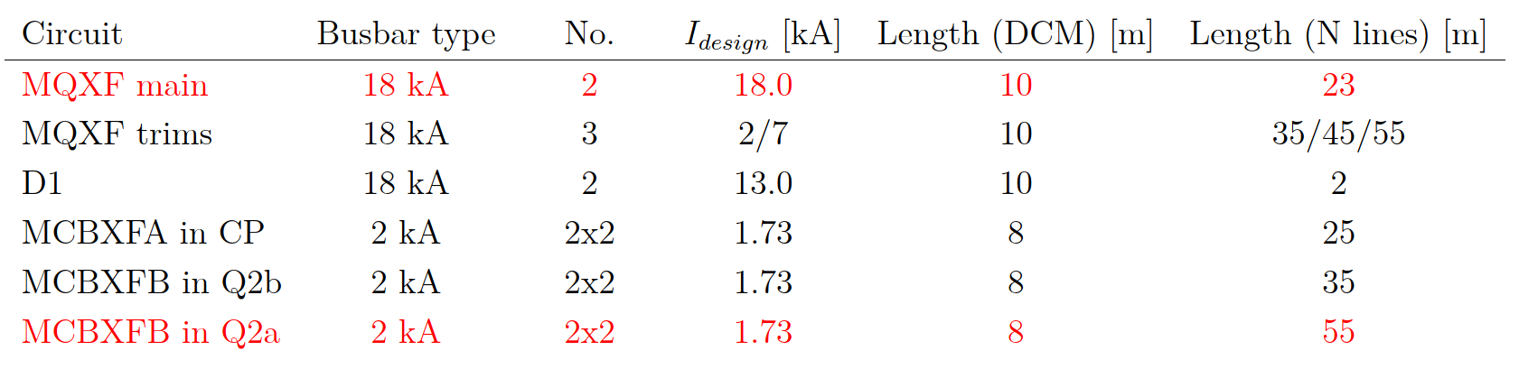
Introduction
Courtesy: E.Todesco
Cases analysed here

Slide 6
Contents
Introduction
The 2 kA and 18 kA busbars
THEA model
Results
Current dump and validation time
Quench stoppers
To resume and conclusions

Slide 7
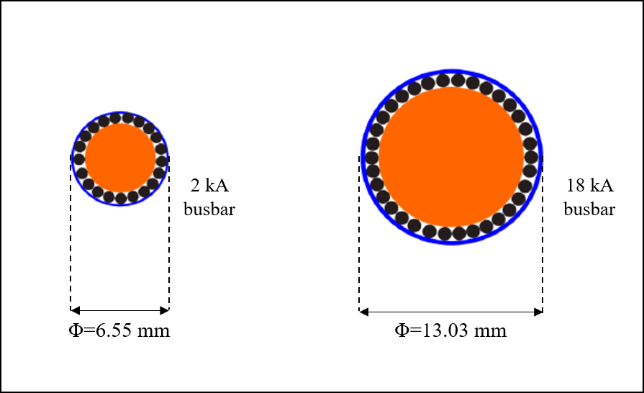
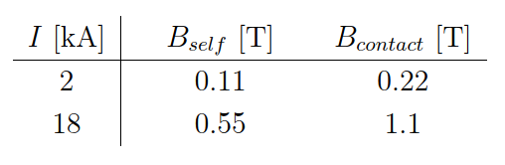
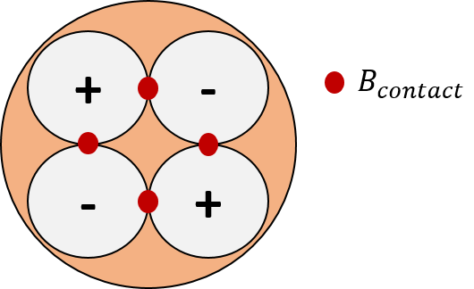
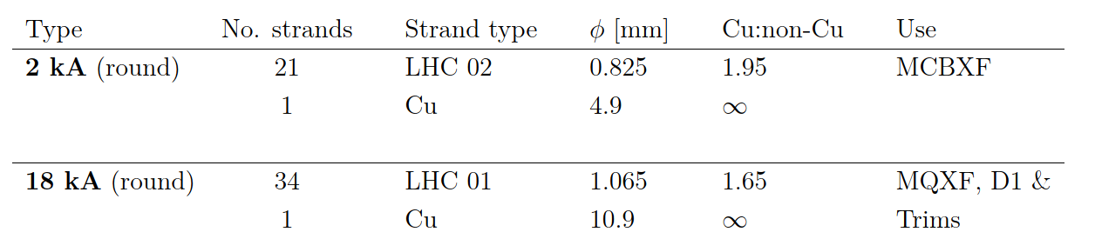
The 2 kA and 18 kA busbar
The 2 kA and 18 kA circuits in the DFX, DCM, and N lines are made of NbTi round busbars:
Cu core is multifilamentary and void fraction is ~30 % [1]
[1] J. Fleiter and S. Hopkins, Private communication

Slide 8
Contents
Introduction
The 2 kA and 18 kA busbars
THEA model
Results
Current dump and validation time
Quench stoppers
To resume and conclusions

Slide 9
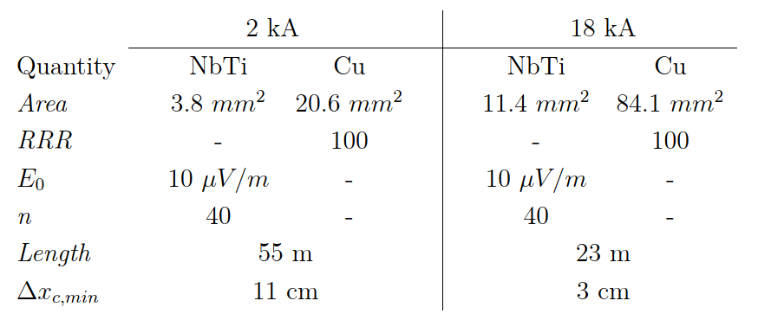



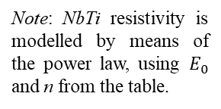
THEA Model
We define 1 thermal component coupled to 1 electric component. There is no transverse heat propagation to the surroundings (e.g. a jacket).
We set an initial minimum normal region at the centre of the domain, ${Δx}_{c,min}$, to trigger the quench propagation. $T_{0}\left({Δx}_{c,min}\right)=10 K$ and $T_{0}=1.9 K$ elsewhere.
Note: NbTi resistivity is modelled by means of the power law, using $E_{0}$ and n from the table.
Ex: 18 kA busbar
I=18 kA
B=0.55 T
$$T_{bound}$$
1.9 K
$$T_{bound}$$
1.9 K
x=0
$${Δx}_{c,min}$$
x=23 m
Note: the component is represented as a cylinder, but it is treated as a 1-D line by the code

Slide 10
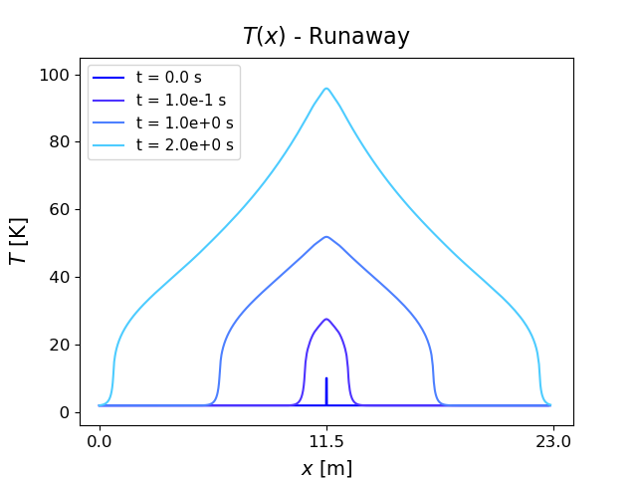
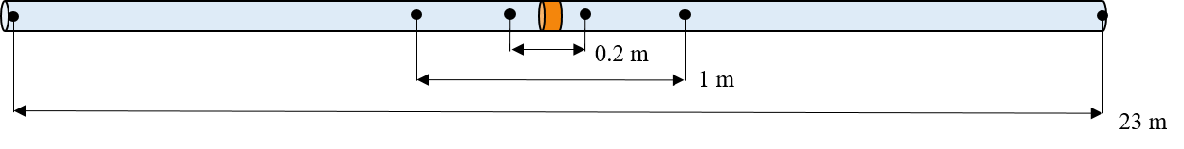
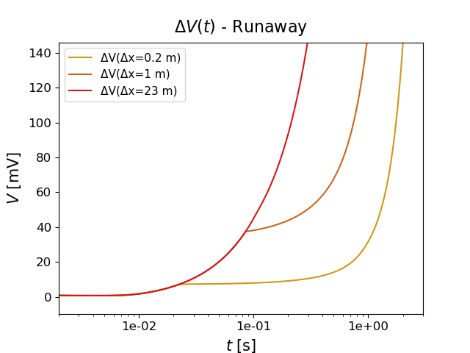
Results
T(x) profile
ΔV(t) evolution
‘Knees’ define the moments when the region inside the corresponding
V taps loses the sc state.

Slide 11
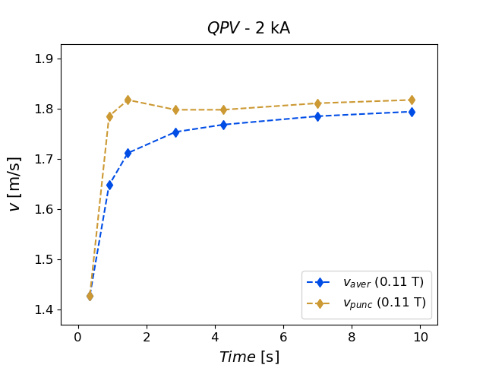
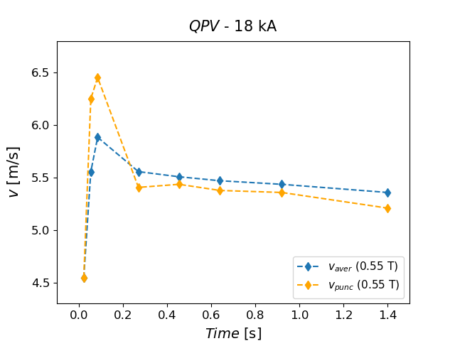


Results
Knees are useful to derive the QPV
1) Average velocity: $v_{aver}=\frac{1}{2}\frac{{Δx}_{i}}{t_{i}}$
2) Punctual velocity: $v_{punc}=\frac{1}{2}\frac{{Δx}_{i}−{Δx}_{i−1}}{t_{i}−t_{i−1}}$
The QPV is 1.7 m/s in the 2 kA busbar and roughly 3 times higher in the 18 kA busbar (5.4 m/s).

Slide 12
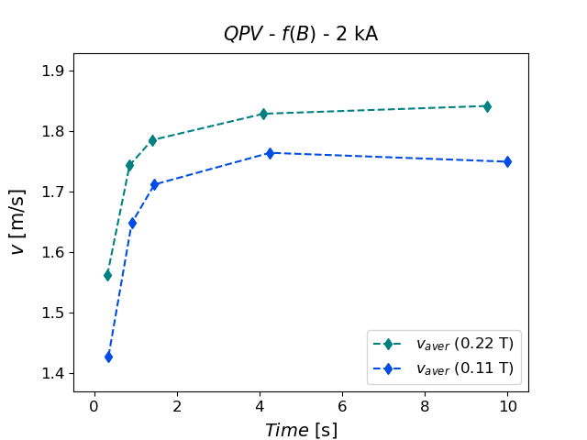
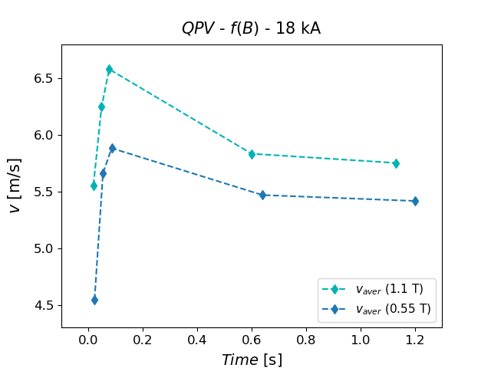
Results
QPV as f(B)
The field increase makes the QPV to increase by ~0.1 m/s and 0.5 m/s in the 2 kA and 18 kA busbars, respectively.
Given the same ratio of field increase (2, in this case), an higher absolute field makes the QPV to accelerate more.

Slide 13
Contents
Introduction
The 2 kA and 18 kA busbars
THEA model
Results
Current dump and validation time
Quench stoppers
To resume and conclusions

Slide 14
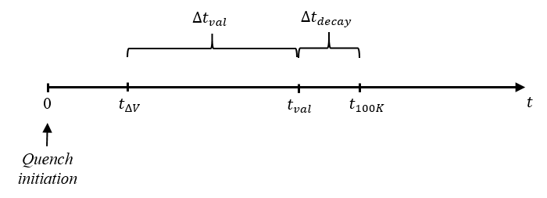



Current dump and validation time
Time scale
$t_{ΔV}$ depends on the detection threshold, ΔV
$I_{nom}∗e^{−{{Δt}_{decay}}/τ}=0.1∗I_{nom}$
$${Δt}_{decay}=2.3 τ$$
τ is the time-constant of a specific circuit
We want to derive the maximum validation time, ${Δt}_{val,max}$, to assure that current reduces by 90 % before $T_{peak}=100 K$ of a constant current case: $t_{100 K}$.
${Δt}_{val,max}= t_{100K}−{Δt}_{decay} − t_{ΔV}$
Once we know $t_{100 K}$ and ${Δt}_{decay}$, the detection threshold $ΔV$ determines the remaining parameters.

Slide 15
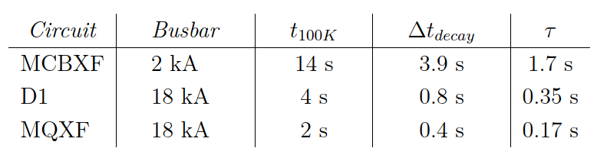
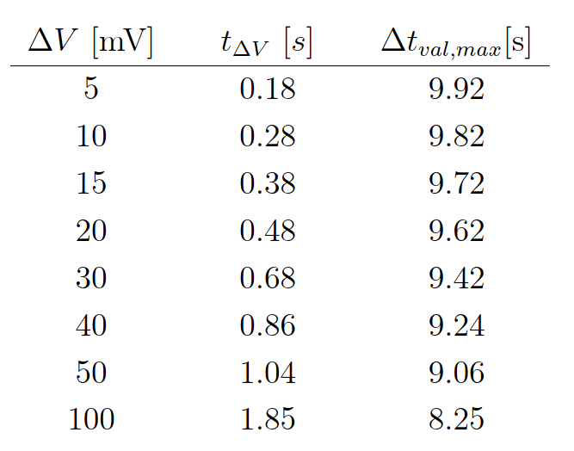
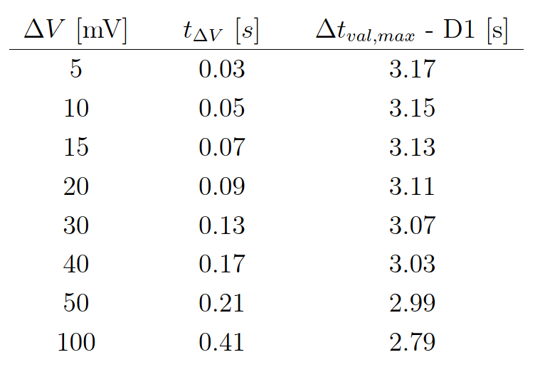
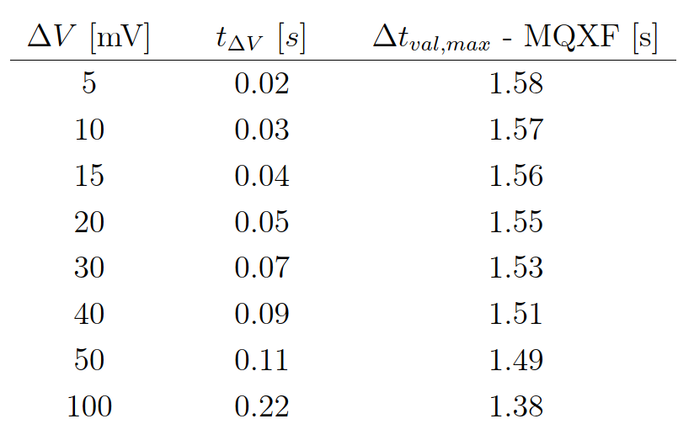
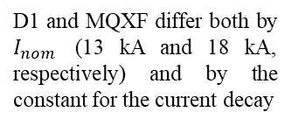


Current dump and validation time
We express $t_{100 K}$ and ${Δt}_{decay}$ for each circuit of interest.
Note: ${Δt}_{decay}=2.3 τ$
D1 and MQXF differ both by $I_{nom}$ (13 kA and 18 kA, respectively) and by the constant for the current decay
$${Δt}_{val,max}= t_{100K}−{Δt}_{decay} − t_{ΔV}$$
2 kA circuit (MCBXF)
18 kA circuit (D1)
18 kA circuit (MQXF)
Taking the 100 mV threshold as reference for quench detection [1], the maximum validation time is at least 8.2 s for the 2 kA circuit of the MCBXFs, 2.8 s for the 18 kA circuit of D1, and 1.4 s for the MQXF.
[1] R. Denz, Quench Detection Systems for HL-LHC Busbars, 2021

Slide 16
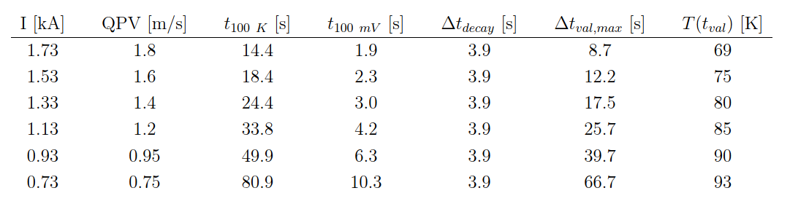
QPV and validation time as f(I)
We study the dependence of the QPV and validation time on the busbar current (ex. 2 kA busbar).
Transition to normal state slows down as I decreases: $t_{100 mV} ↑$ , $t_{100 K} ↑↑$ , and ${Δt}_{val,max} ↑$ , as well.
The maximum validation time, ${Δt}_{val,max}$, corresponding to $I_{nom}$ guarantees the proper busbar protection under all operating conditions.

Slide 17
Contents
Introduction
The 2 kA and 18 kA busbars
THEA model
Results
Current dump and validation time
Quench stoppers
To resume and conclusions

Slide 18
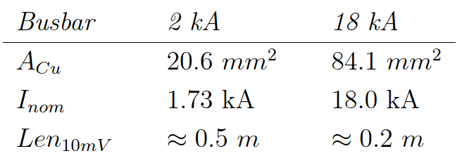

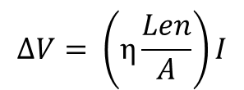
Quench stoppers
Is it possible that a quench remains confined in a limited busbar region without being detected, while T diverges above 100 K?
To answer this question, we analyse the quench length to have a voltage drop of 10 mV:
$$ΔV= \left(η\frac{Len}{A}\right)I$$
Ohm’s law; η is the resistivity
Current flows only in copper during quench
$$A= A_{Cu}$$
Thus, $η= η_{Cu}(T)$. We start the computations assuming: $η=η_{1.9 K}≈2∗{10}^{−10} Ω m.$
These are the model lengths we study in THEA to freeze the quench in a limited region.

Slide 19
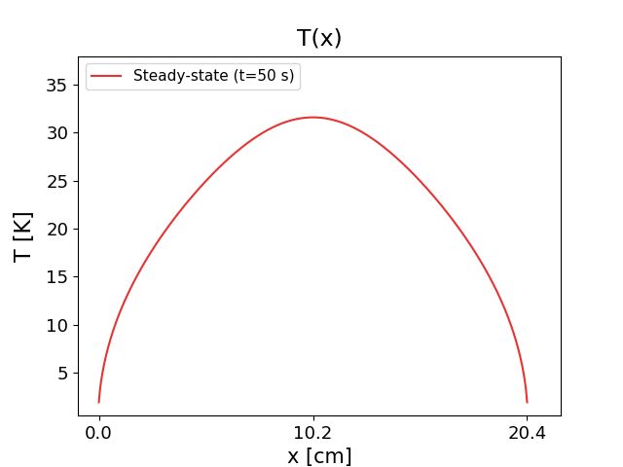
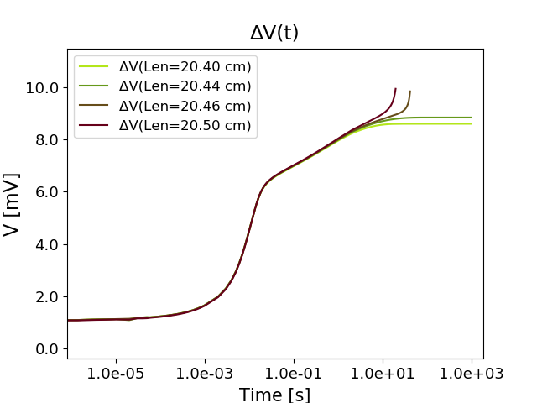



Quench stoppers
In particular, we analyse the 18 kA busbar, defining a ~20 cm domain (see previous slide).
Quench propagates from an initial normal region, but it is forced to stop due to the boundaries at 1.9 K.
$$T_{peak}$$
I=18 kA ;
B=0.55 T
$$T_{bound}$$
1.9 K
$$T_{bound}$$
1.9 K
x=0
x=20.4 cm
Voltage extraction
$$ΔV(Δx=Len)$$

Slide 20
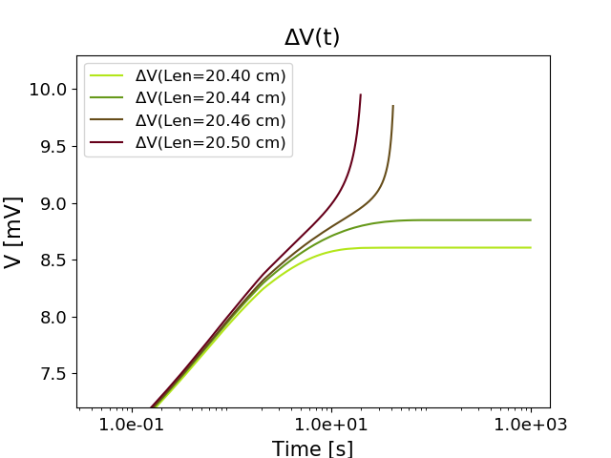
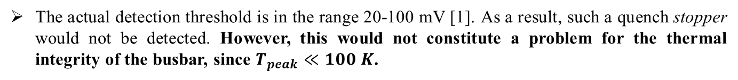

Quench stoppers
${Len}_{lim}=20.44 cm$ is the limit length to have quench, without runaway.
Indeed: ${ΔV}_{ss}\left({Len}_{lim}\right)=8.8 mV$ and $T_{peak, ss}=33 K$
(Similar values for the 2 kA busbar, with ${Len}_{lim}=55.3 cm$)
The actual detection threshold is in the range 20-100 mV [1]. As a result, such a quench stopper would not be detected. However, this would not constitute a problem for the thermal integrity of the busbar, since $T_{peak}≪100 K$.
[1] R. Denz, Quench Detection Systems for HL-LHC Busbars, 2021

Slide 21
Contents
Introduction
The 2 kA and 18 kA busbars
THEA model
Results
Current dump and validation time
Quench stoppers
To resume and conclusions

Slide 22
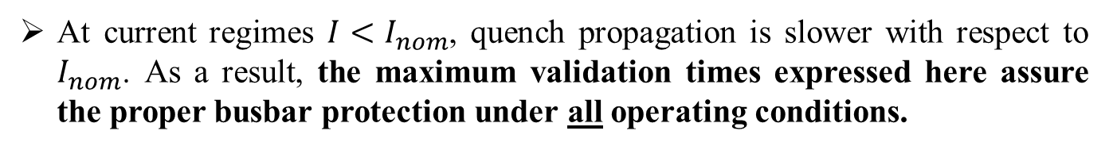
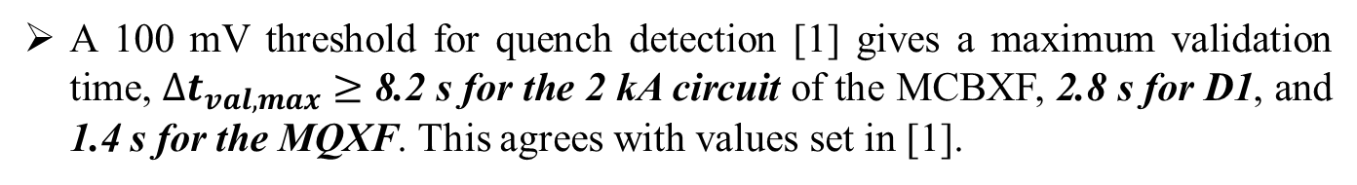
To resume and conclusions
The QPV is 1.7 m/s in the 2 kA busbar and 5.4 m/s in the 18 kA busbar.
The QPV increases as a result of an higher field at the contact point between a feed and a return line in the DCM. The increase in the QPV is more relevant at an higher absolute field (18 kA vs 2 kA busbar).
A 100 mV threshold for quench detection [1] gives a maximum validation time, ${Δt}_{val,max}≥$ 8.2 s for the 2 kA circuit of the MCBXF, 2.8 s for D1, and 1.4 s for the MQXF. This agrees with values set in [1].
At current regimes $I<I_{nom}$, quench propagation is slower with respect to $I_{nom}$. As a result, the maximum validation times expressed here assure the proper busbar protection under all operating conditions.

Slide 23
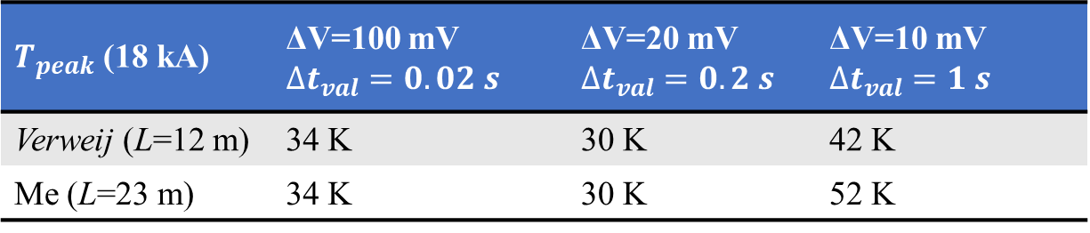
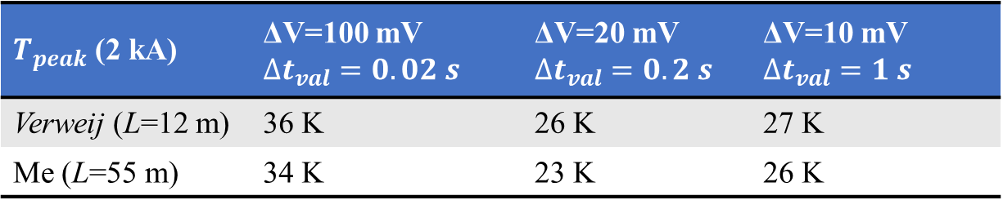
To resume and conclusions
A quench may occur in a busbar region shorter than 20 cm (for the
18 kA busbar; 50 cm for the 2 kA busbar) without being detected. However, the peak temperature would be around 30 K so that it does not pose a threat for busbar integrity.
Comparison with A. Verweij (asymmetric quench propagation) [2]
$T_{peak}$ (2 kA) | ΔV=100 mV ${Δt}_{val}=0.02 s$ | ΔV=20 mV ${Δt}_{val}=0.2 s$ | ΔV=10 mV ${Δt}_{val}=1 s$
Verweij (L=12 m) | 36 K | 26 K | 27 K
Me (L=55 m) | 34 K | 23 K | 26 K
$T_{peak}$ (18 kA) | ΔV=100 mV ${Δt}_{val}=0.02 s$ | ΔV=20 mV ${Δt}_{val}=0.2 s$ | ΔV=10 mV ${Δt}_{val}=1 s$
Verweij (L=12 m) | 34 K | 30 K | 42 K
Me (L=23 m) | 34 K | 30 K | 52 K
[2] A.Verweij, Validation of the busbar protection scheme, 2021

Slide 24
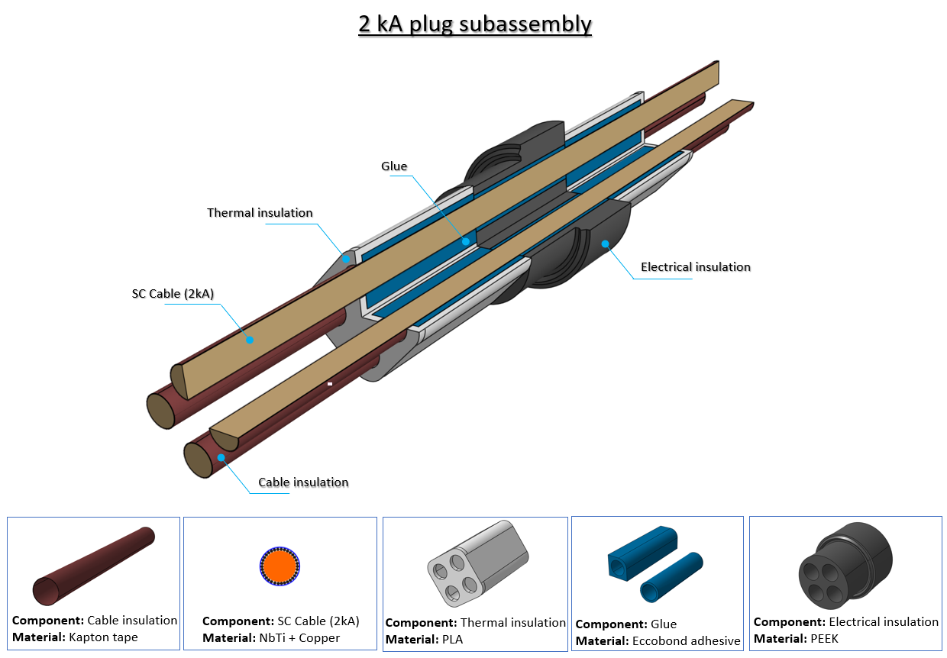
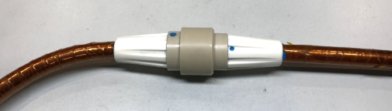
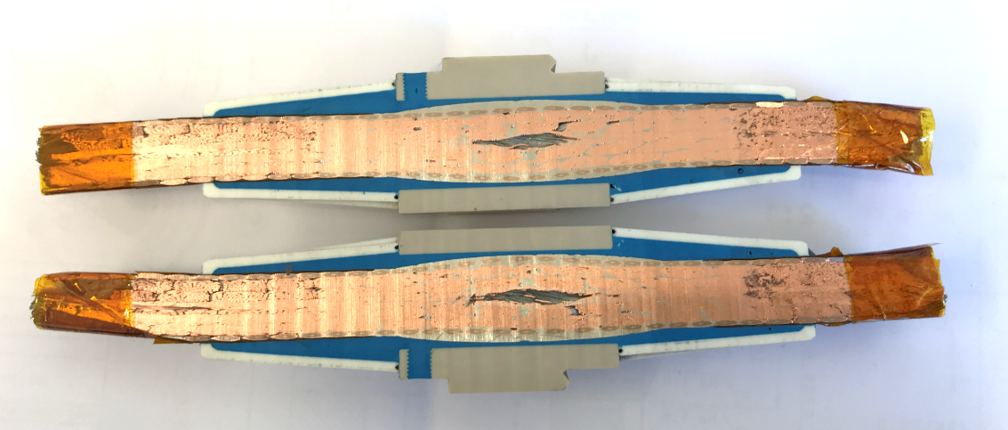
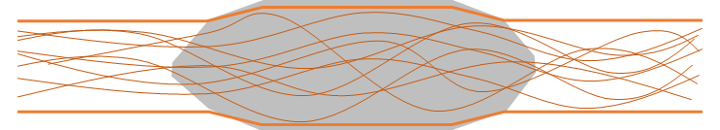
Next steps: Busbars through the Plug
We are interested in the quench propagation in the 2 kA and 18 kA busbars passing through the λ-plate (‘Plug’).
The Plug assures electrical continuity of the powering, but hydraulic discontinuity between the LHe and SFHe volumes of the DFX and of the DCM.
Plug
3 x 4-in-1 2 kA
round busbars
Courtesy: Y. Leclercq
Courtesy: Y. Leclercq
40
2 kA busbar
Ø 6.5
Ø 7.0
Ø 6.5

Slide 25
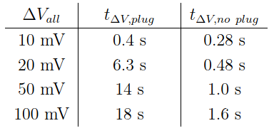
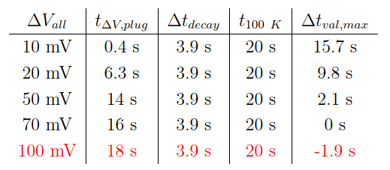
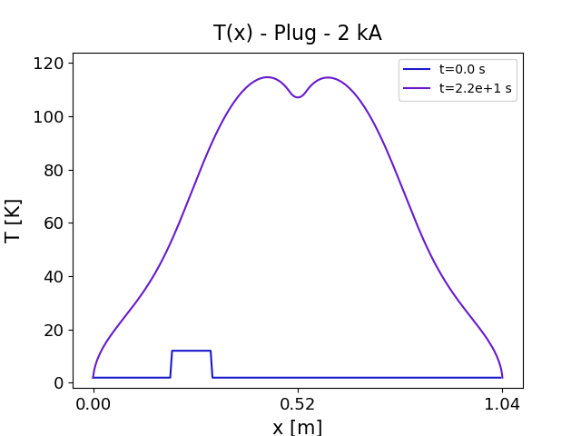

Results – 2 kA busbar
Would the additional PbSn cause a delay in quench detection?
Yes, the PbSn in the Plug actually slows down the quench propagation (due to the PbSn heat capacity) so that detection is delayed, as well.
2) If yes, how to proceed to evaluate this risk?
$${Δt}_{val,max}= t_{100K}−{Δt}_{decay} − t_{ΔV}$$
$$T_{peak}\left(t_{100 mV}+{Δt}_{val}+{Δt}_{decay}\right)=T(22 s)=114 K$$
20 ms
→ Be careful to the Cu content !

Slide 26
Appendix

Slide 27
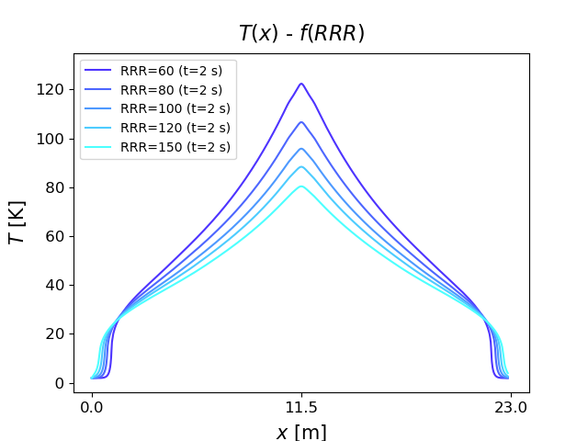
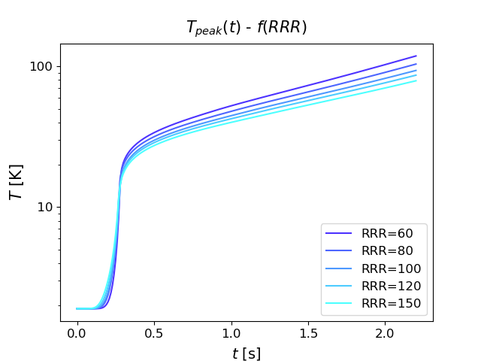
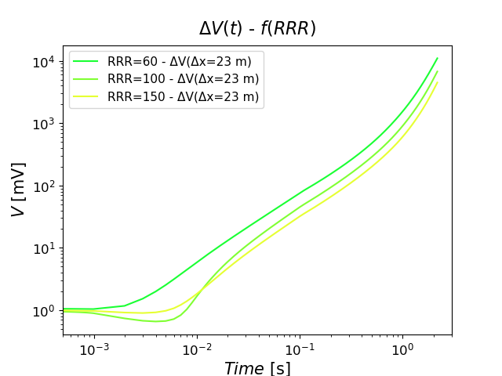
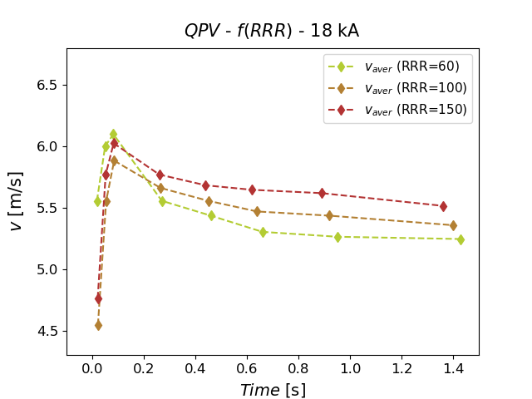
Effect of the RRR
The RRR has a clear impact on the T, ΔV, and QPV (ex. 18 kA busbar)

Slide 28
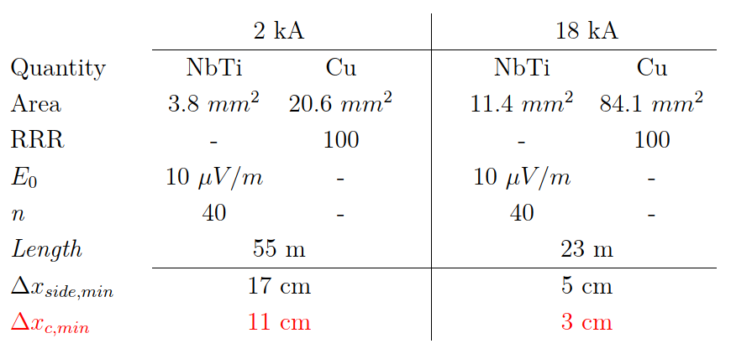

Asymmetric quench
We define a model with the initial normal region located on one side of the domain: ${Δx}_{side,min}$.
The other model parameters are the same of the symmetric case.
Note: NbTi resistivity is modelled by means of the power law using parameters from the table.
By comparison:
Ex: 18 kA busbar
I=18 kA
B=0.55 T
$$T_{bound}$$
1.9 K
$$T_{bound}$$
1.9 K
x=0
$${Δx}_{side,min}$$
x=23 m
Note: the component is represented as a cylinder, but it is treated as a 1-D line by the code

Slide 29
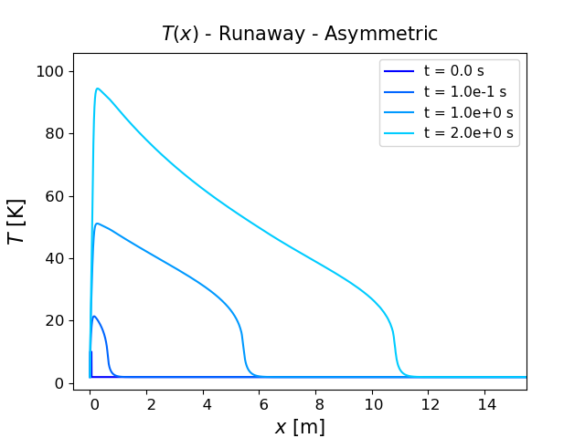
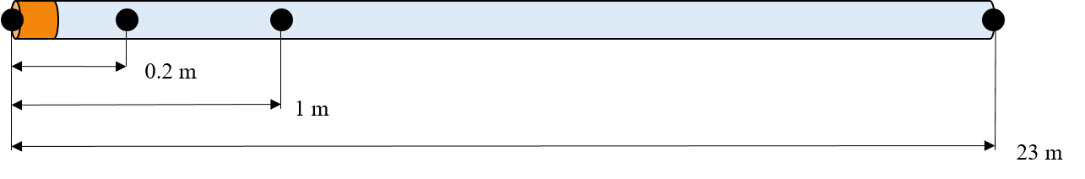
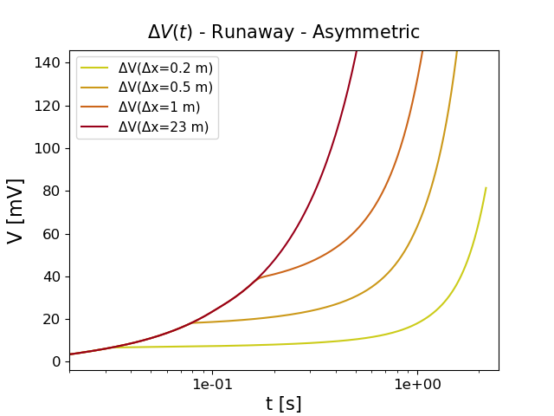
Asymmetric quench
T(x) profile
ΔV(t) evolution
‘Knees’ define the moments when the regions inside the corresponding
V taps lose the sc state.
Knees are useful to derive the QPV

Slide 30


Asymmetric quench
QPV as f(B)
The QPV is ~1.7 m/s and 5.5 m/s in the 2 kA and 18 kA busbars, respectively. This confirms the numbers of the symmetric case shown above.

Slide 31




Quench stoppers
Parametric study: what happens to ${Len}_{lim}$ if the busbar operates at $I<I_{nom}$?
$$\frac{{Len}_{lim} (I)}{{Len}_{lim} (I_{nom})}= \frac{I_{nom}}{I}$$

Slide 32










Quench stoppers
Why is $T_{peak}$ almost the same for each combination of domain length and current?
The governing equation and boundary conditions at steady state are:
$$k\frac{d^{2}T}{dx^{2}}=−q_{g}$$
(k is considered constant and equal to its average value in the T range under study, 1.9-30 K )
$$T\left(x=0\right)=T_{0}$$
$$T\left(x=x_{0}\right)=T_{0}$$
Steady-state temperature profile
$T\left(x\right)=−\frac{q_{g}}{2k}x^{2}+\frac{q_{g}}{2k}x_{0}x+ T_{0}$
Peak temperature :
$T_{peak}=T\left(\frac{x_{0}}{2}\right)=\frac{q_{g}}{8k}{x_{0}}^{2}+T_{0}$
$x_{0} ∝ Len$
$$x_{0}^{2} ∝ {Len }^{2}$$
$q_{g} ∝ I^{2}$
If $I↓$ , ${Len}_{lim} (∝1/I) ↑$ . Consequently, $x_{0}^{2} ↑$ while $q_{g}↓$ proportionally.
Thus, $T_{peak }$ remains the same.

