Slide 1

preSupernova neutrinos: open questions
Cecilia Lunardini
Arizona State University
Co-convenor: Andrey Seshukov
(disclaimer: references can be found in the SNEWS2.0 paper)
Notes:
Aim for 8 minutes max.

Slide 2
Presupernova → collapse → explosion
Neutrinos from advanced stages of nuclear burning
  Thermal (pair production)
  Beta processes (capture, decay)
0.1-5 MeV energy
  Need low threshold detector
Detectable hours (days?) before the neutrino burst
  For near-earth stars (D<1 kpc)

Slide 3
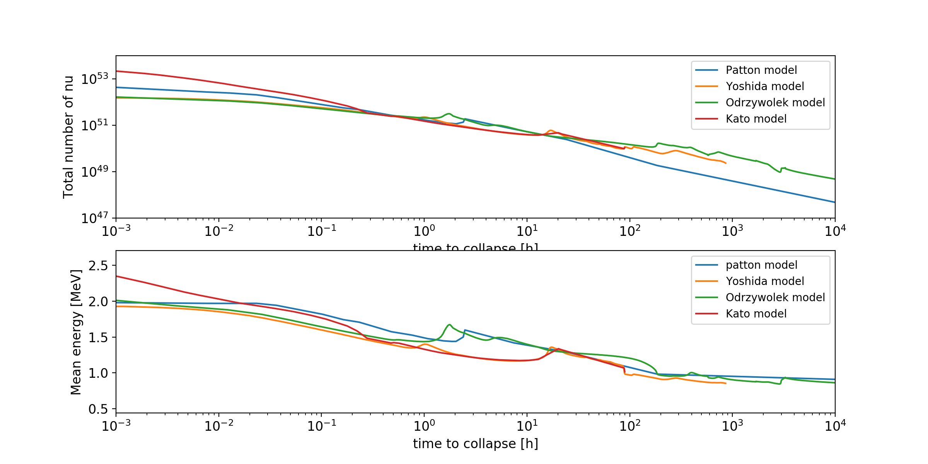
Overview of models
Fig. courtesy of Koji Ishidoshiro

Slide 4
Numbers of events

Slide 5
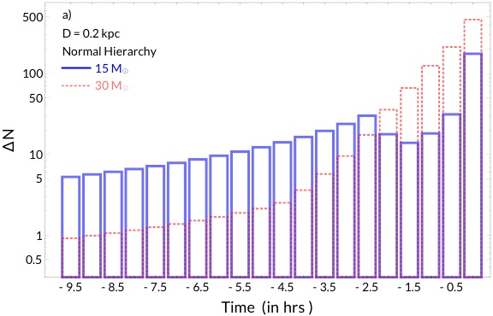
Signal at liquid scintillator detector
Silicon-burning bump
JUNO-like detector (17 kt), inverse beta decay (IBD):
  E > 1.8 MeV threshold
  Background: 2.6 events/hour in reactor-on phase

Slide 6
Pointing at 10-kt scale LS detectors
Sensitivity up to 1 kpc; angular error ~70° from IBD
  Can provide shortlist of 4-10 candidates, about 1 hour prior to collapse
Possible long term improvements:
  ~30° with THEIA (100 kt)
  ~10° with LS-Li

Slide 7
Presupernova neutrinos @SNEWS2.0
Dedicated “slow burn” alarm?
  How to discover a slow, directional rise above background in real time?
O(day) early alert: dedicated alert system?
  Different technical possibilities
  Different/broader list of alert recipients
Greater public involvement: the event of the millennium
  Role of mainstream media and social media?
  Danger of disinformation → opportunity/duty of information?

