Slide 1
International Particle Physics Outreach Group
IPPOG new webpages & RDB
Barbora Bruant Gulejova
Strategic Development Lead, IPPOG

Slide 2
Outline
New websites after alpha testing and feedback
For IPPOGers – Documents organisation and collection
IPPOG structured content at CDS
IMC and Global Cosmics websites
Resource Database
Timeline / Plan
Open discussion

Slide 3

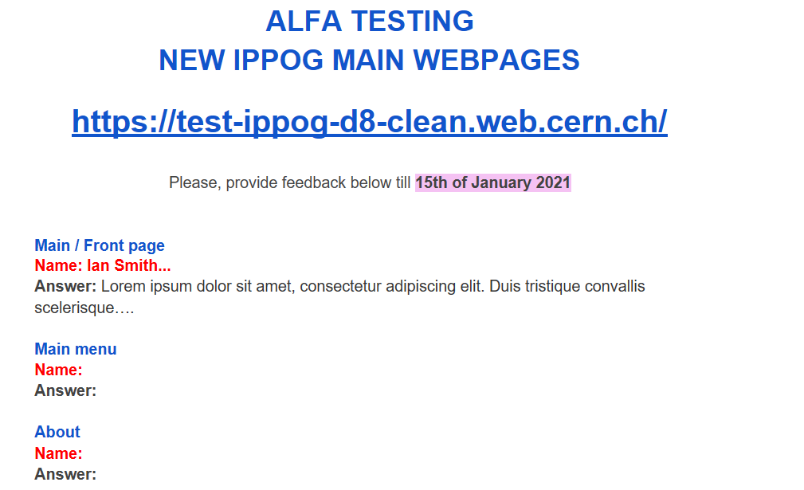

Alpha-testing of IPPOG main pages by IPPOG community!
https://test-ippog-d8-clean.web.cern.ch/
Available from TODAY 2nd of December 2020
NOTE:
Only design, sitemap and structure is “final”
.Content, texts and images are not yet final : will be developed next year
Reminder from last meeting!
Check it out in details, PLEASE!
Send us feedback through google doc here
Till 15th of January 2021

Slide 4
Feedback after ALPHA - testing
Lot of feedback received:
      Google Doc – January 2021
      2 dedicated feedback online sessions - February 2021
      Web SG meeting to decide on ambiguous feedback – March 2021
Main topics from feedback:
      Change of order of items at the frontpage: News, Activities, RDB, About
      Main menu – content (simplified) and functionality (technical challenge)
      More aligned and coherent lay-out, fonts, colours, contrast…
      Many more…

Slide 5
Feedback implementation
February – May 2021
Long list (several hundreds) of specific changes applied:
6 ITERATIONS (see progress reports 31 and 32)
NEW DESIGNS DEVELOPMENT and IMPLEMENTATION

Slide 6


Web development management
DESIGN
WEB DEV
Good team!
IPPOG chairs
CERN Drupal experts
Regular
Iterative sprints
Feedback
IPPOG Web SG
CERNCDS
Global Cosmics SG
IMC SG
RDB Curation Group
https://test-ippog-d8-clean.web.cern.ch/

Slide 7
Close to finished new IPPOG website
https://test-ippog-d8-clean.web.cern.ch/
Design, sitemap and structure is “final”
Texts and images are not yet final : under the development

Slide 8
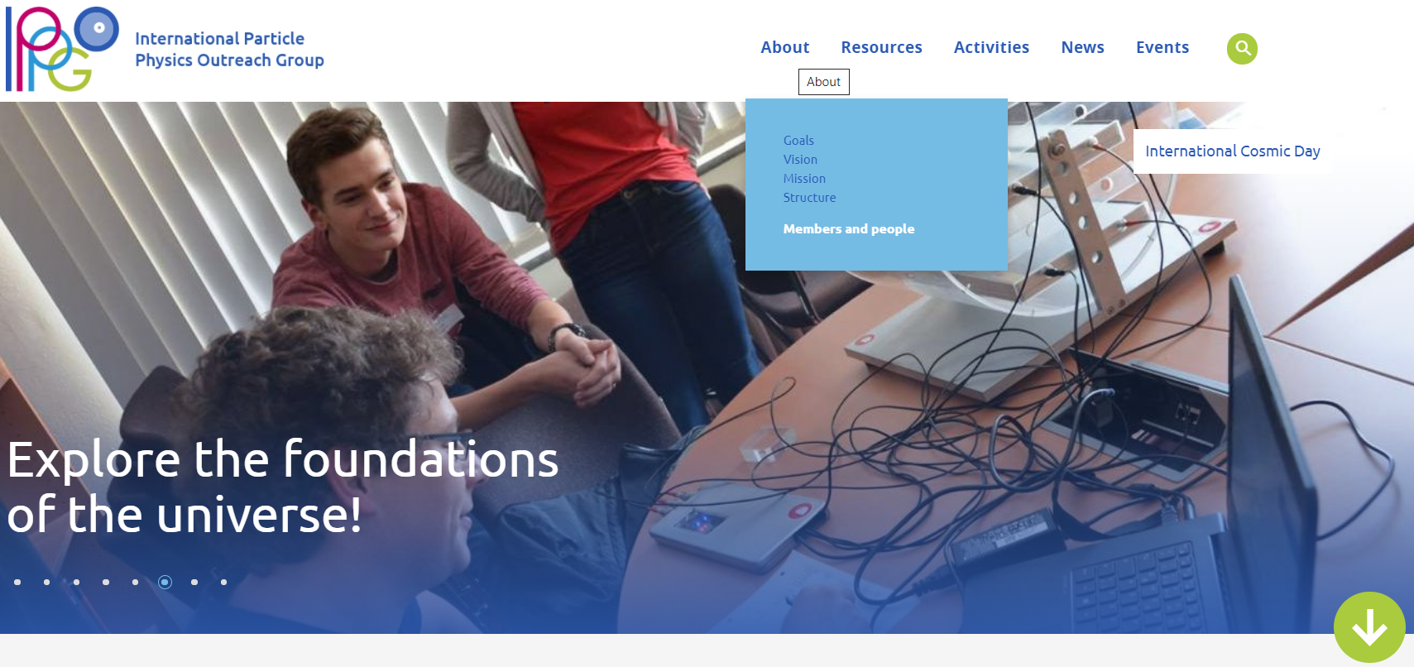

MAIN MENU
Only when signed in
Hover: see submenu
Click: enter subpage
Technically challenging,
coding involved,
but maintainable.

Slide 9
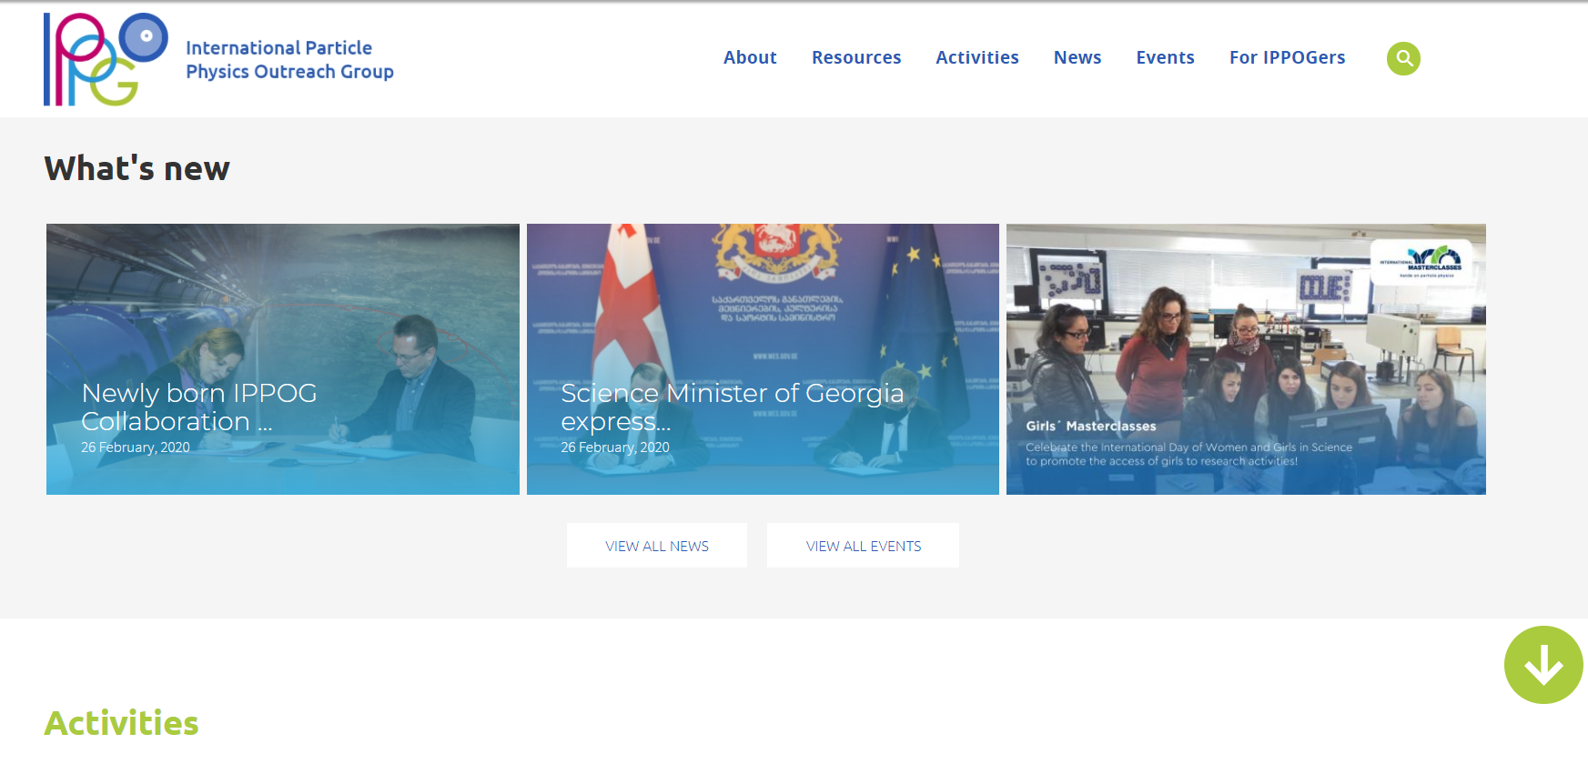
FRONTAPGE / NEWS and EVENTS: What’s new
Hover: see submenu
Click: enter subpage
Technically challenging,
coding involved,
but maintainable.
2 news
1 event

Slide 10
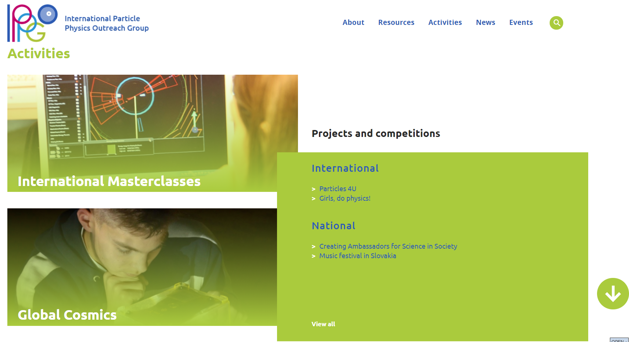
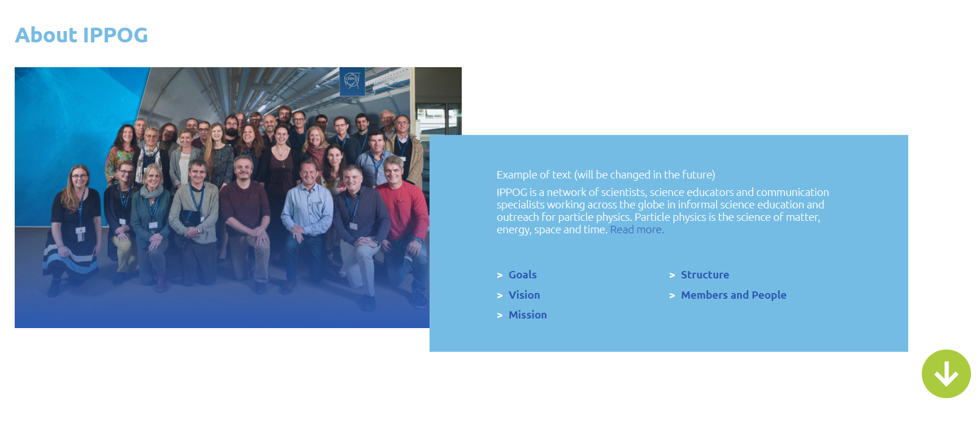
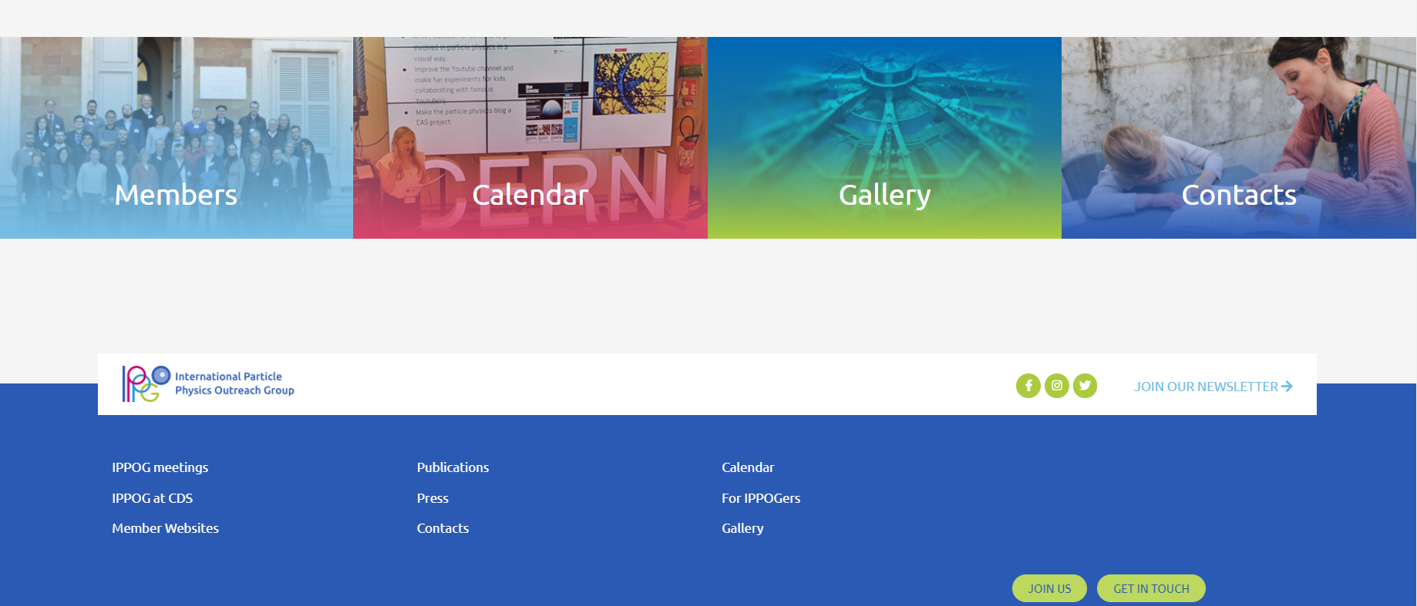
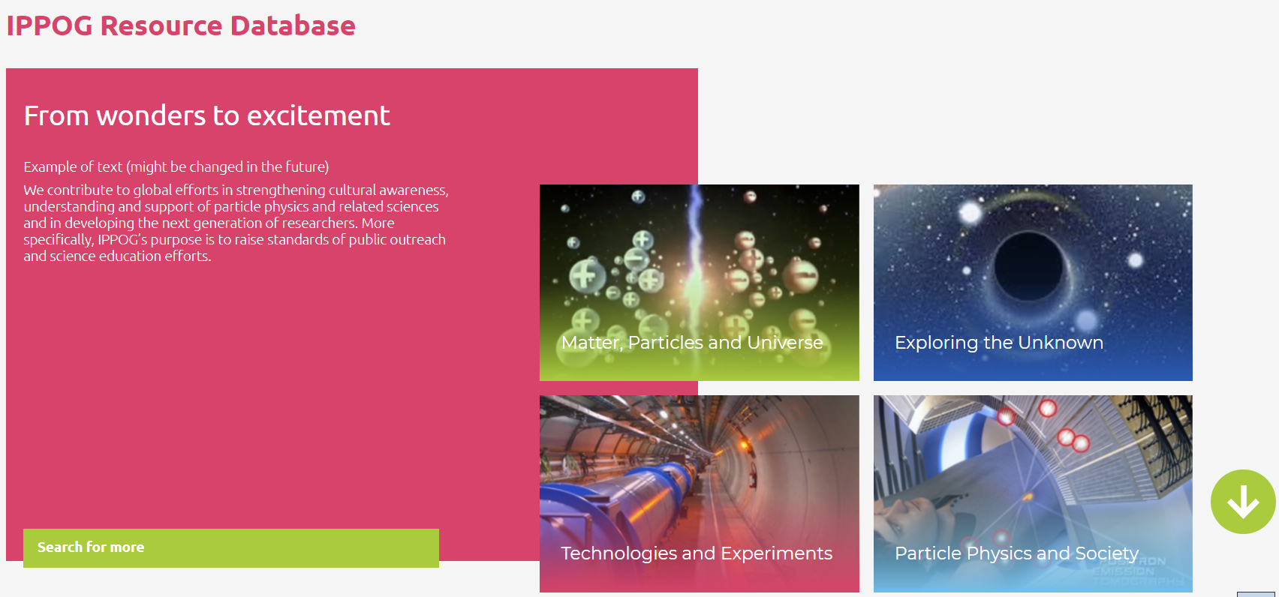
Frontpage – change of order
Only when signed in
Scroll down
Hover: see submenu
Click: enter subpage
Scroll down
Technically challenging,
coding involved,
but maintainable.

Slide 11
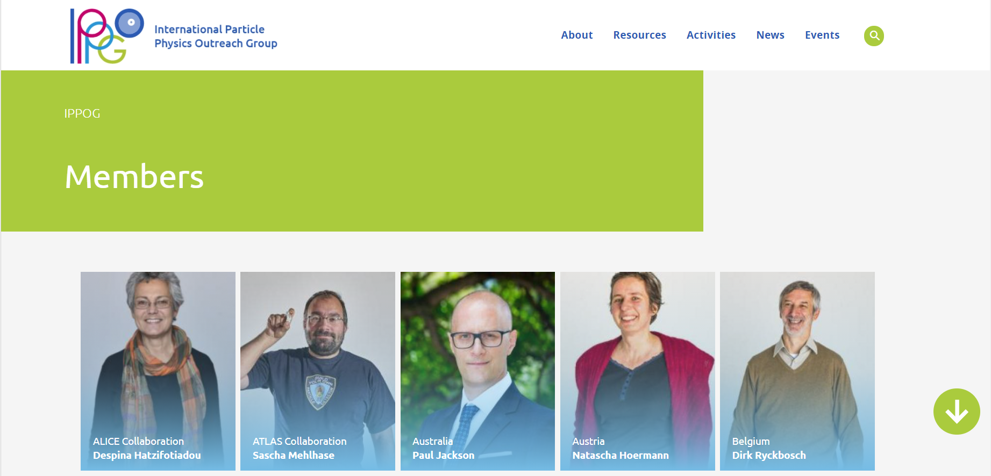

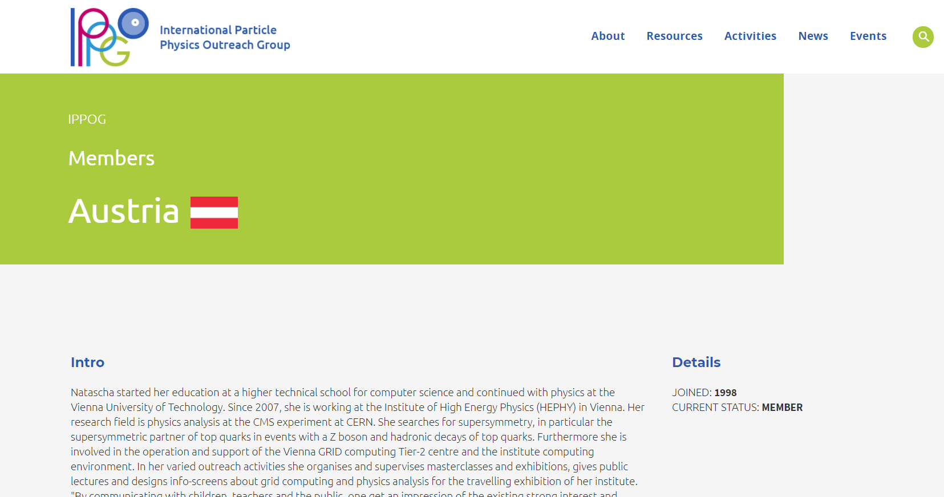
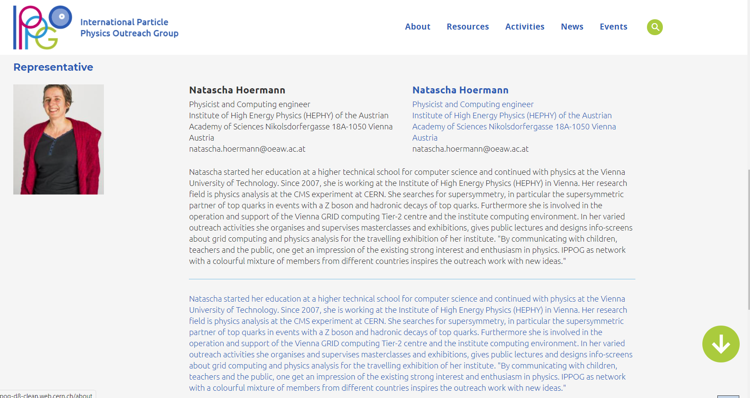

Members and people
Only when signed in
Bio of representative:
English
Local language
Scroll down
Scroll down
Technically challenging,
coding involved,
but maintainable.
Description of member:
English
Local language

Slide 12
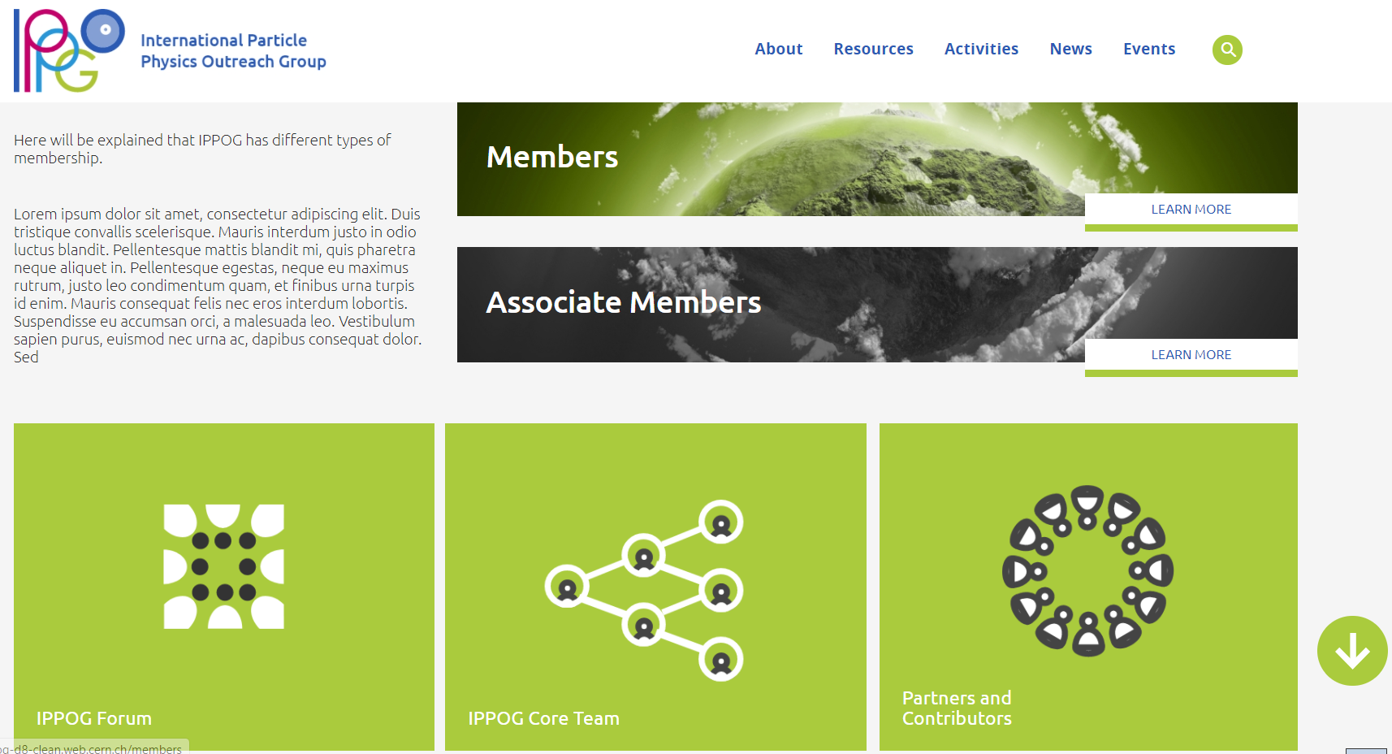
Members and people page
Hover: see submenu
Click: enter subpage
CB members invite official
Forum members associated
with specific Member.
Includes Coordination team,
Activities Coordinators, Former Chairs and
Former Staff

Slide 13
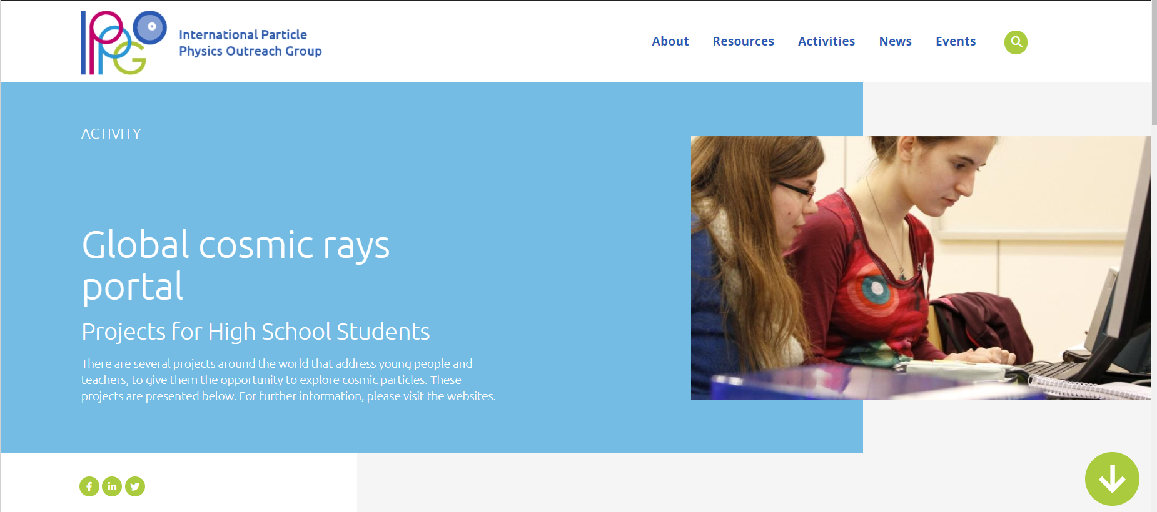
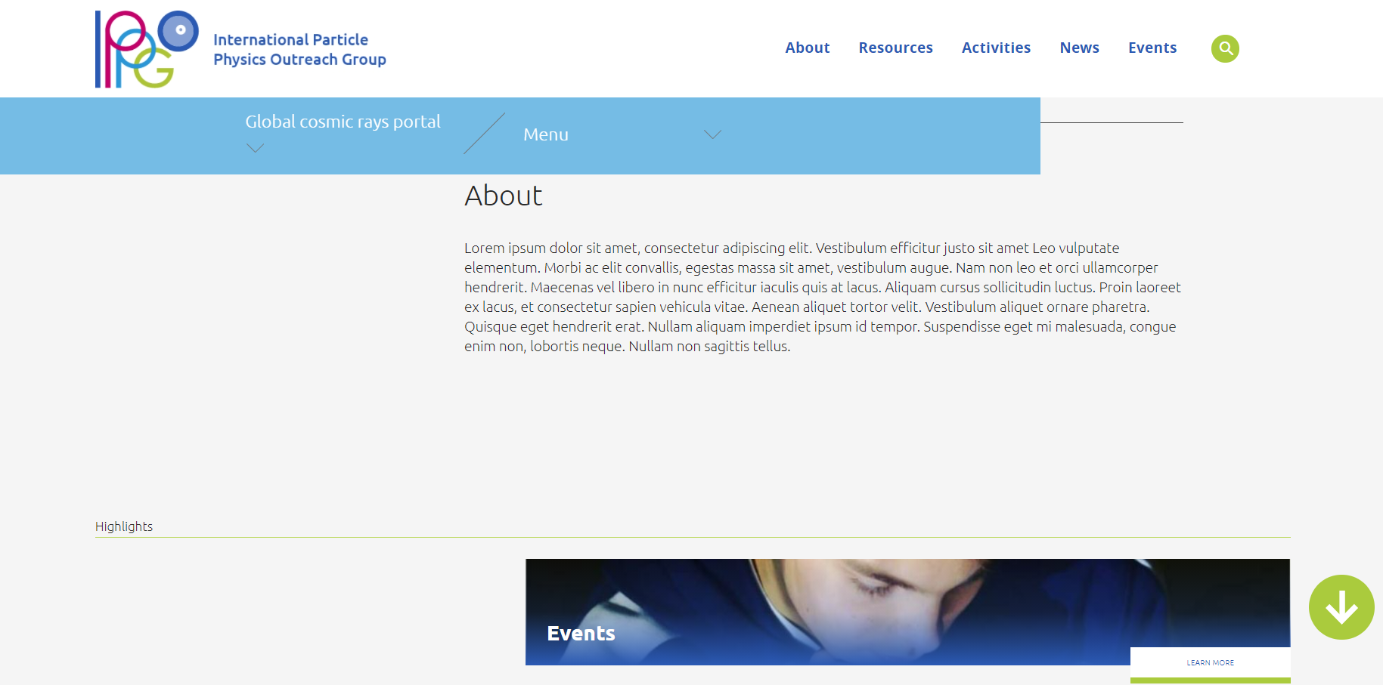
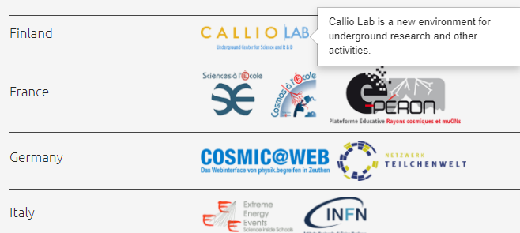
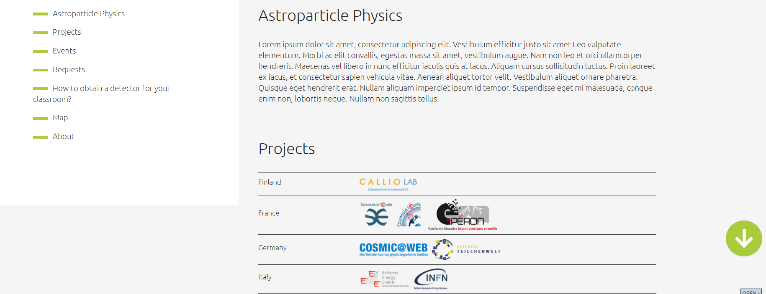
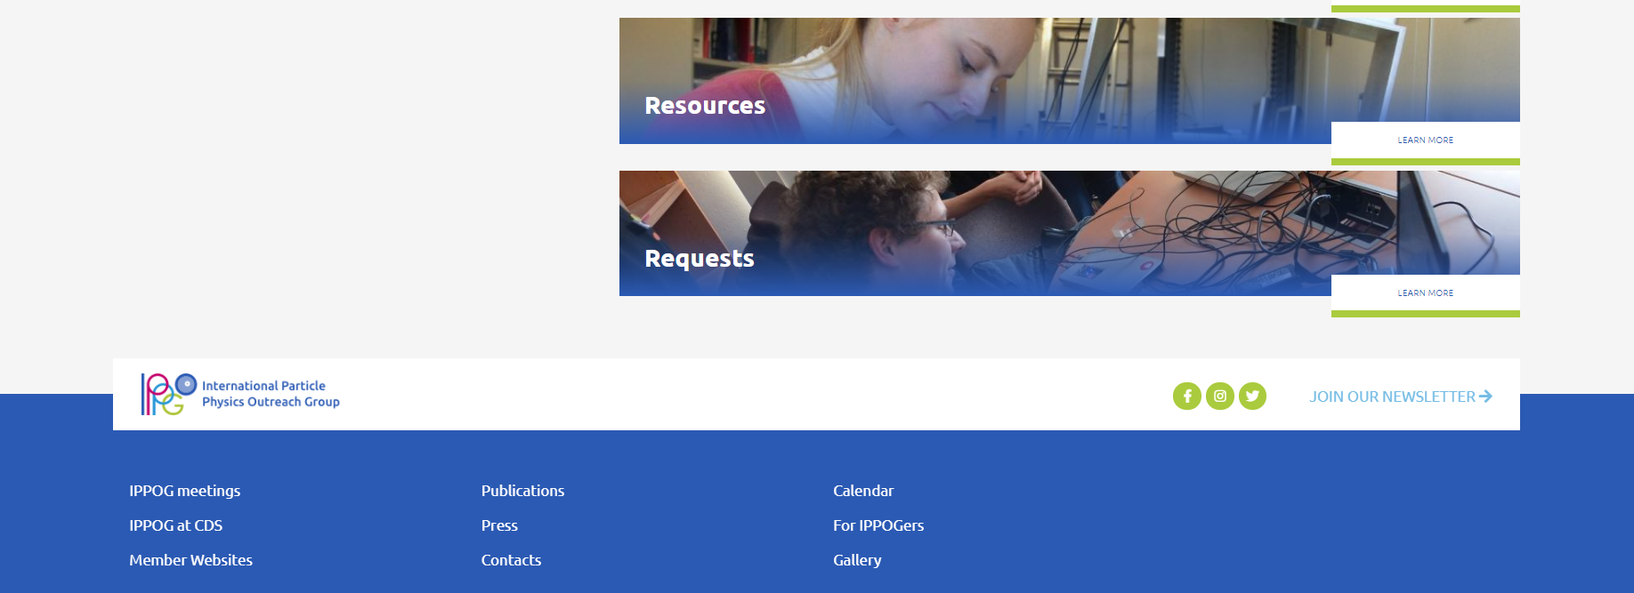
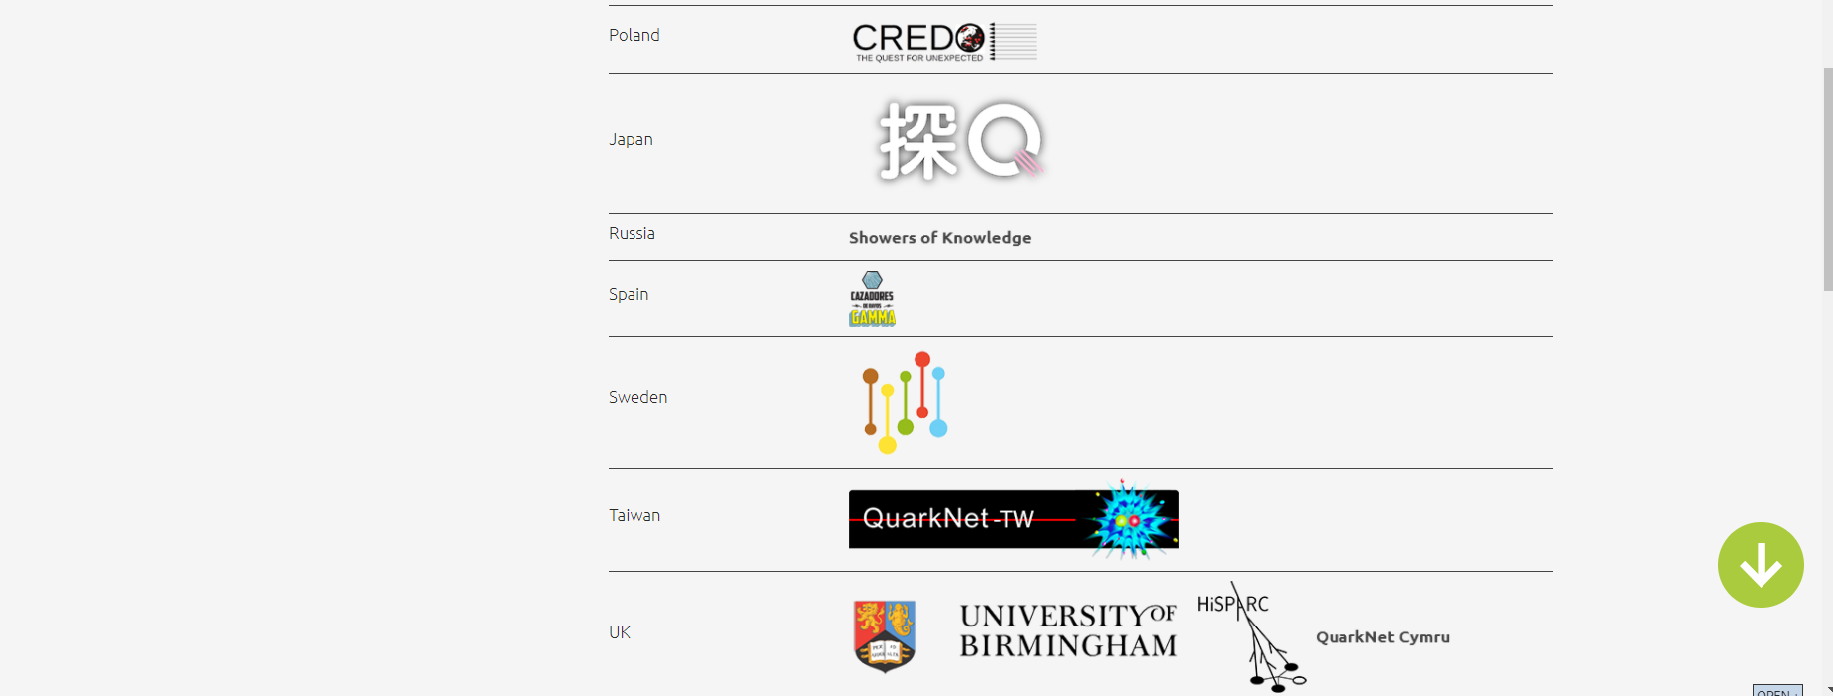
Global Cosmics
Scroll down
Hover: see submenu
Click: enter subpage
Includes Coordination team,
Activities Coordinators, Former Chairs and
Former Staff
13
21th IPPOG meeting, 19 May 2021, online

Slide 14
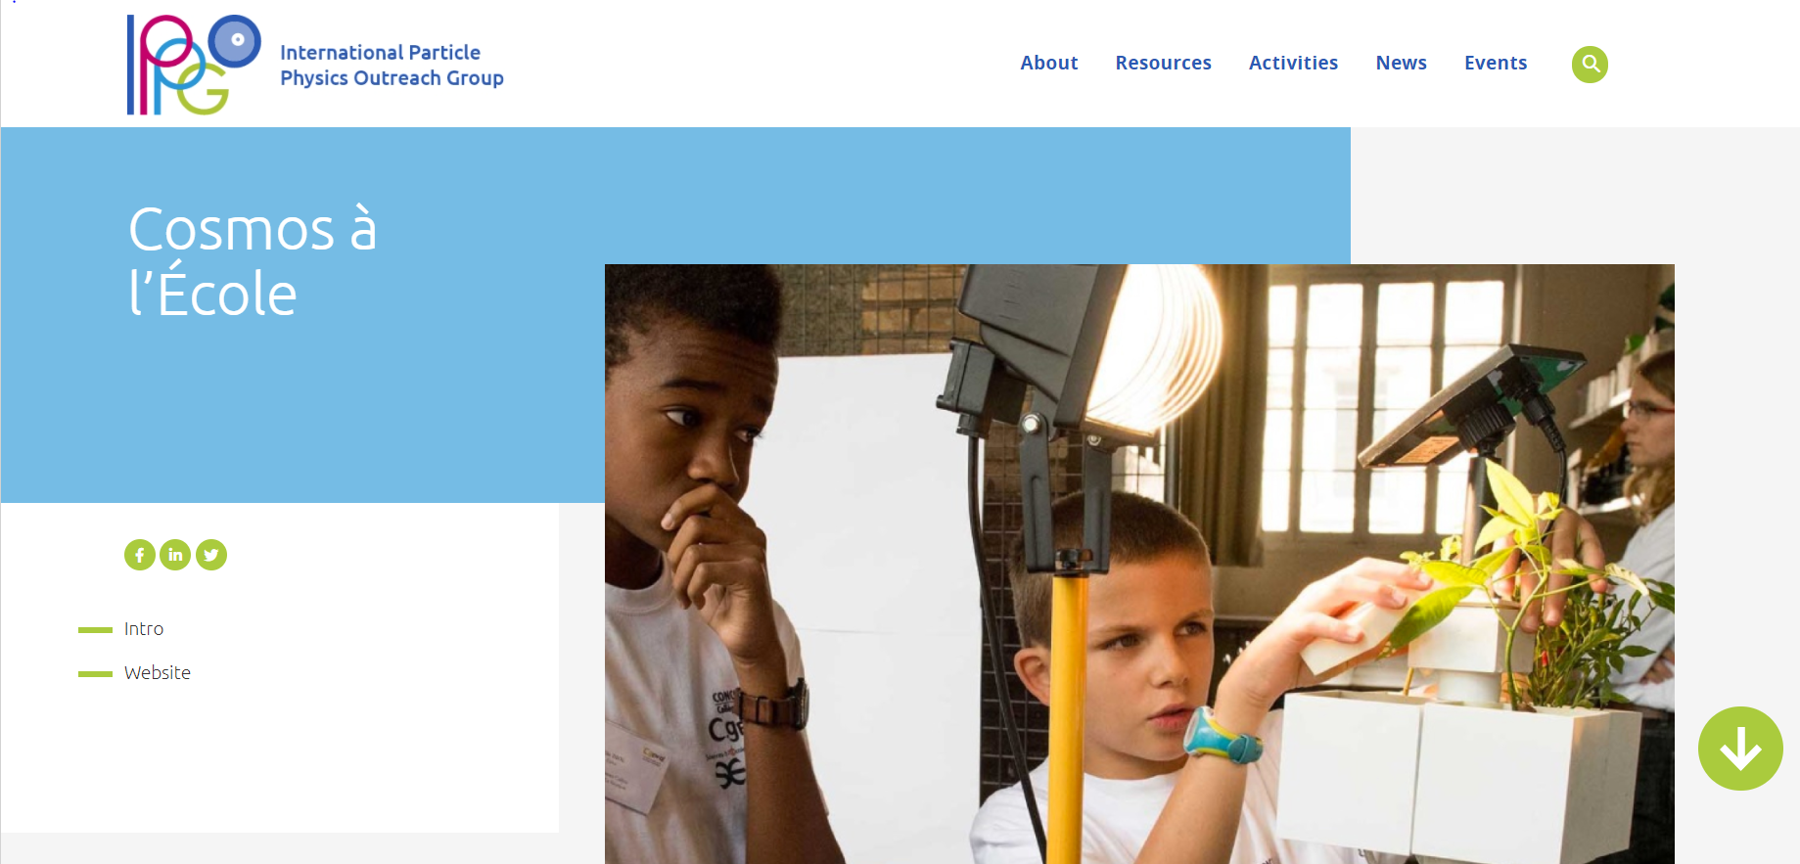
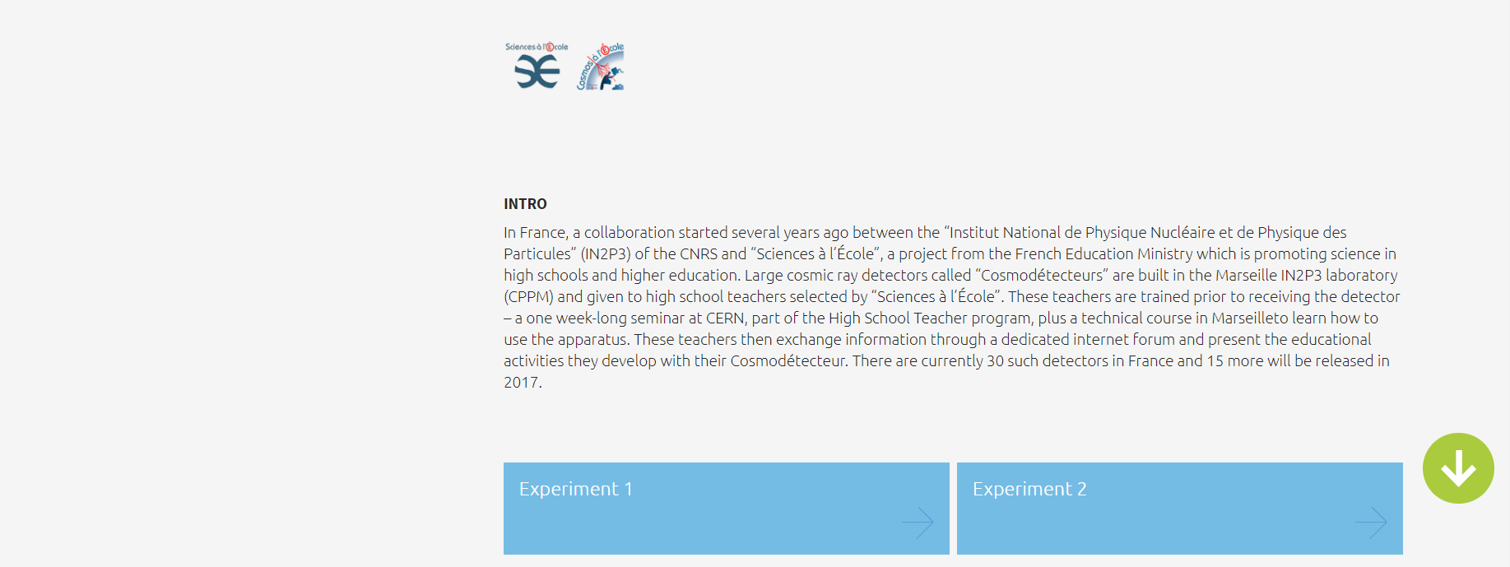
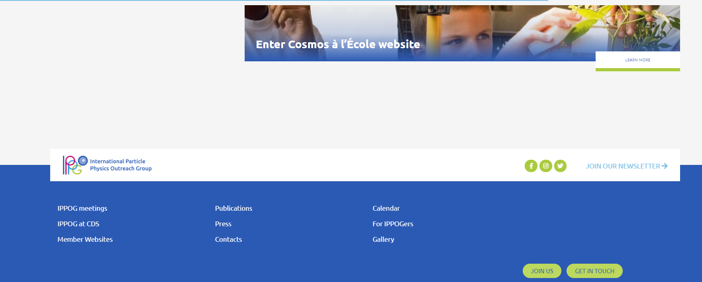
Global Cosmics Projects Pages
PROPER URL (as part of GC portal):
https://ippog.org/global-cosmics/cosmos-lecole
NEXT STEPS:
Global Cosmics SG meeting in June
Validation of designs
Input from projects: image + text

Slide 15
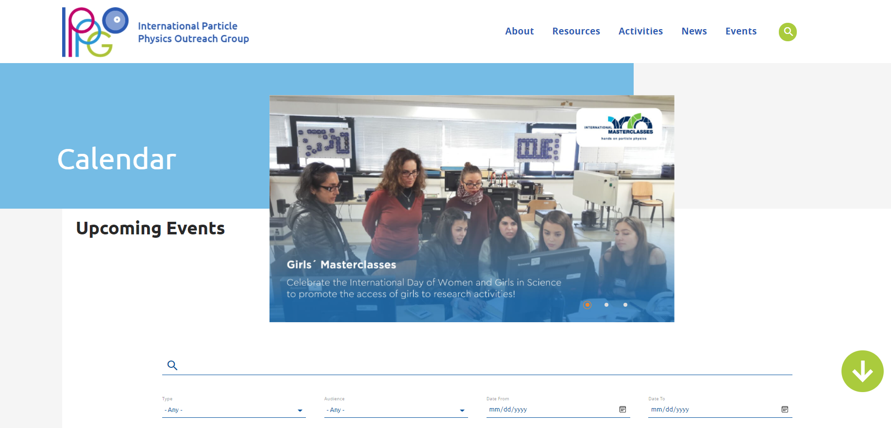
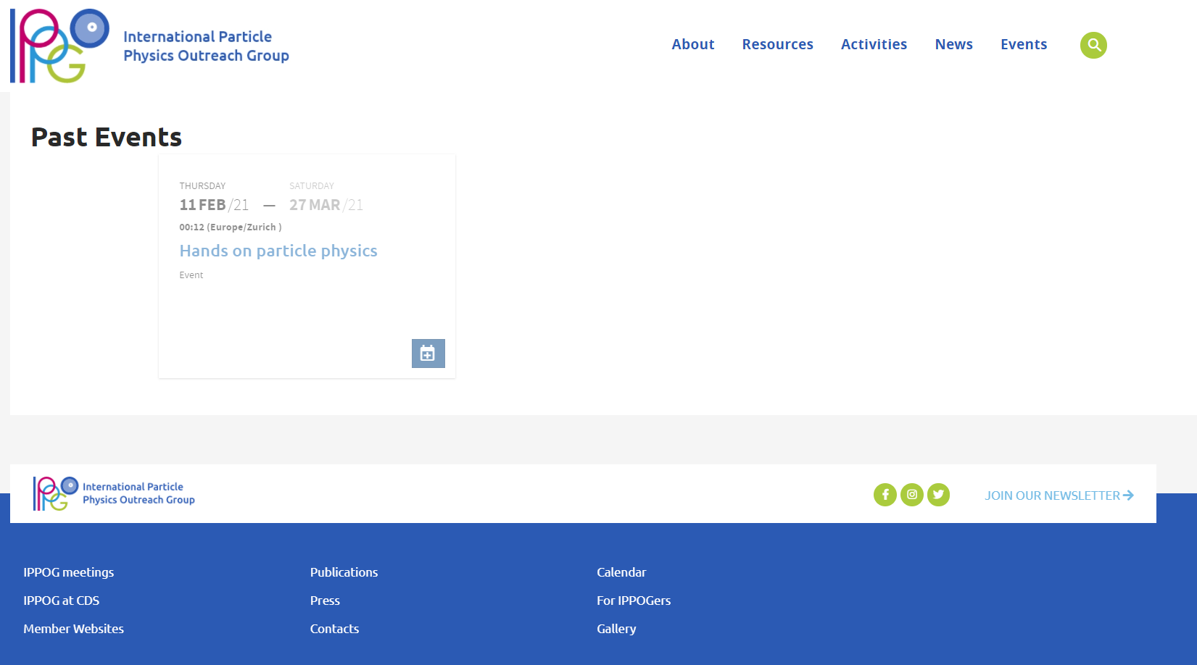
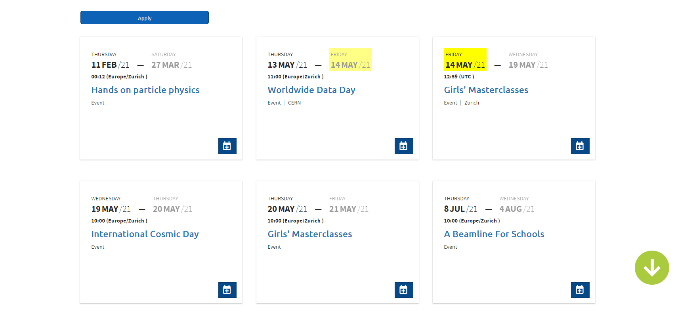
Calendar / Events
Sliding show
Scroll down

Slide 16
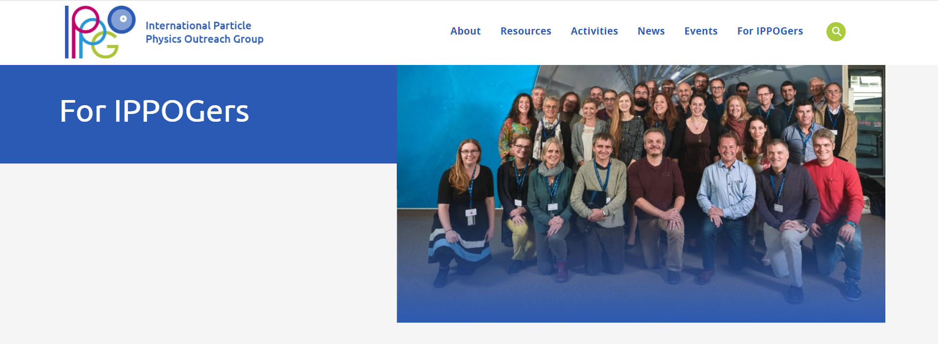
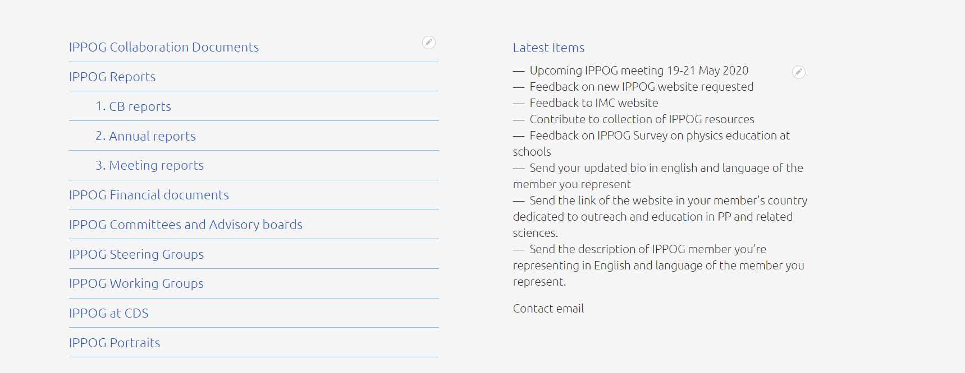
Structured organisation of IPPOG documents & data
BIG EFFORT
Already done (Barbora)
Still needed (IPPOGers)
Links from new CDS collections

Slide 17
New organisation of IPPOG at CDS
New changes:
IPPOG much more visible on CDS
Submission in less clicks
New categorisation
New links to collections / categories
BIG EFFORT
Already done (Barbora)
Still needed (IPPOGers)

Slide 18
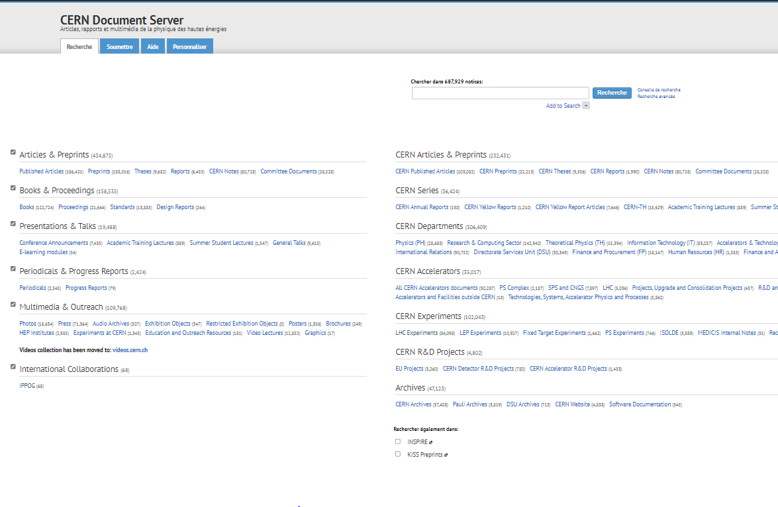
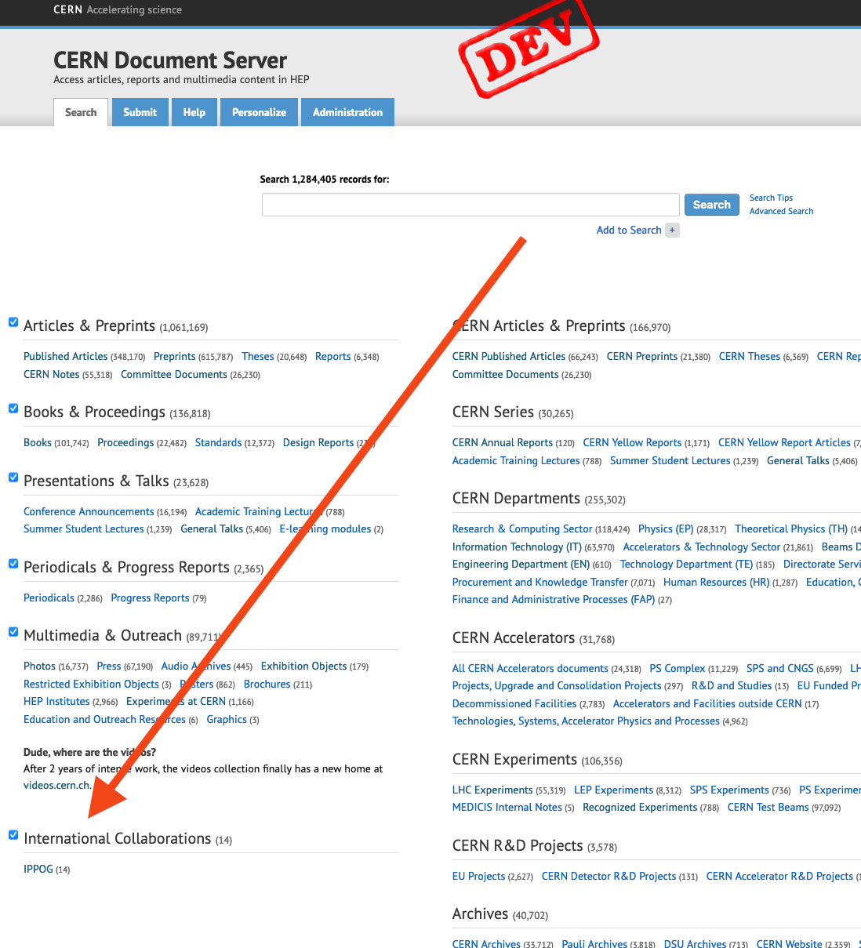
New organisation of IPPOG at CDS
Before IPPOG was below archives

Slide 19
New organisation of IPPOG at CDS
New changes:
IPPOG much more visible on CDS
Submission in less clicks
New categorisation
New links to collections / categories
BIG EFFORT
Already done (Barbora)
Still needed (IPPOGers)

Slide 20
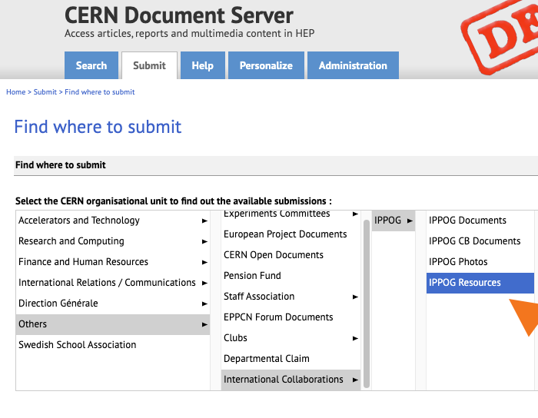
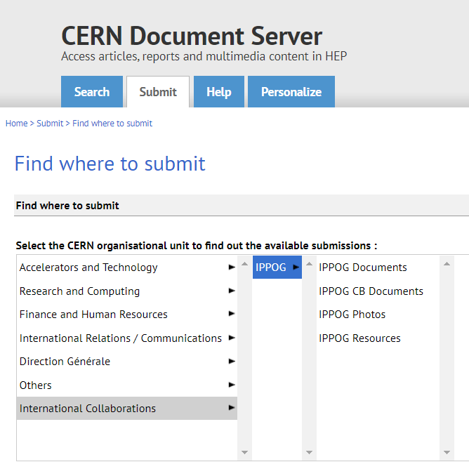
New organisation of IPPOG at CDS

Slide 21
New organisation of IPPOG at CDS
New changes:
IPPOG much more visible on CDS
Submission in less clicks
New categorisation
New links to collections / categories
BIG EFFORT
Already done (Barbora)
Still needed (IPPOGers)

Slide 22
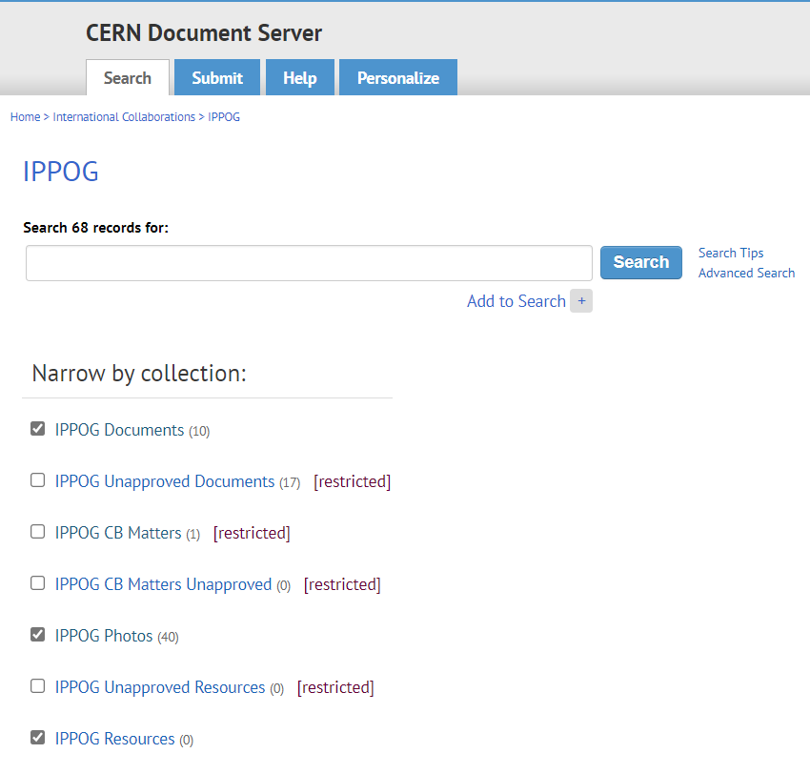
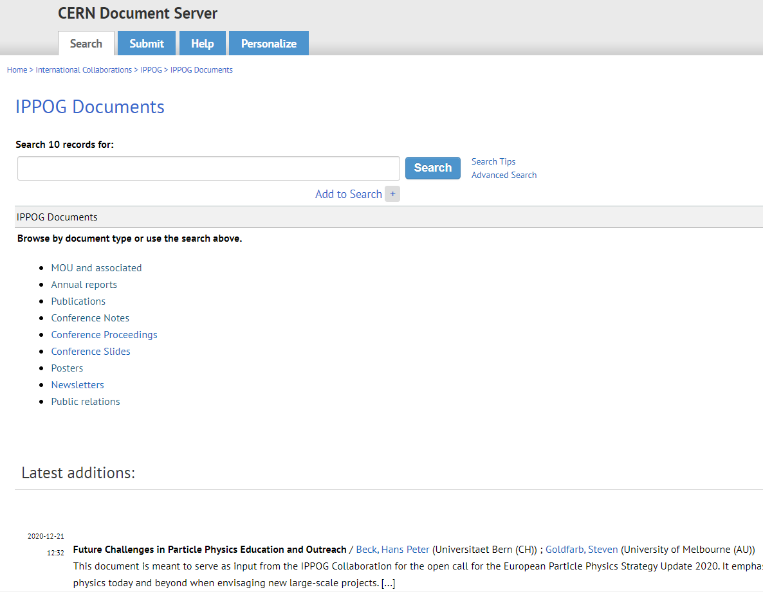
New organisation of IPPOG at CDS
New collections by category
Links to “For IPPOGers”
PLEASE, SUBMIT, SUBMIT, SUBMIT!!!!

Slide 23
Structured organisation of IPPOG documents & data
BIG EFFORT
Already done (Barbora)
Still needed (IPPOGers)
Links from new CDS collections
PLEASE, COMPLETE / CORRECT
Dedicated websites with all information

Slide 24
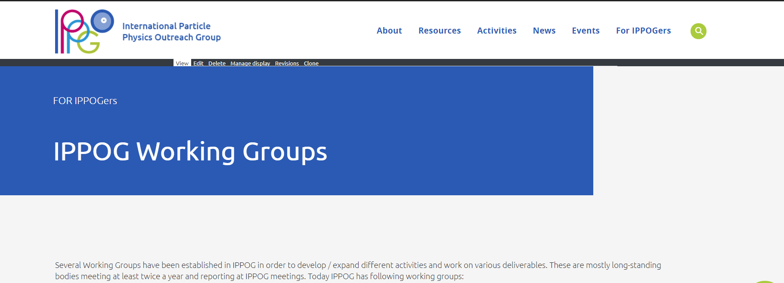
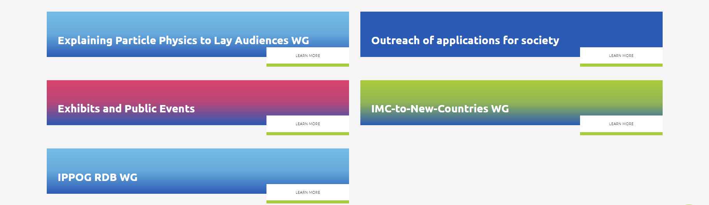
New organisation of IPPOG at CDS
New collections by category
Links to “For IPPOGers”
PLEASE, SUBMIT, SUBMIT, SUBMIT!!!!

Slide 25
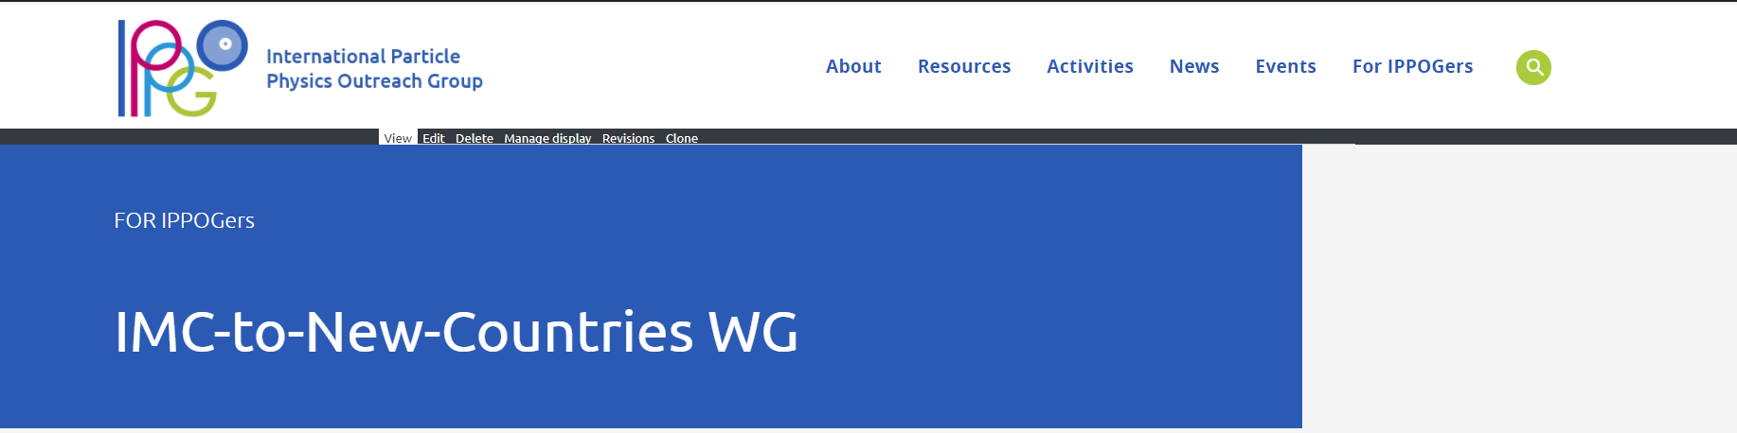



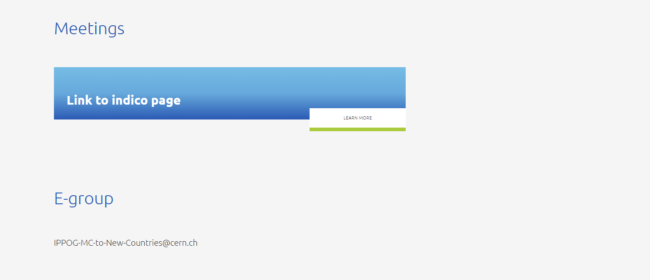
New organisation of IPPOG at CDS
Scroll down
New collections by category
Links to “For IPPOGers”
PLEASE, SUBMIT, SUBMIT, SUBMIT!!!!

Slide 26
Structured organisation of IPPOG documents & data
BIG EFFORT
Already done (Barbora)
Still needed (IPPOGers)
Links from new CDS collections
TO DO / Pending issues
Dedicated websites with all information

Slide 27

Close to finished new IPPOG website
https://test-ippog-d8-clean.web.cern.ch/
Design, sitemap and structure is “final”
Texts and images are not yet final : under the development
Chance to send me requested information for all who didn’t yet (till 10th June):
Updated bio
Member description
National website with PP outreach material (if exists)
Photos suitable for website
PLAN: fill in all available information in June 2021
BETA-TESTING end of JUNE 2021!!! (~ in 1 month from now…)

Slide 28
Revised IPPOG website preliminary plan
Reminder from last meeting - December 2020
Start of
Alpha audience IPPOG testing
Start of
Beta audience teachers testing
Draft website proposal
without content
*Maybe* publish
new IMC page
RDB curation
finished
May 2020
Fall 2020
Spring 2021
Fall 2021
End 2021
Dec 2020
Summer 2021
Launch of new IPPOG website
Start of
RDB curation
Fully developed front page
Draft of activities pages
Proposed migration for IMC
Draft of Membership pages
Completed front page
Migrated / developed most of the content except of RDB
Good progress on Global Cosmics
Close to
finalised RDB

Slide 29
Revised IPPOG website preliminary plan
Start of
Alpha audience IPPOG testing
Start of
Beta audience teachers testing
Draft website proposal
without content
*Maybe* publish
new IMC page
RDB curation
finished
May 2020
Fall 2020
Spring 2021
Fall 2021
End 2021
Dec 2020
Summer 2021
Launch of new IPPOG website
Start of
RDB curation
Fully developed front page
Draft of activities pages
Proposed migration for IMC
Draft of Membership pages
Completed front page
Migrated / developed most of the content except of RDB
Good progress on Global Cosmics
Close to
finalised RDB

Slide 30
Revised IPPOG website preliminary plan
Start of
Alpha audience IPPOG testing
Start of
Beta audience teachers testing
Draft website proposal
without content
*Maybe* publish
new IMC page
RDB curation
finished
May 2020
Fall 2020
Spring 2021
Fall 2021
End 2021
Dec 2020
Summer 2021
Launch of new IPPOG website
Start of
RDB curation
Fully developed front page
Draft of activities pages
Proposed migration for IMC
Draft of Membership pages
Completed front page
Migrated / developed most of the content except of RDB
Good progress on Global Cosmics
Close to
finalised RDB

Slide 31
Revised IPPOG website preliminary plan
Start of
Alpha audience IPPOG testing
Start of
Beta audience teachers testing
Draft website proposal
without content
*Maybe* publish
new IMC page
RDB curation
finished
May 2020
Fall 2020
Spring 2021
Fall 2021
End 2021
Dec 2020
Summer 2021
Launch of new IPPOG website
Start of
RDB curation
Fully developed front page
Draft of activities pages
Proposed migration for IMC
Draft of Membership pages
Completed front page
Migrated / developed most of the content except of RDB
Good progress on Global Cosmics
Close to
finalised RDB

Slide 32

PLAN till the end of 2021
Beta-testing launched end June 2021
Feedback & content proposals collected during summer break
Website published in November / beg. December 2021
No guarantee for implementing anything what comes after 15th September
Global Cosmics - OK
RDB – still huge job - hopefully OK (depends on input from IPPOG)
IMC – next year - advanced design, but not yet green light from IMC SG to implement
- not necessary condition to publish IPPOG Website

Slide 33
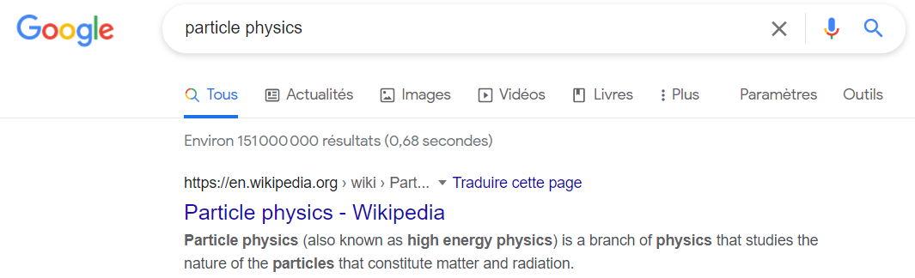
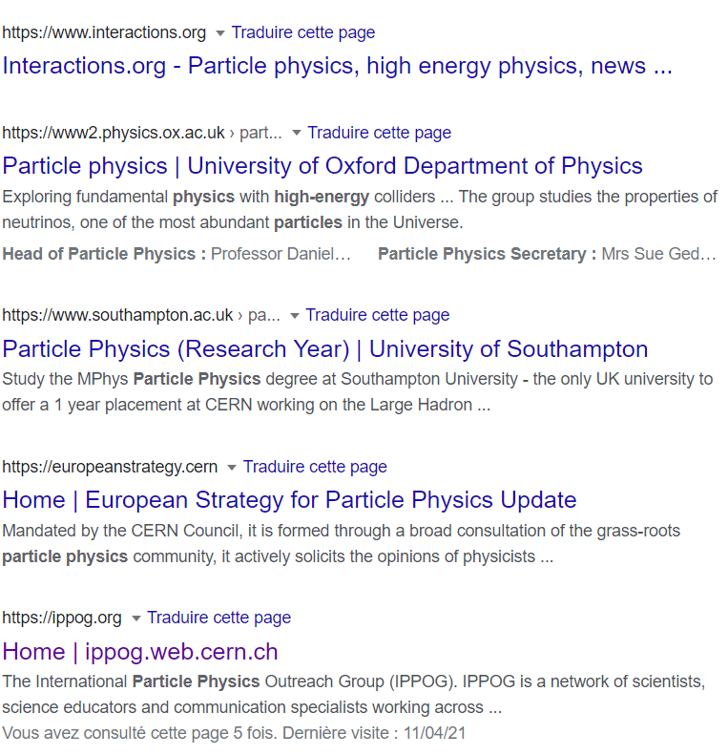
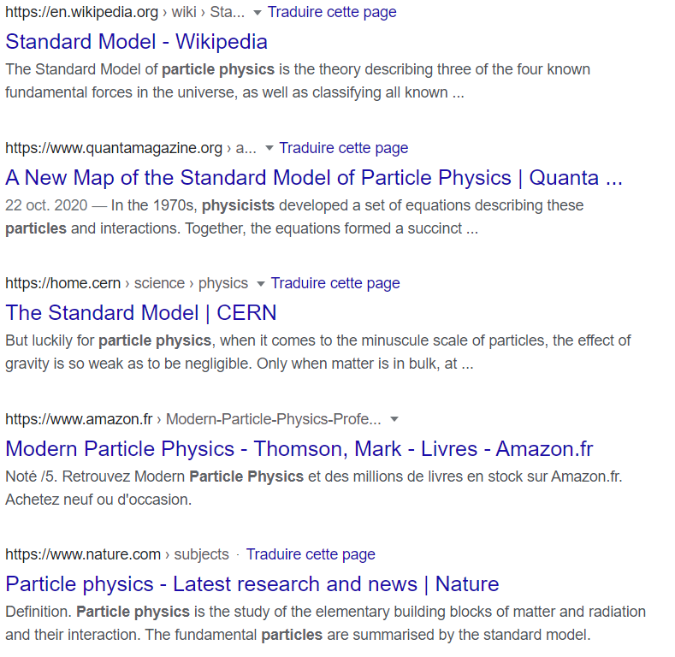

Visibility / «Foundability» on internet
Website must have
METATAGS
(keywords)
IPPOG TO DO by
end of October 2021:
Define metatags
for each subpage of
IPPOG webpages
Scroll down
33th place
IPPOG WIKIPEDIA
Volunteers…
(Darren)

Slide 34
IPPOG Resource Database - Outline
Website preview / new look - reminder
Status quo, Goals & Challenges
Technical part: Drupal – CDS interface
Content: old and new
New RDB WG
Timeline / Plan
Open discussion

Slide 35

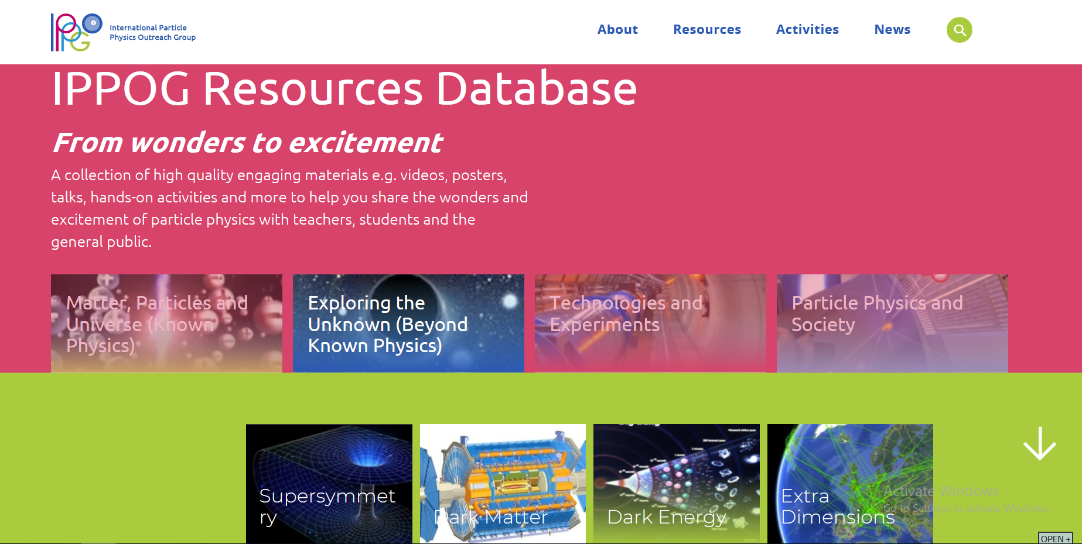
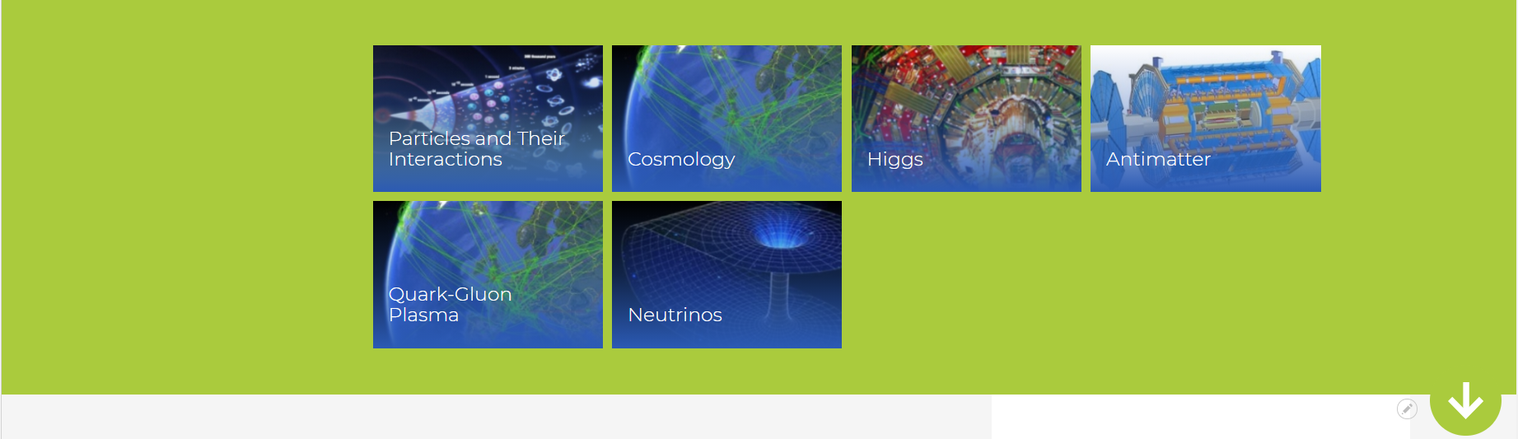
New IPPOG RDB website preview
https://test-ippog-d8-clean.web.cern.ch/
SEARCH:
1) Choose physics topic
(from picture)
2) Filter in search
engine

Slide 36
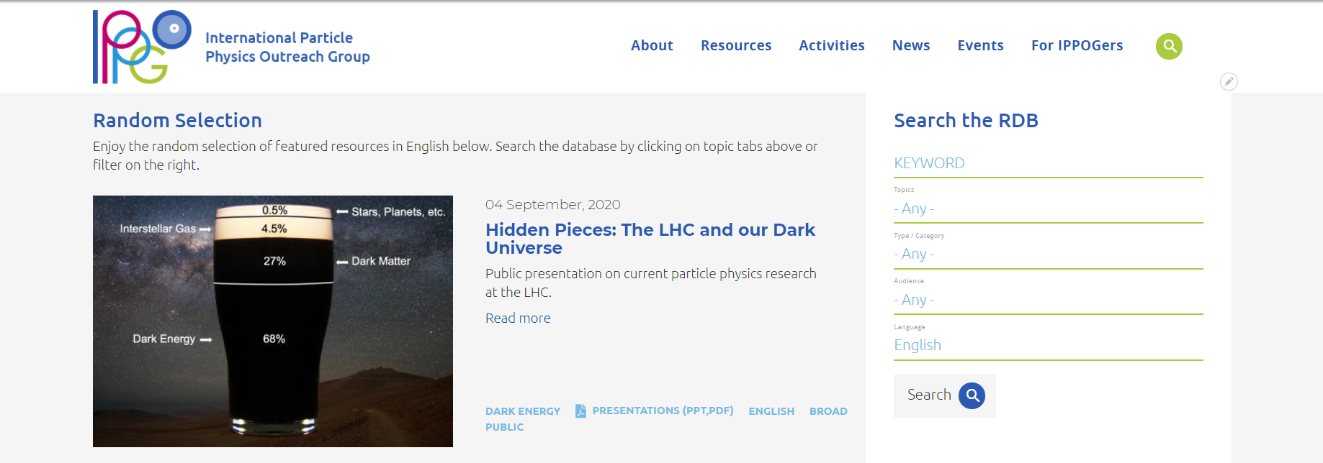
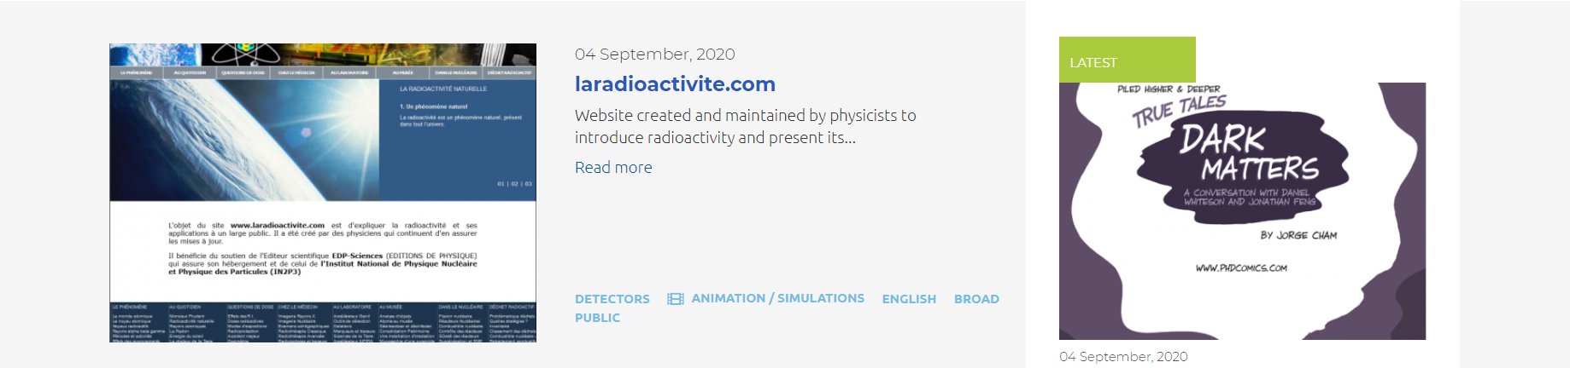
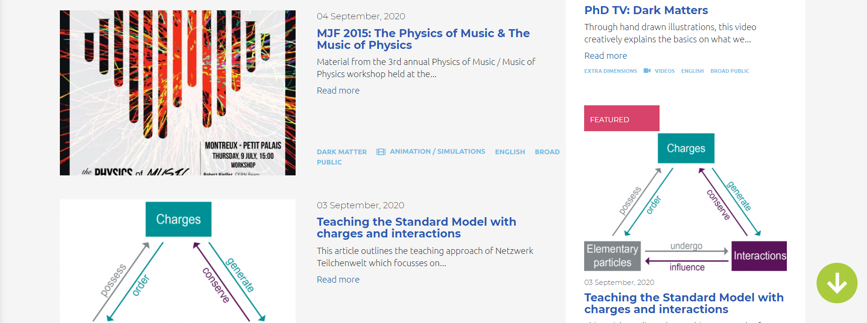
https://test-ippog-d8-clean.web.cern.ch/
SEARCH:
1) Choose physics topic
(from picture)
2) Filter in search
engine
- Order of items according the ranking
- Otherwise RANDOM selection
changing at each refresh…
NOW: Only few items for illustration
No real submissions…
20th IPPOG meeting, 3 December 2020, online

Slide 37
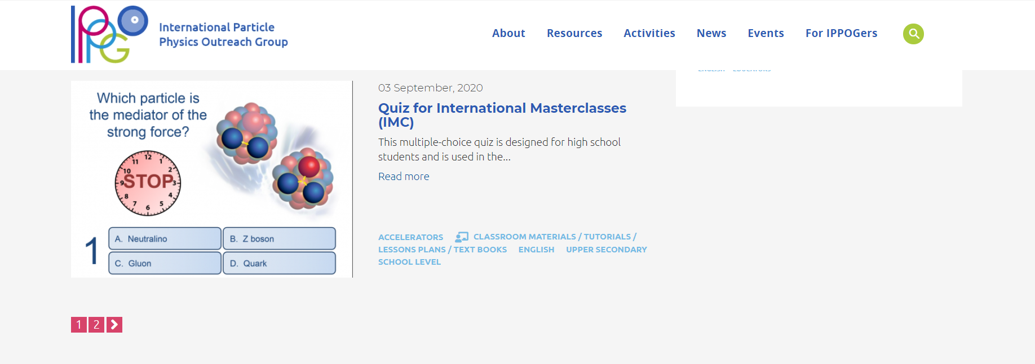
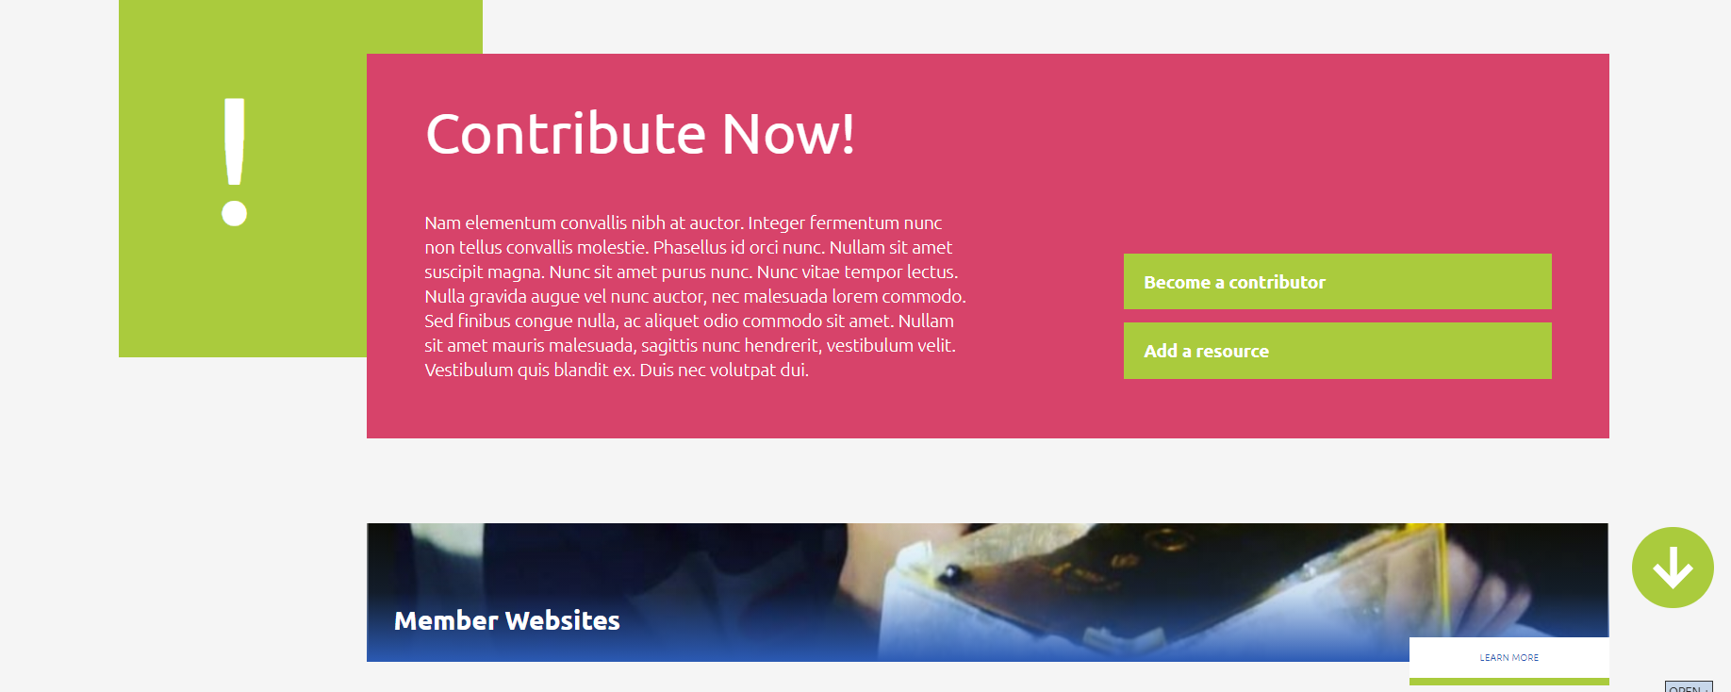
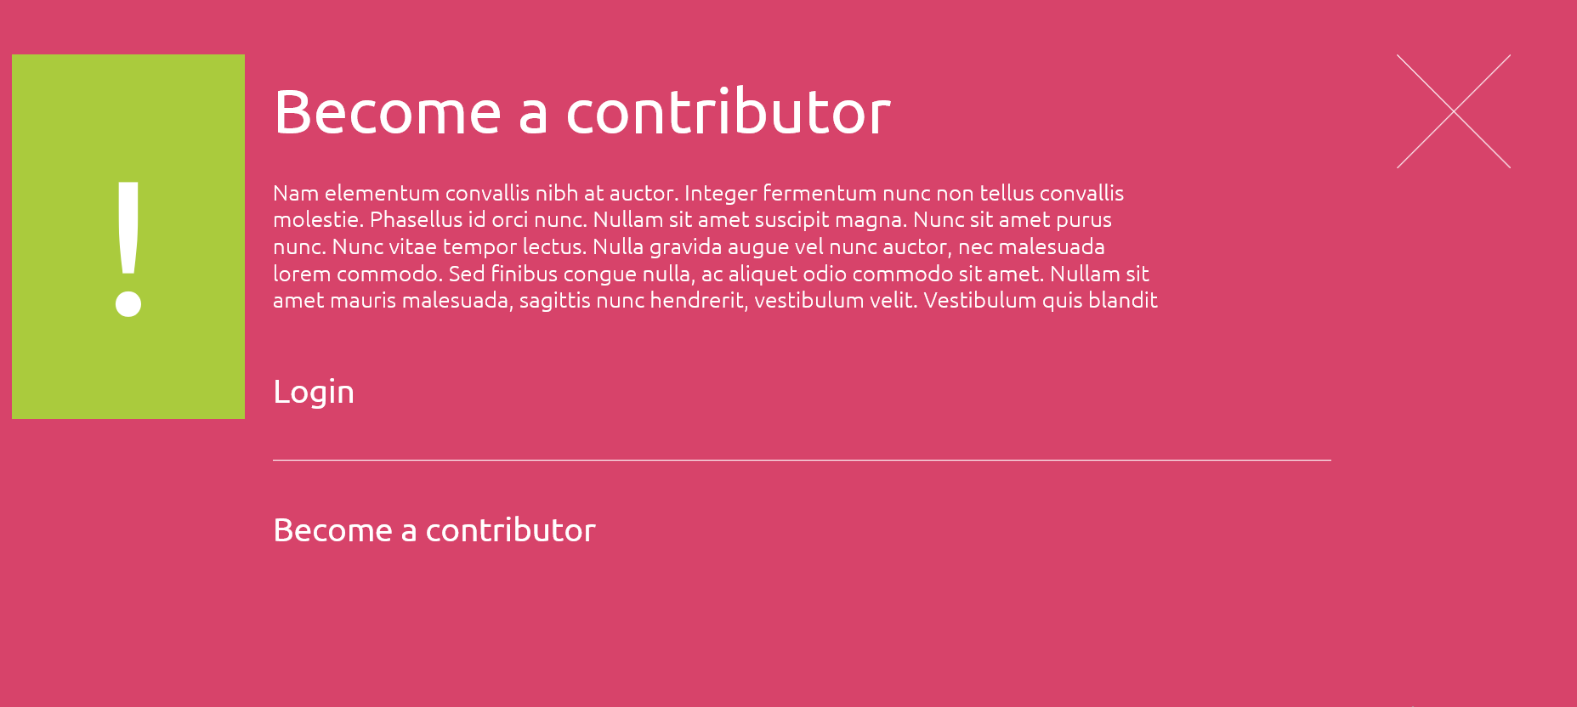
USER FRIENDLY
SUBMISSIONS:
- Clear instruction
- Form for contributors

Slide 38


What is IPPOG Resource Database?
From official IPPOG’s communications
RDB is:
online platform to facilitate the exchange of PP E&O resources across the globe
collection of high-quality engaging materials (e.g. videos, posters, talks, hands-on activities, tools, brochures and more)
recommended by IPPOG representatives and contributors
to share wonders and excitement of PP with teachers, students and general public
readily understandable and regularly updated to reflect the latest discoveries in PP

Slide 39
IPPOG RDB: from HISTORY to STATUS QUO
History:
Idea born in 2009: transformation of EPPOG from a “discussion forum” to a possible world leader in informal scientific E&O activities for PP and related fields.
Initially “EPPOG Best Practice Database” meant to be used by science institutions and laboratories for outreach and informal science education purposes
self-sustaining, users vote on highest quality & most useful items to be best practice
First version released in 2011
Status 10 years later:
IPPOG contributors continued to submit items published after IPPOG chairs approval
5-10 new items each year & no more submissions since 1 year
~ 370 items: many of them 10 years old…
The idea of the RDB was born in 2009 at an EPPOG meeting at CERN, when EPPOG after more than 15 years of its existence was on the verge of a transformation from a “discussion forum” to a possible world leader in outreach and informal scientific education activities for particle physics and related fields. Initially called the EPPOG Best Practice Database, it was meant to be used by science institutions and laboratories for outreach and informal science education purposes. The eventual aim was that the database would be self-sustaining, with the EPPOG members (and others) adding new items when appropriate and users “voting” to ensure that the highest quality and most useful items are the ones that become the “best practice” [38]. Consequently, the first version of the IPPOG’s Resource Database was released in 2011.
After almost 10 years, IPPOG is now embarking on an ambitious project to improve the user experience across the IPPOG digital portfolio (website and social media channels) and to strengthen the IPPOG brand online by creating a new website including a new RDB. The goal of the new design is to greatly broaden the audience type and use of the web pages and available resources. The visual impact needs to be enhanced in order to pursue IPPOG’s mission and communicate its messages to its existing and new audiences, as well as new potential members, partners and sponsors. IPPOG wants the new website to become more open to students, teachers and the general public, and for the RDB to become the primary source of particle physics outreach material in the world.
39
21th IPPOG meeting, 19 May 2021, online
IPPOG new webpages & RDB

Slide 40
IPPOG RDB: from STATUS QUO to VISION
IPPOG is a platform for (has a potential to):
sharing, developing and improving
explanatory and teaching materials, strategies, methods, activities and tools
to reach broader audiences
based on the world best practices in E&O of PP and related sciences
“IPPOG wants the new website to become more open to students, teachers and the general public, and for the RDB to become the primary source of particle physics outreach material in the world.”
40
21th IPPOG meeting, 19 May 2021, online
IPPOG new webpages & RDB
Vision of IPPOG’s RDB after 10 years…:
IPPOG works to improve the user experience across the IPPOG digital portfolio
strengthen the IPPOG brand online by creating a new website including a new RDB
greatly broaden the audience type and use of the webpages & available resources

Slide 41
IPPOG Resource Database Challenges
TECHNICAL
Interface between CDS and Drupal
CONTENT
Curation of existing / “old” items
Collection of new / up-to-date best items
TIME
RDB populated and published by November 2020

Slide 42

IPPOG RDB: CDS – Drupal Interface
RDB resources will be stored at CDS
– safe and makes Drupal website lighter
In-Kind contribution from CERN
Dedicated submission form at CDS
CDS: IPPOG / Resources
new IPPOG RDB taxonomy
all fields which we need to display for RDB item
Several discussions & interactive sprints
Ready now
Interface from CDS to Drupal
Connection does not exist, we must create it: BLIND company
Program will automatically fetch data from CDS after the submission /
approval and display at RDB website
To be ready for september

Slide 43
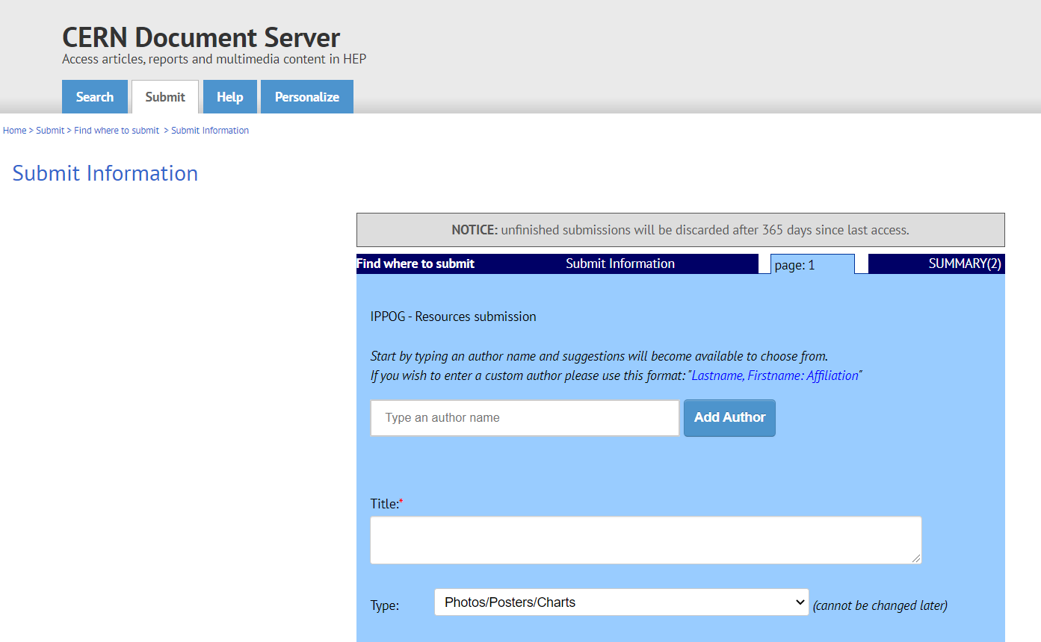
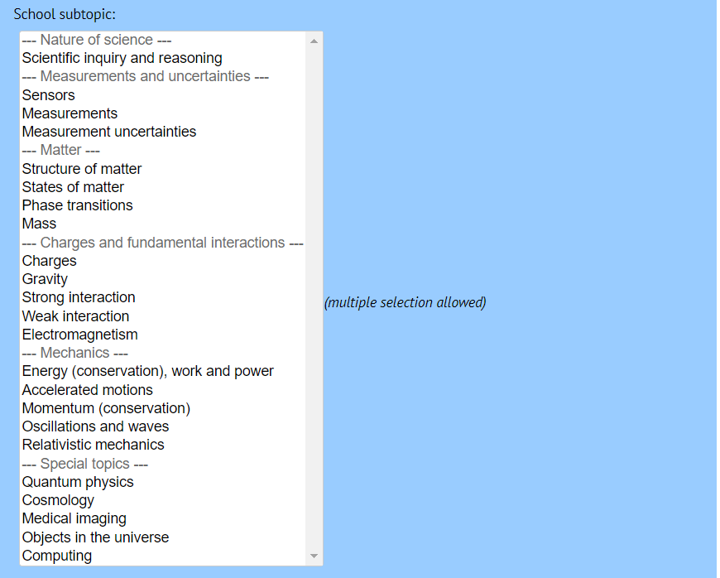
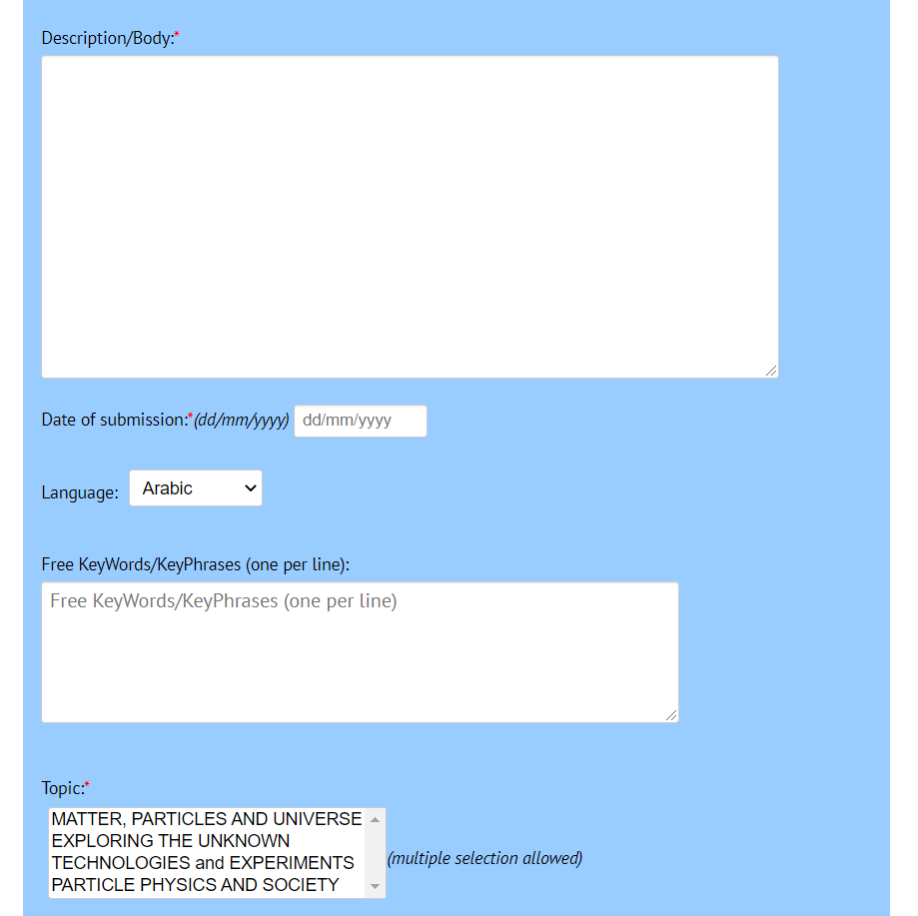
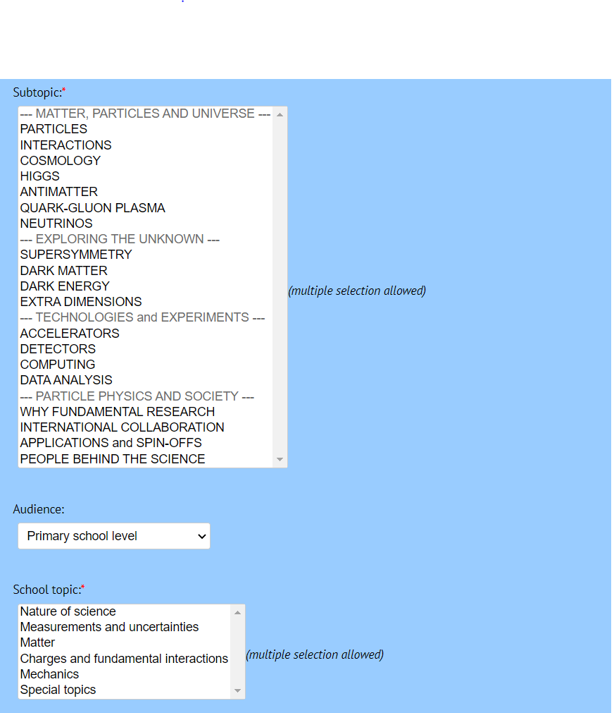

CDS RDB submission form

Slide 44
IPPOG Resource Database Challenges
TECHNICAL
Interface between CDS and Drupal
CRITERIA
Is the physics right?
Is it a topic of interest?
Is it related to particle physics or associated fields?
Is it up-to-date or has it been superseded?
Are you aware of a similar resource in the same language?
Do you consider this resource as really outstanding?
CONTENT
Curation of existing / “old” items
Collection of new / up-to-date best items
TIME
RDB populated and published by November 2020

Slide 45
IPPOG RDB curation group
~ 40 members from around the world: - physics teachers, scientists and science communicators
Alberto Ruiz Jimeno
Andreas Delannoy
Ani Torres
Anna Marie Wolf
Carlos Cunha
Cassondra McHugh-Lowther
Cédric Vanden Driessche
Claire Bonnoit-Chevalier
Daniela Ambar Gayoso Miranda
Dario Menasce
Despina Hatzifotiadou
Enrique Arce-Larreta
Harry Stuckey
Ian Bearden
Ivan Melo
Jean-Christophe Pelhate
Joel Klammer
José María Díaz Fuentes
Julia Woithe
Kevin Martz
Kevin Mosedale
Lucia Battistella
Luís Afonso
Maria Niland
Marla Glover
Michael R. Fetsko
Michael Wadness
Miki Otsuka
Moritz Springer
Patricia Teles
Pierluigi Paolucci
Ram Krishna Sharma
Richard Dower
Robert Nickson
Soleiman Rasouli
Spencer Pasero
Stefania Della Sciucca
Yury Ivanov
Creation in June 2020
- enlarged in April 2021
New Curation tool developed – launched December 2020
366 resources: each evaluated by 2-3 experts => ~ 800 items to curate
Status: 346 curated vs 400 planned as for today!
Plan: finish by end of summer 2021!

Slide 46







IPPOG Resource Database CURATION TOOL

Slide 47

IPPOG RDB curation statistics per user
Only 20 people
(> half of the group) contributed so far…
Today
Didn’t contribute yet:
Andreas Delannoy
Carlos Cunha
Cassondra McHugh-Lowther
Dario Menasce
Enrique Arce-Larreta
Ivan Melo
Luis Afonso
Maria Niland
Marla Glover
Michael Wadness
Miki Otsuka
Soleiman Rasouli
Spencer Pasero

Slide 48

IPPOG RDB curation time evolution
507
346

Slide 49
IPPOG Resource Database Challenges
TECHNICAL
Interface between CDS and Drupal
CONTENT
Curation of existing / “old” items
Collection of new / up-to-date best items
TIME
RDB populated and published by November 2020

Slide 50


Collecting new resources for RDB
Started in December 2020
Simple google doc
Regular reminders by email
In December 3 pages
Today 25 pages

Slide 51
Creation of new RDB WG
WE NEED TO:
Complete
Wrap up
Evaluate
Assign new tags
- with help of dedicated
curation tool
New dedicated WG needed!
RDB Working Group
Open to join!
RUIZ JIMENO, Alberto
SHARMAZANASHVILI, Alexander
STRANDBERG, Jonas
WOZNIAK, Krzysztof Wieslaw
WETZLER, Susan
WEGNER, Jeremy
KLAMMER, Joel
GLOVER, Marla
COYLE, Helen
PAOLUCCI, Pierluigi
6 members also in
RDB curation group
KIRILOVA, Galina
KLEIN BOESING, Christian
BEARDEN, Ian Gardner
GAMEIRO MUNHOZ, Marcelo
GORISEK, Andrej
HADJIISKA, Roumyana Mileva
HATZIFOTIADOU, Despina
MELO, Ivan
PRICE, Darren
BARDEEN, Marge
Thanks Ken
& Spencer
“RDB specifications” doc
- Article from BBG: “IPPOG – Bridging the gap between science education at school and modern scientific research”
Later we will need RDB standing committee
2011.14743.pdf (cern.ch)
Notes:
Pierluigi Paolucci

Slide 52
RDB TIME PLAN
CERN help
TAGS
ASSIGNMENT
CONTENT READY
RDB
POPULATION
COLLECTION
PUBLISH
NEW items
RBD WG
EVALUATION
June 2021
July 2021
September 2021
November 2021
August 2021
October 2021
OLD items
RDB curation group
CURATION
CDS-DRUPAL
INTERFACE
READY
CDS-DRUPAL INTERFACE
BLIND
DEVELOPMENT

Slide 53
DISCUSSION
Feedback on website
Feedback on RDB
What do we want to have in RDB? Few best? Everything?
How many new items do we aim to have when launched?
Criteria?
???

