Slide 1
General information
G. Iadarola
ABP Computing Meeting – 23 Apr 2021

Slide 2
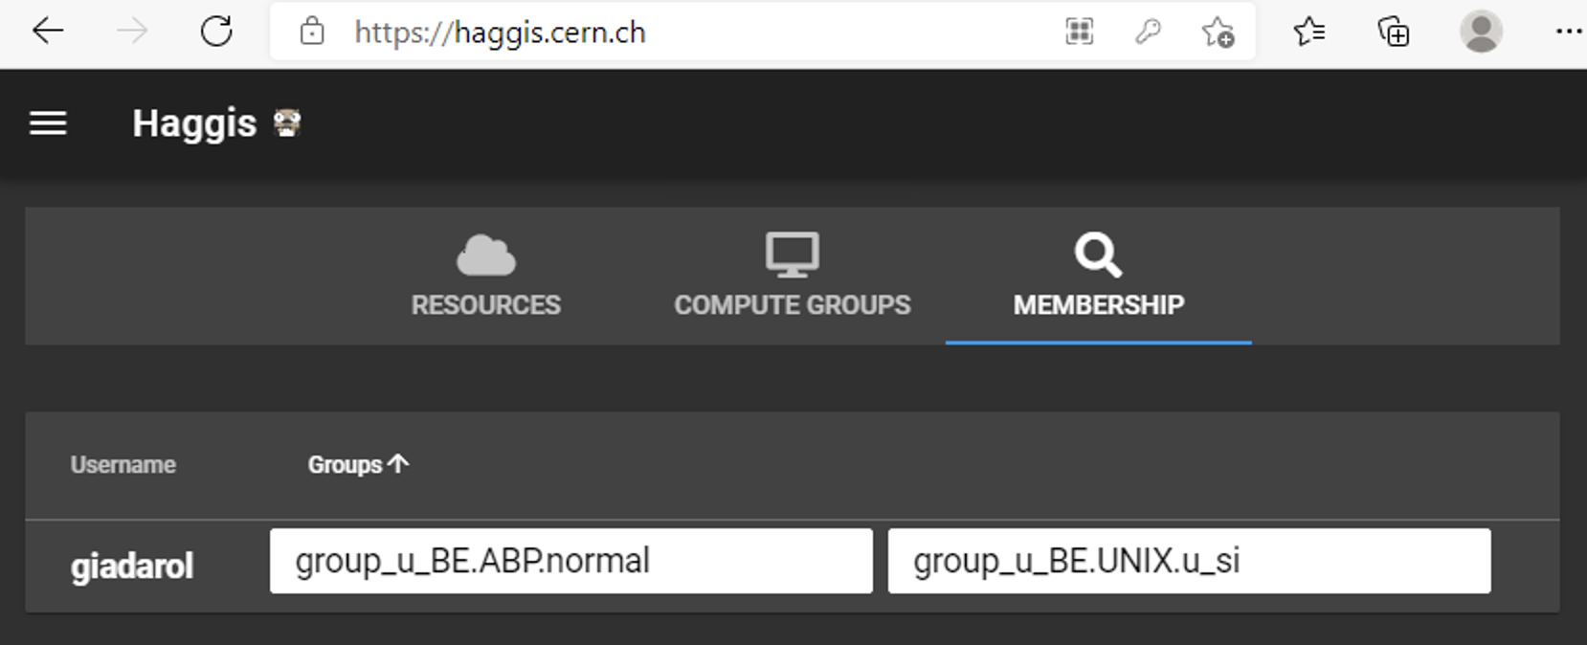
General information
Very interesting workshop on “CloudBank” pilot project on Tuesday
  Usage of computing resources from commercial providers (e.g. Google, Amazon)
  https://indico.cern.ch/event/1021544/
HTCondor queues
  Users from old e-groups (SLAP, ICE) redistributed (thanks to Massimo for the Help)
  Old e-groups will be discontinued today, ithould be transparent for users
    Let me know if you see anomalies
    You can can check on https://haggis.cern.ch/
Click here
used by htcondor
2

Slide 3
Thanks for your attention!

