Slide 1
24th WP4 Coordination Meeting RFD CM in SM18, Prep Meeting
HL-LHC WP4
18 May 2021, CERN

Slide 2
General WP4 News
RFD1 – Retest after 2K leak foreseen next week
RFD2 – Beam screen assembly preparation
SPS-BA6 cryomodule stable at 2K since 15-Apr
RF conditioning progressing well up to 5 kW in pulsed mode, anticipate CW in ~ 2weeks (depending on vacuum level)
LLRF and Controls commissioning should be planned for June
1st industrial DQW series cavity arrived at CERN – cold test foreseen last part of June
Collaborations
Proposal to change the scope of Russian in-kind from HOM couplers to HPRF lines is accepted with the production of DQW-HOMs & FA’s inhouse to start soon.

Slide 3
M7 Installation & Test Checklist
RFD Cryomodule in SM18
Integration of RFD-CM and connections to interfaces
Transport to M7-bunker. Any MME/vacuum actions before installation in M7?
High power RF
Check all services needed for the amplifier (IOT ?) & FPC
Integration and installation of amplifier, transmission lines and FPC transition
Cryogenics
What steps needed for connection of the RFD. For DQW in 2017 – plan B was implemented
Updates of instrumentation, process control, cool-down speed etc.. ?
Engineering specification for Cryomodule EDMS 2043014 § 4.3, heat load estimations and dynamic load. New circuits compared to what it was done in 2017 for example beam screen cooling circuit.
Alignment: Jack positions or wheels(?), floor markings, installation and monitoring (FSI)
Vacuum: Leak checks and pump down sequence including 2nd beam chamber (SPS-DQW → EDMS 1858682)
Low level RF (2 modules to be installed in SM18?), PLC (configured as SPS ready), Tuner verifications at 2 K (range & hysteresis)
RF Instrumentation, access system checks & Radiation monitoring

Slide 4
Overview Planning Proposal
Q2-Q3 2021 | Q3-Q4 2021 | Q1 2022 | Q2 2022 | Q3-Q4 2022
Integration | M7 preparation | RF Installation | CM Arrival from UK & M7 Installation
 | Cryogenics |  | RF conditioning & CM testing
 | Services checks & update
SM18-CC contact person: N. Valverde (support from K. Turaj)
During 2021 more detailed planning for next year on the actual installation and execution of the work will be provided
Integration to also start for SPS-BA6 with RFD module

Slide 5
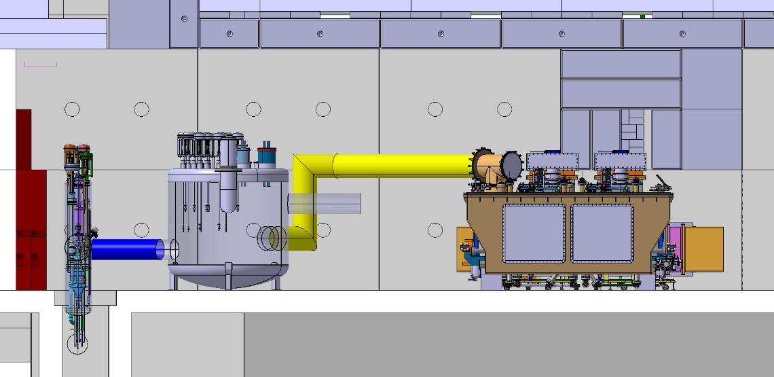
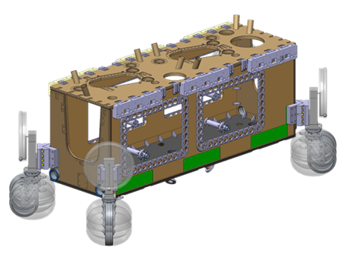
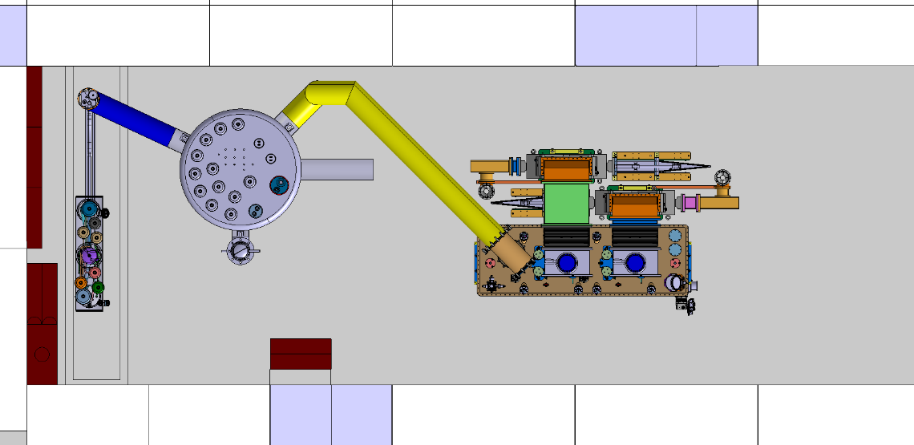
First Conceptual Integration in M7
M7- 3D images from Olivier Pirotte

Slide 6
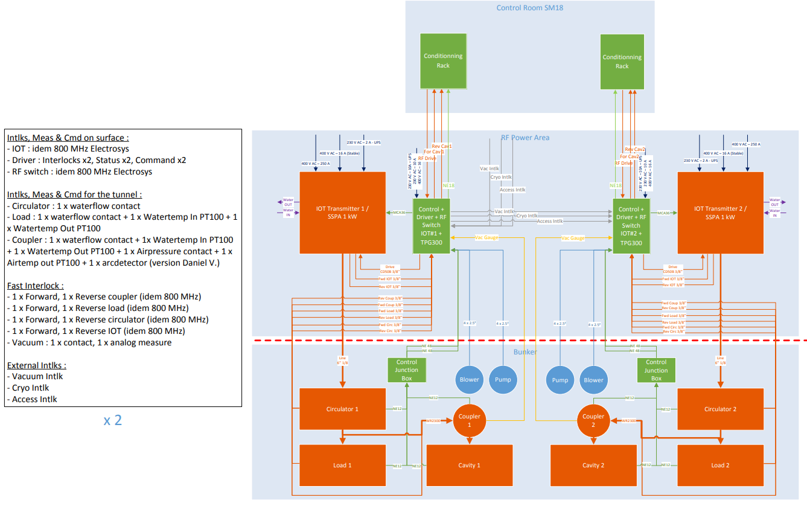
EDMS 1818059 M7 cable diagrams (for RF & Interlocks)
Simon Barriere

