Slide 1
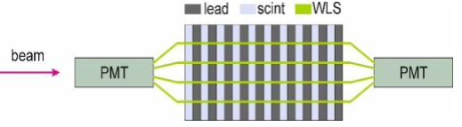
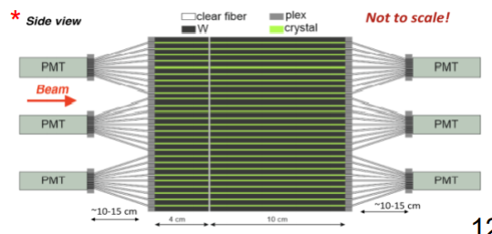
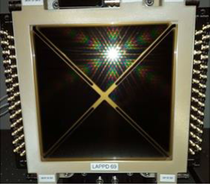
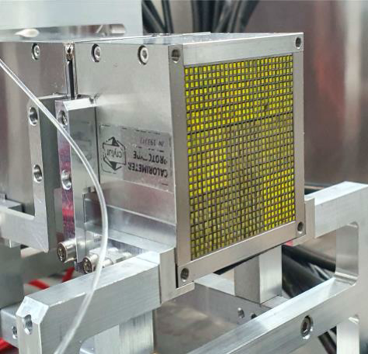
LHCb ECAL Upgrade 2 – prototypes to be studied
Purpose: study of different options considered for the LHCb U2 (Lumi of 1..2∙10³⁴ cm⁻²s⁻¹, doses up to 1 MGy for 300 fb⁻¹).
To be measured: energy resolution, intrinsic time resolution.
Several ECAL prototypes, built with different technologies.
Ways to improve the intrinsic time resolution:
Two longitudinal sections (split at ~7X₀), double sided readout
PMTs with best time characteristics
The ECAL prototypes
W-GAGG:Ce SPACAL: for the very central area. GAGG:Ce is an
extremely radiation hard scintillator, with a very high light yield
Pb-PS:PTF:POPOP SPACAL: for intermediate areas. The scintillator
can be a polystyrene-based one (PTF and POPOP dopants)
  tests with polysiloxane-based scintillators are foreseen
Modified Shashlik, with improved time resolution: for periphery
  With faster WLS fibers (R&D with KURARAY)
  Two modes of double sided readout: split and continuous WLS fibers
LAPPD (only MCP part) can be (optionally) used as a timing layer in between the longitudinal sections (LAPPD Gen II received in Bologna for tests)
timing
layer

Slide 2
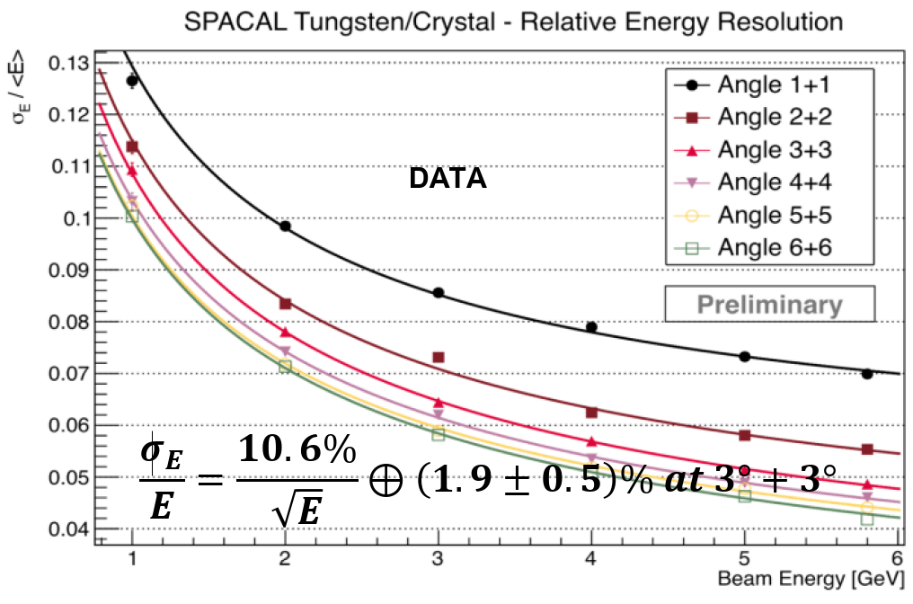
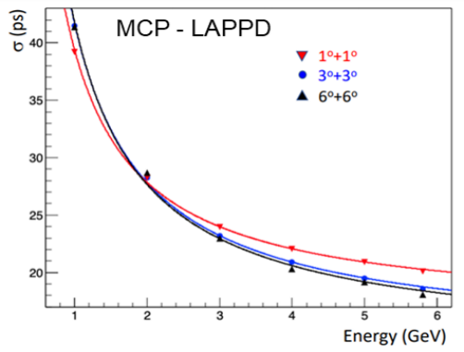
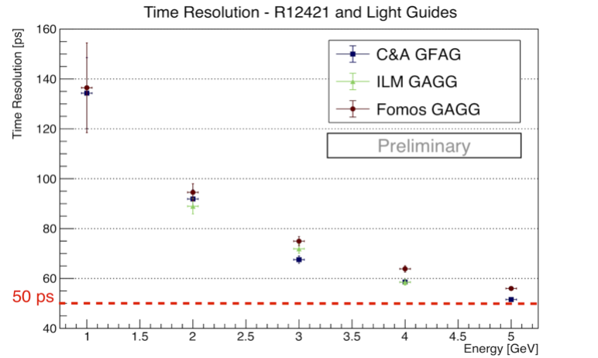
Beam requirements
Up to now, we tested the prototypes in DESY, at 1-5 GeV electrons. At LHCb, ECAL will work at higher energies!
We absolutely need to study the performance till as high energies as possible in NA (at least 100-150 GeV).
Beam requirements:
e±:
  Wide range of energies: (10?)-20-150 GeV
  Good purity (>50%)
  Rate: > 1 kHz during the spill (for most of the energies)
μ
  high energy, 50-150 GeV

Slide 3
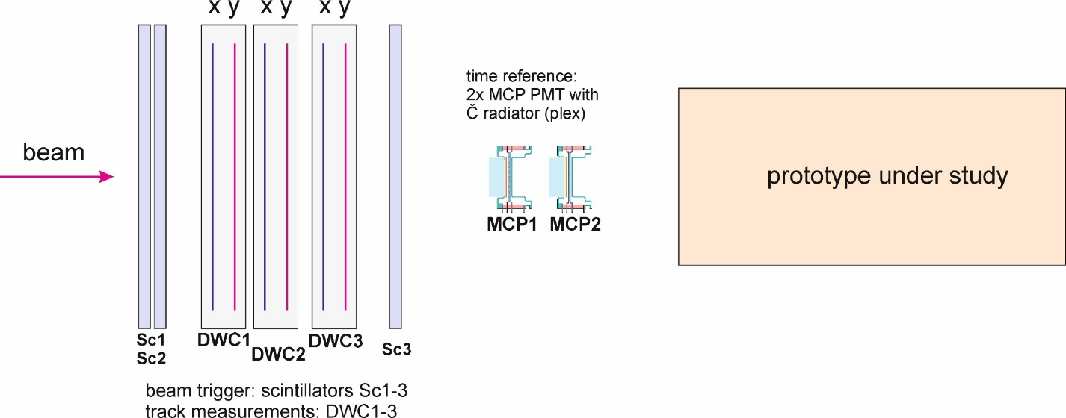
Infrastructure requirements – option 1 (PPE164)
The idea is to use as much as possible the CMS infrastructure which is present in the area
The setup is:
Scintillators for the beam trigger (CMS)
SciFi hodoscope (CMS)
Two MCP-PMT-based Cerenkov counters
(plex radiator) for the time reference (provided by us)
Required infrastructure:
Rack for electronics (present at PPE164)
XY moving table (present at PPE164)
beam
prototype under study

Slide 4
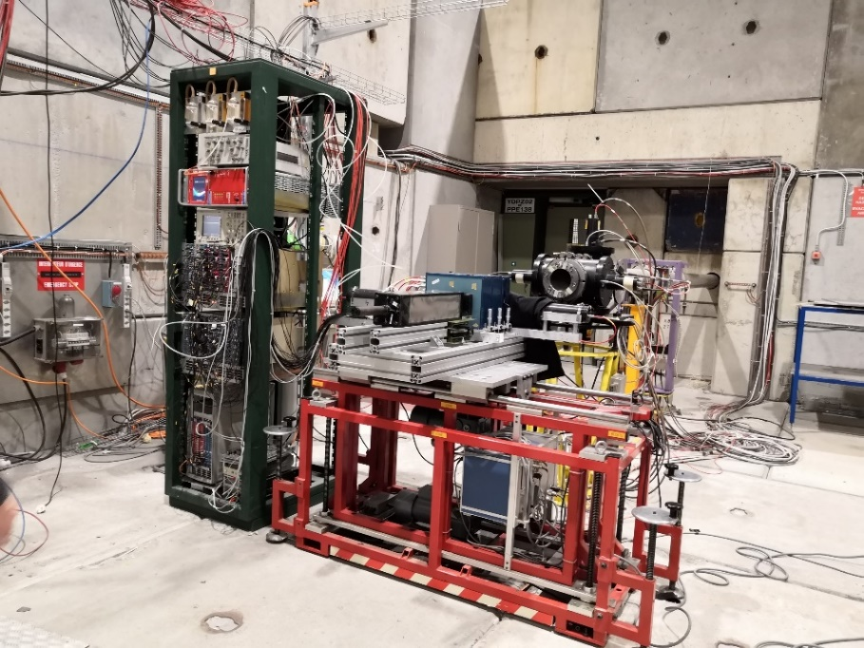
Infrastructure requirements – option 2 (outside of PPE164)
Mostly a standalone / portable setup
The setup is:
Scintillators for the beam trigger
Two MCP-PMT-based Cerenkov counters
(plex radiator) for the time reference
Three XY DWC for coordinate measurements
Required infrastructure:
Rack for electronics
XY moving table (provided by us)
Gas (Ar/CO₂) for DWC (provided by us)
Need a place to install the bottle
beam
prototype under study
@H8, 2018

Slide 5
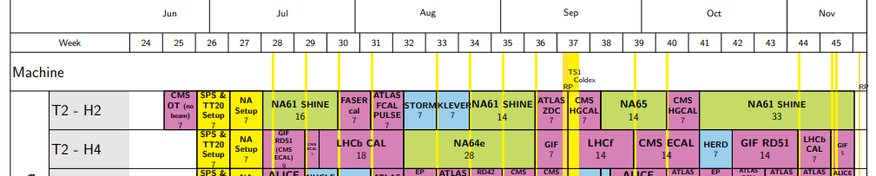
note on planning
More prototypes are expected after / will arrive late for our July-August tests.
We would need some more time in October (3 days?).
Can be any beam line, not necessarily H4
Can be night shifts only.

