Slide 1
NA65/DsTau
Akitaka Ariga

Slide 2










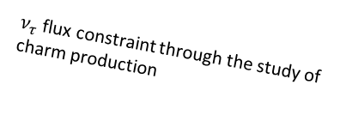



The NA65/DsTau experiment at the CERN SPS
Study of ν_{τ} production for future tau neutrino experiments.
  Measurement of $D_{s}$ double differential production cross section
  Reduce uncertainty of $ν_{τ}$ flux from >50% to 10% → Fundamental input for future ν_{τ} experiment: SHiP, and indirectly FASER
Forward charm physics, charm/gluon PDF
Principle of the experiment
  Detection of “double-kink + charm decay” topology within 10 mm.
  $4.6×{10}^{9}$ protons, $2.3×{10}^{8}$ proton interactions in target, ${10}^{5}$ charm pairs, $1000 D_{s}→τ→X$ detected events.
$ν$ oscillation experiments
DONuT
Re-evaluation of $ν_{τ}$ cross-section (2020)
-2008
Small kink at D_{s} → τ
400 GeV
proton
ν_{τ}
Ds
Tau
$ν_{τ}$ flux estimation
D_{s}
X
Precise $ν_{τ}$ cross-section.
New physics searches in neutrino scattering
τ
2027?-
D⁺
ν_{τ}
$ν_{τ}$ flux constraint through the study of charm production
X'
Astrophysical $ν_{τ}$ observations
~5 mm
2022-

Slide 3
Beam requirement
Beam: 400 GeV proton
Beam size/shape: 2 cm x 2 cm. larger is better
  Gaussian-like shape is better than square-like profile.
  A sigma of distribution ~10 mm (not RMS)
Beam intensity: a few x 10⁵/spill
Spill structure: flatter is better

Slide 4
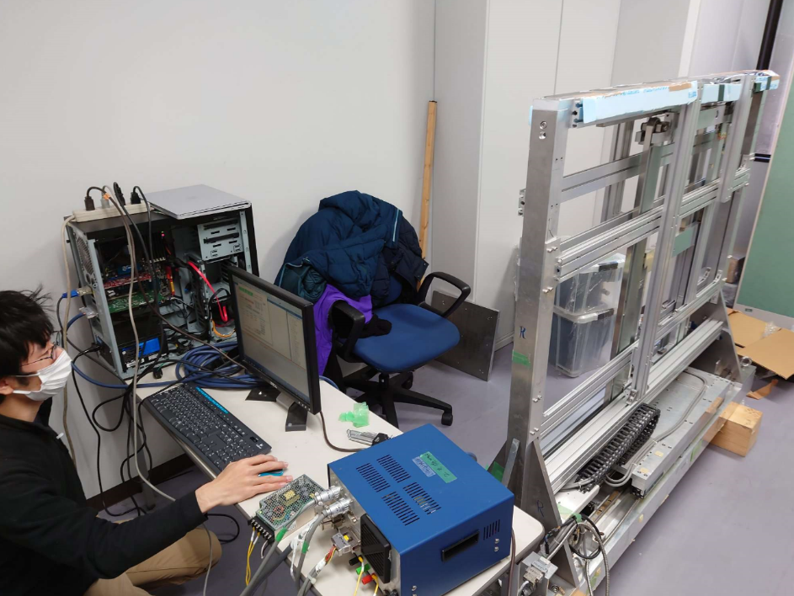
Requirements for infrastructure
Storage of our target mover (1m x 2 m + some carton boxes)
Vacuum pipe to transport proton beam
Beam profile monitor
Movable table (DESY table might be not big enough?)
DsTau target mover
~200 kg
DWC
Vacuum pipe
Detector
Counter
Movable table

