Slide 1
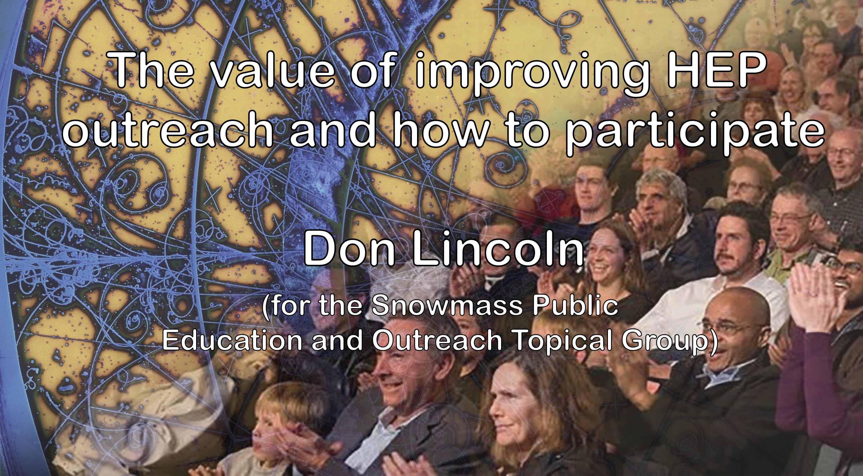

Slide 2
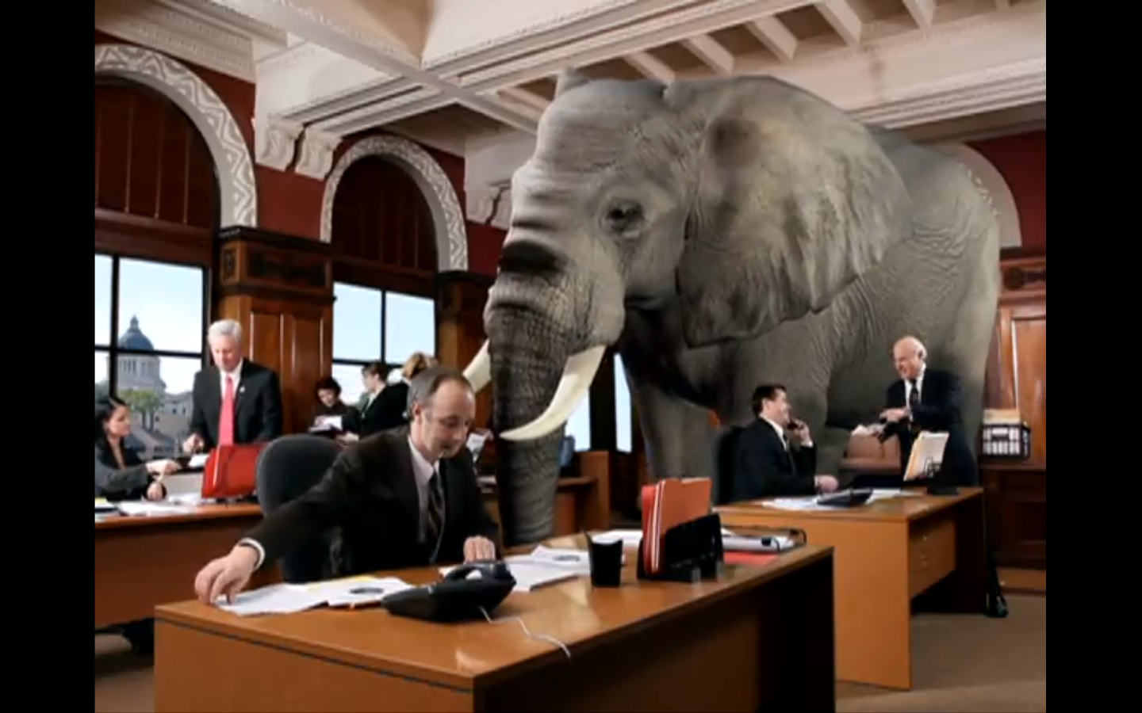

Slide 3
Outline
The importance of outreach
The kinds of outreach you can personally do
List of upcoming trainings that you can take.
Caveats: I can only cover so much in a short talk. My apologies
if I overlooked your own efforts, or your favorites. It’s a very
broad subject.

Slide 4
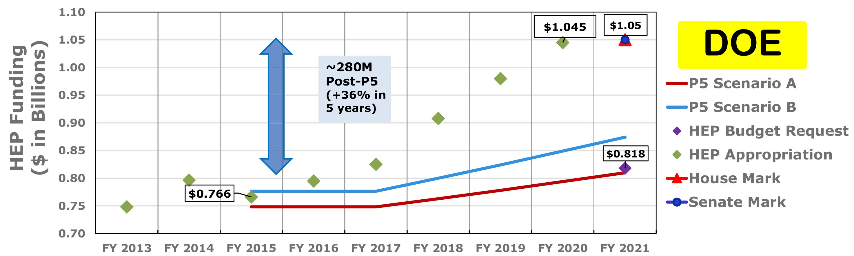
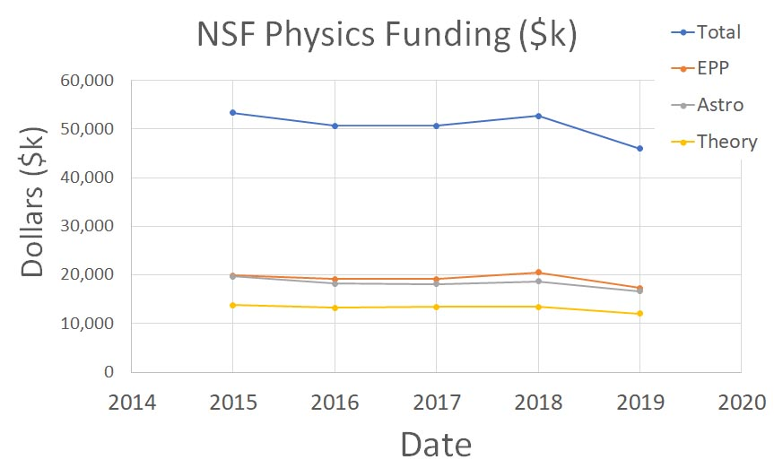
So why do outreach? (#1)
Basically, because everyone watching this topic is funded with federal money.
It is imperative that we continue to advocate for ongoing funding, or our work stops.
We get $1.05 billion from DOE and about $50 million from NSF.
There is at least one audience we need to take seriously (policy makers).

Slide 5

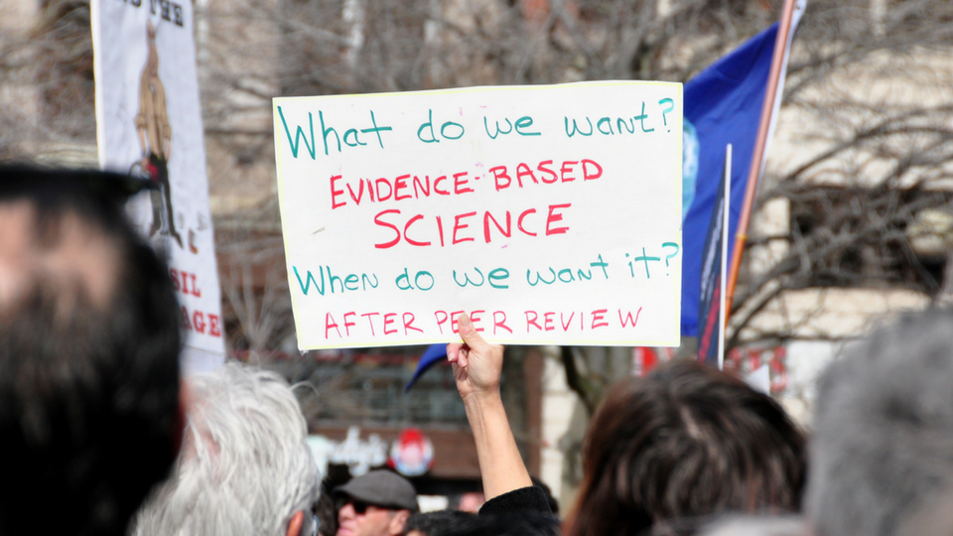


So why do outreach? (#2)
Science enthusiasts. These are our allies. They will help contact Congress and advocate for science.
First, we must feed their interests
Second, we need to motivate them to contact Congress.

Slide 6
So why do outreach? (#3)
Crackpots. If we don’t engage with them, or at least add a different voice to the conversation, all we’ll have are crackpots talking. And that does none of us any good.
The images here are HEP-specific, but there is also covid, vaccines, 5G, climate change, cell phone worries, acid rain, UFO mania, etc.
We have to speak up!!

Slide 7

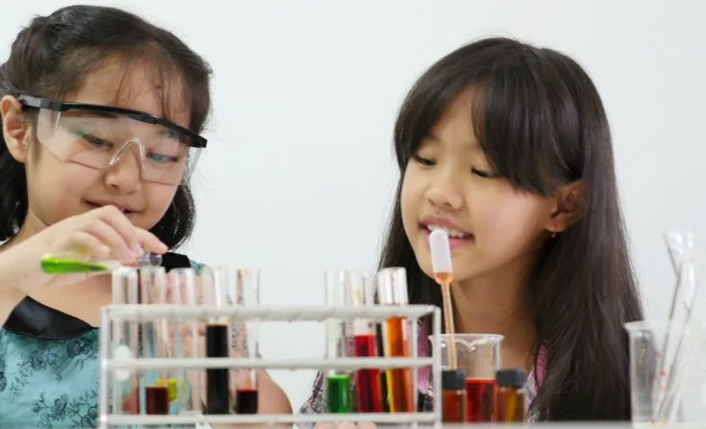
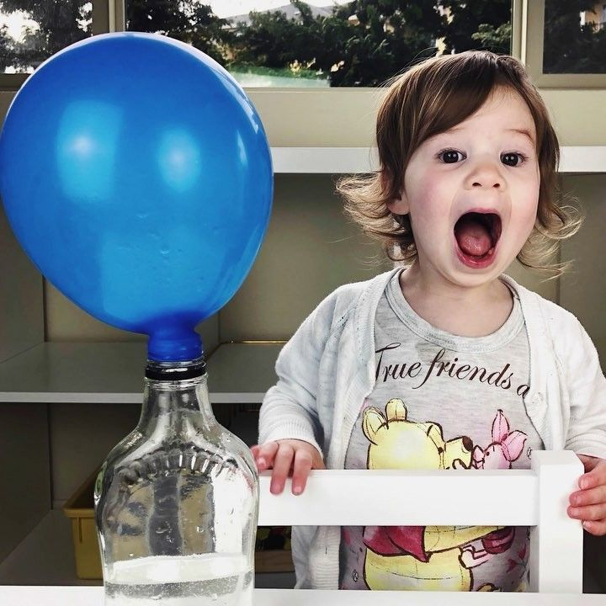

So why do outreach? (#2)
Kids! They are our future. They need to be scientifically savvy, or at least scientifically friendly
Underrepresented groups. The broader we recruit, the smarter the field becomes. White guys don’t have a monopoly on brains.

Slide 8
Types of outreach

Slide 9
So, you want to do outreach. What kind?
Policy Makers
Media
Middle School
Education
Outreach
General Public
High School
Community
Relations
Undergraduate
National vs. Local
K-5
Formal vs. Informal

Slide 10
Congress
Department of Energy
Industry leaders
National university leaders
Policy Makers
National Science Foundation
Executive Branch (OMB, OSTP)
URA Board of Trustees
Local elected officials
International university leaders
CERN Research Council
City of Chicago officials
Your state officials
Federal, State and local regulatory agencies
International funding agencies
Your university leadership
State of South Dakota officials
Notes:
- Will not delve into international decision makers – a whole other, extremely complicated topic

Slide 11
So you want to start doing outreach…
What is your goal?
  Engage students? Make impact in Washington DC? Engage national public?
What methodology will you use?
  Lectures? Blogs? DC visits? Write for magazines? Visit community groups?
How will you connect with your audience?
  If you make a brochure, how will you deliver it? If you make a website, how will you advertise?
How will you know that you have been successful?
  What impact did you actually have? (As opposed to what you imagined?)
Talk to someone who is already doing it. Experience helps.

Slide 12
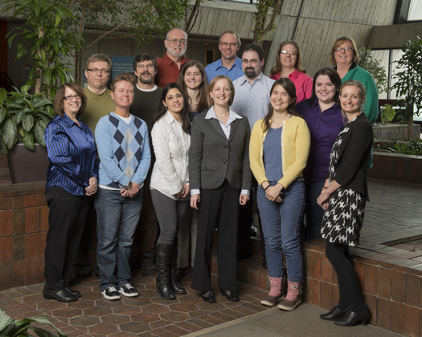
Your Institution’s Office of Communication
Mission
Build support for your institution among decision makers and opinion leaders, and members of the public, particularly the local community
Provide accurate, up-to-date information on institution’s activities and scientific achievements to stakeholders
Fermilab’s OoC (very dated)

Slide 13
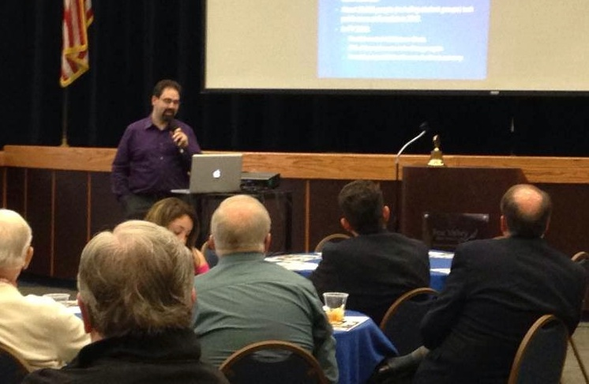
Local Community Presentations / Public Lectures
Local groups often request presentations on science/physics topics.
Typical audiences include Rotary, Kiwanis, retirement groups, men’s or women’s groups, etc.
Smaller presentations for other interested parties, (e.g. senior centers, astronomy clubs, libraries, etc.) are a great way to make an entrée into the public speaking world.
And then there are the bigger public lectures organized by your institutions, which comes with a bigger advertising effort.
Notes:
Mr. Freeze, etc.

Slide 14
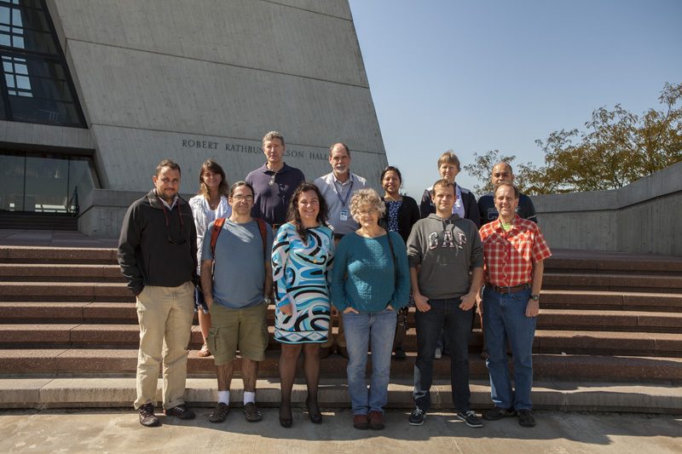
Annual Trip to DC
This is high-impact, high-stress stuff.
If you elect to participate, you need to get training.
You will be expected to find connections between you and as many representatives/senators as possible.
This is all about building AND MAINTAINING relationships.
Buy a good suit.
Contact information here:
https://uec.fnal.gov/government-relations-subcommittee/

Slide 15
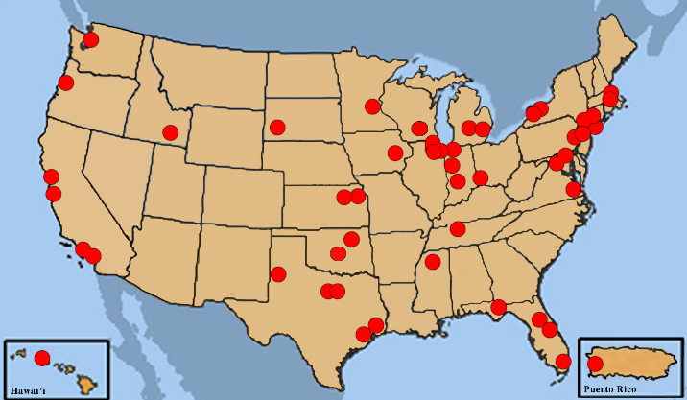
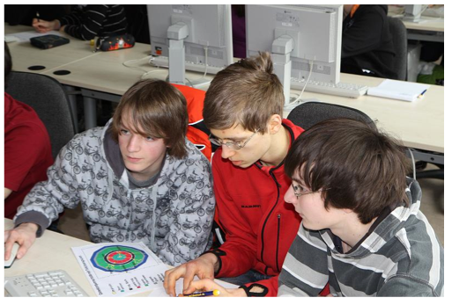
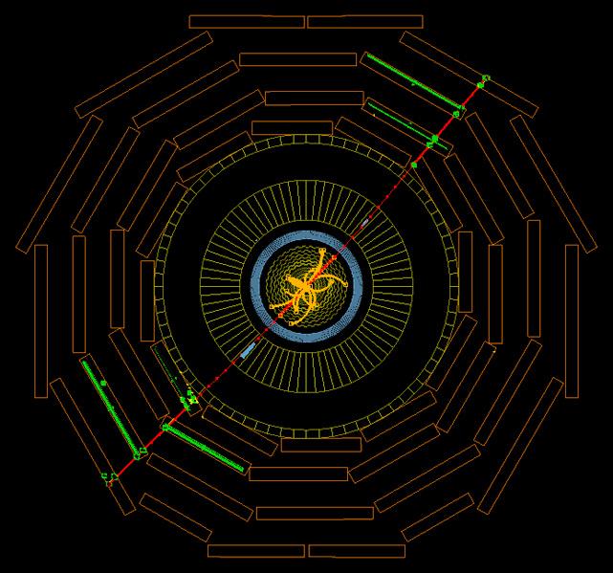
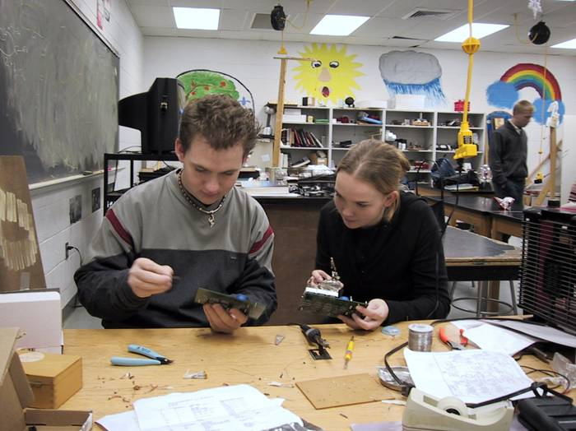
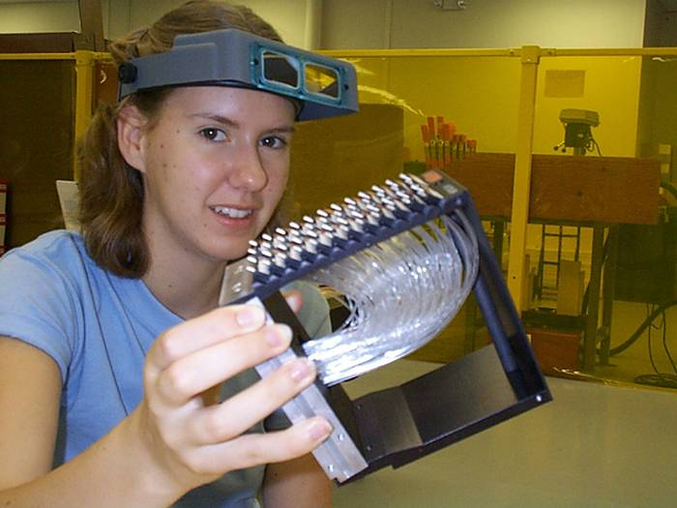
The QuarkNet Collaboration
High School Masterclasses
Hands-on Measurements
with Real Data
Engaging teachers and their students in scientific
research
If you’re interested in either endeavor, contact
Ken Cecire (kcecire@nd.edu)
quarknet.i2u2.org
Notes:
began with a way to share cosmic ray data for shower studies
Led to online instructional model for student investigations with data from professional data (real data)
LIGO data - seismic background - this is the Tohoku earthquake March 2011

Slide 16
Going Solo

Slide 17
Television
Magazines
Radio
Methodologies
Blogs
Books
Podcasts
YouTube
Videos
Public Lectures
Online Courses
Social Media
Public
Festivals
Café Scientifique

Slide 18

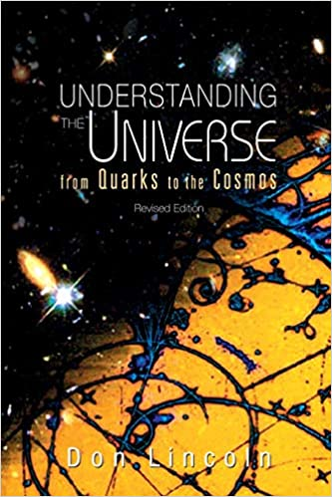
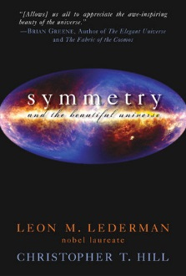
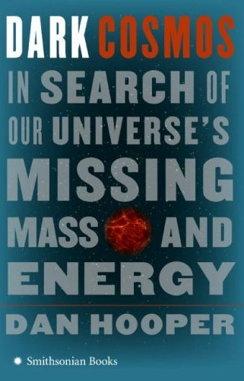




Books
Hard to write
Harder to sell

Slide 19
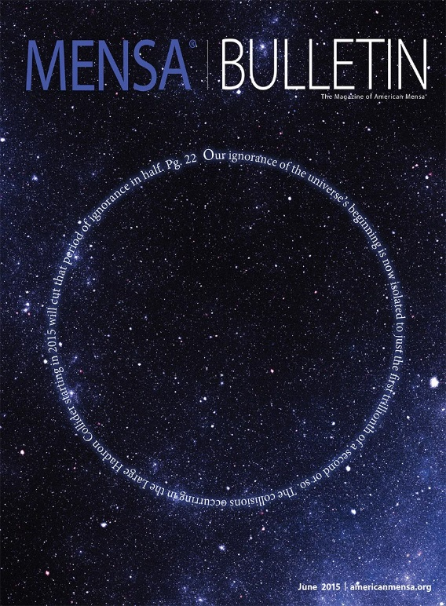


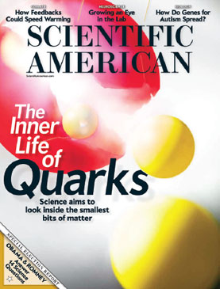

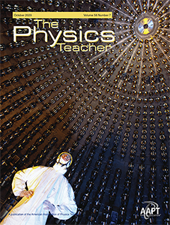
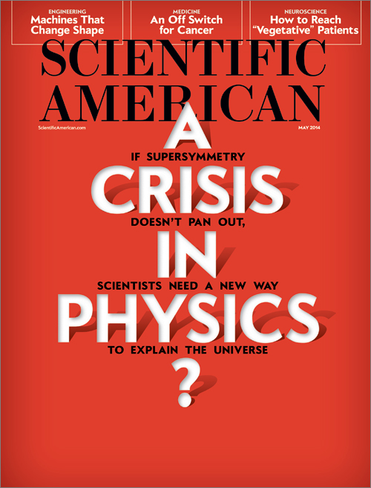
Magazines
Hard to write
Harder to sell

Slide 20
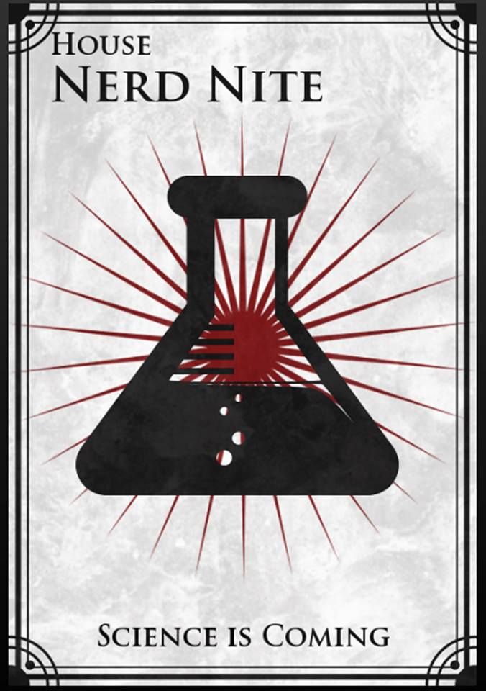
Café Scientifique
Nerd Nite
Downtown Chicago
Evidence based entertainment…

Slide 21
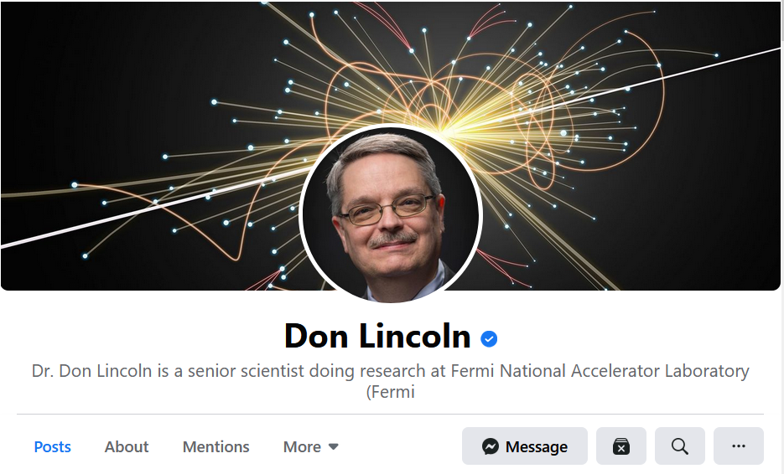
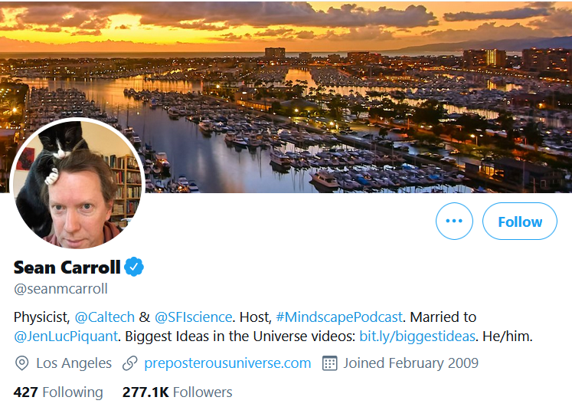
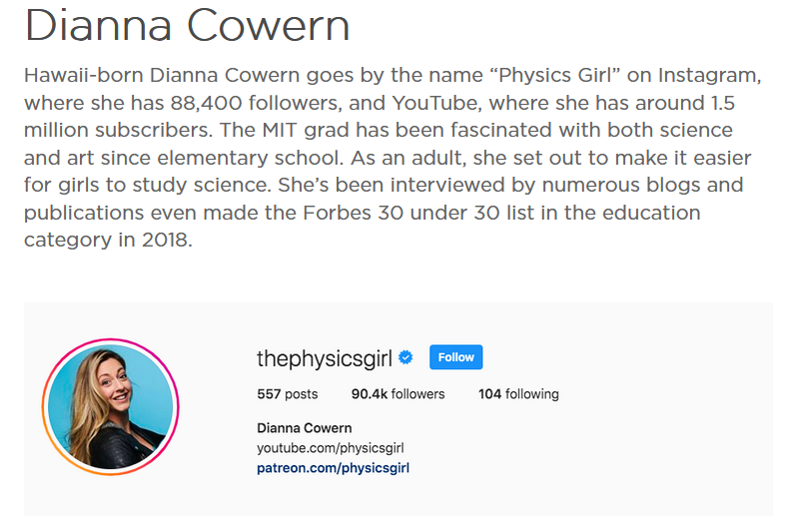
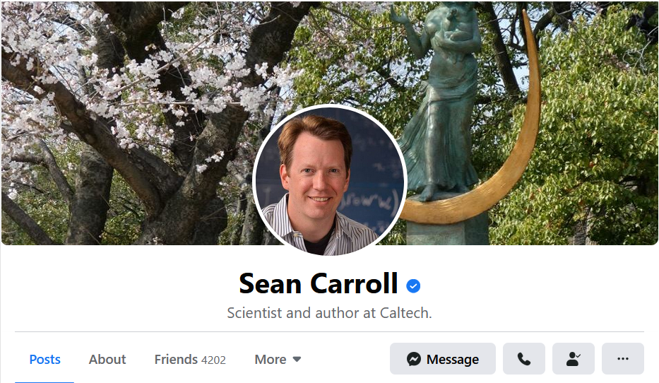
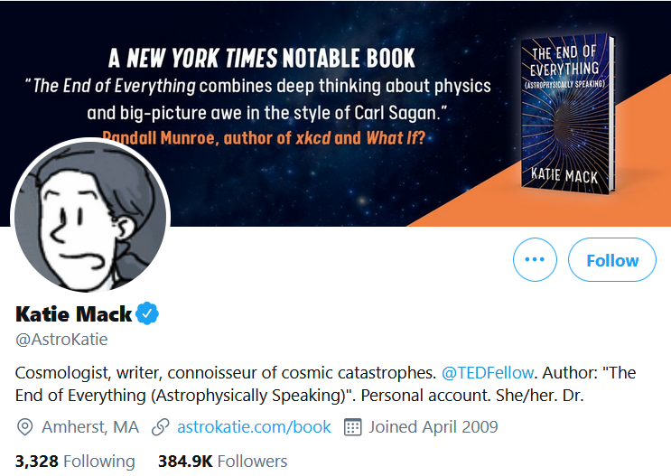
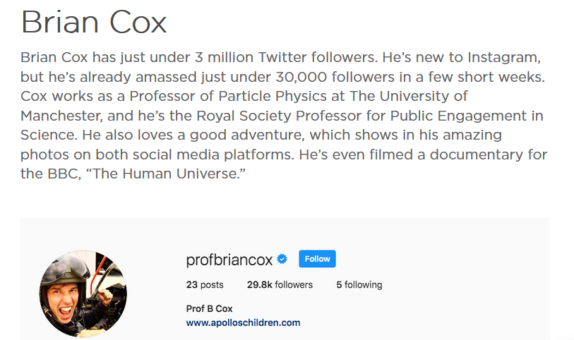
Social Media
Very hard to build audience
Requires sustained effort
Facebook
Twitter
Instagram
Snapchat
TikTok
Etc.
20k subscribers
200k subscribers
90k subscribers
4k subscribers
30k subscribers
380k subscribers

Slide 22
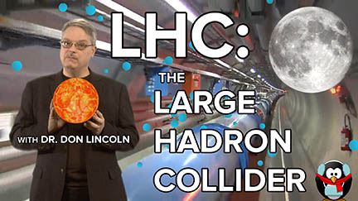
Videos
Lots of competition
Requires some technical support
Hard to build online audience
Must be quality
FNAL YouTube channel ~550k subscribers
Typical viewership > 100k/video
Some > 1M/video (a few > 4M!!!)
Some channels >>MUCH<< better.

Slide 23
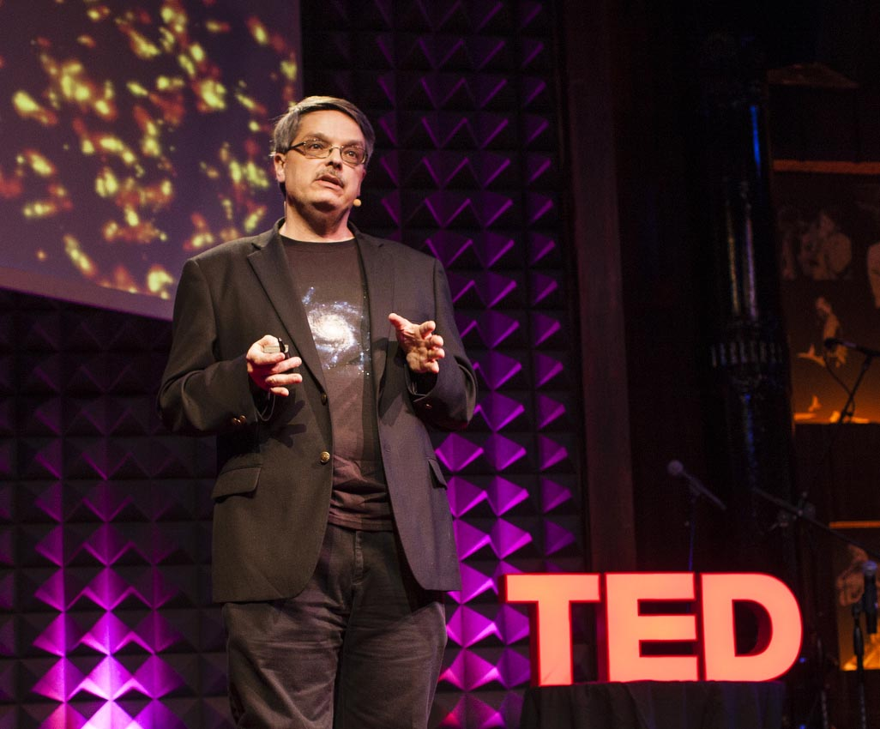
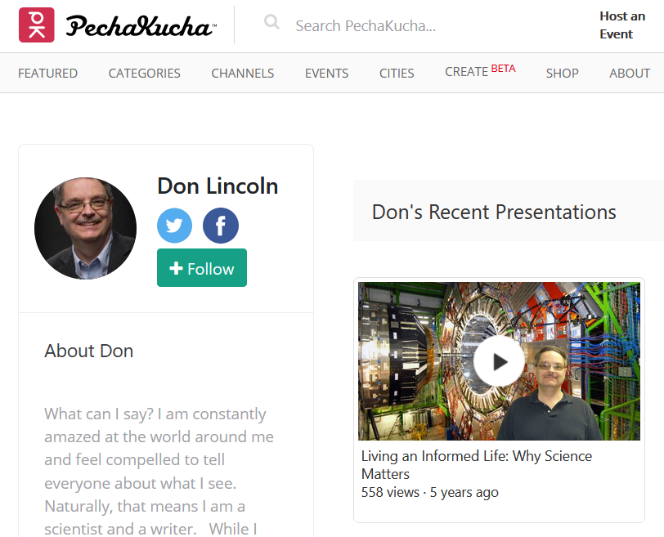
TED/TEDx/Pechukacha/Story Collider
Not so hard to participate if you can find an event being scheduled.
TEDx is >>way<< easier than TED.
Often more about emotion than pure science. The more emotional talks get more views.

Slide 24
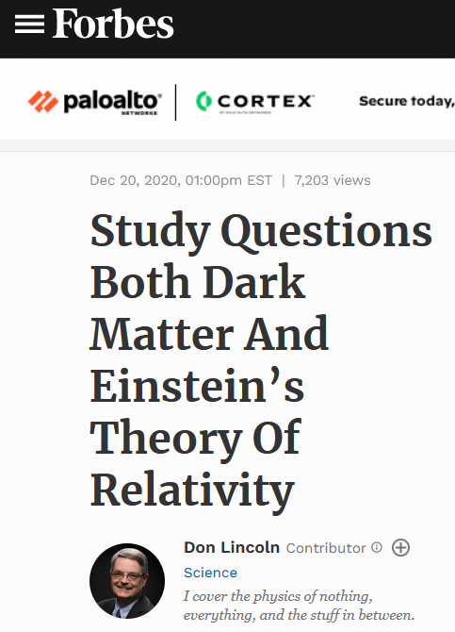
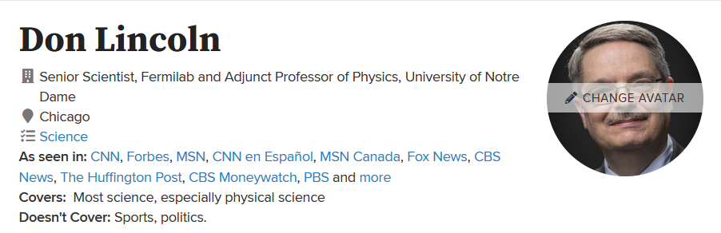
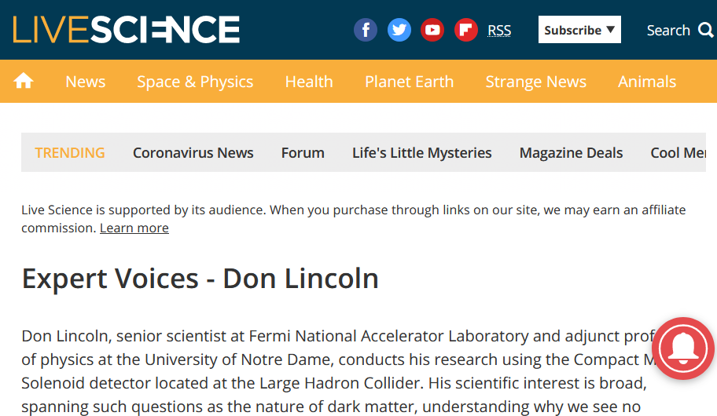
Write for newspaper/online media/OpEds
Hard to get foot in door.
Works on “journalist time,” not “academic time.”

Slide 25
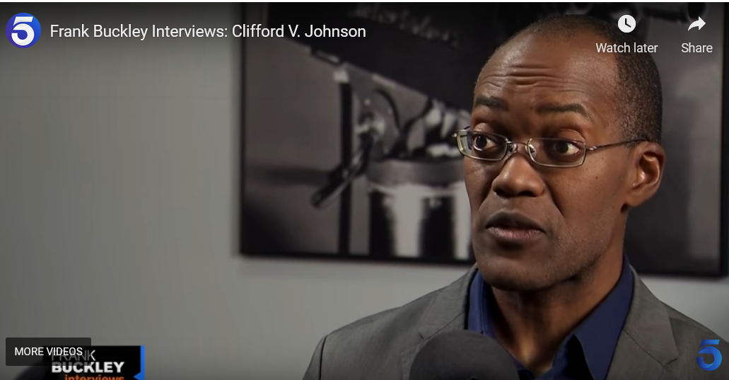
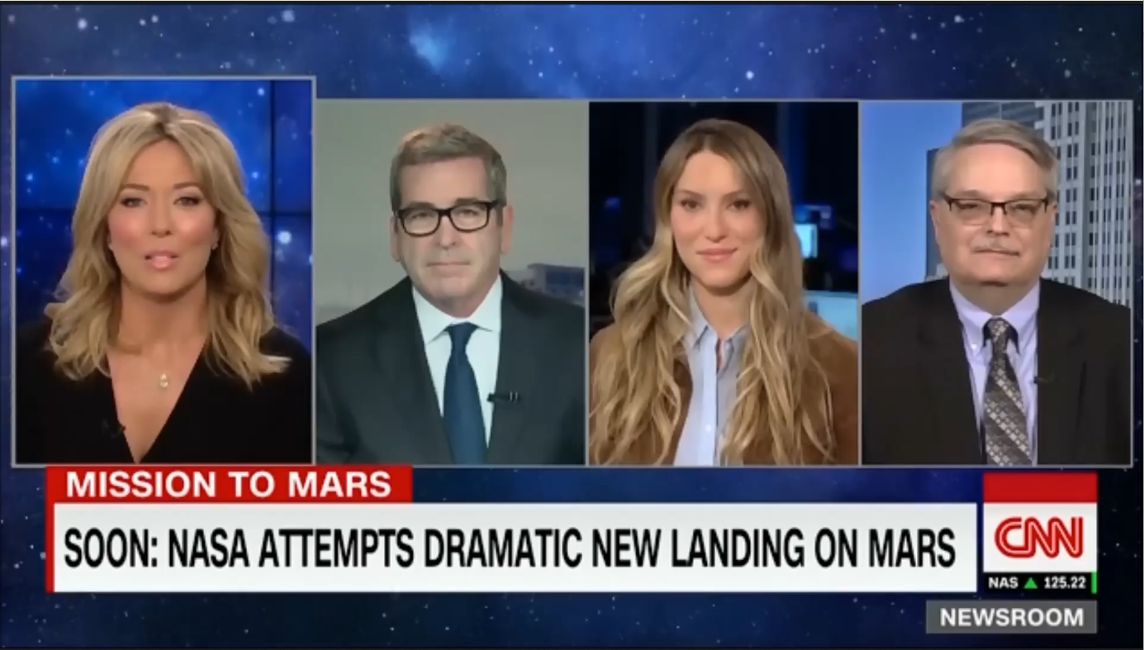
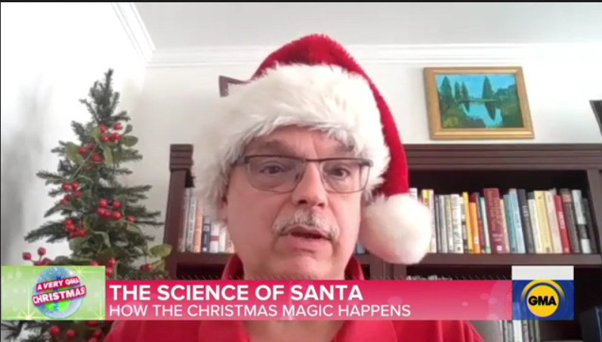
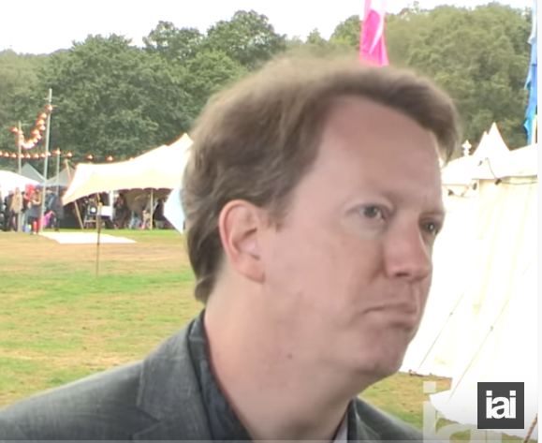
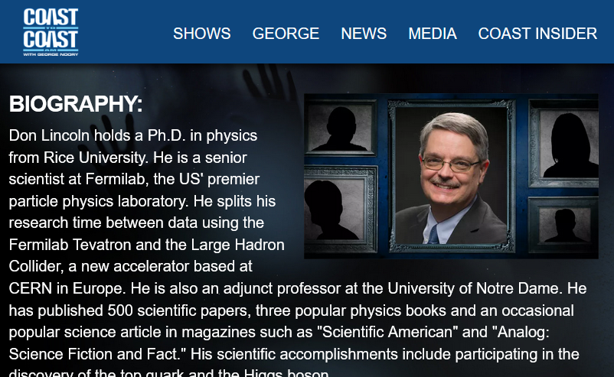
Television/Radio
Super hard to get into.
Happens after success in another technique.
          Looks and charm matter for TV

Slide 26
Blogging
Dark Energy Detectives
46k followers on Tumblr
Quantum Diaries, now defunct
High effort, can be low impact, must feed the beast

Slide 27
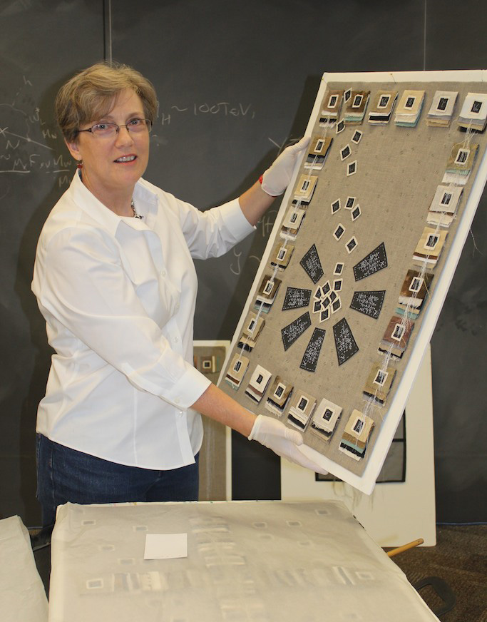
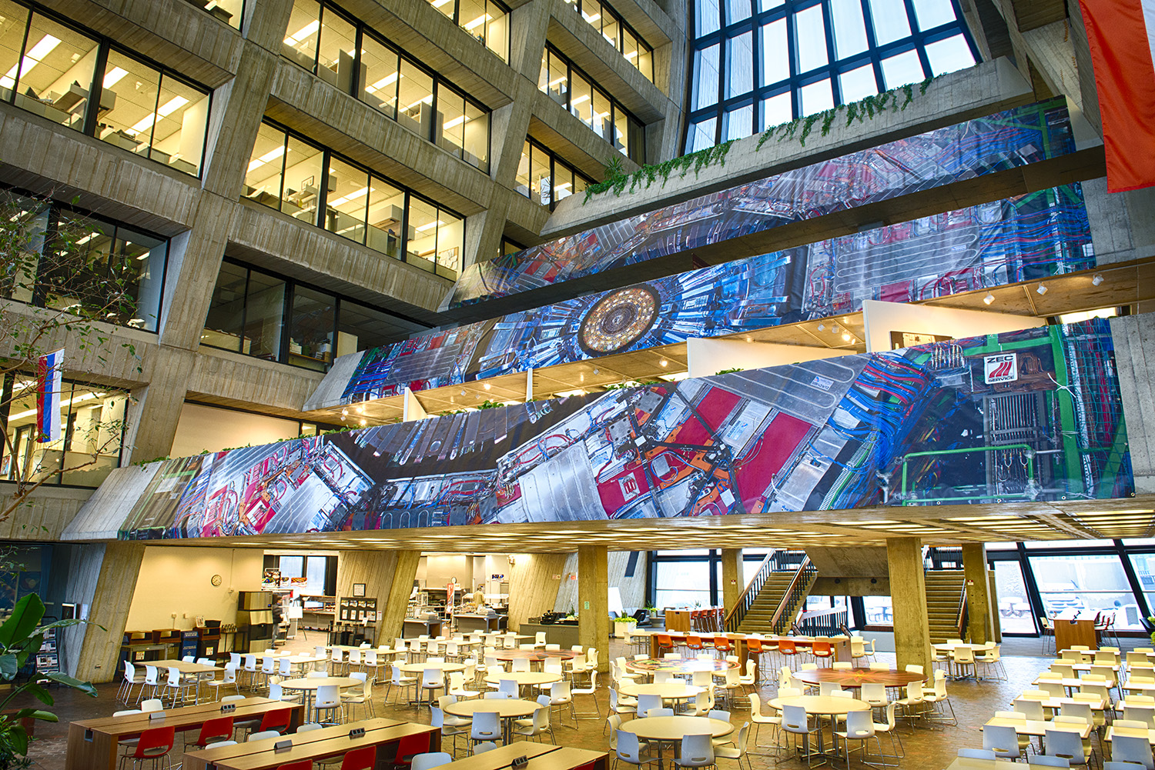
Art
Art@CMS
Traveling show of CMS art
Could come to your institution
Lindsay Olson
Fermilab’s First Artist in Residence
  (For this generation [Angela Gonzalez])
Neutrinos and LHC

Slide 28
Training

Slide 29
Outreach Training Opportunities
The APS is holding many trainings in this area (all times, ET):
  Already held, available on video
    Different Forms of Public Engagement
    How to Write an OpEd
    Digital Video Editing for Beginner Science Communicators
  Upcoming
    Creating a Podcast to Engage the Public (July 14, 12:00 - 1:00 p.m. )
    Designing Creative Graphics for Public Engagement (July 20, 1:00 - 3:00 p.m.)
    Using Social Media for Public Engagement (July 22, 2:00 - 4:00 p.m. )
  Contact information
    Website: https://www.aps.org/webinars/engaging.cfm
    Mailing list: https://info.aps.org/careers/webinars

Slide 30
Snowmass-motivated Training Opportunities
These are not yet available. The Snowmass E&O group is putting together trainings for the fall.
These are the topics we are considering:
  Story-telling combined with a history of science talk
  Social media
  How to talk to children about physics
  How to give public tours
  How to organize your own event
  Science on tap / Nerd nite
Please help us decide which to do first by completing this online survey.
  https://www.surveymonkey.com/r/NH5SPV6

Slide 31
Conclusions
Thanks for listening.
Remember that the more people like us, the better funding we get, and the better society is.
To like us, they need to know us. That means communicating our fantastic physics results
Please think about doing some outreach of your own.

