Slide 1
Glen Crawford
Director, Research and Technology R&D
DOE High Energy Physics

Slide 2
FY 2021 HEP University Comparative Review
DE-FOA-00002424: FY 2021 Research Opportunities in
High Energy Physics
  FOA published on November 17, 2020
  Proposals due on January 26, 2021
  Reviews completed by April 1, 2021
  Decisions by DOE/HEP to recommend proposals for funding by June 1, 2021
  Grant award paperwork still in-process through the DOE system
148 proposals; 145 reviewed; 93 funded
Many thanks to reviewers and panelists for the time and hard work in evaluating this year’s HEP research proposal

Slide 3
FY 2022 HEP Comparative Review
FY 2022 Comparative Review FOA:
  Currently under review at DOE and expected to be issued this summer
  Proposals currently expected to be due in September/October
  Reviews should be completed by end of calendar year 2021/early 2022
  Planned (not-yet-approved) format changes for Bio-sketches, C&P, COIs, Mentoring and Recruitment – including an explicit merit review criteria question on the subject, Budget material, …
More information at the August 2021 Virtual HEP PI Meeting
See the FOA for complete details once published

Slide 4
2021 Virtual HEP PI Meeting
To brief and guide the HEP community on the FY 2022 Comparative Review and provide a status and overview of the DOE-supported HEP program, a virtual DOE-HEP Principal Investigators (PI) Meeting will be held on August 9-12, 2021.
  All interested investigators invited, including existing and future investigators, laboratory staff, and interested postdoctoral researchers considering new faculty or staff positions
  Registration Deadline: August 6, 2021; Registration Fee: None
    https://www.orau.gov/heppi2021/ (encouraged to register for logistical planning)
  Draft Agenda posted:
  General presentations during a plenary Zoom session
  Parallel Zoom sessions led by individual DOE-HEP Program Managers
  Additional sessions targeted at special topics
    for e.g., Early Career research and related concerns; diversity, equity and inclusion in HEP; impacts of COVID-19 on university and laboratory research
  Opportunities to schedule separate 1:1 or small group remote sessions between PIs and DOE PMs across the different HEP program areas during the course of the event

Slide 5

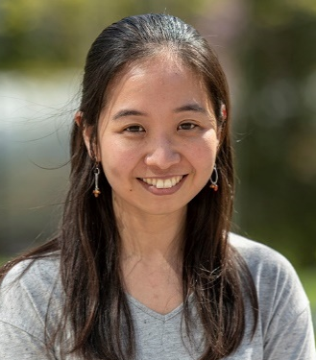
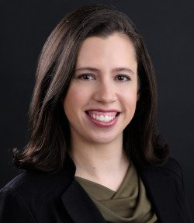
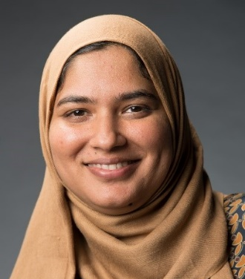
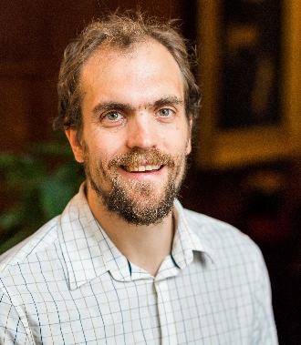

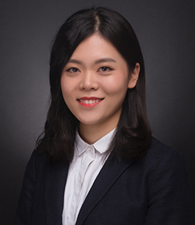
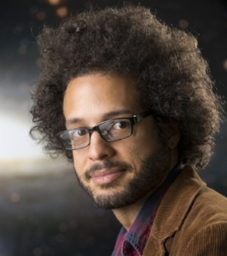
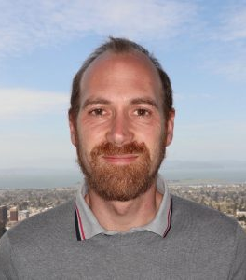
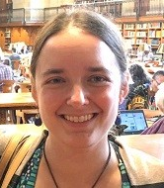
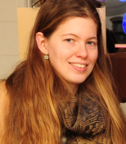
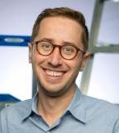
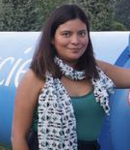


FY 2021 HEP Early Career Awards – Congrats!
Lindsey Bleem, ANL
Chihway Chang, U. Chicago
Netta Engelhardt, MIT
Farah Fahim, FNAL
Philip Harris, MIT
Tongyan Lin, UC San Diego
Xueying Lu, Northern Illinois U.
Brian Nord, FNAL
Simone Pagan Griso, LBNL
Diana Parno, Carnegie Mellon U.
Kiersten Ruisard, ORNL
Daniel Scolnic, Duke U.
Indara Suarez, Boston U.
Caterina Vernieri, SLAC
Hao-Yi Wu, Boise State U.

Slide 6
HEP Budget Request – FY 2022 Highlights
Research funding increases by $21.4M or 5.4% over FY 2021 Enacted, with increases targeted to program and Administration priorities (+$32M).
  Core Research activities increase (+$0.2M) -> flat, no growth
  Accelerator Stewardship subprogram moves to the ARDAP (-$10.8M)
Artificial Intelligence/Machine Learning ($35.8M) – On-chip AI/ML to enable edge computing for winnowing particle events to the most important data. Real-time control of both accelerator and quantum systems to meet the increasing demands of future particle physics experiments.
Integrated Computational and Data Infrastructure for Scientific Discovery ($4.1M) – Data storage innovation to manage tens of exabytes of data/year from future experiments. Investments in software development to improve interface with SC exascale systems and ASCR-supported middleware

Slide 7
HEP Budget Request – FY 2022 Highlights (cont’d)
Quantum Information Science ($26.6M)
  Quantum optimization and quantum machine learning applications for HEP numerical problems: Event generators, event reconstruction, data analysis, quantum data from emerging quantum sensors.
  R&D efforts in quantum devices, system performance and integration, and architecture development: Goal to achieve high-rates, operational robustness, and high-fidelity quantum teleportation utilizing photonic qubits at telecommunication wavelengths, over the same type of optical fibers used by the telecommunication industry
QIS Research Center ($25.0M): HEP will continue support for multi-disciplinary Fermilab-led Superconducting Quantum Materials and Systems (SQMS) Center, which brings together 20 partners from national labs, academia, and industry to develop, construct, and deploy a quantum computer prototype in the largest millikelvin refrigerator ever built

Slide 8
HEP Budget Request – FY 2022 Highlights (cont’d)
Accelerator Science and Technology Initiative ($17.4M): Increase support for
mid- to long-term R&D in high-field magnet and SRF accelerator technology
Microelectronics ($7.0M)
  Ultra-sensitive analog front-end readout, integrated with high speed digital logic
  to create low noise, low-power, high-performance readout electronics
  5G high-bandwidth, low latency millimeter-wave wireless technology. Possible applications include antenna designs for Accelerator tunnels, and directed or autonomous 5G-enabled robots operating in tunnels and high radiation areas
Reaching a New Energy Sciences Workforce (RENEW) ($4.0M): Leverages SC’s unique national laboratories, user facilities, and other research infrastructures to provide undergraduate and graduate training opportunities for students and academic institutions not currently well represented in the U.S. S&T ecosystem.

Slide 9


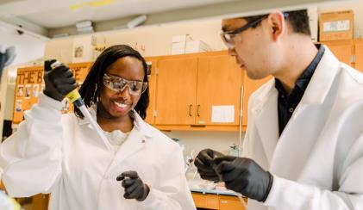
Reaching a New Energy Sciences Workforce (RENEW)
Competitively support new traineeship awards resulting in:
“Hands on” experiences, mentoring, enhanced workforce diversity, equity, and inclusion
Outreach
Listening tours and round tables to:
Gain understanding about challenges
Develop evidence-based solutions
Identify unique Office of Science Lab opportunities
Partner with Minority Serving Institutions and professional societies
Implement action plan
Track post-traineeship outcomes
Assess program effectiveness

Slide 10
Research Traineeships to Broaden and Diversify Nuclear Physics
https://science.osti.gov/-/media/grants/pdf/foas/2021/DE-FOA-0002456.pdf
The DOE SC Nuclear Physics (NP) program … for Research Traineeships to Broaden and Diversify Nuclear Physics (TBD-NP) ... This pilot program is intended to support training and research experiences for members of underserved communities with the goal of increasing the likelihood that participants from underrepresented populations, such as those present at minority serving institutions (MSIs) , will pursue a career in a Science, Technology, Engineering or Math (STEM) related field, particularly in Nuclear Physics.
…informed and influenced by the recommendations in recent reports including the American Institute of Physics TEAM-UP report
HEP is partnering with NP to fund 4 selected Traineeship awards in FY21-22:
https://www.energy.gov/science/articles/department-energy-announces-285-million-support-undergraduate-research

Slide 11
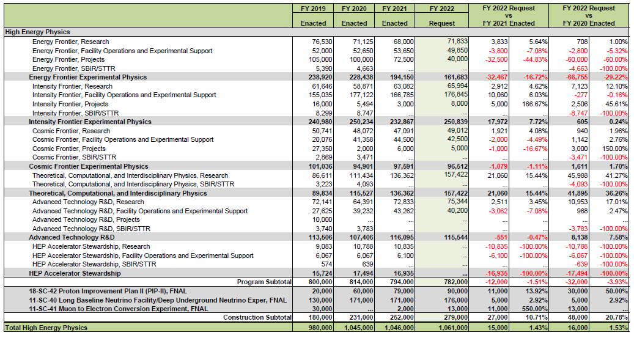
HEP - FY 2022 President’s Request
(Dollars in thousands)

Slide 12
Comments on Budget Process
The budget process for the last several years has been unusual.
  Budget Requests and final Appropriations for DOE Office of Science have not been closely aligned
  Requesting HEP Project funding at the level of the approved baseline(s) would have forced larger cuts into Research.
    Experience has shown Congress is more likely to respond to project shortfalls than research shortfalls.
  In particular, in FY2018-21 Congress added significant funding (above Request) to HEP projects.
    This has been critical to staying on the P5 plan and encouraging international partnerships
    Strong and consistent community support for P5 have also been critical
    But not all projects received similar increases

Slide 13
Fiscal Year 2022
The budget process for FY22 was different due to transition to the new Administration (which happened late in the budget process)
The FY 22 President’s Request Budget for DOE/HEP is down $1.5 million for projects (Line Item Construction + Major Items of Equipment) compared to the FY 21 Appropriation.
  The PIP II request is below the approved baseline.
  LBNF/DUNE is below the planned level.
  HL-LHC projects took larger cuts on a percentage basis.

Slide 14
Mitigations (what we are doing)
Reaffirm our commitment to the P5 plan and priorities therein:
  Talk to CERN management about our ongoing commitment to and priority for HL-LHC.
  Talk to international partners about plans for LBNF/DUNE and PIP-II
  Respond to questions from Congress on impacts.
  All of these have been started and are ongoing.
Wait for the markups from the Senate and the House

Slide 15
Mitigations (what the community can do)
Don’t panic.
Maintain strong and consistent community support for P5
Start-up (restart) Snowmass process in 2021 building on P5

