Slide 1
CLICdp collaboration
https://clicdp.web.cern.ch/
How is it organised?

Slide 2
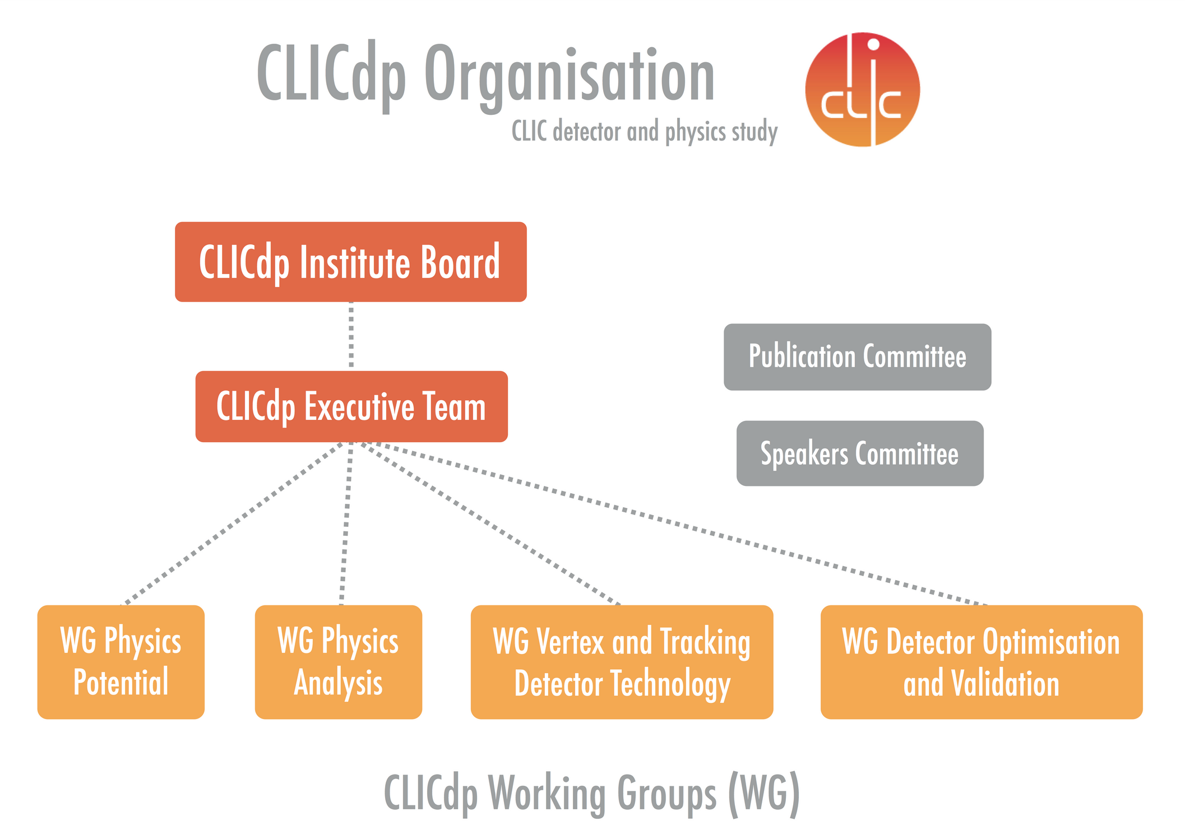

Slide 3

Memorandum on Cooperation (MoC)
Set up in Nov 2012 (after CDR)
Document prepared by the CERN legal service
Now 30 institutes
General description of the purpose
Light-weight engagement (on best effort basis)
CERN is the host laboratory
Cooperation on Linear Colliders mentioned (CERN management request)
Minimal description of the organisation (more details in separate Annexes, which can be updated by the IB as a function of the evolution of the project)
Ultimate decision body is the institute board (IB)
  1 representative per institute
IB chair and Spokesperson are elected by the IB

Slide 4
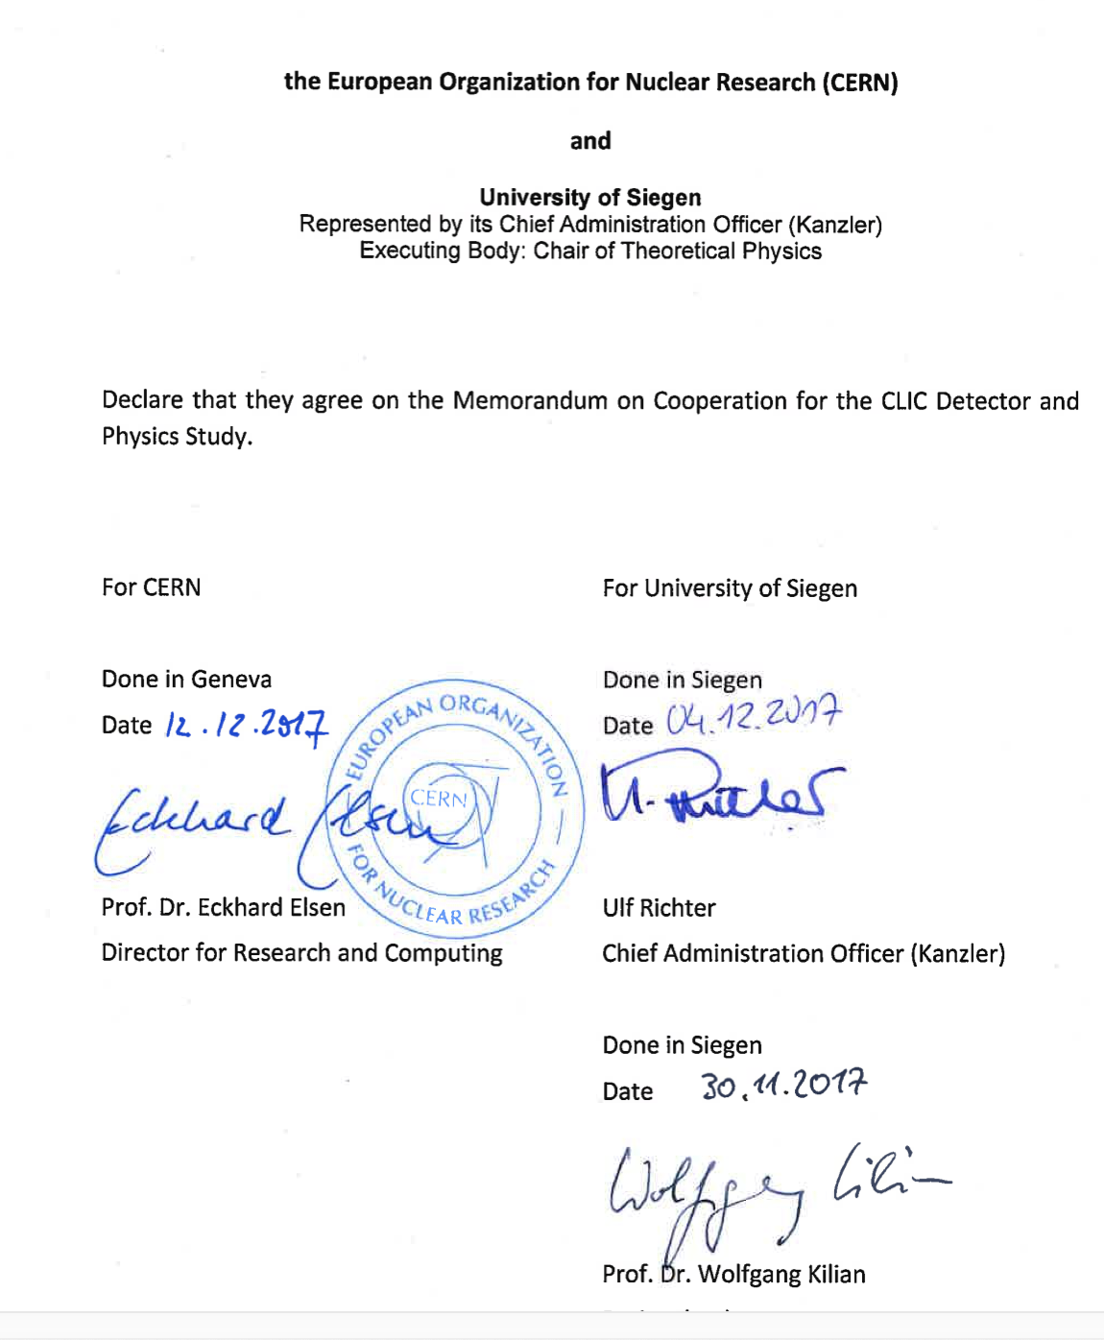
CLICdp “partners” (=institutes)
The admission of a new partner is subject to formal approval of the IB.
The new partner signs the MoC
(= declares to agree with the MoC).
Counter-signed by the CERN research director
Opportunity to define deliverable per institute in a separate Annex (not used so far).

Slide 5
Annex 3: organisational structure
This fixes, e.g. election procedures, terms of office, agendas and minutes…
IB chair:
is elected by IB members;
principle of rotation of roles
term of office is 2 years
can be re-elected once
Spokesperson:
is elected by IB members;
principle of rotation of roles
term of office is 2 years
can be re-elected once

Slide 6
Connection to the CLIC accelerator collaboration here
Chaired by theorists
Led to 2018 CERN yellow report on physics potential
CERN-2018-009-M
Physics simulation studies (principally in full simulation)
Software development included here (note that core SW overlaps with ILC)

Slide 7
Simulation studies, taking input from hardware into account.
This led to fixing the CLICdet geometry/implementation
CLICdet detector model (2017) and the documentation on the performance
CLICdet performance – occupancies - etc

Slide 8
Detector R&D working group
Vertex and tracking technology

Slide 9
Working groups in general:
2 conveners
1 from CERN, 1 from another institute
  (not out of principle, rather a natural choice related to available resources)
Why CLICdp has only one hardware WG?
CLIC detector design had its origin in ILC detectors
Most suitable options chosen:
  Silicon-based vertex and tracking systems
  ECal => Si-W ECal
  HCal => Scint-SiPM-FE
  Compact very-forward calorimeters
Therefore, collaborate with existing hardware collaborations
CALICE
FCAL
Therefore CLICdp only has a WG:
Silicon-based vertex and tracking systems

Slide 10
CLICdp publication committee (PubCom)
Described in Annex 4 of MoC
4 members, rotation of roles, typically 2 members are “junior” (postdoc)
Document review on CERN.cds
  CLICdp-Draft-YEAR-numb (internal to the collaboration for reviewing)
  CLICdp-Note-YEAR-numb (technical descriptions, often submitted to arXiv)
  CLICdp-Pub-YEAR-numb (publications)
  CLICdp-Conf-YEAR-numb (conference proceedings)
Templates provided for documents and for plots
PubCom is very successful !!
CLICdp heritage of ~30 reviewed documents per year
Engagement of young committee members also very successful
See also PubCom Hints and Tips

Slide 11
CLICdp speakers committee (SpeakCom)
Described in Annex 4 of MoC
3 members, rotation of roles, typically 2 members are “junior” (postdoc)
Submitting abstracts
Rehearsals
See very helpful: twiki
Templates provided for presentations and for plots
PubCom is very successful !!
~25 (rehearsed) presentations per year
Engagement of young committee members also very successful
CLIC communication initiative CCI
Together with CLIC accelerator collaboration
Outreach activities
Articles, graphics material
CLIC showroom (building 2008)

