Slide 1
Short pulse cavity proposal
Sergey Arsenyev
May 11, 2021

Slide 2
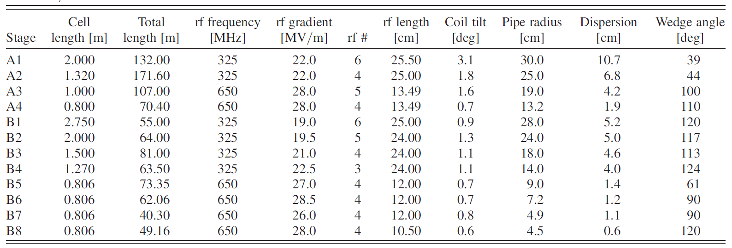

Selected cavity parameters
Rectilinear channel contains some of the most challenging cavity designs in terms of required RF gradient and B-field
Before bunch merge
After bunch merge
Rectilinear cooling channel RF cavities
B=13 T needed!
Assumed cavity properties:
  $f=650 MHz$, $V_{acc}=2.94 MV, φ=41 deg$
  ${\left(\frac{R}{Q}\right)}^{linac}=75 Ω$
  $Q_{0}=G\sqrt{\frac{2σ}{μ_{0}ω}}≈30000$for copper
  $Q_{L}=\frac{Q_{0}}{2}=15000$ for $β=1$ coupling in the absence of the beam
  $$t_{fill}=\frac{2Q_{L}}{ω}≈7 μs$$

Slide 3
Part 1: benefit of short pulse for beam loading compensation

Slide 4
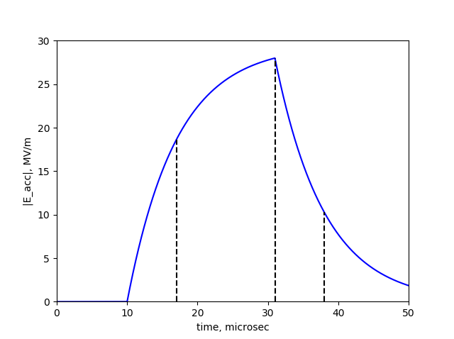
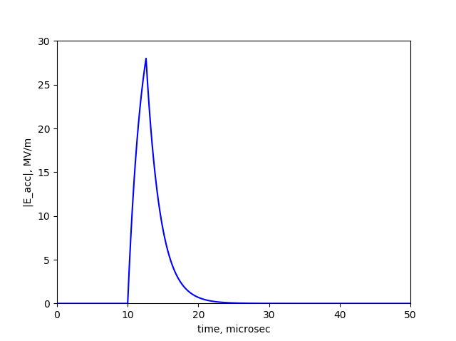



Beam loading compensation
For cavities after the beam merge: Beam loading could be compensated by off-crest acceleration.
For cavities before the bunch merge: beam loading could be compensated by a triangular pulse (early injection) with a very short pulse length:
Beam pass
(not to scale)
Beam pass
(not to scale)
Shorter pulse
$$t_{fill}$$
$$t_{fill}$$
$$t_{pulse}≈t_{train}\frac{U_{cavity}}{U_{taken by train}}$$
60 ns
$≈4$ for selected cavity (want to keep it low for efficiency)

Slide 5
Part 2: benefit of short pulse for breakdown mitigation

Slide 6
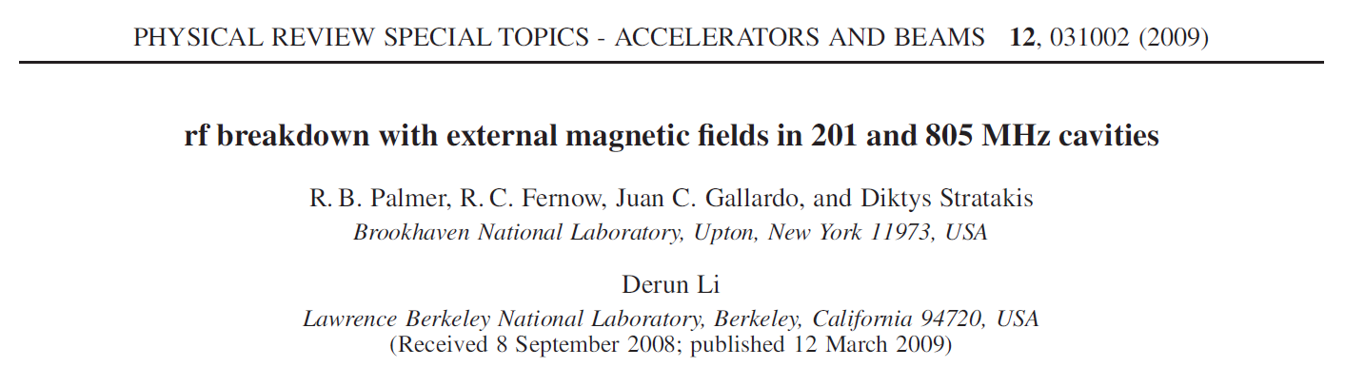

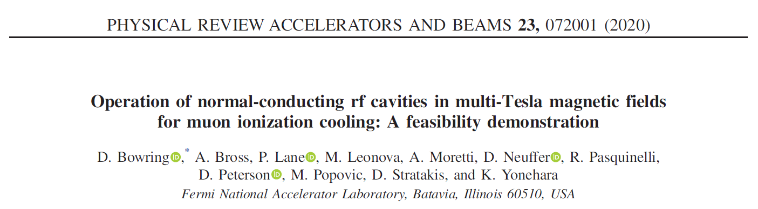
Beamlet breakdown model

Slide 7
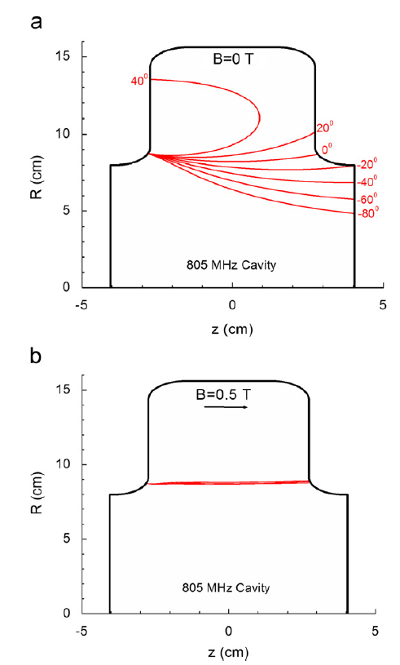

Beamlet breakdown model
Inputs to the model:
Emitter shape (surface dependent)
Beamlet radius (cavity-dependent simulations)
Beamlet impact energy (cavity-dependent simulations)
Electron stopping power (surface dependent)
Output of the model:
Temperature rise at the impact region $→$ causing breakdown
Assumption in this presentation:
The 650 MHz cavity breakdown behavior is similar to the studied 805 pillbox cavity
Heating due to electron bombardment

Slide 8
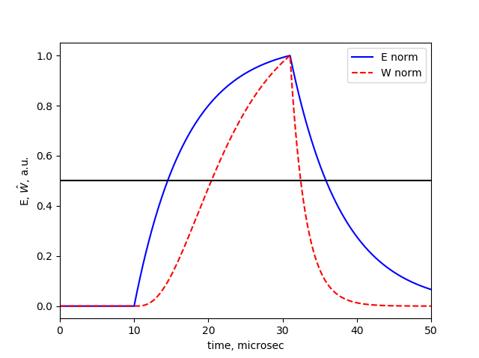


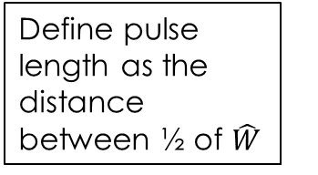
What is $t_{pulse}$ for selected cavity?
We are in an unusual situation: $t_{pulse}$ is defined not by the flat-top time, but by the cavity fill time. How do we define $t_{pulse}$ for a non-rectangular pulse?
If we want to study breakdown, the pulse is defined not by the cavity’s $E(t)$, but by the beamlet heat generation $W(t)$, which results in a narrower pulse.
Define pulse length as the distance between ½ of $\hat{W}$
Max/2
For the selected cavity with $t_{fill}=7 μs$, a sensible $t_{pulse}$ would be $12 μs$ (see Appendix 1)

Slide 9





Can we neglect heat diffusion?
Typically, the size of the heated region is greater than $100 μm$ in radius and depth.
For $t_{pulse}=12 μs$, the heat diffusion length in copper is $δ=\sqrt{αt_{rf}}=37 μm$
For short pulses $t_{pulse}<10 μs$, diffusion length becomes much smaller than the size of the heated region, and diffusion can be neglected.
Typical size of the heated region
$$>100μm$$
$$>100μm$$
Heated region
$$e^{−}$$
$$δ$$
copper
We do not absolutely need this assumption. It merely simplifies the T-rise estimate and gives useful scalings applicable to any cavity

Slide 10
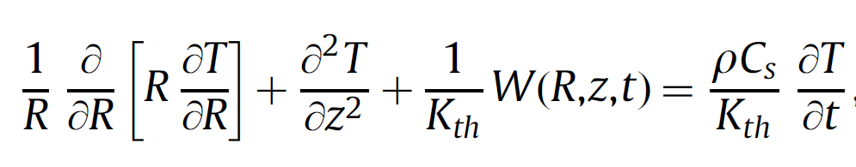






Simplified temperature rise model
          If we neglect the heat diffusion, the heat equation becomes:
$$\frac{∂T}{∂t}=\frac{W}{ρC_{s}}$$
Heat equation with diffusion
Dissipated power density
Density
Specific heat
Emitted current (strongly dependent on surface field)
$W= \frac{I}{e(πR_{f}^{2})}\frac{dE}{dz}=\frac{B^{2}I^{1/3}}{eπξ}\frac{dE}{dz}$
Stopping power
Magnetic field
$$ΔT$$
No diffusion
diffusion
$$∆T=\frac{1}{ρC_{s}}\frac{B^{2}I^{1/3}}{eπξ}\frac{dE}{dz}t_{pulse}$$
    Key points:
    $∆T$ is linear with $t_{pulse}$
    For a fixed $∆T$ and electric gradient, max operating B-field scales as $\frac{1}{\sqrt{t_{pulse}}}$
$$\sim 10 μs$$
$$t_{pulse}$$

Slide 11
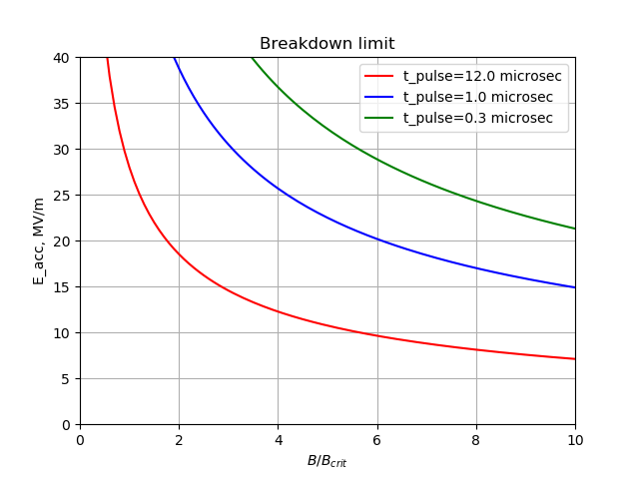


Benefit of a short pulse
Assumption: $\hat{W}∝E^{3.37}$ for the 650 MHz cavity – same as for the 805 MHz pillbox
$×$6 increase in B
$×$3 increase in E
Cavity-dependent value (need simulations)
Going to 300 ns pulse would dramatically improve cavity performance

Slide 12
Part 3: how to achieve short pulse

Slide 13
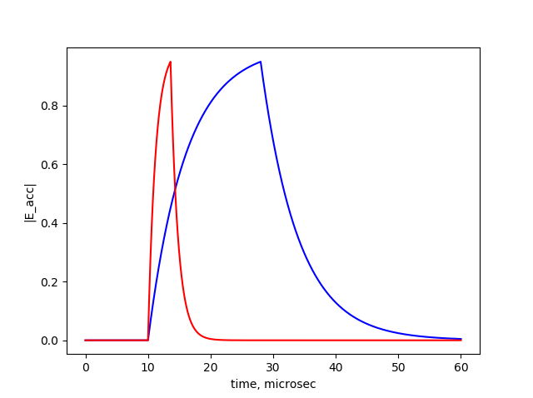




How to achieve shorter RF pulse
Method 1: lower $Q_{0}→Q_{0}/α$
  $t_{fill}$ decreases by factor $α$
  Required $P_{source}$ increases by factor $α$
method 2 is more efficient
Over-coupled cavity:
Method 2: over-coupled cavity with $β≫1$
  $t_{fill}$ decreases by factor $α=\frac{1+β}{2}$
  Required $P_{source}$ increases by factor $\frac{{\left(1+ β\right)}^{2}}{4β}≈α/2$
  The energy consumption per pulse scales as $t_{pulse}P_{source}∝\frac{1+ β}{2β}$ - we save a factor of 2 in energy for $β≫1$
$$β=1$$
$$β=10$$

Slide 14
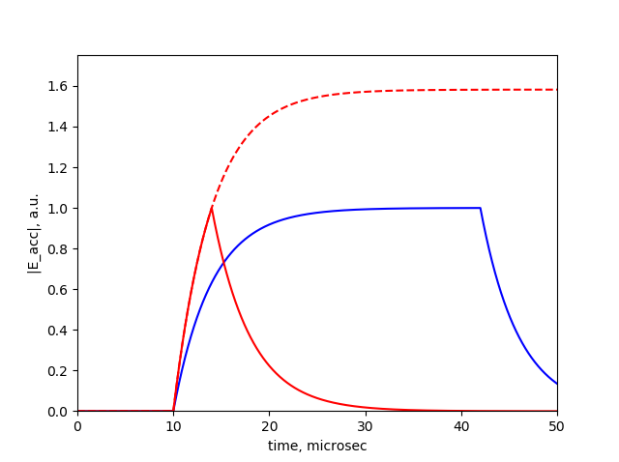


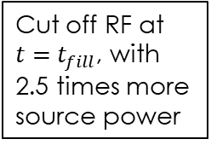
How to achieve shorter RF pulse
Method 3: triangular pulse
  It is beneficial to cut off the input power at $t=kt_{fill}$ before the steady state is reached, resulting in a triangular pulse.
  Required power scaling with the pulse time is more complicated (see Appendix 3)
Triangular pulse:
Cut off RF at $t={ t}_{fill}$, with 2.5 times more source power
Cut off RF at $t=8{ t}_{fill}$
For now, let’s focus on methods 2 and 3

Slide 15
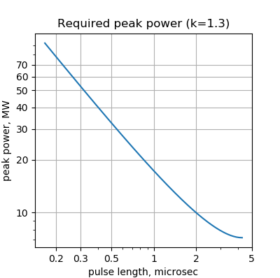



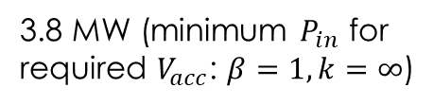

How much power is needed to achieve shorter pulse
Assume that we use two techniques to shorten the pulse:
Over-coupled cavity ($β≫1)$
Triangular pulse (cut off input power at $t=k t_{fill}$)
Optimal $k=1.3$ for $β≫1$ (see Appendix 3)
3.8 MW (minimum $P_{in}$ for required $V_{acc}$: $β=1, k=∞$)
Then for $β≫1$:
$$P_{source}≈P_{0}×0.47 β$$
$$t_{pulse}≈1.22\frac{t_{fill0}}{β}$$
For $β=28, t_{pulse}=300 ns, P_{source}=50 MW$ – feasible with a pulse compressor ($×5$ power gain) and a 10 MW 650 MHz klystron.
$$7 μs$$

Slide 16
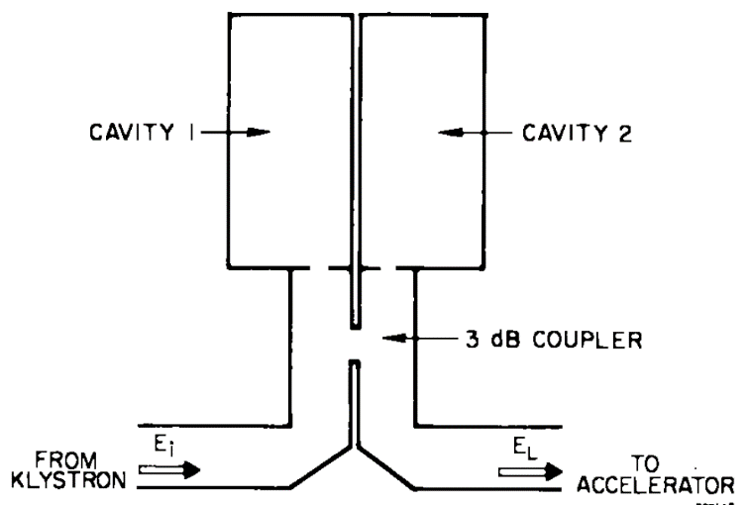
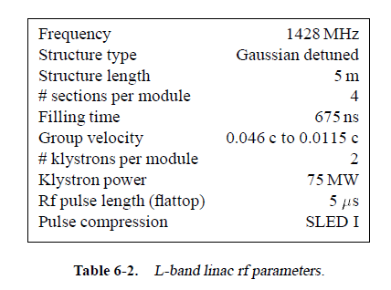
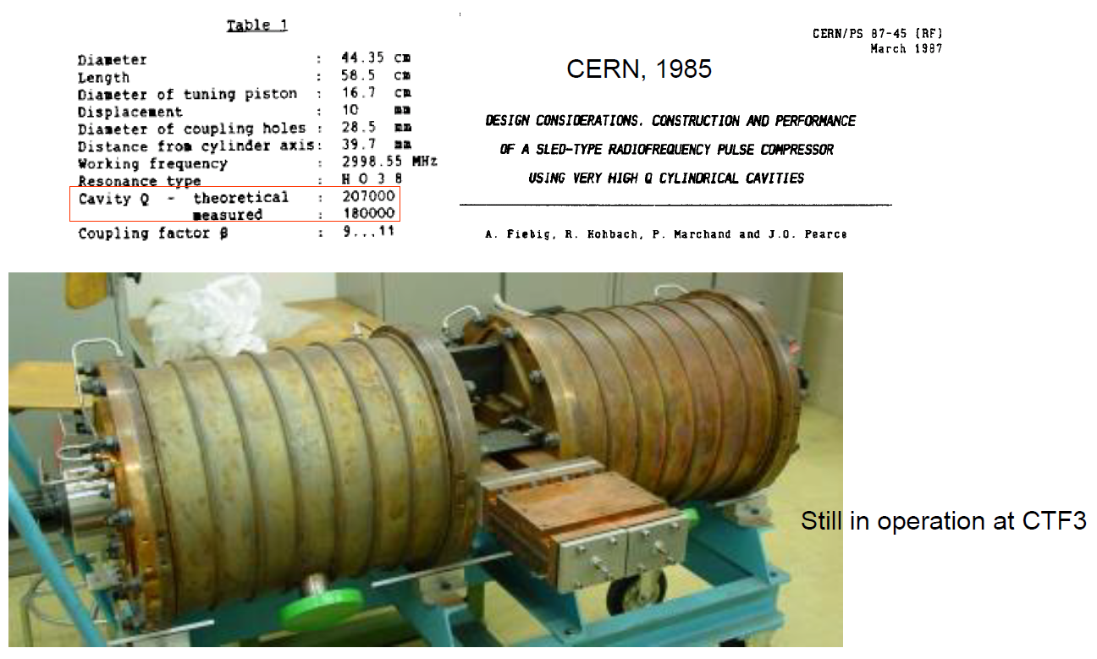

Pulse compressor
We do not need a rectangular pulse – can use the simple SLED I - type compressor.
At S-band and L-band: SLED-I uses 5th harmonic $TE_{015}$ to increase $Q_{0}$
At 650 MHz: $Q_{0}$ high enough even for a low harmonic ? If yes, compressor can be made compact enough.
Envisaged 1.4 GHz linac section for low-frequency NLC
Existing 3 GHz pulse compressor

Slide 17
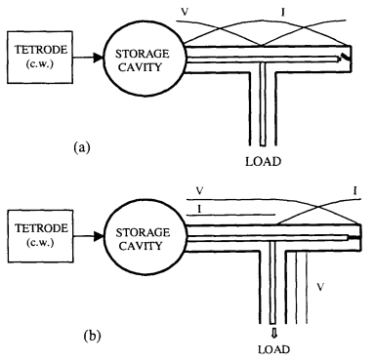
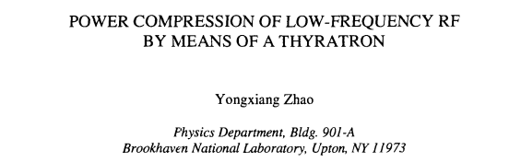
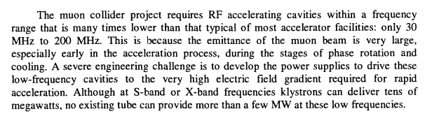
Pulse compressor (continued)
At very low frequencies 30MHz – 200 MHz:
Alternative to SLED: a storage cavity with a switch
Proposal only
Year 2000

Slide 18

Conclusions
Short pulse can help with beam loading compensation
According to the beamlet breakdown model, short pulse can also help with breakdown mitigation
For a fixed accelerating gradient, the maximum operational magnetic field roughly scales as $B∝\frac{1}{\sqrt{t_{pulse}}}$
The short pulse necessarily demands higher input power. The limit to the input power would be the source / compressor cost, and potentially breakdown limit in the couplers.

Slide 19
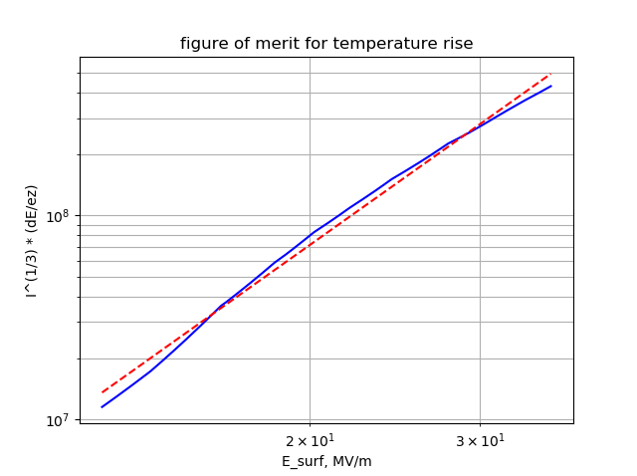





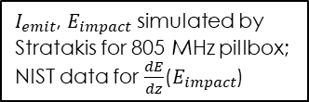
Appendix 1: $t_{pulse}$ definition
For our purposes, the pulse length $t_{rf}$ is defined by beamlet heat generation $\hat{W}\left(t\right)$ and not by $E(t)$: $\hat{W}=\frac{W}{B^{2}}eπξ=I^{1/3}\frac{dE}{dz}$
$I_{emit}$, $E_{impact}$ simulated by Stratakis for 805 MHz pillbox;
NIST data for $\frac{dE}{dz}$($E_{impact}$)
Define pulse length as the distance between ½ of $\hat{W}$
Max/2
fit: $\hat{W}∝E^{3.37}$
The shape of the $\hat{W}$ pulse is narrower than the E-pulse. If $\hat{W}∝E^{p}$ and the RF is cut off at $t=kt_{fill}$, the pulse duration $t_{pulse}=t_{fill}(k+ln⁡(2^{1/p}−1+e^{−k}))$. E.g. for $k=3, p=3.37$, $t_{pulse}=1.72 t_{fill}$.
Assumption: $\hat{W}∝E^{3.37}$ for the 650 MHz cavity – same as for the 805 MHz pillbox. Then pulse length is $12 μs$ for $t_{fill}=7 μs$

Slide 20
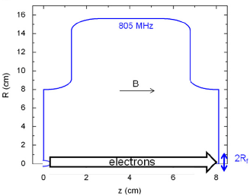
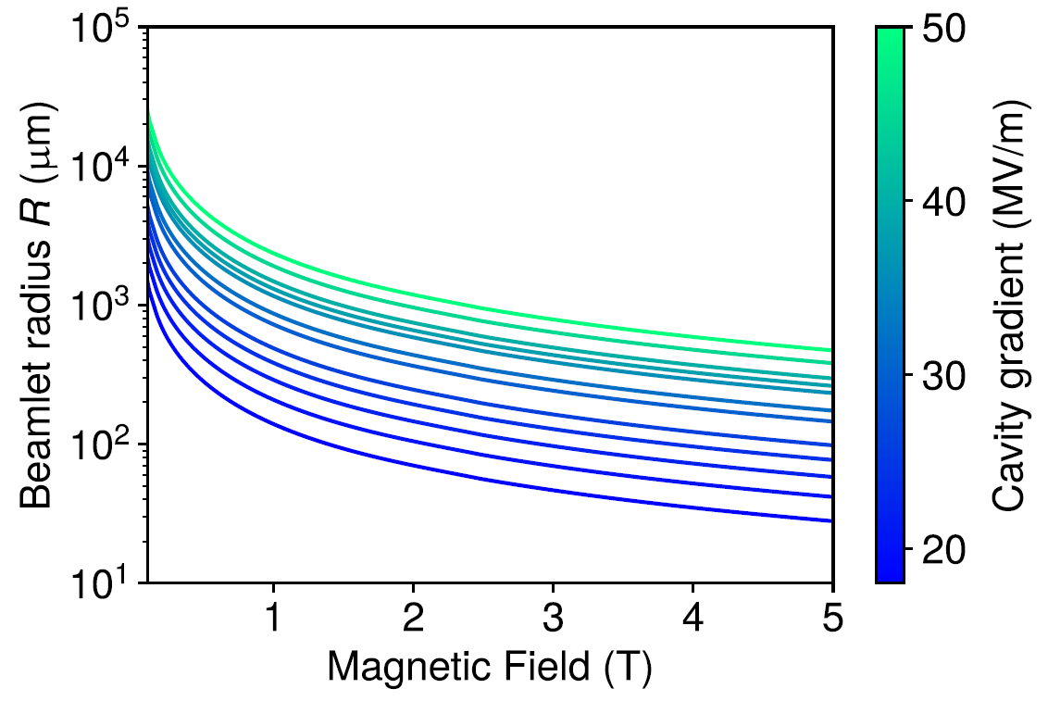
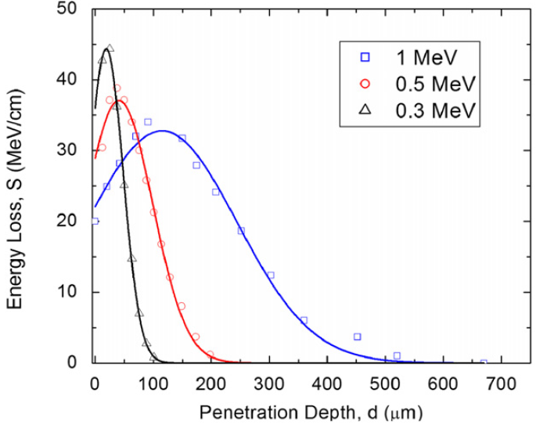

Appendix 2: size of the heated region
For each cavity, beam tracking simulation are required to estimate the size of the heated region. Here are the results for the 805 MHz pillbox simulated by Stratakis, Bowring, etc:
Cavity-dependent constant
$$R= ξ\frac{I^{1/3}}{B}$$

Slide 21
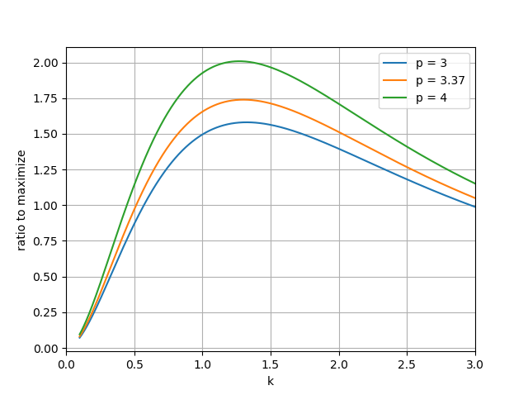




Appendix 3: Optimal $k$
The pulse time and the required power are defined by two parameters: $β$ and $k$:
$$\frac{P}{P_{0}}=\frac{{\left(1+ β\right)}^{2}}{4β{\left(1 −e^{−k}\right)}^{2}}$$
$$\frac{t_{pulse}}{t_{fill0}}=\frac{2}{1+β}\left(k+\ln\left(2^{1/p}−1+e^{−k} \right)\right)$$
$p$ is the dependence of heat generation on gradient $\hat{W}∝E^{p}$
In the regime $β≫1$, we can find the optimal $k$ that maximizes the gain in $t_{pulse}$ over the gain in power. For $p=3.37, k_{opt}=1.3$

Slide 22

Appendix 4: Avoiding coupler breakdown with multiple input couplers
RF source
Potential problem: right after the pulse $P_{ref}=4P_{source}=200 MW$ – can lead to breakdown in couplers – can be solved by having multiple input couplers
Multiple input couplers: each coupler carries only a fraction of the needed input power
Problem: $$$
Compr
Compr
Compr
Compr
Compr

