Slide 1
Potential RF testing opportunities at CERN
Alexej Grudiev on behalf
D. Aguglia, O. Brunner, N. Charitonidis, B. Cure, D. Lazic, J. Parra-Lopez
11/05/2021

Slide 2
What kind of facility we need
Superconducting magnet infrastructure
Magnet
Cryogenics
RF infrastructure
Power converter
RF modulator
RF power source
RF cavity

Slide 3
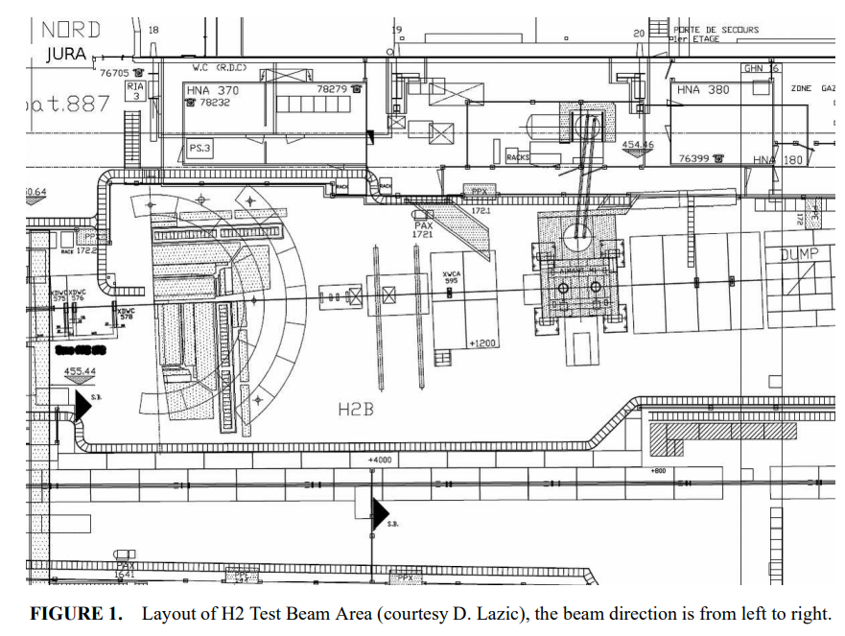
M1-magnet in the North Experimental area
Meeting with M1-magnet/area responsibles on 8 April 2021:
  Nikolaos Charitonidis - responsible beam physicist for the H2 beamline ;
  Benoit Cure - magnet expert;
  Dragoslav Lazic - responsible of the H2-PPE172 zone
M1-magnet is in operation (up to 3 T)
It is in H2-PPE172 zone (B887)
It is potentially available for tests. Tests and installation to be carefully coordinated with the CMS (magnet owner) tests and the beams around the M1-magnet
Magnet orientation B-field direction is perpendicular to the beam line. It can potentially be turned by 90 degree to have B-field parallel to beam axis. Major infrastructure modification: ~50kCHF
The beam line is occasionally used in which case cavity must be removed.
Most of the details described in the proposal of 2010 still valid.

Slide 4
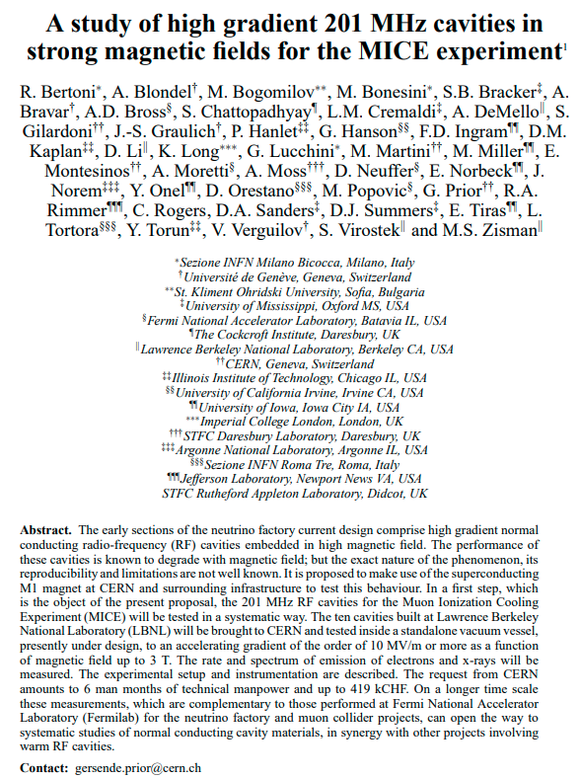
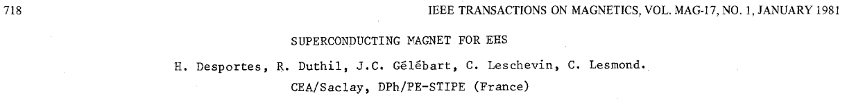
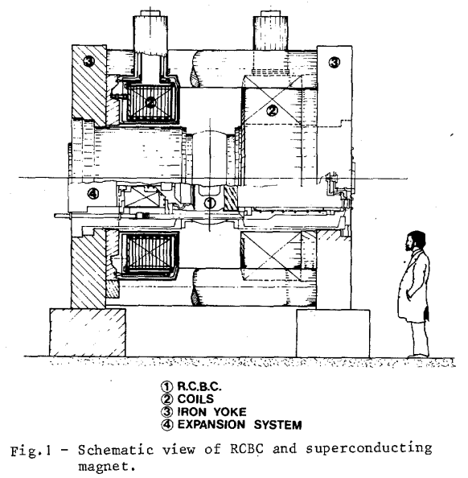
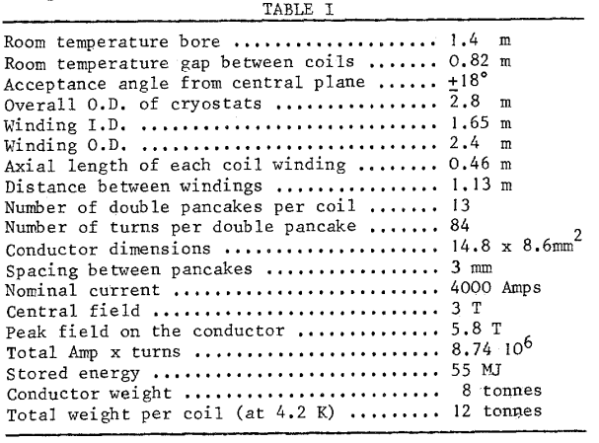
M1-magnet in the North Experimental area
0.8m
1.4m
proposal_rf.dvi (inspirehep.net)
Proposal might be reconsidered
RF must be brought to the magnet
Cost estimate 2010: ~0.5MCHF

Slide 5
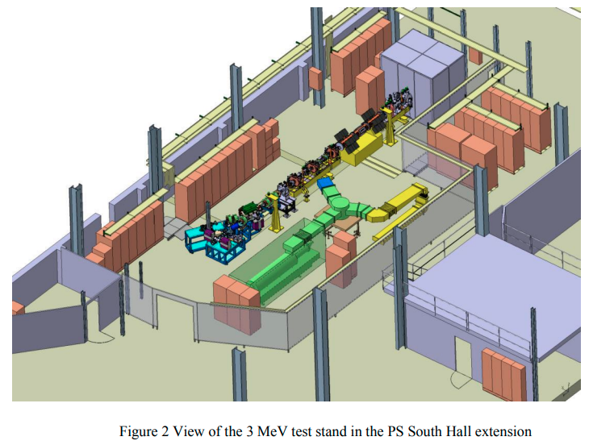
RF test infrastructure at CERN: an example
CERN 3 MeV test stand with L4-RFQ RF station
L4-RFQ Spare project – a new project initiated in 2020
Short-term goals:
  Construct a spare copy of L4-RFQ (2021 – 2022)
  Commission new RFQ with RF and beam in reinstalled 3 MeV test stand (2022 – 2023)
  Make L4-RFQ spare available for replacement in L4
Long-term goals: Develop a new RFQ with better expected performance in terms of
  beam acceptance
  resilience to RF breakdowns under H- irradiation
There is a potential for synergies:
  High gradient under irradiation (p, H-)
  Different material (Cu, CuCrZr, CuBe, Ta, Nb, Ti6Al4V)
  Resources, infrastructure
NO MAGNET, NO CRYOGENICS
NO RADIATION SCHELDING
POWER IS TOO LOW for MC HG RF testing
Commissioned in 2014
L4-RFQ 352 MHz fed by
LEP klystron 1.2 MW
Dismounted after
CERN-ACC-2013-0259.pdf

Slide 6
RF power source and WG components: at 352 MHz (O. Brunner)
Klystron:
  L4 spare klystron: 2.8 MW, best option
  LEP klystron: old, 1.3 MW peak power only
WG components
  Partially available from LEP

Slide 7
Modulator solutions for muon cooling RF testing
J. Parra-Lopez & D. Aguglia
EPC
28th April 2021

Slide 8
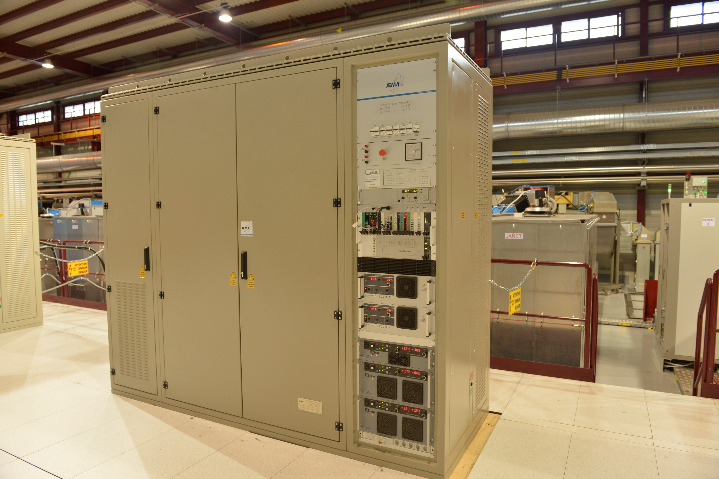
L4 full power modulator
Spec | Value
Voltage | 110 kV
Current | 50 A
Peak power | 5.5 MW
Pulse length | 1.8 ms
Rep. rate | 2 Hz
Cost | 300 kCHF
Preferred solution because standard operation with CERN controls (15 in operation at CERN)
14 units installed in L4
1 unit in RF test stand in bld. 112
L4 missing a spare – discussions ongoing for a solution…
Could be used in muon test facility and be a spare in case of need in L4
Muon could partially contribute to it

Slide 9
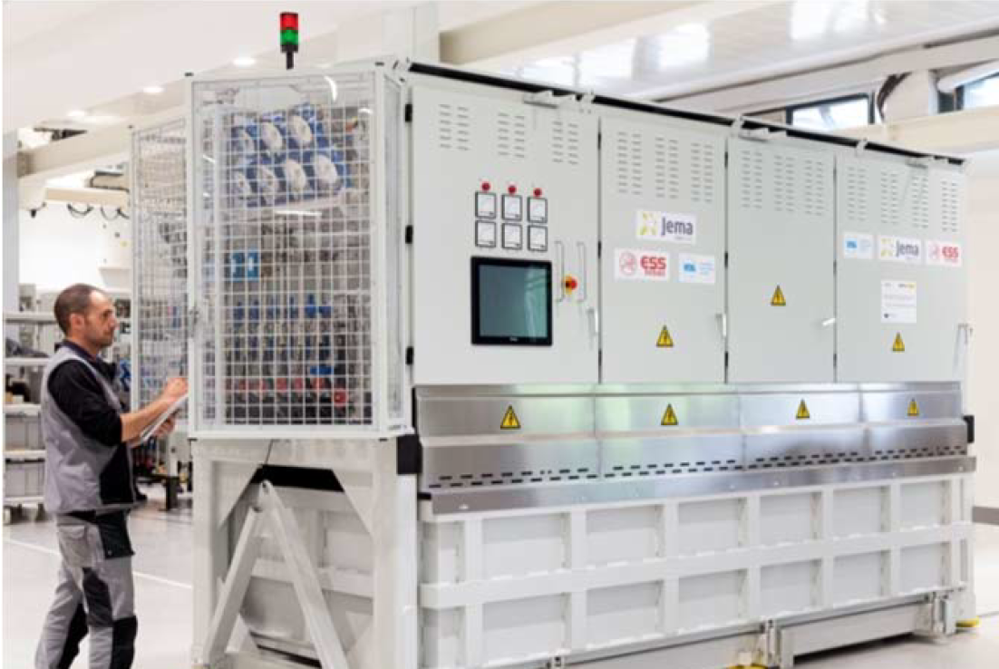
ESS prototype modulator
Spec | Value
Voltage | 115 kV
Current | 100 A
Peak power | 11.5 MW
Rep. rate | 14 Hz
Pulse length | 3.5 ms
Cost | In kind/ collab.?
ESS has an unused prototype modulator (ESS design)
Turn key system for CERN (control to be evaluated) – always difficult / costly to operate for CERN
ESS could contribute lending/transferring it & operating it (in collaboration with EPC)
Water cooling needed
No anode powering
No spares!

Slide 10
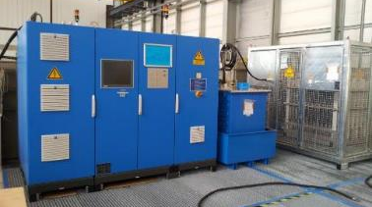
ESS pre-prototype modulator
Spec | Value
Voltage | 115 kV
Current | 25 A
Peak power | 11.5 MW
Rep. rate | 20 Hz
Pulse length | 2.5 ms
Cost | installation
CERN has/owns an unused pre-prototype modulator used to test ESS cavities at CERN
Turn key system – always difficult / costly to operate for CERN
Water cooling needed
No anode powering
No spares!
Low power

Slide 11
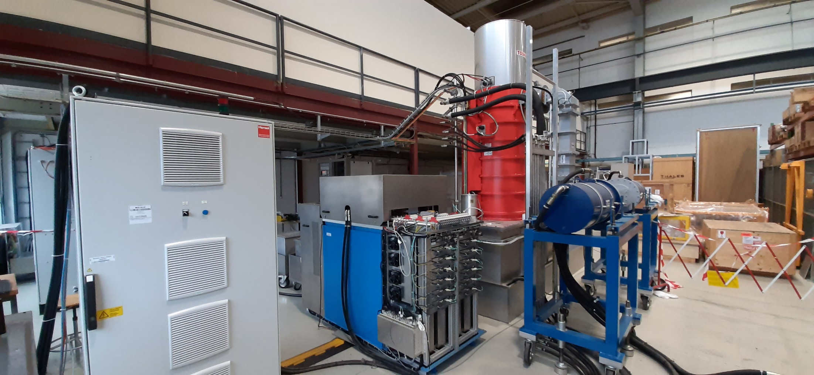
CLIC L-Band prototype modulator
Modulator installed in 112 for CLIC RF L-band klystron tests
Turn key system – always difficult / costly to operate for CERN
Today issues in restarting the system – commissioning not finished yet
Water cooling needed
No anode powering
No spares!
Spec | Value
Voltage | 170 kV
Current | 160 A
Peak power | 29 MW
Rep. rate | 50 Hz
Pulse length | 0.14 ms
Cost | installation

Slide 12
Conclusion
EPC wants to push for a L4 modulator solution.
  Muon collider could partially contribute in the costs
  Solution still to be discussed/announced to other L4 stakeholders
ESS prototype could be an acceptable solution, potentially less expensive
  EPC could accept this if ESS implication in its operation
Other presented solutions not supported by EPC

Slide 13
Summary
Magnet M1 in principle can be used, BUT
  It cannot be moved to another place, since it is still in use
  The testing will be strongly affected by the beam tests in the magnet itself or downstream, in which case the cavity must be replaced by a beam pipe
  Integration in the test beam area is not easy
Klystrons:
  LEP klystrons could be used but must be combined to get to higher power
  L4 spare klystron is better choice since higher power, but its use must be agreed with L4 operation
Modulators:
  L4 spare modulator, is preferred solution for CERN but at the moment there is no budget to build it. It can drive one L4 klystron (2.8 MW) or 2 LEP klystrons (2 x 1.3MW).
  ESS prototype modulator, is an acceptable solution if it comes with operation and spare support from ESS in the framework of a collaboration. It can drive 2 L4 klystrons (2 x 2.8MW) of 4 LEP klystrons (4 x 1.3MW). Higher power: 5.6MW
EL, cooling, controls and electronics are missing
WG components partially available from LEP

