Slide 1

1st Joint CERN – Slovenia Committee Meeting
Report from Slovenia
Dr. Tomaž Boh
Directorate for Science
Ministry of Education, Science and Sport, Slovenia
Ljubljana - Geneve 12.5.2020

Slide 2
Introducing the SI team
Dr. Mitja Slavinec – State secretary
Dr. Tomaž Boh – Director general, Science directorate
Mag. Tea Glažar - SI member of CERN bodies, Science directorate
Mag. Peter Volasko – Head of Science Division

Slide 3
Science policy and landscape

Slide 4
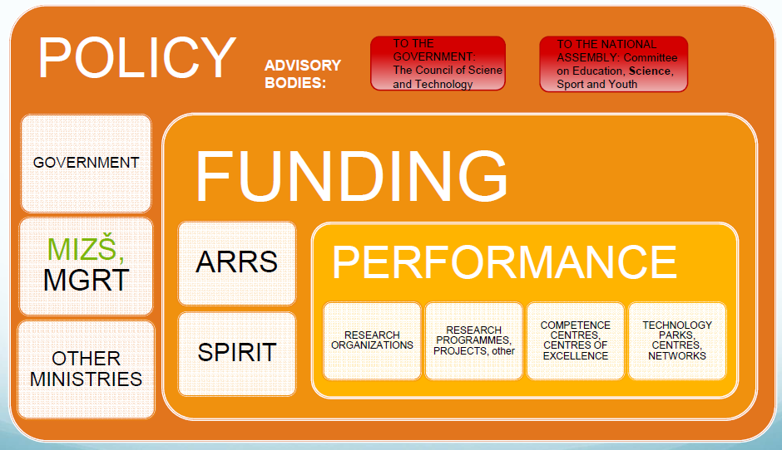
Governance of research system

Slide 5
S&T Landscape
3 public universities + 3 private universities
16 national research institutes
> 600 R&D units in business sector

Slide 6
Funding mechanisms

Slide 7
State budget

Slide 8
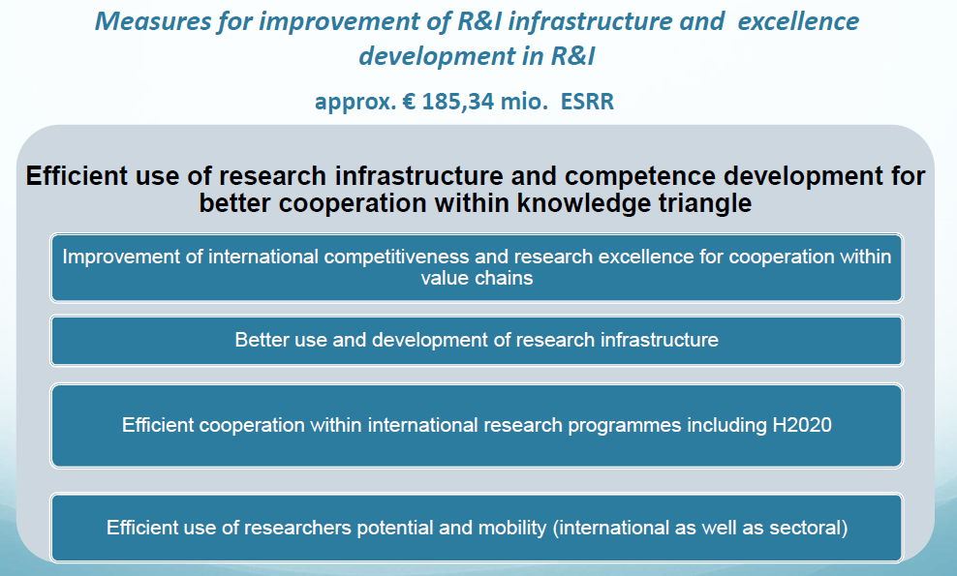
Structural funds 2014 - 2020

Slide 9
Other sources
Resilience and Recovery Fund (~ 67 mio EUR)
  Focus on researchers;
  Green and Digital;
  Connecting research and business sector.
Cohesion policy 2021-2027
  Colaborative research;
  Widdening instruments → synergies;
  Research infrastructure
  Knowledge transfer
Horizont Europe
  Improving the capacity of research institutions

Slide 10
Research infrastructures

Slide 11
Reseach infrastructure capacities
ESFRI infrastructures:
  17 ERIC infrastructures from all research domains;
  FAIR infrastructure;
  Belle II infrastructure;
  CERN
  SEEIIST proposal

Slide 12
National capacities
Triga nuclear reactor;
NMR spectrometry center (800MHz → plan to buy 1GHz)
Crio microscopy
Quantum research (emerging field)
HPC facilities

Slide 13
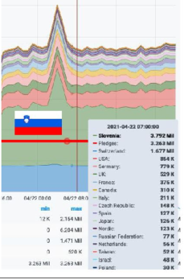

EuroHPC infrastructure
Part of EuroHPC initiative
1st peta scale facility → among 50 strongest computers worldwide

Slide 14
What is new?
Law on research and innovation, which brings:
  More authonomy to Research institutions;
  Stable funding – block funding of institutions;
  Attractive renumeration possibilities;
  Key performing indicators;
  Negotiable targets;
  Increased financing;
  Better governance;
  General research and innovation ecosystem;

Slide 15
… what is new
New Research and Innovation strategy
  Improve the capacity of science;
  Increase the level of internationalisation;
  Special focus on:
    Open science;
    Research infrastructures;
    Research careers;
    Science - Business cooperation

Slide 16
SI - CERN
Very long and good scientific cooperation especially through the CERN experiments
From 2017 (our Associated status) inclusion of Slovenian Industry, nomination of ILO – progress is seen in industrial return for products through the per-stage period
Participarion of Slovenia through its delegates at the CERN Council and its Committees ( Financial and Scientific)
Overall estimation – good and fruithfull cooperation

Slide 17
Thank you!

