Slide 1
Procurement Overview
for Slovenia(Associate Member State
in the pre-stage to membership)

Slide 2
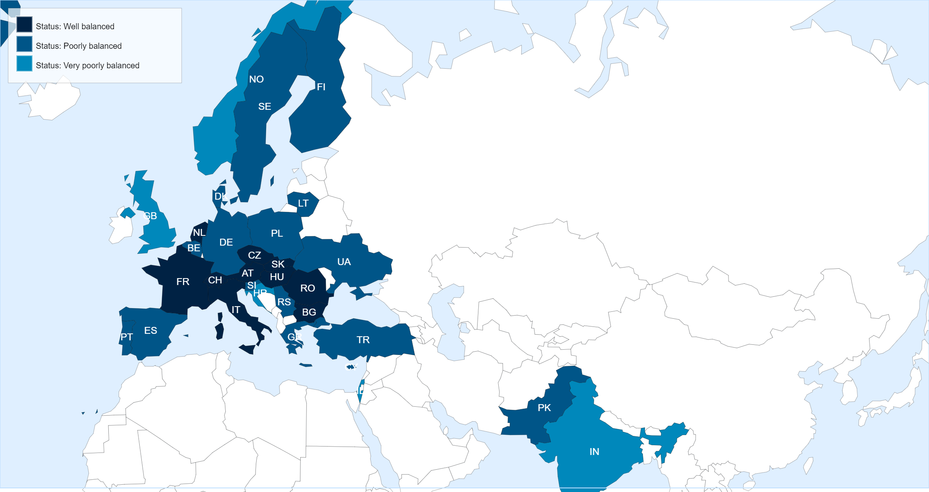
Status of Member States (For Supply contracts from 01.03.2021 until end of February 2022)
Key Figures for Slovenia
* Data not available in the DWH yet.
No. of suppliers registered on eProcurement
51
No. of contracts active in 2020
5
No. of contracts awarded in 2020
–
No. of firms contacted for MS dispatched in 2020
25
No. of firms contacted for IT dispatched in 2020
9
No. of firms contacted for PE dispatched in 2020
11

Slide 3
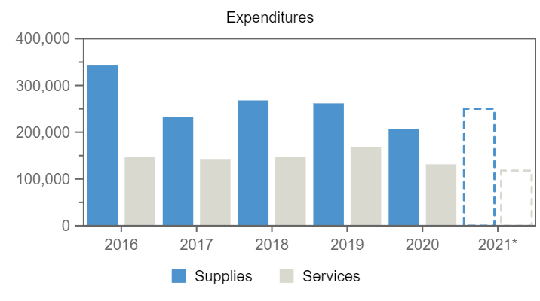
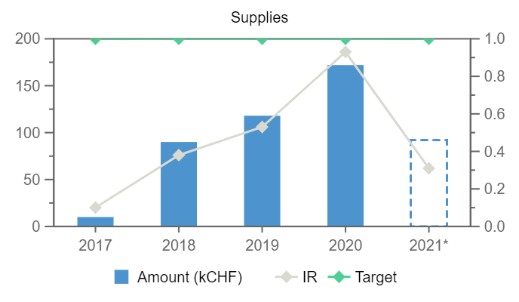
118
172
10
90
92
–
–
–
–
–
Expenditures (Slovenia, kCHF)
Year
2017
2018
2019
2020
2021*
Supplies
Services
Annual contributions and industrial returns for Slovenia
Contributions (kCHF)
Expenditures (All countries totals, kCHF)
Expenditures (Slovenia, kCHF)
Year
Country Contribution
All Countries
%
Year
Supplies
Services
Year
Remaining
Procurement**
Personnel
2017
500
1 142 179
0.04
2016
342 577
146 851
2017
438
10
52
2018
1 000
1 148 237
0.09
2017
232 087
142 732
2018
826
90
84
2019
1 000
1 171 420
0.09
2018
267 860
146 760
2019
753
122
125
2020
1 065
1 196 893
0.09
2019
261 610
167 528
2020
697
187
181
2021
1 410
1 198 811
0.12
2020
207 407
131 216
2021*
1 179
96
135
*Provisional figure
**Including supplies, services, utilities and small orders
Industrial Return
Annual Industrial Return
Year
Supplies
Services
2017
Ratio
Target
Ratio
Target
0.1
1
–
0.4
2018
0.38
1
–
0.4
2019
0.53
1
–
0.4
2020
0.93
1
–
0.4

Slide 4
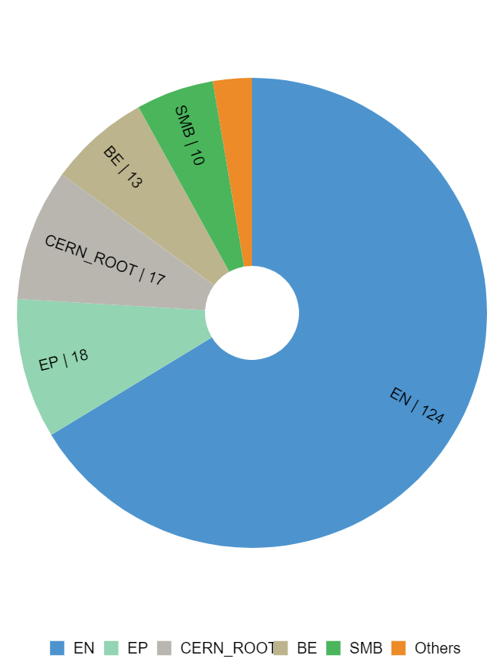
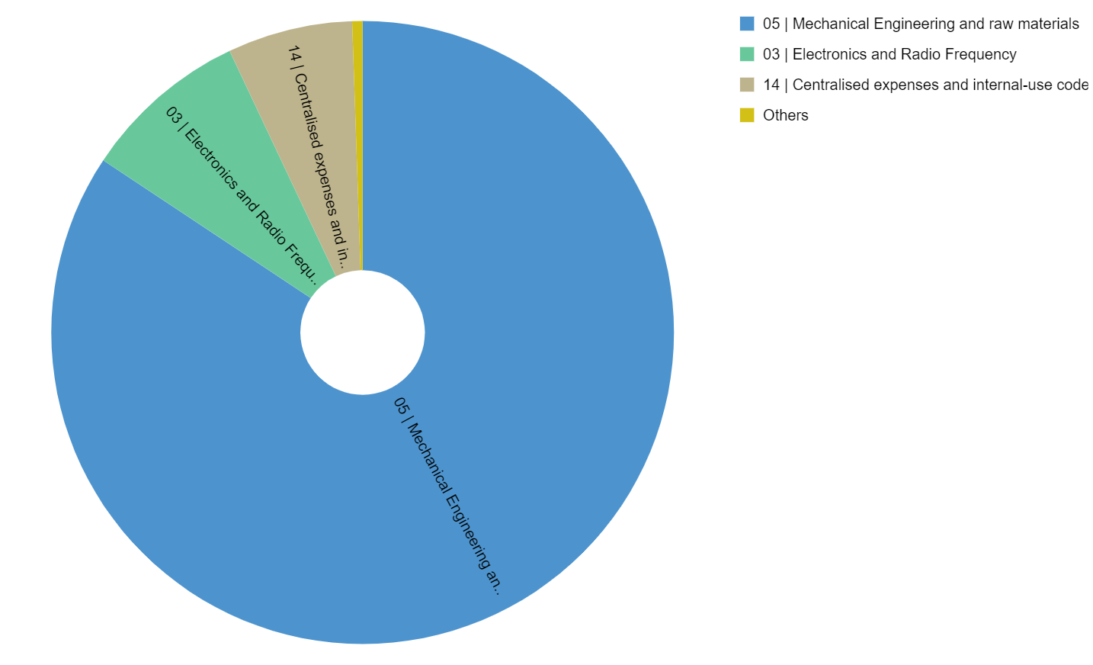
Expenditure by department and procurement codes for Slovenia
Expenditure by Department (kCHF)
Expenditure by (Activity|Procurement) Code (kCHF)

Slide 5
Top Suppliers in Slovenia
By Country of Supplier
By Country of Origin
Supplier Name
Town
No. Orders
CERN Budget (CHF)
Teams Budget (CHF)
Supplier Name
Supplier Country
No. Orders
% SI
CERN (CHF)
Teams (CHF)
ZUSTAL
Ziri
53
114 646
2 779
ZUSTAL
SI
52
99
113 219
2 779
XENYA
Ljubljana
3
–
50 610
JOZEF STEFAN INSTITUTE
SI
14
100
19 952
15 894
JOZEF STEFAN INSTITUTE
Ljubljana
14
19 952
15 894
ELGOLINE LTD
SI
4
100
–
19 277
ELGOLINE LTD
Cerknica
4
–
19 277
JACQUET OSIRO
CH
9
55
17 111
837
INSTRUMENTATION TECHNOLOGIES
Solkan
1
10 803
–
INSTRUMENTATION TECHNOLOGIES
SI
1
100
10 803
–
FOLK PLAST
Laporje
1
3 298
–
NOTZ METALL AG
CH
2
10
10 692
–
VINE
Spodnja Idrija
2
1 394
–
XENYA
SI
3
12
–
6 030
SFS UNIMARKET SA
CH
2 983
1
3 816
628
KEKON DOO
Zuzemberk
1
803
–
FOLK PLAST
SI
1
100
3 298
–
CONTAINER
Celje
1
347
–
RS COMPONENTS
FR
8 742
–
2 222
598
EKWB D.O.O.
Komenda
1
319
–

Slide 6
List of contract/orders with the highest turnover in 2020 for Slovenia
Contract/Order
Description
Supplier
Amount (CHF)
CA8045163
COLLIMATEURS DEUX BLOCS NEUFS
ZUSTAL
13 472
CA8439104
FRESCA2 : TANK HELIUM BERCEAUX
ZUSTAL
12 263
CA8529246
4CH WAVEFORM DIGITIZER SYSTEM
INSTRUMENTATION TECHNOLOGIES
10 803
CA8152337
ADJUSTING PCS MAGNET ELETTRA 2
ZUSTAL
9 055
CA8490585
CE:SI: IRRAD. OF HGCAL TEST STRUCTURES
JOZEF STEFAN INSTITUTE
8 912
DT2033097
LOT ANNEAUX 304L FRESCA2
NOTZ METALL AG
8 221
CA8348060
CE:SI: IRRAD. OF HGCAL TEST STRUCTURES
JOZEF STEFAN INSTITUTE
8 156
CA8422202
CRAB CAVITY RFD TUNING FRAMES
ZUSTAL
7 161
CA8499458
CRAB CAVITY RFD TUNING FRAME
ZUSTAL
6 857
CA8499930
VTRX PLUS BURN-IN TEST.
ZUSTAL
4 213

Slide 7
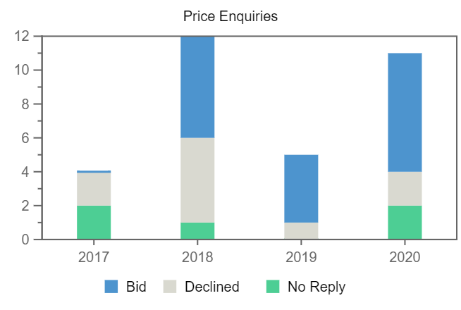
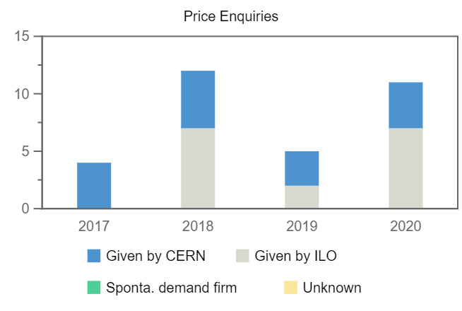
Price Enquiries above 50k CHF for Slovenia
Number of firms contacted
Origin of firms contacted
Year
Firms Contacted
RANK (1)
RANK (2)
RANK (3)
2017
4
–
–
–
2018
12
–
2
1
2019
5
–
1
1
2020
11
1
–
–

Slide 8
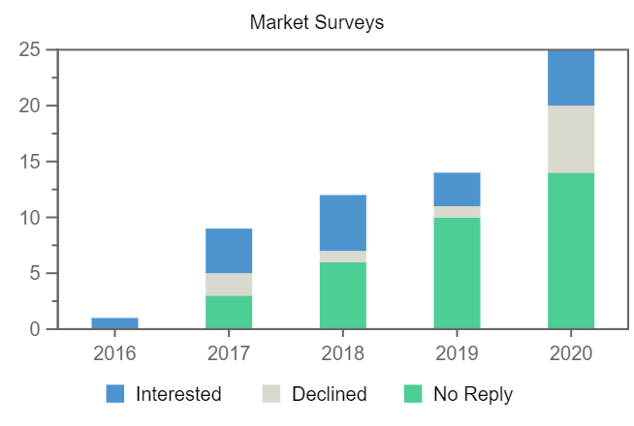
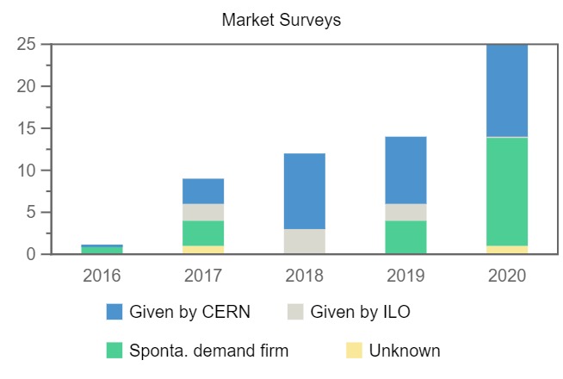
Number of firms contacted
Market Surveys for Slovenia
Year
Firms Contacted
Interested
Declined
No Reply
Selected
2016
1
1
–
–
–
2017
9
4
2
3
–
2018
12
5
1
6
1
2019
14
3
1
10
1
2020
25
5
6
14
2
Origin of firms contacted

Slide 9
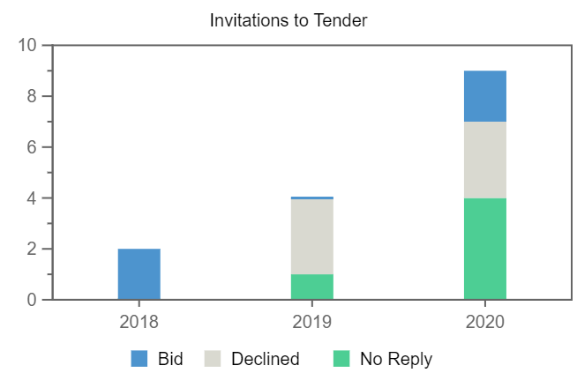
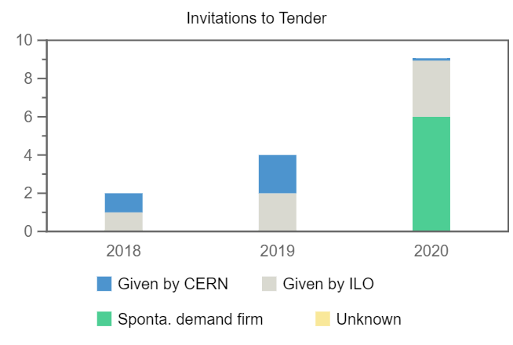
Invitations to Tender for Slovenia
Number of firms contacted
Origin of firms contacted
Year
Firms Contacted
RANK (1)
RANK (2)
RANK (3)
2018
2
–
–
–
2019
4
–
–
–
2020
9
–
–
–

